Slide 1
Tools and Algorithms in Bioinformatics
GCBA815/MCGB815/BMI815, Fall 2017
Week-6: Genomics Browsers
(UCSC, IGV and ExAC)
Babu Guda, Ph.D.
Professor, Genetics, Cell Biology & Anatomy
Director, Bioinformatics and Systems Biology Core
University of Nebraska Medical Center

Slide 2
Terminology
Genome
Typically the nuclear genome in eukaryotes or the only genome in prokaryotes
Extra-nuclear genome
Mitochondrial and chloroplast genomes
Metagenome
A mixture of genomes belonging to multiple species that are not fully characterized
Epigenome
The characteristics of the genome that effects gene expression, such as chromatin packing, methylation, etc.
Pangenome
The union of the gene sets of all the strains of a species, typically applied to prokaryotes (like the pangenome of E. coli)
Human Microbiome (microbe metagenome)
The set of all microbial genomes that harbor human body

Slide 3
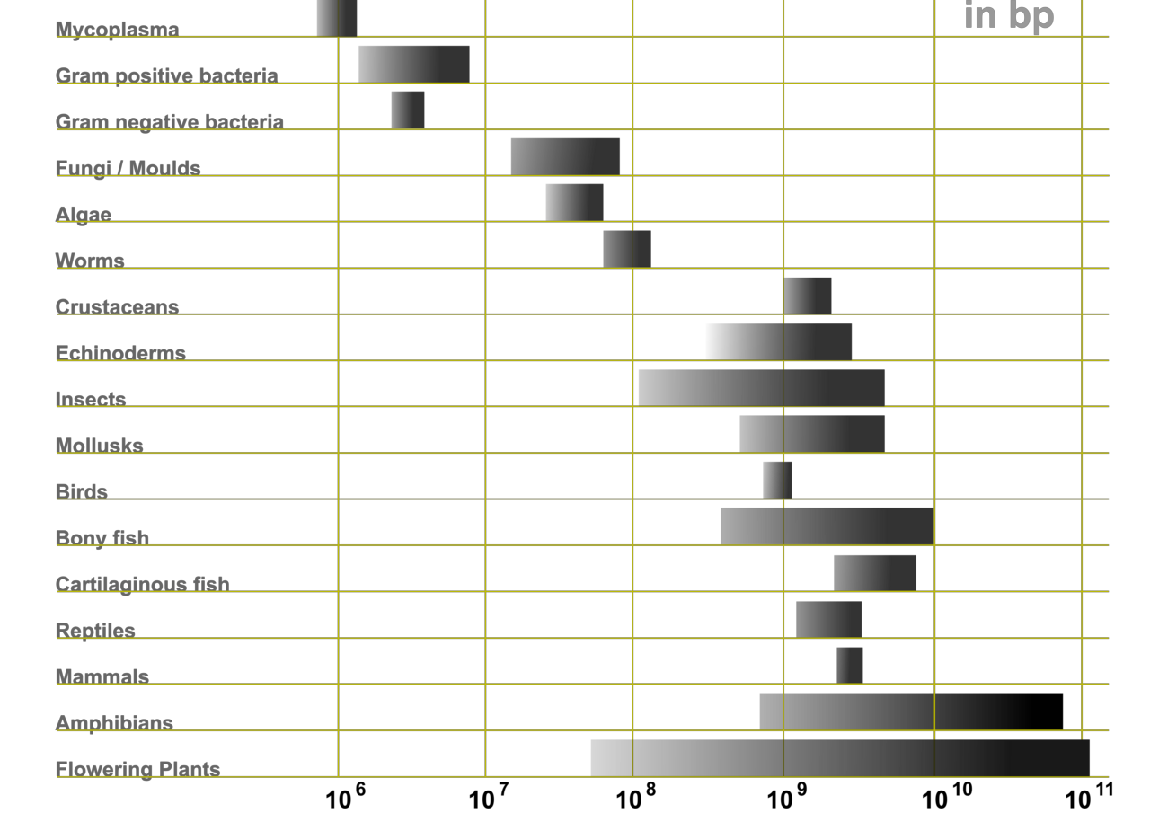
Genome sizes of species in the evolutionary spectrum

Slide 4
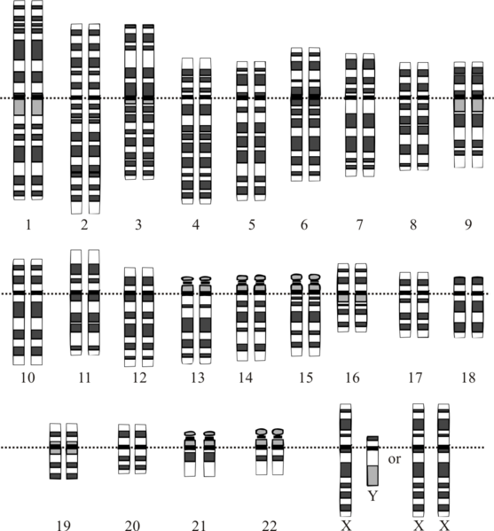
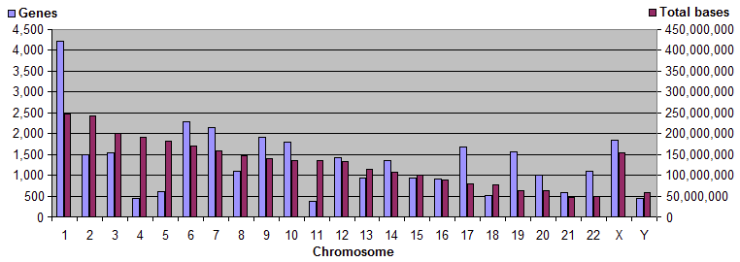
Human Karyotype

Slide 5
Statistics on Human Genome
Haploid nuclear genome size (3.0 x 10⁹ )
Female-3,227 Mbp; Male-3,122 Mbp
Chromosomes: 1-22, X, Y, all linear
Highly conserved regions
Coding DNA covers about 30 Mbp (1%)
Other regulatory regions cover about 100 Mbp (3%)
Repetitive DNA covers more than 50%
Segmental duplication: more than 5%
Endogenous retroviral genomes (ERVs): 5-8% (inherited)
Other associated genomes
Mitochondrial genome: about 16.5 Kbp, circular genome
Viral genomes (transfected exogenous Retroviruses)
Microbiome (~3,000 microbes are estimated to harbor human body)

Slide 6
Statistics on Human Exome
Some exome capture kits include protein coding regions as well as the flanking untranslated regions (5’ UTR and 3’ UTR)
Exome studies usually include all the protein coding regions covering about 30 Mbp of DNA (~1%)
Human genome has approximately 180,000 exons
An estimated 85% of the disease causing mutations exist on exons; hence, clinical sequencing heavily targets exome sequencing
On average there are 9 exons per gene, but the number varies by gene length, which ranges from 1-363.
The Titin gene (TTN) has 363 exons.
Average exon length is about 122 bp
Exons with 3’ UTRs are considerably longer

Slide 7
Statistics on Human Genes/Proteins
About 25K genes code for about 100,000 proteins in human
Not all expressed at the same time or at the same location
Mitochondrial genes: 37 (code for 22 tRNAs, 13 proteins and 2 rRNAs)
Retroviral proteins
About 3.5 million genes encoded by about 3000 microbiome flora
Oral microbiome, gut microbiome, etc.
Coding genes: 20,338 (source Ensembl)
Pseudogenes: 14,638
Gene transcripts: 200,000
For up-to-date stats on human genome, click below
https://www.ensembl.org/Homo_sapiens/Info/Annotation

Slide 8
Genome browsers:
UCSC, IGV, and ExAC
Demonstrator: Adam Cornish
Department of Genetics, Cell Biology and Anatomy
University of Nebraska Medical Center

Slide 9
UCSC Genome Browser
Online tool developed at the University of Santa Cruz California used to provide context and annotations to dozens of genomes. Examples of annotations include:
Sequence
Genes
Phenotypes
mRNA
Expression
Regulation
Sequence conservation
and Variation

Slide 10
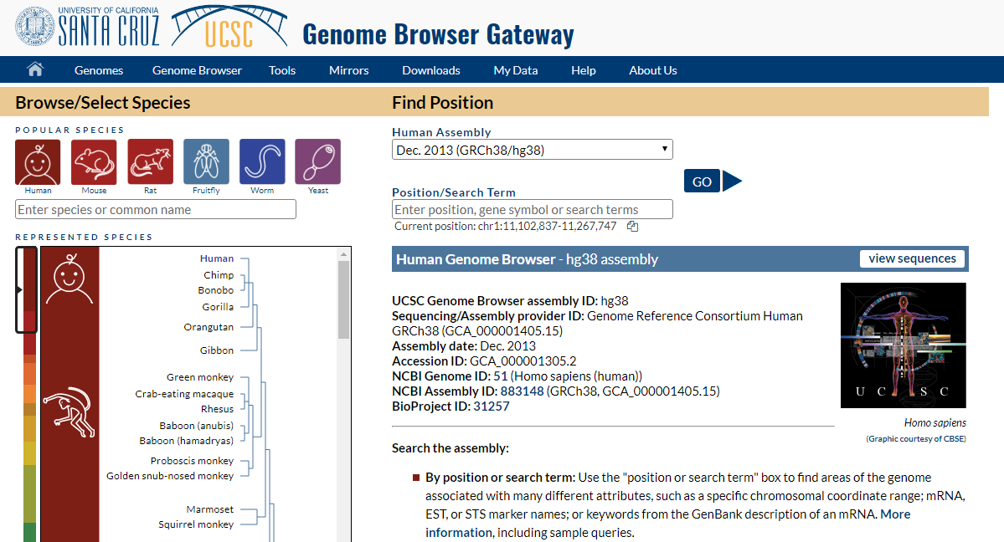
UCSC Genome Browser

Slide 11
UCSC Genome Browser
Select your species to the left
Select the appropriate assembly up above.
Enter the gene you want to investigate
We’re using histone subunit h3: HIST1H3A

Slide 12
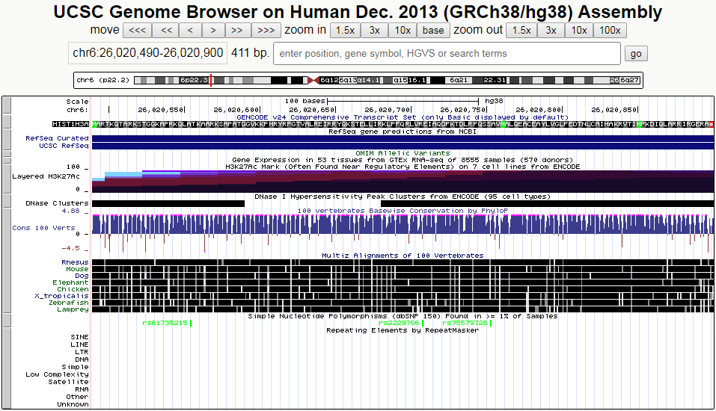
UCSC Genome Browser: HIST1H3A

Slide 13
UCSC Genome Browser: HIST1H3A
Genome location

Slide 14
UCSC Genome Browser: HIST1H3A
Gene ID and amino acid sequence

Slide 15
UCSC Genome Browser: HIST1H3A
Gene expression across 53 different tissue types will be found here

Slide 16
UCSC Genome Browser: HIST1H3A
H3K27Ac marks can be found here from 7 different cell lines

Slide 17
UCSC Genome Browser: HIST1H3A
DNase I hypersensitivity clusters

Slide 18
UCSC Genome Browser: HIST1H3A
DNA conservation across 100 vertebrates

Slide 19
UCSC Genome Browser: HIST1H3A
Amino acid conservation across different species

Slide 20
UCSC Genome Browser: HIST1H3A
Known SNPs as found in dbSNP
Green = synonymous
Red = missense or splice variants
Black = intronic
Blue = UTR

Slide 21
UCSC Genome Browser: HIST1H3A
Known repetitive or low complexity regions

Slide 22
UCSC Genome Browser:
Link: https://genome.ucsc.edu

Slide 23
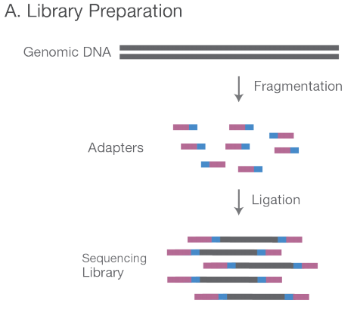
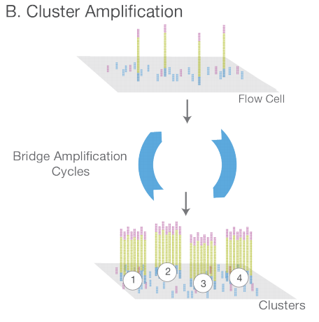
Next Generation Sequencing (NGS) Overview
A. NGS library is prepared by fragmenting a gDNA sample and ligating specialized adapters to both fragment ends.
B. The library is loaded on to a flow cell and the fragments are hybridized. Each fragment is amplified into a clonal cluster.

Slide 24
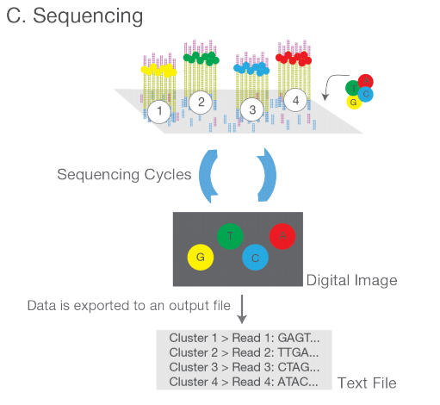
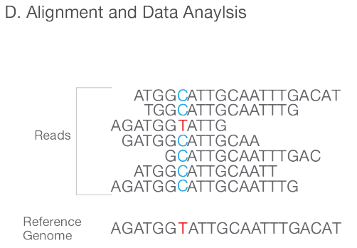
Next Generation Sequencing (NGS) Overview
C. Fluorescently labeled nucleotides are successively flowed and some are incorporated. Each cluster is imaged to detect which nucleotide was added to the cluster. This is repeated for each basepair and generates our Reads.
D. Reads are aligned to a reference genome. After alignment, differences between the sample and the reference can be identified.

Slide 25
Integrative Genomics Viewer (IGV)
Software developed at the Broad Institute to more easily view:
Next Generation Sequencing data
Array-based data
Genome annotations
Variant data (Single Nucleotide Polymorphisms, insertions, deletions, copy number variations, etc.)
GWAS data
and more!
Notes:
Talk about how abundant sequencing data has become and how it’s only going to grow larger.
http://software.broadinstitute.org/software/igv/igv2.3

Slide 26
Integrative Genomics Viewer
Software developed at the Broad Institute to more easily view:
Next Generation Sequencing data
Array-based data
Genome annotations
Variant data (Single Nucleotide Polymorphisms, insertions, deletions, copy number variations, etc.)
GWAS data
and more!
Notes:
Talk about how abundant sequencing data has become and how it’s only going to grow larger.

Slide 27
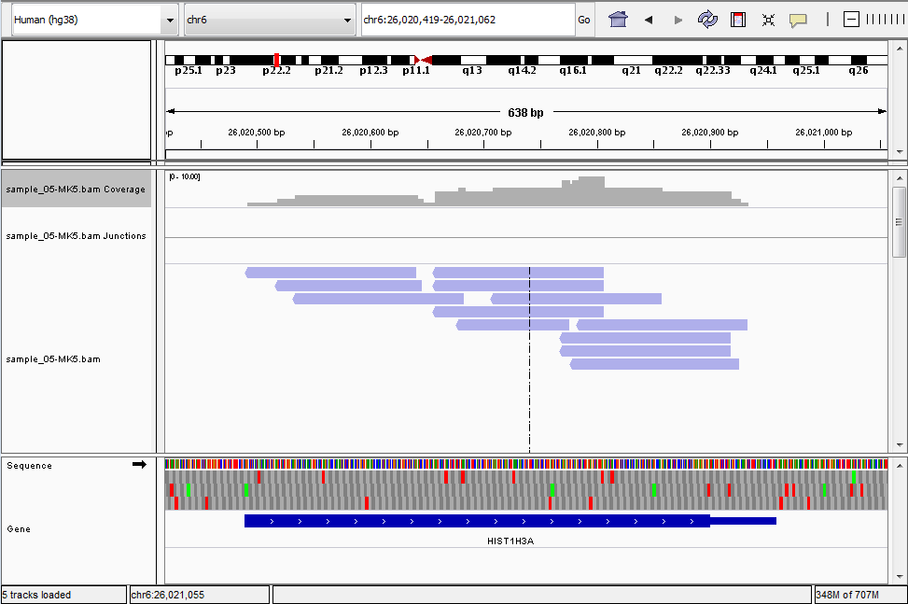
Integrative Genomics Viewer
Notes:
Talk about how abundant sequencing data has become and how it’s only going to grow larger.

Slide 28
Integrative Genomics Viewer
Link to IGV: https://goo.gl/PBamc1
Link to dataset: https://goo.gl/hXfdCx
Notes:
Talk about how abundant sequencing data has become and how it’s only going to grow larger.

Slide 29
ExAC Browser Link: http://exac.broadinstitute.org
The Exome Aggregation Consortium (ExAC) is a collaboration headed by The Broad Institute
Online browser
Human-specific
Currently is an aggregation of exomes acquired from 60,706 unrelated individuals of varying states of health with the exception of severe pediatric diseases
Contains allele frequency information for all variants identified in these exomes
Notes:
Talk about how abundant sequencing data has become and how it’s only going to grow larger.

Slide 30
ExAC Browser
Notes:
Talk about how abundant sequencing data has become and how it’s only going to grow larger.

Slide 31
ExAC Browser
Link: http://exac.broadinstitute.org
Notes:
Talk about how abundant sequencing data has become and how it’s only going to grow larger.

Slide 32
When to use which viewer?
UCSC Genome Browser:
Looking up annotation for genes/regions of interest and you have a small number of small files
IGV:
Loading large datasets (> ~100mb) and a large number of samples
ExAC Browser:
Looking up contextual information for NGS data such as allele frequencies

