Slide 1
Brainstorming session on Metabolic Modeling
J. Sankarasubramanian
Post Doctoral Associate
Babu Guda’s Laboratory

Slide 2
Metabolic reconstruction and FBA
These network reconstructions contain all of the known metabolic reactions in an organism and the genes that encode each enzyme
FBA calculates the flow of metabolites through metabolic network and making it possible to predict the growth rate of an organism or the rate of production of a biotechnologically important metabolite
Haemophilus influenza GSMM which was the first microorganism to have its metabolic model reconstructed

Slide 3
Genome-scale Metabolic Modeling Tools
Kbase
Metacyc
BIGG Model
MOST
antiSMASH
CoReCo
FAME
GEMSiRV
MEMOSys
Merlin
MetaFlux in Pathway Tools
MicrobesFlux
Model SEED
RAVEN Toolbox
SuBliMinaL Toolbox

Slide 4
KBase: The United States Department of Energy Systems Biology Knowledgebase
Arkin et al., 2018
Nature Biotechnology

Slide 5
KBase maintains an internal reference database that consolidates information from widely used external data repositories.
This includes over 90,000 microbial genomes from RefSeq, over 50 plant genomes from Phytozome, over 300 Biolog media formulations, and >30,000 reactions and compounds from KEGG, BIGG, and MetaCyc.
Kbase: http://kbase.us
KBase has a growing collection of more than 70 analysis apps that include:
Assembly and annotation
Sequence alignment and search
Metabolic modeling
RNA-seq and expression data analysis
Comparative and phylogenetic analysis

Slide 6
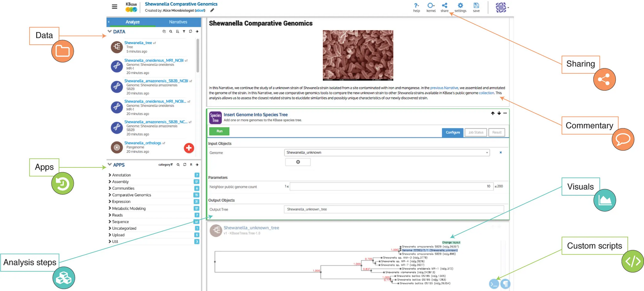

Slide 7
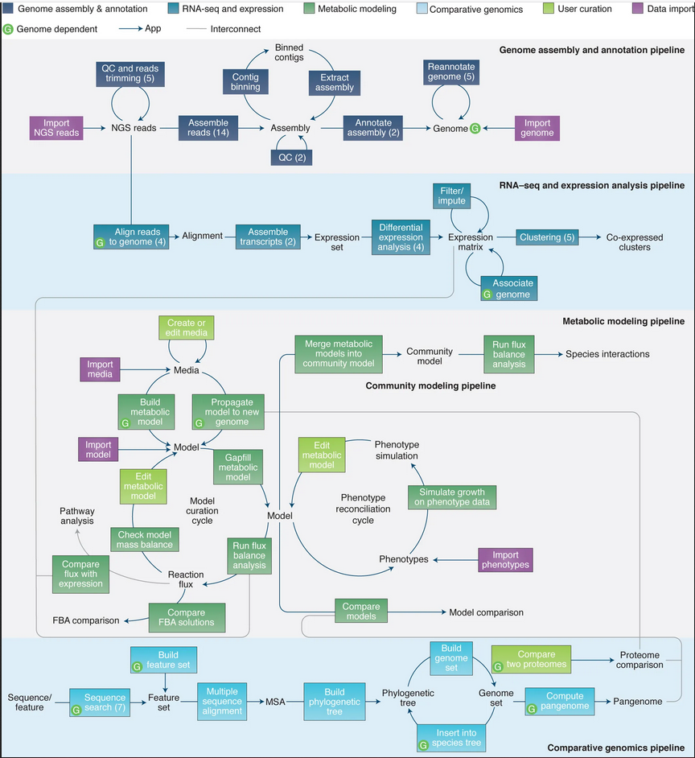

Slide 8
BiGG Models: A platform for integrating, standardizing and sharing genome-scale models
King et al., 2015
Nucleic Acids Research

Slide 9
BiGG Models
Genome-scale metabolic models (GEMs) are mathematically structured knowledge bases that can be used to predict metabolic pathway usage and growth phenotypes
Biochemical, Genetic and Genomic (BiGG) knowledge base for accessing BiGG Models with modeling and analysis tools
Identifying a gene function by sequence homology
Assigning a pathway name to a set of gene products

Slide 10
GEMs contain descriptions of the biophysical constraints on metabolic systems
Nutrient uptake,
oxygen availability,
reaction stoichiometry and
Reversibility
Export models in the Systems Biology Markup Language (SBML)
BiGG Models includes 77 GEMs linked to 71 genome annotations
Model, reaction, metabolite, compartment and gene identifiers are standardized, and pathway maps are included using the Escher pathway visualization library
Availability: http://bigg.ucsd.edu

Slide 11
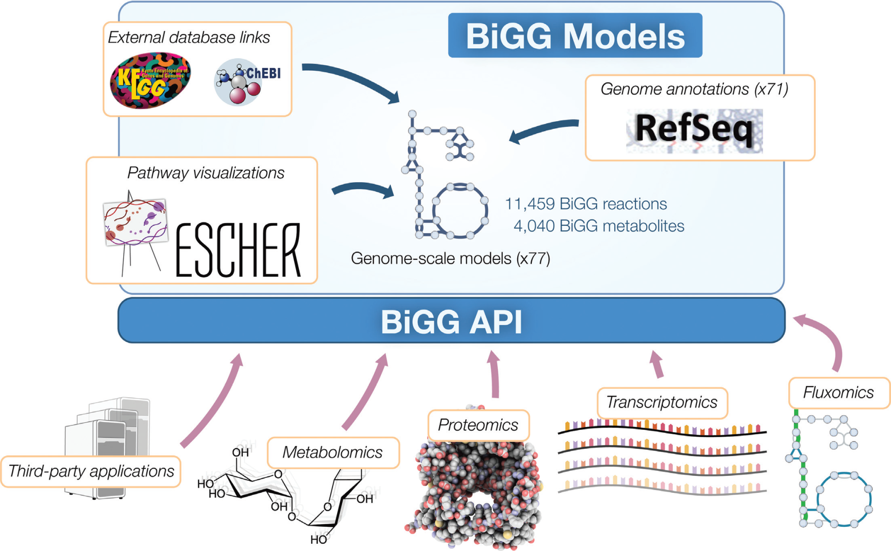

Slide 12
BiGG Models can be analyzed using the many available Constraint-Based Reconstruction and Analysis (COBRA) methods
Models are available in
MATLAB MAT format
JavaScript Object Notation(JSON)

Slide 13
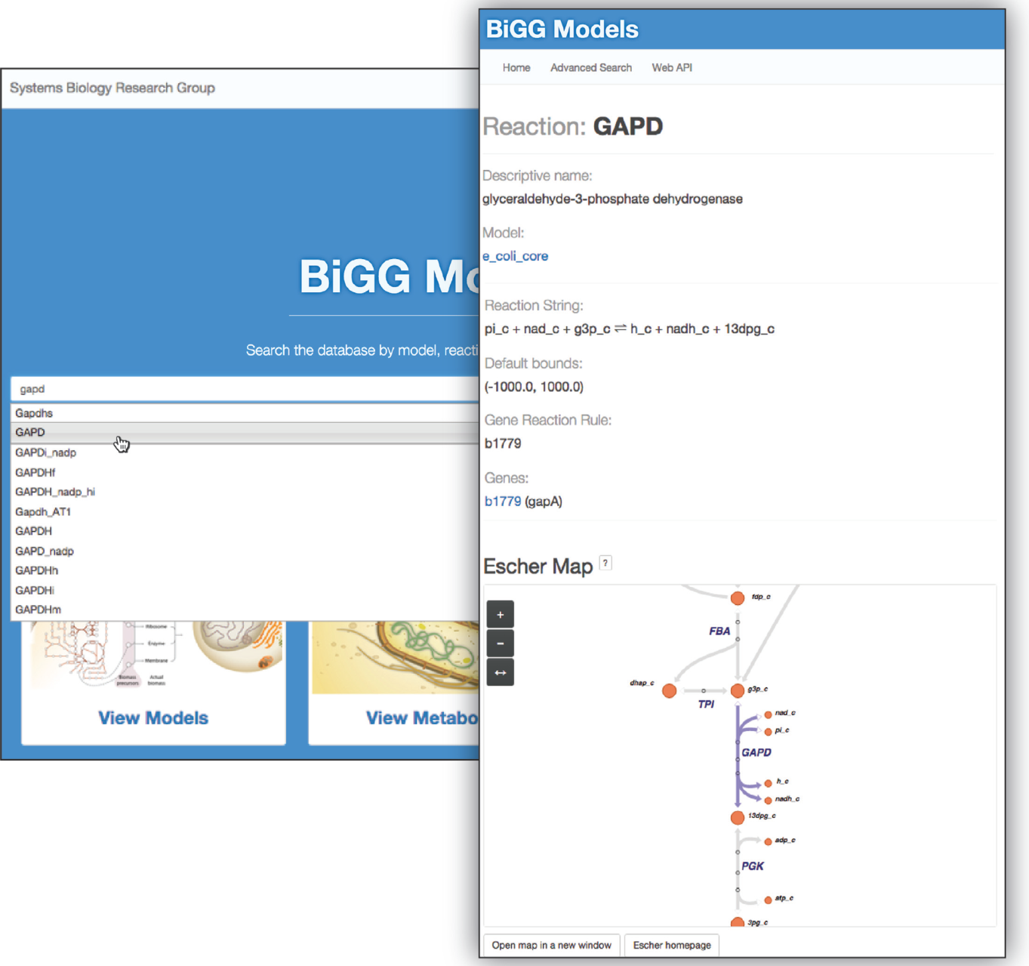
Reactions, metabolites and genes are assigned unique alphanumeric identifiers, based on the IDs
already found in most published GEMs
Metabolites in compartments include a one or two letter compartment code (lowercase letters), and tissue-specific metabolites have a one or two letter tissue code
Prefixed with
R for reactions and
M for metabolites.
The central text box allows users to search for pages in BiGG Models, including models and their reactions, metabolites and genes.

Slide 14
Minimal Information Required in the annotation of Models (MIRIAM) registry with URIs

Slide 15
MOST: a software environment for constraint-based metabolic modeling and strain design
Kelley et al., 2015
Bioinformatics

Slide 16
MOST (metabolic optimization and simulation tool)
Constraint-based models of metabolism
Implements GDBB (genetic design through branch and bound)
GDBB fastest algorithm for finding gene knockouts predicted by FBA to increase production of desired products
Available at http://most.ccib.rutgers.edu/
Input format SMBL and csv spreadsheet type interface
MOST implements
GDBB,
FBA,
E-Flux2 and
Simplified Pearson correlation with Transcriptomic data (SPOT),
E-Flux2 and SPOT are methods for integration of transcriptomic data into constraint-based models
It requires a Mixed Integer Linear Program solver to run FBA, E-Flux2 and GDBB or either Gurobi solver

Slide 17
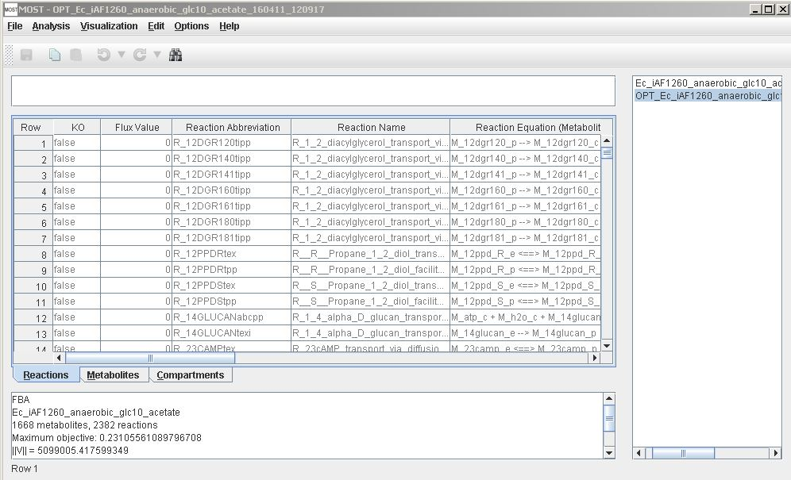

Slide 18
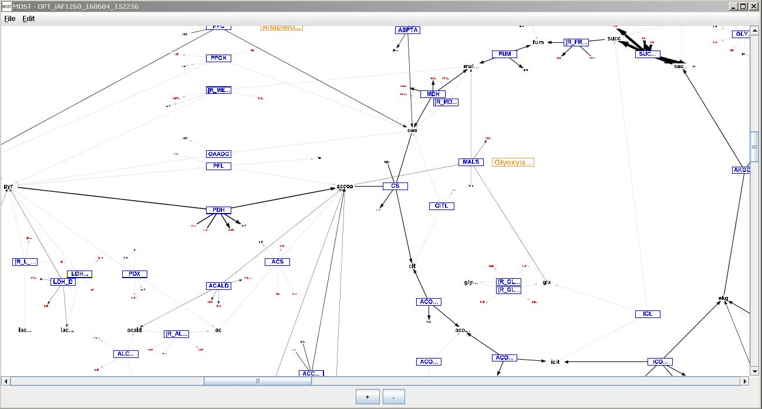
Metabolites in the model are identified with KEGG ids or ChEBI ids

Slide 19
It is the only software package that implements GDBB, the fastest method for finding gene knockouts predicted by FBA to have high output flux of desired products
E-Flux2, and SPOT in an intuitive, easy to use interface with Excel-like editing functionality

Slide 20
Reconstructing genome-scale metabolic models with merlin
Dias et al., 2015
Nucleic Acids Research
Notes:
Dias

Slide 21
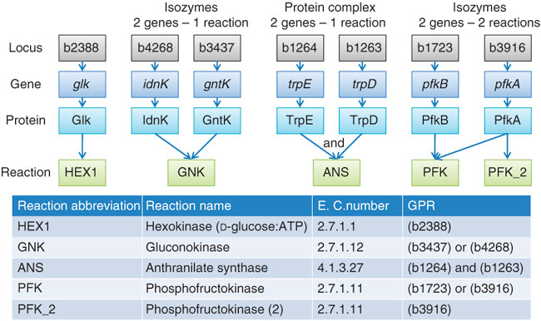
Metabolic Models Reconstruction Using Genome-Scale Information (merlin)
includes tools for the identification and annotation
genes encoding transport proteins,
generating the transport reactions
predicting the organelle localization
gene-proteins-reactions (GPR) associations

Slide 22
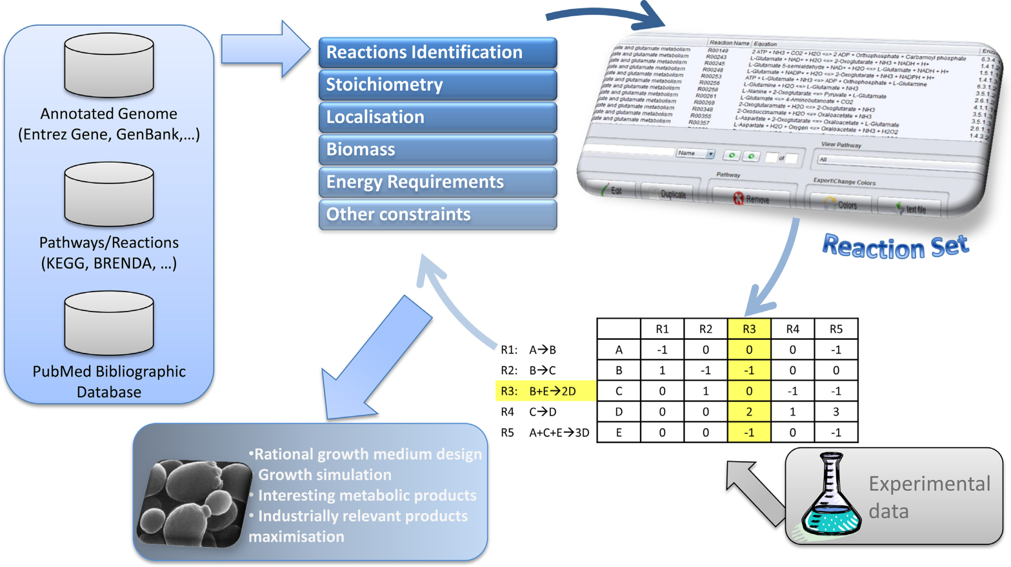
Illustration of the GSMM’s reconstruction process

Slide 23
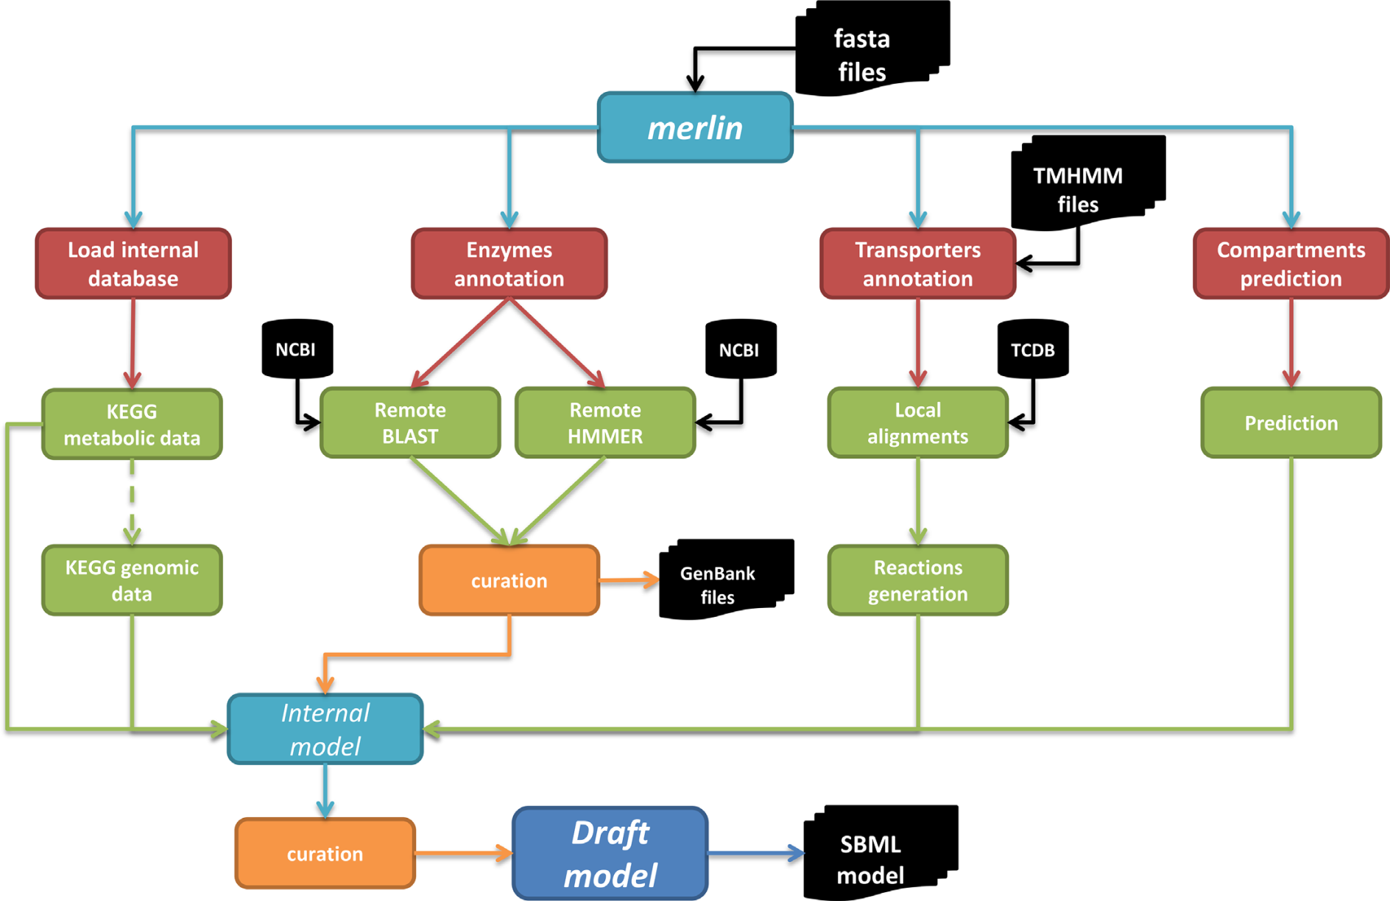
Schematic representation of merlin’s architecture.

Slide 24
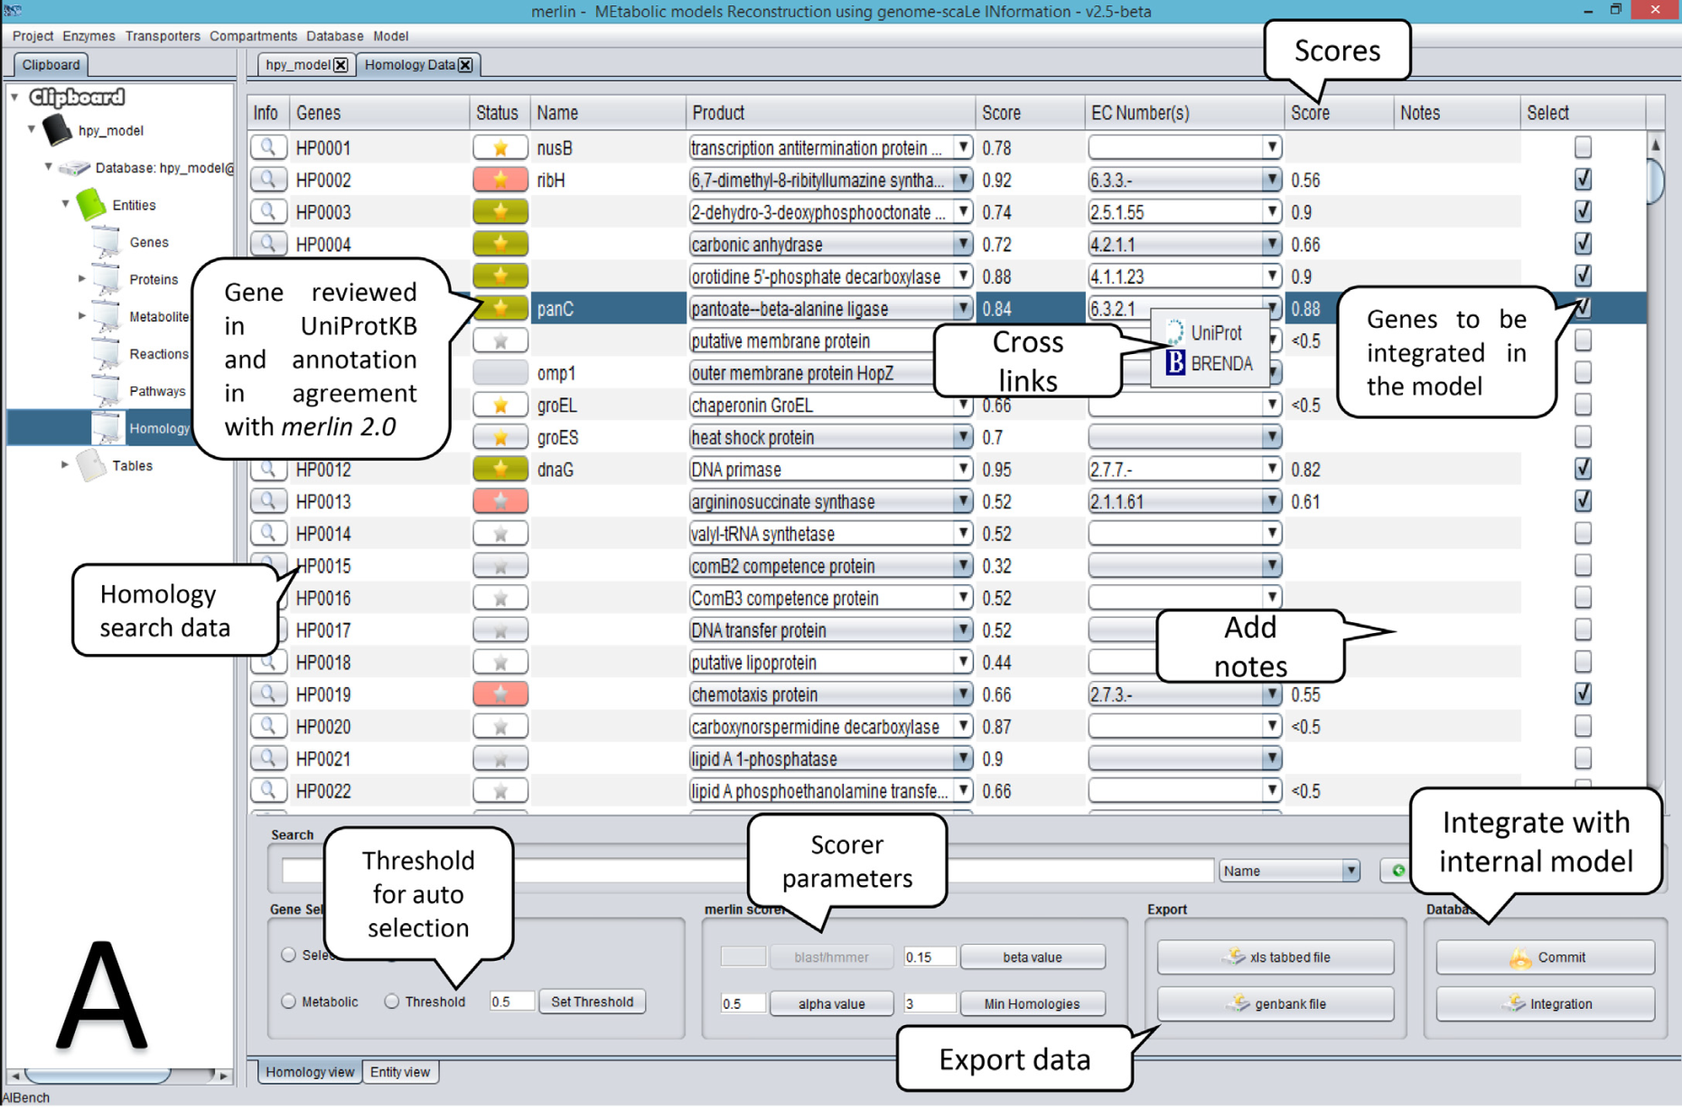

Slide 26
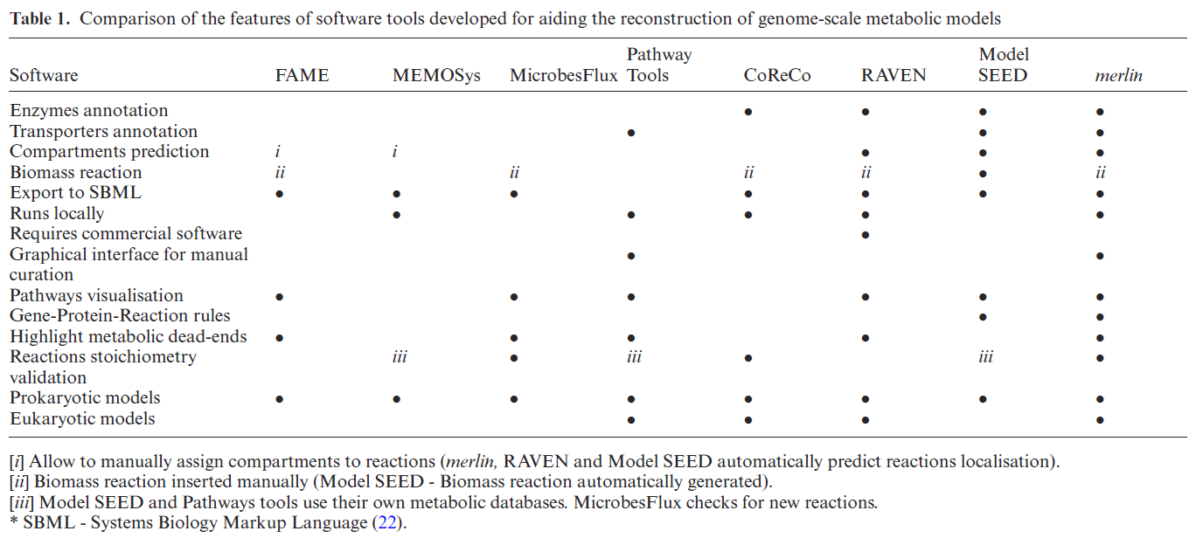
It performs several steps of the reconstruction process, including the functional genomic annotations of the whole genome, using homology tools such as BLAST and HMMER.

Slide 27
Automated Genome Annotation and Metabolic Model Reconstruction in the SEED and Model SEED
Devoid et al., 2013
Methods Mol Biol

Slide 28
Three primary components:
Metabolic pathways of the organism including reaction stoichiometry and reversibility
a set of gene–protein-reaction (GPR) associations
a biomass composition reaction that indicates which small molecules must be produced for an organism to grow and divide

Slide 29
Model is based on eight steps.
1. Requirements for Submitting a Genome Sequence to Automated Annotation.
2. RAST Approach to Automated Genome Annotation
3. Curation of RAST Genome Annotations

Slide 30
4. Requirements for Submitting a Genome for Automated ModelReconstruction
Model SEED home page (http://www.theseed.org/models)
PubSEED (http:// pubseed.theseed.org).
5. Reconstruction of Metabolic Models in Model SEED
functional roles in the annotation ontology
In total, this database contains over 13,000 reactions and over 16,000 reactants
Compounds charge as pH 7
all reactions are proton balanced using the charged forms of the reactants

Slide 31
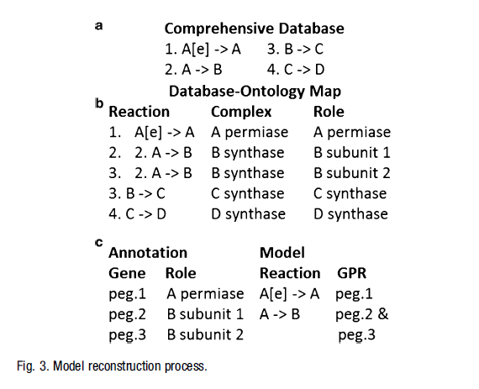

Slide 32
6. Biomass Composition Reactions (BCR) in Model SEED
estimation of the fraction of biomass that consists of DNA, RNA, protein, lipids, cell wall, and cofactors and an estimation of growth-associated ATP consumption
The biomass composition reaction describes the relative quantity of all small molecule metabolites that must be produced in order to generate 1g of biomass
Once all the metabolites in the model BCR have been determined, the stoichiometric coefficients for the metabolites must be computed.

Slide 33
7. Model Auto-completion in the Model SEED
biochemistry database for which generic reactions,
unbalanced reactions,
nonmicrobial reactions were removed
A mapping between reactions and compounds in the model and reactions and compound in the biochemistry database

Slide 34
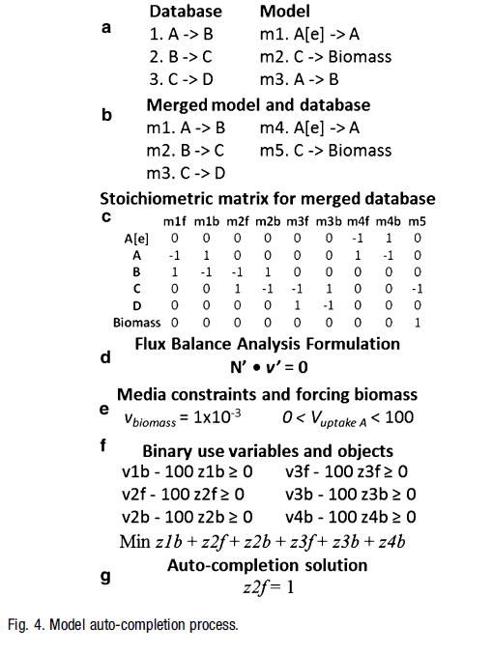
flux balance analysis problem by setting the product of the stoichiometric matrix and the vector of fluxes through the forward and reverse component reactions to be equal to zero
auto-completion with very low tolerance settings (e.g., 1 x10⁻³) and with large bounds on reaction flux and metabolite uptake (e.g., 100).
Binary variables are associated with each component reaction that did not appear in the original model either because annotated reactions were irreversible or because no gene was annotated to perform the reaction. Each binary use variable is equal to “1” if its associated reaction is active and “0” otherwise.

Slide 35
8. Reviewing and Curating a Model SEED Model
Access to the Model SEED website (http://www.theseed.org/models/).
Cytoscape (http://www.cytoscape.org/) and CytoSEED plugin (http://sourceforge.net/projects/cytoseed/) for viewing metabolic models.
FBA on metabolic models using SBML files.
COBRA Toolbox (opencobra.sourceforge.net/) or
OptFlux (www.optflux.org/).

Slide 36
Thank you

