Slide 1
Aspirin for chemoprophylaxis… too cheap to be true??
Thomas White, MD, FACS
Intermountain Health
Nebraska State Trauma Symposium
July, 24, 2025

Slide 2
Disclosures
KLS Martin – Consultant, Educator

Slide 3
VTE and Injury: What we know
VTE = Pulmonary embolism (PE) + Deep vein thrombosis (DVT)
VTE is common in hospitalized patients (58% incidence without prophylaxis)
  DVT 3.5%
  PE/PT 2.0%
Orthopedic trauma is a known risk factor for VTE because of the initial injury, surgical intervention, and postoperative immobilization
  Other risks: 40+ yo, shock on admission, SCI, major TBI

Slide 4
VTE and Injury: What we don’t know…yet
What is the optimal LMWH dosing strategy?
Are alternative oral agents efficacious (e.g. DOACS and ASA)??
How early can VTE prophylaxis be started in high-bleed risk patients?
Are the risk factors for early VTE (i.e. inpatient) the same as for late VTE?
Who deserves post-discharge prophylaxis and for how long?

Slide 5

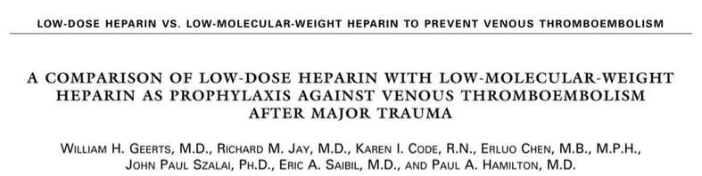
1996.
344 patients.
LMWH is superior to UFH in preventing inhospital VTE
Notes:
LMWH has been front and center since Dr Geerts published his landmark papers describing VTE incidence and the superiority of LMWH over UFH. That was 30 years ago… and little to no head to head studies comparing LMWH to alternative oral agents have been done. Until recently..!

Slide 6
VTE Prevention Strategies Have Evolved
Introduction of multidisciplinary care pathways
Multimodal pain management protocols (including regional anesthesia)
Modifications in surgical technique
Aggressive early ambulation and PT/OT
Earlier discharge
Notes:
Care is very different know from when Geerts did his early LMWH studies

Slide 7
ASPIRIN vs ENOXAPARIN
Notes:
Much of aspirin’s data has come out of arthroplasty literature.

Slide 8
Background: Aspirin vs Enoxaparin Pearls
ASPIRIN (ASA) | ENOXAPARIN (LMWH)
Inhibits cyclooxygenase 1 and 2 No direct clotting cascade effect | Potentiates antithrombin II and inhibits factor Xa
81-325 mg oral daily | 30-60 mg subcutaneous every 12 hours
Costs $0.01-0.02 per 81mg tablet | Costs $5-32 per 40mg/0.4mL
GI side effects | Thrombocytopenia
More accessible (oral route, cheap) | Injection, increased cost
Notes:
ASA inhibits thromboxane A2 synthesis and thus inhibits plt aggregation

Slide 9
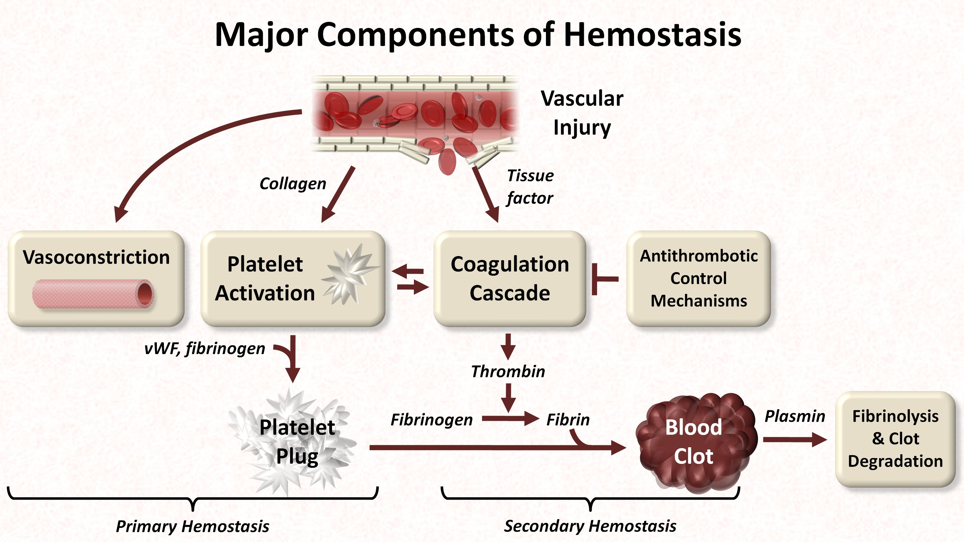
ASPIRIN = antiplatelet
LMWH = anti-clotting cascade
Notes:
ASA inhibits PLTS aggregation
Platelet membrane is the surface for assembly of activated coagulation factors/coagulation cascade
Results in the formation of the fibrin clot

Slide 10
ASA vs Enoxaparin for VTE Prophylaxis in Trauma
2020 ADAPT Trial (“A Different Approach to Preventing Thrombosis”)
  Trauma patients with operative extremity/pelvis, single center
  ASA noninferior to LMWH; ASA preferred based on patient-preference
2023 PREVENT CLOT Trial
2024 Secondary analysis on PREVENT CLOT
Notes:
MD Shock Trauma!
ADAPT was first RCT to look at ASA vs LMWH – both groups had basically identical outcomes except for the minimal importance threshold based on preference for oral vs SQ administration

Slide 11
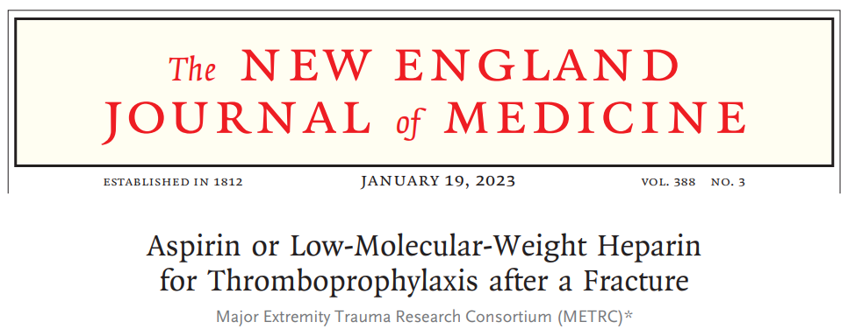
PREVENT CLOT Trial 2023
University of Maryland School of Medicine and the Major Extremity Trauma Research Consortium (Johns Hopkins University School of Public Health)
Patients with operative extremity or any pelvis/acetab fractures (not isolated)
21 centers (US and Canada) enrolled 12,211 patients
RCT assigned patients to LMWH 30mg BID or ASPIRIN 81mg BID, within 48 hours after injury (2 doses of non trial drug allowed)
Non-inferiority analysis (pre-specified margin is set)
  Intervention is not “unacceptably worse than the standard”
Notes:
PREVENT CLOT trial - 21 trauma centers in the United States and Canada.
Investigator-initiated, designed by the protocol committee, and planned and conducted in collaboration with patients and other relevant stakeholders.
Shoulder to wrist and hip to midfoot fxs were included
Adjusted dose levels for LMWH were permitted (weight or AFXA)
Protocol “adherence” defined as 80% of assigned doses (allowed for some missed inpatient doses) AND use of study drug for VTEp on discharge

Slide 12
PREVENT CLOT Study Outcomes
Primary | Secondary | Safety
Death from any cause at 90 days | Nonfatal PE Deep vein thrombosis Cause-specific death | Bleeding events Wound complications Surgical site infections
Notes:
Primary outcome was death (bc this is what patients reported they card most about) from any cause and not PE due to concern of misclassification

Slide 13
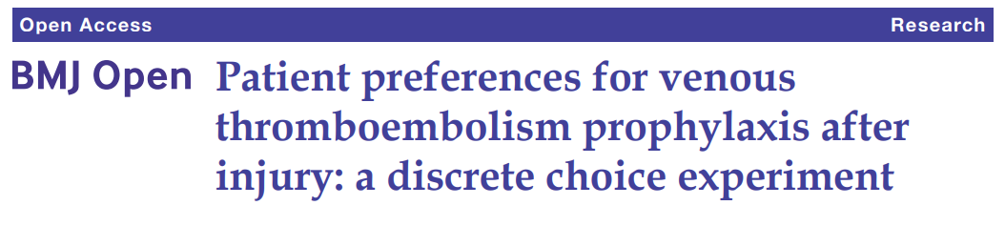
We are in an era of patient-centered healthcare
Evaluated orthopedic trauma patient preferences and acceptable tradeoffs of risks/benefits with regard to VTE prophylaxis
Determined heterogeneity in preferences among subgroups (age, race, injury location, household income, insurance status, etc)
Asks patients to choose the best option between two or more hypothetical scenarios or choice sets
Determines relative magnitude of patient preferences to avoid VTE-related complications in associations with their medication choice
Notes:
- Must focus on outcomes most important to patients and understand trade-off estimates
- Patients were trauma inpatients with ortho injuries at MD shock trauma
- Patients were asked about medications and clinically important outcomes - med route, cost, SEs (site bruising, bleeding or wound complications), risk of VTE requiring therapeutic AC, PE and death
- Reasonable to assume that at the time of survey, most patients were receiving the stdrd which was LMWH

Slide 14
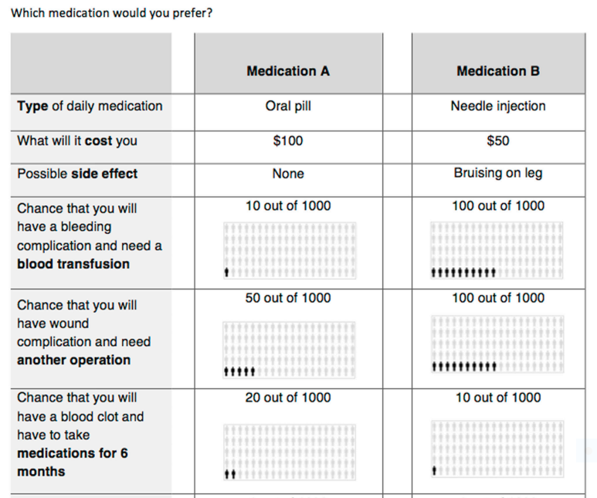

Slide 15
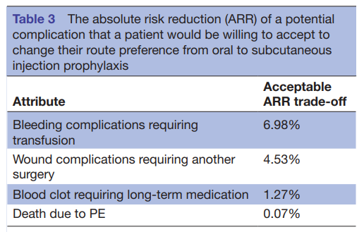
Discrete Choice Experiment Results
Notes:
Overwhelmingly and obviously patients preferred oral route, but authors were surprised at how little risk reduction of death due to PE was needed to change their preference to SQ
Surmise that death could be the easiest outcome for patients to actually understand (or maybe just that no one wants to die?!)
Subgroup heterogeneity - women, white, and LE fxs demonstrated stronger preferences for oral

Slide 16
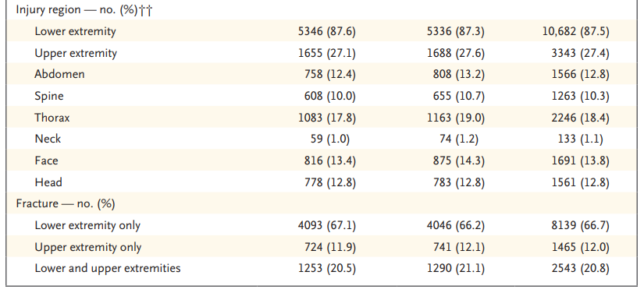
PREVENT CLOT Study Population
Notes:
Median ISS was 9

Slide 17
PREVENT CLOT Results Summary
Hospital LOS 5 days, 8-9 doses given
95% adherence to protocol in ASA group and 97% in LMWH group
91% received VTE prophylaxis at discharge with a 21-day duration (similar)
  Discharge adherence 94% ASA and 87% LMWH groups
All-cause mortality: 0.78% ASA group vs 0.73% LMWH group
Notes:
ITT and per protocol analysis had similar results
No difference in any secondary outcomes (like PE, DVT, bleeding)

Slide 18
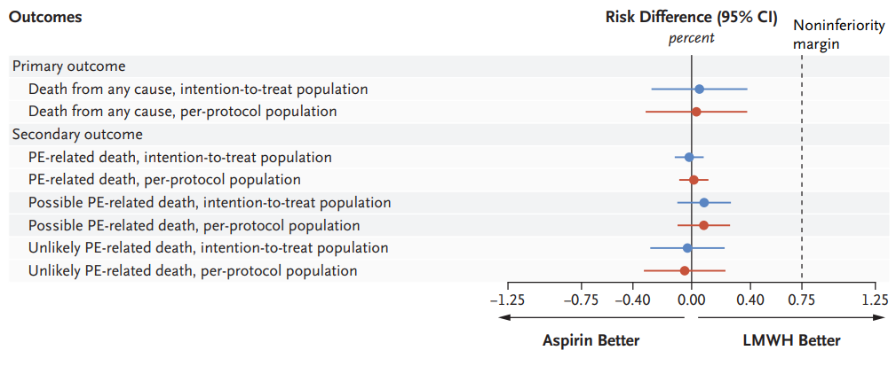
Notes:
ITT outcomes no difference from per protocol outcomes

Slide 19
Secondary outcomes
 | LMWH (n=6110) | ASA (n=6101)DVT | 95% CI
Nonfatal PE | 1.49% | 1.49%
DVT | 1.71% | 2.51% | 0.8% (0.28% to 1.31%)
Proximal | 1.0% | 1.2% | 0.3% (-0.1% to 0.6%)
Distal | 0.9% | 1.5% | 0.6% (0.2% to 1.0%)
Notes:
No diff in PE events, but there was a difference in DVT…which was driven completely by distal DVT only (which we and they do not treat)

Slide 20
PREVENT CLOT Conclusion
Aspirin is noninferior to LMWH in preventing death and is associated with a low incidence of deep vein thrombosis
and pulmonary embolism at 90 days​
Notes:
Fewer DVTs w LMWH but all with respect to distal DVT; secondary outcomes all similar

Slide 21
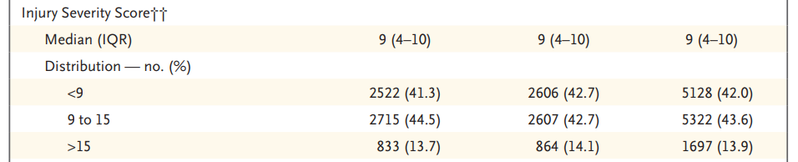
Aspirin for the win?
BUT WHAT ABOUT SICK PEOPLE?
Notes:
FAIR QUESTION!

Slide 22

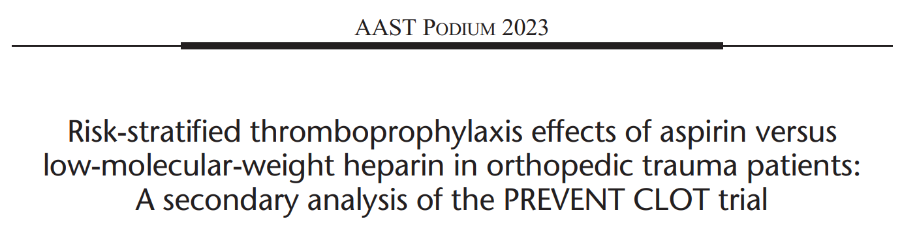

Slide 23
Primary aim
Evaluate if global assessment of treatment effects varied based on baseline risk of VTE
Determine if PREVENT CLOT results apply to patients at highest risk of thrombosis
Secondary aim
Add medication satisfaction to the risk-stratified assessment of treatment effects
Notes:
Chose to insert patient satisfaction
This group takes a patient-centered approach and underscores the reality that patient satisfaction will affect compliance, which may have an effect on VTE rates

Slide 24
Design
Secondary analysis of the original PREVENT CLOT trial
What is a Secondary Analysis?
Re-analyzes previously collected data for purposes other than the original/primary research
Explores new questions and often subgroups
Not adequately powered to achieve study outcome
Notes:
Secondary analyses re-analyze data that was previously collected for an original trial to explore new or more specific questions, often SUBGROUPS. They are NOT adequately powered given often the population is a subset of the entire study population.

Slide 25
Methods
Operative extremity or pelvis/acetab
Did not exclude patients with concomitant injuries
Excluded preinjury anticoagulation, VTE within 6 months and >48h from injury
Patients allowed 2 doses of LMWH prior to initiation of study drug
LMWH 30mg BID (or weight-based) vs Aspirin 81mg BID
  NOT BLINDED to clinicians/patients

Slide 26
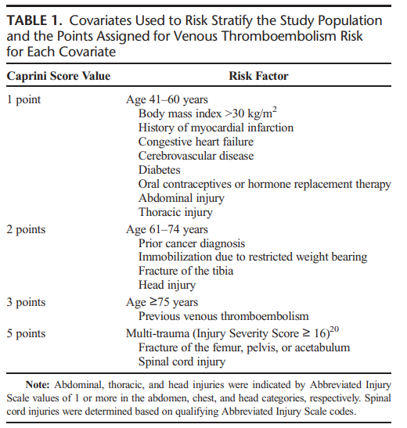
Caprini score for VTE risk
Low (0-4 points)
Low-Med (5-7 points)
Med-High (8-10 points)
High (11+ points)

Slide 27
Primary Outcome (composite)
All cause mortality
Secondary Outcome
Medication satisfaction assessed at 90-days after randomization
PE
DVT
Bleeding events
Notes:
Composite at 90-days (ranked in order based on patient preference)
Secondary – likert scale extremely satisfied to dissatisfied

Slide 28
Patient Follow-Up
Phone or in-person appointment at 90 days
If not available, medical records were reviewed to determine outcomes
Notes:
Outcomes like death, VTE events, and med satisfaction obtained at 90 day f/u appointment

Slide 29
Stats Pearl: Win Ratio Method
An approach for composite outcomes, accounting for relative priorities of the components (hierarchical)
Gives appropriate priority to the clinically important event (not the first event)
Uses outcomes to analyze patients, rather than patients to analyze outcomes
  Define a hierarchy of clinical importance for the outcome components
  Pair each subject in treatment group with each subject in control group
  Evaluate each pair for the occurrence of the components of the outcome in descending order of importance
  Calculate the win ratio by dividing the number of patient pairs with a win by the number of patient pairs with a loss
Notes:
Win ratio commonly used on CV literature (prioritizes clinically important event, not just the first event)
This is considered a more pragmatic technique…to better align with the patient experience

Slide 30
Win Ratio: Benefits
Single measure to estimate a difference in the totality of benefits and harms
Protects against competing risks
Improves statistical power by considering the hierarchical importance of various outcomes (prioritizes the most clinically important events)

Slide 31
Win Ratio: Methods
Matched pairs of ASA vs LMWH patients
Pairwise comparison is done hierarchically (first mortality, followed by PE, DVT, then bleeding)
Win ratio = # wins aspirin arm / # wins in LMWH arm
Performed within each VTE risk group (as defined by Caprini score)
95% confidence interval
Notes:
(‘winner’ or ‘loser’ for who had each outcome first, if at all)
Comparison started with all cause mortality, followed by PE, DVT, then bleeding
Tied if neither had the outcome

Slide 32
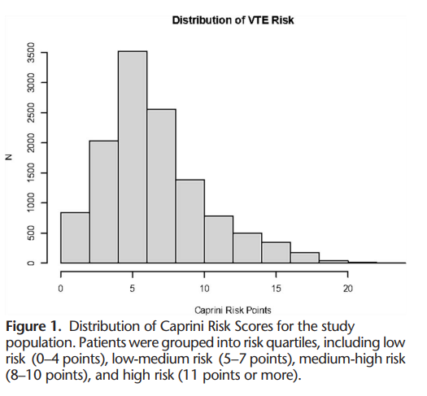
Results: Patient Characteristics
43 yo
62% male
48% had femur, pelvic or acetab
40% had concomitant injuries
Median ISS was 9
Similar surveillance rates
Similar VTE prophylaxis duration

Slide 33
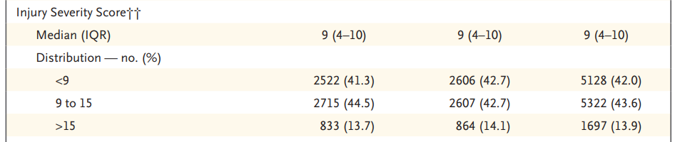

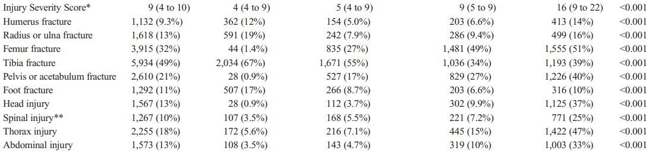
ISS
Caprini
Score

Slide 34
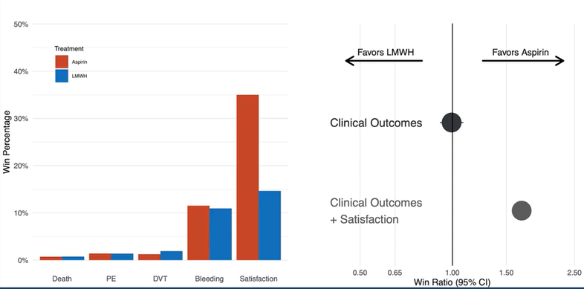
Results
No difference in outcomes; except with patient satisfaction included ASA wins
Notes:
Based on 37 million pairwise comparisons
ASA group won 0.7% vs LMWH 0.8% comparisons by protecting against death
On the left the # wins is reported for each treatment arm for each outcome
On the right is the WIN RATIO

Slide 35
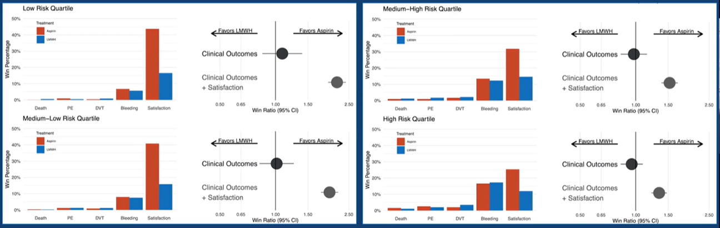
Low Risk: win ratio 2.18; 95% CI, 1.95-2.44; p<0.001
High Risk: win ratio 1.35; 95% CI, 1.23-1.49; p<0.001
Notes:
Patients were stratified into 4 VTE risk QUARTILES – and the 2 medications were indistinguishable in any risk level
When you included ASA – it won over LMWH. But this magnitude of the ASA benefit lessens as VTE risk increases – and this is because of the increase incidence of VTE complications/outcomes like DVT, PE and death (and thus fewer pairs distinguishable by patient satisfaction itself)

Slide 36
Limitations
Patients were allowed to receive up to 2 doses of LMWH prior to enrollment
Duration of prophylaxis was not mandated (but it was similar)
Open-label design could have influenced clinical decisions (e.g. surveillance)
Outcome hierarchy could be debated and may not be exhaustive (but is supported by DCE methods)
Caprini score was used to denote VTE risk (limitations of scoring systems)
ISS is reported, but little granularity on concomitant injury severity (i.e. GCS, vent days, SOI grades etc)
Notes:
But the objective outcome of death cant really be affected by diagnostic bias given open label design

Slide 37
Author Conclusions
VTE outcomes are similar among orthotrauma patients who receive either ASA or LMWH regardless of baseline VTE risk
Novel patient-centered methods resulted in a single measure of total benefits and harm between groups (evaluate options globally)
ASA is heavily favored if patient satisfaction is considered in addition to clinical outcomes
Notes:
This secondary analysis supports the conclusion of the original preventclot trial
Win ratio method allows patients/clinicians to evaluate treatment options GLOBALLY – a more pragmatic approach!
Medication satisfaction drives the ASA benefit!

Slide 38
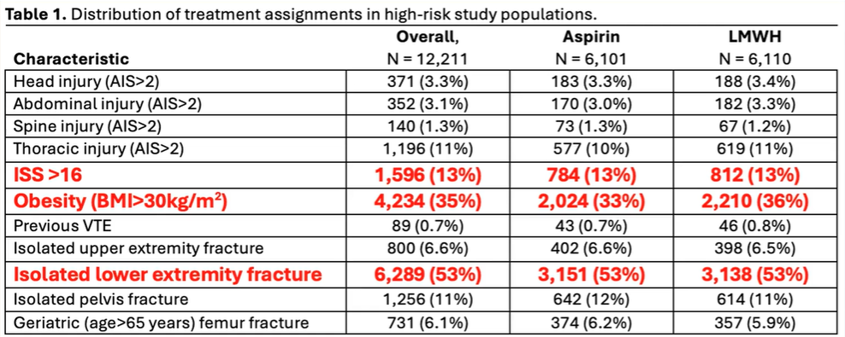
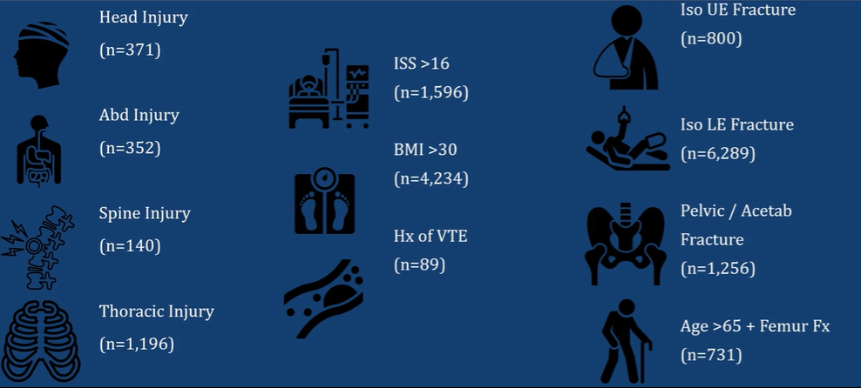
But what about REALLY SICK people?
No difference between ASA and LMWH in any of the clinical outcomes

Slide 39
So what now?
Adoption has been challenging! People can’t believe it could be true.
MD Shock Trauma has written ASA into their inpatient clinical algorithm, but is still waiting on buy-in from partner centers

Slide 40
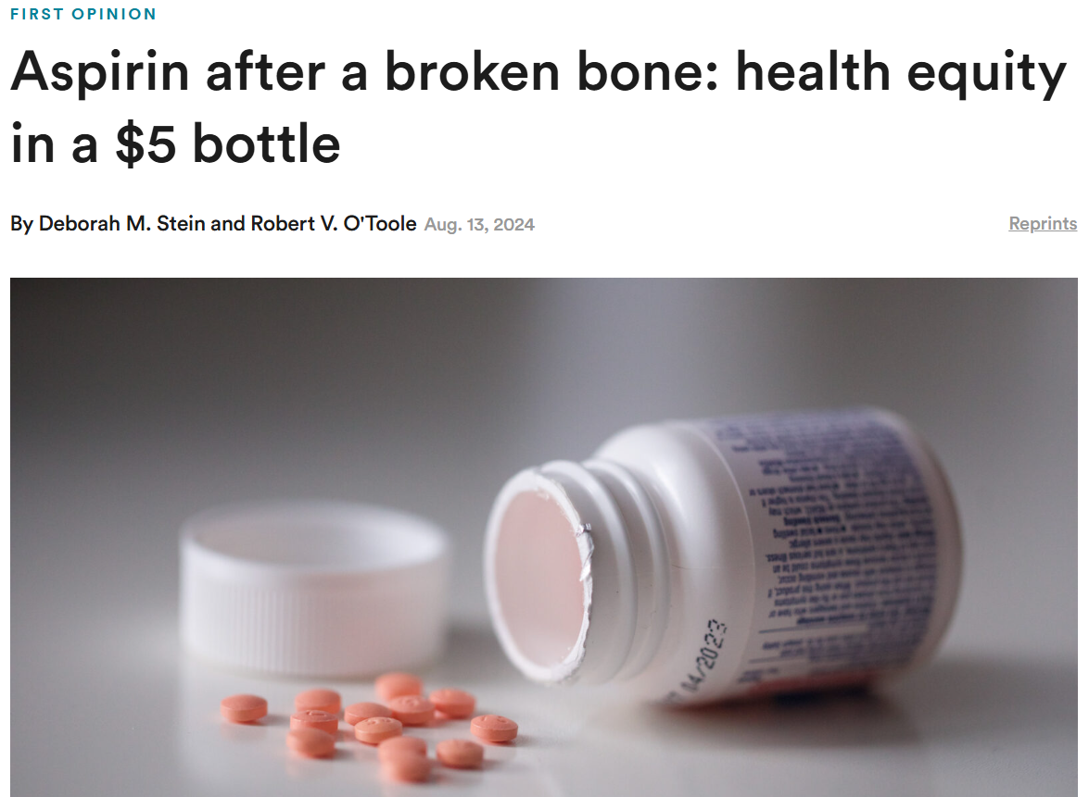
A Health Equity Issue
“From a health equity perspective, people with low-deductible commercial insurance who have a strong support network can afford the cost and burden of a LMWH rx”
“Those who lack social support networks and/or financial resources are far more likely to skip the injectable drug and will run a significantly higher risk of a deadly blood blot”
“Those people are disproportionately from racial and ethnic minority communities as well as poorer communities. It’s a factor that should be taken into account by doctors, hospitals and everyone in the care chain.”
Notes:
The authors were frustrated with the lag in adoption and felt compelled to write this piece on health equity
This is a health equity issue – providing a cheaper medication option to improve access to adequate VTE prevention

Slide 41
1996.
344 patients.
LMWH is superior to UFH in preventing inhospital VTE → changed practice
2024.
12,211 patients.
ASA is noninferior to LMWH in preventing 90-day VTE → ??

Slide 42


Slide 43

Being good at thinking can make us really bad at re-thinking
Re-thinking is a skill set, and also a mindset
Mental horsepower doesn’t translate to mental dexterity
Thinking like a scientist requires searching for reasons why we might be wrong (not for reasons why we might be right) – and revising our views based on what we learn

Slide 44


Slide 45
Thoughts?
Data suggests improved compliance with oral prophylaxis regimens
  Does this affect VTE outcomes?
Cost must be taken into consideration
Some of the most robust data you will see in trauma
Clinical relevance of slight increase in distal DVT only with ASA?
Limitations in severely injured multisystem trauma patients still exist
IMO…we should be replacing LMWH with ASA for ortho/spine fracture patients for inpatient VTE prophylaxis (and strongly consider for most post-discharge regimens)
ASA should be used routinely for prophylaxis on hospital discharge

