Slide 1



Oral Effects of Common Medications Prescribed for Long Term Care Residents

Slide 2

Medications
Module Objective
  Discuss the common oral side effects of medications

Slide 3

Medications
More than 90% of the elderly take prescription medication each week
57% take five or more medications daily
12-20% take more than ten medications daily

Slide 4
Medications
Polypharmacy:
common for nursing home residents
Definition: the use of multiple medications (five or more) by a patient, generally older adults (those aged over 65 years)

Slide 5
Medications
Metabolism
  As we age the metabolism of chemicals is not as efficient
  Drugs stay in the system for a longer period of time

Slide 6
Medications
Polypharmalogical Interactions
  Increase in number of medications prescribed
  Decrease in metabolism rate of drugs
  More reactions can cause issues in geriatric health

Slide 7
Common Conditions of the Elderly Requiring Medications
Hypertension
Stroke and blood clots
Diabetes
Chronic pain
Constipation
Arthritis
Depression and psychological disorders, e.g., dementia, OCD
Parkinson’s disease
Seizures

Slide 8
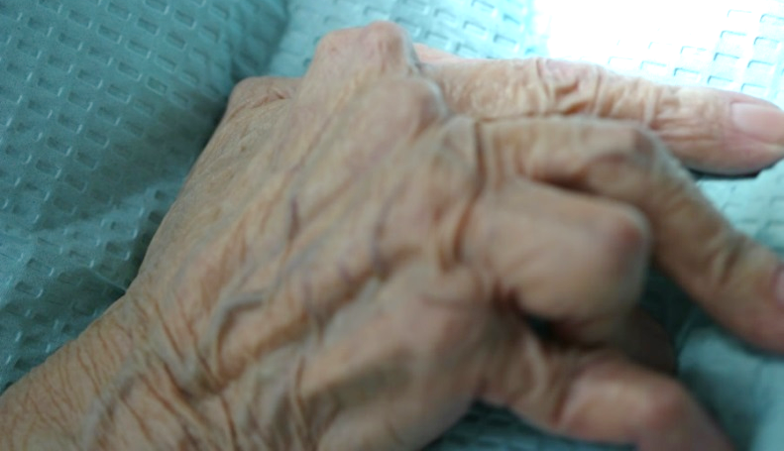
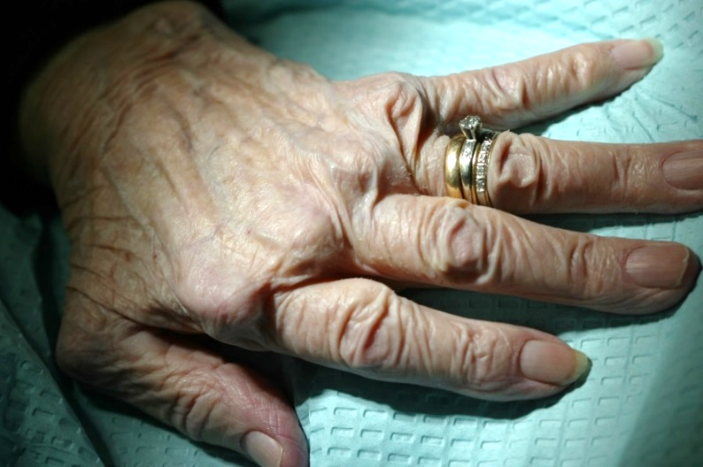
Conditions that may
Require Medications
Arthritis
  Reduce inflammation and combat autoimmune disease.
Secondary problem
  Difficulty with dexterity and manipulation of the toothbrush

Slide 9
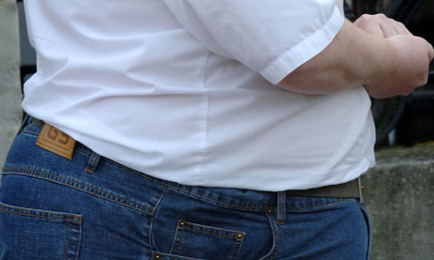
Conditions that may
Require Medications
Obesity
  Diabetes
  Hypertension
  Depression
  Chronic pain

Slide 10
Medications:
Common Oral Side Effects
Xerostomia (chronic dry mouth)
Taste alteration
Candidiasis
Gingival hyperplasia
Stomatitis and mucositis

Slide 11
Medications:
Common Oral Side Effects
Lichenoid drug reaction
Dental erosion due to gastric reflux
Dental caries

Slide 12
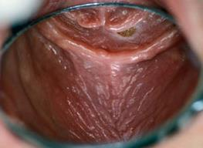
Xerostomia
Sensation of dry mouth due to decreased salivary flow

Slide 13
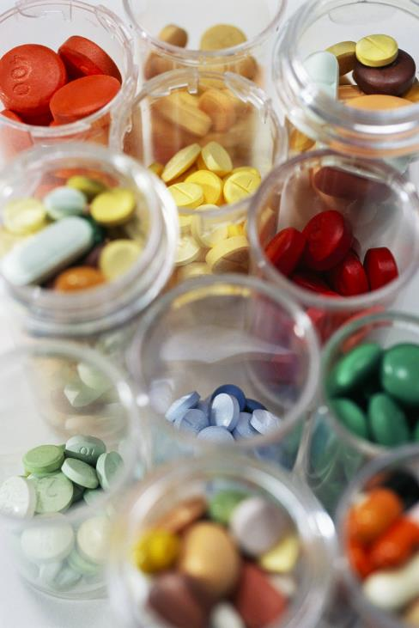
Xerostomia
Over 400 drugs identified that can cause dry mouth
About 13 categories of drugs

Slide 14
Xerostomia
Medication classes causing dry mouth
Antihypertensives – high blood pressure medications
Diuretics – for water retention
Antibiotics
Antihistamines – for allergies
Antidepressants
Anti-psychotics
Anti-anxiety
Anticholinergic
Anticonvulsants

Slide 15
Xerostomia
Medication classes causing dry mouth
Narcotics
Alzheimer’s
Parkinson’s
Arthritics
Laxatives

Slide 16
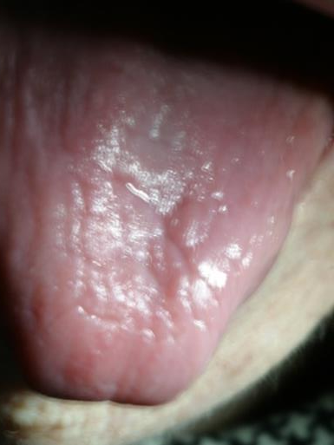
Xerostomia
Symptoms
Difficulty in swallowing and speaking
Altered taste perception
Oral discomfort, burning
sensation
Poor denture retention
(if worn)

Slide 17
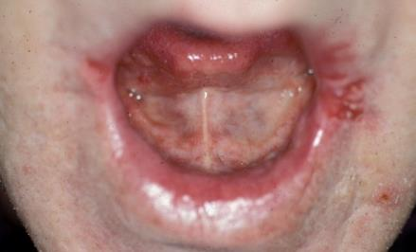
Xerostomia
Symptoms
Evidence of fungal infection or angular cheilitis (sores in the corners of the mouth)

Slide 18
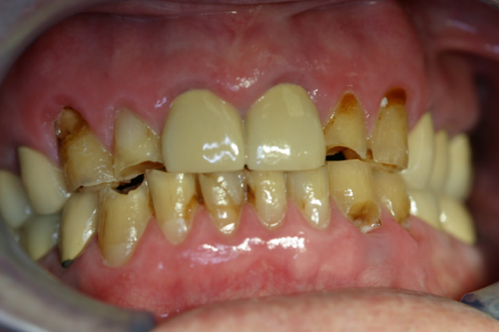
Xerostomia
Symptoms
Gumline tooth decay
Intra-oral soft tissue changes

Slide 19


Xerostomia Management
Avoid:
Inciting medications
Irritants
  Alcohol
  Caffeine
  Tobacco
Sugar-containing drinks and candies

Slide 20
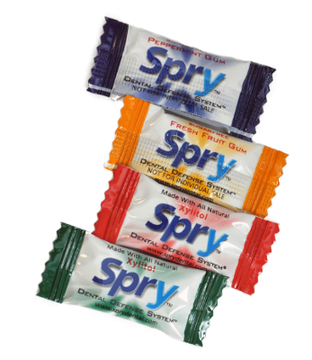
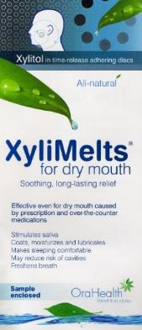
Xerostomia Management
Suggest residents do the following:
  Sipping water frequently especially when eating
  Chew xylitol gums,
  mints and/or candies
  Use saliva substitutes
  Good oral hygiene

Slide 21
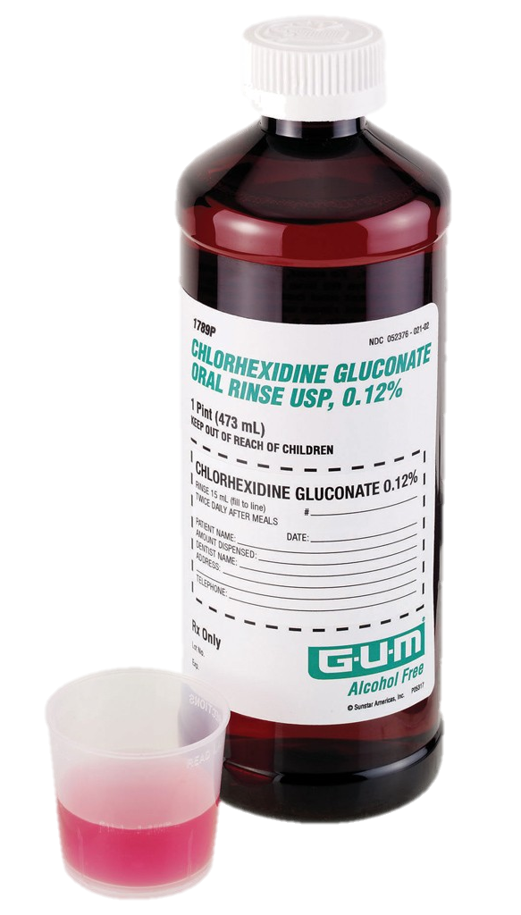
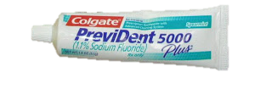
Xerostomia Management
Suggest residents do the following:
  Topical fluoride, fluoride varnish or prescription fluoride toothpaste
  Alcohol-free chlorhexidine rinse
  two times daily
  Biotene products
  Salivary stimulants (Pilocarpine)
  for severe cases

Slide 22

Taste Alteration (Dysgeusia)
Associated with over 200 drugs
Major impact on quality of life
Often overlooked by caregivers, clinicians
Weight loss and depression
Taste may be decreased, altered, or made unpleasant
Compensation with sugared
foods can lead to caries

Slide 23
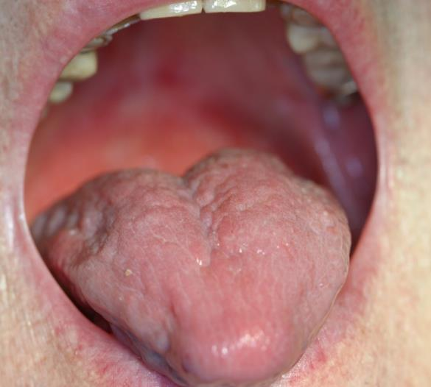
Taste Alteration:
Medication Classes Causing Dysgeusia
Antibiotics
Antifungals
Antivirals
Cardiac medications
Chemotherapy agents
Denuded taste buds

Slide 24
Medication Classes Causing Taste Alteration
Parkinsonian agents
Migraine agents
Thyroid medications
Psychotropics
Radiation (localized)
Denuded taste buds

Slide 25
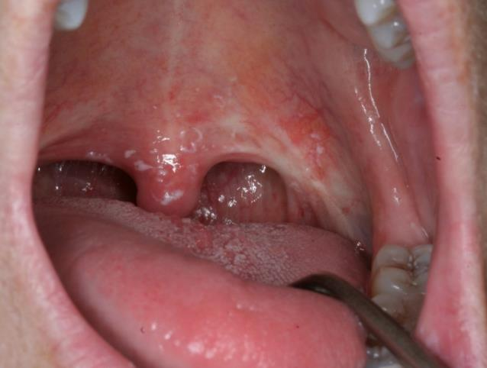
Fungal Infections/Candidiasis
Opportunistic fungal infection in the mouth caused by an overabundance of candida and predisposing factors
Candidiasis: White plaque on the uvula

Slide 26
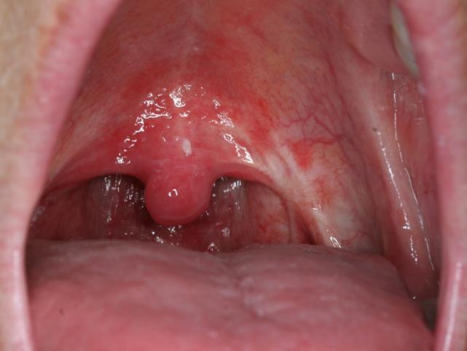
Fungal Infections/Candidiasis
Opportunistic fungal infection in the mouth caused by an overabundance of candida and predisposing factors
Wiping off fungus leaves inflamed tissue

Slide 27
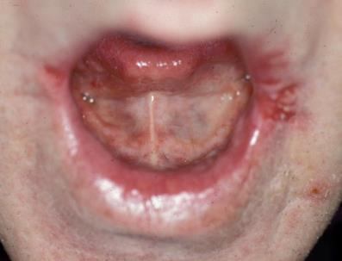
Fungal Infections/Candidiasis
Symptoms
  Lesions can appear in several different forms
  Can be present as a mixed lesion such as angular cheilitis

Slide 28
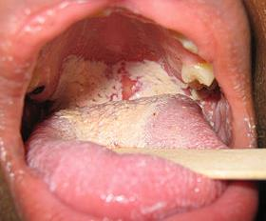
Fungal Infections/Candidiasis
Medication Causes
  Antibiotics (especially broad spectrum)
  Cancer chemotherapy (anti-neoplastic)
  Immunosuppressants
  Steroids
  (including inhalers)

Slide 29
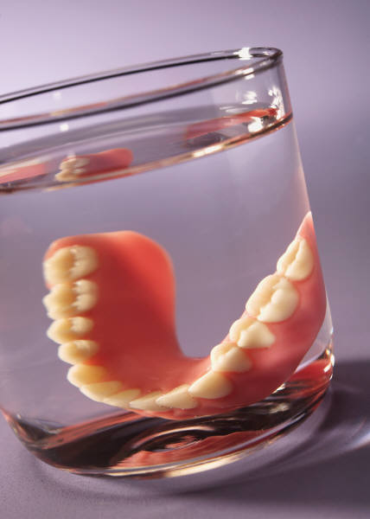
Fungal Infections/Candidiasis
Management
  Search for cause
  Topical products to treat
    Nystatin for denture wearers – 5X day
    Clotrimazole troches
    – 5X day
  Systemic treatment (chronic candidiasis)
    Consult physician
    IV meds for larynx, esophagus

Slide 30
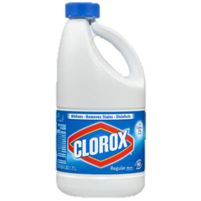
Fungal Infections/Candidiasis
Management
  Denture treatment:
    Disinfect with solution of household bleach (Clorox®)
    1 part to 10 parts water
    Kills microorganisms
    Removes discolorations
    and staining
    Soak for 20 to 30 minutes
    Rinse thoroughly with water

Slide 31
Fungal Infections/Candidiasis
Management
  Denture treatment:
  For nightly storage, mix 1 part bleach to 100 parts water
  (~2 tablespoons per gallon)
  Store in gallon container
  Use to soak dentures overnight
  Rinse thoroughly with water

Slide 32
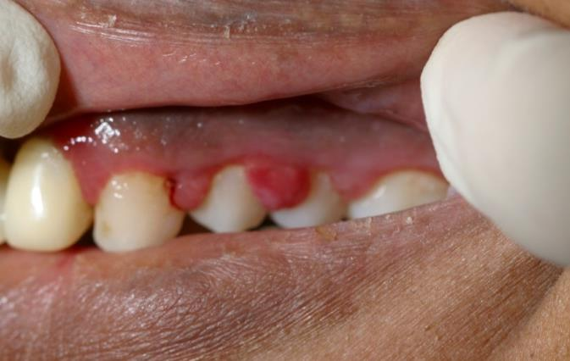
Gingival Enlargement
(gingival hyperplasia)
Overgrowth of gingival tissue (gum tissues)
Appear to balloon around the teeth

Slide 33
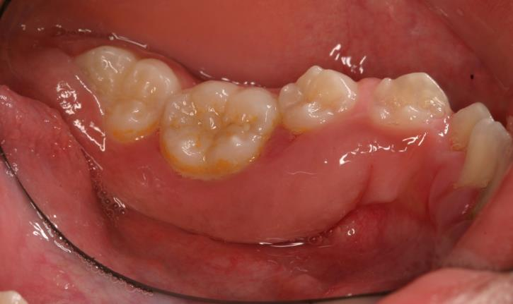
Gingival Enlargement
(gingival hyperplasia)
Symptoms
Gingival (gum tissues) appear swollen around teeth
  Fibrotic
  Inflamed

Slide 34
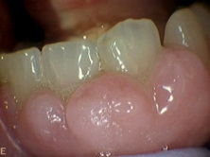
Gingival Enlargement
(gingival hyperplasia)
Medication Causes
Cyclosporine
Calcium channel blockers
Anticonvulsants (Tegretol, Depakote, Dilantin)

Slide 35
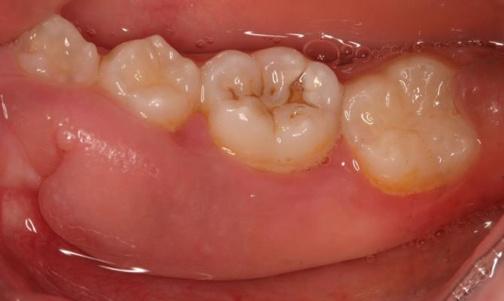
Gingival Enlargement
(gingival hyperplasia)
Management
Occurrence is dose related
Good preventive
oral hygiene
Surgery if severe

Slide 36
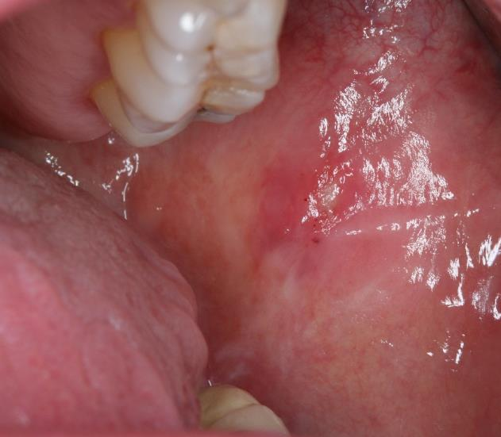
Stomatitis and Mucositis
Inflammation of the mucous lining the cheeks, gums, tongue, lips, throat, palate, floor of mouth.

Slide 37
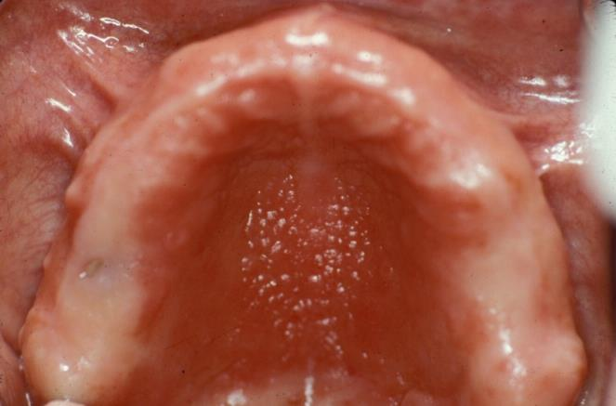
Stomatitis and Mucositis
Symptoms
Erythema of palate with cobblestoning of mucosa (denture)
Erythema and
multiple mucosal
ulcers (radiation,
chemotherapy)
Denture stomatitis

Slide 38
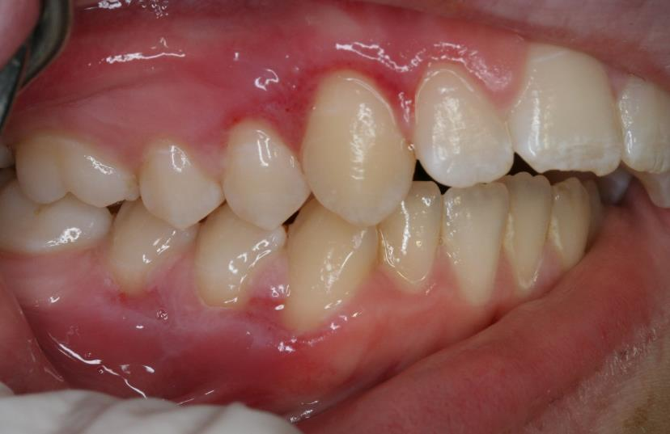
Stomatitis and Mucositis
Medication causes
Chemotherapy (generalized)
Radiation
therapy
(localized)

Slide 39
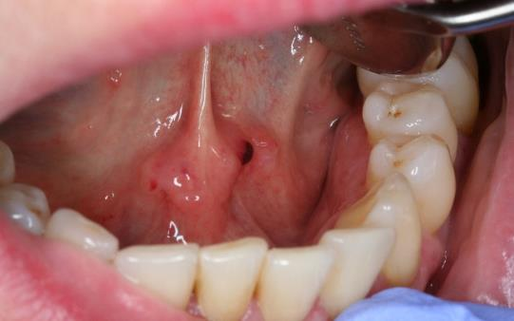
Stomatitis and Mucositis
Management
Topical antifungals for two weeks
Chlorhexidine or salt/soda rinses
Palliative treatment for pain

Slide 40
Lichenoid Drug Reactions
Medication Causes:
Anti-hypertensives
IV Bisphosphonates
NSAIDS
Broad spectrum antibiotics
Antidepressants
Chemotherapy (anti-neoplastic)
Anti-epileptic

Slide 41
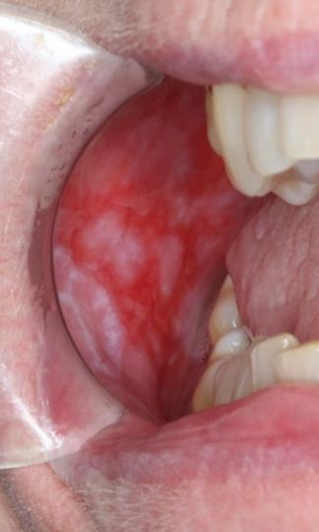
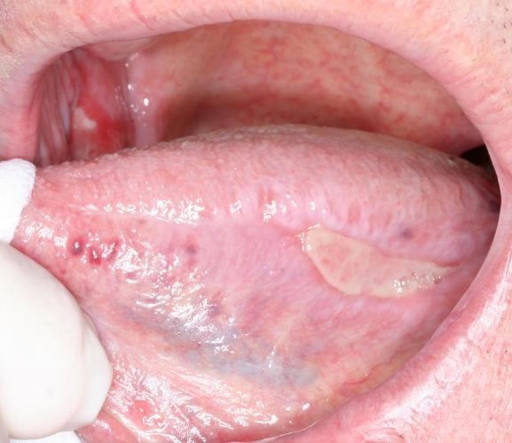
Lichenoid Drug Reactions
White nonwipeable plaques with ulcerations on the cheeks, associated with pain

Slide 42
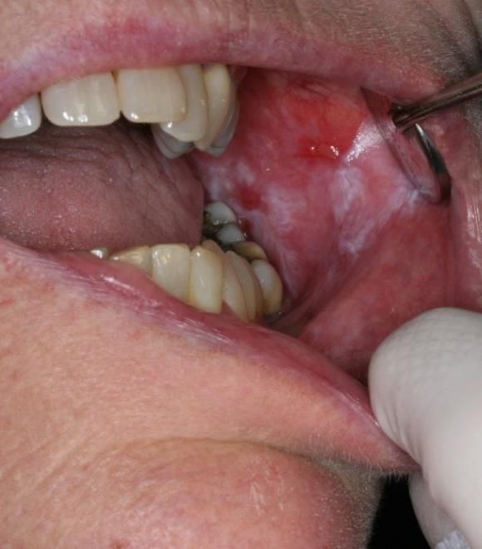
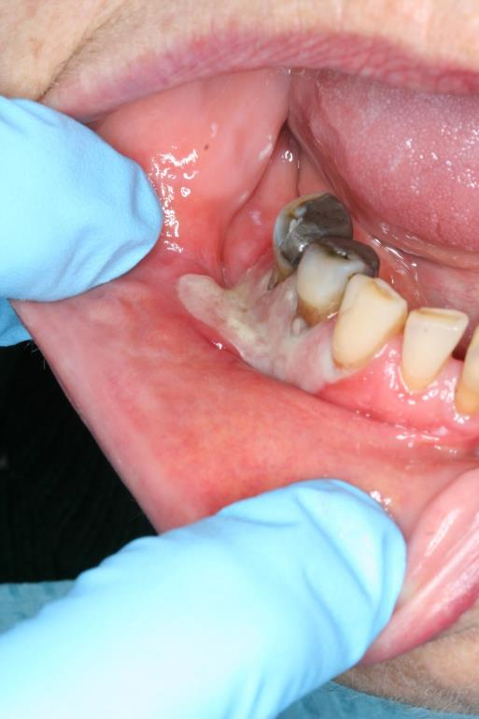
Lichenoid Drug Reactions

Slide 43
Lichenoid Drug Reactions
Management
Palliative treatment
  Topical local anesthetic rinse
  Systemic analgesics
  Topical steroids
  Systemic steroids

Slide 44
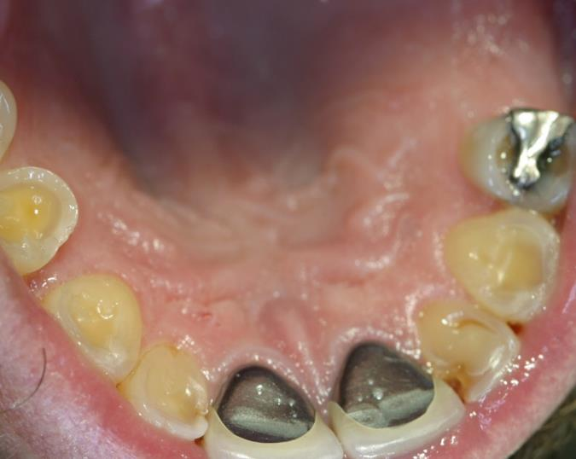
Dental Erosion
Due to Gastric Reflux
Loss of tooth structure through a nonbacterial chemical process

Slide 45
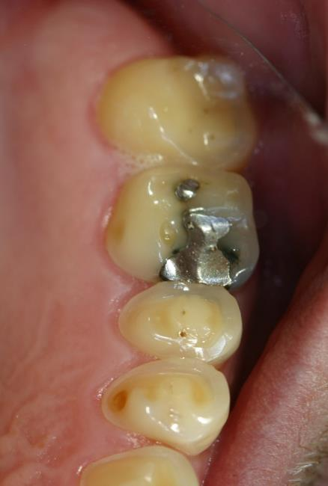
Dental Erosion
Due to Gastric Reflux
Symptoms
Loss of tooth structure especially along the gumline, but could be all over.
Could experience generalized hypersensitivity

Slide 46
Dental Erosion
Due to Gastric Reflux
Medication Causes
Beta blockers
Calcium channel blockers
Progesterone
Nitrates

Slide 47
Dental Erosion
Due to Gastric Reflux
Management
Treatment of GERD to reduce exposure of acid on teeth
Sensitivity toothpaste
Fluoride: varnish, trays or prescription toothpaste
Calcium phosphate products (MI paste)
Xylitol regimen

Slide 48
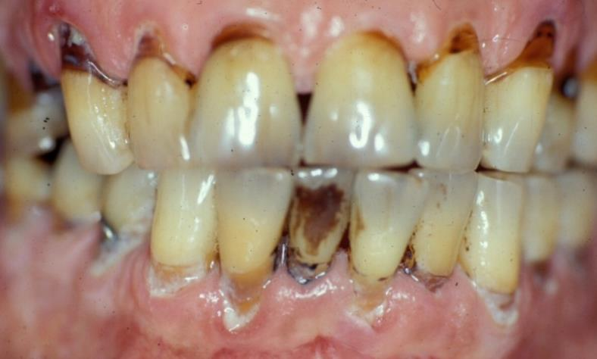
Dental Caries
Elderly population
  > 50% with natural teeth affected
  Root caries common

Slide 49
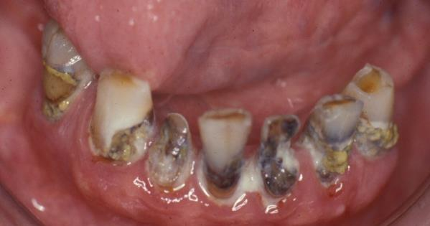
Dental Caries
Symptoms
Mild disease of teeth often asymptomatic
Could experience pain with eating, temperature change or spontaneously
Abscess
Cellulitis

Slide 50

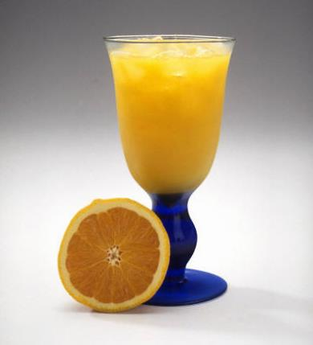
Dental Caries
Medication Causes
Sugar containing medication preparations (i.e., syrups, cough drops)
Crushed medications given in applesauce, juice

Slide 51
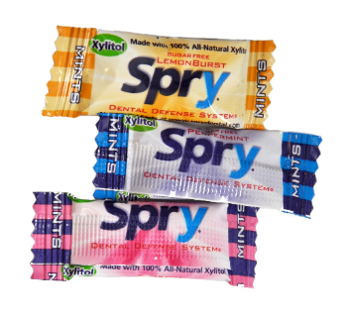
Dental Caries
Management
Change or modify medication
delivery method
Good oral hygiene
Xylitol regimen
Fluoride regimen
Restore teeth by DDS

Slide 52
Take-home Message
Medications may have negative oral consequences which should be monitored and minimized whenever possible.
Good oral preventive care is paramount to reducing the symptoms of medication side effects to maintain quality of life.

Slide 53
References
Smiles for Life: A National Oral Health Curriculum
Clark MB, Douglass AB, Maier R, Deutchman M, Douglass JM, Gonsalves W, Silk H, Tysinger JW, Wrightson AS, Quinonez R, Dolce M, Bowser J. Smiles for Life: A National Oral Health Curriculum. 3rd Edition. Society of Teachers of Family Medicine. 2010. www.smilesforlifeoralhealth.org.
Course Steering Committee Author: A. Stevens Wrightson, M.D.
Dental Consultants: Pamela S. Stein, DMD, MPH; Robert G. Henry, DMD, MPH; Joanna M. Douglass, BDS, DDS.
Smiles for Life Editor: Melinda Clark, MD.
Reviewers: Kathy Kemle, MS, PA-C; Leslie-Faith Morritt Taub,
ANP-C, GNP-BC, CDE, C. BSM, DNSc.

Slide 54
Production Credits
Project Coordinator & Principal Investigator: Darlene Carritt, RDH
Advisor: Prof. Caren Barnes, RDH, MS
Presentation & Graphics: Kim R. Theesen
Photography: Peggy Cain
Video Production & Editing: Calvin Hughes
Editing Assistance: Rita Charles
Consultant: Nagamani Narayana, DMD, MS

Slide 55



Additional Credits
This presentation produced in part with cooperation with the University of Nebraska Medical Center College of Dentistry, Nebraska Department of Health & Human Services, and the Nebraska Health Care Association.

