Slide 1



The Oral-Systemic Link: Diseases and Oral Implications in the Elderly

Slide 2
The Oral-Systemic Link
Does chronic disease increase the burden of oral disease?
Does oral disease increase the burden of chronic disease?

Slide 3
Conditions with
Oral-Systemic Implications
Tooth infection
Aspiration pneumonia
Nutrition
Obesity
Diabetes
Vascular disease
Dementia
Rheumatoid arthritis
Osteoporosis and osteonecrosis

Slide 4
Oral Bacteria
Bacteremia
Cellulitis
Brain Abscess
Sinusitis
Aspiration Pneumonia

Slide 5
Effects of Infection from Teeth
When the pulp in a tooth becomes necrotic secondary to severe caries, infection can spread to become a potentially life-threatening cellulitis.

Slide 6
Effects of Infection from Teeth
Untreated oral bacterial infection can cause:
  Intraoral abscesses
  Sinusitis
  Facial cellulitis
  Periorbital cellulitis
  Bacteremia and its consequences
  Brain abscesses

Slide 7
Effects of Infection from Teeth
Untreated oral bacterial infection can cause:
  Airway compromise secondary to tracking of cellulitis into the facial planes of the neck “Ludwig’s angina”
  Sinusitis, bacteremia, and brain abscesses may occur due to direct bacterial extension into adjacent soft tissues, or systemically through a hematogenous route.

Slide 8
Effects of Infection from Teeth
Elderly Sequela
  Immunocompromised state
  Impaired nutrition
  Poor wound healing
  Antibiotics
    Candidiasis
    Clostridium difficile

Slide 9

Effects of Infection from Teeth
Management
  Alert: Physician and/or dentist

Slide 10
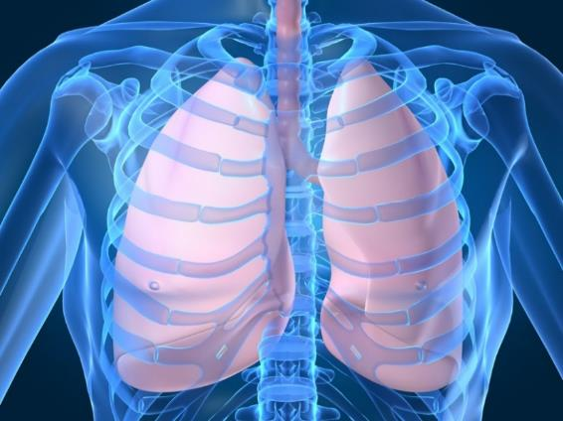
Aspiration Pneumonia
Aspiration of oral bacteria is associated with pneumonia, particularly in bedridden and hospitalized patients.
  Eighty-three percent of
  patients who develop
  nosocomial pneumonias
  are mechanically
  ventilated.

Slide 11
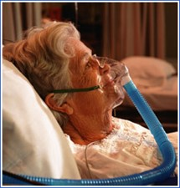
Aspiration Pneumonia
Aspiration of oral bacteria is associated with pneumonia, particularly in bedridden and hospitalized patients.
  Oral care protocol interventions
  led to an 89.7% reduction in
  ventilator associated pneumonia
  (VAP).
  Oral hygiene strategies in
  hospitalized and nursing home populations also can reduce the incidence of pneumonia.

Slide 12
Poor Nutrition
Teeth Related
Systemic Conditions

Slide 13
Nutritional Deficiencies
Dental causes leading to alteration in diet
  Loose or broken teeth
  Tooth loss
  Dentures
  Decreased saliva (xerostomia)

Slide 14

Nutritional Deficiencies
Systemic conditions that may lead to alteration in diet
  Depression
  Dementia

Slide 15
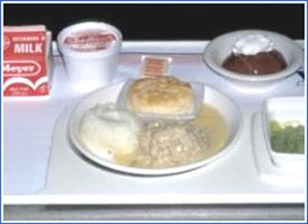
Nutritional Deficiencies
Systemic conditions that may lead to alteration in diet
  Dysphagia
  Chemotherapy (cachexia)
  Vitamin B₁₂ deficiency
  Protein deficiency
Soft Diet

Slide 16

Nutritional Deficiencies
Elders may experience the following:
  Changed sensory perception of eating (texture and taste)
  Decreased masticatory efficiency
  Reduced intake of important nutrients
    Fruits, vegetables and fiber
    Vitamin C and beta-carotene

Slide 17
Nutritional Deficiencies
Elders may experience the following:
  Compensatory habits
    Sucking mints or consuming sweetened beverages to mitigate dry mouth, which may result in empty calories and increased caries risk

Slide 18
Nutritional Deficiencies
Elders may experience the following:
  Impaired wound healing
    All of these factors can lead to inability to heal

Slide 19
Periodontal Disease
Dementia
Diabetes
Obesity
Rheumatoid Arthritis
Vascular Disease

Slide 20
Obesity & Diabetes
The oral-systemic link between obesity and oral disease is intimately tied up with diabetes in a “three-way street.”

Slide 21
Obesity & Diabetes
Fat tissue: a metabolically-active organ that produces tumor necrosis factor alpha (TNF-α) and interleukin 6.
These cytokines promote bone breakdown and inflammation, two processes that potentiate periodontal disease.
TNF-α also causes insulin resistance
that predisposes to Type 2 diabetes.

Slide 22
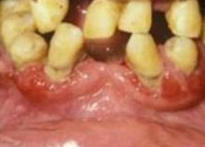
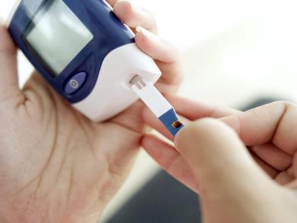
Diabetes & Glycemic Control
Poor glycemic control is in turn associated with periodontal disease.
Periodontal disease leads to worse glycemic control creating a vicious cycle.

Slide 23
Diabetes–Periodontal Disease: A Vicious Cycle
Patients with periodontal disease: twice as likely to develop Diabetes
Periodontal Disease worsens glycemic control
Poor Glycemic Control:
associated with threefold increased risk of periodontal disease
Treatment of periodontal disease results in 10-20% improvement in glycemic control

Slide 24
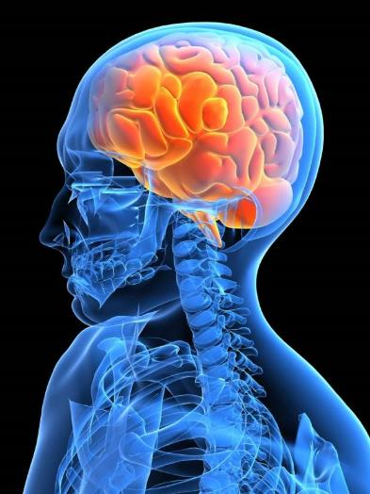
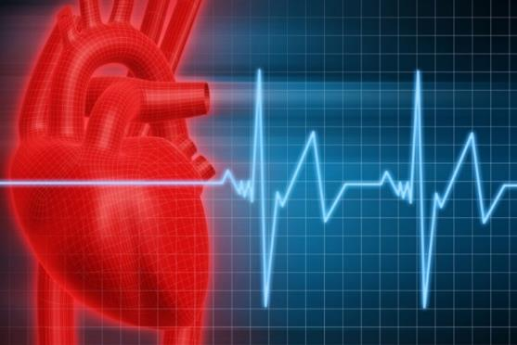
Vascular Disease
Periodontal disease: associated with both coronary artery disease and cerebrovascular disease, but causation is not clear.

Slide 25
Vascular Disease
  Inflammatory cytokines implicated in atherogenesis are also produced in patients with periodontal disease.
  Systemic antibody response to periodontitis is associated with coronary heart disease.

Slide 26
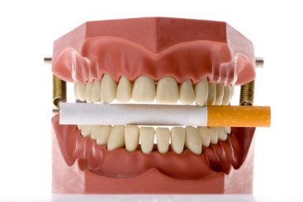
Vascular Disease
Periodontal disease: associated with both coronary artery disease and cerebrovascular disease, but causation is not clear.
  Smoking is associated with both periodontitis and coronary heart disease.
    Both share elevated CRP levels.

Slide 27
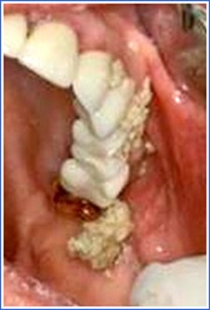
Vascular Disease
Strokes can result in multiple
oral problems:
  Oral sensory and motor deficits
  Poor tongue function and lip seal
  Dysphagia
  Reduced oral clearance of foods and increased food packing
  Reduced dexterity negatively affecting ability to perform oral hygiene
  Increased caries and periodontal disease risk
Food Packing

Slide 28
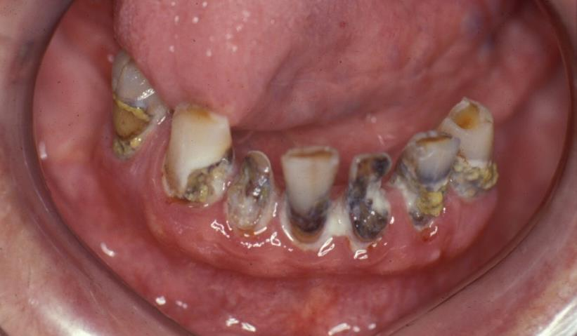
Dementia
Patients with dementia have increased risk for caries, periodontal disease, and oral infections.

Slide 29
Dementia
Contributing factors to oral problems include:
  Self-care deficits
  Chronic disease burden
  Dietary changes
  Difficulty complying with:
    Medications
    Oral hygiene
    Dental appointments

Slide 30
Dementia
Contributing factors to oral problems include:
  Dependence on caregivers
  Behavioral changes
  Postural impairments
  Swallowing difficulty
  Lack of understanding leading to resistance to care

Slide 31
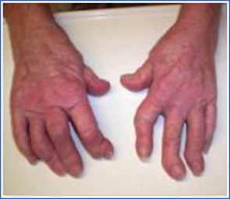
Rheumatoid Arthritis
An inter-relationship exists between oral health and rheumatoid arthritis (RA).
  Periodontal disease is more common in patients with RA
  Treatment of periodontal
  disease may reduce severity
  of RA
  Diminished ability to chew and
  eat if RA involves the
  temporomandibular joint

Slide 32
Rheumatoid Arthritis
An inter-relationship exists between oral health and rheumatoid arthritis (RA).
  Diminished salivary output (Sjögren’s Syndrome), leading to Xerostomia and caries
  Reduced dexterity, which affects
  ability to perform oral hygiene
  Increased caries and periodontal
  disease risk

Slide 33
Periodontal Disease
Dementia
Diabetes
Obesity
Rheumatoid Arthritis
Vascular Disease

Slide 34
Osteoporosis
Patients with osteoporosis may experience oral changes, such as:
  Increased tooth loss
  Additional denture adjustment as jaw shape changes

Slide 35
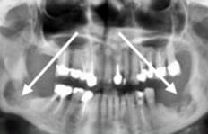
Osteonecrosis
IV bisphosphonates are associated with osteonecrosis of the alveolar bone
Incidence: rare
Can occur at the
site of a tooth
extraction or
spontaneously

Slide 36
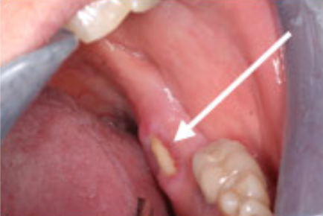
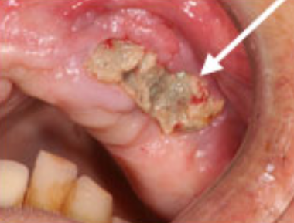
Osteonecrosis
Symptoms
  Jaw pain
  Swelling and infection
  Loosening teeth
  Drainage and exposed bone

Slide 37
Osteonecrosis
Management
  Alert: Physician and/or dentist

Slide 38
Take-home Message
Geriatric oral and systemic health are closely interconnected.
Chronic disease increases the burden of oral disease. The reverse is also true.
Quality of life and chronic disease management of elders are improved with attention to their oral health.
Effective medical – dental collaboration is vital to successful outcomes.

Slide 39
References
Smiles for Life: A National Oral Health Curriculum
Clark MB, Douglass AB, Maier R, Deutchman M, Douglass JM, Gonsalves W, Silk H, Tysinger JW, Wrightson AS, Quinonez R, Dolce M, Bowser J. Smiles for Life: A National Oral Health Curriculum. 3rd Edition. Society of Teachers of Family Medicine. 2010. www.smilesforlifeoralhealth.org.
Course Steering Committee Author: A. Stevens Wrightson, M.D.
Dental Consultants: Pamela S. Stein, DMD, MPH; Robert G. Henry, DMD, MPH; Joanna M. Douglass, BDS, DDS.
Smiles for Life Editor: Melinda Clark, MD.
Reviewers: Kathy Kemle, MS, PA-C; Leslie-Faith Morritt Taub,
ANP-C, GNP-BC, CDE, C. BSM, DNSc.

Slide 40
Production Credits
Project Coordinator & Principal Investigator: Darlene Carritt, RDH
Advisor: Prof. Caren Barnes, RDH, MS
Presentation & Graphics: Kim R. Theesen
Photography: Peggy Cain
Video Production & Editing: Calvin Hughes
Editing Assistance: Rita Charles
Consultant: Nagamani Narayana, DMD, MS
Contributor: Logan Veath

Slide 41



Additional Credits
This presentation produced in part with cooperation with the University of Nebraska Medical Center College of Dentistry, Nebraska Department of Health & Human Services, and the Nebraska Health Care Association.

