Slide 1
Dermatologic Emergencies
Matthew Stephany, MD, FAAD

Slide 2
Outline
Inflammatory
Erythema Multiforme
Steven-Johnson Syndrome
Drug Reaction with Eosinophilia and Systemic Symptoms (DRESS)
Acute Generalized Exanthematous Pustulosis (AGEP)
Infectious
Staph Scalded Skin Syndrome
Necrotizing Fasciitis
Eczema Herpeticum
When should I transfer?

Slide 3
Erythema Multiforme
Self-limited dermatitis
+/- prodrome
Recurrences common
Biggest clinical concern:
Is this SJS?!?
Distribution and morphology helpful
Infectious etiology very common
HSV (50% of cases; 3-14 days prior to dermatitis)
Mycoplasma (common cause of EM major)

Slide 4
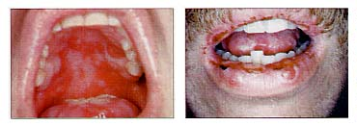
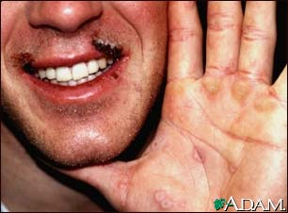
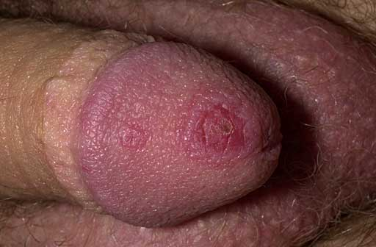
Erythema Multiforme
Notes:
4

Slide 5
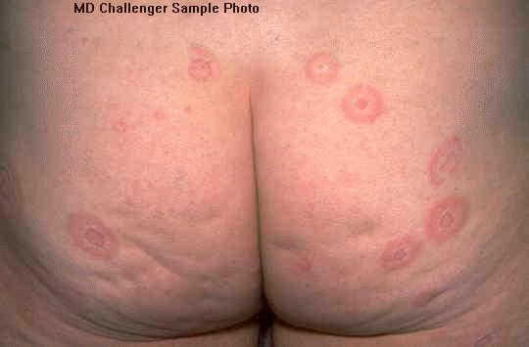
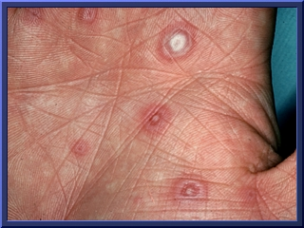
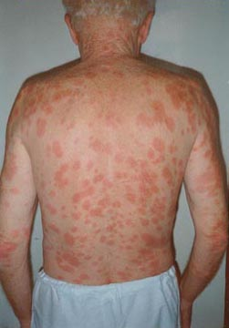
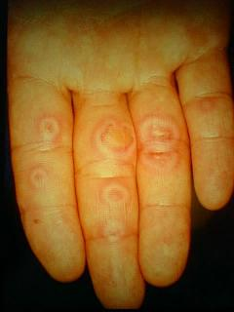
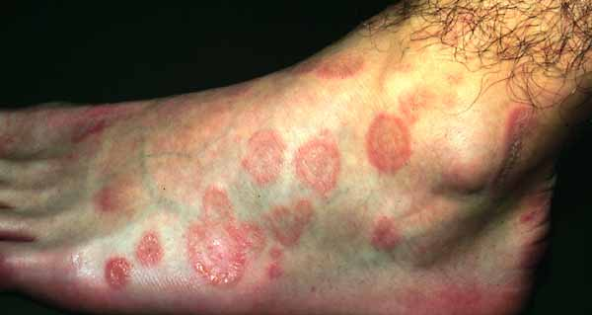
Erythema Multiforme
Targets lesions, esp. hands, forearms, palms, face, trunk

Slide 6
Clinical Course
Abrupt onset: Most lesions occur within first 24h, all before 72h
No prodrome
Lesions can itch/burn
Individual lesions = fixed at same site for 7 days or longer
Whole episode = 2 weeks and heals without scarring (except eyes if not treated)
Recurrences common (especially w/HSV)
Immunosuppresion & PO steroids → Can lead to more frequent HSV-associated outbreaks
5-6 per year w/ possible overlap between episodes
Notes:
Can get PIPA

Slide 7
EM Treatment
Symptomatic treatment:
Prednisone
Antibiotics if secondarily infected
Topical Aquaphor®, hydrocortisone
Antiviral tx for long term ppx w/ Acyclovir, Famciclovir, or Valacyclovir
Oral care
Magic mouthwash (Total volume 236mL w/ H2O)
Benadryl - 0.2g
Magnesium hydroxide 3.15g
Aluminum hydroxide 3.15g
Simethicone 0.315g
Lidocaine 1.6g

Slide 8
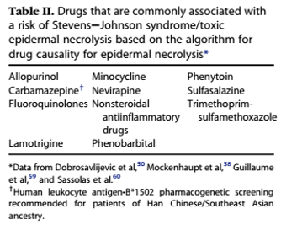
Steven-Johnson Syndrome (SJS) and Toxic Epidermal Necrolysis (TEN)
W > M 3:2 ​
Recurrences are rare
Mortality ranges 25-50% for TEN (~30%), 5% for SJS ​
HIV patients - risk of developing TEN is 1000x higher
Children are affected ​
Incidence SJS + TEN = 2-7 cases per million ppl ​
(0.4-1.9 for TEN)​
Drug >> Infectious
allopurinol, antibiotics (sulfa>>PCN) NSAID, anticonvulsants, sulfonamides, tetracycline
Mycoplasma, HSV

Slide 9
Etiology
Drugs: 95% of TEN cases, 50% SJS cases (>100 medications identified)
Remaining → infection
Mycoplasma pneumoniae, dengue virus, CMV reactivation
Other: MMR, Contrast media
Most drugs: 1-3 weeks after exposure
Antiepileptics within first 2 months
If re-exposure, can occur in hours
Higher risk with longer-half lives
Can cross react within groups
* Underestimation 2/2 EM overlap

Slide 10
High risk groups
Slow acetylators
Immunocompromised (HIV/AIDS - 1000x higher risk)
Radiotherapy + anticonvulsants
Certain HLA alleles in specific populations
HLA-B1502 **– Asians and East Indians (>> Japanese/Korean) - carbamazepine
HLA-B5801 - Han Chinese + Europeans - allopurinol
HLA-A3101 – Europeans - carbamazepine
HLA- B5701** - Abacavir
HLA-DQB601 – Caucasians with SJS + ocular complications
Notes:
abacavir - induced (study found that abacavir naive patients with allotype developed CD8+ response when exposed, but not people without HLA-B5701 allotype)
** FDA recommends genotyping Asians for HLA-B-1502 prior to carbamazepine and everyone for HLA-B-5701 for Abacavir

Slide 11
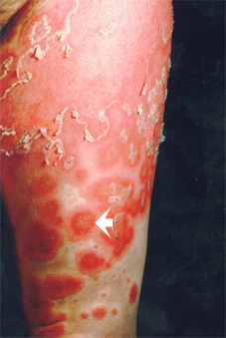
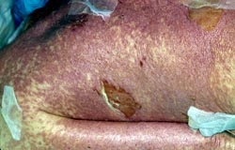
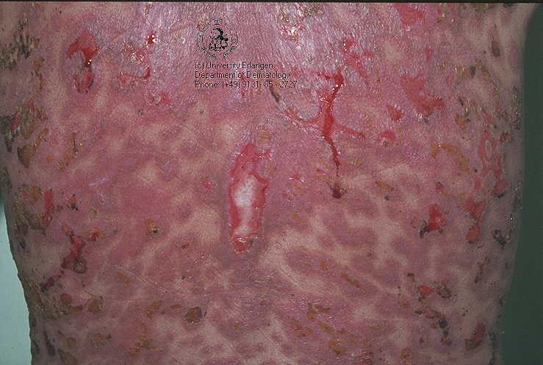
Prodrome 1-3 days prior to lesions
Fever, stinging eyes, dysphagia
Constitutional symptoms
Headache
Fever/chills
Nausea/vomiting
Anxiety/agitation/confusion
First cutaneous symptom:
Burning/tenderness

Slide 12
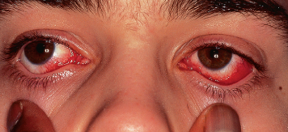
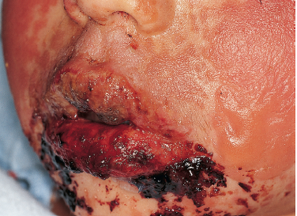
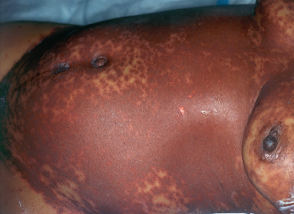
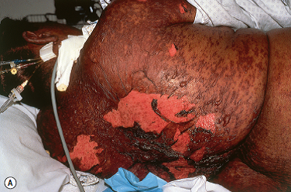
Clinical Presentation

Slide 13
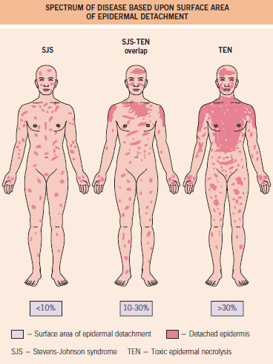
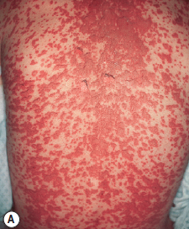
Notes:
JAAD: also differentiates TEN as TEN with spots >30% and TEN without spots >10% (large epidermal sheets without purpuric macules or targets

Slide 14
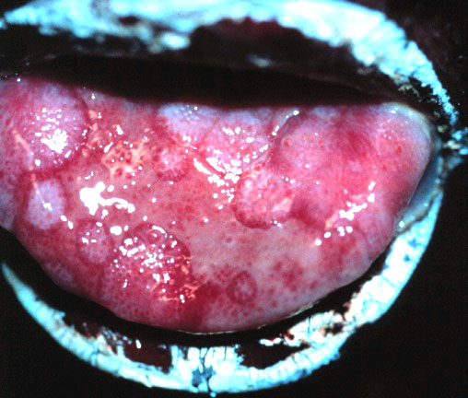
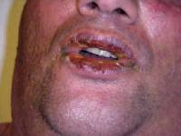
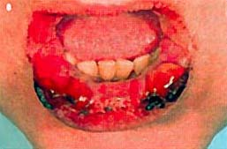
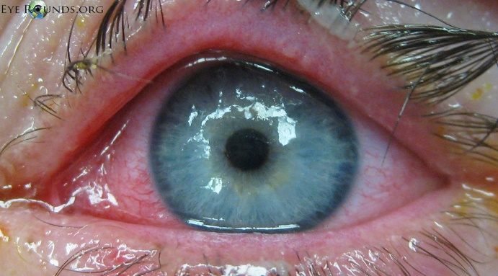
SJS/TEN - Mucosal Involvement
All mucosal surfaces are susceptible
Commonly involved
Oral 93%
Ocular 78%
Genital 63%

Slide 15
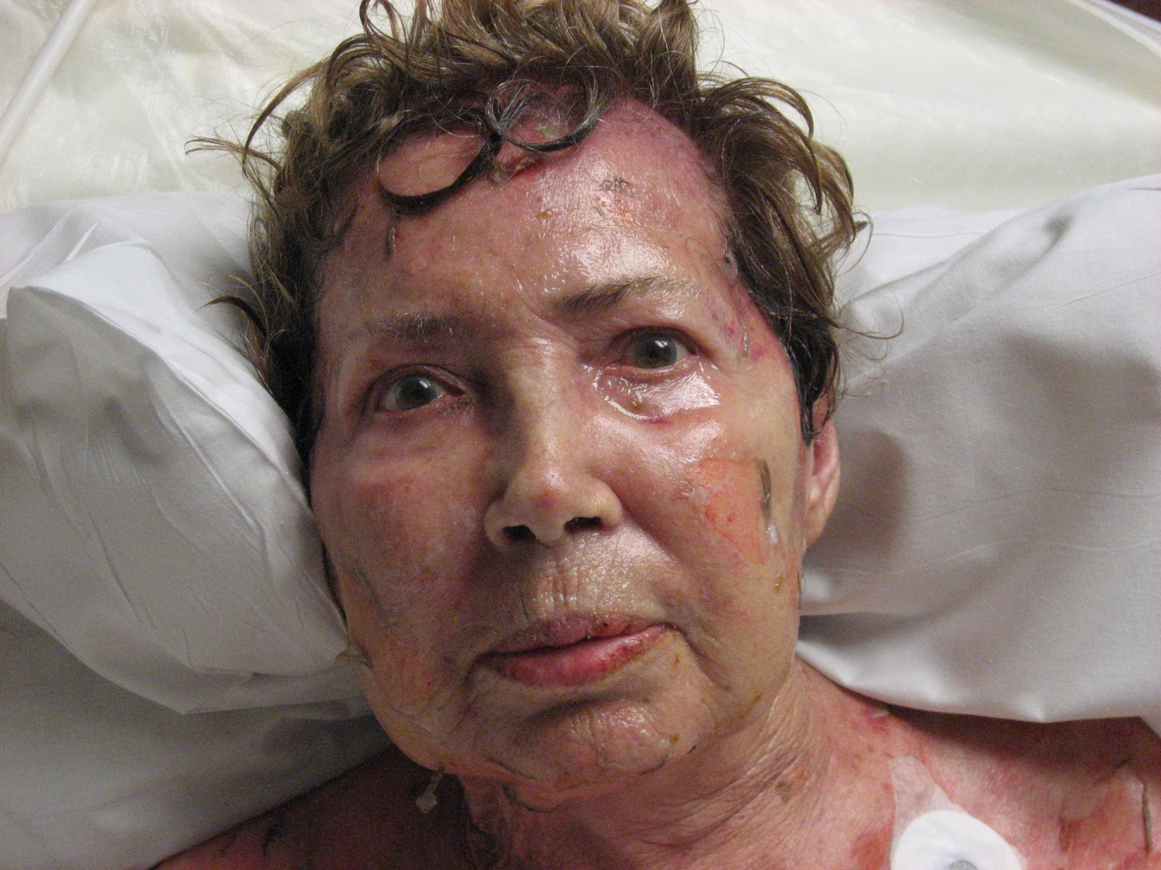

Slide 16
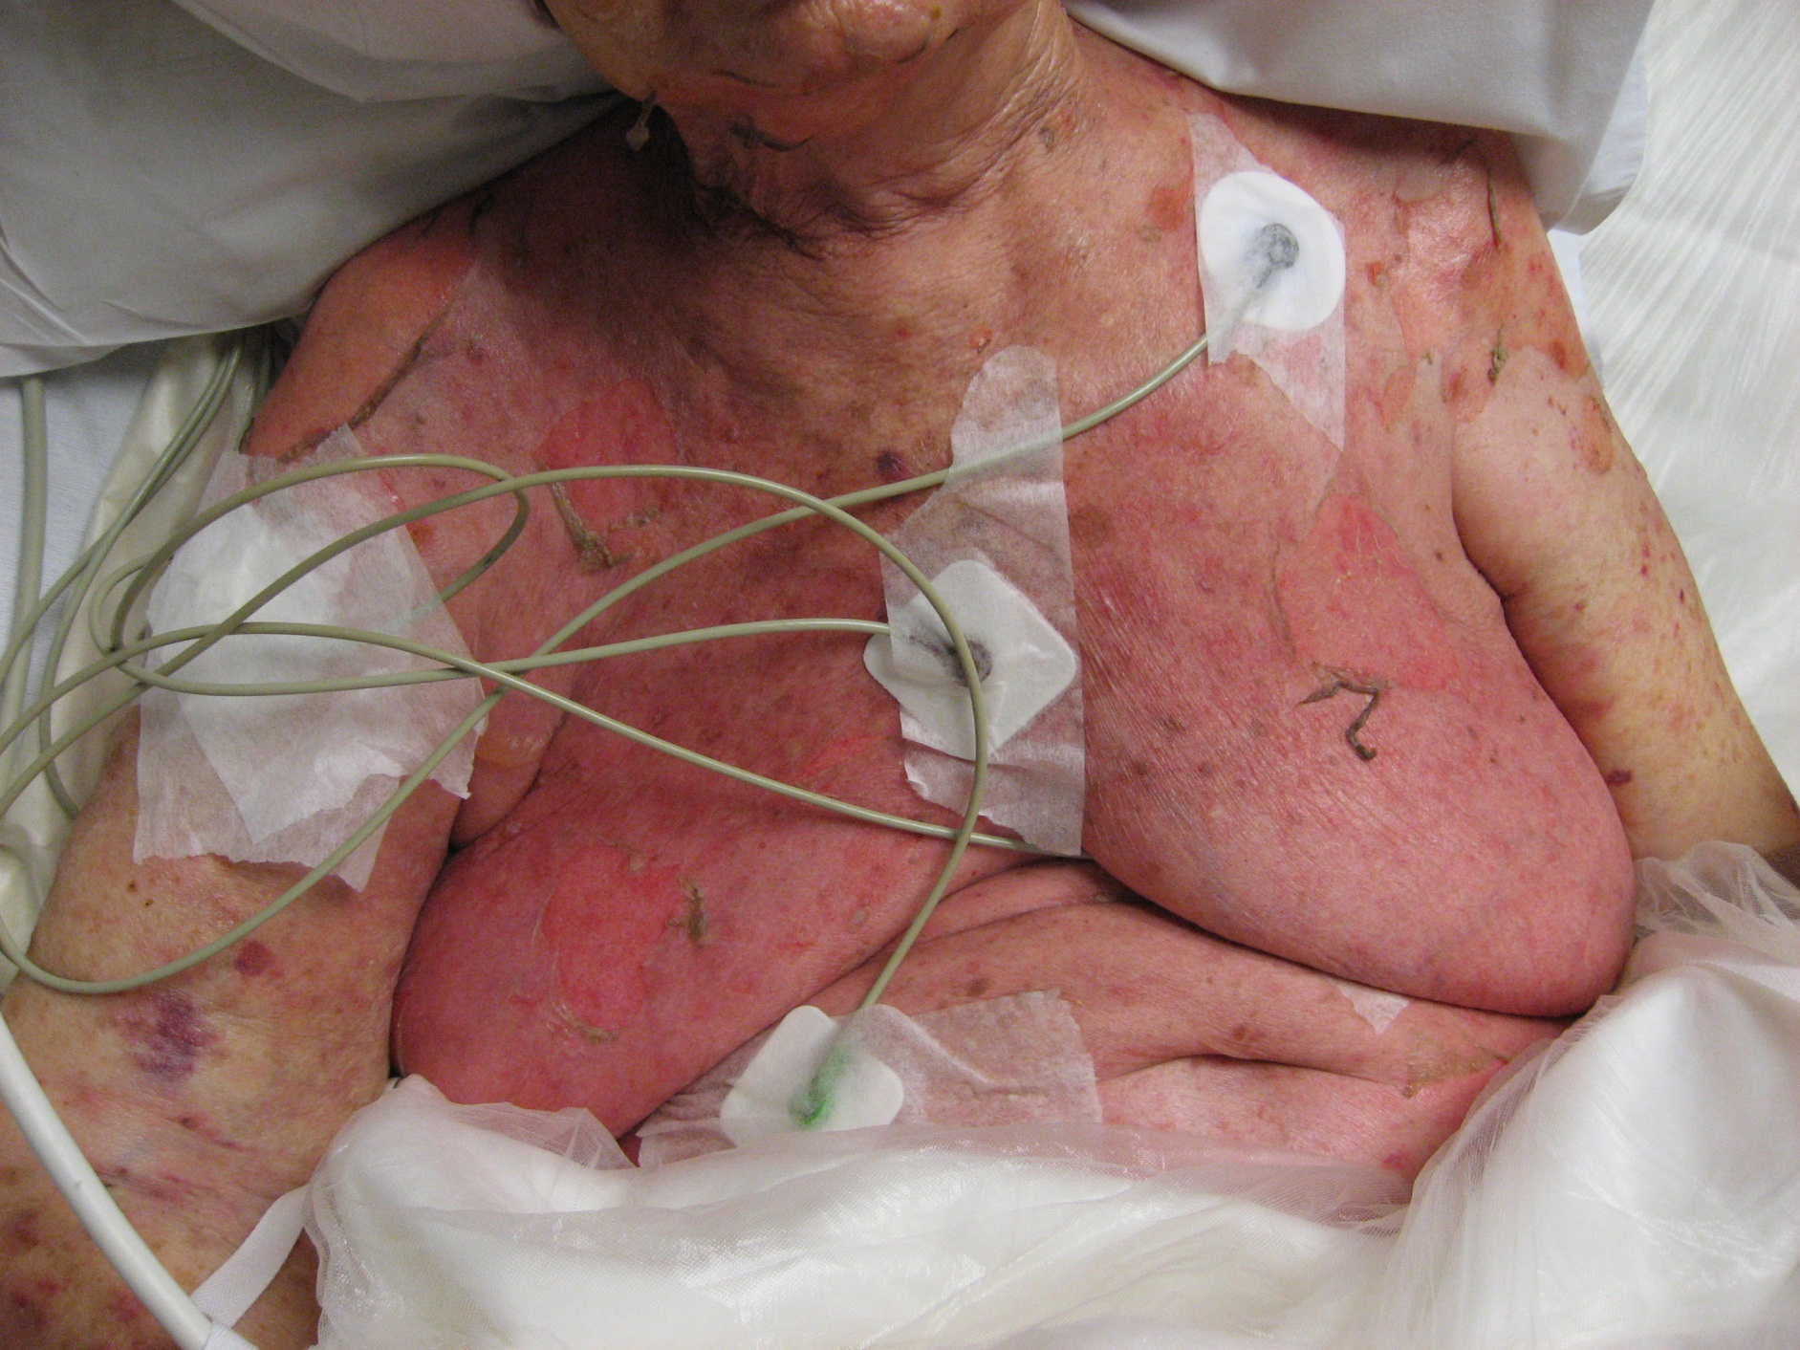

Slide 17
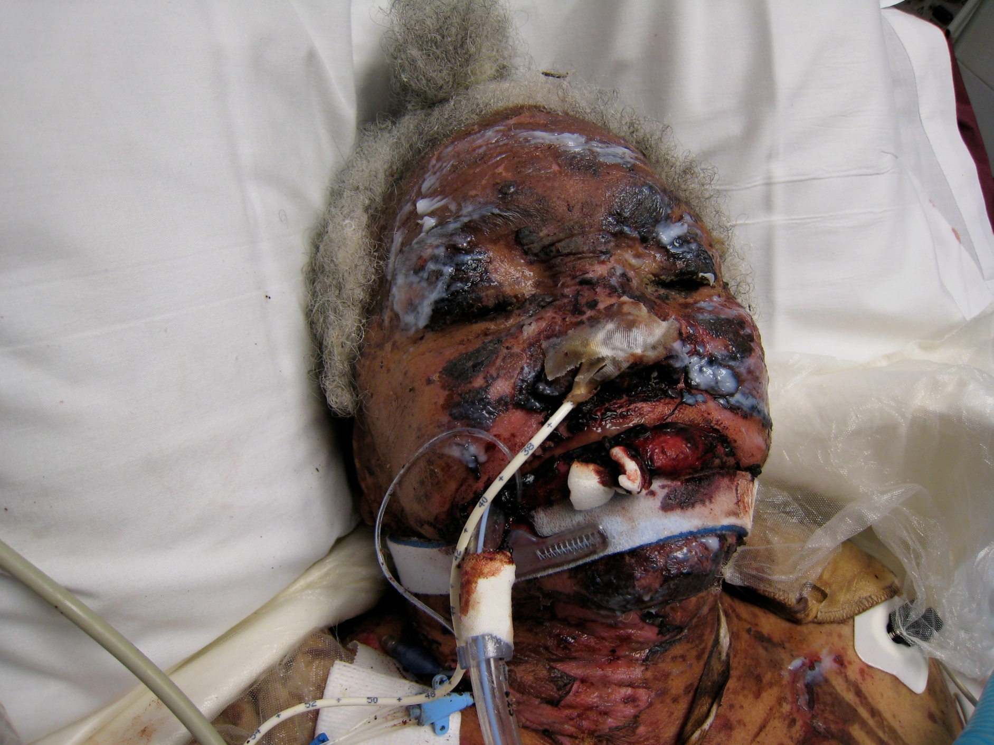

Slide 18
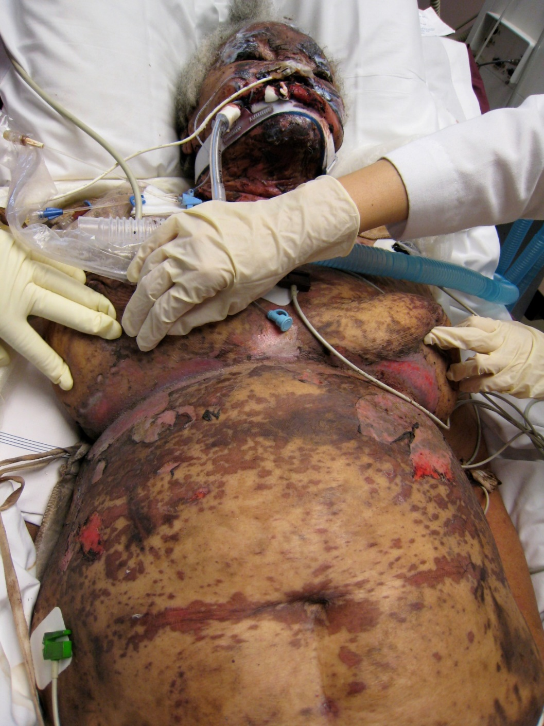

Slide 19
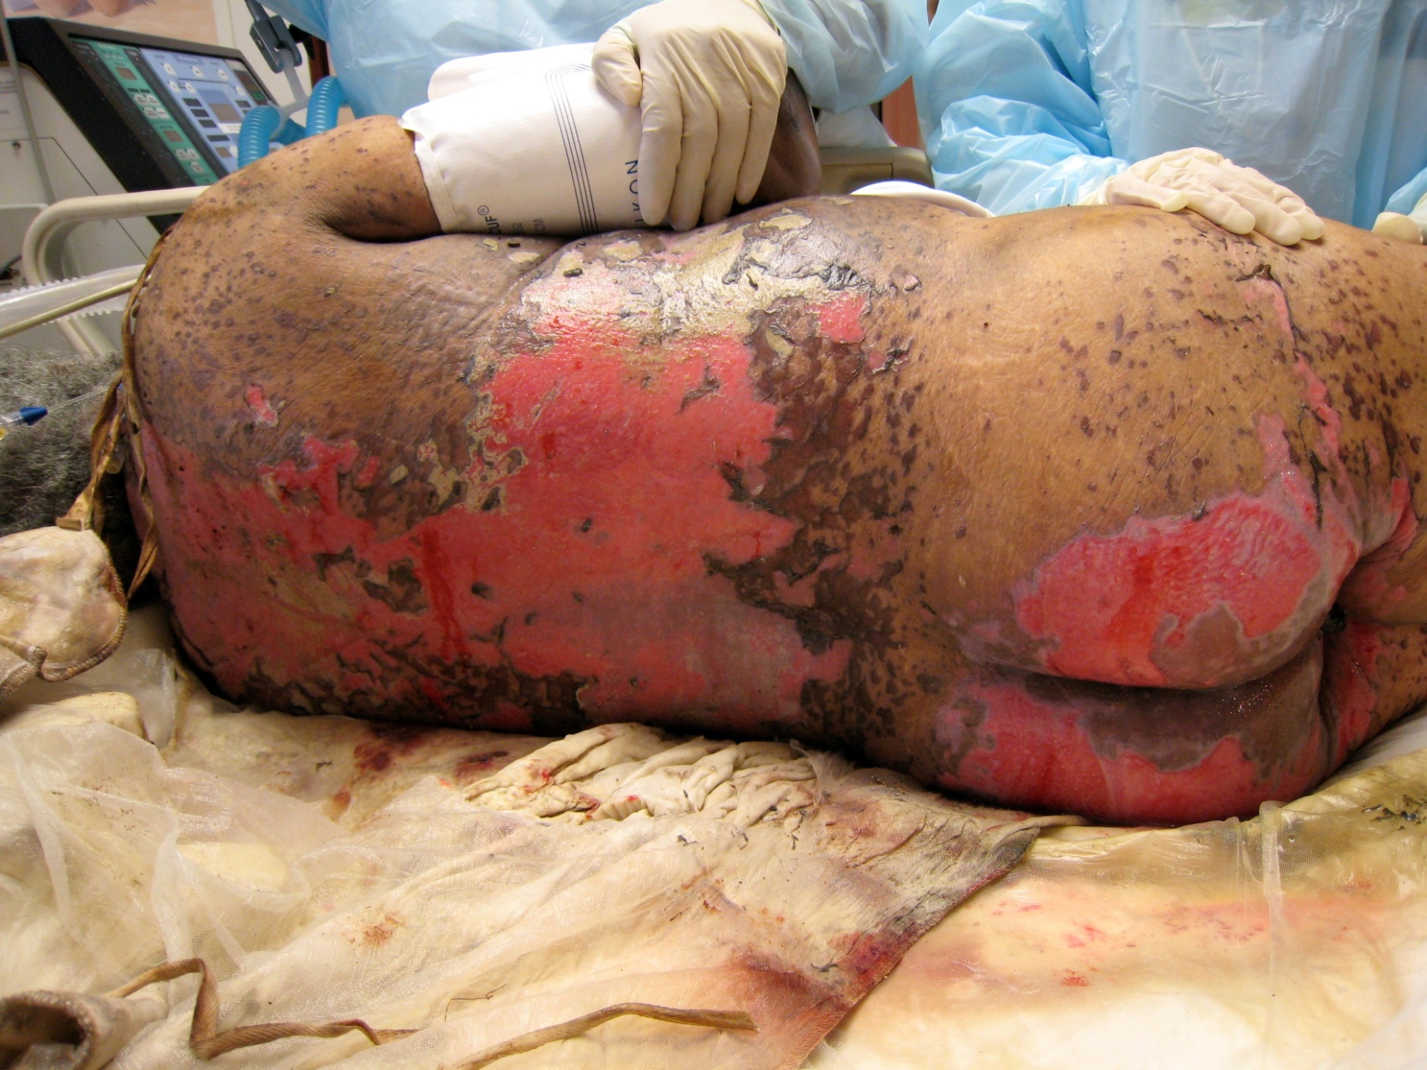

Slide 20
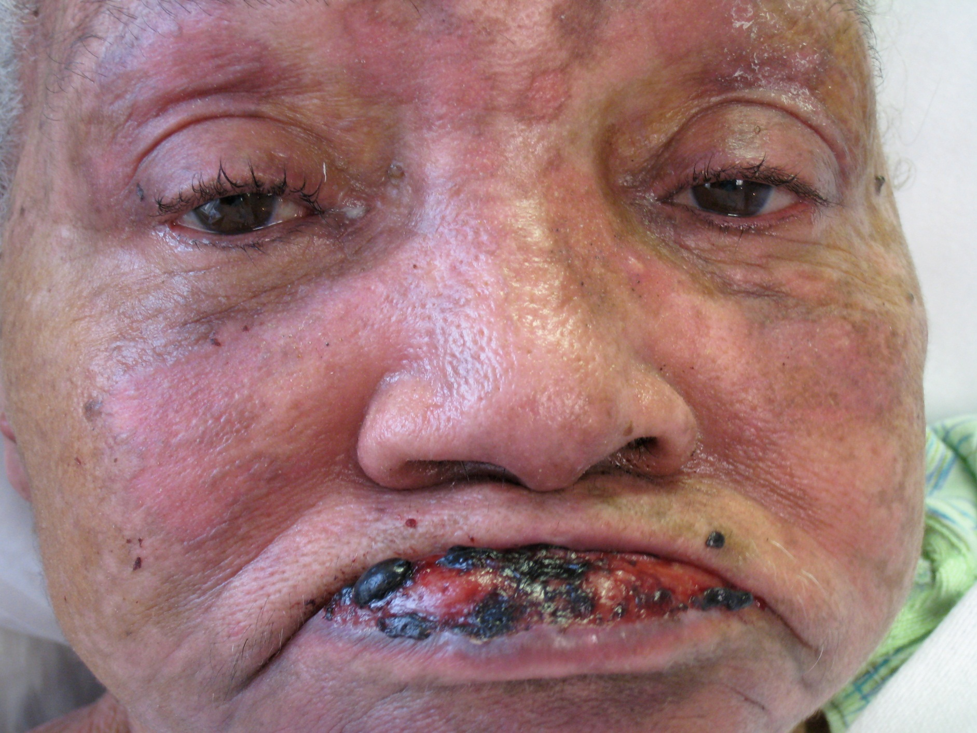

Slide 21
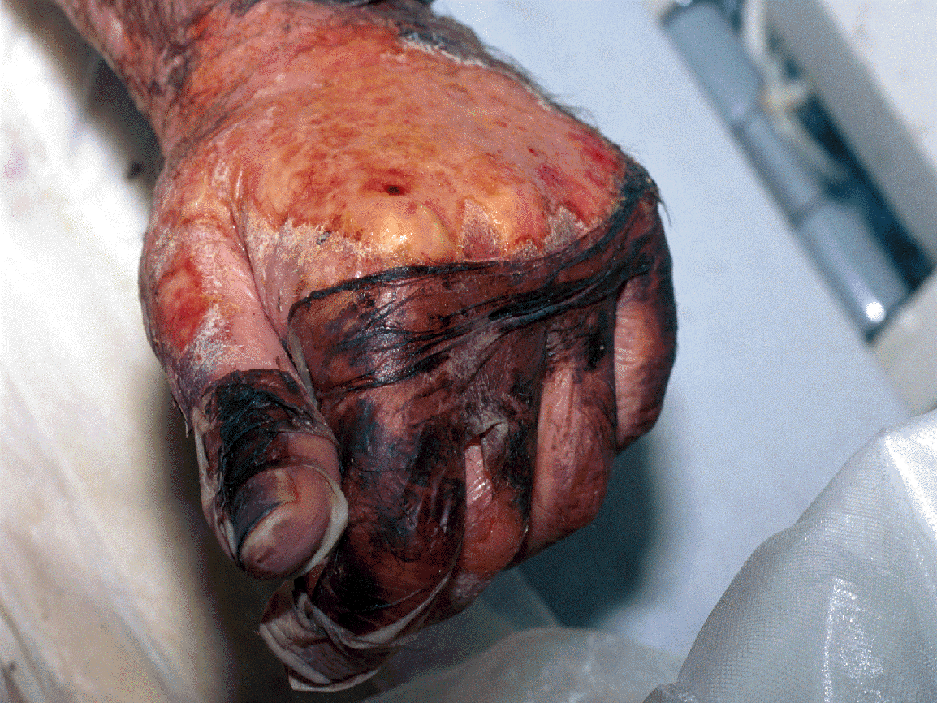

Slide 22
SJS/TEN - High Mortality
Mortality untreated is 15-40%
Majority of patients die from:
Infection
First few days – Staphylococcus aureus
Later – Pseudomonas aeruginosa
Rarely – Candida albicans
Multi-organ system failure
Electrolyte imbalance
ARDS
Roujeau JC, et al. N Engl J Med. 1995; 333: 1600-7.
Roujeau JC, et al. JAAD. 1990; 23: 1039-58.

Slide 23
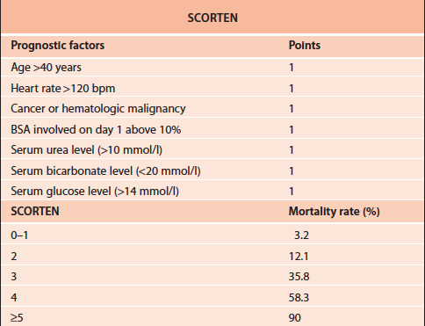
SCORTEN
Done on day 1 and 3 post-admission
Cannot predict which patients SJS→TEN
7 criteria

Slide 24
Out of the woods?
Pts surviving acute phase of TEN have decreased 5-year survival rate
SCORTEN between 3-6, and delay >5 days before admission were independent risk factors
SCORTEN 3-6: median survival = 7 months after d/c;
2-year survival rate = 28%
SCORTEN 0-2: 2-year survival rate = 98%
>5 days = 18-month median survival
2-year survival = 42%
<5days = 2-year survival = 89%

Slide 25
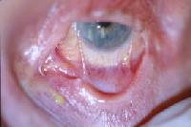
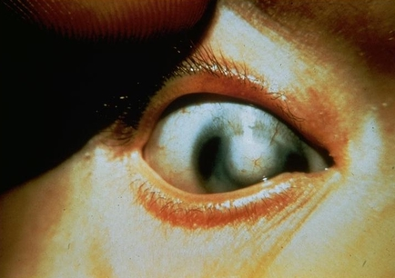
SJS/TEN - Mucosal Sequela
Ophthalmologic
50% of survivors
Sicca syndrome
Corneal pannus
Symblepharon
Entropion / Inward growing eyelashes​
Corneal opacities
Visual impairment/blindness
ALWAYS CALL OPHTHALMOLOGY
Roujeau JC, et al. JAAD. 1990; 23: 1039-58.

Slide 26
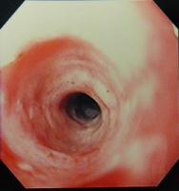
Mucosal Sequela
Gastrointestinal
Esophageal strictures
Bowel perforation
Roujeau JC, et al. JAAD. 1990; 23: 1039-58.

Slide 27
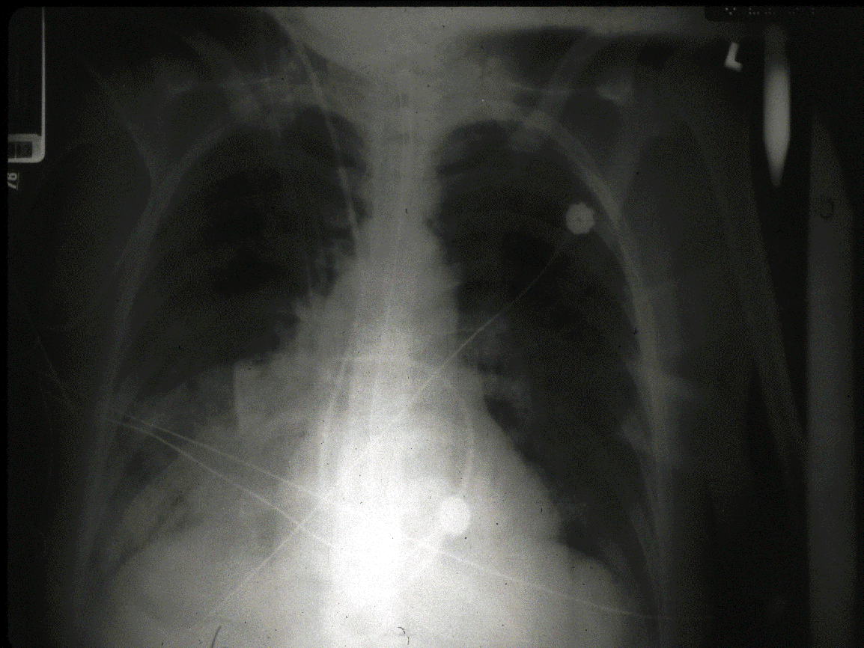
Mucosal Sequela
Respiratory
Bronchial obstruction due to slough
Pneumonia
Acute respiratory distress syndrome
Roujeau JC, et al. JAAD. 1990; 23: 1039-58.

Slide 28
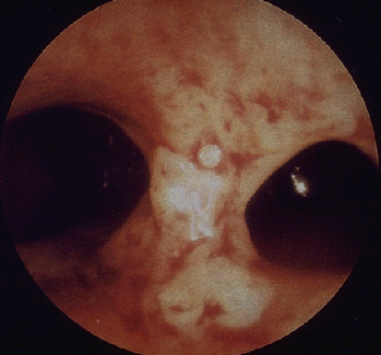
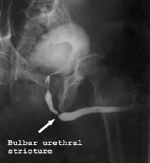
Mucosal Sequela
Urogenital
Vaginal synechiae
Urethral strictures
Roujeau JC, et al. JAAD. 1990. 23: 1039-58.

Slide 29
SJS/TEN - Cutaneous Sequela
Cutaneous scarring​
Eruptive melanocytic nevi​
Nail dystrophy​
Alopecia ​
​
​

Slide 30
Standard Management
Withdrawal of causative agent
* * * * *
Supportive care
* * * * *
Wound care
Roujeau JC, et al. JAAD. 1990; 23: 1039-58.

Slide 31
SJS/TEN Workup
Biopsy with frozen sections if you want results quickly
CBC
Electrolytes
Renal function
Liver function
HSV, bacterial cx
Tzanck smear → r/o Eczema herpeticum

Slide 32
SJS/TEN - Management
Stop causative/suspicious medication(s) - any meds started 7-21d prior (if 1st exposure) or 2d prior (if repeat exposure)
Wound care, oral care, non-stick sheets, supportive care
Etanercept vs cyclosporine vs systemic corticosteroids
Sub-specialist consults
Ophthalmology, Critical care/Pulm, GI, urology or GYN
Close follow up

Slide 33
No Debridement
Blister skin acts as biologic dressing and will re-take as graft
Decreased depigmentation
Increased healing

Slide 34
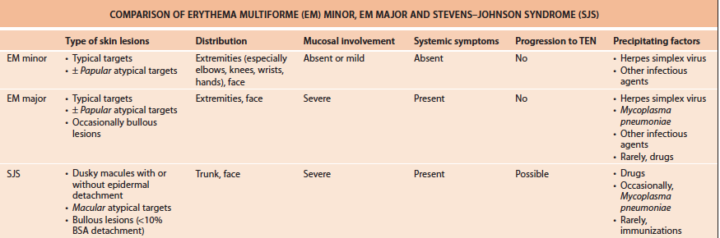
Clinical Features
4 clinical criteria to differentiate EM minor/major vs. SJS
Lesion morphology
Distribution
Mucosal involvement
Systemic symptoms
Notes:
Clinical criteria to help differentiate from SJS
Assler et al. with Roujeau group 1995 – used criteria to blindly determine whether lesions were HSV-related or not (EM vs. SJS) – was helpful in predicting

Slide 35
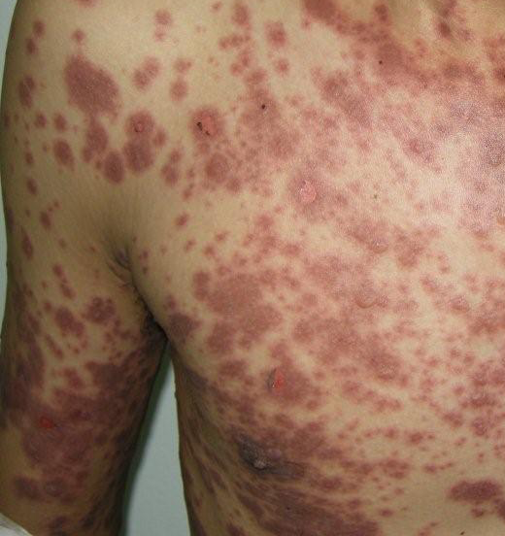
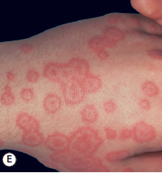
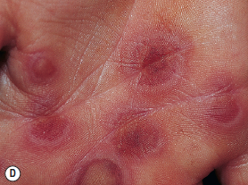
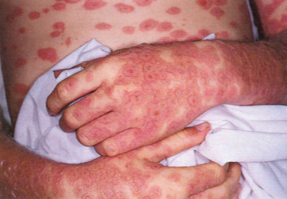

Lesion Morphology
EM Minor/Major
“typical” targets
<3cm in diameter
Regular, round, well-defined
3 distinct zones
Atypical papular targets
SJS
Atypical macular targets
Dusky macules +/- epidermal detachment
Bullous lesions
Notes:
Need to do a FBSE!
some patients only have limited # of typical targets. Others not fully evolved. Sometimes only a few typical targets present --> FBSE!
Increased "atypical" targets can accompany "typical" lesions, or be primary --> BUT THEY ARE PALPABLE

Slide 36
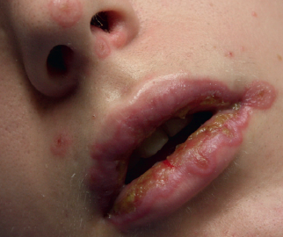
Distribution
EM minor/major: face, UE>LE, palms → trunk
SJS: trunk, face, proximal > distal extremities but +palms/soles
Mucosal involvement
EM minor: none or mild
EM major: severe. Less commonly ocular or genital but can be
SJS: severe, including ocular
Systemic symptoms
EM minor: none or limited
EM major: almost always (fever, weakness, fatigue)
Renal, liver or hematologic abnormalities = RARE
SJS: almost always

Slide 37
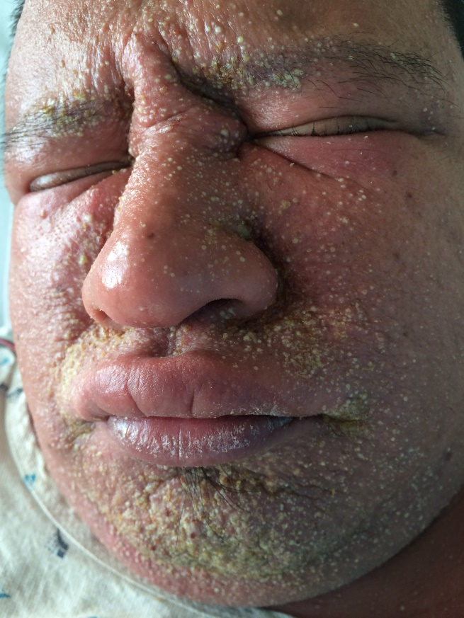
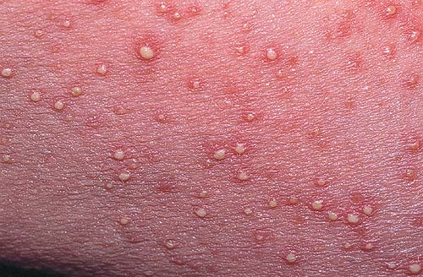
Acute Generalized Exanthematous Pustulosis - AGEP
Acute febrile drug eruption – usually abx
beta lactams, cephalosporins, macrolides, calcium channel blockers, antimalarials
Starts 1-3 days after exposure
Non-follicular sterile pustules
High fever, same day as rash
Face -> intertriginous areas -> then everywhere
Withdrawal of drug and start topical steroids

Slide 38
AGEP
Patients can appear toxic
Drastically elevated inflammatory markers
If concerned for infection, can swab pustule which should be negative

Slide 39
DRESS Syndrome
Anticonvulsants, sulfonamides >> minocycline, allopurinol, gold salts, dapsone, abacavir ​
2-6 weeks after drug exposure
Fever
Morbilliform eruption – face, trunk, extremities
Facial edema
LAD
Eosinophilia
Treatment: Corticosteroids – high dose – several weeks to months
Stop offending agent
Systemic manifestations: ​
Fulminant hepatitis ​
Myocarditis ​
Interstitial pneumonitis ​
Interstitial nephritis ​
Thyroiditis ​
CNS eos ​
GI bleeding if 2/2 allopurinol ​
Cardiac involvement can be very delayed (even after cessation of steroids) ​

Slide 40
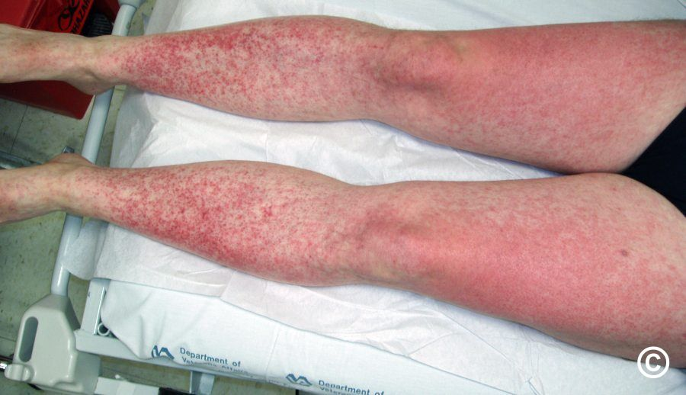
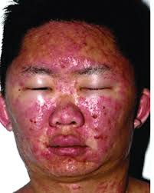
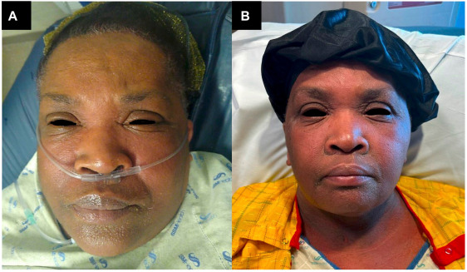
DRESS

Slide 41
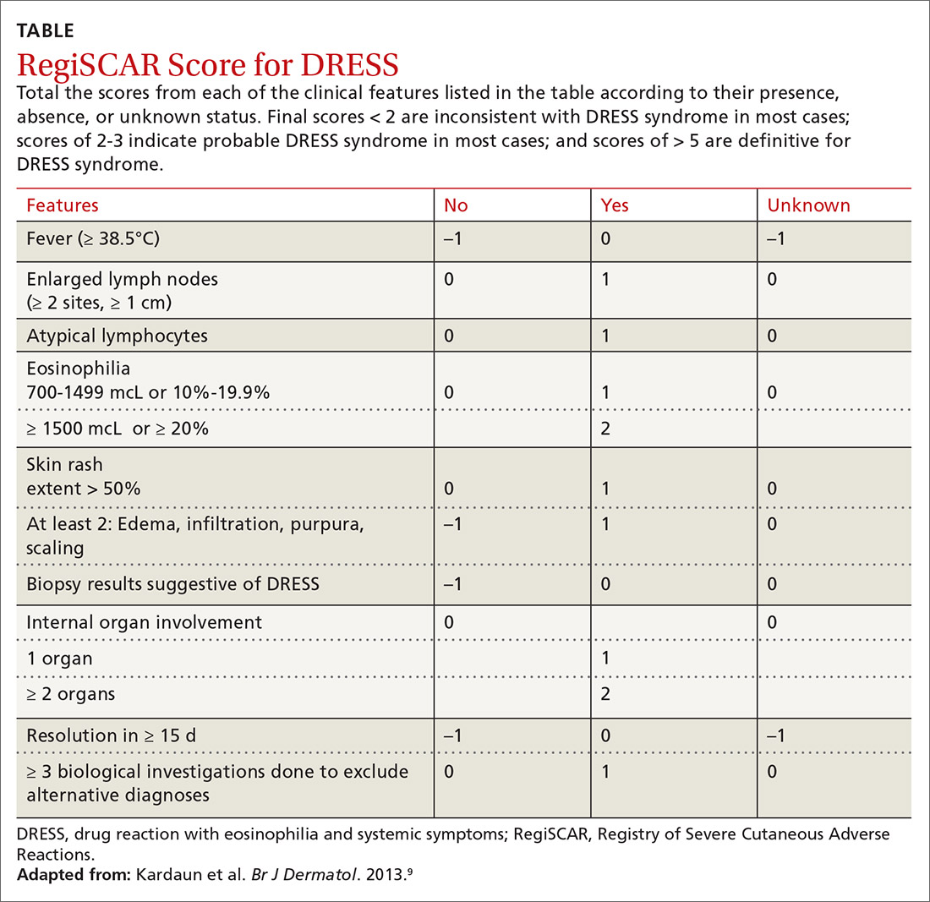
Stuck?
RegiSCAR can be beneficial tool

Slide 42
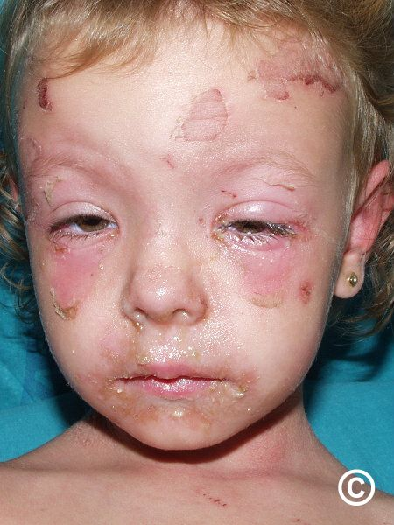
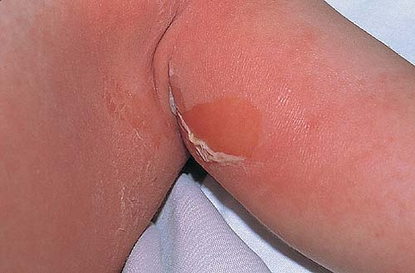
Staphylococcal Scalded Skin Syndrome (SSSS)
Children < 6 yo or adults with renal failure
Exfoliative toxin A and B
Prodrome of fever, malaise, skin tenderness
Erythema of the head, spreads to rest of body

Slide 43
SSSS
Diagnosis mainly clinical
Frozen section – cleavage below stratum granulosum
Culture conjunctiva, nasopharynx, feces - NOT bulla
Blood cx (+/-)
High mortality in elderly
Treatment: penicillinase-resistant, anti-staph antibiotic (dicloxacillin), ceftriaxone, clarithromycin (PCN allergy), vancomycin (if concerned for MRSA)

Slide 44

Necrotizing Fasciitis
Rapidly progressive necrosis of subQ fat and fascia
Usu. Group A strep – or mixed infections
Mortality 20-40%
Pain out of proportion, then no pain
Dishwater sign (+)

Slide 45

Necrotizing Fasciitis
MRI may be helpful or CT to see gas
Surgical debridement - fasciotomy
IV abx – broad spectrum
Add Clindamycin for ribosomal-inhibition

Slide 46



Eczema Herpeticum

Slide 47

Eczema Herpeticum (AKA Kaposi varicelliform eruption)
Diffuse cutaneous HSV infection
Risk factors: Barrier dysfunction
AD, seb derm, scabies, Darier dz, Hailey-Hailey, etc…
Prognosis:
Mild: self-limited
Severe/Immunosuppressed: can be fatal
Workup:
Tzanck/Viral cultures
Bacterial culture
Biopsy r/o immunobullous
Treatment:
IV acyclovir and IV abx for superinfection

Slide 48
When to Admit
Dermatologic condition with features that raise concern for progression
Toxic appearance with dermatologic condition
Condition that requires expedited workup

Slide 49
When to Transfer
If patient is admitted for a primary dermatologic condition and further evaluation is desired
If patient has dermatologic condition that may not be primary condition but is contributing to hospital course and not improving or leading to further morbidity
If dermatologic condition is one that would be expected to be resolved by further workup/treatment

Slide 50
Conclusion
Overall dermatologic emergencies are uncommon and with prompt diagnosis and proper (not perfect) therapy patient outcomes are great
Patient's status should always be considered when it comes to inpatient admission
The differentiation between infectious and non-infectious etiologies may lead to delay in care

Slide 51
Helpful Resources
Visual Dx
Dermnet.nz
UpToDate
Open Evidence

