Slide 1
“We got this hand…….”
Joseph A. Morgan, MD
Associate Professor
Hand, Upper Extremity, & Microvascular Surgery
Department of Orthopaedic Surgery & Rehabilitation
University of Nebraska Medical Center
2026

Slide 2
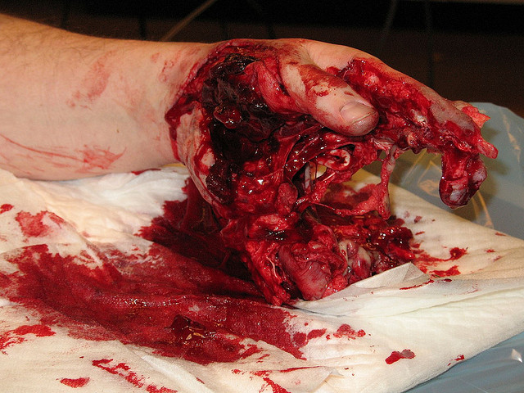
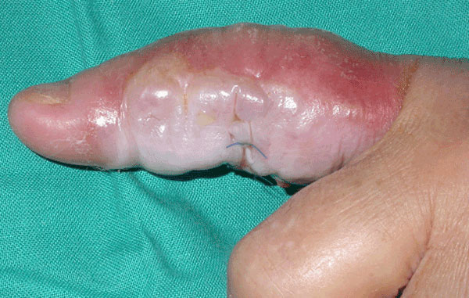
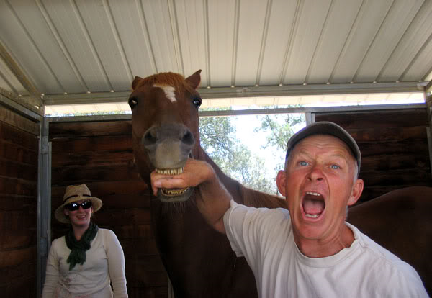
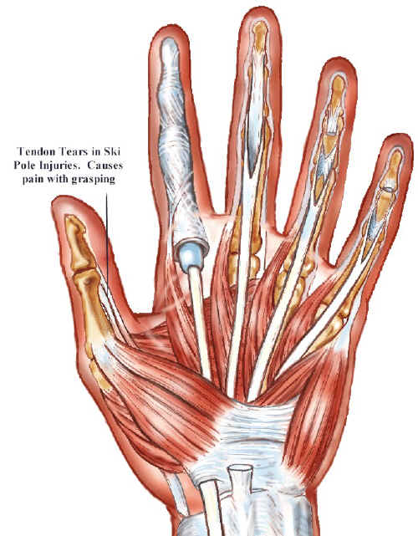
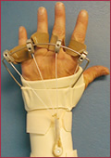
Basics of Hand Exam
Hand eval in setting of trauma
That looks like pus…
Something bit me!
Pertinent anatomy
How to stabilize almost anything
When do I NEED a hand surgeon?

Slide 3
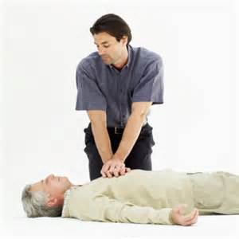
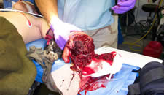
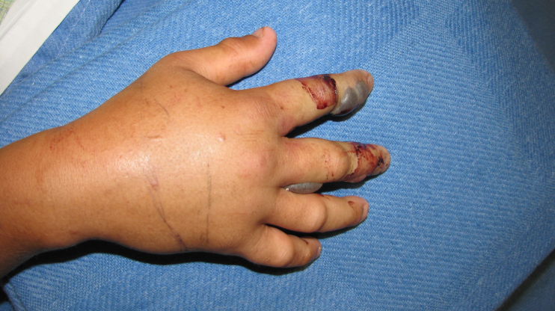
Initial Assessment
ABC’s
Question 1 –
  Can the patient die from this?
    Tourniquet to control bleeding if necessary
Question 2 –
  Can the patient lose a hand or digit because of this?
    Emergent compartment release necessary?

Slide 4
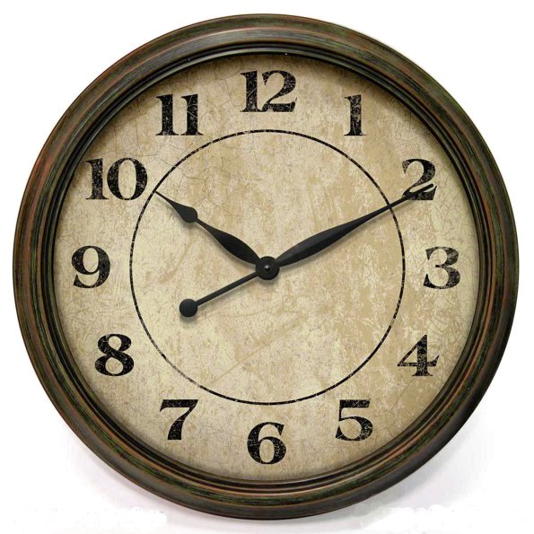
If no to both…
Take a deep breath and relax. You have time.

Slide 5
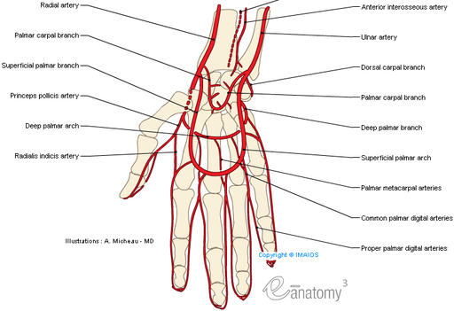
Vascular Status
Radial and Ulnar pulses
  Ulnar is dominant in most people
  Radial is more superficial and generally more easily palpated

Slide 6
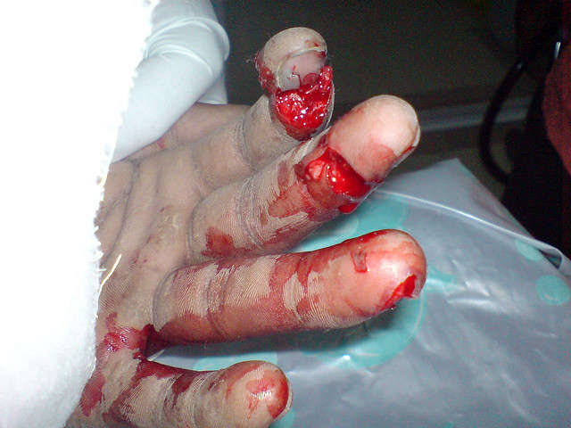
Digital Perfusion?

Slide 7
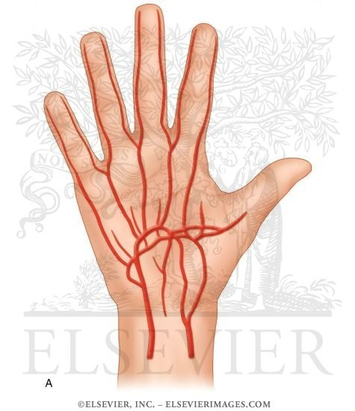
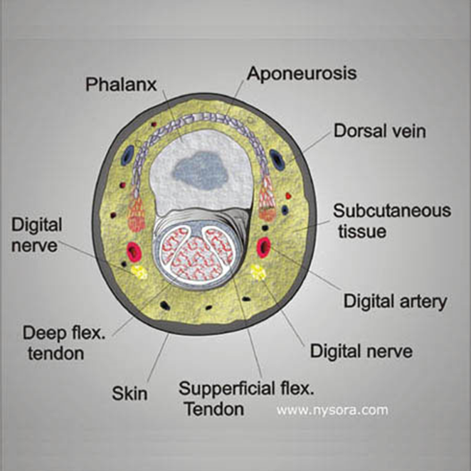
Digital Vasculature

Slide 8
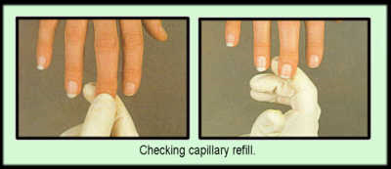
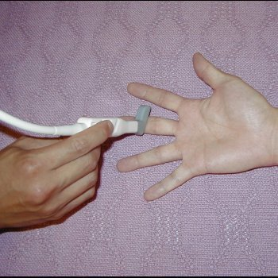
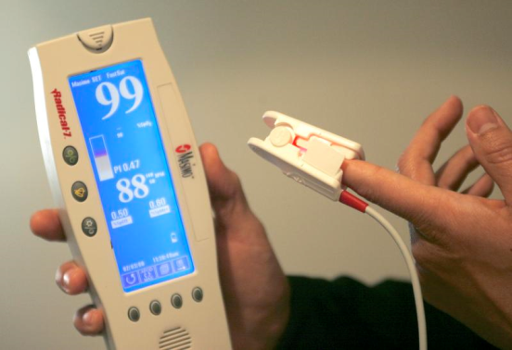
Options for Evaluation
Capillary refill
Doppler Ultrasound
In a pinch and the right situation…
  Pulse oximetry

Slide 9
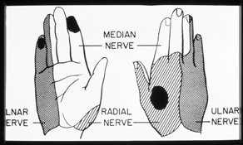
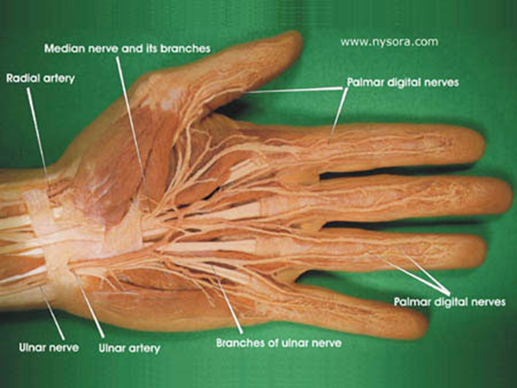
Neurologic Evaluation
Median Nerve
  Sensory to radial palm/digits
  Motor
    AIN
    Recurrent Motor Branch
Radial Nerve
  Sensory to 1st dorsal webspace
  Motor – PIN
Ulnar Nerve
  Sensory to ulnar digits
  Motor
    Ulnar flexors
    Intrinsics

Slide 10
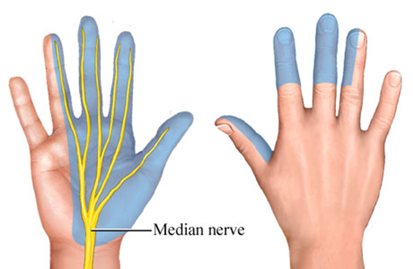
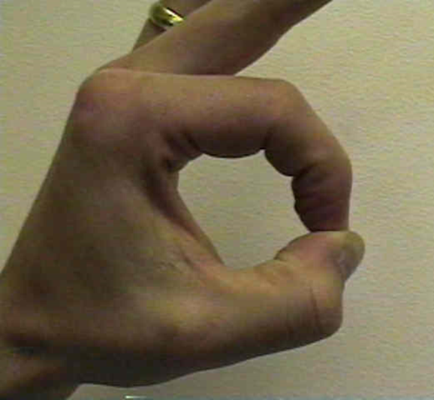
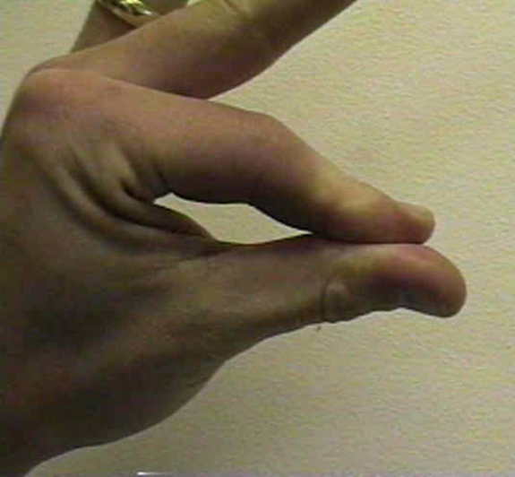
Median Nerve
Check light touch to volar tip of index finger
OK sign - AIN
  FDPi
  FPL
Intact
Deficient

Slide 11
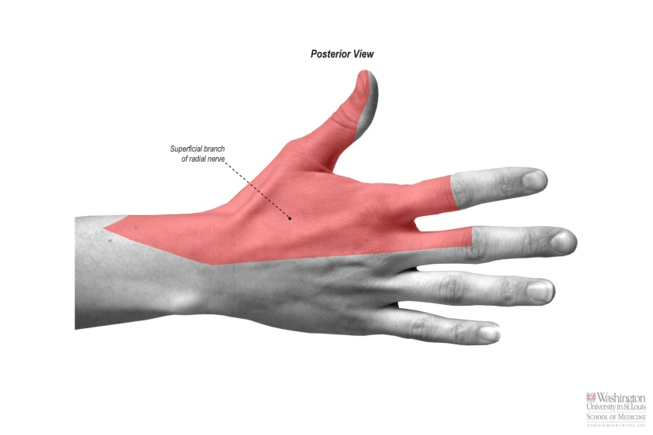

Radial Nerve
Check light touch sensation to 1st dorsal webspace
Thumbs up – PIN
  EPL
  EIP technically better, but can be confused by EDC

Slide 12
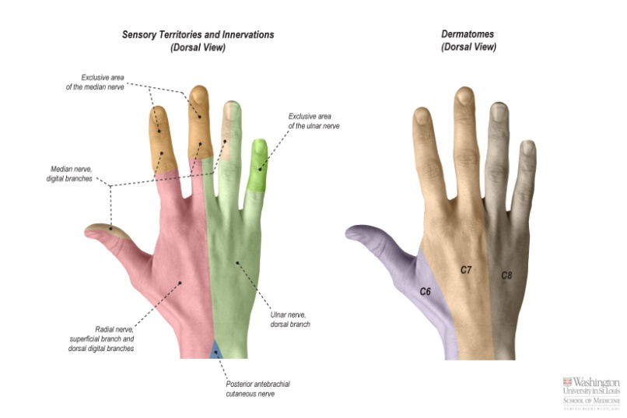
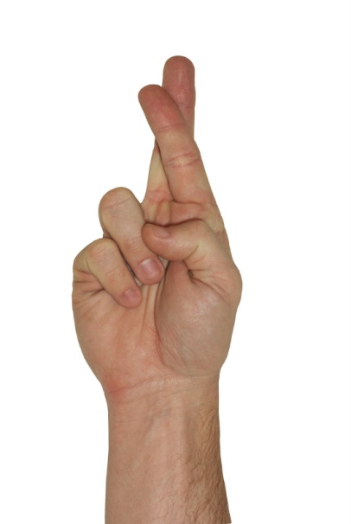
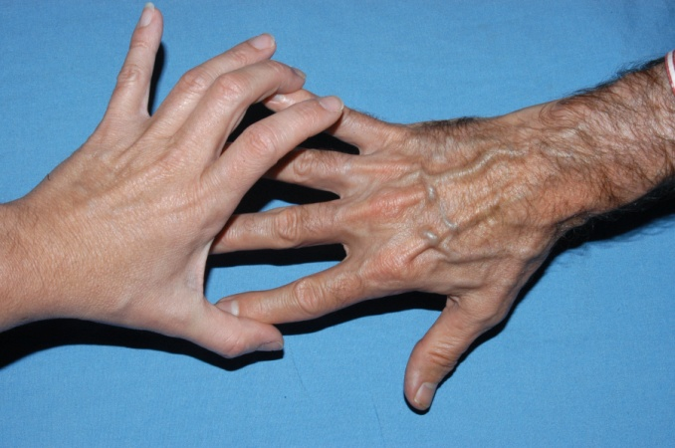
Ulnar Nerve
Check light touch sensation to ulnar tip of small finger
Cross fingers
Resisted finger abduction
  1st dorsal interosseous

Slide 13
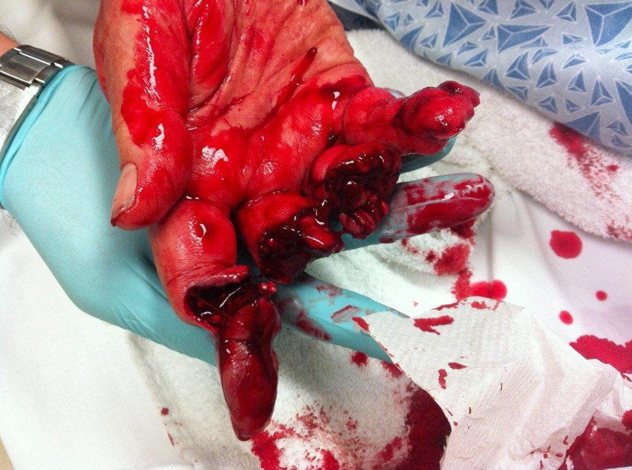
TRAUMA

Slide 14
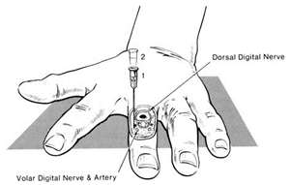
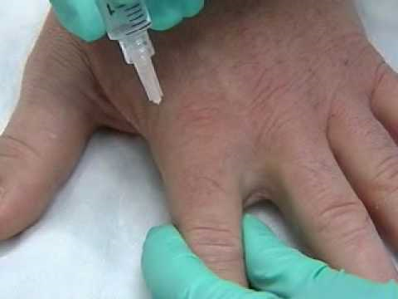
Digital block
Inject DORSALLY at base of digit (less painful)
  I basically aim just distal to level of MP joints
  Be careful to aspirate to avoid intravascular injection
Lidocaine
  < 4.5 mg/kg/dose
  < 300 mg/day
Marcaine
  < 2 mg/kg/dose
  < 400 mg/day
Find out what they had at OSH and when! – Potential for overdose
With or without epinephrine?

Slide 15
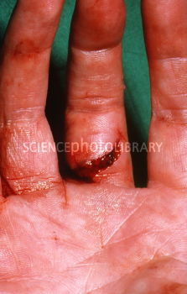
Lacerations
Is it bleeding?
  Stop the bleeding
    Pressure, tie off vessels, electrocautery
Is it contaminated?
  Clean it up
    At least 1 L saline – I prefer 3
Does it need to be closed? Can it be closed?
  Close it
  If contaminated or clearly infected, may close it LOOSELY – Generally 1 stitch only, if you close it at all
    Nylon for hand proper only
    Chromic gut for digits/nailbeds
Don’t forget!
  Antibiotics – 1 dose of IV in ER and Rx for home (Keflex vs. Augmentin vs. Bactrim)
  Tetanus update (if < 5 years since last one)

Slide 16
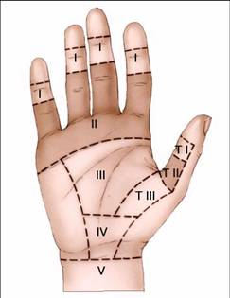
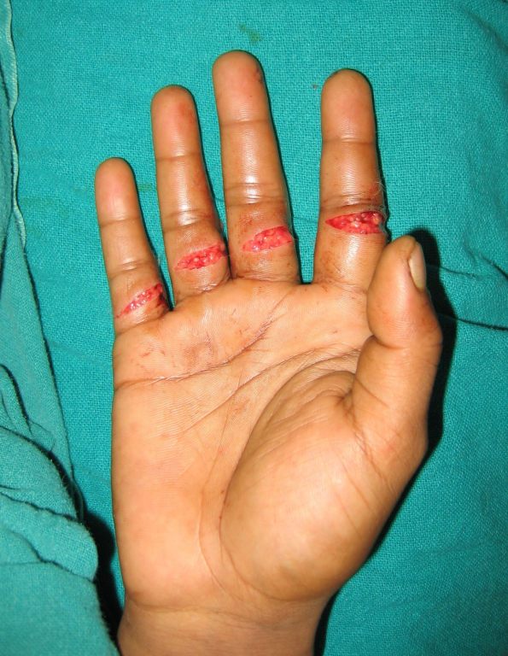
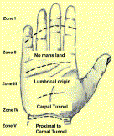
Flexor Tendon Lacerations
Clean/Sew up the skin lac
Immobilize it
Most times, follow-up in clinic
  Exceptions
    Significant contamination
    “Spaghetti Wrist”

Slide 17
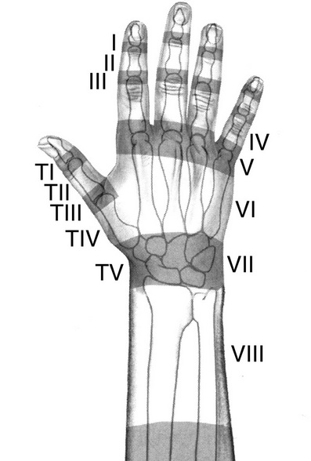
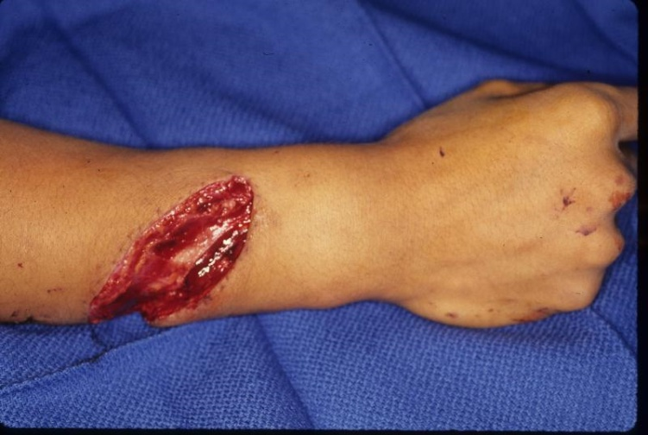
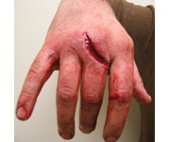
Extensor Tendon Lacerations
Same principles

Slide 18
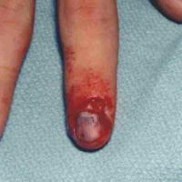
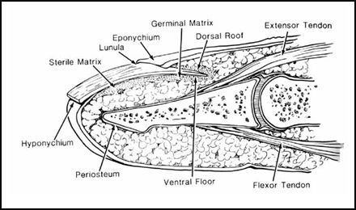
Nailbed Injuries
Often due to car doors, chairs, or other crush mechanisms
Musts
  Elevate the nail
  Repair the bed
  Keep tract open beneath eponychial fold
    Replace nail
    Adaptec
    Suture packaging
    Dermabond?
Seymour fractures – Don’t miss these open fractures in kids!

Slide 19
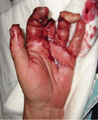
“I swear Doc, I use this tablesaw every day.”
Fingertip amputations
In adults, often necessitate revision amputation, usually in ER
  Rongeur extruded bone
  Close if possible
  Otherwise, just apply a soft bulky dressing
    Xeroflo or Adaptec
    IV3000 – particularly for peds
  Can do advancement flap or other soft tissue coverage procedure later
Otherwise, come to next available clinic
In kids, you can often successfully reattach tissues and expect better healing.
  Replants nearly always indicated in kids

Slide 20
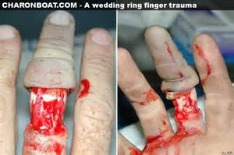
Ring Avulsions
Even when not an avulsion,
  ALL RINGS COME OFF
    Finger will swell, can become ischemic after they go home
    Soap/String technique
    Cut it off with ring remover in ER
Ring caught in conveyor or other machine
Sudden traction on soft tissues
  Can range from laceration to complete amputation
  Often involve NV structures
Damage is almost always even worse than it looks
Urbaniak Classification
  I – Adequate circulation to digit
  II – Inadequate circulation to digit
  III – Complete degloving or amputation
Treatment
  ABX, tetanus
  Wash thoroughly
  Usually OR
  Standard bone/soft tissue care
  Revasc
  Completion or Revision Amputation

Slide 21
When to Replant?
Please! – 5 P’s
Pollux – thumb
Poly – multiple digits
Proximal – to the wrist
Peds – kids
Profundus – Zone I
Sorry! – 5 (or 8?) S’s
Single – 1 digit
Starved – ischemic
Segmental
Smashed – crushed/mangled
Sublimis – Zone II/No Man’s Land
Sick – medically unstable
Psych – psychologically unstable
Soiled – heavy contamination
Ischemia Time
 | Warm | Cold
Hand/Fingers | < 12 h | < 24 h
Forearm | < 6 h | < 12 h

Slide 22
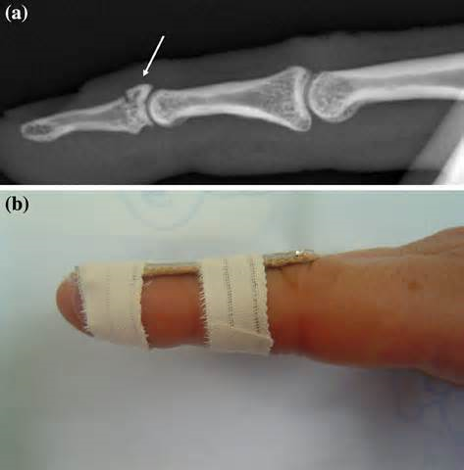
Mallet Fractures
Forced flexion on an extended digit. Avulsion of extensor tendon including base of distal phalanx
Finger splint (The one in the picture isn’t padded well enough)
Be careful not to use a lot of tape
  Traps sweat, macerates skin
Don’t immobilize the PIP joints

Slide 23
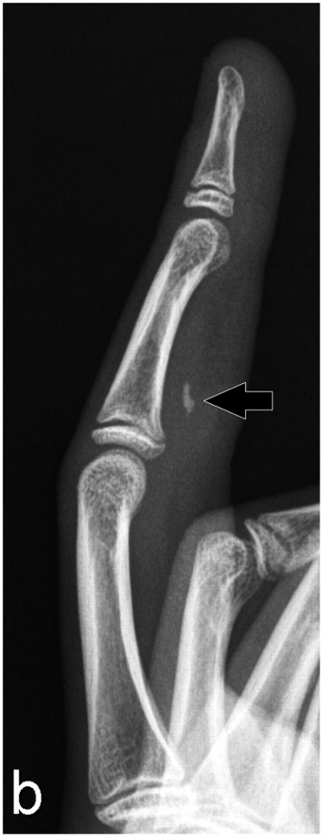
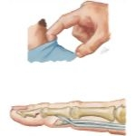
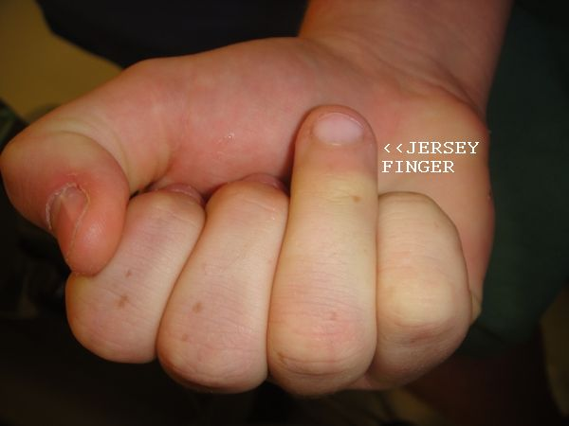
Jersey Finger
Usually results from forced extension of a flexed digit
Avulsion of FDP tendon insertion at base of distal phalanx
Common sports injury
Tendon can retract fragment back to Camper’s chiasm
Leddy classification
Splint in the ER, send to clinic
If displaced at all, need OR

Slide 24
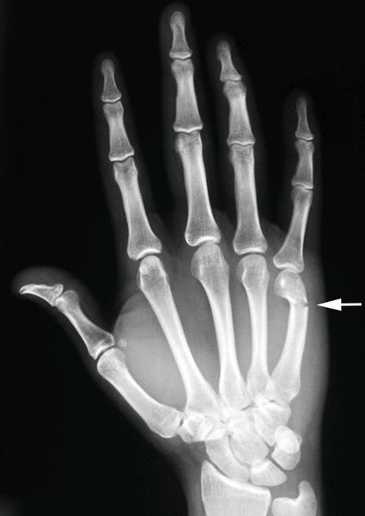
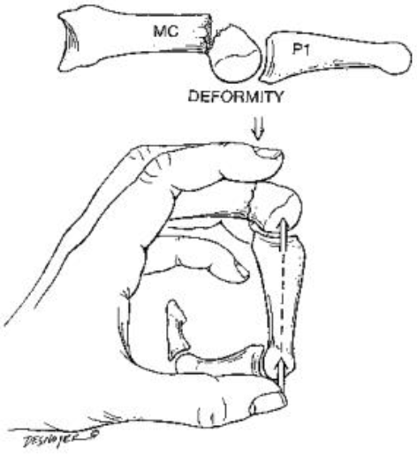
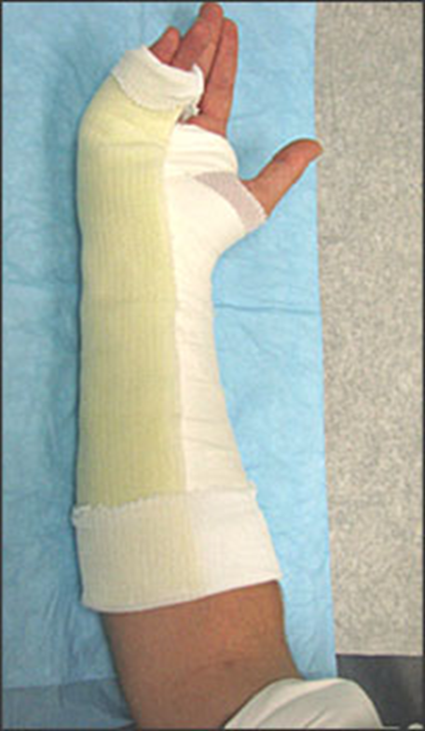
“The Wall Always Wins”
Boxer’s Fractures
Usually a wall-puncher
  High index of suspicion for violent behavior or context for domestic violence
  Serial offenders may need referral for anger management
Reduction not mandatory
  Literature shows reduction is usually lost even if tried, unless it’s pinned
  Jahss maneuver
    MP flexed to 90, dorsally directed force applied to P1 with counterforce on metacarpal shaft
    Not always as successful as it looks – tough to keep it reduced in a splint even if you get it there
Can accept up to 70° of volar angulation
  Reduction generally recommended with scissoring of digits – can’t tolerate a rotational deformity -> OR
Ulnar gutter splint
  Intrinsic-plus position

Slide 25
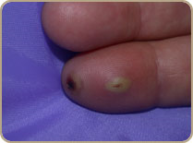
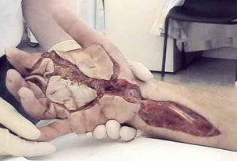
Injection injuries
Usually someone testing the gun
Usually organic compound
  Paint
  Hydraulic fluid
  Oil
Check for site of inoculation
Find out specs on gun if you can
  How many PSI?
  What type of fluid?
To OR NOW

Slide 26
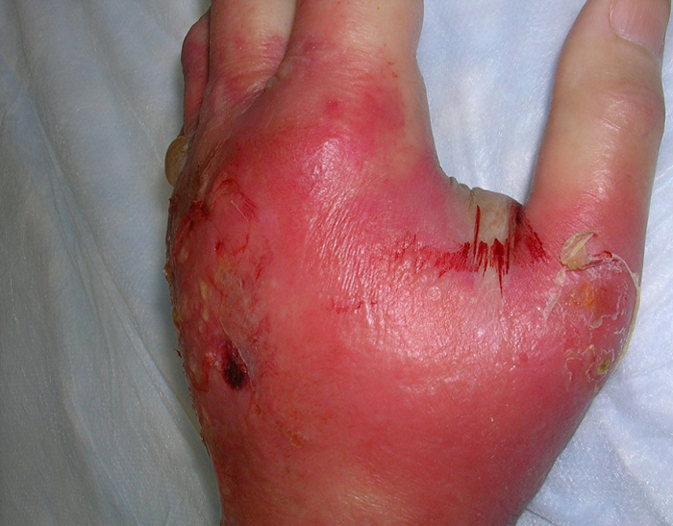
INFECTION

Slide 27
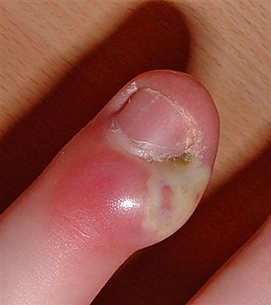


Paronychia
Infection involving the perinychium or eponychium
Nail plate may be removed to facilitate cleaning
Leave it open, pack if needed
Send home with antibiotics
BID packing changes

Slide 28




Felon
Abscess in the fingerpad
Fingerpad divided into many compartments by sagittal septae
MUST incise all septae!!!!
  Irrigate thoroughly
  Pack with ¼” Nu-gauze
  Send home on antibiotics
  BID finger soaks, packing changes
Some recommend a fishmouth incision
I prefer single lateral incision all the way across
  Radial for thumb, small
  Ulnar for index, long, ring

Slide 29

Flexor Tenosynovitis
BIG PROBLEM!
Look for site of inoculation
  Check the flexor creases – If it’s in the PIP crease, it’s in the sheath.
Kanavel’s Cardinal signs
  Intense pain with any extension
    Earliest and most important
  Flexion posture
  Uniform swelling in entire finger
  Percussion tenderness along sheath
To OR NOW
  “When did you eat last?”

Slide 30




Other common sites of infection
Collar button abscess
Almost always need to be drained in the OR

Slide 31

BITES

Slide 32






Animal bites
Cats – Pasteurella
Dogs – Eikenella
  Rabies?
Humans – Eikenella
Tetanus shot
Antibiotics
  Usually go home on Augmentin
Wash it out
Whirlpool BID if staying inpatient
Generally, don’t close it (except to maybe tack an edge down)
  You’ll need a darn good reason

Slide 33



Fight bites
Check for open joints!
  Usually the MP’s
  If the joint is open, almost always needs OR
  If in doubt, needs formal I&D

Slide 34



Snake bites
First off, make sure it isn’t compartment syndrome
  Usually admitted to medicine if non-op
  Frequent compartment checks early on
    Always documented!!!!
Antivenin SOON – What type of snake was it?
  More reliable if the person has worked with and around snakes for a long time
Antibiotics
ELEVATION
  AT ALL TIMES
Pit vipers are the worst for these
  Family Crotalidae
  Antivenin is Cro-Fab

Slide 35

Flash-Flame Burns
90% of thermal burns involve the hands
  Usually exposed
  Close to heat source
  Dorsal > Volar
    Protective mechanism
~1% of population in Western countries will sustain a burn each year
  25% of those will require medical treatment
Workplace accounts for < 1/3 of burn unit admissions and fire-related deaths
Incidence of burn injuries in armed conflicts reported between 2-18% in conventional warfare
Beasley RW. “Burns and Chemical, Cold, and Electrical Injuries.” In Beasley’s Surgery of the Hand. Thieme Medical Publishers, Inc., New York, NY. 2003: 75-86.
Germann G and Weigel G. “The Burned Hand.” In Green’s Operative Hand Surgery. 6th ed. Elsevier Churchill Livingstone, Philadelphia, PA. 2011: 2089-2120.
Pruitt BA. “Combat casualty care and surgical progress. Ann Surg. 2006;243:715-29.

Slide 36

Contact Burns
Contact burns are more likely to involve the palmar surfaces
  Especially young children
Typically more superficial burns (in otherwise awake/alert patient) as nociceptive reflexes result in withdrawal of limb
Must exercise caution to evaluate low-temperature burns to insensate limbs or people rendered unconscious
  Epileptics
  Gross intoxication with EtOH or drugs
  Neuropathic limbs
  Patients down after cardiac/respiratory compromise or CVA
Lister G. “Injury.” In The Hand: Diagnosis and Indications. 3rd ed. Churchill Livingstone, New York, NY. 1993: 126-137.

Slide 37


Burn Injury
Extent of tissue damage depends on
  Temperature of inflicting agent
  Duration of contact
Flash exposure
  Broader areas
  Often associated with systemic and respiratory problems
Contact burn
  Well-Defined and Localized
  Greater Depth
Beasley RW. “Burns and Chemical, Cold, and Electrical Injuries.” In Beasley’s Surgery of the Hand. Thieme Medical Publishers, Inc., New York, NY. 2003: 75-86.

Slide 38


Flash and Contact Burns – Initial Treatment
If burned area is small and superficial
  Rinse wound
  Elevate
  Night-splinting – Intrinsic +
  Analgesia as needed to accommodate motion
    Irreversible CRPS can result from painful motion, clumsy dressings or splints
When wounds are clean and care allows, wounds should be covered with antibacterial cream
  Silver sulfadiazine = easy to remove, water soluble, soothing, antibiotic ($9.25 per 25 g*)
Beasley RW. “Burns and Chemical, Cold, and Electrical Injuries.” In Beasley’s Surgery of the Hand. Thieme Medical Publishers, Inc., New York, NY. 2003: 75-86.
*Flatt AE. “Burns.” In The Care of Minor Hand Injuries. 2nd ed. The C.V. Mosby Company, St. Louis, MO. 1963: 217-227.
†Kamolz L-P, Kitzinger HB, Karle B, Frey M. “The treatment of hand burns.” Burns. 2009;35:327-337.
Barron JN and Evans DM. “Burns.” In The Practice of Hand Surgery. 2nd ed. Lamb DW, Hooper G, and Kuczynski K (ed), Blackwell Scientific Publications, Oxford, England. 1989: 312-319.
Germann G and Weigel G. “The Burned Hand.” In Green’s Operative Hand Surgery. 6th ed. Elsevier Churchill Livingstone, Philadelphia, PA. 2011: 2089-2120.

Slide 39

Cold Exposure Injury
Increased risk of frostbite at < -2°C for > 1 hour (“freezing point” of human tissue)
  Sensory nerve dysfunction occurs at 10°C
  Intracellular ice crystals form at -6°C to -15°C
Hands or feet involved in 90%
Degree of injury dependent on
  Temperature
  Wind velocity (“wind chill”)
  Altitude
  Duration of exposure
  Wetness of tissue
  Patient’s vascular status
  Previous exposure to cold injury
Cannon DL. “Special Hand Disorders.” In Campbell’s Operative Orthopaedics. 12th ed. Canale ST and Beaty JH (ed), Elsevier Mosby, Philadelphia, PA. 2013: 3479-3487.
Watson JT. “Frostbite.” In AAOS Comprehensive Orthopaedic Review. Lieberman JR (ed), American Academy of Orthopaedic Surgeons, Rosemont, IL. 2009: 955.
Germann G and Weigel G. “The Burned Hand.” In Green’s Operative Hand Surgery. 6th ed. Elsevier Churchill Livingstone, Philadelphia, PA. 2011: 2089-2120.
Britt LD, Dascombe WH, Rodriguez A: New horizons in management of hypothermia and frostbite injury, Surg Clin North Am 71:345-370, 1991.

Slide 40


Cold Exposure Injury
At-risk scenarios – Outdoor winter activities
  Outdoor winter activities
    Skiing
    Mountaineering
  Inadequate clothing
  Alcohol abuse
    Stay vigilant for withdrawal, malnutrition
  Psych disorders
  Accidents
Commonly occurs in kids after playing outside in cold for long periods with insufficient or no gloves
  “I lost one, Mom!”
Germann G and Weigel G. “The Burned Hand.” In Green’s Operative Hand Surgery. 6th ed. Elsevier Churchill Livingstone, Philadelphia, PA. 2011: 2089-2120.
Boswick JA. “Cold Injuries.” In The Practice of Hand Surgery. 2nd ed. Lamb DW, Hooper G, and Kuczynski K (ed), Blackwell Scientific Publications, Oxford, England. 1989: 320--324.

Slide 41

Cold Exposure Injury
1st degree frostbite – “Frostnip”
  Erythema with transient paresthesias
  No blistering, no tissue loss
2nd degree frostbite
  Erythema
  Swelling
  Blisters filled with serum
3rd degree frostbite
  Partial gangrene with full-thickness skin loss
  Active hyperemia follows warming of the skin
  Hemorrhagic blisters
  Purplish blue skin
  Hard black eschar with edema of the whole part with blebs in early stages
4th degree frostbite
  Necrosis of deep skin
  Hand is cold, anesthetic, cyanotic, even after warming
  Mummification follows or wet necrosis if infection occurs
Beasley RW. “Burns and Chemical, Cold, and Electrical Injuries.” In Beasley’s Surgery of the Hand. Thieme Medical Publishers, Inc., New York, NY. 2003: 75-86.

Slide 42



Cold Exposure Injury - Treatment
Don’t thaw pt in the field unless you can guarantee no re-freezing
  Shown to cause increased overall damage
Ensure pt’s body core temperature > 35°C before initiating warming of frostbite tissue
Remove jewelry/rings – can be constrictive after digit swelling
Rewarming with 40°-42° C water
  NEED PAIN CONTROL, MAYBE EVEN ANESTHESIA
  Ideal in whirlpool with antiseptic solution
  Continued until tissues are red-purple and pliable
Aspirate clear blisters
  Leave roofs in place (biologic dressing, may speed up epithelialization)
Leave hemorrhagic blisters alone
Aloe vera after rewarming
Antibiotics for deep frostbite
Tetanus immunization
Handford C, Buxton P, Russell K, Imray CEA, et al. Frostbite: A practical approach to hospital management. Ext Phys Med. 2014;3(7):1-10.
Beasley RW. “Burns and Chemical, Cold, and Electrical Injuries.” In Beasley’s Surgery of the Hand. Thieme Medical Publishers, Inc., New York, NY. 2003: 75-86.

Slide 43

SPLINTS

Slide 44


Finger Splints
Alumafoam
Make one for volar/dorsal sides
  Alternate Q2-3H
Thin cloth tape vs. band-aids
  Needs to be able to breathe
Don’t trap sweat in there!
  Skin complications can turn a minor injury into a catastrophic one

Slide 45


Ulnar Gutter Splints
5 x 30 fiberglass or plaster
  Cut to fit
Intrinsic-plus position
Leave 1st-3rd digits free for ADL’s

Slide 46


Wrist/Hand splints
Volar and/or dorsal
+/- fingers
Flexor injuries are splinted in flexion
  Wrist at ~20° of flexion, MP joints at ~60° of flexion
Extensor injuries are splinted in extension
  Full extension, including wrist
  Less of a big deal than flexor injuries, less likely to retract

Slide 47


Thumb Spica splints
Helpful for any fracture in which you need to immobilize the thumb
  Scaphoid fractures
  1st Metacarpal/phalanx fractures
Unless the injury involves it, you should generally leave the IP joint free to move.

Slide 48
Think about it!
In an adult, don’t immobilize a joint if you don’t have to!
Stiffness in the hand can be a difficult and time-consuming problem to treat.
But, not really an issue for kids – Cast away.

Slide 49




So….when do I NEED a hand surgeon?
Mangled or exploded hand
  Industrial injury
  Fireworks injury
Acutely dysvascular hand or digit
  Are they a replant/revasc candidate?
Compartment Syndrome
Flexor tenosynovitis

Slide 50





So….when do I NEED a hand surgeon?
Spaghetti wrist
  Often have vascular injury
Deep hand abscess
Injection injury
Bites that inoculated joints
Open fractures or joints
  Modern recs for timing of surgery is controversial – May not need emergent surgery
    Definitely start antibiotics right away
    Medicolegally, probably best to let your hand surgeon make the call

Slide 51

Questions?

Slide 52



Thanks!

