Slide 1
Rural Emergency Medicine Course Obstetrical Emergencies

Slide 2

Survey
Please complete this survey BEFORE you review this PowerPoint. We will ask you to repeat the survey after the presentation/simulation so we can track learning objectives.
Thank you!

Slide 3
Learning Objectives
Describe the scope and impact of maternal care deserts in Nebraska.
Identify clinical signs and diagnostic criteria for preeclampsia with severe features and eclampsia.
Initiate evidence-based first-line management of eclampsia, including magnesium sulfate therapy.
Recognize early signs of magnesium toxicity and implement appropriate treatment.
Define diagnostic criteria and common etiologies of postpartum hemorrhage.
Develop a systematic approach to the evaluation and management of postpartum hemorrhage.

Slide 4
Rural Disparities
79% of rural counties lack OBGYNs
~6% of all OBGYNs practice in rural communities
The number of women of childbearing age who live within a half-hour drive of obstetric care fell from more than 90% in 2010 to about 60% in 2021

Slide 5
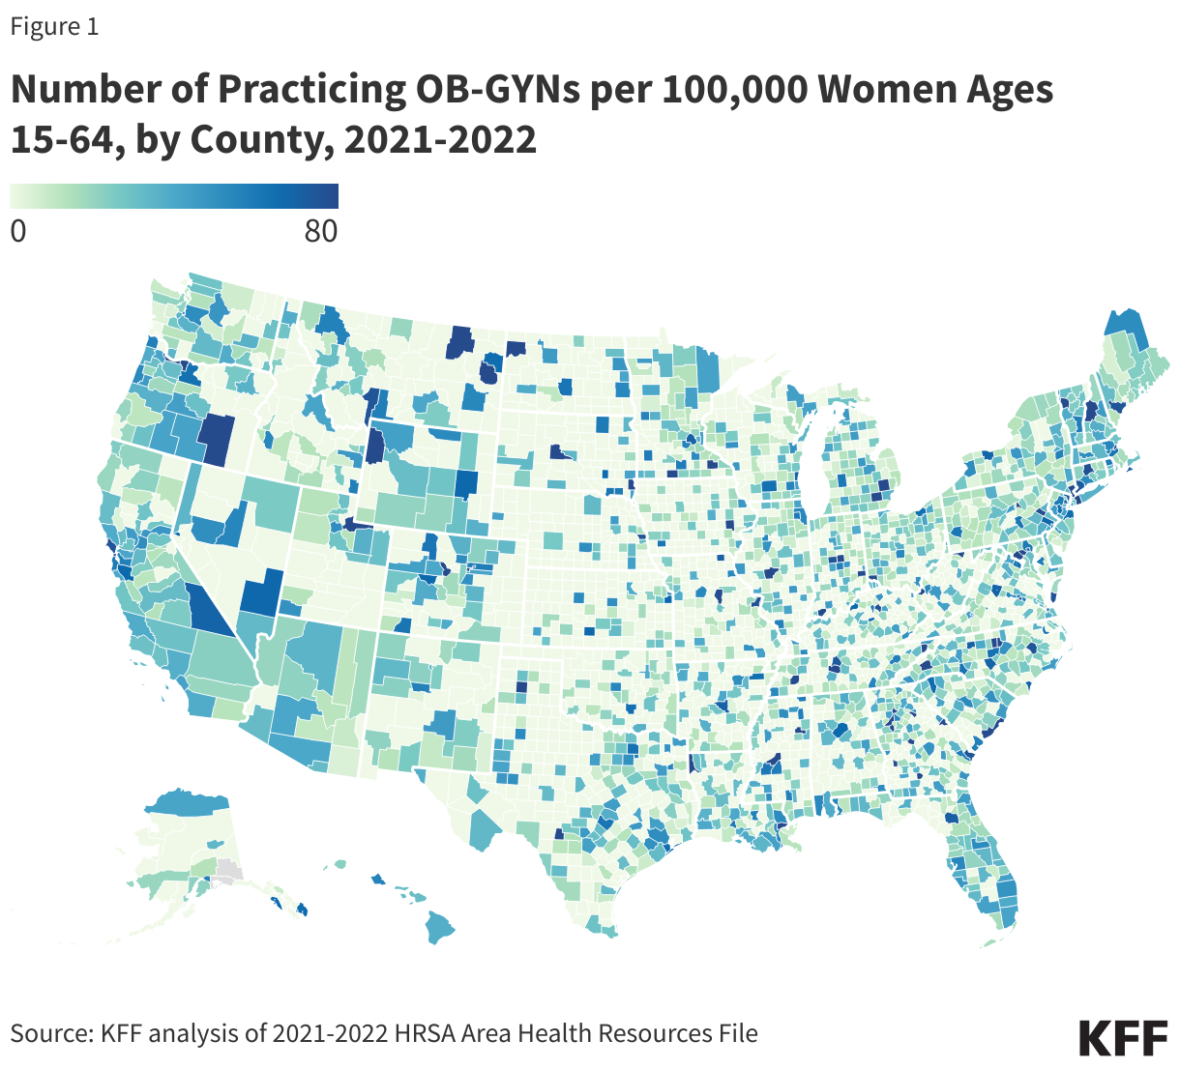

Slide 6
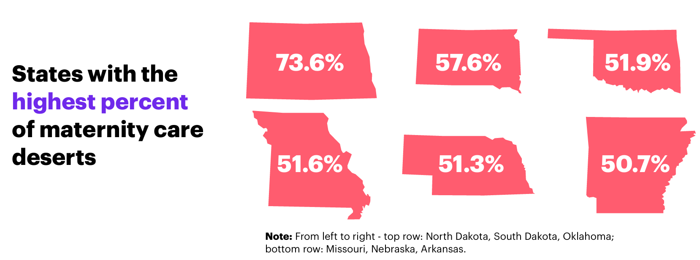
Rural Disparities

Slide 7
Nebraska
51.6% of Nebraska counties are classified as maternity care deserts, compared with 32.6% nationally.
15.9% of women in Nebraska lack access to a birthing hospital within a 30-minute drive.
Limited access to obstetric and reproductive health services places Nebraska women at increased risk for adverse maternal outcomes.

Slide 8
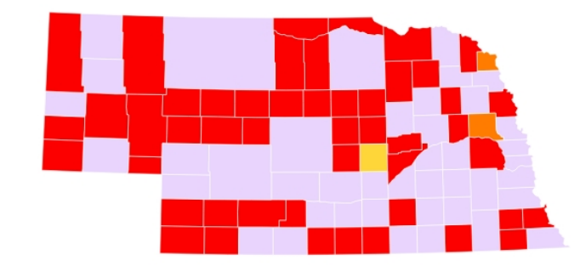

In NE, there was an 8% decrease in the number of birthing hospitals between 2020 and 2019.
In NE, there were 2,073 babies born in maternity care deserts, 8.4% of all births.

Slide 9
Hypertensive Disorders of Pregnancy

Slide 10
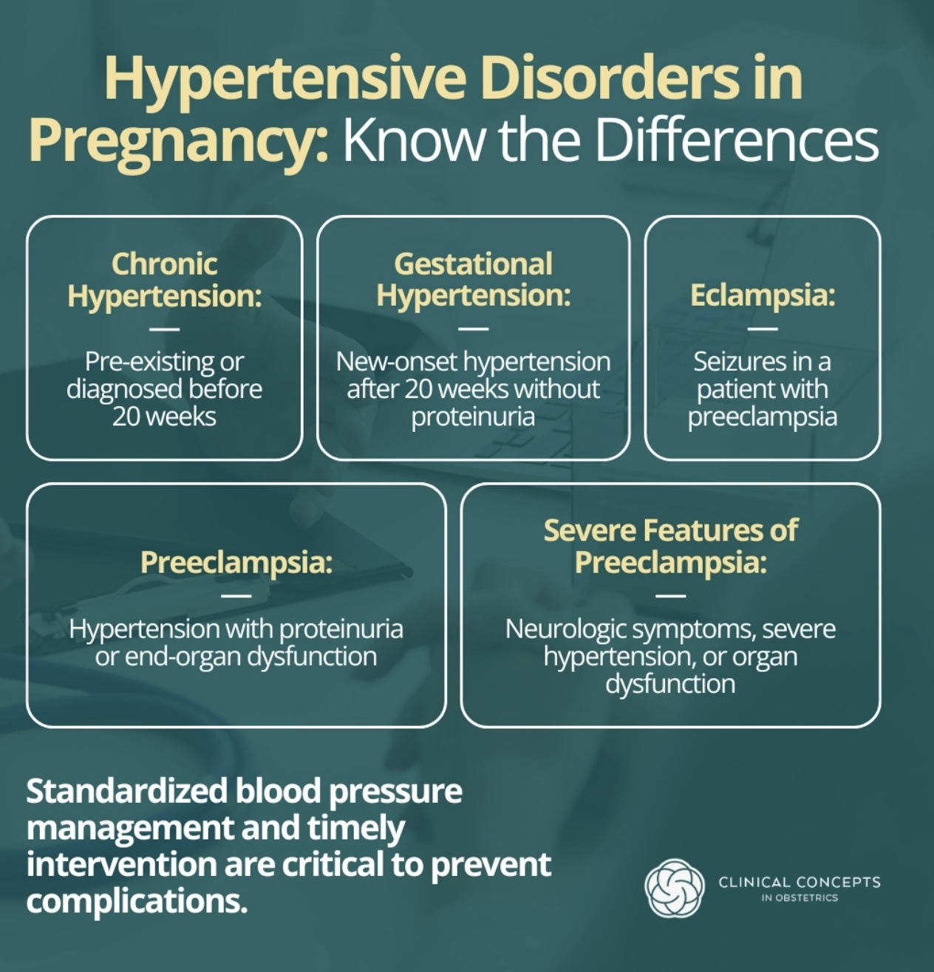

Slide 11
Background - Eclampsia
Eclampsia is defined as new-onset generalized seizures in a patient with preeclampsia that cannot be attributed to another neurologic cause.
Can occur during pregnancy, intrapartum, or postpartum, most commonly in the third trimester or within 48 hours after delivery.
Seizures are typically generalized tonic–clonic.
Represents the most common severe neurologic complication of pregnancy.
Associated with significant maternal morbidity and mortality, including hypoxic-ischemic brain injury and intracranial hemorrhage.
Early recognition and rapid management are critical.

Slide 12
Eclampsia- Life Threatening Emergency
Maternal complications
Stroke
HELLP syndrome
Pulmonary edema
Posterior Reversible Encephalopathy Syndrome (PRES)
Fetal complications
Hypoxia
Preterm delivery

Slide 13
Eclampsia Management Principals
Stabilize airway and patient
Left lateral decubitus position
Continuous fetal monitoring
Obtain IV access if possible
Magnesium sulfate → first-line to prevent recurrent seizures
4gm IV bolus over 15-20 mins then 2 gms/hr
or 5mg IM in each buttock (10mg total)
4mg IV Ativan if refractory
Control blood pressure
Nifedipine, labetalol, hydralazine
Delivery → definitive treatment once stable
STAT OB consult

Slide 14
Blood Pressure Control
Severe range (SR) blood pressure is ≥160/110 mmHg
If two consecutive SR BP, treat with one of the following
Oral nifedipine 10mg
IV Labetalol 20mg
IV Hydralazine 5mg
Repeat BP every 15-20 minutes
If continued severe range blood pressures, treat with the following algorithm

Slide 15
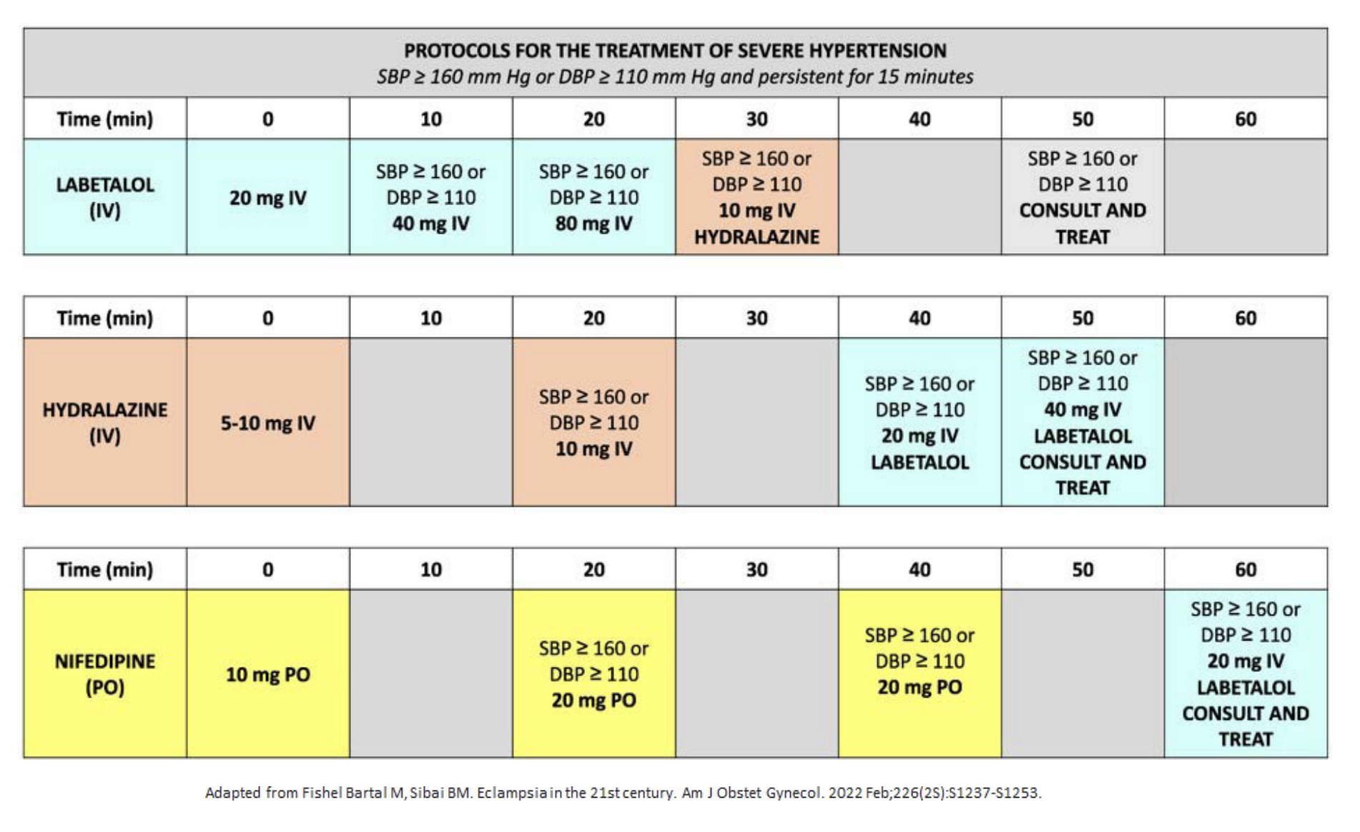

Slide 16
Magnesium Toxicity
4–7 mEq/L (therapeutic range)
Flushing, warmth, nausea, mildly decreased (but present) deep tendon reflexes
7–10 mEq/L
Loss of deep tendon reflexes, lethargy/somnolence
10–13 mEq/L
Respiratory depression, slurred speech, muscle weakness/paralysis
>13 mEq/L
Respiratory arrest, cardiac conduction abnormalities (eg. heart block)
>15 mEq/L
Cardiac arrest
Antidote: IV Calcium Gluconate (1 g over 2–3 minutes)

Slide 17
Postpartum Hemorrhage

Slide 18
Postpartum Hemorrhage (PPH) Maternal Morbidity and Mortality
Approximately 3-5% of OB patients will experience a postpartum hemorrhage
PPH accounts for about 70,000 deaths worldwide annually
27% of maternal deaths worldwide
11.2% of US maternal deaths
Often preventable with early recognition and intervention

Slide 19

Postpartum Hemorrhage (PPH)
Definition of Postpartum Hemorrhage
Blood loss of 1,000 ml or more
Blood loss with signs or symptoms of hypovolemia
Occurs
During delivery
Within 24 hours after delivery

Slide 20
Causes of PPH
Primary PPH (<24 hrs)
Uterine atony
Lacerations
Retained placenta
Coagulopathy
Uterine inversion
Delayed PPH (24 hrs → 12wks pp)
Retained products
Infection
Subinvolution of the uterus
Inherited coagulopathy (e.g. vWD)

Slide 21
Evaluation of PPH The 4 T's
Tone
Uterine atony
Suspected and treated first
Trauma
Lacerations
Hematomas
Tissue
Retained products of conception
Thrombin
Reminder to evaluate and correct coagulation status

Slide 22
Initial Management of PPH
Maintain hemodynamic stability
Massive transfusion protocol
Adequate IV access
Call for help
Empty bladder (Foley)
Bimanual uterine massage
Remove intrauterine clots/tissue
Massage uterus
Transabdominal ultrasound evaluation
Oxytocin
Additional uterotonics
IV TXA
Mechanical tamponade
Bakari balloon
Jada
Uterine Artery Embolization

Slide 23
Uterotonics
Oxytocin
10 units IM or 10-40 units in 1 L IV infusion
Misoprostol (Cytotec)
600-1000 mcg (rectal)
May cause shivering and transient fever/headache
Methylergonovine (Methergine)
0.2 mg IM q2-4 hrs
Avoid in hypertension/preeclampsia
Carboprost (Hemabate)
0.25 mg IM q 15-90 mins. Max 2 mg (8 doses).
Avoid in asthma. Can cause diarrhea.

Slide 24
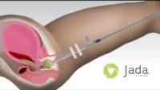
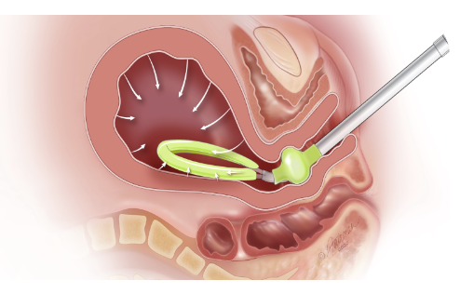
Jada System
“Fast control of abnormal postpartum uterine bleeding” https://www.thejadasystem.com/

Slide 25
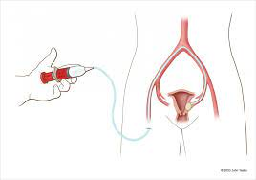
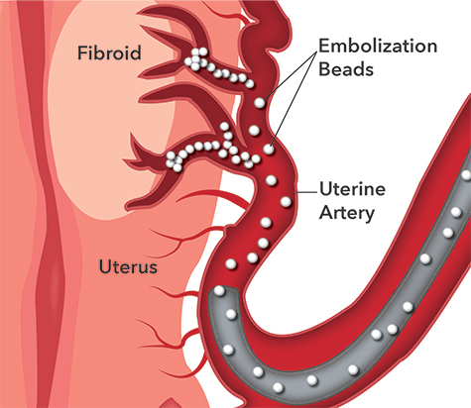
Uterine Artery Embolization
Not available in all facilities, need interventional radiology available to perform this procedure

Slide 26
Massive Transfusion Protocol
Recommendation for 1:1:1 ratio
1 unit RBCs
1 unit FFP
1 unit apheresis pack of platelets
Check fibrinogen early
< 200 mg/dL = severe hemorrhage (DIC)
Treatment with FFP
Tranexamic Acid (TXA)
1gram IV as soon as possible, can repeat once if bleeding persists after 30 minutes
Maximum dose 2 grams in 24 hours

Slide 27
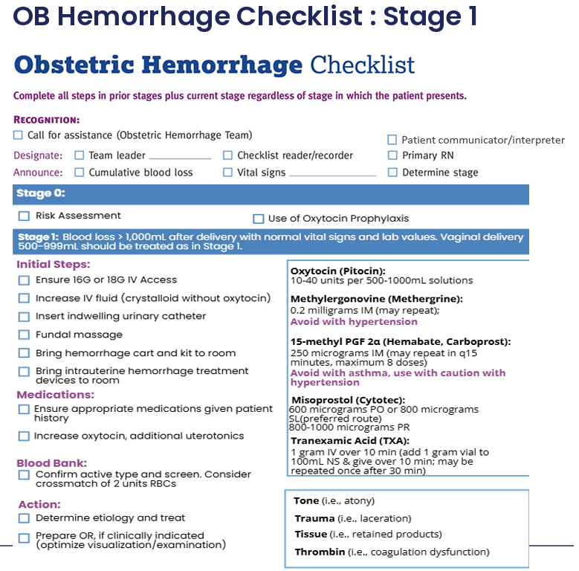

Slide 28
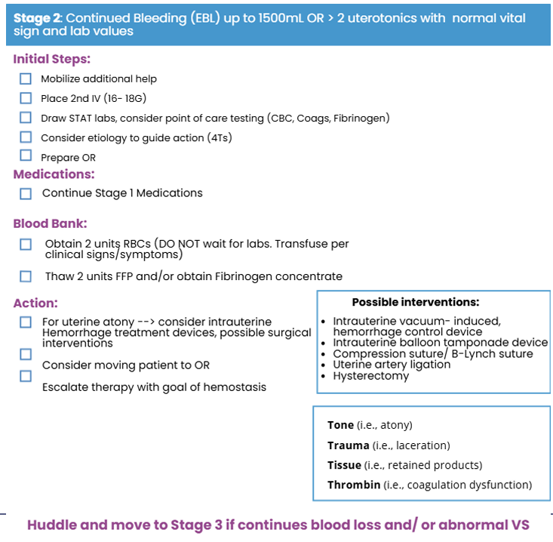

Slide 29
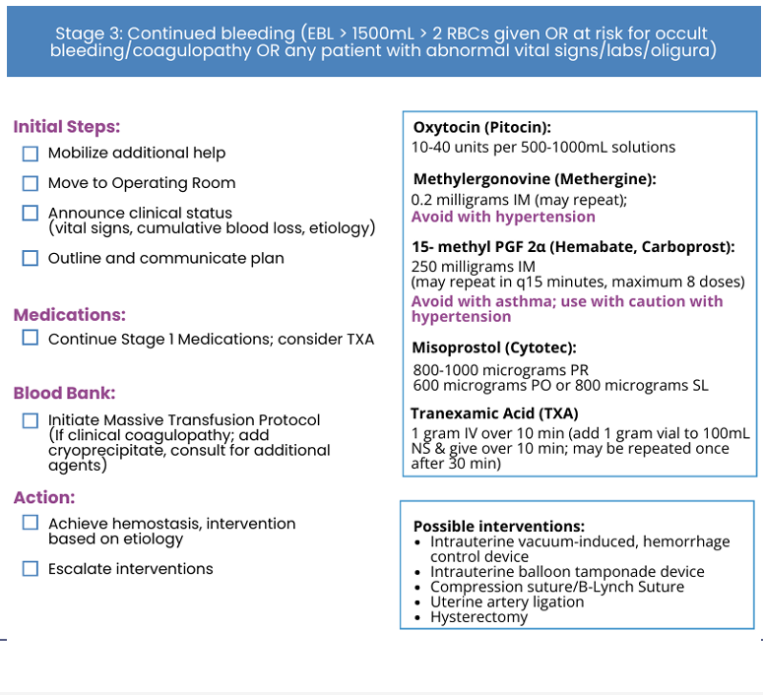

Slide 30
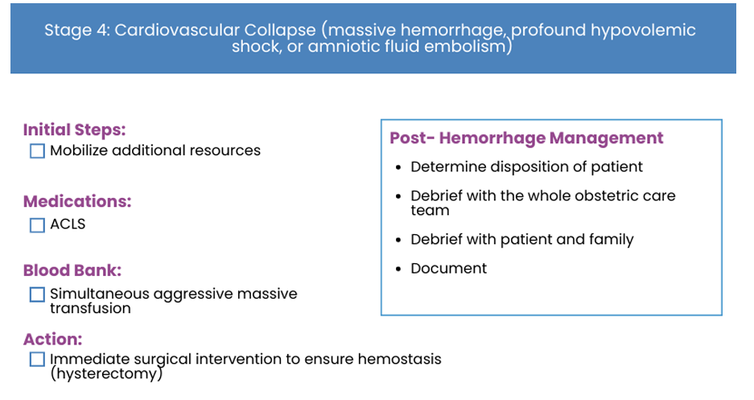

Slide 31
Obstetric Hemorrhage Checklist
Click to access the ACOG OB Hemorrhage Checklist​

Slide 32
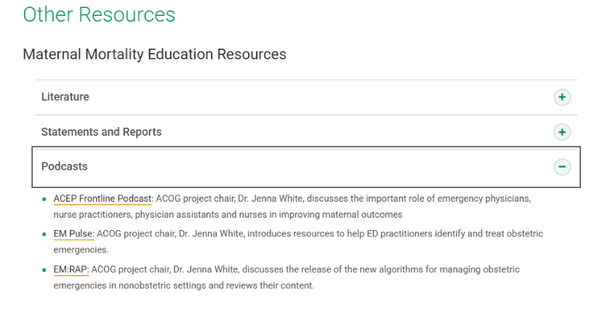

Slide 33
References
American College of Obstetricians and Gynecologists. Practice Bulletin No. 183: Postpartum Hemorrhage. Obstet Gynecol. 2017.
Christopher B-Lynch, Andrew Coker, A. H. Lawal, et al. The B-Lynch surgical technique for the control of massive postpartum hemorrhage: An alternative to hysterectomy? BJOG. 1997;104:372–375. Adapted from: J. E. Ferguson, J. F. Bourgeois, P. B. Underwood. B-Lynch suture for postpartum hemorrhage. Obstet Gynecol. 2000;95:1020–1022.
Nursing@Georgetown. Maternal health around the world. UNICEF Global Development Commons. Accessed [insert date]. https://gdc.unicef.org/resource/maternal-health-around-world
American College of Obstetricians and Gynecologists. Health disparities in rural women. Committee Opinion No. 586. 2014. https://www.acog.org/clinical/clinical-guidance/committee-opinion/articles/2014/02/health-disparities-in-rural-women
Kaiser Family Foundation. Access to OB-GYNs: Evaluating workforce supply and ACA marketplace networks. https://www.kff.org/affordable-care-act/access-to-ob-gyns-evaluating-workforce-supply-and-aca-marketplace-networks/
American College of Obstetricians and Gynecologists. Obstetric Hemorrhage Bundle: Complete Slide Set. https://www.acog.org/-/media/project/acog/acogorg/files/membership-and-community/districts/ii/smi/obstetric-hemorrhage-bundle_complete-slide-set.pdf
B. Ranchoff, A. Kofner, O. Baker, et al. Obstetric service availability and travel time to access obstetric services in the US, 2010–2021. Am J Prev Med. 2026

