Slide 1
Ob/Gyn Emergencies
Jennifer Griffin Miller, MD, MPH
Associate Professor
Department of Obstetrics and Gynecology

Slide 2
Objectives
Discuss emergent obstetrical deliveries, including post partum hemorrhage, shoulder dystocia, severe hypertension, and eclampsia.
Consider etiologies of bleeding in early pregnancy, including miscarriage, septic abortion, and ectopic pregnancy.
Review presentation and diagnosis of ovarian torsion.
Discuss evaluation and management of abnormal uterine bleeding and heavy menstrual bleeding.
Examine treatment of Bartholin abscess.

Slide 3
Obstetrical Emergencies

Slide 4
Frequency of Common Delivery Complications
Shoulder Dystocia ~1-2% of births
Postpartum Hemorrhage 2.7-4.3%
Obstetrical Anal Sphincter Injury (OASIS) 2.9-4.9%
Eclampsia 0.19% (~50% occur postpartum)

Slide 5
Shoulder Dystocia

Slide 6
Shoulder Dystocia
Occurs when normal traction on the fetal head does not lead to delivery of the shoulders.
Risk factors include macrosomia, prior shoulder dystocia, and diabetes/GDM.
Most cases have no risk factor.
More common in term versus preterm deliveries.
Recognition of dystocia and getting help are first steps.
Team training and simulation to prepare for SD are key.

Slide 7
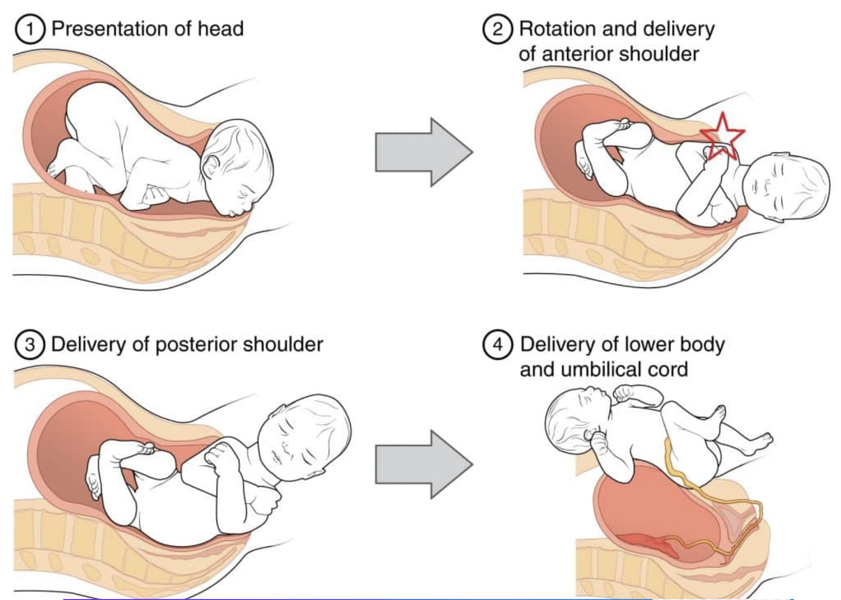
Identifying Shoulder Dystocia
After head delivers and restitutes to side, gentle downward pressure is applied to fetal head.
If anterior shoulder does not deliver with this manuever, shoulder dystocia is identified.

Slide 8
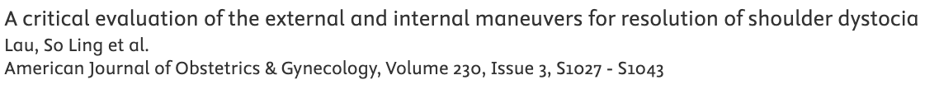
Steps in Management
Once identified, the provider should alert team and get additional help in room.
One member of team should mark start time.
Provider should communicate clearly to patient; she should stop pushing.
Team members should assist patient into knee-chest position (McRobert’s Manuever).

Slide 9
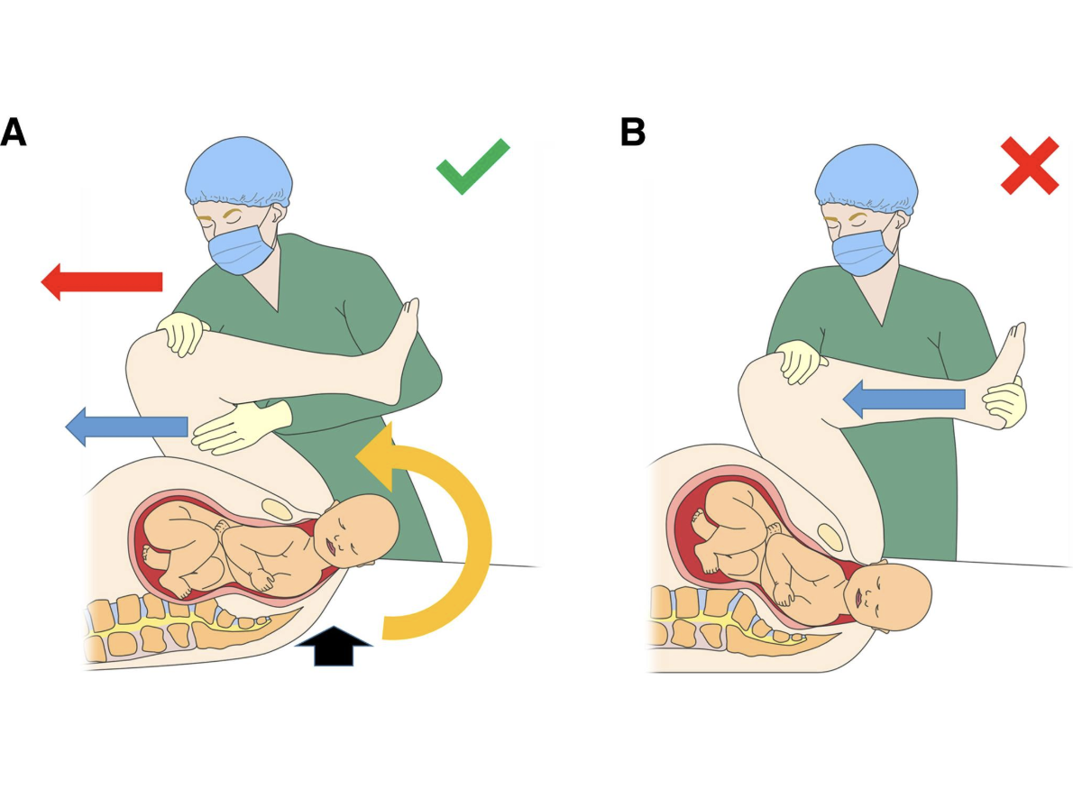
McRoberts Manuever
Patient should be assisted in flexion of hips.
Goal of flexion until maternal buttocks are coming off table.

Slide 10
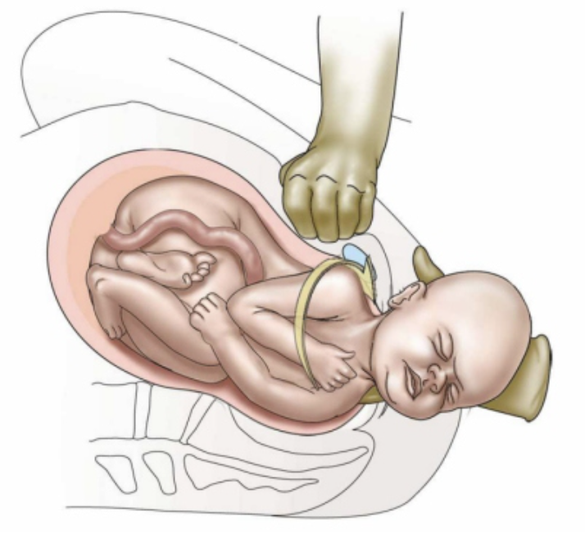
Suprapubic Pressure
Team member should be standing on a stool or with bed lowered for proper angle.
Pressure should be applied down and to rotate toward fetal abdomen above pubic symphysis
Provider should again attempt to deliver anterior shoulder with downward traction.

Slide 11
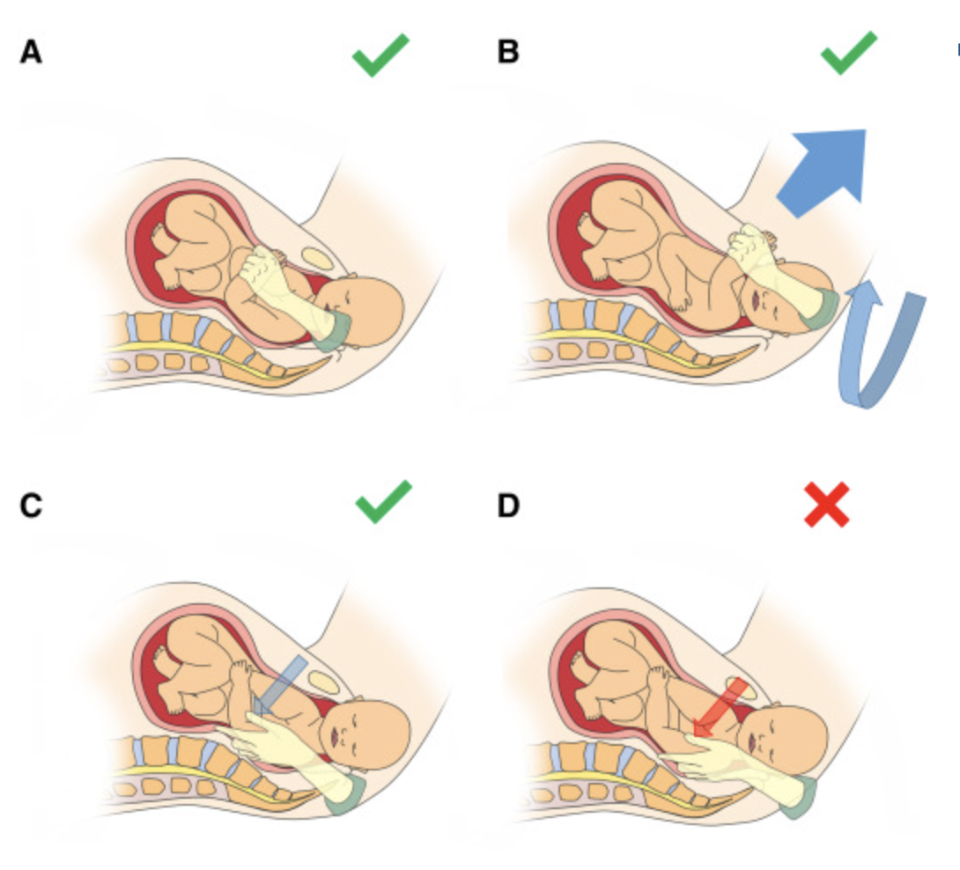
Delivery of Posterior Arm
Posterior arm delivery has success ~85%
Need to put entire hand in vagina to access posterior arm.
Rotate arm across chest to deliver arm.

Slide 12
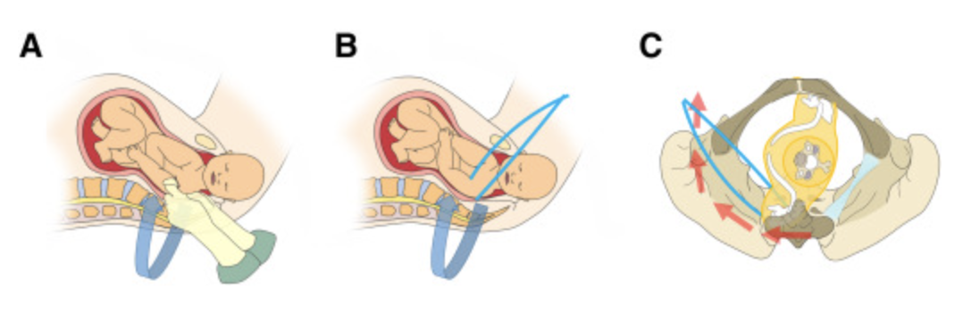
Shoulder Shrug Manuever
If unable to place hand in vagina, this is good alternative.
Use finger/thumb or a rubber catheter to create sling under posterior axilla
Traction to deliver posterior shoulder

Slide 13
Next Steps
If shoulder dystocia persists, consider the following steps:
Repeat all manuevers again from the beginning.
Consider repositioning to all fours.
Consider rotational manuevers.
Switch delivering provider to go through manuevers again.

Slide 14
Postpartum Hemorrhage

Slide 15
Postpartum Hemorrhage
Definition: blood loss of >500 mL within 24 hrs of birth (>1000 mL = severe)
Cause of 27% of maternal death worldwide
Identification and communication are important first steps
Get help.
Uterine atony is most common cause.
Routine administration of oxytocin after delivery of fetus

Slide 16
Postpartum Hemorrhage—Steps
Obtain adequate IV access and IV fluids.
Positioning and lighting to perform proper exam.
Fundal massage to identify and treat atony.
Look for perineal, vaginal, and cervical lacerations.
Consider bimanual massage and manual exploration of uterine cavity to evacuate clots and any retained POC.
Consider activation of massive transfusion protocol for severe hemorrhage.

Slide 17
Medications for PPH
Oxytocin
IM 5-10 Units, up to 4 doses
IV 10-40 IU/liter LR bolus
Methylergonovine maleate (Methergine)
0.2 mg IM every 2-4 hours up to 5 doses
Contraindications: hypertension
Carboprost tromethamine (Hemabate)
250 mcg IM every 15-90 min up to 8 doses
Contraindications: Asthma
Tranexamic acid (TXA)
1g IV over 10 min, may give 2nd dose after 30 min
Recombinant factor VIIa
50-100 mcg/kg in single dose
Misoprostol
800 mcg sublingual or rectal.
Postpartum Hemorrhage NEJM April 28, 2021

Slide 18
Surgical Interventions--PPH
Manual exploration of uterine cavity
Bedside curettage if appropriate; may be facilitated by ultrasound guidance
Placement of Bakri or Jada balloon for tamponade
Transition to OR for surgical evaluation, hysterectomy
Interventional radiology—uterine artery embolization

Slide 19
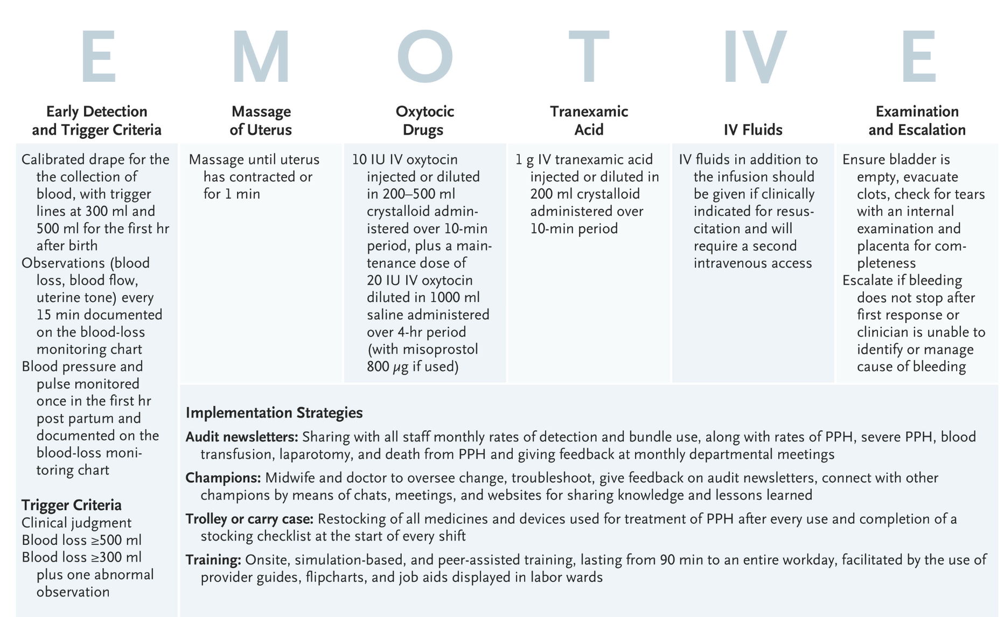
PPH Protocol
Randomized Trial of Early Detection and Treatment of Postpartum Hemorrhage. NEJM May 9, 2023

Slide 20
Severe Hypertension in Pregnancy

Slide 21
Severe Hypertension in Pregnant and Postpartum Women
Defined as systolic >160 or diastolic >110 mm Hg.
Risk of stroke, eclampsia
Treatment within 30 min is critical.

Slide 22
Management of Hypertension
Urgent treatment of hypertension with antihypertensive agents (see next slide)
Continue treatment until BP <160/110
Administration of Magnesium Sulfate for seizure prevention
IV: 4 g bolus then 2 g/hour infusion
IM: 10 g IM and 5 g every 4 hours

Slide 23
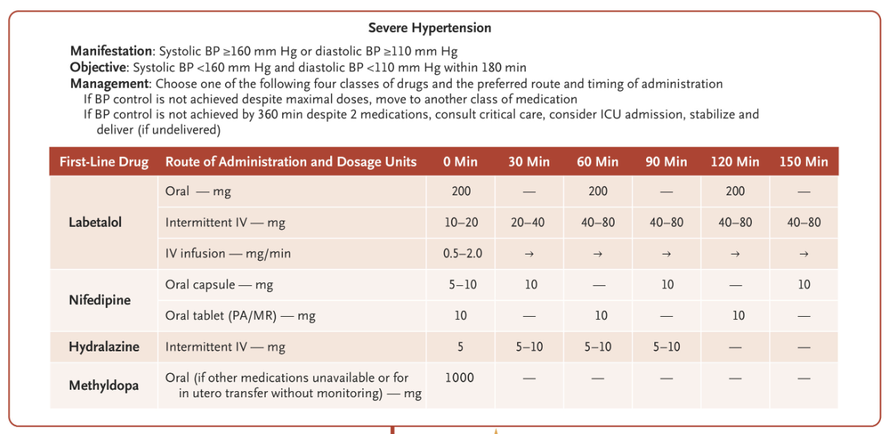
Antihypertensive Therapy
Preeclampsia. NEJM May 11, 2022

Slide 24
Eclampsia
A tonic-clonic seizure in a patient with preeclampsia
Incidence 1.6-10/10000 births in developing countries
Management with Magnesium Sulfate
4 g bolus then 2 g/hour IV
10 g IM and then 5 g every 4 hours
May use diazepam or phenytoin if refractory
Treat hypertension
Imaging if neurologic deficits persist

Slide 25
Bleeding in Early Pregnancy

Slide 26
Definitions
Threatened Miscarriage
Bleeding in IUP with no passage of tissue
Inevitable Miscarraige
Bleeding in IUP with open cervical os
Incomplete Miscarriage
Incomplete passage of POC resulting in ongoing bleeding/cramping
Complete Miscarriage
Complete passage of POC with resolving symptoms
Ectopic Pregnancy
Pregnancy outside of the uterus (fallopian tube most common)
Pregnancy of Unknown Location
Bleeding in early pregnancy without adequate evidence to determine location

Slide 27
Steps in Evaluation
Determine EDC by LMP if known.
Has an ultrasound been done to determine dating/viability in this pregnancy?
If yes and patient had viable IUP, may proceed to ultrasound.
If no or PUL on prior ultrasound, order quantitative hCG and ultrasound.
Examine patient, noting amount of bleeding, cervical os open or closed, pain, abdominal findings, vitals.

Slide 28
Determining Location/Viability
Goal is to avoid intervention (medical or surgical) in cases without a clear diagnosis.
hCG discrimination zone between 1500-3000 mIU/mL
If hGC less than discrimination zone, in otherwise stable patient with no concerning ultrasound findings, would recommend repeating hCG every 48 hours until above zone. (this is a Pregnancy of Unknown Location, PUL)

Slide 29
Determining Location/Viability
If hCG above discrimination zone with IUP, use radiologic criteria to determine viability. (gestational sac diameter, fetal pole CRL, presence of cardiac motion).
GSC >25 mm without fetal pole– non-viable
Fetal pole crown rump length 7+ mm without cardiac motion– non viable
May repeat ultrasound in 7-10 days.
If hCG above zone with no IUP, options for treatment of ectopic versus curettage to r/o miscarriage of IUP. Expectant management may be considered in appropriate patient.

Slide 30
Management of Miscarraige
In non-viable IUP, options include:
Expectant management (stable patient)—66-91% effective
Medical management
Misoprostal 800 mcg vaginally, may repeat in 24 hours
Mifepristone 200 mg oral improves efficacy
Efficacy of 81-95% with combined approach
Surgical management
MVA or suction D&C

Slide 31
Management of Ectopic Pregnancy
Medical:
Methotrexate 50 mg/m2 in single or multidose protocol
hCG monitoring days 4 and 7, follow to zero
Contraindications:
Inability to get reliable follow up care
Kidney/liver disease
Hemodynamic instability/ rupture
Relative: hCG above 10,000, cardiac activity
Surgical
Salpingectomy or salpingostomy

Slide 32
Septic Abortion
Early IUP or abortion with signs of infection including fever, abdominal pain, tachycardia, leukocytosis
Fluid resuscitation and empiric antibiotic therapy
Ampicillin, gentamycin, metronidazole
Piperacillin-tazobactam
Clindamycin, gentamycin
Prompt uterine evacuation is required, regardless of fetal viability.

Slide 33
Acute Pelvic Pain

Slide 34
Acute Pelvic Pain
Several causes for pelvic pain may have overlapping or non-specific symptoms. Ovarian torsion should be considered:
Pain of acute, sudden nature.
Severe pain.
Nausea, vomiting.
Presence of cyst or mass on imaging.

Slide 35
Differential diagnosis
Hemorrhagic/ruptured ovarian cyst
PID
Appendicitis
Nephrolithiasis
Ectopic Pregnancy
Evaluation needed:
Urine hCG
Pelvic ultrasound for eval of ovaries and dopplers
CT for stone, appy
CBC
Urinalysis
Abd and pelvic exam

Slide 36
Gyn Consult
Cyst Rupture/Hemorrhagic Cyst:
Expect normal doppler flow
May or may not have cyst
Abdominal pain, usually without peritoneal signs
May have free fluid
May be mid-cycle
Conservative management most cases
Ovarian Torsion:
Absent doppler flow
Mass often present
Pain with peritoneal signs
May or may not have free fluid
Surgical management required

Slide 37
Pelvic Inflammatory Disease
Non-specific pelvic pain with cervical motion or uterine/adnexal tenderness.
May have vaginal discharge, fever, GI symptoms.
Should be considered if no other apparent cause for pelvic pain.
Follow CDC treatment guidelines
If unable to tolerate p.o. or with imaging concerning for abscess, inpatient management with IV abx indicated.

Slide 38
Abnormal Vaginal Bleeding

Slide 39
Vaginal Bleeding
Consider possible etiologies:
Pregnancy—always rule out!
Heavy menstrual bleeding
Is this occurring at the time of their normal menses?
Is this typical for them?
Non-cyclic abnormal bleeding (pre/post menopausal)
Uterine etiology most likely cause
Consider alternatives
Cervical mass
Vaginal laceration
PALM-COEIN

Slide 40
Vaginal Bleeding
Prompt assessment for hypovolemia/hemodynamic instability!
Vitals—IVF, order blood products if indicated
Quantification of ongoing blood loss with pad weights
Exam
Determine if vagina and cervix are normal in appearance.
Visualize amount of active bleeding from os

Slide 41
Vaginal Bleeding
Labs:
CBC (coags if bleeding is extreme, low hgb)
Plan to transfuse for hgb <7
Imaging:
Pelvic ultrasound will be used in eventual workup
Evaluates for anatomic causes like fibroids
In active bleeding setting, evaluation of endometrium may be limited

Slide 42
VB—Management
Medical Management:
Initial tx for hemodynamically stable patient
IV Estrogen (CEE)
25 mg every 4-6 hrs
Limited data for use in pts with CV risk factors
Add oral progestin (medroxyprogesterone 10 mg daily) or COC at discharge
Tranexamic acid (IV or oral)
10 mg/kg slow IV infusion or IM q 8 hours (*renal dosing)
1300 mg oral tablets q 8 hours

Slide 43
VB—Management
Combined oral contraceptives
Three tablets daily for up to one week, then taper
Stops bleeding in 88% within 3 days
Follow CDC MEC guidelines
Medroxyprogesterone acetate
10 mg three times daily for one week, then taper
Stops bleeding in 76% within 3 days

Slide 44
VB—Management
Other Management Considerations:
Intrauterine tamponade
26F foley with 30 mL saline
Surgical intervention may be needed especially if hemodynamically unstable
IR uterine artery embolization
If bleeding is vaginal/cervical:
Tightly packing vagina to await consult/transport
Patient needs foley in place!

Slide 45
Bartholin Abscess

Slide 46
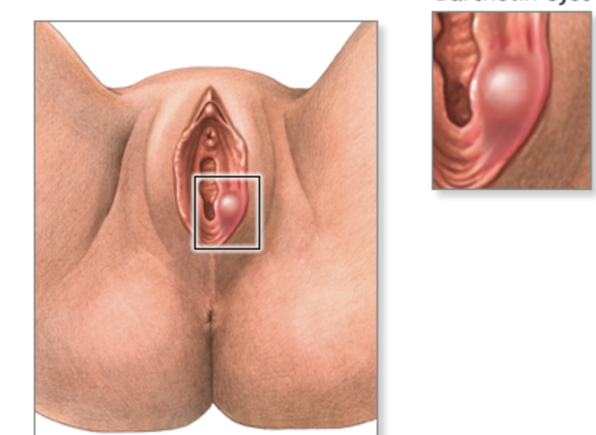
Bartholin Abscess
Due to obstruction of duct draining the gland, with subsequent infection.
Polymicrobial infection.
Acutely—needle aspiration vs I&D with Word Catheter
Add antibiotics for surrounding cellulitis or high risk patient.

Slide 47
Other Tips
Word catheter should NOT be placed for other vulvar or perianal abscesses. (Creates a fistula.)
If a cyst is present that is NOT infected, would recommend conservative management (sitz baths in warm water.)

