Slide 1
Pediatric Respiratory Emergencies
Hunter Creglow, MD
PEM Fellow, PGY-5

Slide 2
objectives
Review similarities and differences between adult and pediatric respiratory anatomy and physiology
Review different types of pediatric respiratory emergencies
Review equipment and medication needed for managing pediatric airways
Discuss the approach to managing pediatric respiratory emergencies
Practice some cases (if there’s time)

Slide 3

Respiratory Distress/Failure
Why do we harp on this so much in the world of Pediatrics?
#2 Leading Cause of Pediatric ED visits
#1 Leading Cause of Pediatric Cardiac Arrest is Respiratory Failure

Slide 4
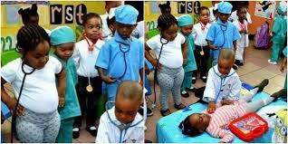
Kids are not little adults!!
The phrase you’re probably tired of hearing us pediatricians say
Is it always true?
Can there be overlap?
Can we use that overlap to our advantage?

Slide 5
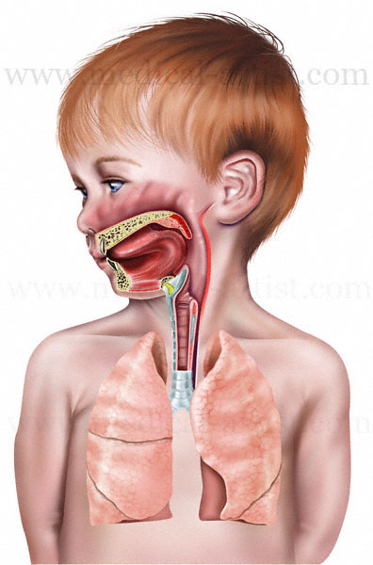
Pediatric vs adult: HeaD & Neck
Nose:
Vocal Cords:
Diameter:
Smooth Muscle:
Head-to-Body Ratio:

Slide 6
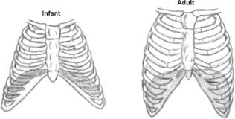
Pediatric vs adult: Chest
Horizontal ribs
Flatter Diaphragm
Ribs & Sternum are cartilage
Less pulmonary reserve
Heart takes up more thoracic space
Poor accessory muscle development
Larger abdominal organs - pushes up diaphragm

Slide 7
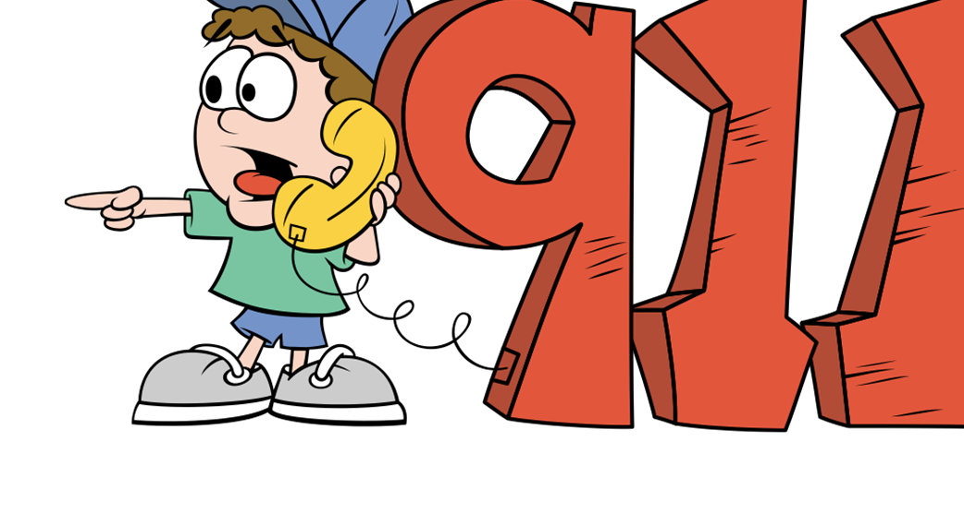
Distress leads to Failure, failure leads to arrest
Respiratory Care in Peds is important!
Some kids will just stay in distress
Some may get worse
The key is recognizing and intervening early

Slide 8
Common respiratory disorders in pediatrics

Slide 9
5 most common non-traumatic peds respiratory
Asthma
Croup
Bronchiolitis
Epiglottitis
Foreign Body

Slide 10
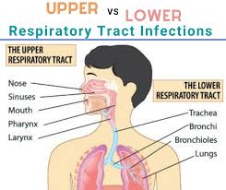
Let’s divide them up

Slide 11
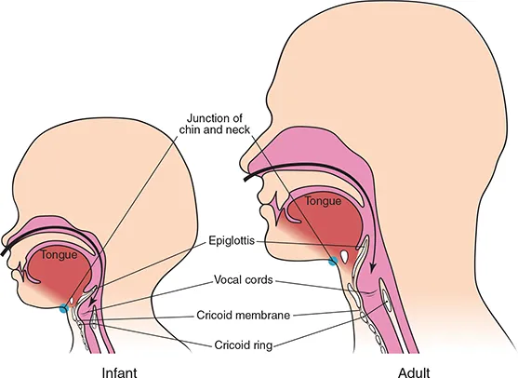
Upper Airway
Nose
Pharynx
Larynx
Noisy during inspiration

Slide 12
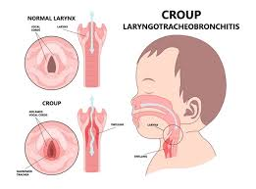
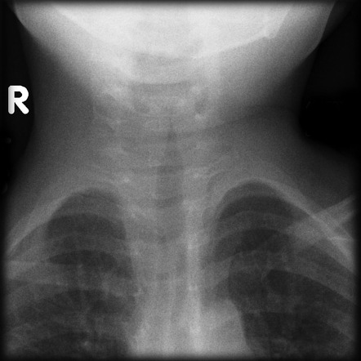
Croup
What is it?
Laryngotracheobronchitis
Viral illness
Narrowing of upper airway due to inflammation
Steroids fix inflammation
Rac epi to buy time
Heliox? HHF?
Difficult tube

Slide 13
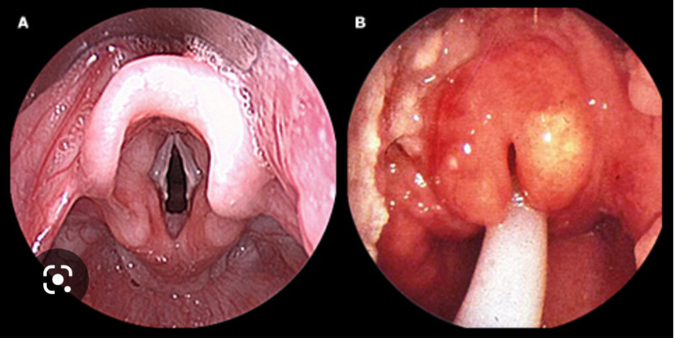
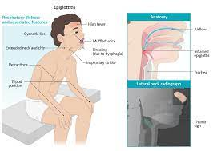
epiglotittis
What is it?
Bacterial Infection (most commonly)
Inflammation of epiglottis
Stridulous, febrile, very ill-appearing
The traditional tri-pod presentation
Vaccines no making rare
Very difficult tube

Slide 14
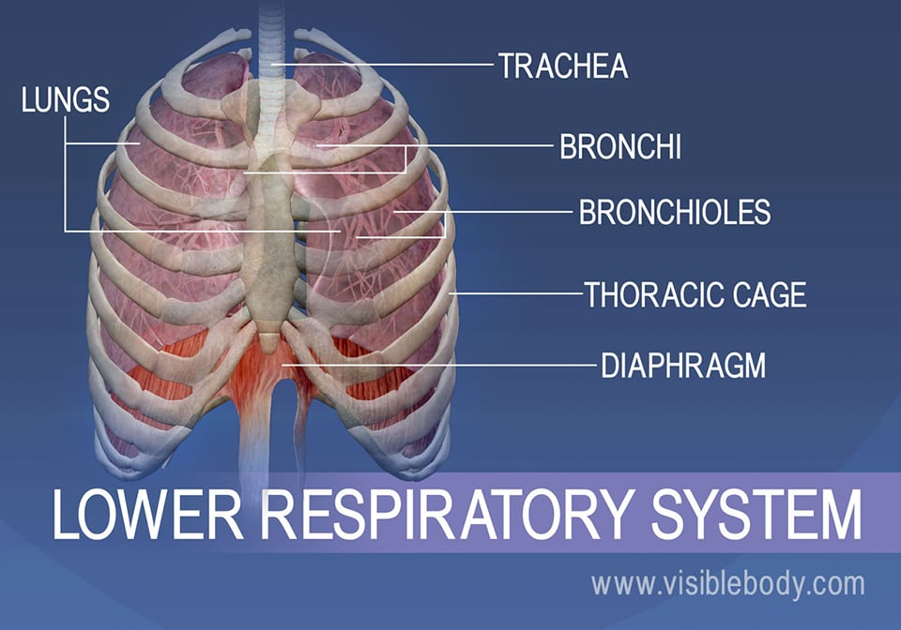
Lower airway
Noisy during expiration (typically)
Trachea
Bronchi
Peripheral Airways

Slide 15
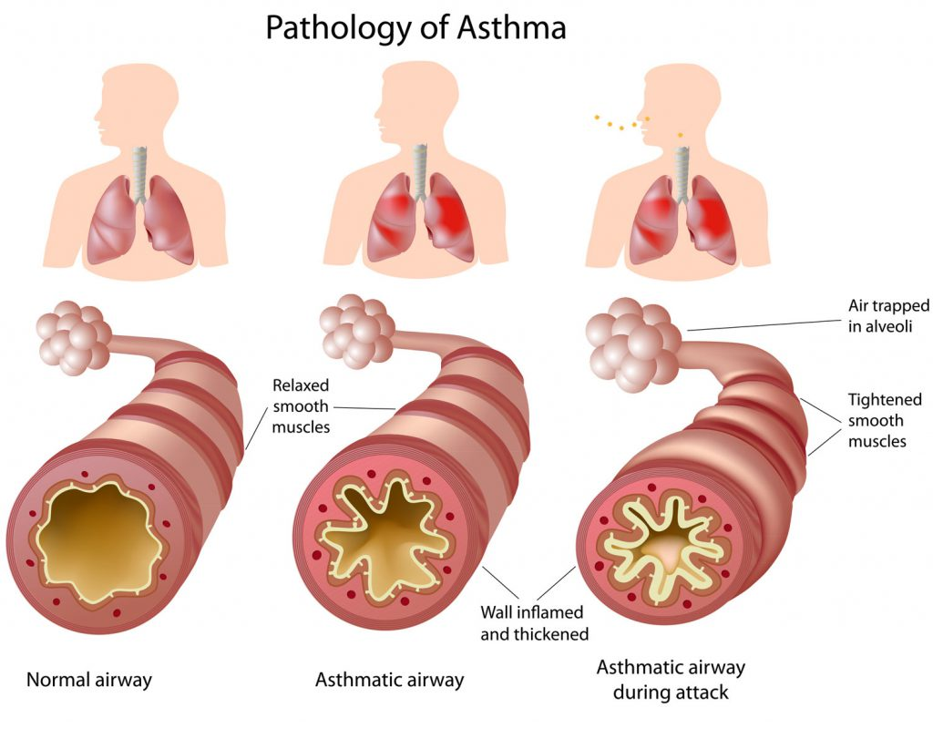
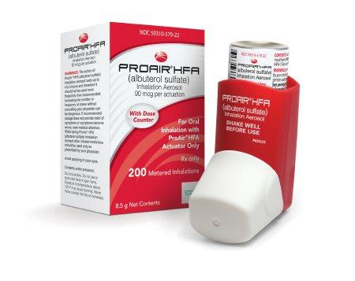
asthma
What is it?
Chronic inflammation of the small airways
Characterized by intermittent obstructive airflow
Steroids fix inflammation
Albuterol to buy time
Will review further management
INTUBATION IS LAST RESORT

Slide 16
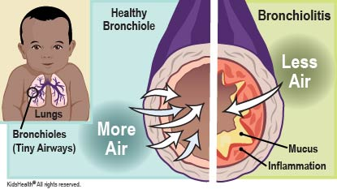
bronchiolitis
What is it?
Viral illness
Starts with 2-3 days cough and congestion
Inflammation and mucous in small airways
Suction, suction, suction
Supplemental O2 as needed
Can consider bronchodilator trial in certain scenarios

Slide 17
Foreign body (could be either)
Upper Airway
Can be partial or complete obstruction
Partial >> keep calm and get to bronchoscopy
Complete >> BLS techniques
Lower Airway
Can be as proximal as main bronchus >>ball valve effect (unilateral hyperinflation)
Can be all the way out to small airways >> recurrent pna
Standard supp. O2 and keep comfy
Needs bronchoscopy

Slide 18
Other non-traumatic respiratory emergencis
Ingestion
Shock
Anaphylaxis
Seizures

Slide 19
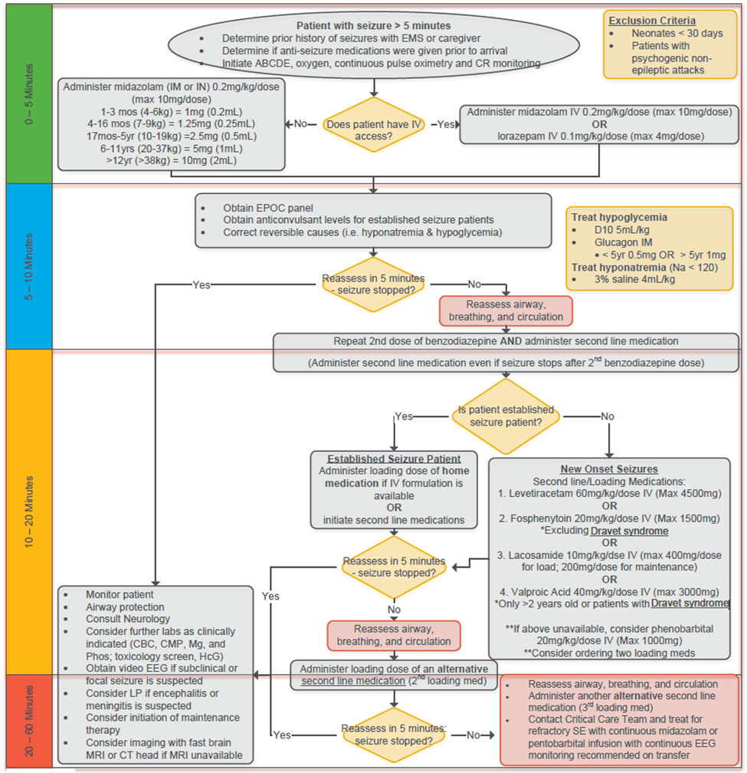
seizures
Highlight >> treat the seizures!
Control airway as needed
Can bag through it
Can use LMA
Tube if all else fails

Slide 20
Pediatric trauma
This could easily be it’s own course
All boils down to the ABCD’s we learn in ATLS
Will highlight special considerations in airway section
When in doubt, if you are truly worried and have no support, secure the airway

Slide 21
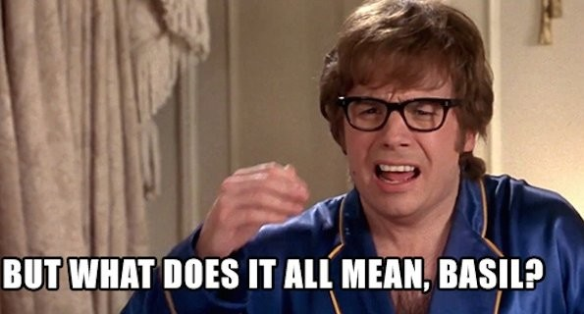

Slide 22
Enough info bombardment, let’s get to the good stuff
We need to know how to approach a kid in respiratory distress
We need to know the warning signs
We need to know what to do when things are going wrong

Slide 23
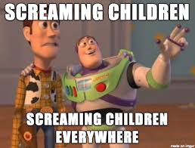
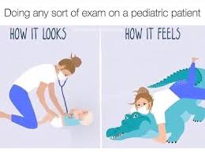
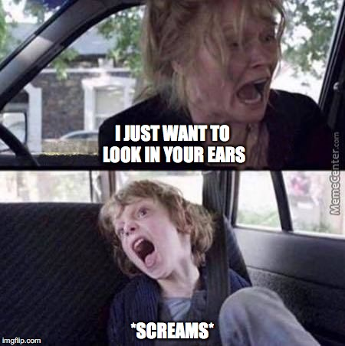

Children can be scary, how do we prepare ourselves??

Slide 24
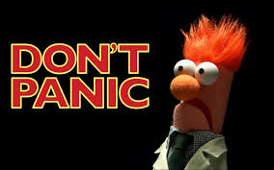
General approach
Always remember our ABCDE’s!!! (see there is overlap)
Have the right equipment
Know when to use the equipment
Utilize expertise when available

Slide 25
Evaluating a kid in respiratory distress
Immediately establish sick vs not sick
If sick, start with standard ABCD evaluation
Otherwise, move to history and physical
Upper vs Lower airway
Retractions
O2 saturations (>90% doesn’t always mean they’re fine)
Remainder of vitals just as important
Remember, make the kid comfortable, it can really change their exam
DO NOT immediately take them from their parents! Could be dangerous

Slide 26
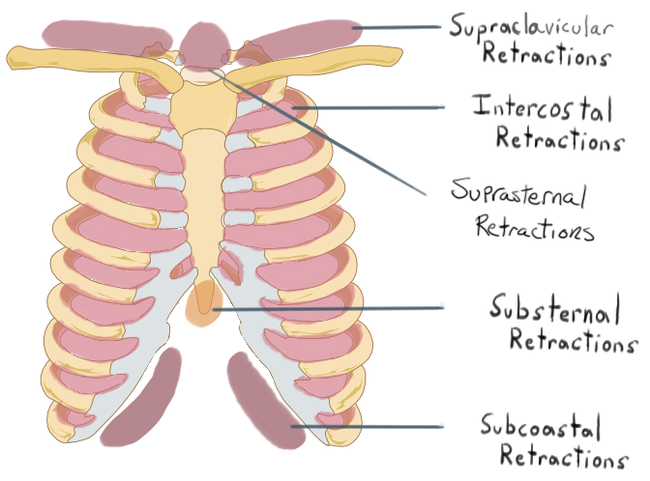
Retractions, Our Warning Signs
Natural progression
From the bottom up
Subcostal > intercostal > suprasternal > nasal flaring > grunting/head bobbing
Grunting is AutoPEEP > BAD

Slide 27
Special Considerations
Complex medical kids might have different progression of retractions
Neuromuscular kids might not have retractions
Ask parents for history
If a neuromuscular kid is working > they absolutely need support
Consider a blood gas
Also, if they are tachypneic without abnormal breath sounds, may not be respiratory

Slide 28
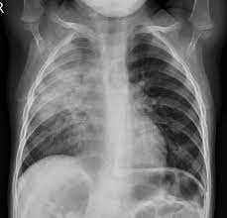
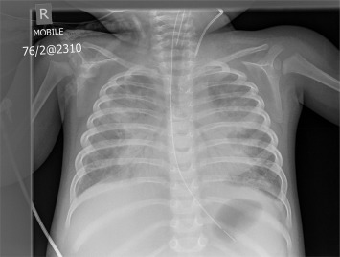
Imaging
X-Rays
Can be useful
Not always needed
Not necessary for asthma or bronchiolitis
Helpful when asthmatics or bronchiolytics aren’t acting quite like they should
Helpful screen for effusions (POCUS helpful too)

Slide 29
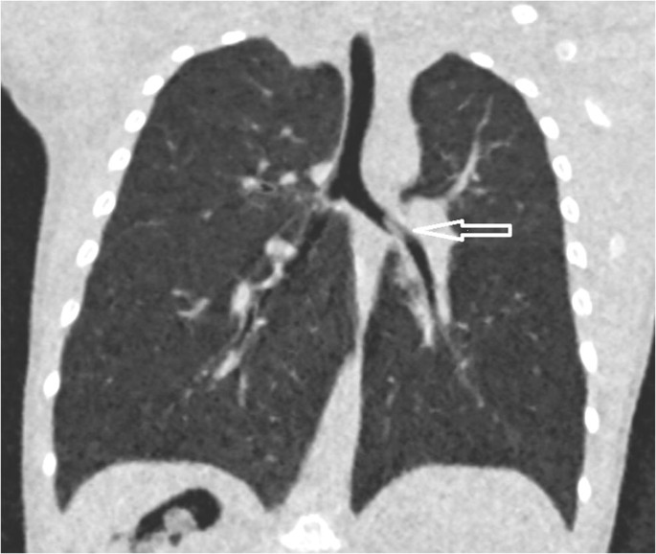
Other Imaging
CT Chest
Less commonly needed in peds
Complex kids with known pathology
Airway foreign body if no one there to bronch
Sick kids whose CXR isn’t giving a definitive answer
Have to be stable before they go

Slide 30
Blood gasses
Different Types
Capillary > Quick, good for pCO2, not great for oxygenation
Venous > Quick and easy, get with other venous labs, good for pH and pCO2 (adjust ranges)
Arterial > only for accurate measure of oxygenation
When to get them
Help decide when to escalate
Helps see if escalation was effective
Consider in kids that seem sicker than they should
Strongly consider in complex kids with new O2 requirement

Slide 31
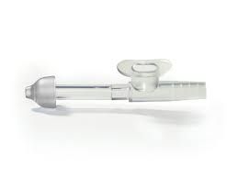
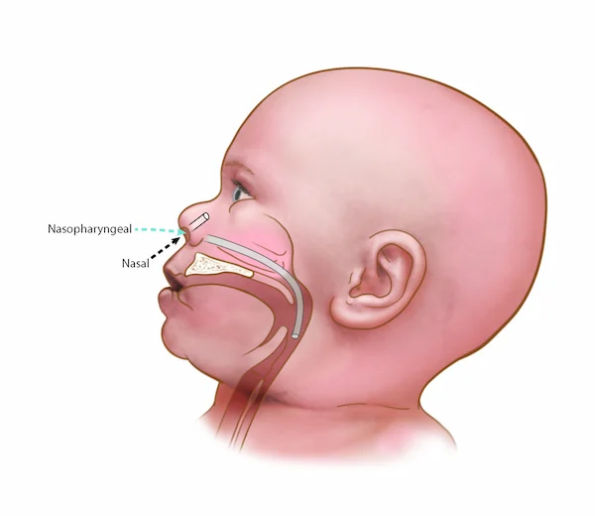
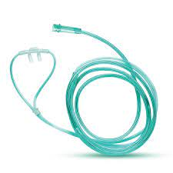
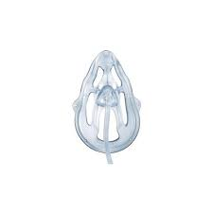
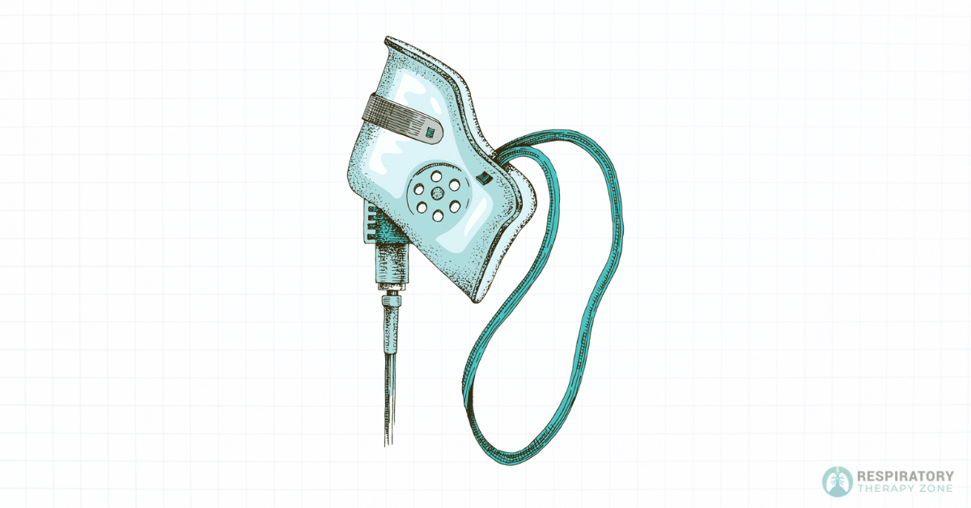
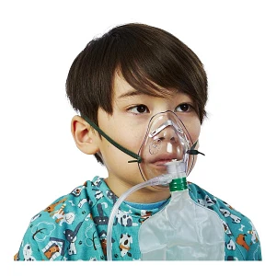
Respiratory equipment
The Basics
Suction: NA vs NP
Low Flow O2: NC vs Oxymask
Higher (but not HHF) Flow O2:
Simple Face Mask vs Non-rebreather

Slide 32
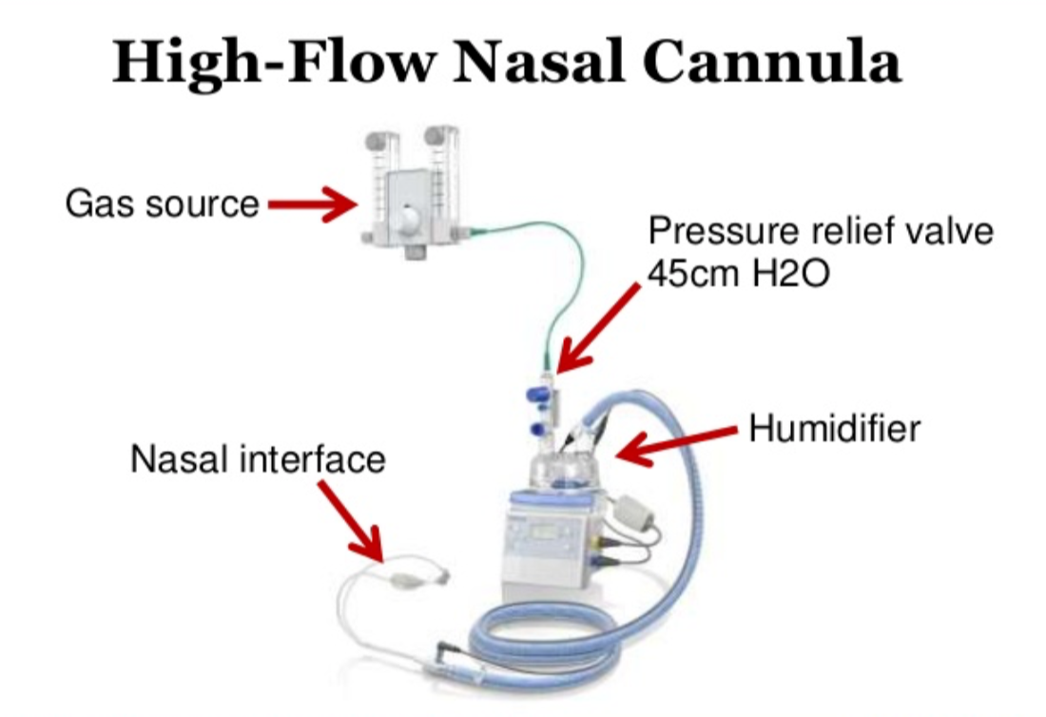
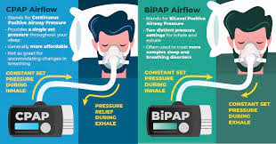
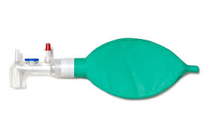
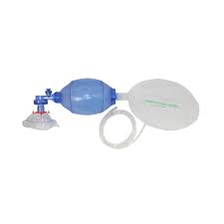
Respiratory Equipment
Advanced
High Flow O2: Various Forms of HHF
Pressure Delivery: CPAP vs BiPAP
Old Reliable (Manual PPV):
Anesthesia vs BVM

Slide 33
Escalating Therapy
Step wise approach
If patient mildly ill > start simple and move up
If worried > ok to skip steps
Always reassess after interventions
Varies based on illness

Slide 34
Escalating by illness
Bronchiolitis
Assess retractions and SpO2
Suction
Reassess > start O2 if needed
HFNC for those working hard or needing more O2 than LFNC
Reassess > if still really working consider blood gas vs BiPAP
Croup
Decadron 0.6mg/kg
Rac epi for stridor at rest
Can give as many times as needed
If rac epi not helping > HFNC
Consider Heliox if available

Slide 35
Escalating by illness (Asthma)
Standard
Assess wheezes and retractions
No wheeze is not good
Duoneb + steroids (IV/IM/PO)
Reasses > Atrovent worthless after 2 doses
Continuous Albuterol
IV mag + Bolus
Advanced
IM Epi can save you (and them)
IM terbutaline helpful (don’t give continuously if hypoxic)
If things aren’t working or acting right > use your adjunct evals
Consider CXR for unexplained hypoxia or increased WOB after wheezes gone
Blood gas before escalating
4) BiPAP for really sick kiddos (consider conscious sedation)
5) Intubation last ditch effort

Slide 36
Escalation Cases
Quick Discussions

Slide 37
What if it continues to go wrong?

Slide 38
Deciding to Intubate
There are certain scenarios where this becomes the only option.
There are also times when this is most appropriate to start
If this is the case, the best we can do is be prepared.

Slide 39
Indications for intubation
Altered mental status (GCS <8)
Hypercapnia not responding to BiPAP/hypercapnia causing AMS
Hypoxia not responding to BiPAP
Impending airway failure (burns/epiglottitis)
Complex/Very ill children who need to reduce metabolic demand

Slide 40
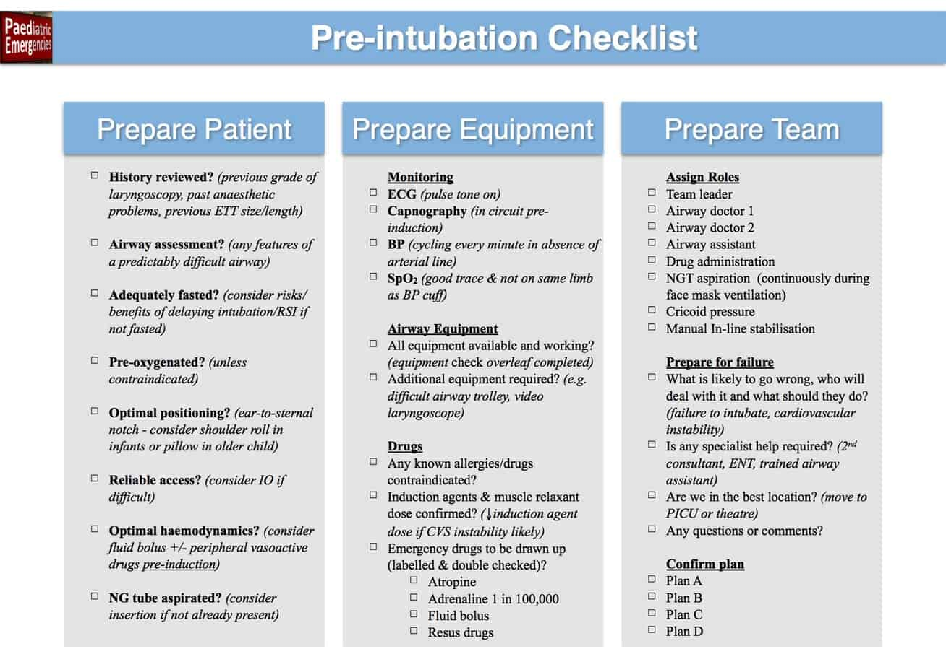
What you’ll need
Make a check list and follow it
Intubation equipment
Adjuncts/Backups
Meds
RT
Vent for after
Meds for after

Slide 41
Meds
Analgesia/Adjunct
Induction
Paralytic
Fentanyl
Morphine
Atropine
Lidocaine
Versed
Etomidate
Ketamine
Propofol
Rocuronium
Vecuronium
Succinylcholine

Slide 42
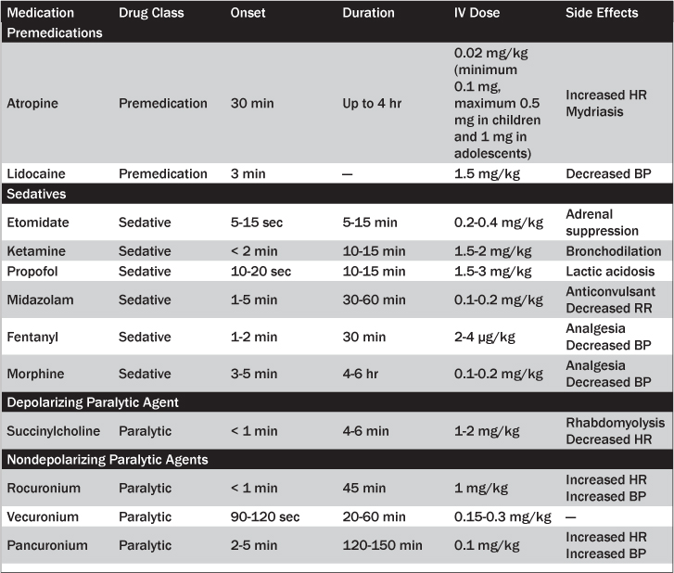

Slide 43
Meds considerations
Since peds is weight based, just find what is comfortable and stick to it
Can’t really go wrong with Ketamine + Roc (2/kg and 1/kg)
Data now shows Roc is fine with head trauma
Etomidate not advised for septic or AI patients
Succ really does kinda suck now
Lido recommended for increased ICP
Atropine pre med for little kids (varied by provider)

Slide 44
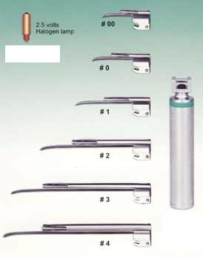
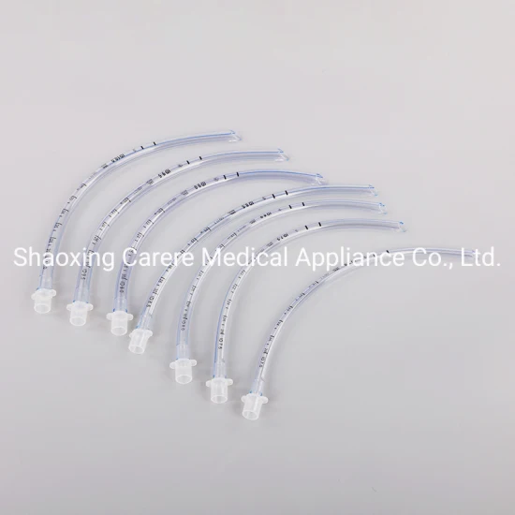
Standard Equipment
Make a checklist for every intubation
Consult the Broselow’s Tape for sizes
BVM/NC for preoxygenation
Laryngoscope
ETT
Suction
EtCO2
Adjuncts
Plans B and C!!!

Slide 45
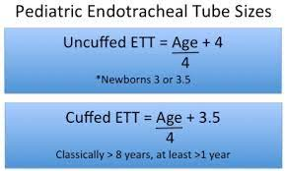
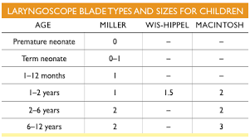
Equipment
Know the right tube and blade size
Again, when in doubt, consult our friend Broselow

Slide 46
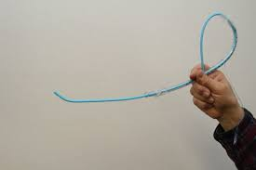
Adjuncts/Back ups
Visual Guidance when able
Bougies are our friends
There’s Nothing Wrong with an LMA
These should be out and ready
When in doubt > pull out and bag

Slide 47
Special considerations for special populations
Visual guidance strongly recommended for any known difficult airways
Cardiac kids and very small children can code during these
Have Epi and compression board at the ready
NEVER EVER PARALYZE A CHILD YOU CAN’T BAG!!!

Slide 48
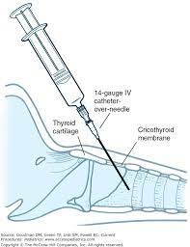
The Oh S**T moments
What do you do when ETT won’/ can’t go in.
Try BVM if able/appropriate
Try LMA if able/appropriate
Last ditch is cricothyrotomy
Surgical >/= 12 (10 if big kid)
Needle w/ Jet insufflation <12
Insufflation cannot provide ventilation!!!

Slide 49
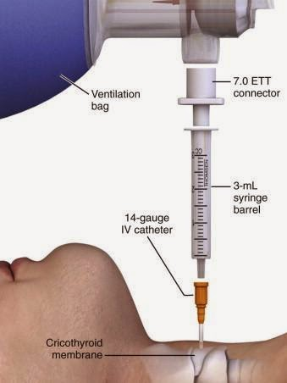
Mcgyver Insufflation
Can make your own jet insufflation if needed
Hold onto this as tight as you can
It’s high pressure
Things pop off
Call ENT immediately!

Slide 50
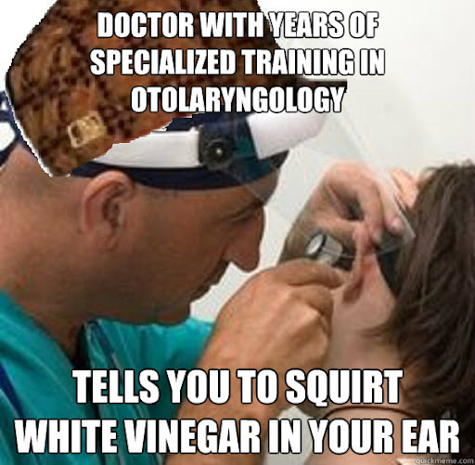
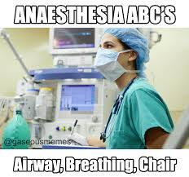
Expertise (if available)
Use your friends when you can

Slide 51
To Tube or Not to tube?
This should be asked every time
Some will be worse with intubation
Kids breathe faster than our vents
Kids more likely to code during intubation
Asthmatics struggle on vents
When in doubt, just bag and call us ….. We will absolutely never ever ever judge you when you ask us about intubation

Slide 52
Post-Intubation considerations
You will need long term sedation
Our 2 most common are Fentanyl and Precedex gtts
Know standard ventilator starting points
SIMV-PRVC is always a good starting mode
TV 6-8mL/kg standard, 4-6mL/kg for ARDS
Starting PEEP 5-6, go up as needed to maintain O2
If FiO2 > 50%, consider increasing PEEP

Slide 53
Let’s Summarize
Kids can seem scary
The biggest thing we can do is be prepared and be calm
They may not be little adults, but the process can be similar
Understand progression of retractions
Recognize the warning signs
Step wise progression for therapy
Weigh risks and benefits of intubation
Have an intubation checklist with plans B and C
Ketamine and Roc are always great for intubation
Never feel bad phoning a pediatric trained friend

Slide 54
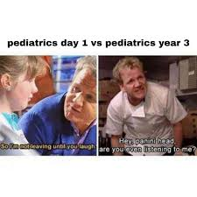
Thank you
Thanks for listening
hcreglow@childrensnebraska.org
Please reach out with any questions or suggestions

