Slide 1
Critical Care in the ED
Thomas Perry, DO, MS
Assistant Professor
Department of Emergency Medicine
University of Nebraska Medical Center

Slide 2
Disclosures
None

Slide 3
Objectives
Differentiate between types of vasopressors and optimize utilization
Develop standardized approach to the undifferentiated shock patient
Manage shock depending on the underlying etiology
Develop strategies in caring for post-ROSC patients
  Ventilator management
  Medication management

Slide 4
Outline
Shock
  Types
Receptors
  Types
  Action
Vasopressors
Inotropes
Other Agents
Approach to Shock
Mechanical Ventilation
  NIPPV
  Modes
  Settings
  Modifications
Peri-Intubation Optimization
OHCA
Post-ROSC
Mechanical Circulatory Support
Delayed Transport
Summary
Resources

Slide 5
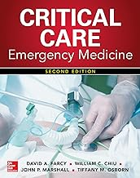

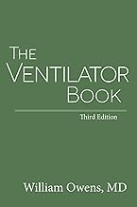
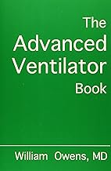

Resources

Slide 6
Shock

Slide 7
Shock^{A}
"State of cellular and tissue hypoxia due to either reduced oxygen delivery, increased oxygen consumption, inadequate oxygen utilization, or a combination of these processes." -Uptodate.com
Can occur with hypotension, normotension, or hypertension
Cellular oxygen demand > oxygen delivery

Slide 8
Shock^{A}
Stages
  Pre-shock
    Compensated or cryptic shock
    Signs
      Abnormal Vital Signs
        Tachycardia
        Tachypnea
      Elevated lactic acid
  Shock
    Compensatory mechanisms overwhelmed
      Signs
        Tachycardia, dyspnea, restlessness, diaphoresis, metabolic acidosis, hypotension, oliguria, cool and clammy skin
  End-organ dysfunction
    Irreversible organ damage
    Multiorgan failure
    Death
    Signs
      Anuria, acidemia, depressed CO, refractory hypotension, lactic acidosis, altered mental status

Slide 9
Shock⁴
Terms
Central Venous Pressure (CVP)^{D}
  CVP = Amount of blood returning to the heart, approximates RA pressure
  Normal: 3-8 mmHg
Pulmonary Capillary Wedge Pressure (PCWP)^{E}
  PCWP = balloon wedged in pulmonary artery, approximates LA pressure
  Normal: 2-15 mmHg
Cardiac Output (CO)^{B}
  Volume of blood being pumped from the LV
  CO = HR x Stroke Volume
  Normal: 4-8 L/min
Cardiac Index (CI)
  CI = CO / BSA
  Normal: 2.5-4 L/min/m²
Systemic Vascular Resistance (SVR)^{C}
  Resistance of the systemic circulation
  SVR = 80 x (MAP-CVP)/CO
  Normal: 800-1600 dyn/cm/sec⁻⁵
POCUS*
POCUS
POCUS*
POCUS*

Slide 10
Shock^{A}
Hypovolemic Shock
  Reduced intravascular volume
  "Empty tank"
Distributive Shock
  Severe peripheral vasodilation
  "Leaky pipes"
Cardiogenic Shock
  Intracardiac failure
  "Pump failure"
Obstructive Shock
  Extracardiac pump failure
  "Clogged pipes/Pump failure"
Mixed

Slide 11
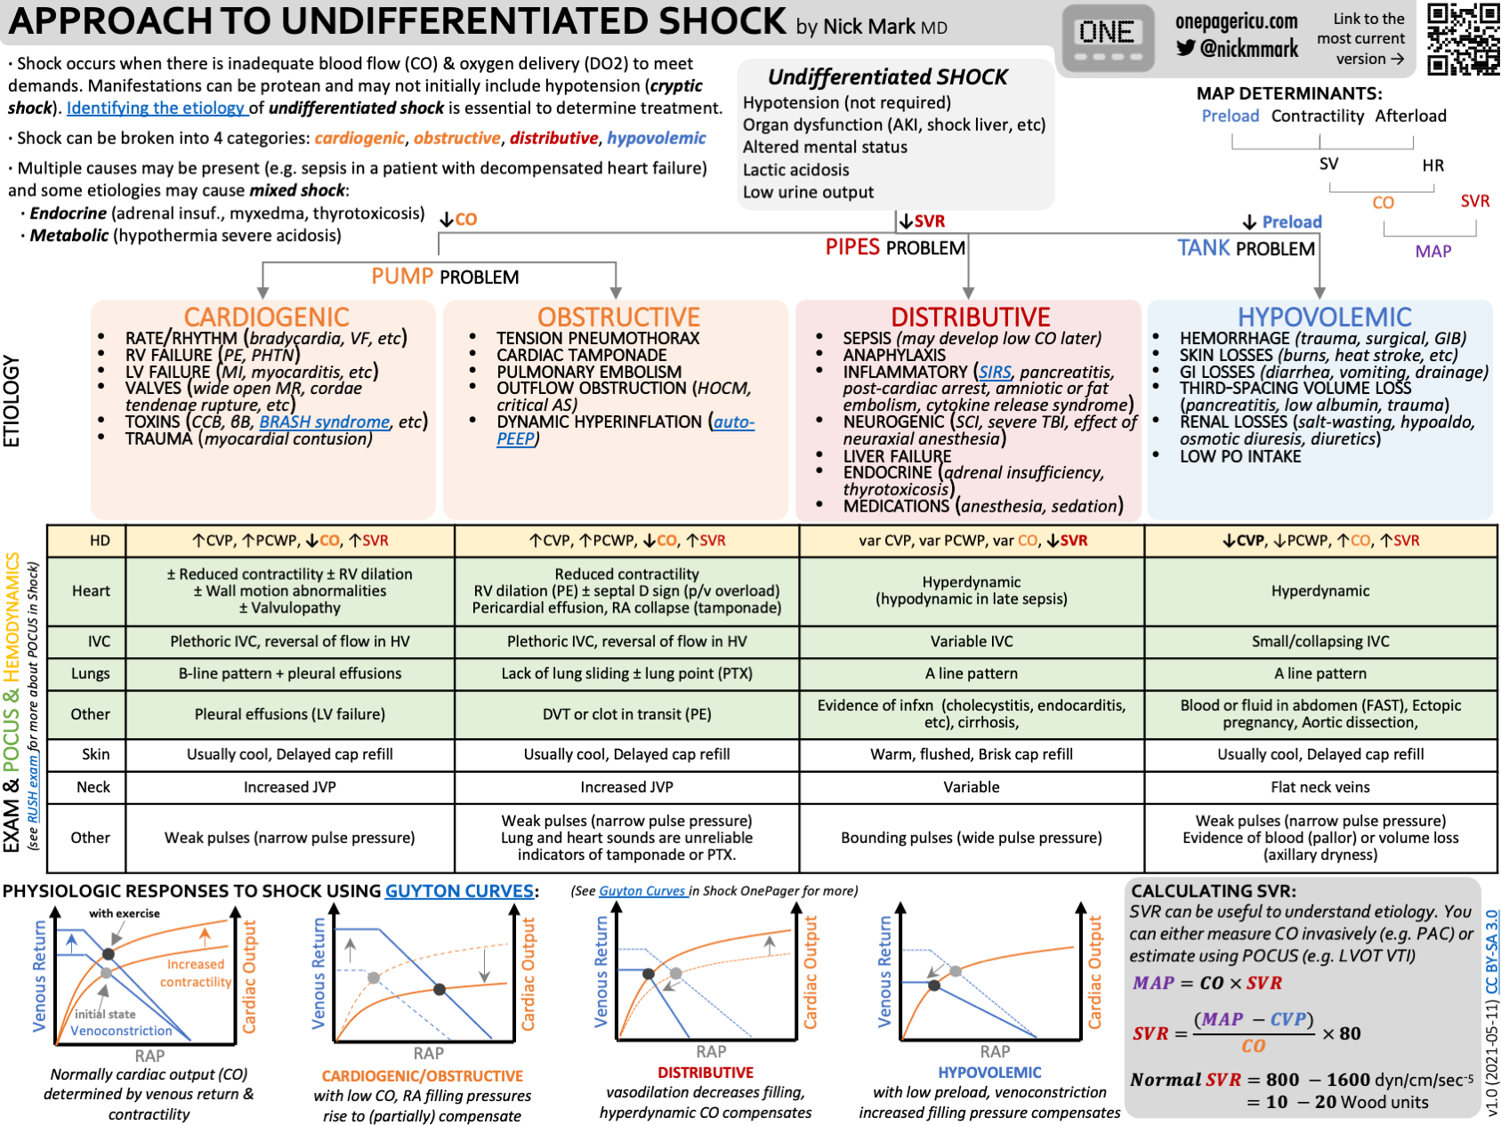

Slide 12
Hypovolemic Shock^{I}
Hemodynamics
  CVP
  PCWP
  CO
  SVR
POCUS
  Cardiac Function
  IVC Size
  Free Fluid
Exam:
  Usually cool skin, delayed capillary refill
  Flat neck veins
  Weak pulses (narrow pulse pressure)
  Pallor
"Volume" Issue

Slide 13
Hypovolemic Shock^{I}
Causes:
  Hemorrhage
  Skin Losses - Burn, exposure
  GI Losses
  Third-spacing
  Renal Losses
  Poor PO intake

Slide 14
Distributive Shock^{I}
Hemodynamics
  CVP
  PCWP
  CO
  SVR
POCUS
  Cardiac Function
  IVC Variablity
Exam:
  Warm, flushed skin
  Brisk capillary refill
  Variable neck veins
  Bounding pulses (wide pulse pressure)
"Tone" Issue

Slide 15
Distributive Shock^{I}
Causes:
  SIRS
    Pancreatitis, burns, trauma, air embolism, amniotic fluid embolism, fat embolism
  Sepsis
  Anaphylaxis
  Neurogenic
  Inflammatory
  Liver Failure
  Endocrine
  Medications/Vasoplegia

Slide 16
Cardiogenic Shock^{I}
Hemodynamics
  CVP
  PCWP
  CO
  SVR
POCUS
  Cardiac Function, Valves, RV/LV Size, WMA
  IVC Size = plethoric
  B-lines, pleural effusions
Exam:
  Usually cool skin
  Delayed capillary refill
  Increased JVP
  Weak pulses (narrow pulse pressure)
"Pump" Issue

Slide 17
Cardiogenic Shock^{I}
Causes:
  Arrythmias: Bradycardia, Tachycardia
  Pulmonary Embolism (right-sided failure)*
  Pulmonary Hypertension
  ACS/AMI (left-sided failure)
  Myocarditis (left-sided failure)
  Valvulopathy
  Toxins/Overdose
  Trauma
  Sepsis
  Lung Disease (right-sided failure)

Slide 18
Obstructive Shock^{I}
Hemodynamics
  CVP
  PCWP
  CO
  SVR
POCUS
  Cardiac Function
  Lung Sliding
  IVC Size
  Thrombus/Embolus
Exam:
  Usually cool skin
  Poor capillary refill
  Increased JVP
  Weak pulses (narrow pulse pressure)
  Diminished lung or heart sounds on auscultation
    Unreliable to rule out presence/absence
"Pump/Pipe" Issue

Slide 19
Obstructive Shock^{I}
Causes:
  Cardiac Tamponade
  Tension Pneumothorax
  Pulmonary Embolism*
  LV Outflow Obstruction
  Dynamic Hyperinflation (Auto-PEEP)

Slide 20
Mixed^{I,A}
More than one type may be present:
  Septic – distributive + hypovolemic + cardiogenic (myocardial depression)
  Spinal Cord Injury – distributive + cardiogenic (myocardial depression)
  LV Rupture – cardiogenic + obstructive (tamponade)
  Trauma – hypovolemic + distributive (fat embolism)
Other contributing factors:
  Endocrine
    Adrenal Insufficiency
    Myxedema
    Thyrotoxicosis
  Metabolic
    Hypothermia
    Severe Acidosis

Slide 21
Receptors

Slide 22
Alpha (α) receptors⁷
Where: vascular walls
Action: Vasoconstriction
  α₁ - stimulation of venous smooth muscle vasoconstriction
  α₂ – vasodilation of arteries and vasoconstriction of veins
    Negligible, not considered clinically significant

Slide 23
Beta (β) receptors⁷
Where: β₁ – heart, β₂ – blood vessels
Action:
  β₁:
    increase cardiac contractility (inotropic)
    increased heart rate (chronotropic)
    increased atrial conduction (dromotropic)
  β₂ – relaxation of smooth muscle of coronary and skeletal muscle arteries resulting in vasodilation. Bronchiolar dilation.

Slide 24
V receptors⁵
Where:
  V₁ – Vascular smooth muscle, V₂ – Kidney collecting ducts, V₃ – CNS
  *No V receptors in pulmonary vasculature
    no effect of PVR
Action: Vasoconstriction
  V₁ - Vasoconstriction
  V₂ – Water retention

Slide 25
Dopamine (DA) Receptors⁷
Where: renal, splanchnic, coronary, and cerebral vascular beds
Action:
  Increased contractility
  Increased HR
  Diuresis and natriuresis

Slide 26
Vasopressors

Slide 27
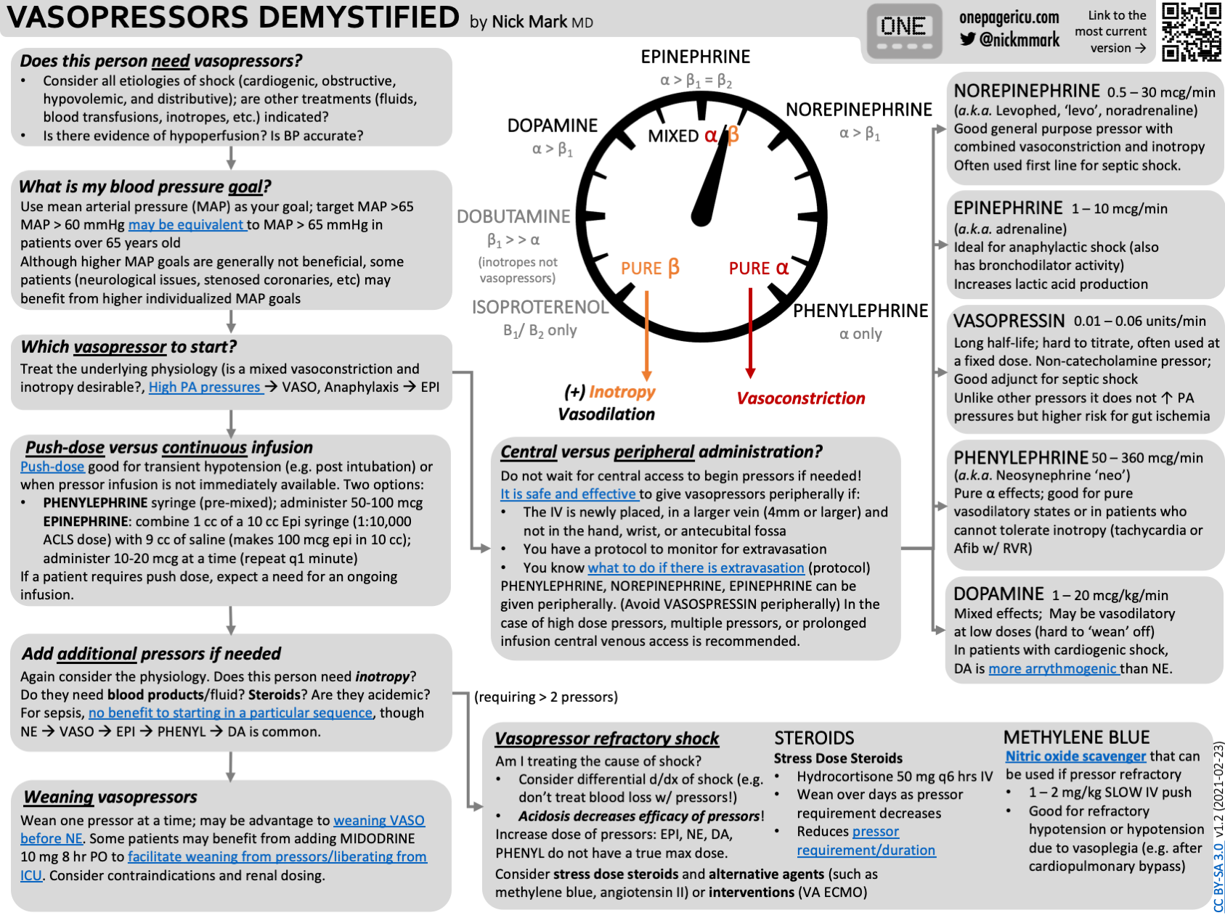

Slide 28
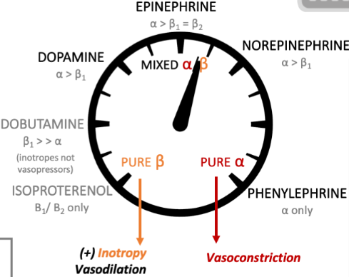
Vasopressors^{J}
Phenylephrine
  α₁
Dosing: 50-300 mcg/min
Effect:
  HR: Variable
  MAP: Increased
  SVR: Increased
  CO: n/a

Slide 29
Vasopressors^{J}
Norepinephrine
  Strong α, moderate β₁>β₂
Dosing: 1-30 mcg/min
Effect:
  HR: Variable
  MAP: Increased
  SVR: Increased
  CO: Increased

Slide 30
Vasopressors^{J}
Epinephrine
  α>β₁=β₂, β₃
  Predominantly β effects at lower doses
Dosing: 1-10 mcg/min
Effect:
  HR: Increased
  MAP: Variable
  SVR: Increased
  CO: Increased

Slide 31
Vasopressors^{J}
Dopamine
  DA, α₁>β₁, β₂
Dosing: 1-20 mcg/kg/min
Effect:
  HR: Increased
  MAP: Increased
  SVR: Increased
  CO: Increased

Slide 32
Vasopressors^{J}
Vasopressin
  V₁ and V₂
Dosing: 0.03 units/min (0.04 units/min)
Effect:
  HR: n/a
  MAP: Increased
  SVR: Increased
  CO: Increased

Slide 33
Vasopressors^{J}
Push-dose Pressors
  Phenylephrine
    Pre-mixed syringe
    Dosing: 100-200 mcg (1-2 mL)
  Epinephrine
    1 mL (0.1 mg) Epinephrine + 9 mL flush = 10 mcg/mL
    Dosing: 10-20 mcg (1-2 mL)

Slide 34
Peripheral Vasopressors^{1,2,3}
Can be safe
  Duration: 24hrs
    MAX: 48-72 hrs
  Single pressor per PIV
  MAX dosage
  Vasopressors studied: norepinephrine, dopamine, phenylephrine, epinephrine
Policy and procedures
  IV site
    Frequency of IV site checks
    Large Peripheral IV 20-18g
    Avoid wrist and AC fossa
    Ultrasound-guided, deeper/bigger vein
  Extravasation

Slide 35
Inotropes

Slide 36
Inotropes^{7,8}
Increase cardiac contractility
  Alters force or energy of muscular contraction
  Increases intracellular calcium concentration or sensitivity
Notes:
Intracellular calcium: make sure to replete if low, may see increase in BP with calcium pushes

Slide 37
Inotropes^{J,7,8}
Dobutamine
  β₁ > β₂
Dosing: 2-20 mcg/kg/min (2.5-5 mcg/kg/min)
Effect:
  HR: Increased
  MAP: Variable
  SVR: Decreased
  CO: Increased
Hypotension

Slide 38
Inotropes^{J,7,8}
Milrinone
  PDE3 inhibitor --> increases cAMP --> β₁ & β₂
Dosing
  Bolus: 50 mcg/kg
  Maintenance: 0.25 - 1 mcg/kg/min
Effect:
  HR: n/a
  MAP: Variable
  SVR: Decreased
  CO: Increased
Hypotension

Slide 39
Inotropes^{J,7,8}
Isoproterenol
  β₁ & β₂
Dosing: 2-10 mcg/min
Effect:
  HR: Increased
  MAP: Decreased
  SVR: Decreased
  CO: Variable

Slide 40
Other Agents

Slide 41
Other Agents^{M}
Methylene Blue
  MOA: Inhibits nitric oxide synthase and guanylyl cyclase activation
    Inhibits vascular smooth muscle relaxation
  Dosing: 1-2 mg/kg over 10-20 minutes
    Infusion: 0.5-1 mg/kg/hr
  Adverse: Serotonin Syndrome, hemolysis, methemoglobinemia (high concentrations), anaphylaxis, tachycardia, poor SpO₂ reading, headache, myalgia, myoclonus

Slide 42
Other Agents^{M}
Hydroxocobalamin (CyanoKit)
  MOA: Direct binding of nitric oxide, inhibitory of nitric oxide synthase and guanylyl cyclase
    Inhibits vascular smooth muscle relaxation
  Dosing: 5g IV over 5-10 minutes
    Long Infusion: 2.5g over 5-10min, then 2.5g over 6 hr
  Adverse: diarrhea, anaphylaxis, headache, nephrolithiasis, pruritus, angioedema, AKI

Slide 43
Other Agents^{M}
Angiotensin II (Giapreza)
  MOA: Octapeptide causes venous and arterial smooth muscle vasoconstriction; acts on CNS to increase vasopressin production
  Dosing: 10-20 ng/kg/min, increase 10ng/kg/min every 5min up to max of 80 ng/kg/min for first 3 hours
    Maintenance dose should not exceed 40 ng/kg/min
  Adverse: VTE, thrombocytopenia, arrhythmia, mesenteric ischemia, headache
Notes:
Active hormone that acts on the ATII receptors

Slide 44
Break (~15min)

Slide 45
Critical Care in the ED
Part II
Thomas Perry, DO, MS
Assistant Professor
Department of Emergency Medicine
University of Nebraska Medical Center

Slide 46
Approach to Shock

Slide 47
Shock^{A}
"State of cellular and tissue hypoxia due to either reduced oxygen delivery, increased oxygen consumption, inadequate oxygen utilization, or a combination of these processes." -Uptodate.com
Can occur with hypotension, normotension, or hypertension
Cellular oxygen demand > oxygen delivery

Slide 48
Shock^{A}
Hypovolemic Shock
  Reduced intravascular volume
  "Empty tank"
Distributive Shock
  Severe peripheral vasodilation
  "Leaky pipes"
Cardiogenic Shock
  Intracardiac failure
  "Pump failure"
Obstructive Shock
  Extracardiac pump failure
  "Clogged pipes/Pump failure"
Mixed

Slide 49
Undifferentiated Shock
Shock is present
  Uncertain of etiology
Oxygen demand > oxygen delivery
  Hypoperfusion
+/- Hypotension

Slide 51
Pulmonary Artery Catheter
AKA Swan-Ganz

Slide 52
Pulmonary Artery Catheter
Insertion
Preparation and Setup
  Obtain Consent
  Position patient in supine position
  Site Selection
    Right IJ is usually preferred vessel
    Scan with ultrasound to look at patency and anatomy
  Sterility
    Full drape, gown, hat, mask, gloves

Slide 53
Pulmonary Artery Catheter
2. Venous Access and Sheath Placement
  Access
    Usually obtained using Seldinger technique
      Needle inserted using ultrasound guidance into the RIJ
      Guidewire threaded through needle
      Dilator inserted to facilitate placement of introducer sheath
      Venous confirmation of placement
        Transduce
        Manometry
        Ultrasound vessel showing guidewire
          Short and long axis
Bedside Ultrasound
+ Physical Exam

Slide 54
Shock⁴
Terms
Central Venous Pressure (CVP)^{D}
  CVP = Amount of blood returning to the heart, approximates RA pressure
  Normal: 3-8 mmHg
Pulmonary Capillary Wedge Pressure (PCWP)^{E}
  PCWP = balloon wedged in pulmonary artery, approximates LA pressure
  Normal: 2-15 mmHg
Cardiac Output (CO)^{B}
  Volume of blood being pumped from the LV
  CO = HR x Stroke Volume
  Normal: 4-8 L/min
Cardiac Index (CI)
  CI = CO / BSA
  Normal: 2.5-4 L/min/m²
Systemic Vascular Resistance (SVR)^{C}
  Resistance of the systemic circulation
  SVR = 80 x (MAP-CVP)/CO
  Normal: 800-1600 dyn/cm/sec⁻⁵
POCUS*
POCUS
POCUS*
POCUS*

Slide 55
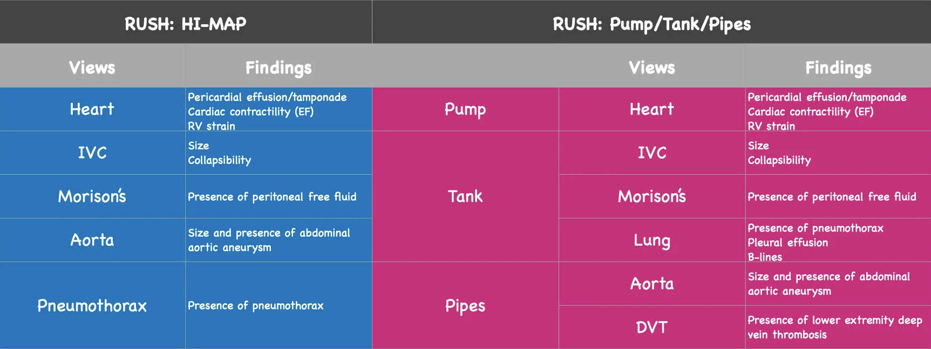
Ultrasound Guidance
*Rapid Ultrasound for Shock and Hypotension (RUSH)
https://www.acep.org/sonoguide/advanced/rush

Slide 56

https://www.thepocusatlas.com/

Slide 57
Ultrasound Normals

Slide 58
Cardiac
(Heart)

Slide 59
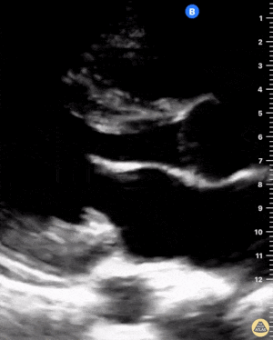
HI-MAP
https://www.thepocusatlas.com/echocardiography-2

Slide 60
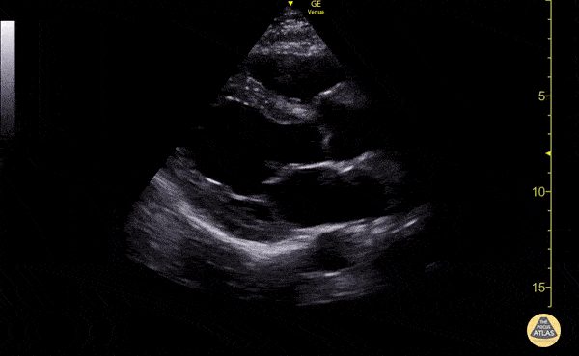
HI-MAP
https://www.thepocusatlas.com/echocardiography-2

Slide 61
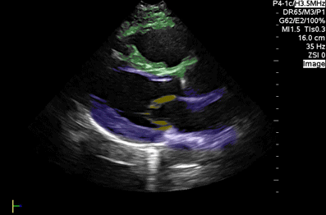
HI-MAP
https://www.thepocusatlas.com/echocardiography-2

Slide 62
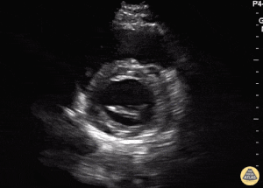
HI-MAP
https://www.thepocusatlas.com/echocardiography-2

Slide 63
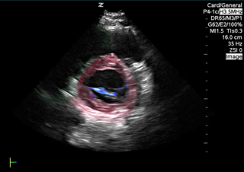
HI-MAP
https://www.thepocusatlas.com/echocardiography-2

Slide 64
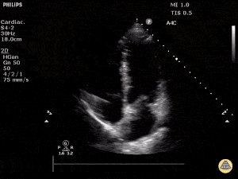
HI-MAP
https://www.thepocusatlas.com/echocardiography-2

Slide 65
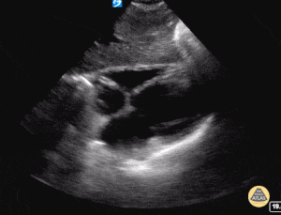
HI-MAP
https://www.thepocusatlas.com/echocardiography-2

Slide 66
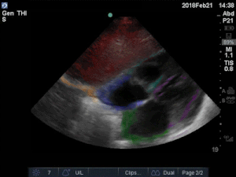
HI-MAP
https://www.thepocusatlas.com/echocardiography-2

Slide 67
Inferior Vena Cava

Slide 68
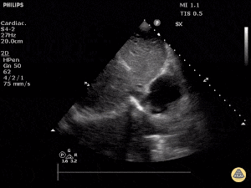
HI-MAP
https://www.thepocusatlas.com/vascular

Slide 69
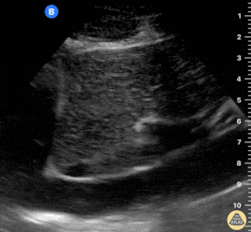
HI-MAP
https://www.thepocusatlas.com/vascular

Slide 70
Abdomen
(Morison's Pouch)

Slide 71
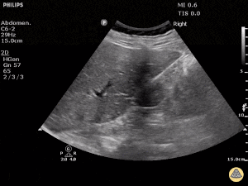
HIMAP
https://www.thepocusatlas.com/trauma-atlas

Slide 72
Abdominal Aorta
(Aneurysm)

Slide 73
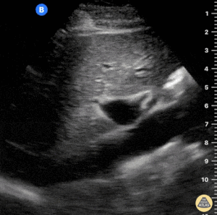
HIMAP
https://www.thepocusatlas.com/vascular

Slide 74
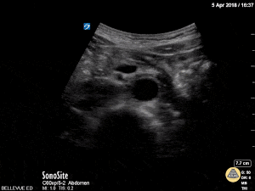
HI-MAP
https://www.thepocusatlas.com/vascular

Slide 75
Pulmonary
(Pneumothorax)

Slide 76
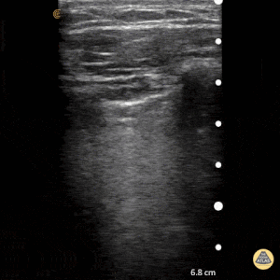
HI-MAP
https://www.thepocusatlas.com/pulmonary

Slide 77
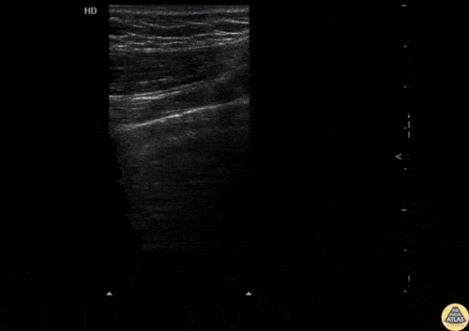
HIMAP
https://www.thepocusatlas.com/pulmonary

Slide 78
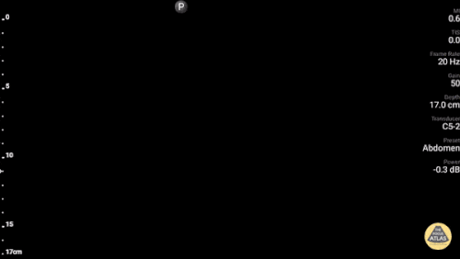
HI-MAP
https://www.thepocusatlas.com/pulmonary

Slide 79
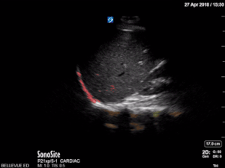
HI-MAP
https://www.thepocusatlas.com/pulmonary

Slide 80
Ultrasound Guidance
*Rapid Ultrasound for Shock and Hypotension (RUSH)
https://www.acep.org/sonoguide/advanced/rush

Slide 81
Shock^{A}
Hypovolemic Shock
  Reduced intravascular volume
  "Empty tank"
Distributive Shock
  Severe peripheral vasodilation
  "Leaky pipes"
Cardiogenic Shock
  Intracardiac failure
  "Pump failure"
Obstructive Shock
  Extracardiac pump failure
  "Clogged pipes/Pump failure"
Mixed

Slide 82
Treatment⁷
Hypovolemic Shock
  Fill the tank
  Initial:
    2L Crystalloid
  First-line:
    Blood products/fluids as indicated
  Second-line:
    Norepinephrine, Epinephrine

Slide 83
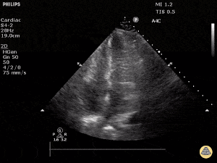
HI-MAP
Normal
Hyperdynamic
https://www.thepocusatlas.com/echocardiography-2

Slide 84
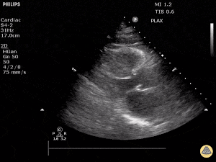
HI-MAP
Normal
Hyperdynamic
https://www.thepocusatlas.com/echocardiography-2

Slide 85
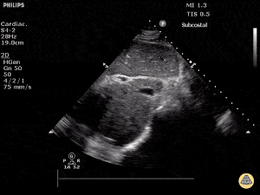
HI-MAP
Normal
Hypovolemic
https://www.thepocusatlas.com/vascular

Slide 86
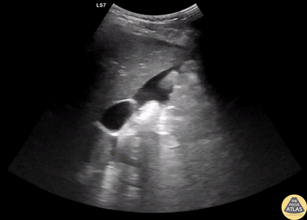
HI-MAP
Normal
Positive FAST
https://www.thepocusatlas.com/trauma-atlas

Slide 87
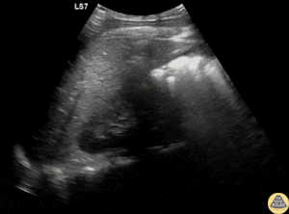
HI-MAP
Normal
Positive FAST
https://www.thepocusatlas.com/trauma-atlas

Slide 88
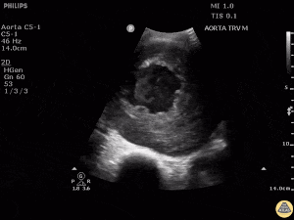
HI-MAP
Normal
Abdominal Aortic Aneurysm
https://www.thepocusatlas.com/vascular

Slide 89
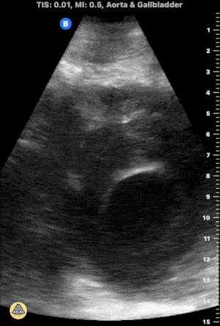
HI-MAP
Normal
Abdominal Aortic Aneurysm
https://www.thepocusatlas.com/vascular

Slide 90
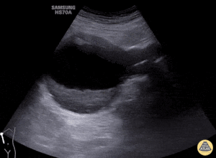
HI-MAP
Normal
Abdominal Aortic Aneurysm
https://www.thepocusatlas.com/vascular

Slide 91
Treatment⁷
Septic Shock
  Fix the pipes
  Initial Treatment
    2L Crystalloid
  First-line:
    Norepinephrine
  Second-line:
    Epinephrine
    Vasopressin
    Phenylephrine
    Dopamine

Slide 92
HI-MAP
Normal
Hyperdynamic
https://www.thepocusatlas.com/echocardiography-2

Slide 93
HI-MAP
Normal
Hyperdynamic
https://www.thepocusatlas.com/echocardiography-2

Slide 94
HI-MAP
Normal
Hypovolemic
https://www.thepocusatlas.com/vascular

Slide 95
Treatment⁷
Anaphylactic Shock
  Fix the pipes
  Initial:
    2L Crystalloid
  First-line:
    Epinephrine

Slide 96
Treatment⁷
Neurogenic
  Fix the pipes
  Initial:
    2L Crystalloid
  First-line:
    Norepinephrine
    Vasopressin
  Second-line:
    Phenylephrine
      Monitor for bradycardia

Slide 97
Treatment⁷
Cardiogenic Shock
  Right-sided
  Improve the Pump
  Initial:
    20 ml/kg Crystalloid
  First-line:
    Dopamine (if hypotensive)
    Dobutamine (if normotensive)
  Second-line:
    Epinephrine
    Milrinone (severe CHF or RV infarct)

Slide 98
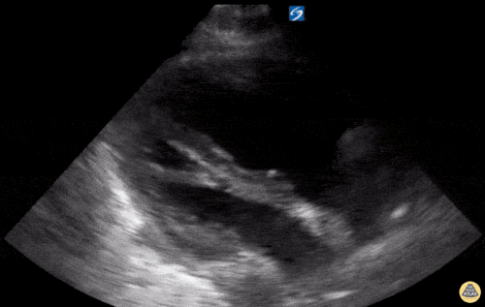
HI-MAP
Normal
Dilated RV
https://www.thepocusatlas.com/echocardiography-2

Slide 99
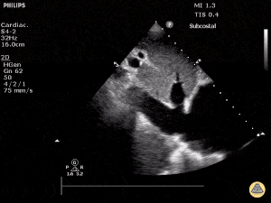
HI-MAP
Normal
Plethoric IVC
https://www.thepocusatlas.com/echocardiography-2

Slide 100
Treatment⁷
Cardiogenic Shock
  Left-sided
  Improve the Pump
  Initial:
    Cautious IV fluids
  First-line:
    Dobutamine (if normotensive)
    Norepinephrine (if hypotensive)
  Second-line:
    Dobutamine + Norepinephrine
    Epinephrine
    Milrinone (severe CHF or RV infarct)

Slide 101
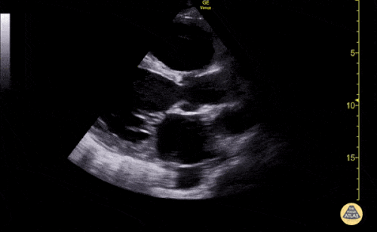
HI-MAP
Normal
Reduced LVEF
https://www.thepocusatlas.com/echocardiography-2

Slide 102
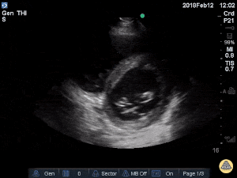
HI-MAP
Normal
Reduced LVEF
https://www.thepocusatlas.com/echocardiography-2

Slide 103
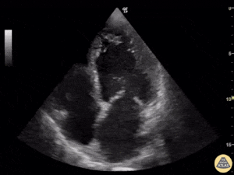
HI-MAP
Normal
Reduced LVEF
https://www.thepocusatlas.com/echocardiography-2

Slide 104
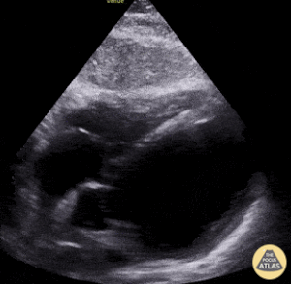
HI-MAP
Normal
Reduced LVEF
https://www.thepocusatlas.com/echocardiography-2

Slide 105
HI-MAP
Normal
Plethoric IVC
https://www.thepocusatlas.com/echocardiography-2

Slide 106
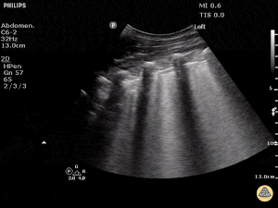
HI-MAP
Normal
Pulmonary Edema
“B-Lines”
https://www.thepocusatlas.com/pulmonary

Slide 107
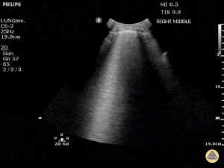
HI-MAP
Normal
Pulmonary Edema
“B-Lines”
https://www.thepocusatlas.com/pulmonary

Slide 108
Treatment⁷
Obstructive Shock
  Left-sided vs Right-sided
  ***Get rid of the obstruction***
  Initial:
    IV fluids
  First-line:
    Norepinephrine (if hypotensive)
  Second-line:
    Epinephrine
    Vasopressin

Slide 109
HI-MAP
Normal
Dilated RV
https://www.thepocusatlas.com/echocardiography-2

Slide 110
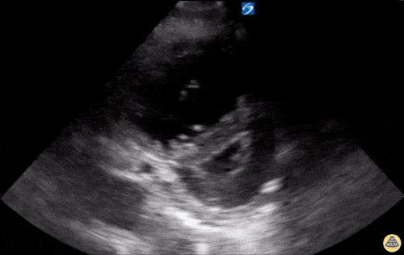
HI-MAP
Normal
Dilated RV
https://www.thepocusatlas.com/echocardiography-2

Slide 111
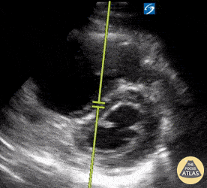
HI-MAP
Normal
Dilated RV
https://www.thepocusatlas.com/echocardiography-2

Slide 112
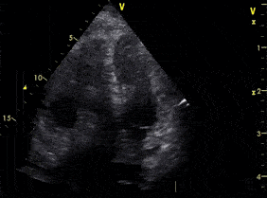
HI-MAP
Normal
Dilated RV
https://www.thepocusatlas.com/echocardiography-2

Slide 113
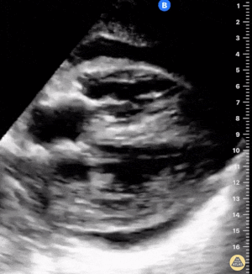
HI-MAP
Normal
Cardiac
Tamponade
https://www.thepocusatlas.com/echocardiography-2

Slide 114
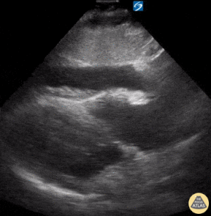
HI-MAP
Normal
Cardiac Tamponade
https://www.thepocusatlas.com/echocardiography-2

Slide 115
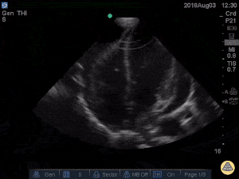
HI-MAP
Normal
Cardiac Tamponade
https://www.thepocusatlas.com/echocardiography-2

Slide 116
HI-MAP
Normal
Plethoric IVC
https://www.thepocusatlas.com/echocardiography-2

Slide 117
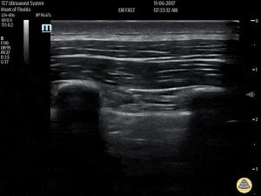
HI-MAP
Normal
No Lung Sliding
https://www.thepocusatlas.com/pulmonary

Slide 118
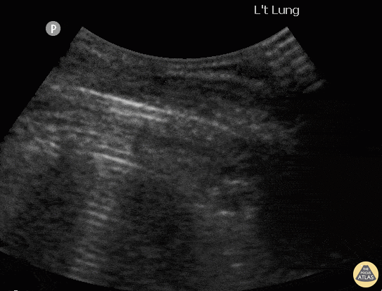
HI-MAP
Normal
Lung Point
https://www.thepocusatlas.com/pulmonary

Slide 119
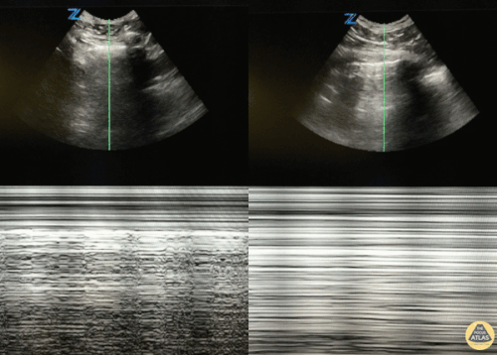
HI-MAP
Normal
“Waves on Sandy Beach”
Abnormal
“Barcode”
https://www.thepocusatlas.com/pulmonary

Slide 120
Treatment
Refractory Shock
  Reconsider differential diagnosis of shock
  Correct acidosis
    Acidosis decreases efficacy of vasopressors
  No true maximum dosage of vasopressors
  Stress dose steroids
    Hydrocortisone 50 mg q 6 hours
  Profound Vasoplegia
    Methylene Blue
    Hydroxocobalamin
  Angiotensin II (Giapreza)
  Mechanical Circulatory Support

Slide 121
Shock⁴
Terms
Central Venous Pressure (CVP)^{D}
  CVP = Amount of blood returning to the heart, approximates RA pressure
  Normal: 3-8 mmHg
Pulmonary Capillary Wedge Pressure (PCWP)^{E}
  PCWP = balloon wedged in pulmonary artery, approximates LA pressure
  Normal: 2-15 mmHg
Cardiac Output (CO)^{B}
  Volume of blood being pumped from the LV
  CO = HR x Stroke Volume
  Normal: 4-8 L/min
Cardiac Index (CI)
  CI = CO / BSA
  Normal: 2.5-4 L/min/m²
Systemic Vascular Resistance (SVR)^{C}
  Resistance of the systemic circulation
  SVR = 80 x (MAP-CVP)/CO
  Normal: 800-1600 dyn/cm/sec⁻⁵
POCUS*
POCUS
POCUS*
POCUS*

Slide 122
Cardiac Output

Slide 123
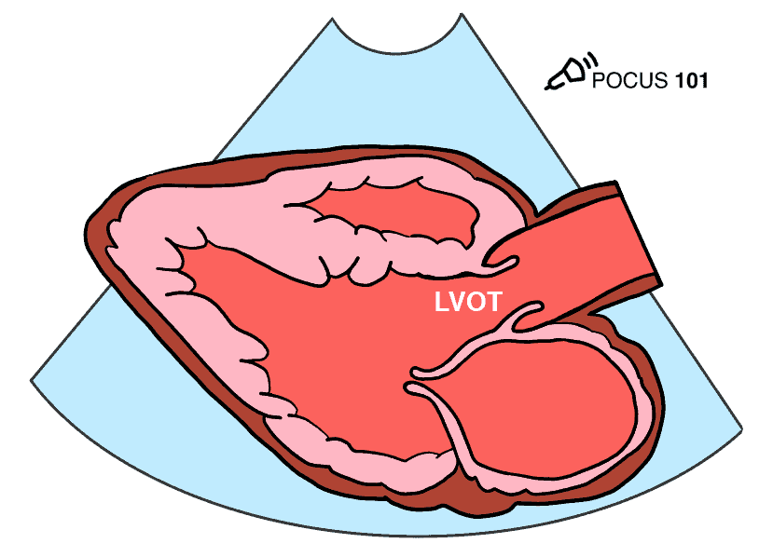


Cardiac Output
STEP 1
https://www.pocus101.com/measuring-cardiac-output-with-echocardiography-made-easy/

Slide 124


Cardiac Output
STEP 2
https://www.pocus101.com/measuring-cardiac-output-with-echocardiography-made-easy/

Slide 125


Cardiac Output
STEP 3
https://www.pocus101.com/measuring-cardiac-output-with-echocardiography-made-easy/

Slide 126


Cardiac Output
STEP 4
https://www.pocus101.com/measuring-cardiac-output-with-echocardiography-made-easy/

Slide 127

Cardiac Output
STEP 4
https://www.pocus101.com/measuring-cardiac-output-with-echocardiography-made-easy/

Slide 128

Cardiac Output
https://www.pocus101.com/measuring-cardiac-output-with-echocardiography-made-easy/

Slide 129



Slide 130
Mechanical Ventilation

Slide 131
Mechanical Ventilators^{9,10}
Maintains respiratory and metabolic functions of lungs
  Tool to support patient until recovery
  Not curative
Non-invasive vs invasive

Slide 132
Mechanical Ventilation^{9,10}
Indications
  Respiratory Failure
    Hypoxic
    Hypercapnic
    Hypoxic and Hypercapnic
  Airway Compromise
    Angioedema
    Massive GI Bleed
    Aspiration risk due to AMS or intoxication
  Expected Clinical Course
    Needing procedure: bronchoscopy, endoscopy
    Rapid clinical deterioration
    Transportation

Slide 133
NIPPV^{9,10}
Requires spontaneously breathing patient
Indications:
  Airway obstruction diseases
    Asthma, COPD, OSA
  Hypoxic Respiratory Failure
    Pneumonia, Pulmonary edema
Contraindications:
  Uncooperative
  Recent upper GI or airway surgery
  Unable to protect airway
    GI bleed, Obtundation, Active vomiting

Slide 134
NIPPV^{9,10}
CPAP
  Provides PEEP
  Assists with oxygenation
  Initial settings: 5 cm H₂O
Bilevel (aka BiPAP)
  Provides IPAP and EPAP (PEEP)
  Assists with oxygenation and ventilation
  Initial settings: IPAP – 10 cm H₂O, EPAP – 5 cm H₂O

Slide 135
Ventilator Modes^{9,10}
Assist Control
  Requires least effort from patient
  Delivers set number of breaths per minute
  Allows patient to spontaneously trigger
  All breaths are supported (assisted)
    Volume assist-control
      Each breath receives set Vt
    Pressure assist-control
      Each breath reaches a set pressure
    Dual-control Mode
      PRVC, CMV with Autoflow, VC+
  Uses:
    ARDS, Shock, Multisystem Trauma, Pulmonary Edema
    Settings: Rate, Vt, PEEP, FiO₂

Slide 136
Ventilator Modes^{9,10}
IMV
  Delivers a set number of breaths per minute
  Delivered breaths are usually volume-controlled
SIMV
  Allows spontaneous breaths
    Unsupported breaths
  Adjusts timing of mandatory breaths
SIMV-PS
  Pressure-supported spontaneous breaths
  Settings: Rate, Vt, PEEP, FiO₂

Slide 137
Ventilator Modes^{9,10}
Pressure Support Ventilation
  Augments spontaneous breathing
  Patient determines rate and volume
  Settings: IPAP, PEEP/EPAP
  Normal IPAP: 0-35 cm H₂O (avg 5-10)
  Normal PEEP: 5 cm H₂O
    *NO guaranteed minute ventilation
    *Set rate alarm
  Can be combined in other vent modes to support spontaneous breathing

Slide 138
Ventilator Modes^{9,10}
CPAP
  Spontaneous breathing
  Often used for SBT (ventilator weaning)
  Can help reduce work of breathing
  Settings
    Amount of PEEP to prevent:
      Alveolar de-recruitment
      Atelectasis
      Hypoxia
    Normal CPAP = 5-10 cm H₂O

Slide 139
Ventilator Settings^{9,10,K}
Minute Ventilation
  Normal 4-7 L/min
  CO₂ elimination
PBW
  M: 50 + (2.3 x [ht in inches – 60])
  F: 45.5 + (2.3 x [ht in inches – 60]
PIP (peak inspiratory pressures)
  Upper Limit: 35
P_{plat} (plateau pressure)
  Goal < 30
Notes:
Minute Ventilation = RR x tidal volume

Slide 140
Ventilator Settings^{9,10,K}
I:E ratio
  1:3 = normal
  Vented patient:
    between 1:2 and 1:4
Trigger
  Flow: Sensing Inspiratory Effort by Patient
    Range: 1-6 L/min
    Usual 2 L/min
  Pressure: Sensing decreased airway pressure = patient breathing
    Usual 1 – 4 cm H2O
Respiratory Rate
  Normal: 12 – 18 breaths/min

Slide 141


Slide 142
Peri-Intubation Optimization

Slide 143
Pre-intubation Optimization
Know your equipment
Assessment
  Plan for difficult airway
Positioning
  Patient
  Proceduralist
Pre-oxygenation
Pre-medicate
  IV Fluids
  Vasopressors
  Push dose pressors
Have backups and adjuncts ready/available
Communication
Have sedation ready

Slide 144
Pre-intubation Optimization^{N}
Predicting a Difficult Airway
LEMON
  Look
    Trauma, short neck, micrognathia, surgery/scars, beard, edentulous/dentures
  Evaluate (3-3-2-1)
  Mallampati
  Obstruction
    Peritonsillar abscess, epiglottitis
  Neck Mobility

Slide 145
Pre-intubation Optimization
Anticipated Ventilator Settings
  RR = 12 – 18 bpm
  Vt = 6 – 8 ml/kg PBW
  PEEP = 5 cm H₂O
  FiO₂ = 100%
  PRVC 14/450/5/100%

Slide 146
Post-Intubation Optimization
Check EtCO₂
Auscultate
Secure ETT
Chest X-ray
NG/OG insertion
Foley
Sedation
Restraints
Blood gas
Labs

Slide 147
Post-Intubation Optimization
Blood gas
  Always check a blood gas after making ventilator changes
    30-60 min after ventilator changes
  ABG vs VBG
    If SpO₂ is adequate, VBG is ok
    If SpO₂ unreliable, ABG is needed

Slide 148
Post-Intubation Optimization^{9,10}
Hypoxemia
  PaO₂ or SpO₂ too low
Solution
  Increase FiO₂
  Increase PEEP
    Set FiO₂ 100%
    Increase PEEP 2-3 cm H₂O every 10-15 min
    Then, decrease FiO₂
      MAX 60%
    Target PaO₂ > 60 or SpO₂ >92% (aka normoxia)

Slide 149
Post-Intubation Optimization^{9,10}
Hypercarbia (Acidemia)
  PaCO₂ too high
Solution
  Increase Respiratory Rate
  Increase Vt (tidal volume)
  pH correction
    Rate is better than Vt
  P_{plat} < 30 cm H₂O, and minimize AutoPEEP

Slide 150
Post-Intubation Optimization^{9,10}
Hypocarbia (Alkalemia)
  PaCO₂ too low
Solution
  Decrease Respiratory Rate
  Decrease Vt
  pH correction
    Rate is better than Vt

Slide 151
Post-Intubation Optimization^{9,10}
HIGH PEEP (Soft MAX PEEP = 10)
  Increased Intra-Thoracic Pressure
    decreased venous return and preload
Solution
  Decrease PEEP
  Increase FiO₂

Slide 152
Post-Intubation Optimization^{9,10}
High Airway Pressures
  High Peak Pressures
  PIP alarms
Solution
  Decrease RR
  Decrease Vt
Unable to decrease RR or Vt
  Permissive Hypercarbia
  Goal: pH > 7.2

Slide 153
Ventilator Problems^{9,10}
High Pressure Alarms
  Check P_{plat}
    Safe P_{plat} 30-35 cm H₂O
  High P_{airway}, Low P_{plat}
    High airway resistance
      Check ETT for kinking?
      Mucus plugging?
      Bronchospasm?
      ETT too small?
  High P_{airway}, High P_{plat}
    Lung problem
      Mainstem intubation?
      Atelectasis or lobar collapse?
      Pulmonary Edema?
      ARDS?
      Pneumothorax?
  If P_{plat} > 35 cm H₂O, decrease Vt (lowest = 4 ml/kg PBW)

Slide 154
Ventilator Problems^{9,10}
Sudden Drop in SpO₂
  Disconnect Vent
    BVM
  Check ETT position
  CXR
  Auscultate
    Bilateral breath sounds? Equal?
  Suction

Slide 155
Ventilator Problems^{9,10}
Hypotension
  Reduce sedation
  Reduce PEEP
    Overdistension of alveoli causing decreased venous return

Slide 156
Ventilator Problems^{9,10}
Ventilator dyssynchrony
  Check for Auto-PEEP
  Untreated pain
  Not meeting respiratory demands
    Check RR and Vt to make sure they are adequate for patient
  Consider changing ventilator mode
  Check for other causes of distress
    Cardiac ischemia, fever, abdominal distension, neurological deterioration
  Caution in deep sedation/paralytics
    Can be preterminal if not optimized

Slide 157
Ventilator Problems^{9,10}
Breath Stacking
  Prevention
    Lower RR
    Increased Flow Rate (80-100 L/min)
    Lower Tidal Volumes (5-7 mL/kg PBW)
    Better I:E ratio
Hypercarbia = Acidemia
  Increased cerebral blood flow (increased ICP)
  Myocardial depression and arrhythmias
  Abnormal cellular metabolism
Hyperventilation
  No longer routinely recommended in head injuries, associated with deleterious effects
    Can be used until other therapies take effect, MAX 1-2 hrs in duration

Slide 158
Ventilator Problems^{9,10}
Auto-Peep/Intrinsic Peep
  "Gas trapping" or dynamic hyperinflation
  Can impair venous return to the heart
    Hypotension
  Abdominal muscle contraction to help exhale
  Distended neck veins
  Perform expiratory hold
    If alveolar end-expiratory pressure > PEEP
      Auto-peep is present
Solution
  Decrease inspiratory time
  Decrease RR
  Meds: bronchodilators, steroids, sedation
  Adjust PEEP to 75-85% of measured Auto-PEEP

Slide 159
Out-of-Hospital
Cardiac Arrest

Slide 160
OHCA Preparation
Assign Roles
  Code Leader
  Proceduralist/POCUS
  Medication Administration
  Defibrillator
  Recorder
  Family Support
Gather Supplies
Brief Handoff from EMS
  Duration of downtime?
  Witnessed?
  Initial Rhythm?
  Comorbidities?

Slide 161

https://cpr.heart.org/en/resuscitation-science/cpr-and-ecc-guidelines/algorithms

Slide 162

https://cpr.heart.org/en/resuscitation-science/cpr-and-ecc-guidelines/algorithms

Slide 163
OHCA^{L}
Key points:
  Compressions
    Mechanical > Manual
    Minimize interruptions
    Watch for fatigue
    Efficacy
      EtCO₂ >20 mmHg, DBP > 20 mmHg
  Communication
    Clear and concise directions
    Encourage or correct helpers
    Closed loop
    Use team member names

Slide 164
OHCA^{L}
Key points:
  Airway
    Do not stop compressions for ETT, place a supraglottic airway
  Adjuncts
    Arterial line
    Ultrasound
  H's and T’s
  Defibrillator
    Charge before pulse check
    A/P position of pads may be more likely to achieve ROSC
    Change location of pads for refractory VT/VF
  Family Presence
    Initially removed from room
    May be of some benefit to return if willing
      Can reduce incidence of anxiety and depression

Slide 165


Slide 166

https://cpr.heart.org/en/resuscitation-science/cpr-and-ecc-guidelines/algorithms
Notes:
Removed “Bystander” Wording

Slide 167

https://cpr.heart.org/en/resuscitation-science/cpr-and-ecc-guidelines/algorithms

Slide 168
OHCA^{L}
Termination of Efforts
  EtCO2 < 10 mmHg after >20 min CPR
  Duration of arrest >30 min without ROSC
  Severe Acidosis pH < 6.8
  Severe Hyperkalemia K > 10
  Lack of cardiac motion on POCUS

Slide 169
Post-ROSC

Slide 170
Post-ROSC⁷
Early Post-ROSC Priorities
  Adequate oxygenation and ventilation
  Stabilize hemodynamics and reverse shock
  Treat inciting cause
  Neuroprotective strategies
  Correct Metabolic Derangements

Slide 171
Post-ROSC⁷
Resuscitation Goals
  Preload
    IV fluid resuscitation
  Perfusion Pressure
    MAP > 65
      Vasopressors
    Avoid hypotension
  Perfusion Optimization
    Urine output > 0.5 ml/kg/hr
    Inotropes
    Lactate Clearance

Slide 172
Post-ROSC^{7,8}
Post-cardiac arrest syndrome
  Complex immunologic response
    Cytokines
    Coagulopathy
    Endothelial dysfunction
  Microvascular and macrovascular dysfunction
    Hemodynamic instability
    Organ dysfunction

Slide 173
Post-ROSC^{7,8}
Myocardial Dysfunction
  Global systolic and diastolic stunning
  Nadir 6-8 hrs post-ROSC
  Reversible in 48-72 hrs
Presence of shock despite optimization of preload and pressors
  Suggests presence of cardiac dysfunction
  Consider inotropes or MCS
    MCS = IABP or ECLS

Slide 174
Post-ROSC^{7,8}
Cerebral Injury
  Ischemia-reperfusion injury
  Focus on neuroprotective strategies
  Neurologic prognosis difficult immediate post-ROSC
    Extent of injury unable to be determined by exam or imaging
    Delay neurologic prognostication for > 72 hrs
  Consider TTM

Slide 175
Post-ROSC^{7,8}
Targeted Temperature Management
  Neuroprotective therapy with neurologic and survival benefit
    Modulates neuronal reperfusion injury
    Greatest benefit when started early
      Within 6hrs of ROSC
  Ideal temperature = unknown
    32-34°C
    36°C, comparable
  Active temperature control
    Prevent hyperthermia

Slide 176
Post-ROSC^{7,8}
Seizures (or myoclonus)
  Post-ROSC patients monitored for seizures
  Can worsen cerebral injury
  Medication management
    Benzodiazepines
    Levetiracetam
    Phenytoin
    Barbiturates

Slide 177
Post-ROSC^{7,8}
Evidence-based Support Therapies
  Sterile precautions for all procedures
  Safe mechanical ventilation
    Low Vt, P_{plat} < 30
  Aspiration precautions
    Elevate head of bed 30-45
    OG/NG placement
    Oral Cares
  Blood sugar control
    Goal: 120-180
  Prophylaxis
    GI stress ulcer prophylaxis
    DVT prophylaxis

Slide 178


Slide 179
Mechanical Circulatory Support

Slide 180
Mechanical Circulatory Support^{6,7}
Flow pumps that augments function of a failing heart
Purpose
  Restore perfusion to meet metabolic demands
  Reduce workload of heart
    LV unloading
    Decreased afterload
  Maintains adequate CPP
  Bridge therapy
    Decision
    Recovery
    Transplantation

Slide 181
Mechanical Circulatory Support^{6,7}
Devices:
  IABP
    Diastole – balloon inflation leads to increased DBP and increases coronary perfusion
    Systole – balloon deflation leads to decrease afterload
  Percutaneous VAD (Impella CP and RP)
    Catheter-mounted MCS device
      Microaxial flow pump
    Augments systemic perfusion
    Unloads LV
  ECLS (aka ECMO)
    Mechanical Pump
    Membrane Lung
    VA – hemodynamic support and respiratory support
    VV – respiratory support

Slide 182
Mechanical Circulatory Support^{6,7,8}
Indications
  Soft Inclusion
    SBP < 90 mmHg for prolonged period of time
    Vasopressors needed to achieve SBP > 90 mmHg + signs of end-organ hypoperfusion
  Cardiac index ≤ 2.2 L/min
  Elevated PCWP ≥ 15 mmHg
  Lactate > 2.0

Slide 183
Delayed Transport

Slide 184
Delayed Transport
Interventions
  Insert Foley
  Insert OG/NG
  Restraints
  Sedation
  Cooling/Warming blanket
  Arterial Line
  Central Line vs PICC

Slide 185
Delayed Transport
Imaging
  Chest X-ray
    Daily
      Line/tube positioning
      Clinical status
    PRN
      Changes in oxygenation, ventilator alarms
      Adjustments of line and tubes
  Abdominal X-ray
    PRN
      Line/tube positioning

Slide 186
Delayed Transport
Imaging
  CT
    Head
      After prolonged codes
      Repeat @ 24hrs for known ICH
    Chest
      Chest trauma from CPR
      Rib/Sternal Fractures
      Concern for bleeding
    Abdomen/Pelvis
      Concern for bleeding

Slide 187
Delayed Transport
Imaging
  MRI
    Brain
      Prognostication
        Delay until >72hrs

Slide 188
Delayed Transport
Labs
  CBC
  CMP/BMP
  Magnesium
  Phosphorus
  Ionized Calcium
  ABG/VBG
  Troponin
  Procalcitonin
  Lactic Acid
  POC Glucose
    Goal: 120-180

Slide 189
Delayed Transport
Medications
  GI prophylaxis
    H2 blocker vs PPI
  Sedation
    Target RASS -2 – 0
  Dosing frequency
    Order meds per recommended scheduling
  Home meds
    Order important home medications
      Immune suppression
      Anti-platelet agents
      Anticoagulation

Slide 190
Delayed Transport
Monitoring
  HR
    Goal: 60-100
    Treat arrhythmias, optimize electrolytes
  BP
    SBP > 90 mmHg
    MAP > 65 mmHg
  SpO₂
    Sats > 90%
    Pulse oximetry, unless poor perfusion
  UOP
    Goal: 0.5 ml/kg/hr

Slide 191
Delayed Transport
Re-engage with accepting facility
  Clinical deterioration
  Difficulty maintaining hemodynamic goals
  Changes in level of care
  Patient demise
  Recommendations

Slide 192
Summary

Slide 193
Summary
ICU care is becoming more common in the ED
Have a plan
Communication is key
Get familiar with your tools
Norepinephrine is often a good first choice
Lung protective settings
When you make changes, check your work
Prevent hyperthermia
Call for help

Slide 195
Resources

Slide 196



AI in Medicine

Slide 197
Publications
Tian DH, Smyth C, Keijzers G, Macdonald SP, Peake S, Udy A, Delaney A. Safety of peripheral administration of vasopressor medications: A systematic review. Emerg Med Australas. 2020 Apr;32(2):220-227. doi: 10.1111/1742-6723.13406. Epub 2019 Nov 7. PMID: 31698544.
Yerke JR, Mireles-Cabodevila E, Chen AY, Bass SN, Reddy AJ, Bauer SR, Kokoczka L, Dugar S, Moghekar A. Peripheral Administration of Norepinephrine: A Prospective Observational Study. Chest. 2024 Feb;165(2):348-355. doi: 10.1016/j.chest.2023.08.019. Epub 2023 Aug 21. PMID: 37611862; PMCID: PMC10851275.
Cardenas-Garcia J, Schaub KF, Belchikov YG, Narasimhan M, Koenig SJ, Mayo PH. Safety of peripheral intravenous administration of vasoactive medication. J Hosp Med. 2015 Sep;10(9):581-5. doi: 10.1002/jhm.2394. Epub 2015 May 26. PMID: 26014852.
Patel N, Durland J, Makaryus AN. Physiology, Cardiac Index. [Updated 2022 Sep 26]. In: StatPearls [Internet]. Treasure Island (FL): StatPearls Publishing; 2024 Jan-. Available from: https://www.ncbi.nlm.nih.gov/books/NBK539905/
Tanja A. Treschan, Jürgen Peters, David C. Warltier; The Vasopressin System: Physiology and Clinical Strategies. Anesthesiology 2006; 105:599–612 doi: https://doi.org/10.1097/00000542-200609000-00026
Szyguła-Jurkiewicz B, Szczurek W, Suliga K, Rempega G, Rajwa P. Mechanical circulatory support in heart failure. Kardiochir Torakochirurgia Pol. 2016 Jun;13(2):130-4. doi: 10.5114/kitp.2016.61046. Epub 2016 Jun 30. PMID: 27516785; PMCID: PMC4971267.
Farcy DA, Chiu WC, Marshall JP, Osborn TM. Critical Care: Emergency Medicine. 2nd edition. McGraw Hill Education; 2017.
Vincent JL, Abraham E, Moore FA, Kochanek PM, Fink MP. Textbook of Critical Care. 7th edition. Elsevier; 2017.
Owens W. The Ventilator Book. 2nd edition. First Draught Press; 2018.
Owens W. The Advanced Ventilator Book. 1st edition. First Draught Press; 2017.

Slide 198
Websites
https://www.uptodate.com/contents/definition-classification-etiology-and-pathophysiology-of-shock-in-adults?search=shock&source=search_result&selectedTitle=1%7E150&usage_type=default&display_rank=1
https://en.wikipedia.org/wiki/Cardiac_output
https://en.wikipedia.org/wiki/Vascular_resistance
https://en.wikipedia.org/wiki/Central_venous_pressure
https://en.wikipedia.org/wiki/Pulmonary_wedge_pressure
https://en.wikipedia.org/wiki/Inotrope
https://cpr.heart.org/en/resuscitation-science/cpr-and-ecc-guidelines/algorithms
https://onepagericu.com
https://onepagericu.com/undifferentiated-shock
https://onepagericu.com/vasopressors
https://onepagericu.com/vent-basics
https://onepagericu.com/running-a-code
https://www.uptodate.com/contents/image?topicKey=ANEST%2F115472&view=machineLearning&search=vasoplegia&sectionRank=1&usage_type=default&imageKey=ANEST%2F126194&rank=1~26&source=machineLearning&display_rank=1
https://wikem.org/wiki/Predicting_the_difficult_airway
https://www.acep.org/sonoguide/advanced/rush
https://www.pocus101.com/measuring-cardiac-output-with-echocardiography-made-easy/

