Slide 1

Pediatric Sepsis A Timeline

Slide 2
Pediatric Sepsis is a problem . . .
Sepsis is the leading cause of death in hospitalized children, killing almost 5,000 children annually in the U.S., more than cancer
Sepsis is expensive; costs to treat severe sepsis range from $65k-$85k. It accounts for 16% of all pediatric health care spending – around $5 billion
As many as 80,000 children are hospitalized annually for sepsis
Sepsis is treatable, sepsis deaths are preventable and the high costs of advanced treatment are avoidable

Slide 3
Timeline

Slide 4
Timeline
DO2
and
VO2

Slide 5

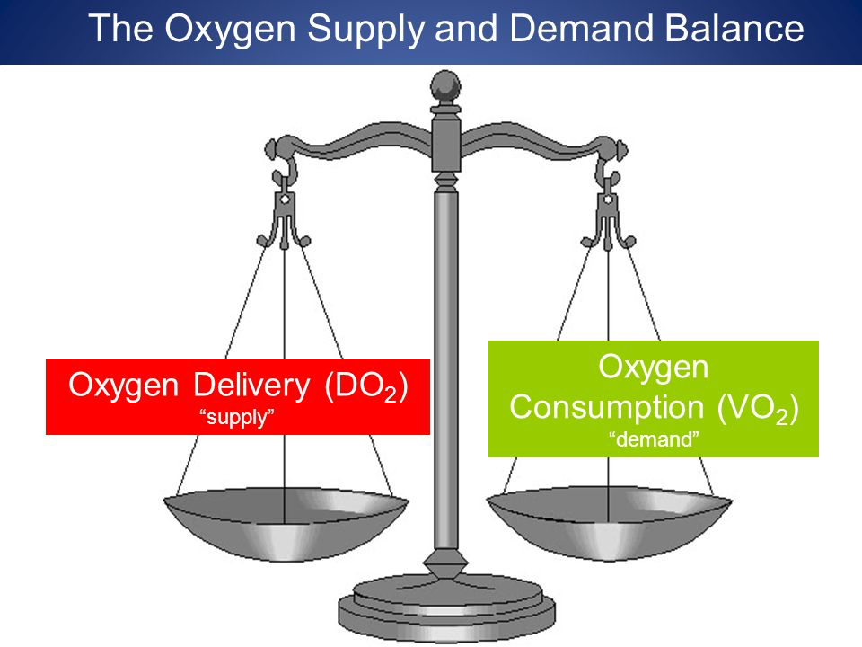
Carcillo et al Crit Care Med 17:1 1989
Sequential physiologic interactions
in pediatric cardiogenic and septic
shock

Slide 6
Timeline
DO2
and
VO2

Slide 7
Timeline
DO2
and
VO2
Early Fluid Resuscitation

Slide 8
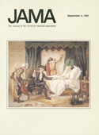
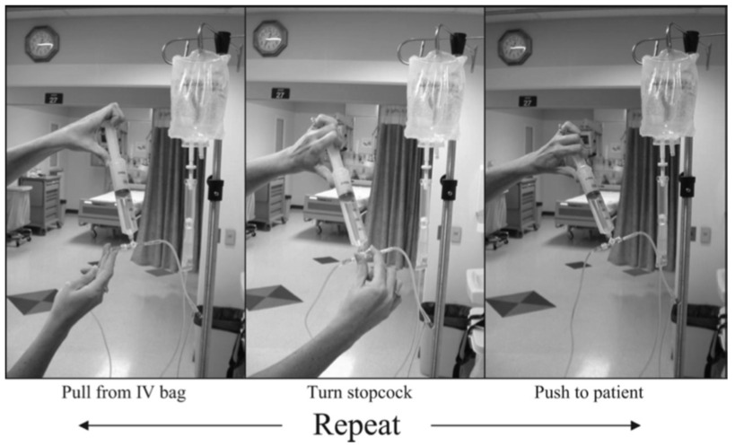
Carcillo et al JAMA 266:9 1991
Role of Early Fluid Resuscitation in
Pediatric Septic Shock
They discovered that rapid resuscitation with fluids in excess of 40ml/kg in the first hour from presentation to the emergency department improved outcomes in pediatric septic shock

Slide 9
Timeline
DO2
and
VO2
Early Fluid Resuscitation

Slide 10
Timeline
DO2
and
VO2
Fluid-Refractory
Sepsis
Early Fluid Resuscitation

Slide 11

Ceneviva et al Pediatrics 102:2 1998
Hemodynamic Support in
Fluid-Refractory Pediatric Septic Shock
“Unlike adults, children with fluid-refractory shock are frequently hypodynamic and respond to inotrope therapy. Attention to maintenance of cardiac output may be of greater importance to improved survival in children with fluid-refractory septic shock.”

Slide 12
Timeline
DO2
and
VO2
Fluid-Refractory
Sepsis
Early Fluid Resuscitation

Slide 13
Timeline
DO2
and
VO2
Fluid-Refractory
Sepsis
Early Fluid Resuscitation
ACCM/PALS
Guideline
2002

Slide 14


Carcillo et al Crit Care Med 30:6 2002
Clinical practice parameters for hemodynamic support of pediatric and neonatal patients in septic shock
Defined septic shock and outlined resuscitation interventions that had been proven clinically effective

Slide 15
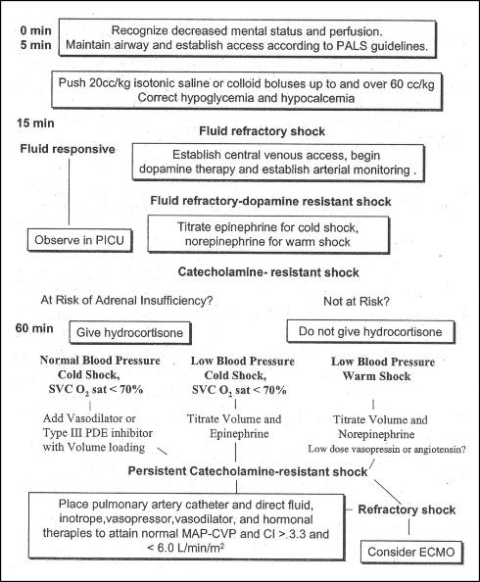

Slide 16
Timeline
DO2
and
VO2
Fluid-Refractory
Sepsis
Early Fluid Resuscitation
ACCM/PALS
Guideline
2002

Slide 17
Timeline
DO2
and
VO2
Fluid-Refractory
Sepsis
Study the Guideline
Early Fluid Resuscitation
ACCM/PALS
Guideline
2002

Slide 18

Han et al., Pediatrics 112: 2003
Early reversal of pediatric-neonatal septic shock by community physicians is associated with improved outcome
A 9 year retrospective study of patients initially seen in a community hospital and then transferred to Children’s Hospital of Pittsburgh for septic shock

Slide 19

Han et al., Pediatrics 112: 2003
Overall 29% of study patients died
When septic shock was reversed in the community setting it was associated with 96% survival and >9-fold increased odds of survival
Each additional hour of persistent shock was associated with >2-fold increased odds of mortality

Slide 20
Han et al., Pediatrics 112: 2003
Resuscitation practice was consistent with ACCM-PALS Guidelines in only 27 (30%) patients
However, when practice was in agreement with guideline recommendations, a lower mortality was observed
(8% vs 38%)

Slide 21
Timeline
DO2
and
VO2
Fluid-Refractory
Sepsis
Study the Guideline
Early Fluid Resuscitation
ACCM/PALS
Guideline
2002

Slide 22
Timeline
DO2
and
VO2
Fluid-Refractory
Sepsis
Study the Guideline
Early Fluid Resuscitation
ACCM/PALS
Guideline
2002
Early Antibiotics

Slide 23
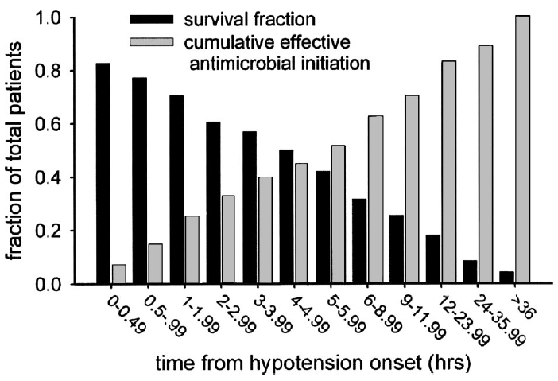
Kumar et al, Crit Care Med 34: 2006
Duration of hypotension before initiation of effective antimicrobial therapy is the critical determinant of survival in human septic shock.
Every hour delay in receiving effective antibiotics is associated with a 7.6% decrease in survival in adults with septic shock

Slide 24
Timeline
DO2
and
VO2
Fluid-Refractory
Sepsis
Study the Guideline
Early Fluid Resuscitation
ACCM/PALS
Guideline
2002
Early Antibiotics

Slide 25
Timeline
DO2
and
VO2
Fluid-Refractory
Sepsis
ACCM/PALS
Guideline
Update 2009
Study the Guideline
Early Fluid Resuscitation
ACCM/PALS
Guideline
2002
Early Antibiotics

Slide 26
Brierley et al., Crit Care Med 37:2 2009
Clinical practice parameters for hemodynamic support of pediatric and neonatal septic shock: 2007 update from the American College of Critical Care Medicine.
Reviewed the implementation of the 2002 guidelines and initial data

Slide 27

Brierley et al., Crit Care Med 37:2 2009
Centers that implemented the 2002 guidelines reported best practice outcomes (hospital mortality 1%-3% in previously healthy, and 7%-10% in chronically ill children)
Early use of 2002 guidelines was associated with improved outcome in the community hospital emergency department (number needed to treat = 3.3) and tertiary pediatric intensive care setting (number needed to treat = 3.6)
Every hour that went by without guideline adherence
was associated with a 1.4-fold increased mortality risk

Slide 28

Brierley et al., Crit Care Med 37:2 2009
The updated 2009 guidelines continue to recognize an increased likelihood that children with septic shock, compared with adults, require:
Proportionally larger quantities of fluid
Inotrope and vasodilator therapies
Hydrocortisone adrenal insufficiency
ECMO for refractory shock

Slide 29
Brierley et al., Crit Care Med 37:2 2009
The major new recommendation in the 2009 update:
Earlier use of inotrope support through peripheral access until central access is attained
Subsequent intensive care unit hemodynamic support directed to goals of central venous oxygen saturation >70%

Slide 30
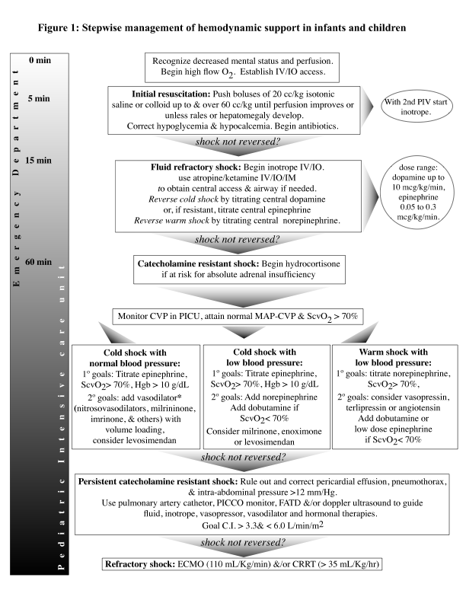
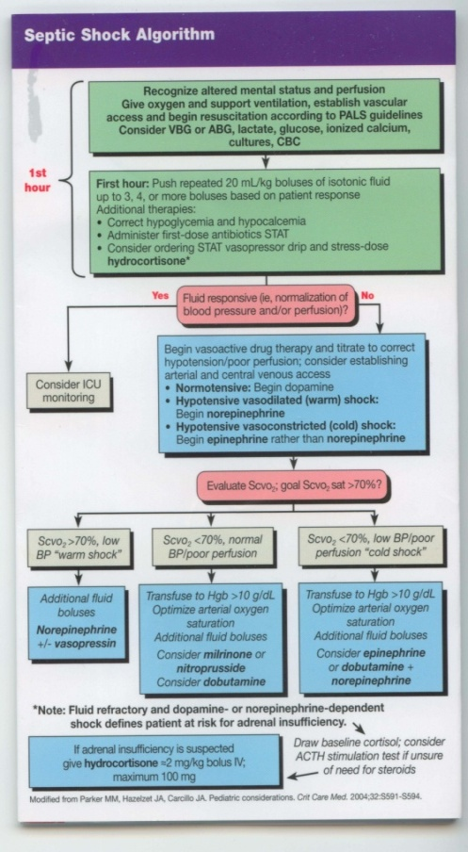
ACCM Guidelines:
60 cc/kg in 15 minutes
PALS Guidelines:
60 cc/kg in 60 minutes
Notes:
30
The ACCM guidelines have been incorporated into the PALS algorithm. However, one major difference exists between the two. While ACCM guidelines call for 60 cc/kg within 15 minutes, PALS recommends 60 cc/kg within 60 minutes.

Slide 31
Timeline
DO2
and
VO2
Fluid-Refractory
Sepsis
ACCM/PALS
Guideline
Update 2009
Study the Guideline
Early Fluid Resuscitation
ACCM/PALS
Guideline
2002
Early Antibiotics

Slide 32
Timeline
DO2
and
VO2
Fluid-Refractory
Sepsis
ACCM/PALS
Guideline
Update 2009
Study the Guideline
Early Fluid Resuscitation
ACCM/PALS
Guideline
2002
Early Antibiotics
Implementation and QI

Slide 33
Cruz et al., Pediatrics 127:e758 2011
Implementation of goal-directed therapy for children with
suspected sepsis in the emergency department.
Implementation of an emergency department protocol for the recognition of septic shock and facilitate adherence to national treatment guidelines
When compared with children seen before the protocol, time from triage to first bolus decreased from a median of 56 to 22 minutes (P < .001) and triage to first antibiotics decreased from a median of 130 to 38 minutes (P < .001).

Slide 34
Larsen et al., Pediatrics 127:e1585 2011
An emergency department septic shock protocol and care guideline
for children initiated at triage.
Septic shock protocol and care guideline to expedite identification of septic shock and increase compliance with recommended therapy
Gains in care included more complete recording of triage vital signs, timely fluid resuscitation and antibiotic administration, and serum lactate determination
The median hospital length of stay declined over the study period (median: 181-140 hours; P < .05)

Slide 35
Paul et al., Pediatrics 130:e273 2012
Adherence to PALS Sepsis
Guidelines and Hospital
Length of Stay.
Examined a hospital’s adherence to 2006 Pediatric Advanced Life Support guidelines for severe sepsis and septic shock
Complete PALS adherence resulted in a 57% shorter hospital LOS (P = .009)

Slide 36
Timeline
DO2
and
VO2
Fluid-Refractory
Sepsis
ACCM/PALS
Guideline
Update 2009
Study the Guideline
Early Fluid Resuscitation
ACCM/PALS
Guideline
2002
Early Antibiotics
Implementation and QI

Slide 37
Timeline
DO2
and
VO2
Fluid-Refractory
Sepsis
ACCM/PALS
Guideline
Update 2009
Surviving Sepsis Campaign
Study the Guideline
Early Fluid Resuscitation
ACCM/PALS
Guideline
2002
Early Antibiotics
Implementation and QI

Slide 38

Dellinger et al., Int Care MedFeb165-228 2013
Surviving Sepsis Campaign: international guidelines for management of severe sepsis and septic shock, 2012.
Dellinger RP, Levy MM, Rhodes A, Annane D, Gerlach H, Opal SM, Sevransky JE, Sprung CL, Douglas IS, Jaeschke R, Osborn TM, Nunnally ME, Townsend SR, Reinhart K, Kleinpell RM, Angus DC, Deutschman CS, Machado FR, Rubenfeld GD, Webb S, Beale RJ, Vincent JL, Moreno R; Surviving Sepsis Campaign Guidelines Committee including The Pediatric Subgroup.
A consensus committee of 68 international experts representing 30 international organizations

Slide 39
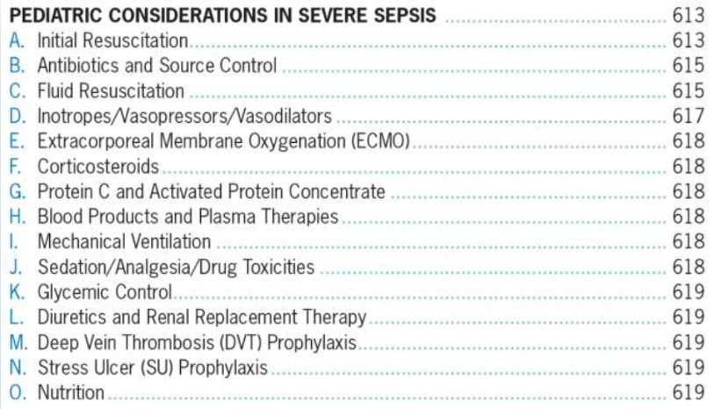
Surviving Sepsis Campaign

Slide 40
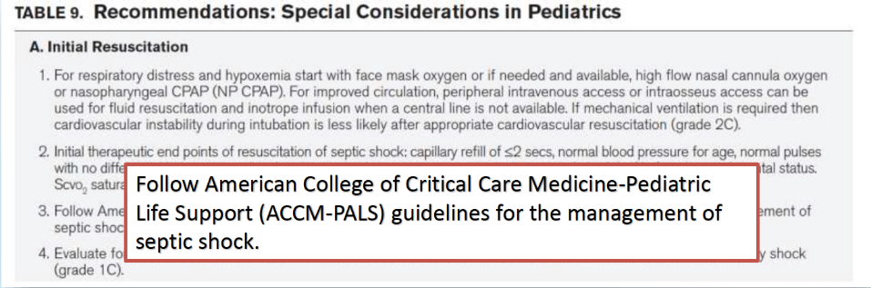
Surviving Sepsis Campaign

Slide 41
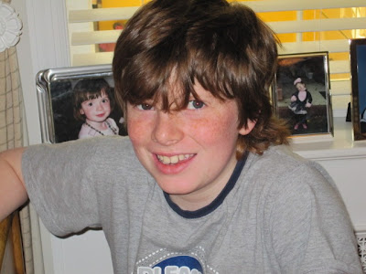
NYC case 2012
Rory Staunton

Slide 42
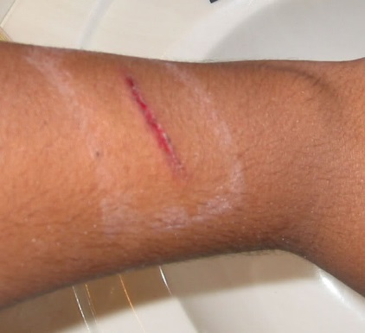
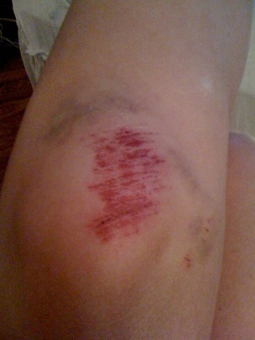
NYC case
12y/o M with no significant PMH, while playing basketball suffered a small laceration to his arm and an abrasion to his knee

Slide 43
NYC case
12y/o M with no significant PMH, while playing basketball suffered a small laceration to his arm and an abrasion to his knee
The following day he developed high fever (104), shaking chills, and vomiting

Slide 44
NYC case
12y/o M with no significant PMH, while playing basketball suffered a small laceration to his arm and an abrasion to his knee
The following day he developed fever, shaking chills, and vomiting
He saw his PCP where his clinic vitals were T 102, HR 140, RR 36 she felt he was dehydrated and referred him to New York University Medical Center

Slide 45
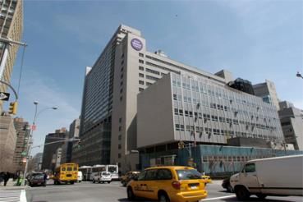
NYC case
At presentation to the ED he had a RR of 20, HR of 143, and a normal temp (he received antipyretics at PCP)

Slide 46
NYC case
At presentation to the ED he had a RR of 20, HR of 143, and a normal temp (he received antipyretics at PCP)
An IV was placed and basic labs drawn

Slide 47
NYC case
At presentation to the ED he had a RR of 20, HR of 143, and a normal temp (he received antipyretics at PCP)
An IV was placed and basic labs drawn
He was given a bolus of fluid and Zofran

Slide 48
NYC case
At presentation to the ED he had a RR of 20, HR of 143, and a normal temp (he received antipyretics at PCP)
An IV was placed and basic labs drawn
He was given a bolus of fluid and Zofran
The treating physician thought the fluids had made Rory better and discharged him as having Gastroenteritis

Slide 49
NYC case
Discharge order was placed before labs were resulted

Slide 50
NYC case
Discharge order was placed before labs were resulted
Last set of vitals (after discharge)
T 102, HR 131

Slide 51
NYC case
Rory continued to vomit all night and had progressive weakness

Slide 52
NYC case
Rory continued to vomit all night and had progressive weakness
He returned to the hospital the next day diagnosed with septic shock and admitted to the PICU

Slide 53
NYC case
Rory continued to vomit all night and had progressive weakness
He returned to the hospital the next day diagnosed with septic shock and admitted to the PICU
He died two days later of multi-system organ failure

Slide 54
NYC case
M.E. diagnosis: Group A Streptococcus Septicemia

Slide 55


NYC case

Slide 56
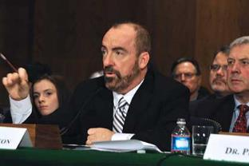
New Regulations
“The medical staff shall be responsible for the collection, use, and reporting of quality measures related to the recognition and treatment of severe sepsis for purposes of internal quality improvement and hospital reporting to the Department”

Slide 57
Timeline
DO2
and
VO2
Fluid-Refractory
Sepsis
ACCM/PALS
Guideline
Update 2009
Surviving Sepsis Campaign
Study the Guideline
Early Fluid Resuscitation
ACCM/PALS
Guideline
2002
Early Antibiotics
Implementation and QI

Slide 58
Timeline
DO2
and
VO2
Fluid-Refractory
Sepsis
ACCM/PALS
Guideline
Update 2009
Surviving Sepsis Campaign
Study the Guideline
Early Fluid Resuscitation
ACCM/PALS
Guideline
2002
Early Antibiotics
Implementation and QI
Pediatric Septic Shock Collaborative

Slide 59

Historical Overview
2011
● Began as a project with the AAP’s Section on Emergency Medicine, Committee on Quality Transformation
● 47 hospitals
2012
● Partnered with Children’s Hospital Association (CHA)
● Associated costs
● 15 hospitals
● Tenure: June 2012 – June 2013
CHA Package
● Advisory board members in both initiatives
● Fundamental principles: inclusion to current focus on early diagnosis and escalation

Slide 60

INTERVENTION KEY DRIVERS
CHANGE STRATEGIES
Rapidly evaluate patients with who appear ill, have abnormal vital signs, shows signs of mental status change
Identify patients who are at high risk for sepsis
Use standardized studies (lab, microbiology, rad)
Understand difference between compensated and uncompensated shock
KEY DRIVERS
Rapidly escalate to senior physician
Assign adequate personnel
Preplanned strategy for location of care and resources to care for patient
Written protocol to delineate how resources external to ED can be activated if ED reaches capacity
Recognition
Aims:
•To decrease the relative rate of mortality in septic shock by 20%.
•To increase the number of patients who receive first IV fluid bolus in 20 minutes by 20% in year one.
Escalation
Maintain or restore airway
Obtain vascular access quickly
Maintain or restore circulation and heart rate
Ongoing vital signs monitoring
Maintain metabolic control and urine output
Use standardized empiric antibiotic protocols
Diagnose infection
Rapid medication delivery
Rapid physician notification of study results
1st hour of Resuscitation
Transfer
Ensure patient is stable for transfer
Consider admitting lower acuity children to non-critical care unit for monitoring
Alert ICU and transport team of potential admission
Use a standardized system for transferring patients
Use standardized handoff communication tools
Ongoing Management
Continue vital signs monitoring
Use standardized guidelines/protocols/algorithms
Adjust treatments according to physiologic response
Identify and control infection source
Address potentially reversible morbidities
Consider ECMO only when conventional therapies cannot support patient

Slide 61

EDUCATION KEY DRIVERS
CHANGE STRATEGIES
Core knowledge will include
Understand compensated vs. uncompensated shock
Recognize shock based on vital signs and physical exam
Initiate interventions rapidly, i.e.
Up to 60 cc/kg of IVF in the first hour
Rapid administration of antibiotics
KEY DRIVERS
Identify Core Knowledge
For Education and Key
Learning Objectives
All persons involved in the care of children in the ED including, RNs, attendings, fellows, residents, techs, mid-level providers, clerks and transport teams
Ensure completion of modules and questions
Aims:
To insure key ED providers possess core knowledge with regard to sepsis and care of the sepsis patient.
To train 90% of ED providers in months 1-3 on intervention bundle strategies and QI.
Identify Appropriate Staff
To Receive Education
And Customize
If Necessary
Education will occur throughout the year
More than one delivery method should be used for the education and might include (but not limited to)
Individual (case review) and aggregate
Learning modules, pathways accessible via the web +/- relevant hyperlinks, newsletters, email updates, PowerPoint presentations, AAP MOC Sepsis program, Simulation Lab, bulletin board postings
Meetings: divisional (educational conference), resident (noon conference) and departmental (Grand Rounds)
Celebrate successes
Provide Appropriate
Methods for
Education Delivery
Expose Providers to Repeated Education

Slide 62
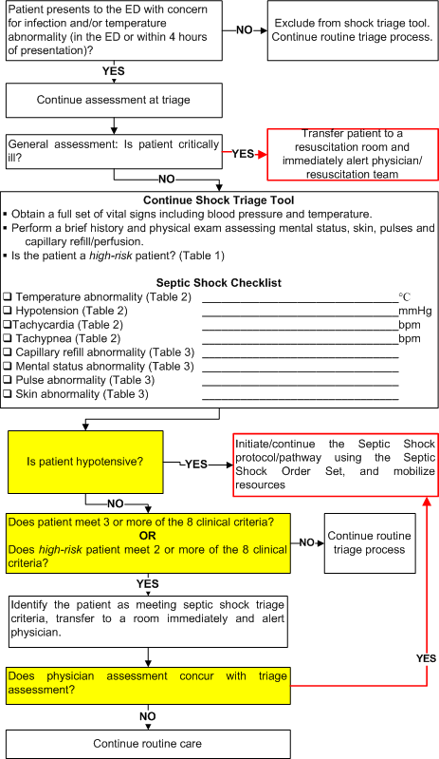
Table 1. High Risk Conditions
• Malignancy
• Asplenia (including SCD)
• Bone marrow transplant
• Central or indwelling line/catheter
• Solid organ transplant
• Severe MR/CP
• Immunodeficiency, immunocompromised or immunosuppression
Table 2. Vital Signs (PALS)
Age | Heart Rate | Resp Rate | Systolic BP | Temp (°C)
0d - 1m | > 205 | > 60 | < 60 | <36 or >38
≥ 1m - 3m | > 205 | > 60 | < 70 | <36 or >38
≥ 3m - 1y | > 190 | > 60 | < 70 | <36 or >38.5
≥ 1y - 2y | > 190 | > 40 | < 70 + (age in yr × x2) | <36 or >38.5
≥ 2y - 4y | > 140 | > 40 | < 70 + (age in yr × x2) | <36 or >38.5
≥ 4y - 6y | > 140 | > 34 | < 70 + (age in yr × x2) | <36 or >38.5
≥ 6y - 10y | > 140 | > 30 | < 70 + (age in yr × x2) | <36 or >38.5
≥ 10y - 13y | > 100 | > 30 | < 90 | <36 or >38.5
≥ 13y | > 100 | > 16 | < 90 | <36 or >38.5
Table 3. Exam Abnormalities
 | Cold Shock | Warm Shock | Non-specific
Pulses (central vs. peripheral) | Decreased or Weak | Bounding
Capillary refill (central vs. peripheral) | ≥ 3 sec | Flash (< 1 sec)
Skin | Mottled, Cool | Flushed, ruddy, erthyroderma (other than face) | Petechiae below the nipple, any purpura
Mental Status |  |  | Decreased, irritability, confusion, inappropriate crying or drowsiness, poor interaction with parents, lethargy, diminished arousability, obtunded

Slide 63
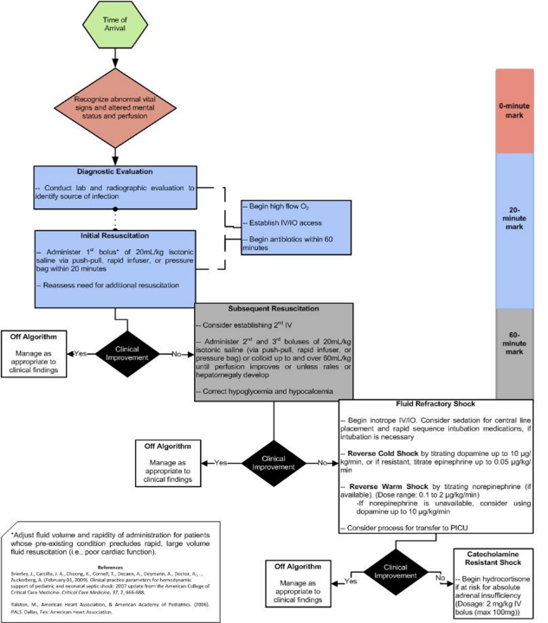

Slide 64

Patient FT
- 17 yo M with hx of CP, ID, severe scoliosis s/p spinal fusion, nonverbal and J-tube dependent who presented with difficulty breathing and fever x 2 days. Home health RN noted tachycardia, tachypnea with 55/min, and O2 sat of 88% requiring O2. Patient transferred to PCH ED by ambulance
At triage patient’s vitals were
Temp: 38.6 HR: 165
RR: 26 BP: 122/86
SaO2: 95% (RA)
Triaged “Yellow” on a busy night with multiple traumas.
Triage Time: 2106 (given Motrin at 2130)
First seen by resident: 2200
First seen by attending: 2230 (1 our 24 minutes from arrival)
On attending exam patient found to be responding to painful stimuli only. Diaphoretic, tachycardic (185), with bounding pulses.

Slide 65
Table 1. High Risk Conditions
• Malignancy
• Asplenia (including SCD)
• Bone marrow transplant
• Central or indwelling line/catheter
• Solid organ transplant
• Severe MR/CP
• Immunodeficiency, immunocompromised or immunosuppression
Table 2. Vital Signs (PALS)
Age | Heart Rate | Resp Rate | Systolic BP | Temp (°C)
0d - 1m | > 205 | > 60 | < 60 | <36 or >38
≥ 1m - 3m | > 205 | > 60 | < 70 | <36 or >38
≥ 3m - 1y | > 190 | > 60 | < 70 | <36 or >38.5
≥ 1y - 2y | > 190 | > 40 | < 70 + (age in yr × x2) | <36 or >38.5
≥ 2y - 4y | > 140 | > 40 | < 70 + (age in yr × x2) | <36 or >38.5
≥ 4y - 6y | > 140 | > 34 | < 70 + (age in yr × x2) | <36 or >38.5
≥ 6y - 10y | > 140 | > 30 | < 70 + (age in yr × x2) | <36 or >38.5
≥ 10y - 13y | > 100 | > 30 | < 90 | <36 or >38.5
≥ 13y | > 100 | > 16 | < 90 | <36 or >38.5
Table 3. Exam Abnormalities
 | Cold Shock | Warm Shock | Non-specific
Pulses (central vs. peripheral) | Decreased or Weak | Bounding
Capillary refill (central vs. peripheral) | ≥ 3 sec | Flash (< 1 sec)
Skin | Mottled, Cool | Flushed, ruddy, erthyroderma (other than face) | Petechiae below the nipple, any purpura
Mental Status |  |  | Decreased, irritability, confusion, inappropriate crying or drowsiness, poor interaction with parents, lethargy, diminished arousability, obtunded

Slide 66

Patient FT
Patient moved to resus room and Aggressive Sepsis management initiated:
Time to completion of 1st bolus: 1hr and 35 minutes from presentation and 10 minutes from sepsis recognition
(PALS goal 20 minutes)
Time to completion of 3rd bolus: 2hr and 10 minutes from presentation and 45 minutes from sepsis recognition
(PALS goal 60 minutes)
Time to administration of antibiotics: 1hr and 55 minutes from presentation and 30 minutes from sepsis recognition
(PALS goal 60 minutes)
Patient briefly required Norepinephrine in the PICU, spent 11 days in the hospital. Discharged in his usual state of health.

Slide 67

What did this teach us?
When sepsis was recognized, and care was rapidly escalated, the PCH ED was capable of meeting PALS standards for optimal Sepsis management
Our triage process was suboptimal at recognizing sepsis

Slide 68

PCH IT Department
In order for triage sepsis recognition to work we needed two things:
A Best Practice Triage Alert (BPA) built into the EMR
An electronic system to identify all patients eventually diagnosed with sepsis so that we know if we are missing cases

Slide 69

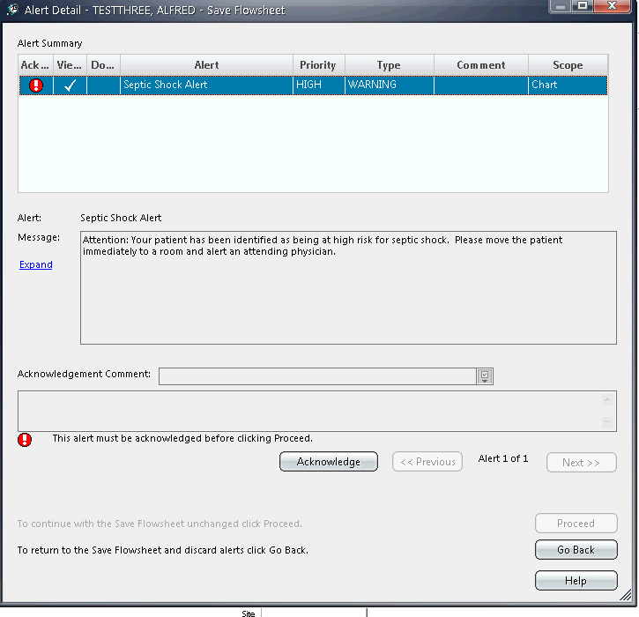
Example of alert

Slide 70
Sepsis intervention
When a patient fires the alert they are triaged high acuity and brought immediately back to a room
An attending or fellow must see the patient within 10 minutes
They then decide whether to use (green light) or not use (red light) the package
The IT department created an EMR order bundle for sepsis
When activated the patient receives:
20cc/kg of fluids in 20 minutes
60cc/kg of fluids in 60 minutes
Antibiotics given STAT
Options for inotropes and hydrocortisone

Slide 71
Timeline
Improving Pediatric Sepsis Outcomes
DO2
and
VO2
Fluid-Refractory
Sepsis
ACCM/PALS
Guideline
Update 2009
Surviving Sepsis Campaign
Study the Guideline
Early Fluid Resuscitation
ACCM/PALS
Guideline
2002
Early Antibiotics
Implementation and QI
Pediatric Septic Shock Collaborative

Slide 72


PSSC->IPSO

Slide 73
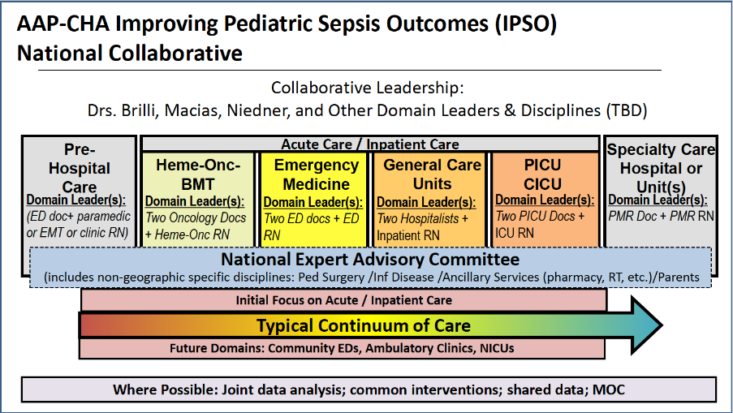

Slide 74
ACCM/PALS
Guideline
Update 2009
DO2
and
VO2
Fluid-Refractory
Sepsis
Surviving Sepsis Campaign
Study the Guideline
IPSO
Early Fluid Resuscitation
ACCM/PALS
Guideline
2002
Early Antibiotics
Implementation and QI
Pediatric Septic Shock Collaborative
Surviving Sepsis 2021

Slide 75

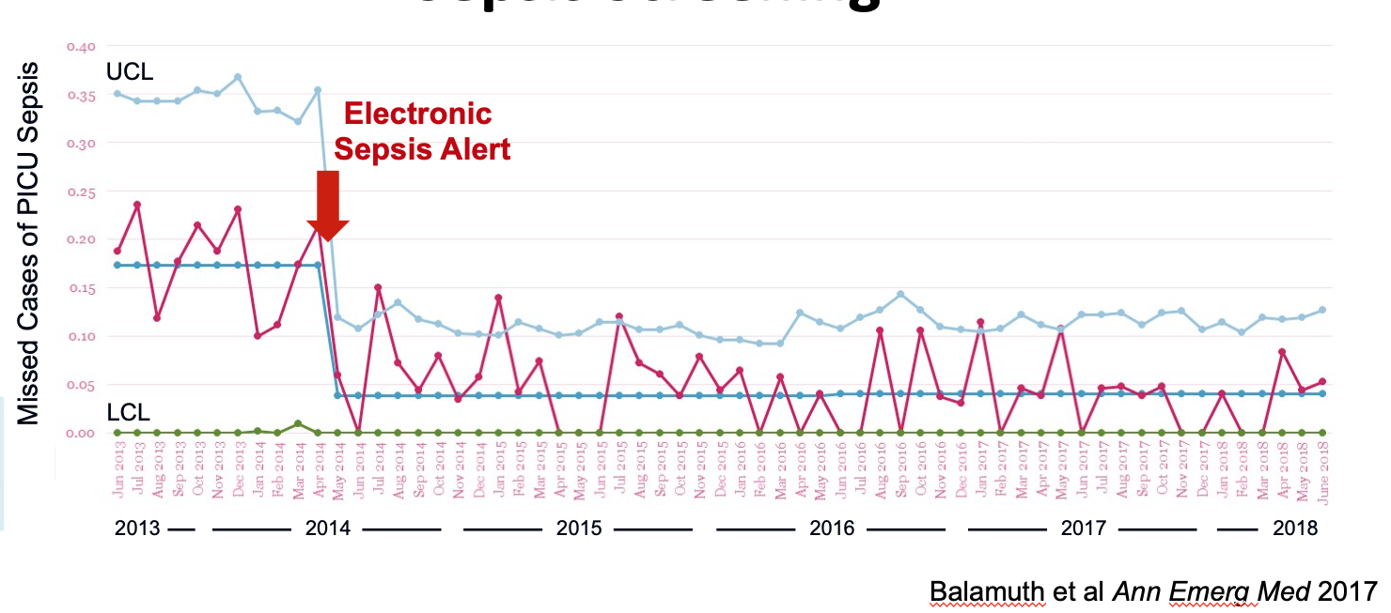
Notes:
The recommend a robust electronic screening tool and systematic plan for resuscitation.

Slide 76
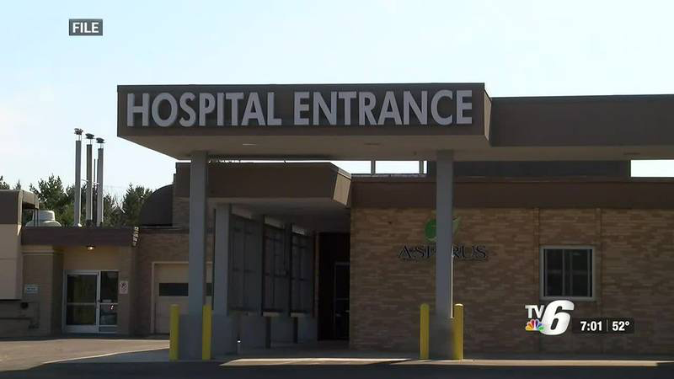
Notes:
New recommendation that patients at outlying hospitals without an ICU DO NOT administer fluid bolus unless the patient is hypotensive. In settings with an ICU give 40-60mL/kg over the first hour.

Slide 77
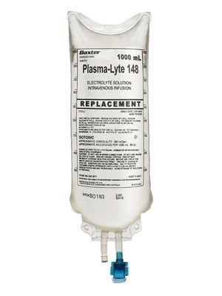
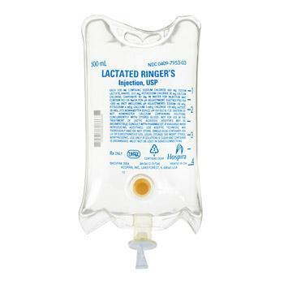
Notes:
Balanced fluid resuscitation (weak evidence, low rec)

Slide 78
ACCM/PALS
Guideline
Update 2009
DO2
and
VO2
Fluid-Refractory
Sepsis
Surviving Sepsis Campaign
Study the Guideline
IPSO
FUTURE
Early Fluid Resuscitation
ACCM/PALS
Guideline
2002
Early Antibiotics
Implementation and QI
Pediatric Septic Shock Collaborative
Surviving Sepsis 2021

Slide 79

So what can my rural hospital do???

Slide 80

Recognition
Half the battle in sepsis is RECOGNITION
40% of all pediatric visits are for fever
25% of sepsis patients have NO fever
65%+ are diagnosed with some infectious process
Hypotension is a LATE finding in kids and can’t be relied on
Fever increases HR and RR
How do you find the needle in the haystack?
MAKE the Needle Bigger

Slide 81


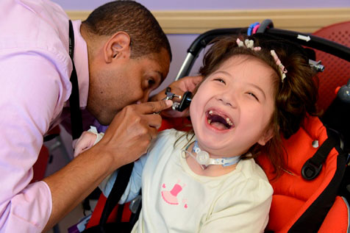
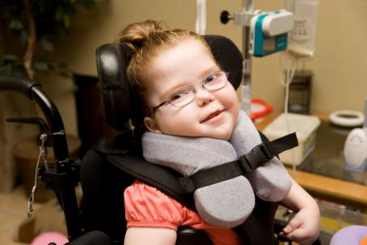
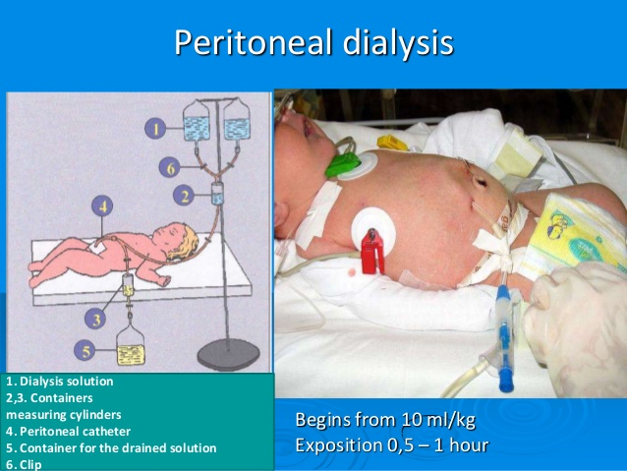
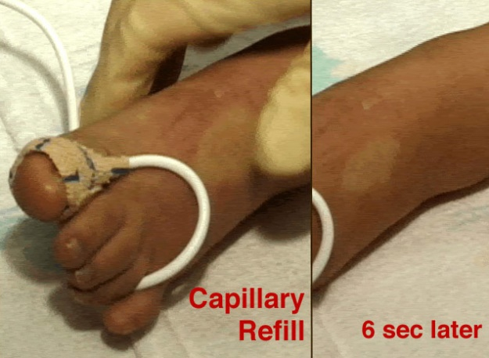

Recognition
Train your team to look for sepsis red flags in kids
High risk patient
Altered Mental Status
Poor perfusion
Persistent tachycardia after fever gone

Slide 82




Recognition
Let your EMR help!
If you think about sepsis when risk factors are present you are more likely to identify it
Build EMR alerts
Borrow from existing models from your EMR vendor
Lean on your referral center for pediatrics

Slide 83


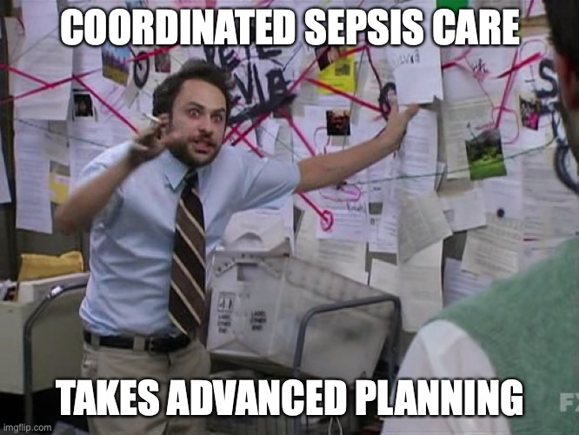
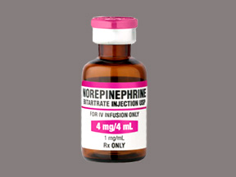
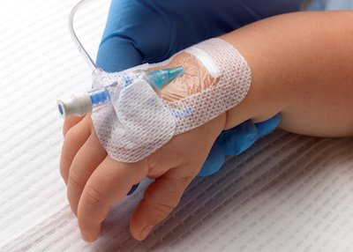
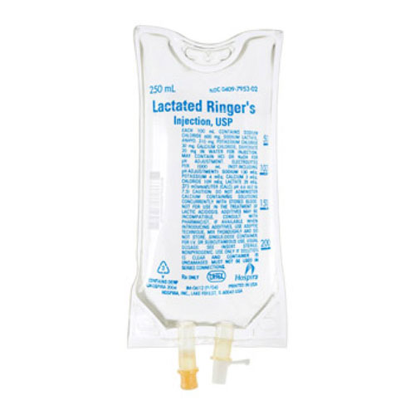
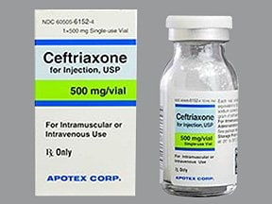
Escalation of Care

Slide 84

Remember
Quick Recognition and escalation of care in sepsis SAVES LIVES
You are our front line defense against this disease

