Slide 1
Signs of Stroke Big & Small
T. Scott Diesing, M.D. FHM
Neurohospitalist
Medical Director of Inpatient Neurology
Division Chief of Neurohospital Medicine
Associate Professor
Dept. Neurological Sciences

Slide 2
Agenda
Update on the current state of hyperacute intervention options for ischemic stroke.
Review classic and common stroke syndromes.
Tips on identifying high-reliability stroke signs.
Posterior circulation strokes: differentiating dizzy from deadly.
The latest literature. What's on the horizon?

Slide 3
Hyper-Acute Stroke Interventions

Slide 4
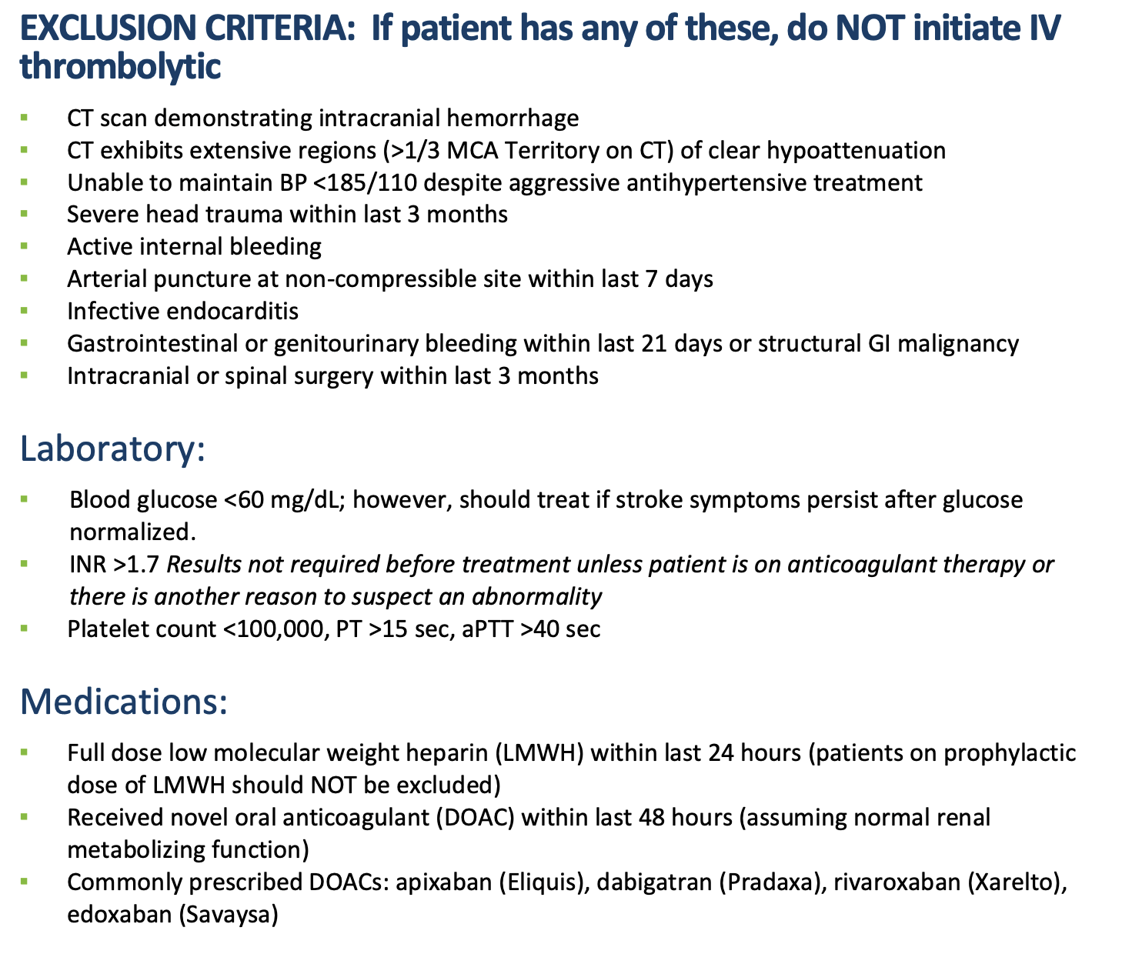
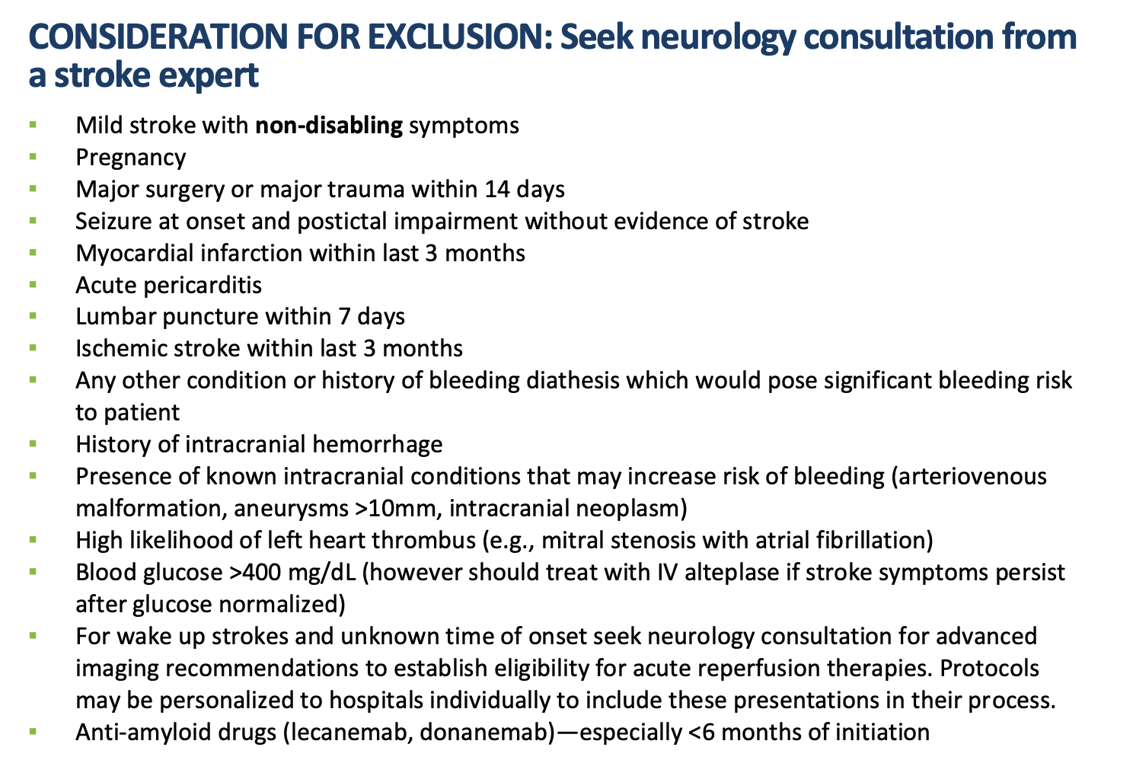
Thrombolytic Contraindications…sorta
Notes:
Evolving, nuanced, always exceptions

Slide 5
Thrombolysis if LTKW < 4.5hrs
High-yield tips on contraindications:
Should have disabling or potentially disabling deficits
“Minor” strokes may be better off with DAPT
Low NIHSS ≠ non-disabling
No similar transient symptoms in past few days
No DOACs or LMWH <48hrs, or warfarin and INR >1.7
DVT prophylactic doses are OK
BP must be < 185/110 immediately before administration
NEW -> anti-amyloid infusion therapy (lecanemab, donanemab)

Slide 6
Thrombectomy if LTKW 0-24hrs
Must have an occlusion!
Disabling or potentially disabling deficits
Must be a large vessel occlusion (LVO)
Carotids, vertebrobasilar, circle of Willis, M1/2
If LTKW <4.5hrs and + LVO ->can get both TNK and thrombectomy
If LTKW >4.5 hours
& no LVO -> medical management
+ LVO -> can get thrombectomy if perfusion scan good

Slide 7
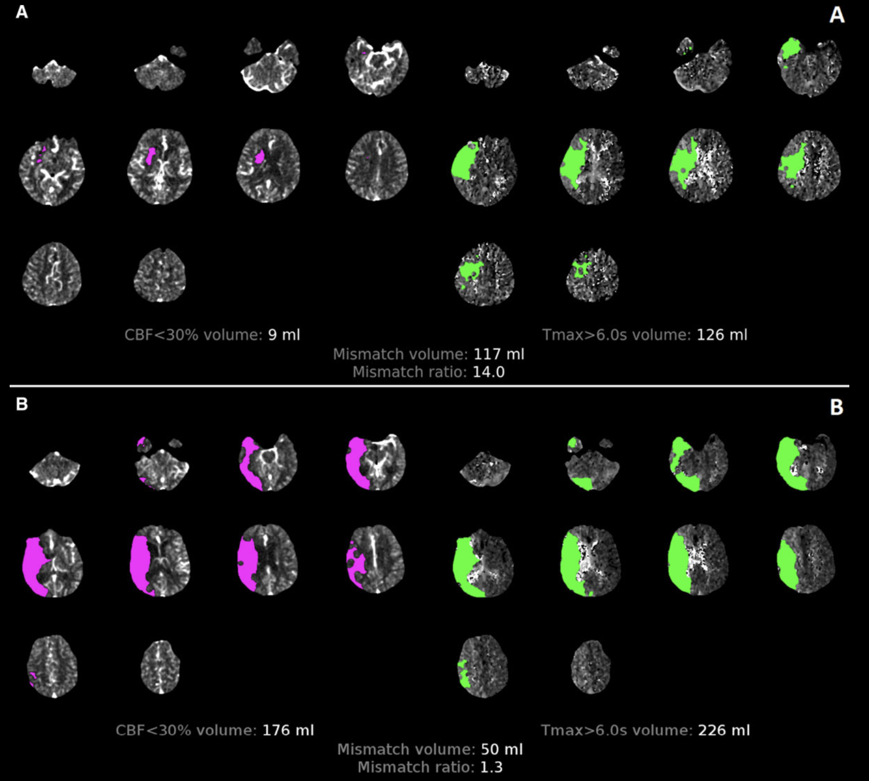
CT Perfusion
<- Favorable
Large penumbra
Small core
<- Unfavorable
Large core
Small volume of salvageable brain

Slide 8
Classic Stroke Syndromes
Notes:
Assuming single lesion.
Asymmetry is the theme.

Slide 9
Most common Strokes
24% Middle cerebral artery
23% Internal capsule or thalamic lacune
8% Brainstem lacune
7% Posterior cerebral artery
6% Cerebellar or other brainstem
5% Basilar artery
~11% Multifocal
4% Anterior cerebral artery
26% post. circulation
Notes:
Half of all ischemic strokes will be MCA or thalamocapsular lacunes.
26% are posterior circulation
We will go through the common signs.

Slide 10
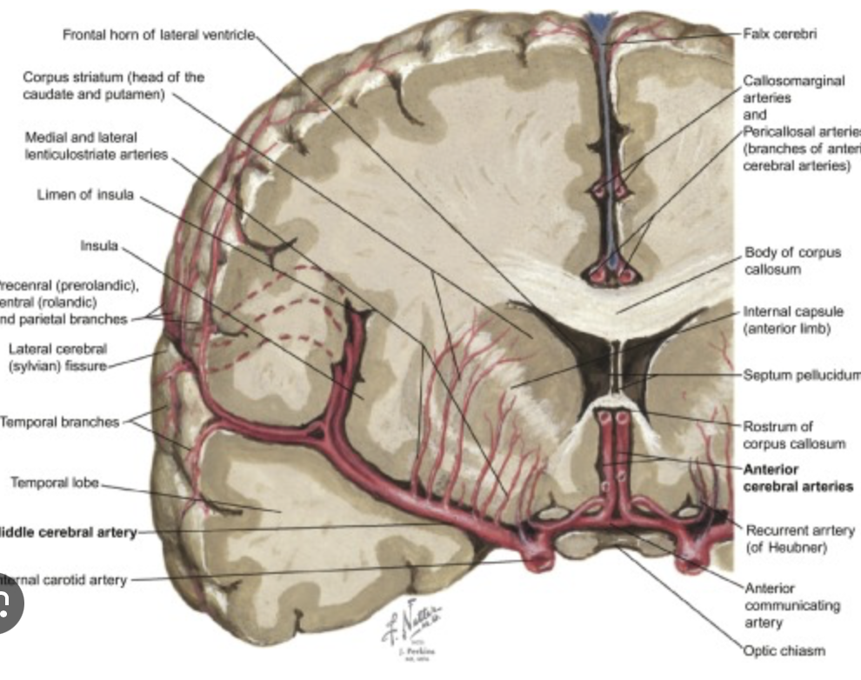
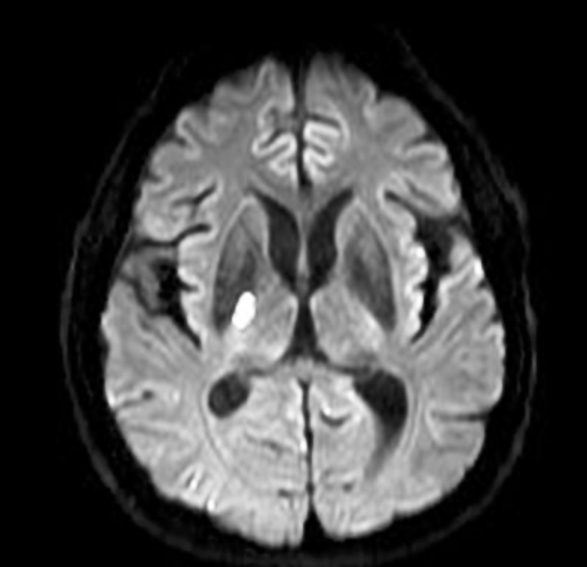
Lacunar Syndromes: Thalamocapsular
Notes:
Unique anatomy
Large to small vessel transition
Non-anastomotic
Condensed tracts

Slide 11
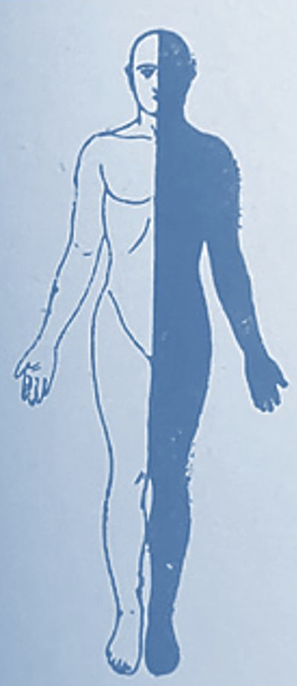
Lacunar Syndromes
One side of body completely affected
Complete unilateral weakness & numbness
Pure motor hemiparesis
Pure sensory hemi-numbness
Ataxic hemiparesis
*Dysarthria-clumsy hand syndrome
Notes:
Total hemi-body involvement.
Face amr and leg equally affected.
Usually includes torso.

Slide 12
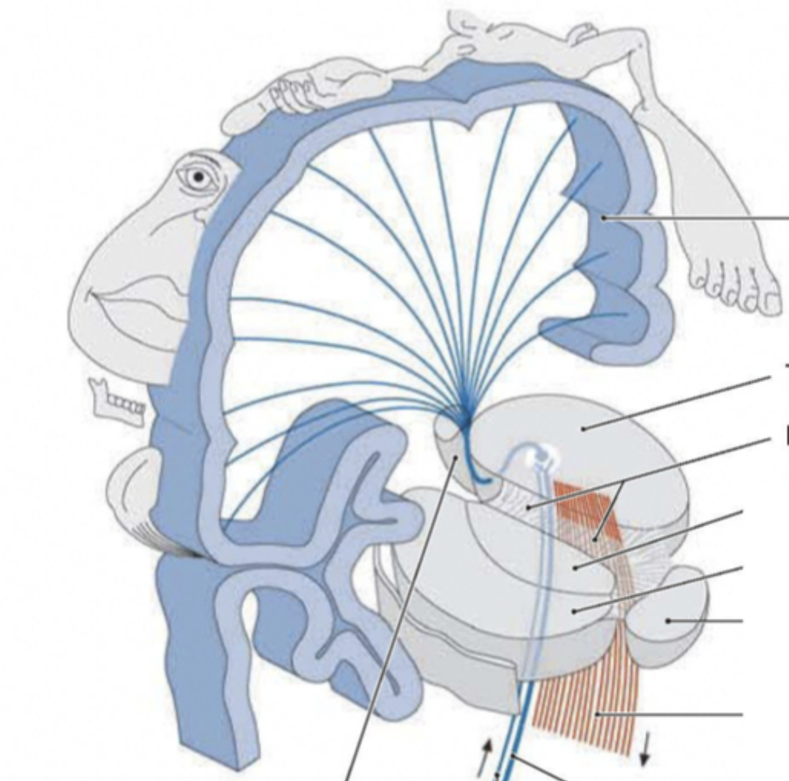
Weakness Patterns
Small subcortical lacune
Face = arm = leg
Large cortical infarct
Face ≠ arm ≠ leg
Often face & arm affected and distal leg spared.
Can be very focal such has “Hand-Knob” stroke

Slide 13
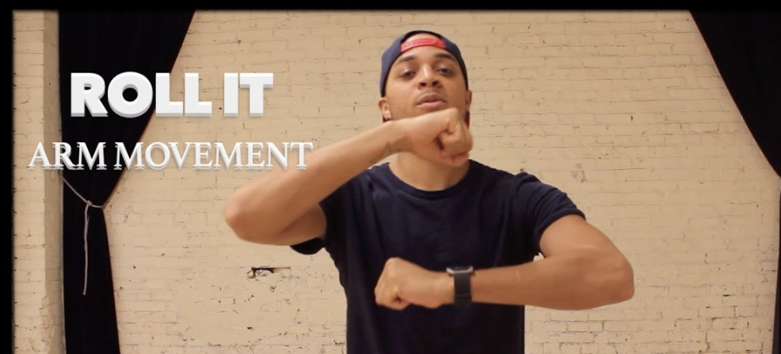
Weakness: Subtle Signs
Pronator drift
Elbows straight and elevated, thumbs out to sides.
Asymmetric finger (or toe) taps (aka dysiadochokinesia)
Should still be asymmetric while testing both sides
Satellite sign ->
Good arm rotates around weak arm like a satellite.

Slide 14
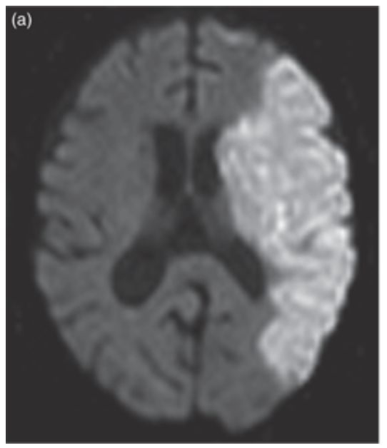
Middle Cerebral Artery Strokes
Unilateral weakness & numbness of arm, face, proximal leg.
+/- Gaze deviation away from weak side.
+/- Aphasia
+/- Hemi-neglect
+/- Vision loss to weak side, affecting both eyes

Slide 15
High-Reliability Stroke Signs
Notes:
Gaze deviation
Neglect
Aphasia
Asymmetric deficits
Crossed deficits at the neck
Not always present but very strongly associated with large infarcts.

Slide 16
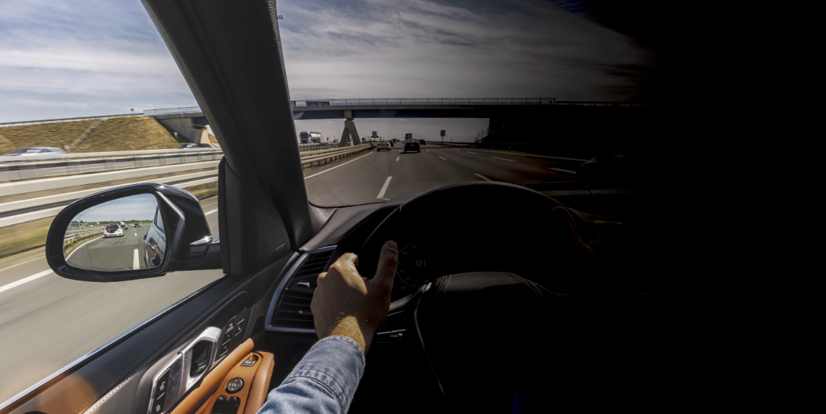
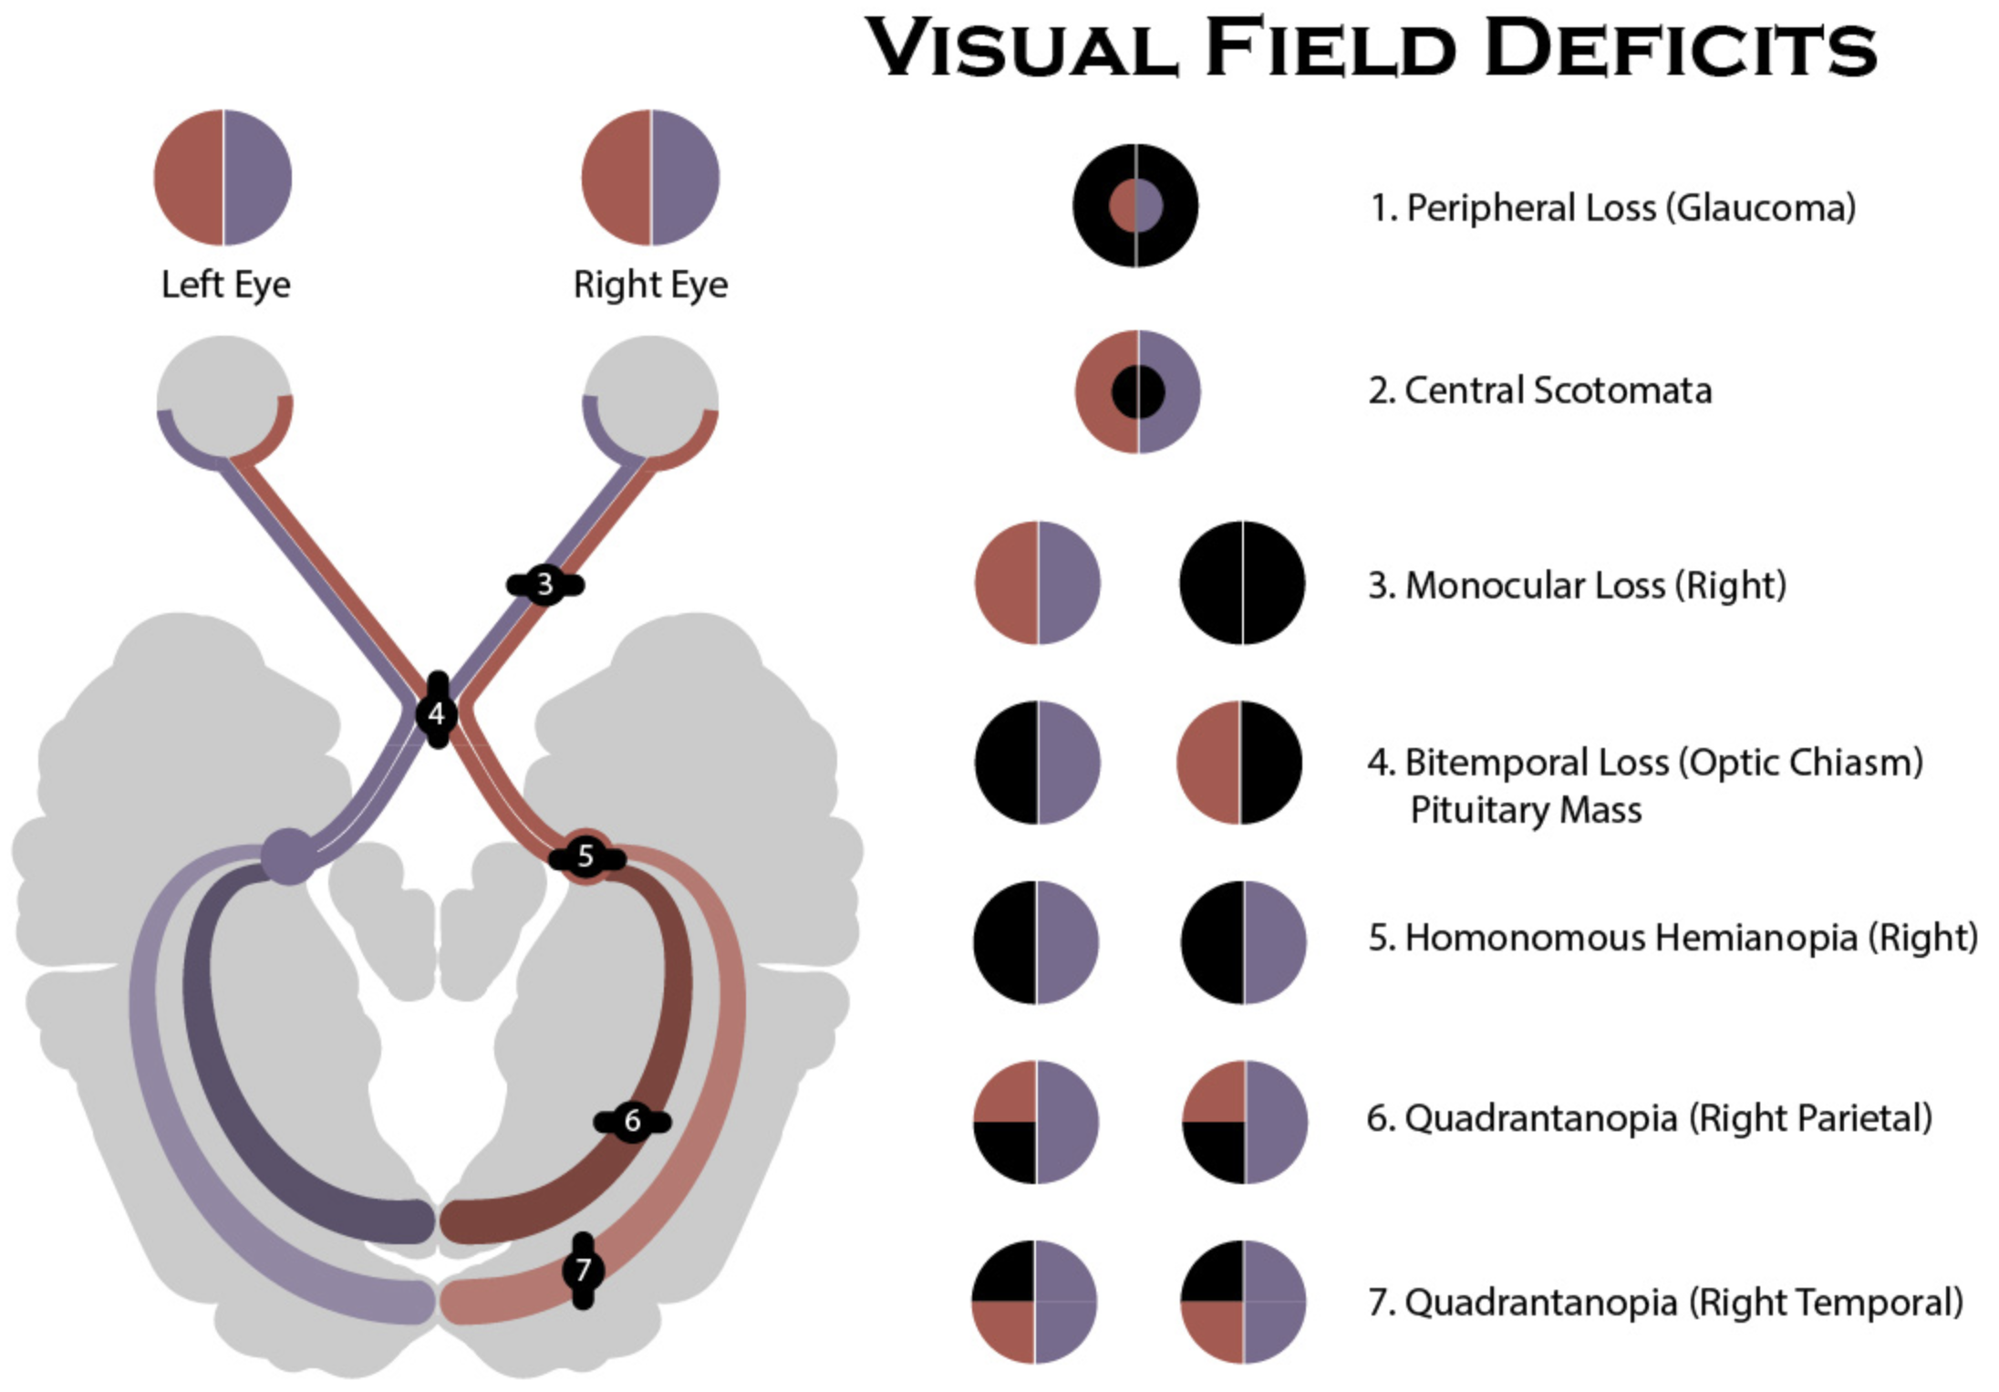
Painless Binocular Loss of Vision
Notes:
Highly reliable – Likely a stroke
PCA, MCA
Patient may not even be aware – concurrent neglect.

Slide 17
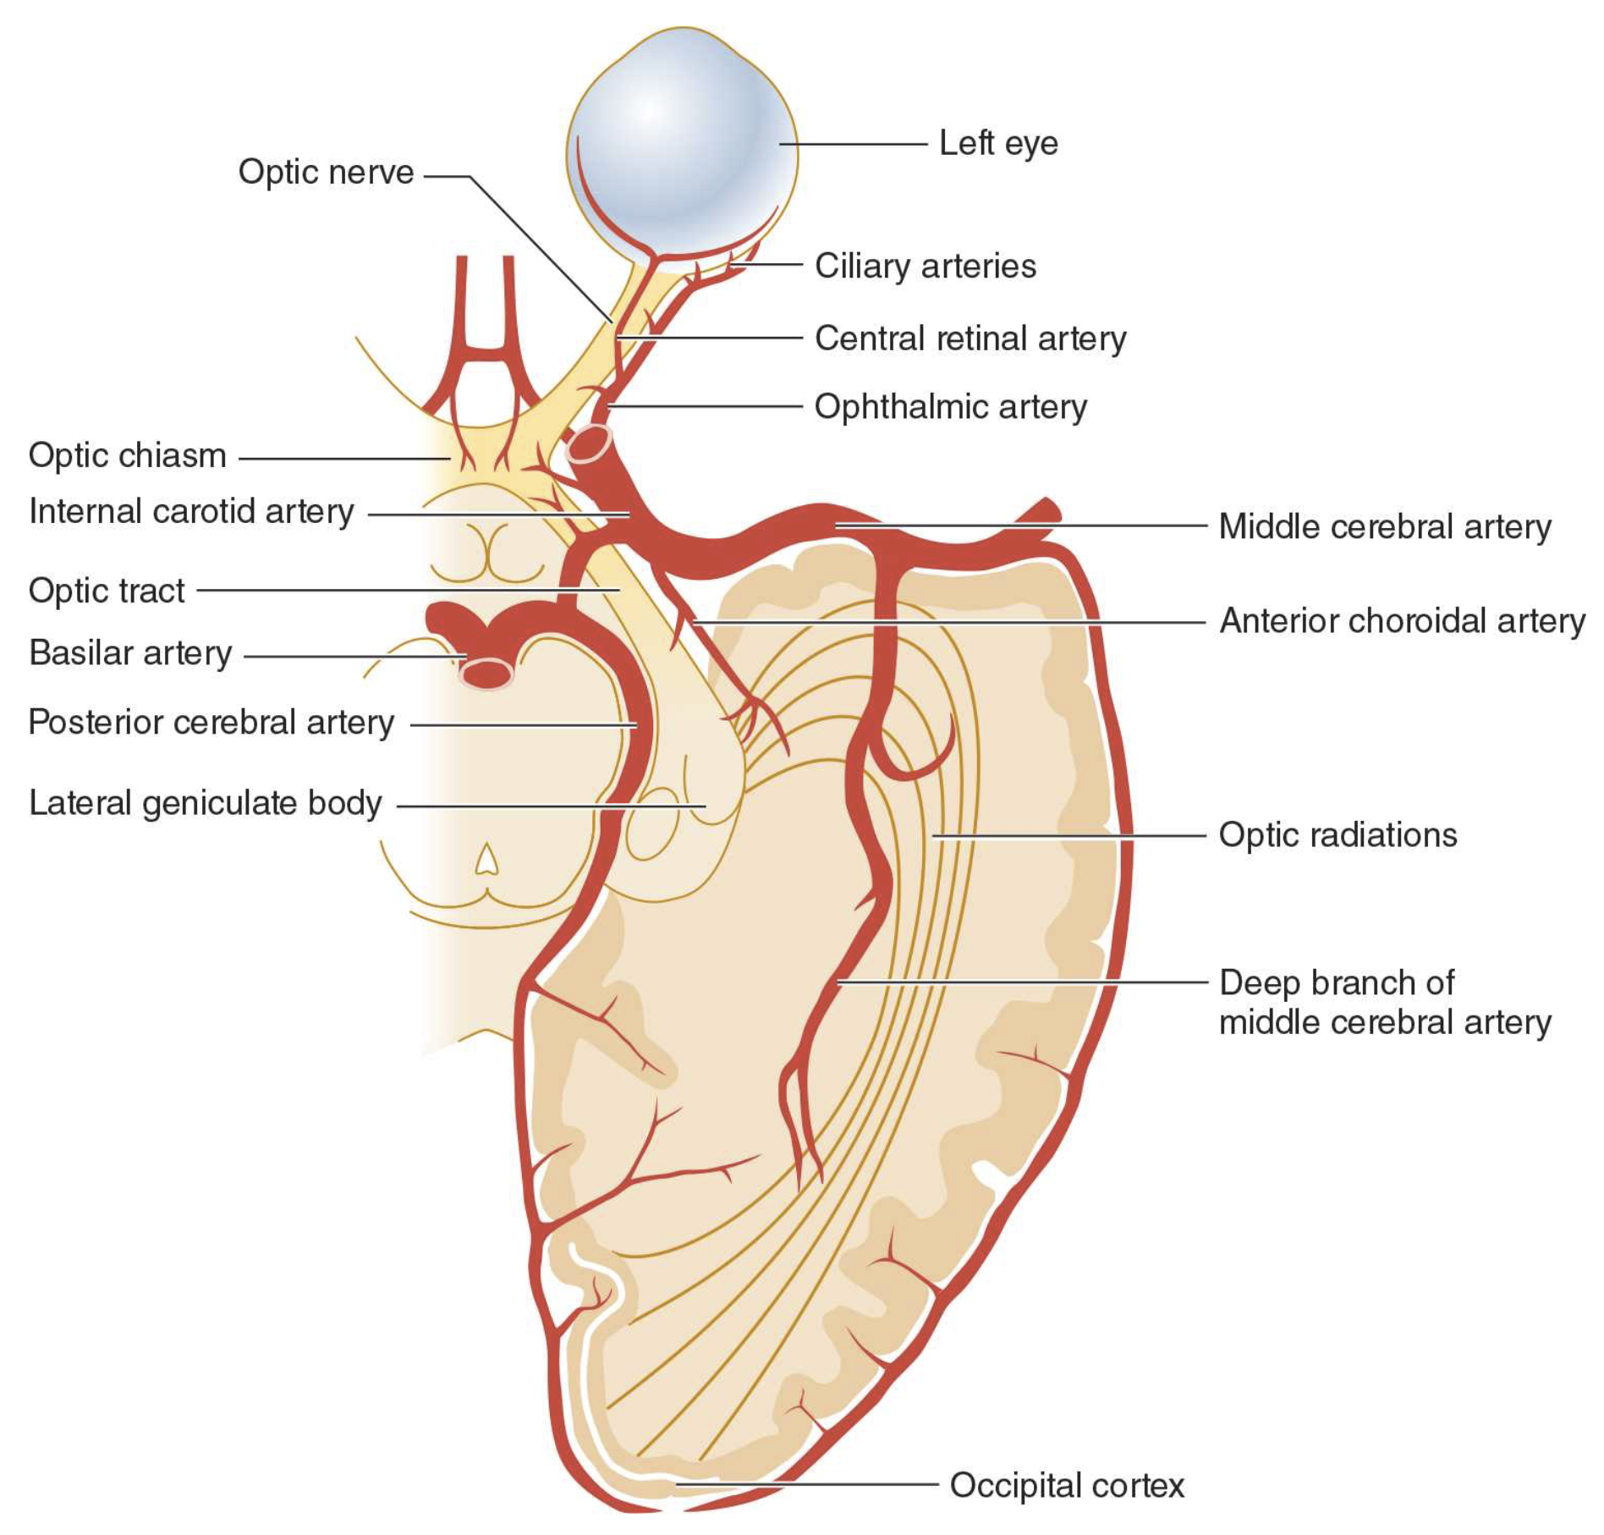
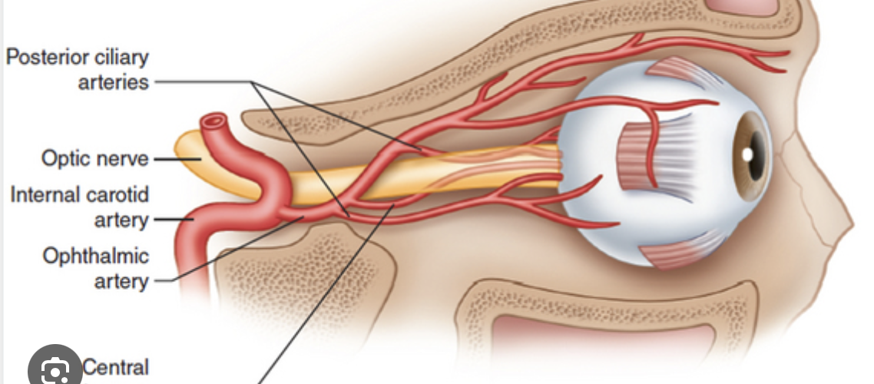
Painless Monocular Loss of Vision
Less specific to stroke, but still a reliable sign.
Notes:
Can be monocular or binocular but monocular can be many things and not as reliable (retinal, glaucoma)
Concerning for imminent carotid occlusion.

Slide 18
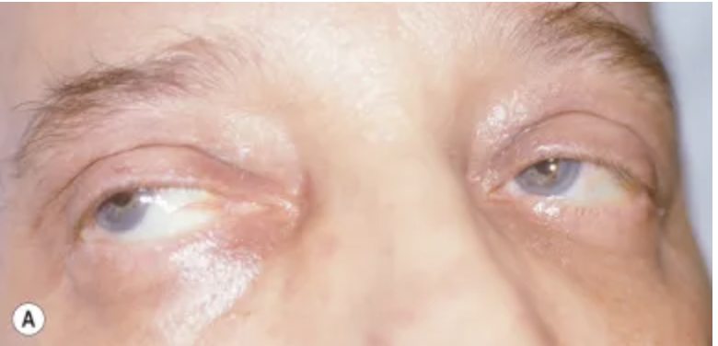
Conjugate Gaze Deviation
In an awake patient, both eyes looking to 1 side and can't voluntarily cross midline.
Not much else will cause this acutely except an ongoing seizure.
Look toward the stroke, away from the seizure

Slide 19
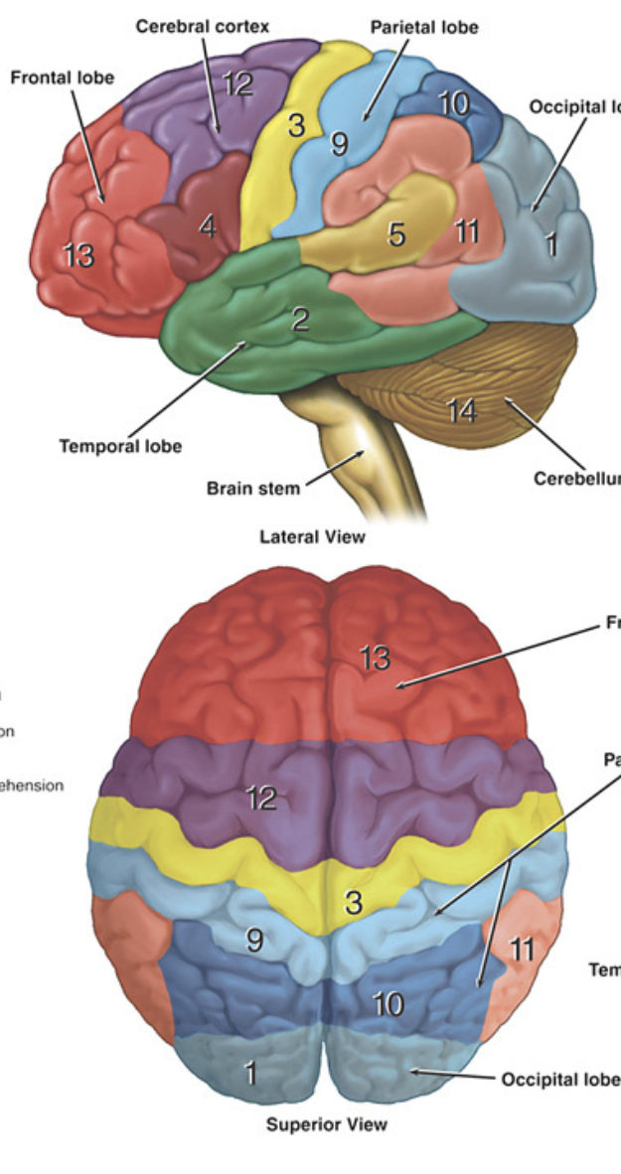
Conjugate Gaze Deviation
Can be:
Anterior hemisphere (frontal eye fields)
Posterior hemisphere (neglect)
Brainstem (can't even cross midline involuntarily with Doll’s Eyes maneuver)
Notes:
Sensitive for 3 locations.

Slide 20
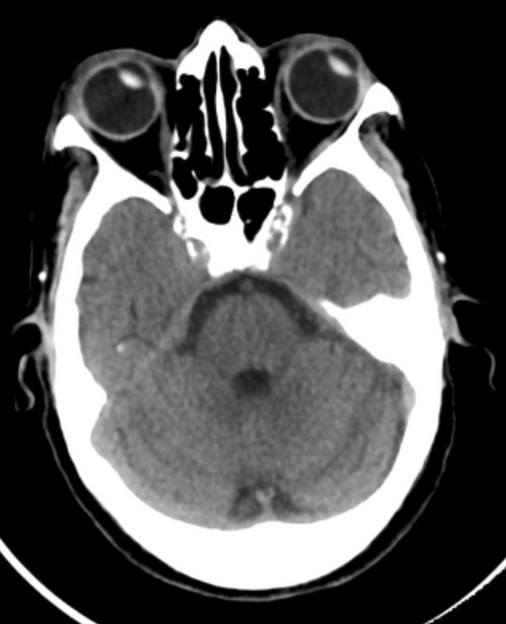
Notes:
Prevost (prey voh) sign or Vulpian sign

Slide 21
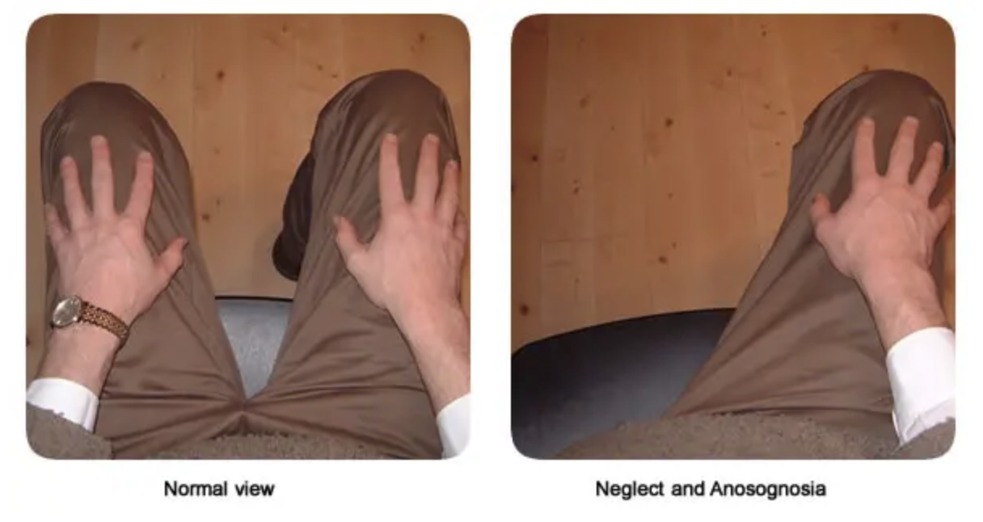
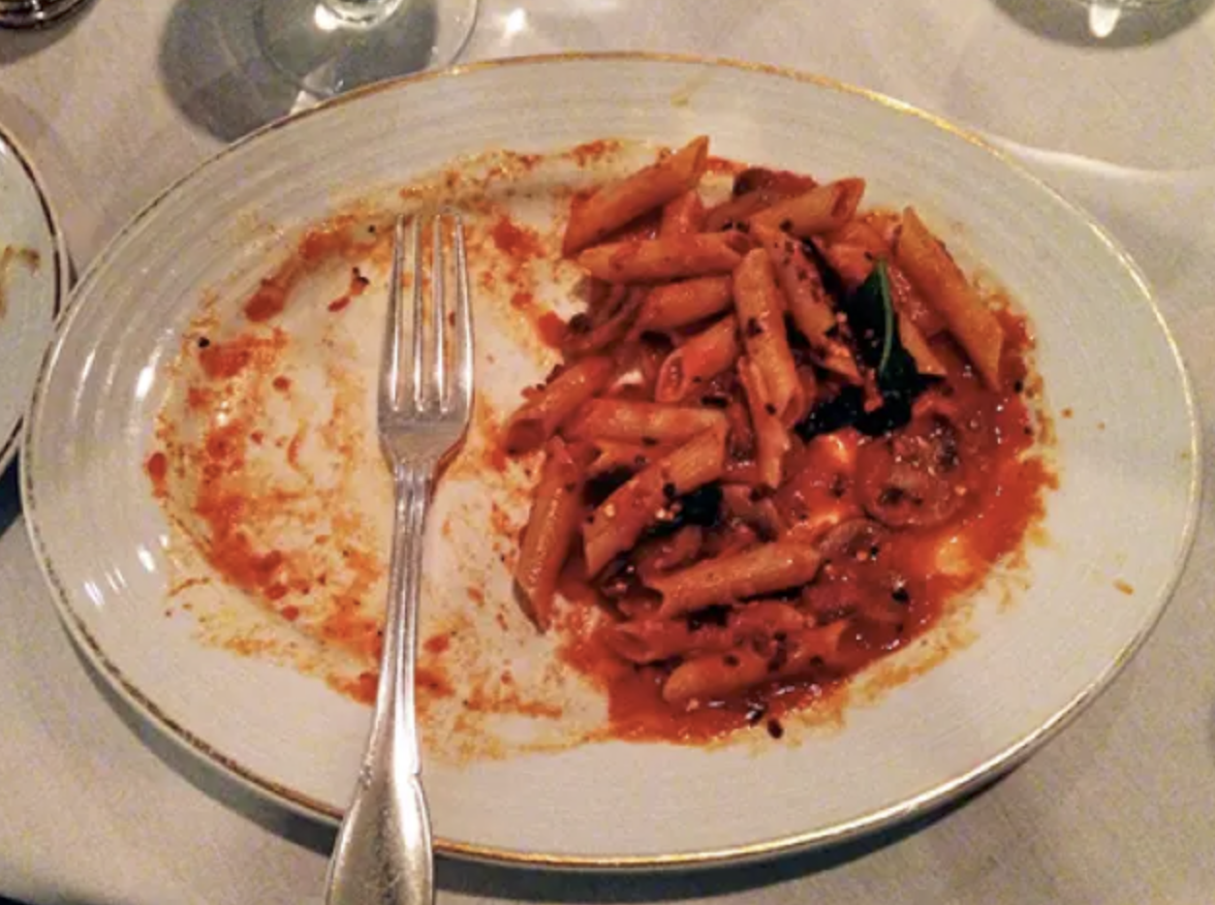
Hemi-Neglect
Patient is unaware or unable to recognize that there is a left (or right) side of themselves, the room, the world….
& may not think that’s wrong (anosognosia)
Often neglectful of the paretic side.

Slide 22
Hemi-Neglect
If called or stimulated from the neglected side, they will look the opposite way for the source.
If asked to raise both arms together, only the unaffected will raise, and the patient will believe they followed the command.
You may see intact sub-conscious movements of the neglected limb.
Movement with yawning, startle reactions, withdrawal, etc.

Slide 23
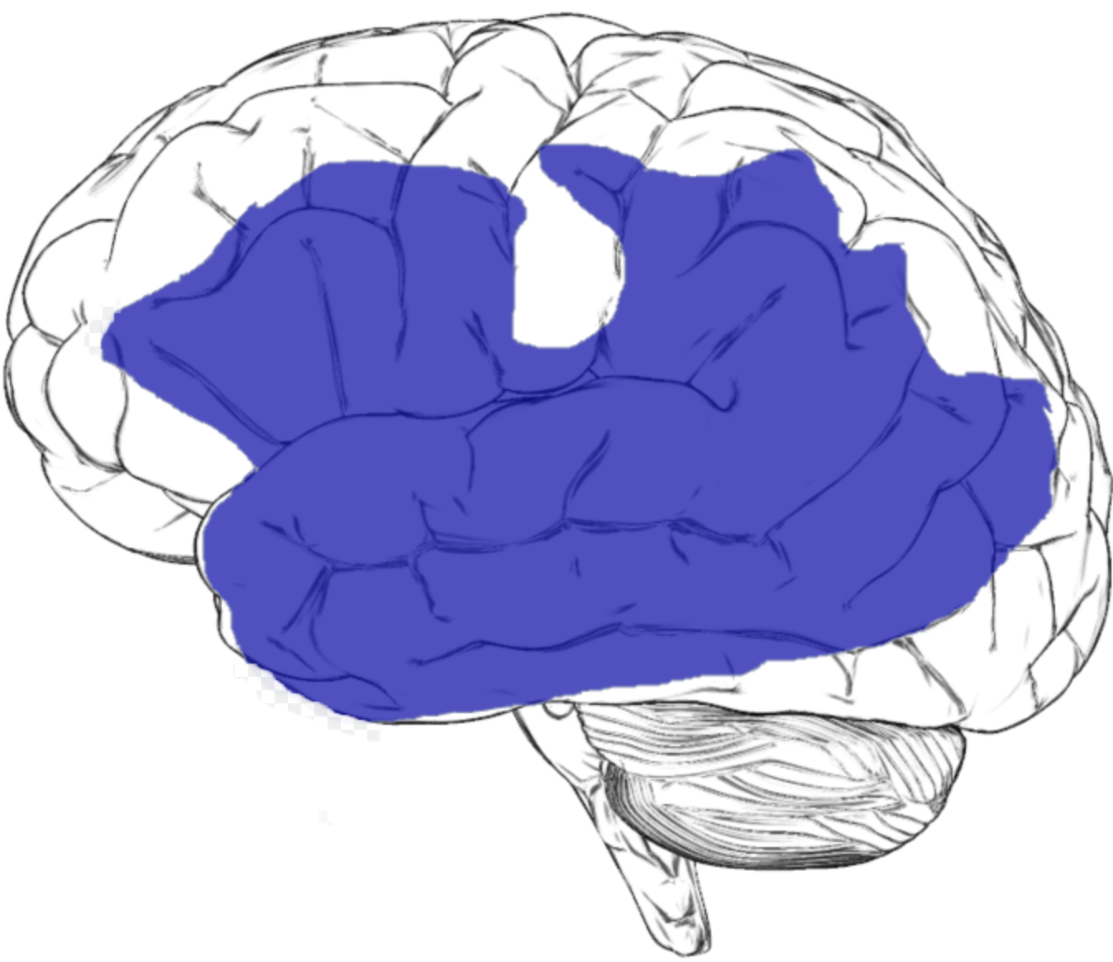
Aphasias
Broca’s (aka motor, expressive, anterior)
Can’t make the sounds but understands.
Wernicke's (aka sensory, receptive, posterior)
Makes sounds but the wrong ones. Doesn’t understand.
Mixed – Some of both.
Global – No language at all. Often mute.
…or are they just confused?
Notes:
Picture illustrates the entire network and why often people present with mixed or global aphasia.

Slide 24
More likely aphasic if …
Using the same word in place of most others.
“My my my my oh no oh no oh no my my oh no…”
Using the wrong words or names.
“Tall my wife, mine, tall my wine”“
Using words that are not real words.
“Borl youd nor meed ming”
Disproportionately intact common social responses or swearing..

Slide 25
Posterior Circulation Strokes (PCS): Differentiating Dizzy from Deadly?

Slide 26
Dizzy, Deadly, or Defendant?
Posterior Circulation Strokes (PCS)
~ 20% of all ischemic strokes
3X more likely to be misdiagnosed.
Relatively higher incidences in young & very old.
Can have very low and very high NIHSS.
Presentations are more often vague or non-specific.
Presentations more often point away from stroke.
CT is less sensitive in the brainstem.
Notes:
Not suspected in the young, masked by too many other things in the old.
NIHSS is biased towards anterior circulation strokes
(headache, LOC, loss of hearing)

Slide 27
“76yo CC: dizzy/unsteady”. 😱
Dizziness is the most common (~50-75%) symptom of PCS
4% of all ED CCs are “dizzy”
3.2% of ED patients with dizziness are having a stroke/TIA.
Yet dizziness by itself is uncommon.
Only 0.7% isolated dizzy patients are stroke/TIA
🤔… But is it really isolated?
Notes:
Kerber et al 2006

Slide 28
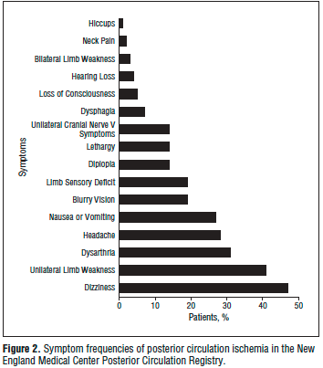
Presenting Symptoms of PCS: Triage
Pre-hospital - Most of these symptoms are not picked up by FAST, RACE, or CSS
ED Triage – Can make up for it using “3N5D”
Nausea
Numbness
Nystagmus
Dizziness
Diplopia
Dysarthria
Dysphagia
Drop attacks
Notes:
47% “dizziness” whatever that means
Unilateral weakness or numbness is easy to interpret but the rest are very vague and subjective especially for a triage nurse.
The majority of these symptroms are not picked up by FAST, RACE, or Cincinnati stroke scale

Slide 29
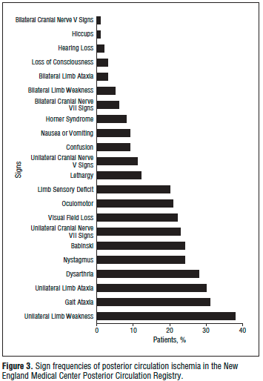

Exam Findings in PCS
Be confident that your exam is normal.
Tips on picking up subtle signs of ataxia, nystagmus, oculomotor dysfunction, & skew.
Notes:
Really be sure there is no ataxia (discuss tips to identifu it), disconjugate eyes, nystagmus, Babinski, facial palsy, choking on saliva (my sign)

Slide 30
Finger-Chase for Upper Limb Ataxia
Finger-chase >> than finger-to-nose test
Both require a target that moves in all 3 planes.
Finger-chase test
Examiner holds index finger out & moves it to new position every few seconds.
Patient tries to keep their index finger as close as possible to examiner’s index finger without touching.
Anything worse than 5 cm off or touching fingers = abnormal

Slide 31
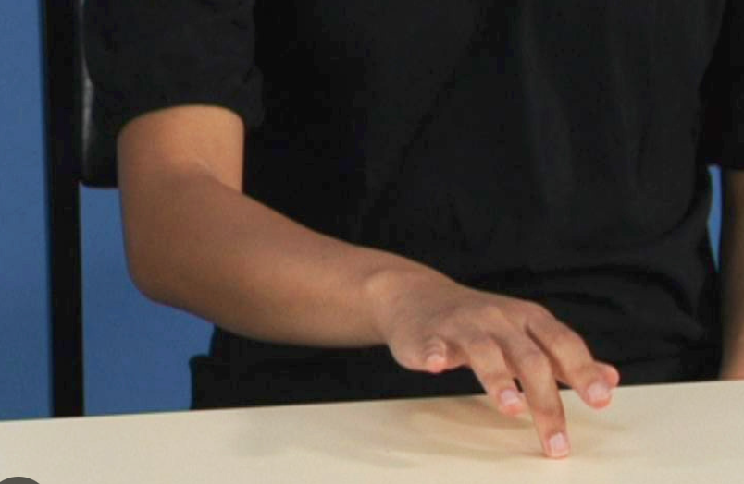
Tips for Identifying Upper Limb Ataxia
All testing techniques must have elbow elevated.
If significant shoulder problems:
Finger-tap test is best
You don’t have to be an expert. Just look for asymmetry!

Slide 32
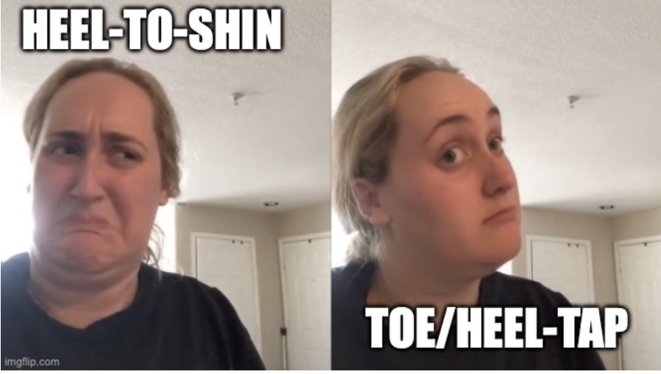
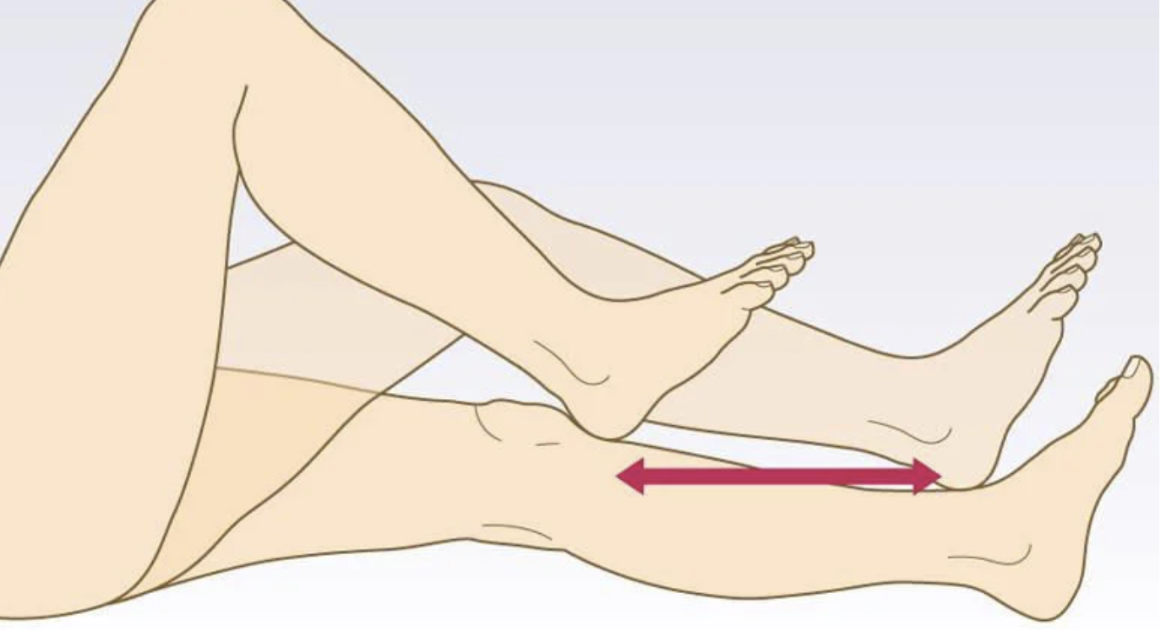
Tips for Identifying Lower Limb Ataxia

Slide 33
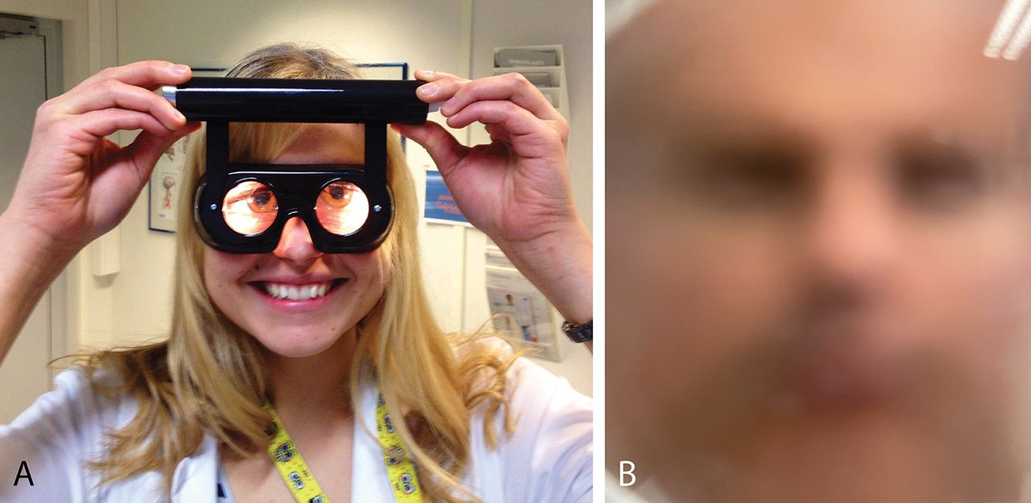
Tips on Eliciting Subtle Nystagmus
Initial exam tips:
Move your finger slowly and stay within shoulders.
Focused exam tip:
Eliminate visual fixation.
$1,000 Frenzel goggles
not needed.

Slide 34
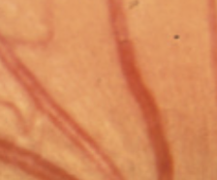
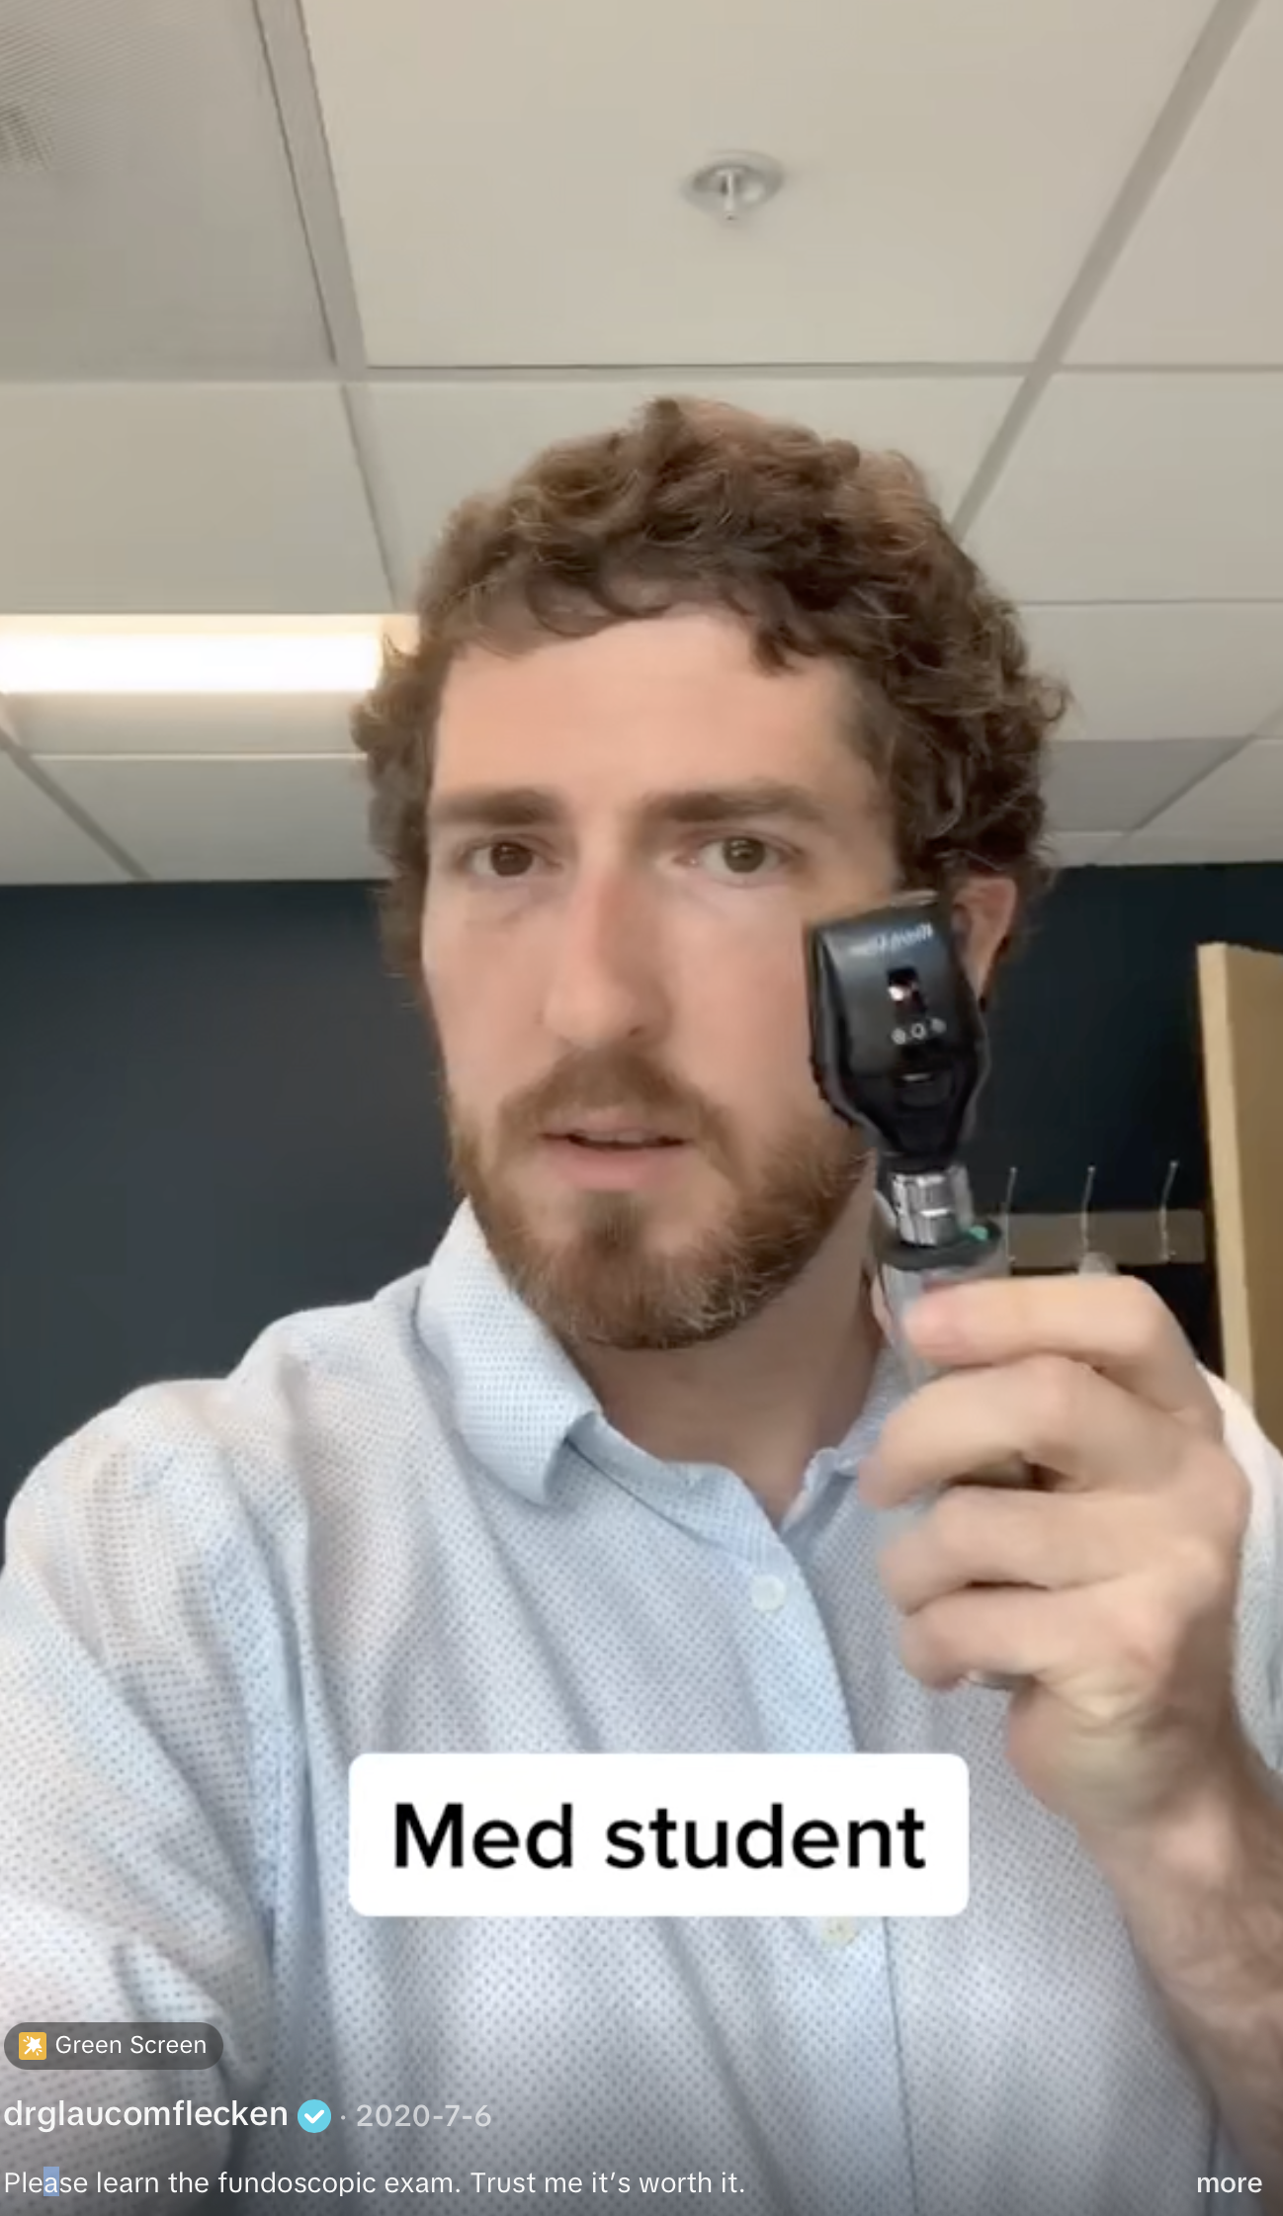
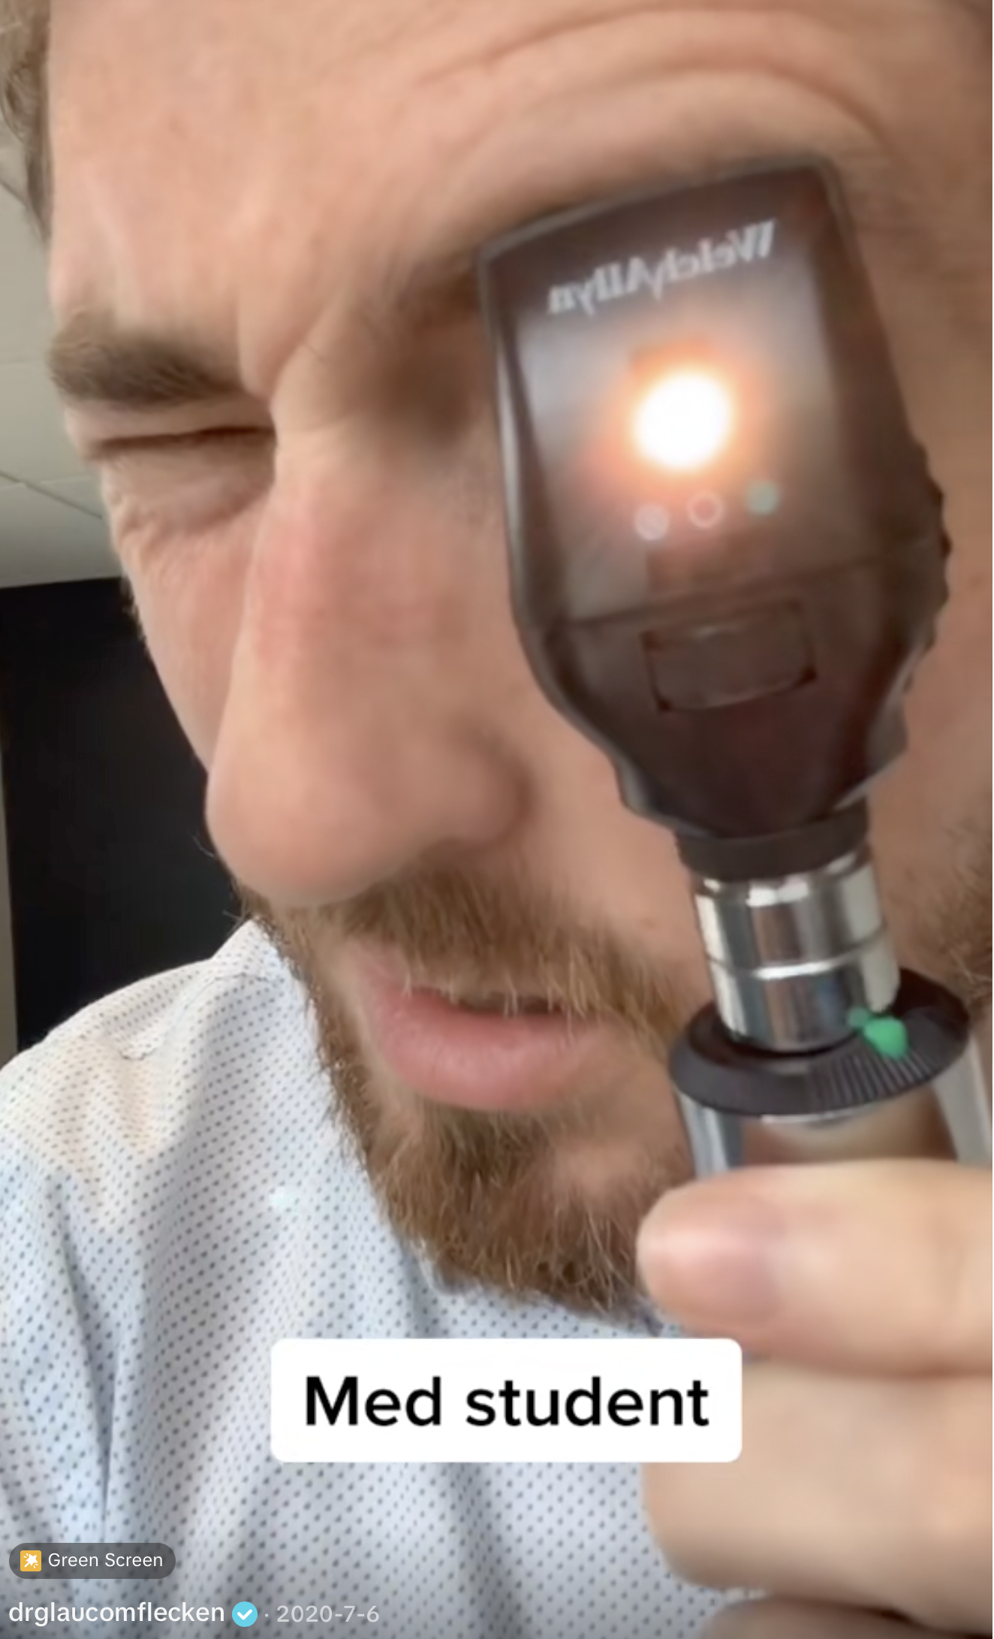
Poor Man’s Frenzel Goggles

Slide 35
Nystagmus: Nerdy Neurology Extras
Peripheral cause (vestibulopathy)
Horizontal (+/- torsional) unidirectional
Central cause (brainstem)
Any vertical, or multidirectional nystagmus.
Worsens when looking to the side.
Notes:
Worsens = fast component worse when looking away from lesioned ear. Bad ear draws slow deviation towards it.

Slide 36
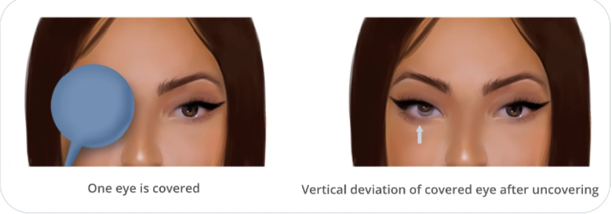
Oculomotor Dysfunction
Test of Skew
Any correction upon uncovering is abnormal.
Vertical corrections are from the brainstem dysfunction.
Notes:
Move the target. Hold for 2 secs.

Slide 37
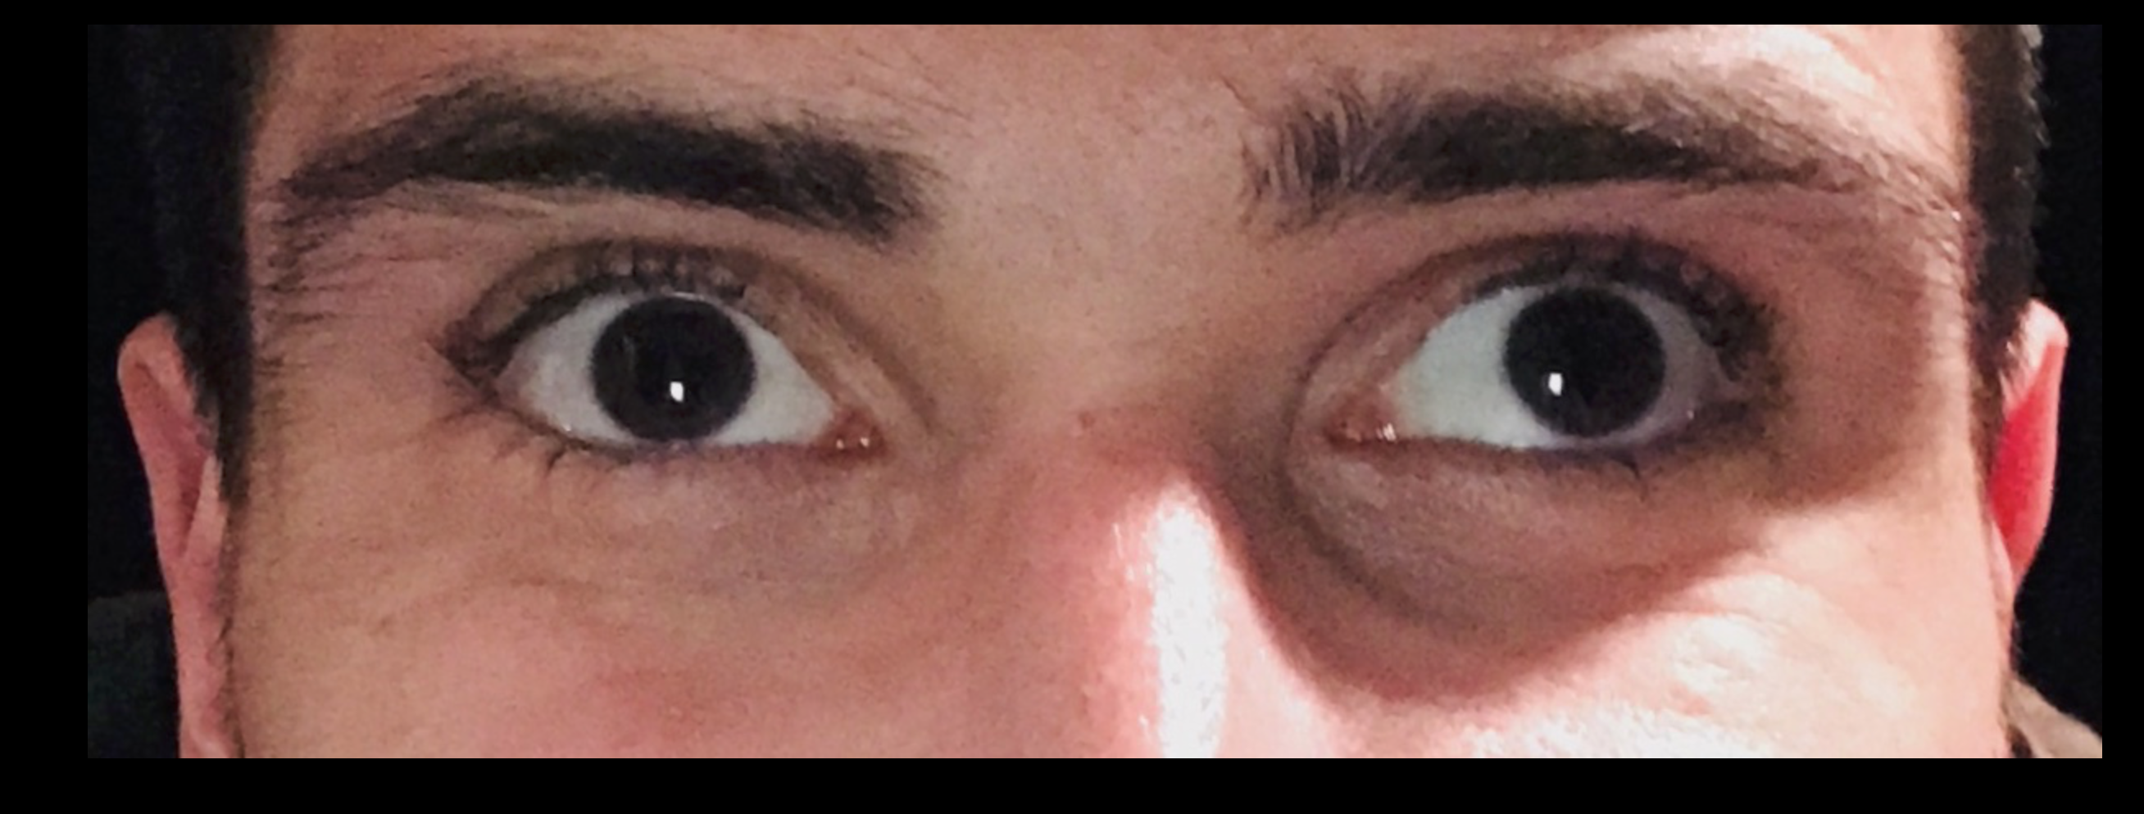
Tips: Subtle Oculomotor Dysfunction
“I can’t tell if there is misalignment, but something looks off.”
Pen-light reflection
Look at the where a focused light reflects off the pupil or iris.

Slide 38
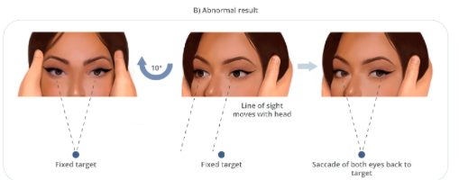
Tips: Subtle Oculomotor Dysfunction
Head Impulse test
Quick but gentle 15 degrees
Catch up saccade to midline suggests peripheral cause
Notes:
Warn the patient what you are going to do.
Abnomal ear is the the one that needs a corrective saccade when you turn the head that way. EG turn head to right -> get saccade = right vestibulopathy

Slide 39
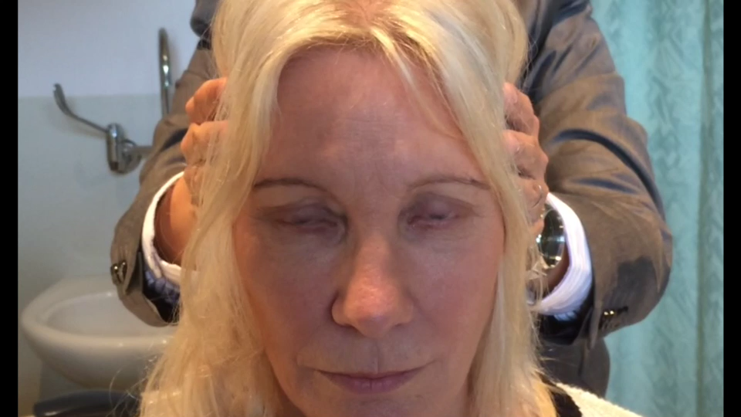
Head Impulse Test
Notes:
Tsang et all 2017

Slide 40
HINTS: Really helpful in AVS
Head Impulse Nystagmus Test of Skew
+HINTS Test
Normal horizontal head impulse test (no catch up)
Gaze directed nystagmus
Skew deviation
In patients with acute vestibular syndromes (AVS)
NPV 97% & PPV 60%
For posterior circulation strokes

Slide 41
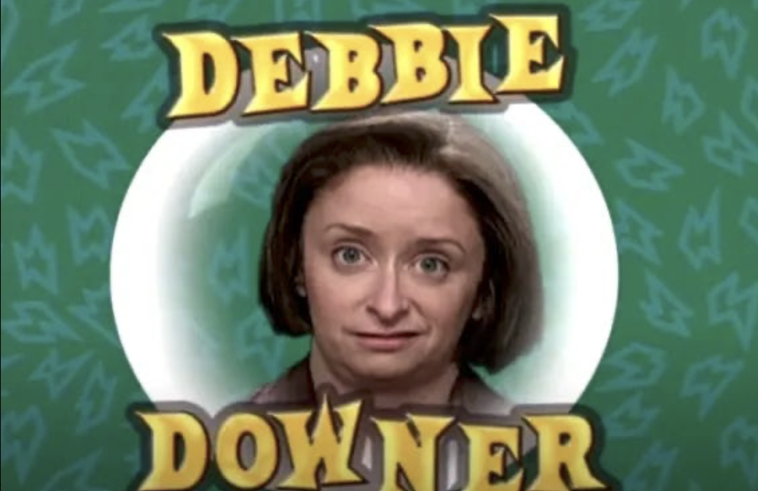
Hints on HINTS
Real world retrospective reviews & meta-analyses not as good.
Only applicable in acute vestibular syndromes (AVS)
Ongoing vertigo, unsteady, nausea, & nystagmus
Not applicable for episodic or positional vertigo.
Many patients get “dizzy meds” prior to focused exam.

Slide 42
Hints on Sneaky PCS Presentations
Specific situations where PCS can be missed.
Found down with disconjugate eyes or nystagmus
The obtunded “drunk”
Acute painless unilateral deafness and dizziness
Hiccups & soft neurologic symptoms.

Slide 43
Latest Literature on Thrombolytics
Anti-amyloid infusion therapies for Alzheimer’s
Lecanemab (Leqembi)
Donanemab (Kinsula)
Are new contraindications to thrombolysis due to high risk of intracranial hemorrhage.
Notes:
Wake up and extended window thrombolysis
AD infusions contraindication

Slide 44
Latest Literature on Thrombolytics
Late window thrombolysis may be on the horizon?
Thrombolytics for LTKW 4.5-24 hours
Using CT perfusion or MRI DWI/FLAIR mismatch
Showed benefit (~ 10% more people normal or nearly so at 90 days)
With no additional risk of ICH compared to standard 0-4.5hr window.
Mostly Chinese trials
OPTION (NEJM, Feb 2026, Ma et al)
EXPECTS (EXPECTS, NEJM Apr 2025, Yan et al)

Slide 45
Latest Literature on Thrombectomy
MeVO (Medium Vessel Occlusions) trials
Going after anything other than proximal MCA occlusion (M1s and proximal M2s) may not be helpful?
Large Core trials
Attempting thrombectomy despite a large infarct core may be beneficial in selected cases.

Slide 46
Agenda
Update on the current state of hyperacute intervention options for ischemic stroke.
Review classic and common stroke syndromes.
Tips on identifying high-reliability stroke signs.
Posterior circulation strokes: differentiating dizzy from deadly.
The latest literature. What's on the horizon?

Slide 47
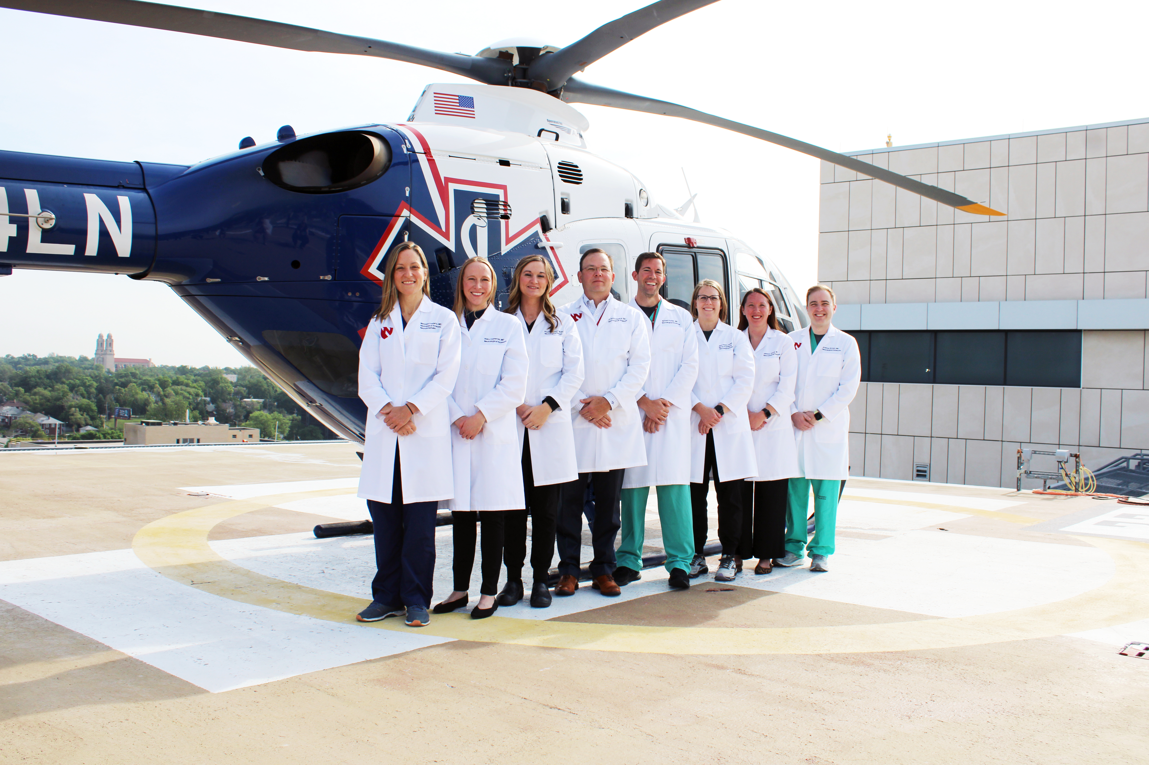
T. Scott Diesing tdiesing@unmc.edu

