Slide 1
Initial Assessment of the Trauma Patient
Zachary M. Bauman, DO, MHA, FACOS, FACS
Professor of Surgery
Medical Director of Surgical Safety
Medical Director of the Chest Wall Injury Program
Nebraska Medical Center, Omaha, NE

Slide 2
Disclosures
Paid educational consultant for Zimmer-Biomet, KLS-Martin, AtriCure, Smith and Nephew

Slide 3
Objectives
Overview of trauma epidemiology
Apply principles of primary and secondary surveys
Identify management priorities
Institute appropriate resuscitation and monitoring procedures
Pinpoint reasons to initiate early transfer to another facility
Teletrauma/RTTDC

Slide 4

Trauma in the U.S.
2.7 million hospital admissions/year
Leading cause of death for ages 1-44
100,000 deaths per year from traumatic injuries
  ½ die before they reach medical care

Slide 5
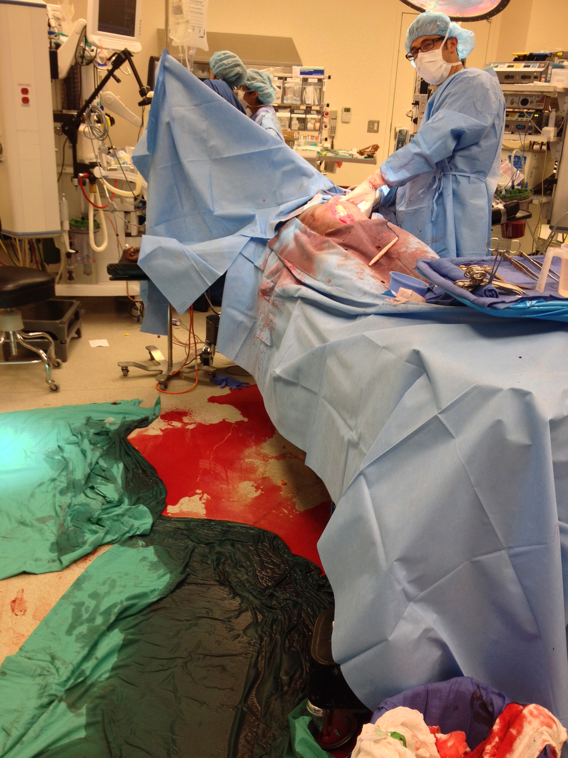
Hemorrhage is the leading cause of death in civilian and military trauma.
Eastridge, et al., J Trauma 2011;71:S4-8.
Kelly, et al., J Trauma 2008;64:S21-26.
Holcomb, et al., Ann Surg 2007;245:986-91.
Eastridge, et al., J Trauma Acute Care Surg 2012;73:S431-7.
Tien, et al., J Trauma 2007;62:142-6.
Teixeira, et al., J Trauma 2007;63:1338-47.

Slide 6
Number of Incidents by Age

Slide 7
Number of Incidents by Age and Gender

Slide 8
Fatality Rate by Age

Slide 9
Epidemiology
Trimodal distribution of mortality
Golden Hour = 80% of trauma deaths in first hour after injury
Rapid trauma care has greatest level of impact in these patients
50%
30%
20%
Immediately
Hours
Days/Weeks
Notes:
Within first hour: lacerations/penetrating injury to brain, brainstem, aorta, spinal cord, heart.
Within 3 hours: epidural, subdural, hemopneumothorax, pelvic fractures, long bone fractures, abdominal injuries.
Within days to weeks: sepsis, MSOF

Slide 10

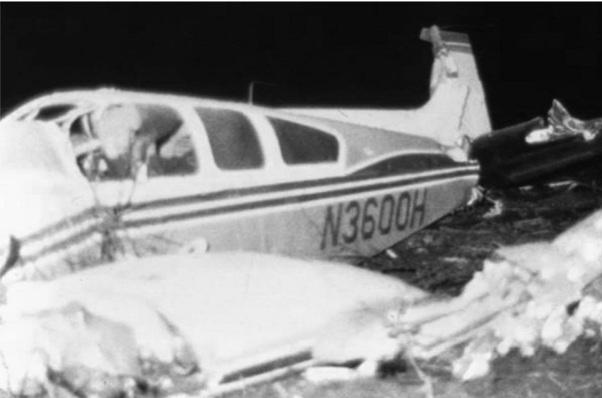
History of ATLS
Standardized Trauma Assessment
  Nebraska Cornfield, 1976
  Dr. James Styner
  Lead to development of ATLS
Notes:
Nebraska, 1976
- Orthopedic surgeon piloting a plane
- Crashed into a rural Nebraska Cornfield
- Surgeon sustained serious injuries, 3 children sustained critical injuries, wife killed instantly
- Care delivered on scene and at initial facility was inadequate
- Lead to development of ATLS Course in 1978

Slide 11
History of Trauma Systems
  First developed by military in wartime
    MASH Units
  Expanded in US to Level 1, 2, 3 Trauma Centers
    Level 1 – Highest level of care, leaders in research, clinical care and education
    Level 2 – Provides definitive care in wide range of complex traumatic patients
    Level 3 – Provides initial stabilization and treatment. May care for uncomplicated trauma patients
    Level 4 – Provides initial stabilization and transfers all trauma patients for definitive care
Notes:
Nebraska, 1976
- Orthopedic surgeon piloting a plane
- Crashed into a rural Nebraska Cornfield
- Surgeon sustained serious injuries, 3 children sustained critical injuries, wife killed instantly
- Care delivered on scene and at initial facility was inadequate
- Lead to development of ATLS Course in 1978

Slide 12
History of Trauma Systems
Worldwide, injuries are a leading public health problem accounting for 10% of global mortality!!!
23 – 25% of the US population lives in rural America, however 56.9% of all deaths caused by motor vehicle crashes occur in this setting!!!!
> 600 people die or sustain long-term disability from traumatic injury each day in the US….
→ 40% of these deaths are preventable if availability to
a well-organized trauma system!!!

Slide 13
Number of Incidents by Mechanism of Injury

Slide 14
Mechanisms of Blunt Injury
  Compression Forces
  Shear Forces
    Acceleration/Deceleration Injury
    Aorta
      Shearing force = Spectrum from full thickness tear (exsanguination) to partial tear (pseudoaneurysm)
  Overpressure
    Body cavity compressed at a rate faster than the tissue around it, resulting in rupture of the closed space
    Diaphragmatic rupture, bladder injury
Notes:
Mechanisms of Traumatic Injury
Blunt Trauma
Three separate types of forces involved in blunt traumatic injury that produce injury to the body and internal organs
Compression
Compression forces occur when cells in tissues are compressed and crushed similar to placing an organ (spleen) on a table and hitting it repeatedly with a hammer
Shear
Shear forces occur when an organ and the organ’s attachment do not accelerate or decelerate at the same time or same rate of speed.
Prime example is the aorta, the large blood artery that leaves the heart and carries blood to the body. The aorta is attached by branching vessels to the spine along the majority of the descending portion but is not attached by the same mechanism at the arch of the aorta.
So if a rapid decelerating mechanism is encountered the arch may move more freely than the descending aorta and the result is a shearing force or tearing that results in a full thickness tear in the aorta or disruption leading to immediate exsanguination or less extensive tear resulting in a pseudoaneurysm.
Similar shear forces work on other organs such as the spleen, kidney, etc.
Overpressure
Overpressure occurs when a body cavity is compressed at a rate faster than the tissue around it, resulting in overpressure and rupture of the closed space.
Example is a plastic bag filled with air that is then punched rapidly and results in high enough pressure to rupture the bag.
Similar mechanisms involved in abdominal cavity when compressed against the steering column of a car resulting in diaphragmatic rupture into the thoracic cavity. Also mechanisms involved in other organs with similar contained pressures, eg bladder, bowels, lungs.
Vehicular Collisions
Frontal Impact Collisions – A vehicle traveling at a higher rate of speed hits another vehicle that is moving at a slower rate of speed or is not moving at all and the vehicles are oriented with the passengers towards each other
The occupants of the vehicle traveling faster will continue to move forward even after the car has been stopped by the collision until they have impacted against another structure (steering wheel, windshield)
Lateral Impact Collisions
Rear Impact Collisions
Off-Center or Rotational Collisions
Rollover
Occupant Protection
Open Vehicles

Slide 15
Basics of Trauma Assessment
Preparation
  Team assembly
  Room preparation
  Equipment check
Triage
  Sort patients by level of acuity
  Not exceed your ability/resources:
  treat life-threatening injuries/patients first
  Will exceed your capacity/resources:
  treat the greatest chance of survival, with the least time, equipment, and personnel
Notes:
Basics of Trauma Assessment
The trauma assessment is comprised of several steps designed to construct a standardized method for trauma assessment to ultimately decrease trauma morbidity and mortality. It is comprised of several steps:
Preparation
Triage
Primary Survey
Resuscitation
Secondary Survey
Monitoring and Evaluation
Transfer to definitive care
saf

Slide 16
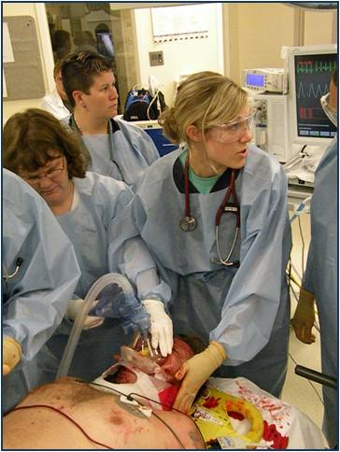
Basics of Trauma Assessment
Primary survey
  Designed to identify injuries that are immediately life threatening and to treat them as they are identified
Resuscitation
  Rapid procedures and adjuncts to treat injuries found in primary survey before completing the secondary survey
Notes:
Basics of Trauma Assessment
The trauma assessment is comprised of several steps designed to construct a standardized method for trauma assessment to ultimately decrease trauma morbidity and mortality. It is comprised of several steps:
Preparation
Triage
Primary Survey
Resuscitation
Secondary Survey
Monitoring and Evaluation
Transfer to definitive care
saf

Slide 17
Basics of Trauma Assessment
Secondary survey
  Full history and physical exam to evaluate for other traumatic injuries
Monitoring and evaluation, secondary adjuncts
Transfer to definitive care
  Floor, ICU, OR, IR, another facility
Notes:
Basics of Trauma Assessment
The trauma assessment is comprised of several steps designed to construct a standardized method for trauma assessment to ultimately decrease trauma morbidity and mortality. It is comprised of several steps:
Preparation
Triage
Primary Survey
Resuscitation
Secondary Survey
Monitoring and Evaluation
Transfer to definitive care
saf

Slide 18
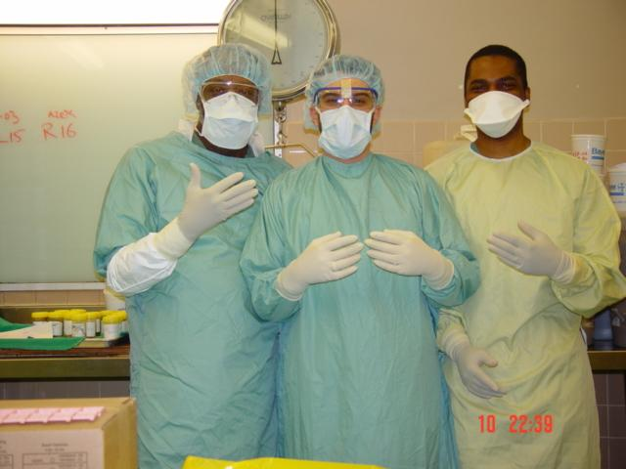
PPE
Cap
Gown
Gloves
Mask
Goggles/face Shield
Lead apron
Shoe covers

Slide 19
Primary Survey
Key Principles
  When you find a problem during the primary survey, FIX IT!
  If the patient gets worse, restart from the beginning of the primary survey

Slide 20
Primary Survey
Airway with c-spine protection
Breathing with adequate oxygenation
Circulation with hemorrhage control
Disability and brief neurologic exam
Exposure/Environment

Slide 21
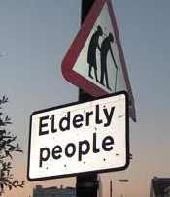
Primary Survey
Same priorities for all patients
Special consideration:
  Elderly
  Pediatrics
  Pregnancy

Slide 22
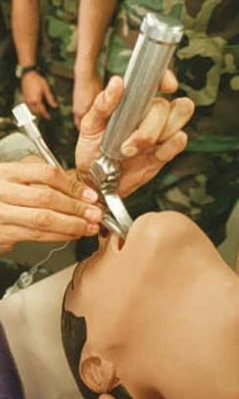
Primary Survey:
Airway
Assess for patency
Establish patent airway
Maintain patent airway
Protect c-spine
Pitfalls
Progressive loss of airway
Difficult airway & need for surgical airway
Severe facial/airway trauma
Equipment failure

Slide 23
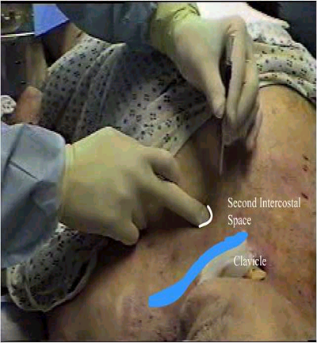
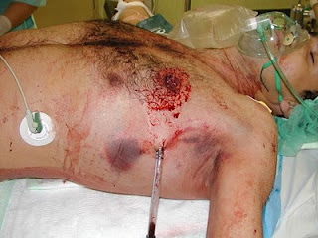
Primary Survey:
Breathing
Assess and ensure adequate oxygenation and ventilation
Respiratory rate
Chest movement
Air entry/breath sounds
Oxygen saturation

Slide 24
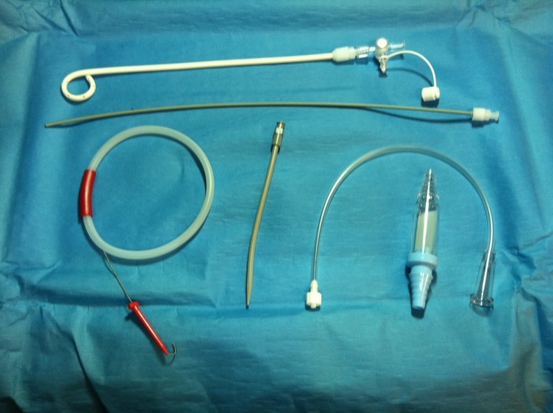
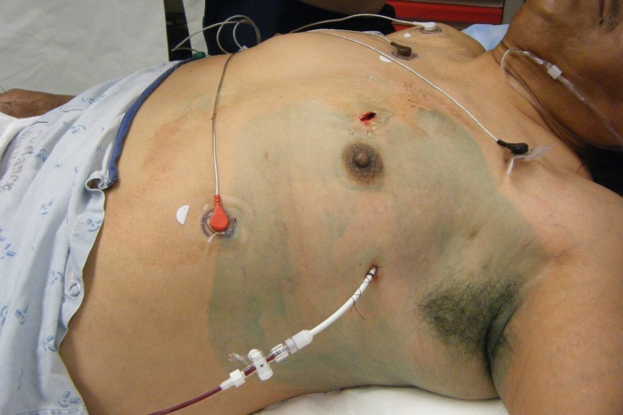
Primary Survey:
Breathing
14Fr Pigtail Catheters have been shown to be just as good as large bore catheters at draining PTX and HTX.

Slide 25
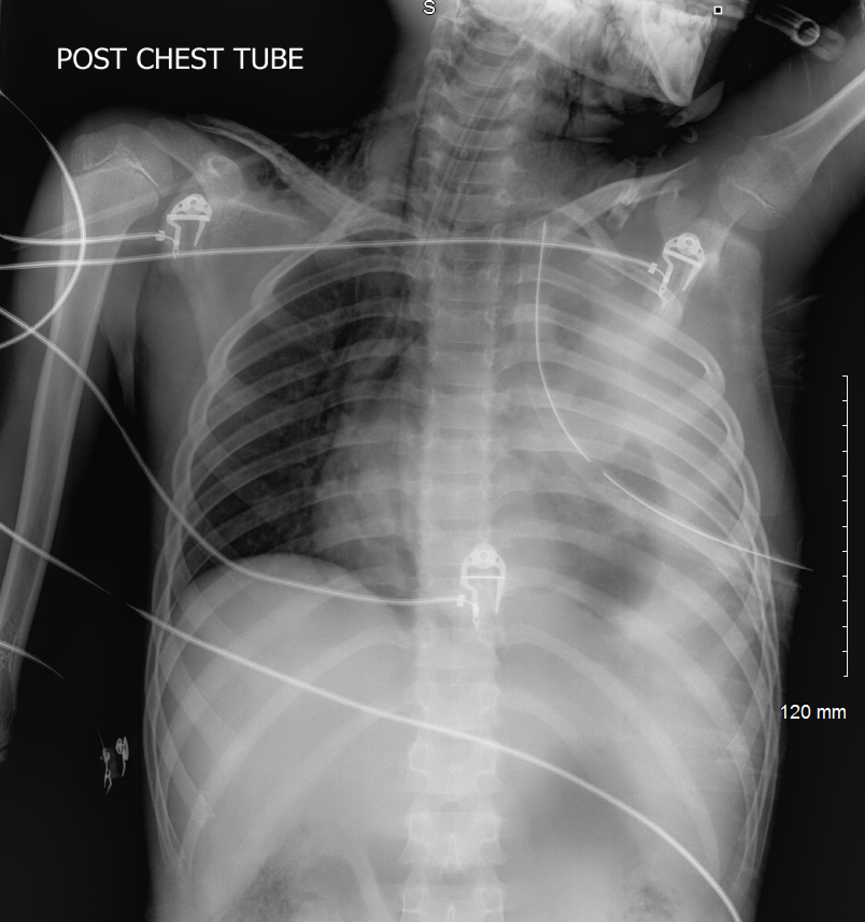
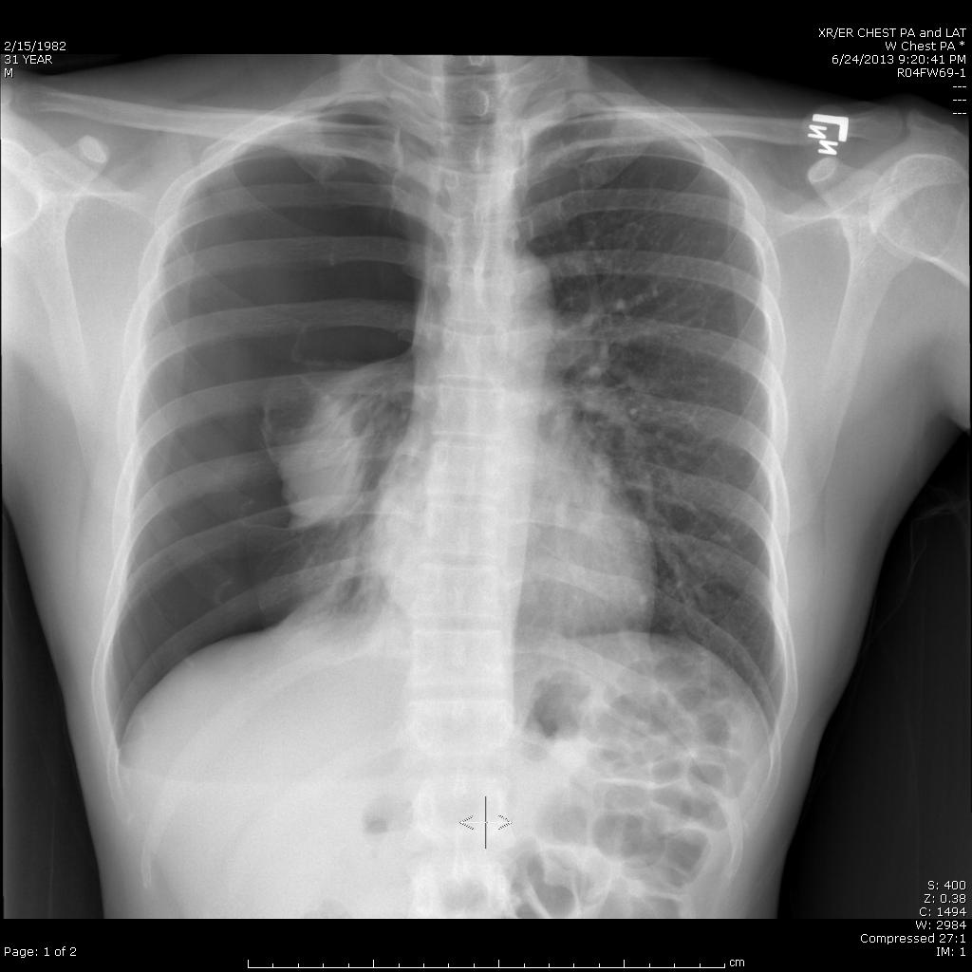
Primary Survey:
Breathing
Life threatening chest injuries
  Tension pneumothorax
  Massive hemothorax
  Pneumothorax
    Chest tube for transfer
  Flail chest

Slide 26
Early VATS for Retained Hemothorax
Radiographically apparent hemothorax after tube thoracostomy
→ 33% rate of empyema (Karmy-Jones R et al. Can Respir J.)
If retained hemothorax within 72 hours of initial chest tube placement
→ Patients benefited from early VATS (3-7
days) as opposed to second chest tube
- Shorter duration of chest tube drainage
- Shorter duration in hospital stay
- Significantly less hospital costs
- Almost half the patients that had a second chest
tube still required surgery (Meyer DM et al. Ann Thoracic Surg.)

Slide 27
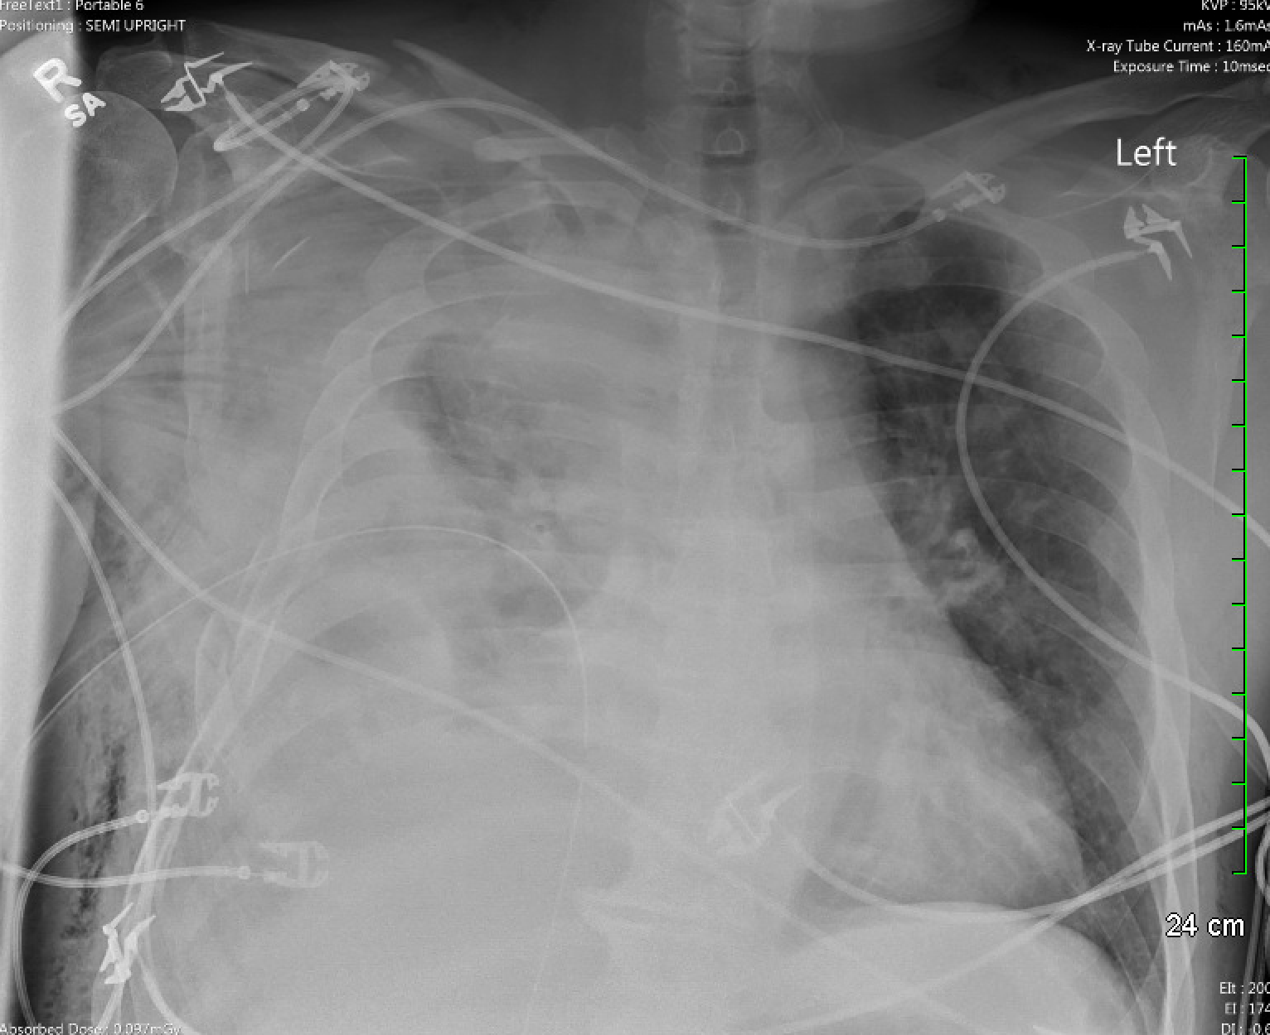

Slide 28
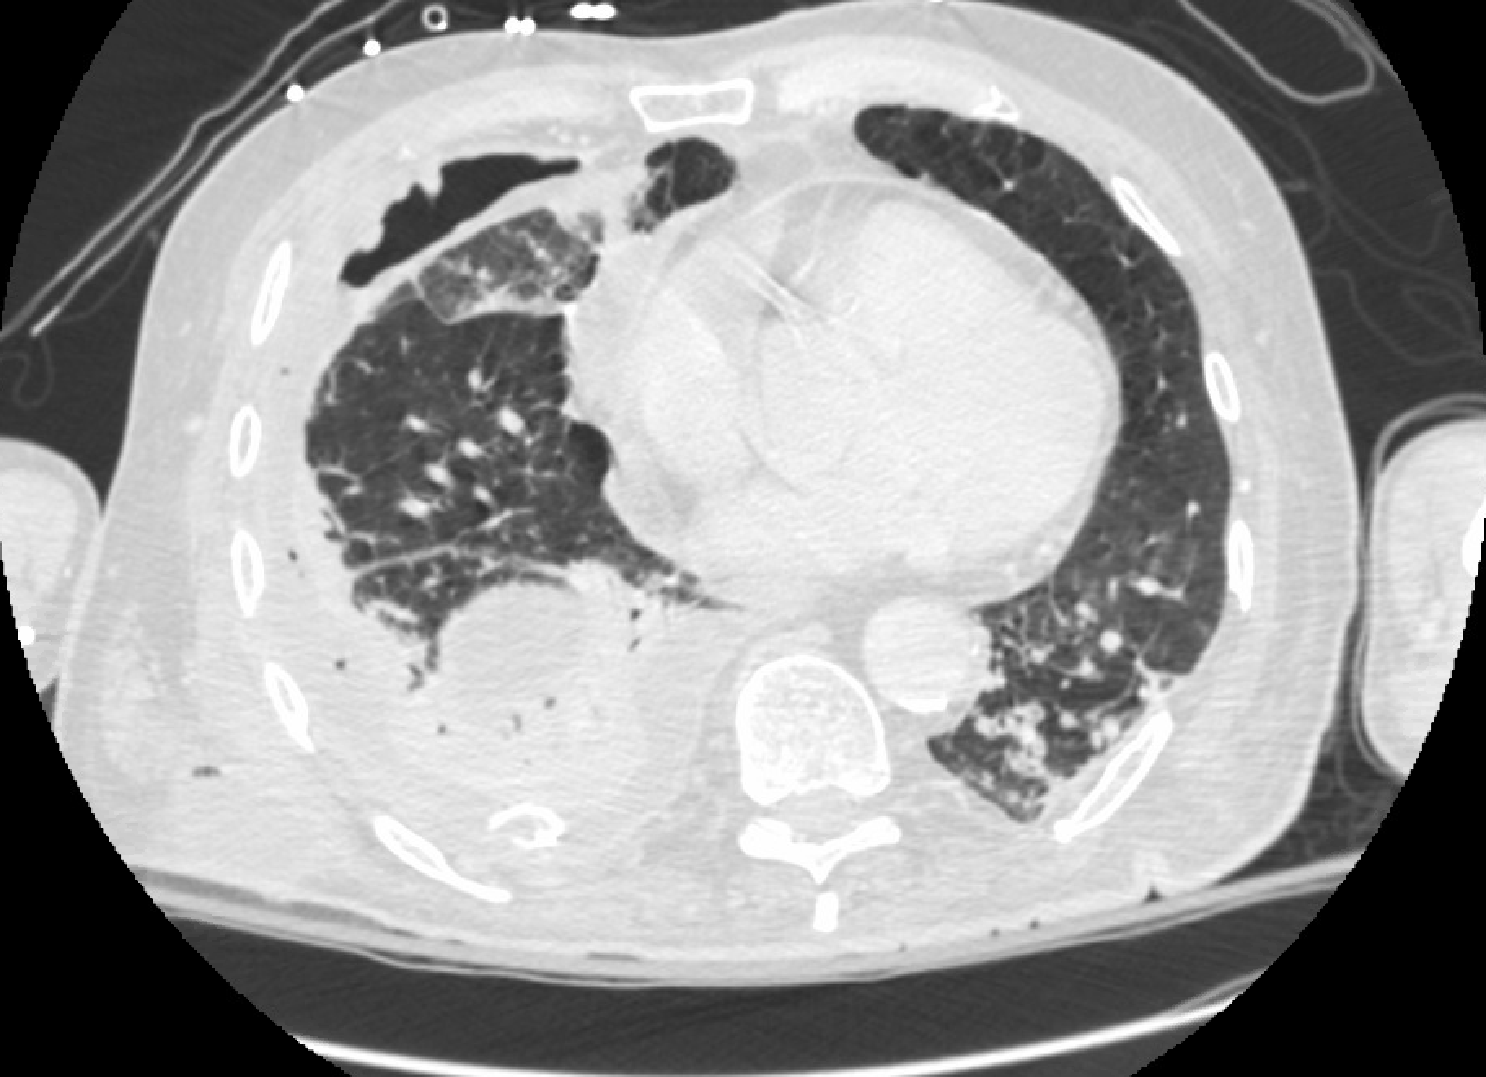

Slide 29
Chest Wall Trauma
39% of patients with blunt thoracic trauma will have multiple rib fractures.
National Trauma Database Study 1994-2003
1 Rib Fracture = 5.8% Mortality
5 Rib Fractures = 10% Mortality
7 Rib Fractures = 15% Mortality
8 or More Rib Fractures = 34.4% Mortality
Flail Chest Alone = 17% Mortality
Flail chest + Pulmonary Contusions = 42% Mortality
Presence of 1st Rib Fracture = 36% Mortality
70% of patients with rib fractures are still not back to full work capacity at 6 months
60% of patients with ribs fractures are still having pain at 1 year from injury
Witt et al. TSACO. 2017

Slide 30
Chest Wall Trauma
Over the age of 65…
  The risk of pneumonia increases by 27% with each rib fracture!!
  Mortality increases by 19% for each rib fractured!!
  Mortality for patient’s with blunt chest trauma is nearly double for those over 65 years of age compared with those under 65 even when the Injury Severity Score is the same or less!!!
  Morbidity, Hospital LOS and ICU Length of Stay is higher for those >65 y/o after sustaining 3 rib fractures
Kane ED et al. JACS. 2018

Slide 31
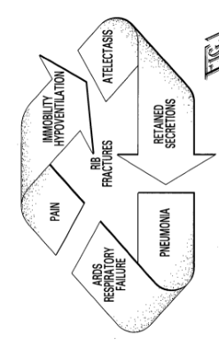

Slide 32
Surgical Stabilization of Rib Fractures
Still a very new procedure
Still a lot of controversy sounding it
Time to fixation?
  Most studies would argue within the first 24-72 hours of injury
Who do we offer surgical stabilization?
Traumatic brain injured patients?

Slide 33
Surgical Stabilization of Rib Fractures
Flail chest patients should be given strong consideration for rib fixation:
  Improved mortality (OR 0.3)
  Decreased ventilator days (6.07 days)
  Decreased ICU LOS (4.21 days)
  Decreased hospital LOS (7.63 days)
  Decreased incidence of pneumonia (OR 0.24)
  Decreased need for tracheostomy (OR 0.24)
  Increase in inspiratory volume and peak flows by 71%
Kasotakis G et al. J Trauma. 2017
Pieracci FM et al. J Trauma. 2015
Slobogean GP et al. Arch Trauma Res. 2015

Slide 34
Surgical Stabilization of Rib Fractures
What do we know?
  Patients with 3 or more rib fractures benefit from surgical fixation compared to those who are managed non-operatively.
  Patients 65 years or older, benefit more from surgical fixation than those younger than 65.
Kane et al. JACS. 2018

Slide 35
Surgical Stabilization of Rib Fractures
What do we know? (Pieracci et al. J Trauma. 2018)
  Early surgical fixation results in decrease in operative time by 68 minutes
  Each additional hospital day before surgical fixation was independently associated with:
    31% increased likelihood of pneumonia
    27% increased likelihood of prolonged ventilation
    26% increased likelihood of tracheostomy

Slide 36
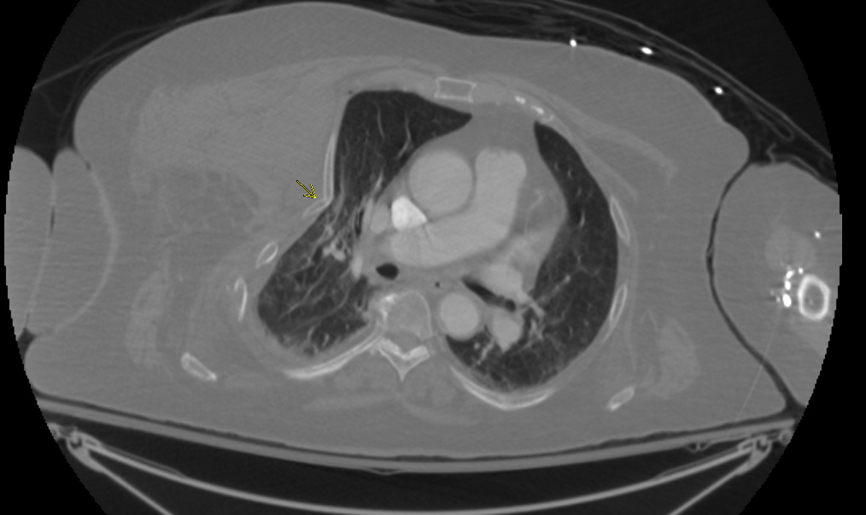

Slide 37
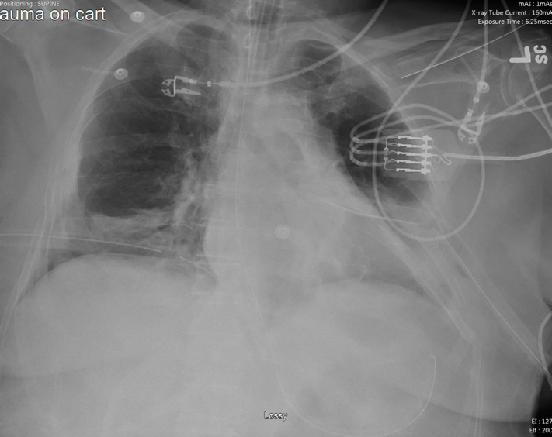
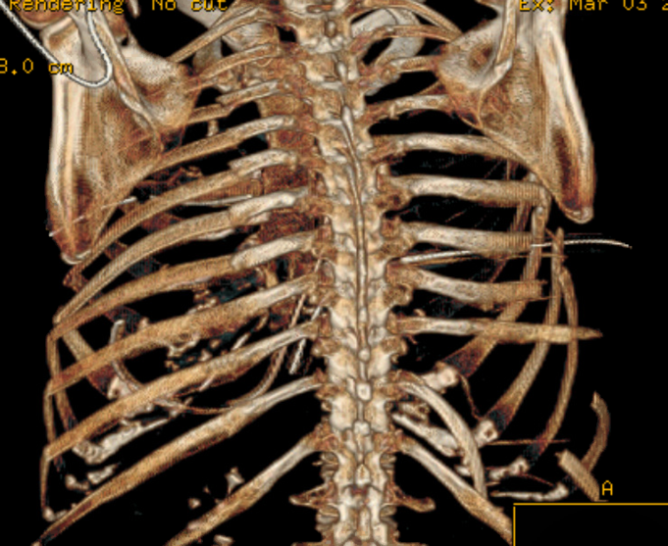

Slide 38
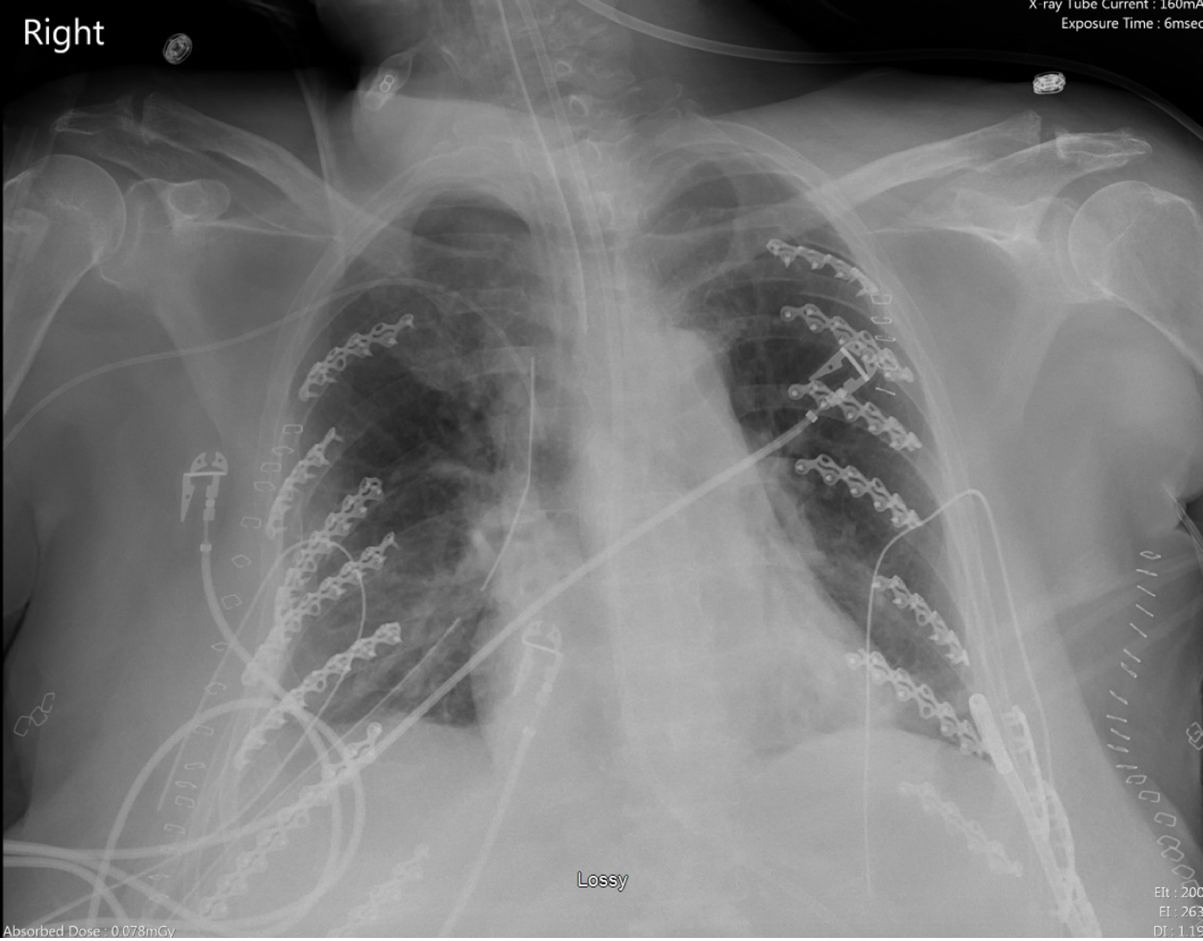

Slide 39

Primary Survey: Circulation
Assess for end organ perfusion
  Level of consciousness
  Skin color, temperature
  Pulse rate, character
  Shock Index
    HR/SBP

Slide 40
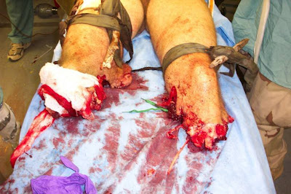
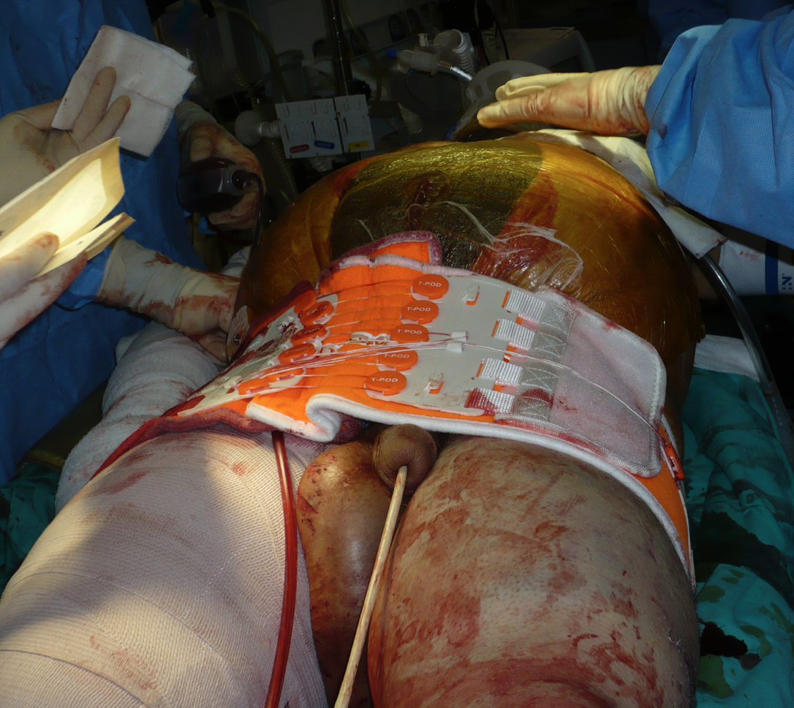
Primary survey: Circulation
Control hemorrhage
Direct pressure
Tourniquet
Pelvic binder

Slide 41
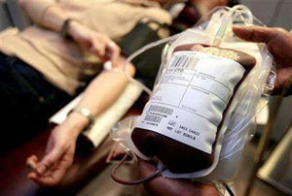
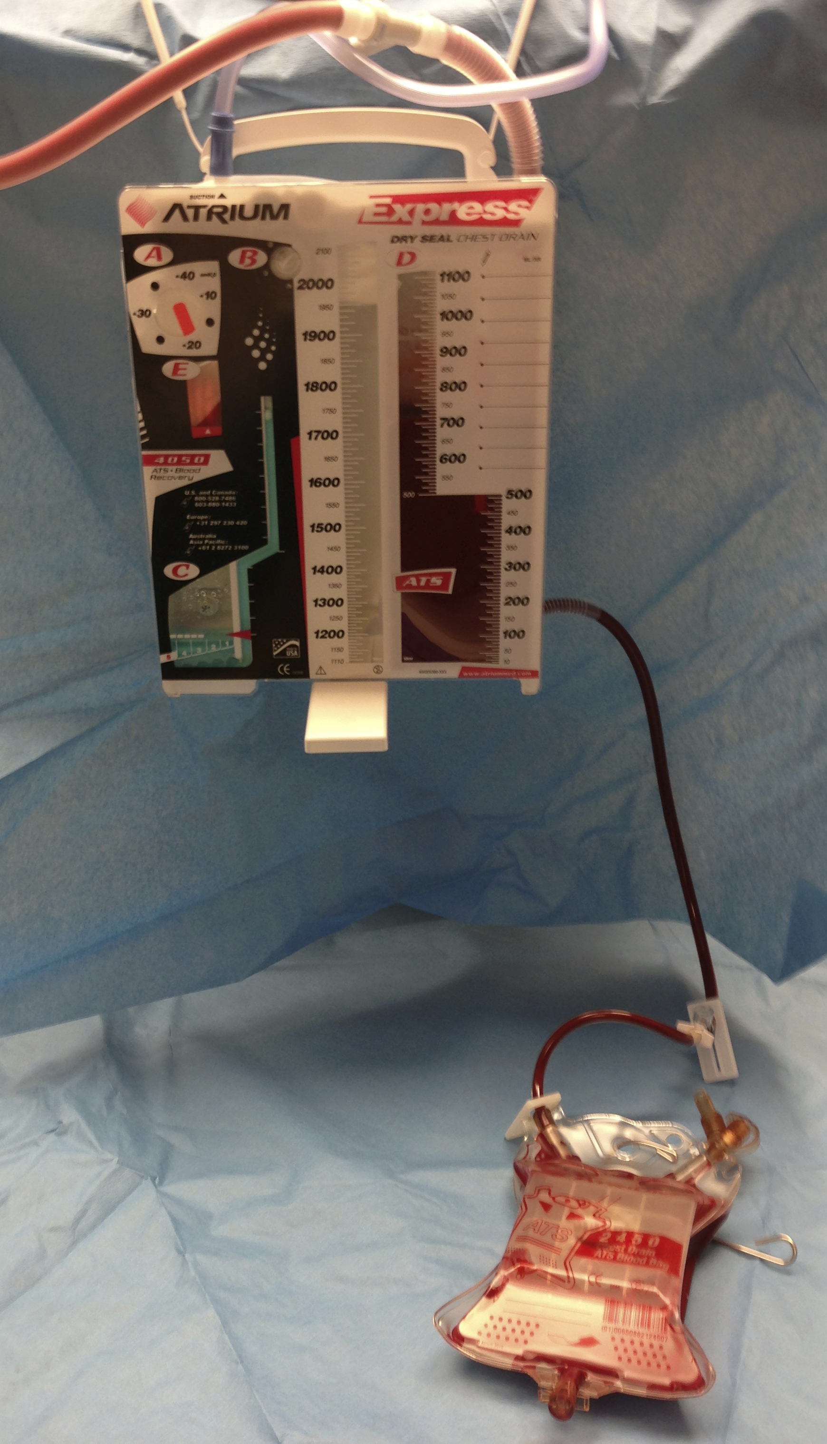
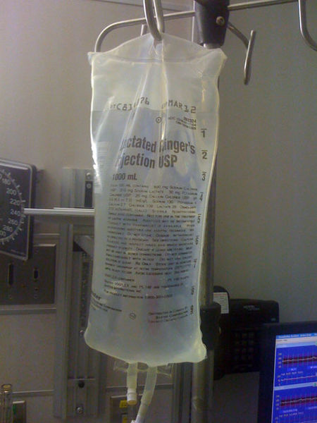
Primary survey: Circulation
Restore volume
Large bore IVs or central access
Crystalloid (2 L)
Blood products (FFP:platelets:RBC)
Ratio 1:1:1 or 1:1:2
Continually reassess!

Slide 42
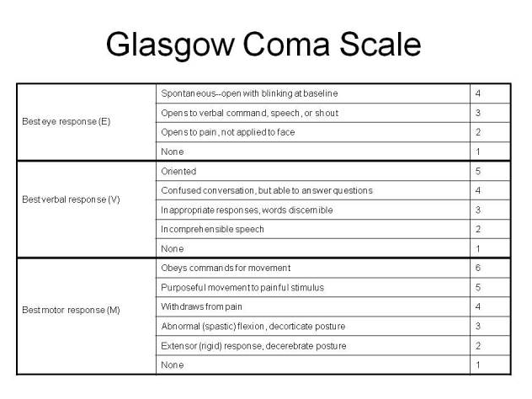
Primary Survey:
Disability
GCS
Pupillary response
Extremity motion
Continually observe for deterioration
GCS <8: intubation

Slide 43
Primary Survey: Exposure/Environment
Exposure
Complete removal of clothing
360º logroll
Check hiding spots: axilla, perineum, rectal
Environment
Room temperature
Cover patient ASAP

Slide 44
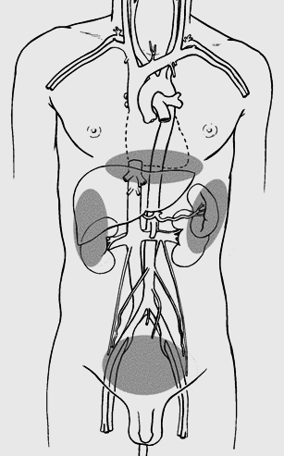
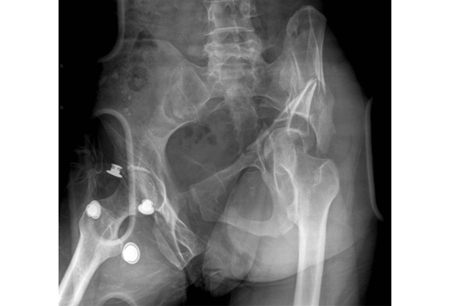
Adjuncts: F, G . . .
FAST
Foley
Gastric Tube (NG or OG)
Vital signs (HR, rhythm, BP, RR, Pulse ox)
ECG
Labs (ABG, VBG, Lactate, CBC, BMP, INR, HCG, UDS)
CXR/PXR

Slide 45
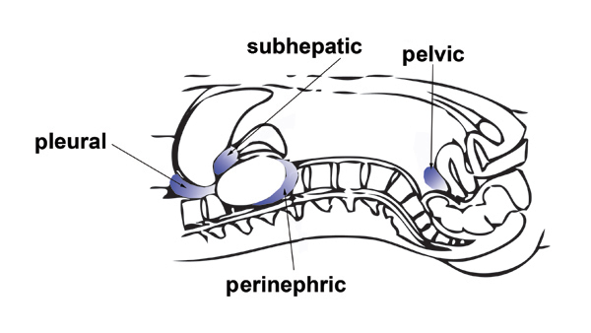
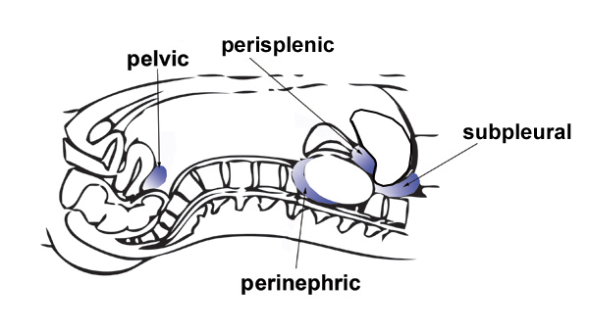
FAST (Focused Assessment with Sonography for Trauma)
Identifies significant pericardial and intraperitoneal fluid
No amount or characterization
No retroperitoneum
Most useful in Blunt Mechanism

Slide 46
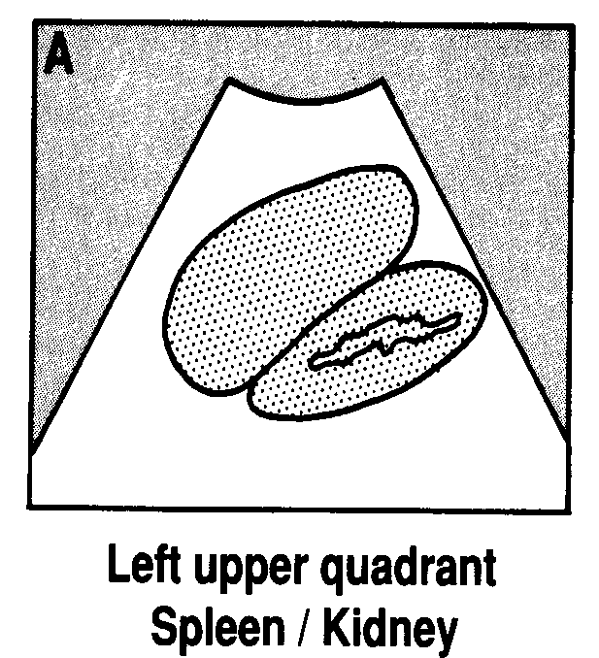
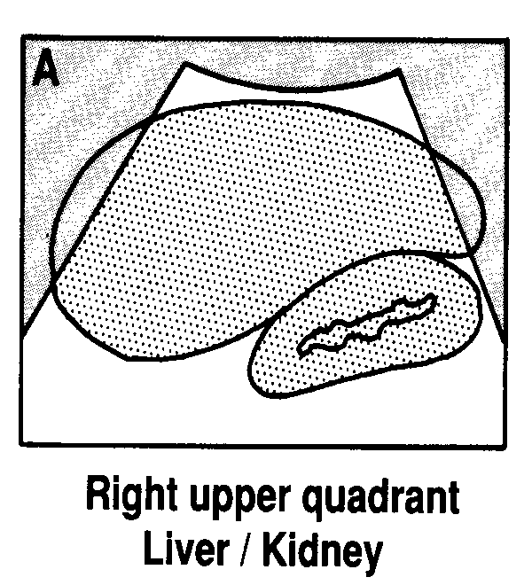
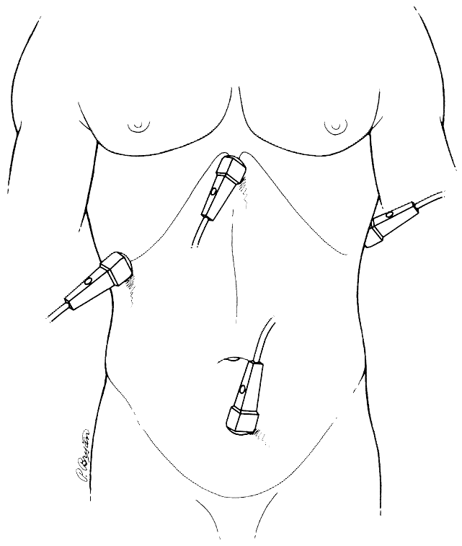
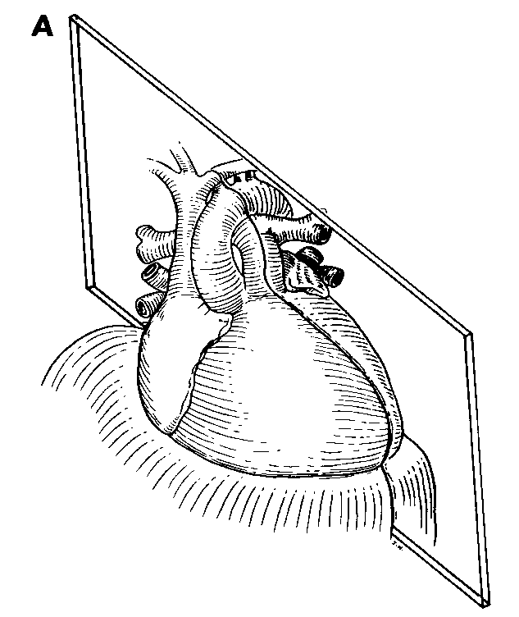
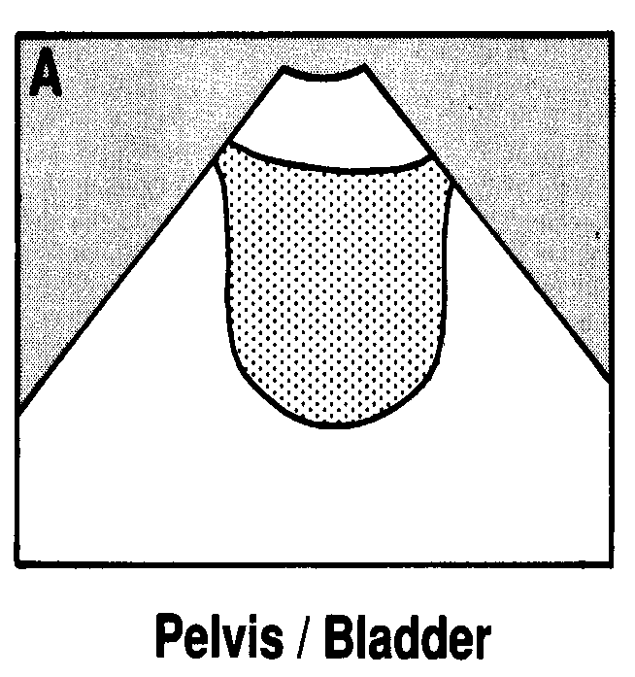
RUQ: Morrison’s pouch
LUQ: peri-splenic and peri-renal views
Pelvic: pouch of Douglas
Pericardial window
BLACK = BLOOD

Slide 47
Ideal Situations for FAST
Unclear cause of hypotension
Identify need for emergent bedside procedure (eFAST)
Prep for transfer to a trauma center
Intoxicated patients who can be observed and re-examined
Multiple wounds/unclear trajectory – especially upper abdomen and lower chest
Concerning MOI, but no indication for CT

Slide 48
Secondary Survey
No patient with abnormal/unaddressed primary survey should proceed through a secondary survey.
AMPLE history
  Allergies
  Meds
  Past illness
  Last meal
  Events/Environment
Head to toe physical exam
  Complete neuro exam
  Detailed extremity exam

Slide 49
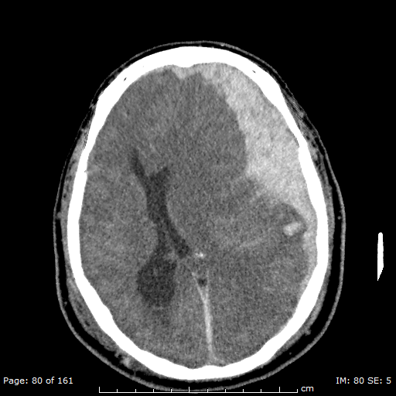
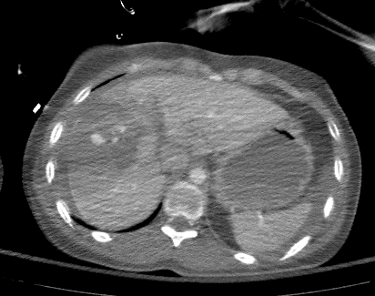
Definitive Care
Secondary Survey followed by radiographic evaluation
  CT
  Consultation
    Neurosurgery
    Orthopedic Surgery
    Vascular Surgery
    Interventional Radiology

Slide 50


Definitive Care
IMAGING SHOULD NEVER DELAY TRANSFER
VOMIT: Victim of
Modern Imaging Technology
Transfer to definitive care
OR
  ICU/floor
  Higher level facility

Slide 51
Additional Resources

Slide 52
Need for Teletrauma
Low volume trauma hospitals often have very limited staff.
  Management errors
  Deviation from standard of care
  Lack of training
  Lack of continuous medical education
Lack of access to immediate subspecialty care.
  Trauma surgeon
  Neurosurgeon
  Orthopedic surgeon

Slide 53
Benefits of Teletrauma
  Help calm the team and make sure management errors or deviation from standard of care does not occur.
      **** First Do No Harm ***
  2. During the initial assessment phase, the virtual trauma surgeon may be able to defer time-consuming procedures and expedite transfer to the trauma center.

Slide 54
Benefits of Teletrauma
  The consulting trauma surgeon can answer questions directly, providing immediate feedback such as early administration of blood products, reversal of therapeutic anticoagulation, airway management, etc.
  Providing continual medical education.
    Debriefing after all trauma experiences
    Hosting extracurricular teletrauma conferences
    Providing specific patient care feedback
    *** Relationship Building ***

Slide 55
Benefits of Teletrauma
Decreases costs to all parties involved, including the patient.
    Often, patients are transferred to the trauma center when they could actually be managed at the remote hospital with the virtual presence of a trauma surgeon or specialist.
    Improves resource utilization.

Slide 56
Benefits of Teletrauma
Study out of Mississippi (Duchesne et al. Impact of telemedicine upon rural trauma care. J Trauma. 2008)
  315 patients before teletrauma and 463 patients after teletrauma
  All 315 patients were transferred before implementation
  After implementation, all 463 patients had a virtual consult
  Results:
    Only 51 patients were transferred
    Total cost savings → $6,505,941
    Decreased length of stay at community hospital by 45.5h
    Decrease in time to transfer by 11.3h

Slide 57
Rural Trauma Team Development Course
  Come to your institution for a day. Course is paid for by Nebraska Medicine and promoted by the American College of Surgeons
  8 CME credit course
  Provide education on how to most effectively manage trauma patients based on the resources at your hospital.
  Also encourage and educate on how you can utilize your teletrauma system for better patient care.
  Stop the Bleed Program

Slide 58
Conclusion
Assessment of the trauma patient is a standard algorithm designed to ensure life threatening injuries are addressed rapidly and do not get missed
Definitive care is one of the most important steps in successful resuscitation of a trauma patient!

Slide 59
Contacts
Dr. Zachary Bauman, DO, MHA
Professor of Surgery
Department of Emergency General Surgery, Trauma and Critical Care Surgery
zachary.bauman@unmc.edu
402-559-9696

