Slide 1
Unwrapping Your Leadership Presence
Emerging Professionals Program
Christine Mixan
Sr. Organizational Development Consultant
and Executive Coach

Slide 2
…letting the most powerful version of yourself shine through
…a combination of gravitas, communication, and appearance; together, these elements form an impression of trustworthiness, competence, and authenticity
Can I trust this person?
Can I respect this person?

Slide 3
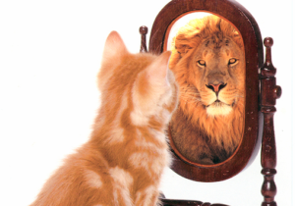
Leadership Presence
A Bias for Action
Growth
Mindset
3 Keys to Great Leadership
Self-Awareness
Growth Mindset
A Bias for Action
Self-Awareness

Slide 4
Self-Awareness
“You've always been what you are. That's not new. What you'll get used to is knowing it.” - Cassandra Clare
“The most fundamental harm we can do to ourselves, is to remain ignorant by not having the courage and the respect to look at ourselves honestly.” - Pema Chödrön
“Everything that irritates us about others can lead us to an understanding of ourselves.” - Carl Jung
“He who knows others is wise. He who knows himself is enlightened.” - Tao Tzu

Slide 5
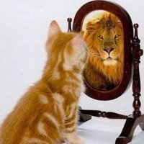
Identity…the you that YOU know
Reputation… the you that OTHERS know

Slide 6
Ask for Feedback
Ask for feedback often
Ask targeted, open-ended questions to get insightful feedback
(i.e. What do you think is working/ not working with my time management?)
Identify your “truth-tellers”
Reflect, plan, and execute changes based on feedback
Commit and follow-up
Create a development plan

Slide 7
Feedback Sources
Managers
Directors
Patients
Supervisors
Students/
Learners
Providers
Peers
Customers
Patient
Experience
Data
YOUR
TITLE 01
Performance
Appraisals
Quality
Outcomes
Assessments

Slide 8
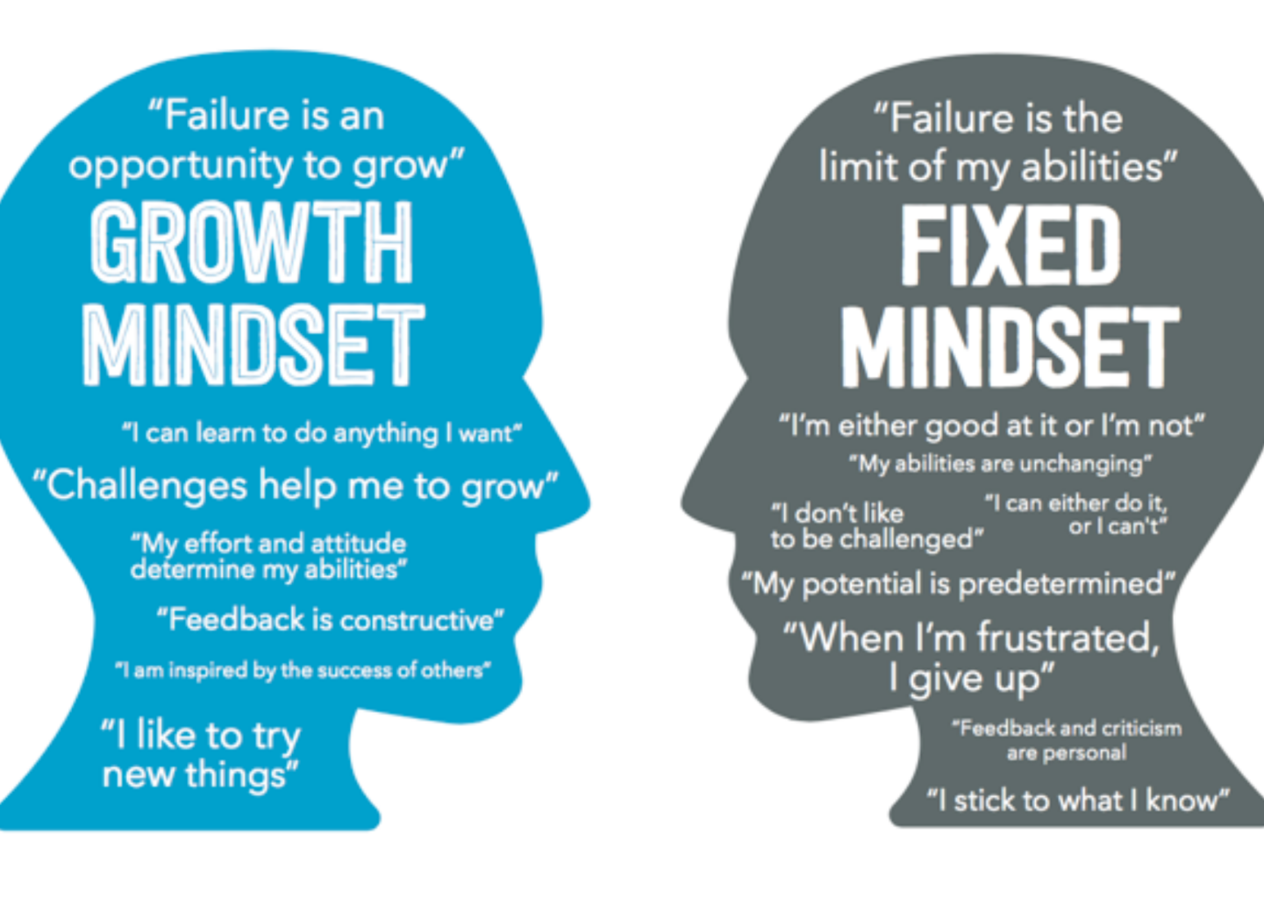
Notes:
https://www.youtube.com/watch?v=75GFzikmRY0

Slide 10
Growth Mindset
3
Surround yourself with people that inspire you
2
Get out of your comfort zone
1
Ask for feedback

Slide 11
A Bias for Action

Slide 12
A Bias for Action
What’s one thing you
didn’t take action on last week, but should have if you had a bias for action?

