Slide 1
Financial Wellness
Jonnisha McCleod
Student Financial Wellness Counselor
Office of Financial Aid
jmccleod@unmc.edu

Slide 2
Financial Wellness at UNMC
Goal:
To foster a community of financially capable students that are empowered with the knowledge needed to make sound financial decisions before, during and after graduate school.

Slide 3
What’s Your Money Personality?
Money Worship: Money worshippers believe more money will solve their problems. They are more likely to overspend and carry debt.
Money Avoidance: Money avoiders believe that money is bad. They are more likely to ignore their finances and avoid talking about money.
Money Status: People who are money status tend to seek more money to gain higher status. They are more likely to make risky financial decisions and buy expensive items.
Money Vigilance: Money vigilants are more likely to save money instead of spending it. They tend to make better financial choices. However, they may be uncomfortable discussing financial matters.

Slide 4
Budgeting

Slide 5
Budgeting: Step-By-Step
Step One: Determine your income
Step Two: List your expenses​​
Step Three: Find a budgeting method​​ (SoFi article)
​
Step Four: Track your expenses​
​
Step Five: Modify as needed

Slide 6
Budgeting Apps
YNAB (You Need A Budget) (Paid App but students may be able to get one year free)
Money Manager Expense & Budget (Free version)
Goodbudget (Free version)
Spendee: Money Manager & Budget Planner (Free version)
Honeydue (Budgeting App for Couples) (Free version)
Everydollar (Free Version)

Slide 7
Credit

Slide 8
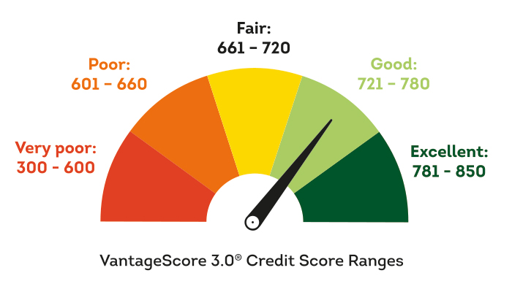
Credit Report and Credit Score
A credit report is a report that includes your full credit history.​
Items that appear on a credit report are addresses, loans, payments
Credit scores are three-digit numbers designed to represent credit risk.​
Credit scores range from 300 (poor) to 850 (excellent).

Slide 9
Building and Maintaining Your Credit
Pay your bills on time​
Get a secured credit card​
Keep your credit utilization rate lower than 30%
Become an authorized credit card user
Take out a credit-building loan​
Review your credit report for inaccuracies
Use an app or website to monitor credit activity

Slide 10
Check Your Credit Report
View your credit report at Annualcreditreport.com​
Scan the QR Code to be directed to the website

Slide 11
Savings and Investments

Slide 12
Savings Tools
Traditional Savings Account
High Yield Savings Account
Money Market Account
https://www.forbes.com/advisor/banking/savings/types-of-savings-accounts/

Slide 13
Common Investing Instruments
Mutual Funds: Mutual funds are companies that pool money from investors and invests in securities.
Bonds: Bonds are financial instruments representing a debt issued by an entity, either a company or government.
Stocks: Stocks are a type of security that gives stockholders a share of ownership in a company.
Certificate of Deposit (CD): A certificate of deposit is a savings account that holds an amount of money for a fixed period of time.

Slide 14
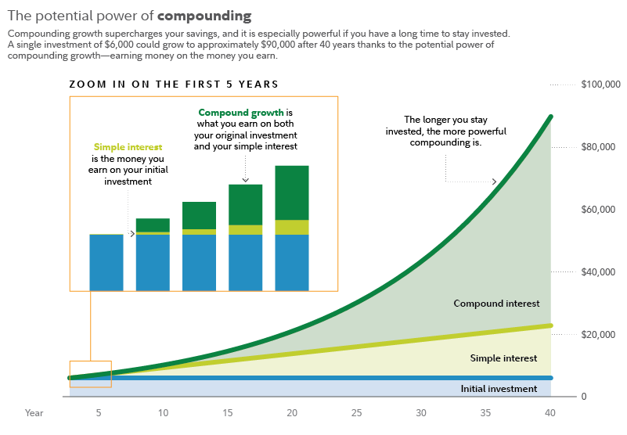
Compounding Interest
Compound interest is when you earn interest on both the money you've saved and the interest you earn.
If you would like to calculate compound interest, there are free online compound interest calculators.

Slide 15
Financial Wellness Resources

Slide 16
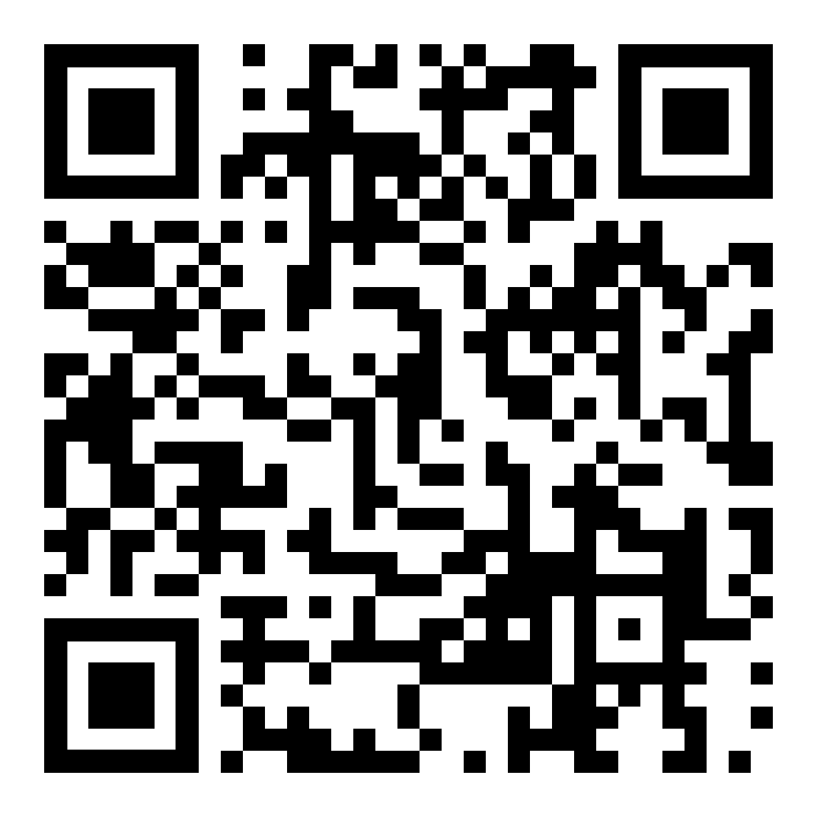
UNMC Financial Aid
Types of Aid
Cost of Attendance
Financial Literacy
Loan Repayment
Student Accounts
https://www.unmc.edu/student-success/financial-aid/index.html

Slide 17
Association of American Medical Colleges (AAMC)
Loan Simulator
Financial Aid resources
Financial wellness resources
Free for any student
https://students-residents.aamc.org/financial-aid

Slide 18
Investor.gov
Investing resources
Retirement resources
Financial Planning Tools
Compound Interest Calculator
Savings Goal Calculator
Retirement Calculator
https://www.investor.gov/

Slide 19
Financial Decision Making
START preparing for your financial future!​
Always “Fact Check” financial advice! Social Media may be helpful but may not "Fact Check“ the information presented.​
Always check with your institution, employers, and loan servicers for any official information.​
If it sounds too good to be true, it probably is!

Slide 20
Student Financial Wellness Counselor
Contact Information:
jmccleod@unmc.edu
Office: WSH 2.0.103
Meetings: https://calendly.com/jmccleod

Slide 21
Contact Financial Aid
Email: finaid@unmc.edu​
Phone: 402-559-4199​
​
www.unmc.edu/financialaid ​
​

