Slide 1
Emergency use of a test article / treatment use of investigational drugs

Slide 2
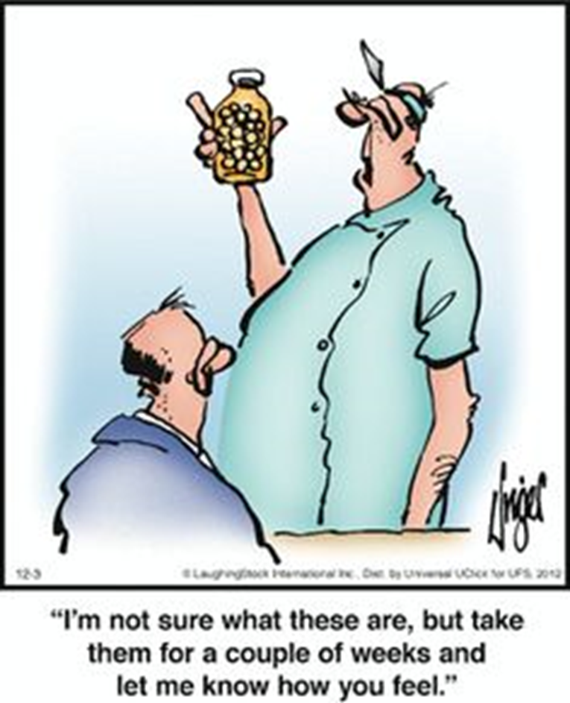

Slide 3
Emergency use is different than Expanded Access ("compassionate use")
Emergency Use
Life threatening situation, no other option, not time for IRB approval
Not research*
Does not require IRB approval (only notification)
Requires sponsor and FDA approval
Requires informed consent
Only one use
Expanded Access
Serious disease, no other satisfactory alternative (may be urgent but not emergent)
Research*
Requires IRB approval (or IRB chair concurrence)
Requires sponsor and FDA approval
Requires informed consent
Single patient or larger population

Slide 4
Emergency use of a test article
Investigators may be confronted with the need to use a test article in an emergency situation
In these circumstances review by a full IRB may not be feasible
FDA regulations allow for an emergency waiver of prior IRB review (21 CFR 56.104(c))

Slide 5
Emergency use of a test article
Life-threatening situation exists requiring treatment with the test article
likelihood of death or severe debilitation is high unless the course of the disease is interrupted
No standard acceptable treatment is available
Insufficient time is available to obtain IRB approval at a convened meeting (21 CFR 56.102(d))
Notes:
This does not require the condition to be immediately life-threatening; rather intervention is required before review by the IRB is feasible

Slide 6
Emergency use of a test article
Emergency use provision in the FDA regulations is an exemption from prior review and approval by the IRB
It is not "emergency IRB approval"
IRB only acknowledges compliance with 21 CFR 56.104(c)

Slide 7
Emergency use of a test article
FDA regards emergency use of a test article (other than a medical device) as a "clinical investigation"
may require data from an emergency use to be reported in a marketing application
However, DHHS states "emergency care may not be claimed as research, nor may the outcome of such care be included in any report of a research activity"
single case reports may be allowable

Slide 8
Process
Treating physician will contact IRB Office and/or Chair prior to use of the test article
Treating physician will contact:
P&T Committee to obtain P&T emergency use approval
Investigational Drug Pharmacist resolve financial responsibility for the pharmacy costs
Sponsor and FDA
Obtain consent from subject
Treating physician will submit the Emergency Use of a Test Article Report to the IRB within 5 business days following initiation of the treatment

Slide 9
Process
Treating physician will contact IRB Office and/or Chair prior to use of the test article
IRBORA@unmc.edu
(402) 559-6463
bgordon@unmc.edu
(402) 559-6045

Slide 10
Process
Treating physician will contact IRB Office and/or Chair prior to use of the test article
Treating physician will contact:
P&T Committee to obtain P&T emergency use approval
Investigational Drug Pharmacist resolve financial responsibility for the pharmacy costs
Sponsor and FDA

Slide 11
Process
Treating physician will contact IRB Office and/or Chair prior to use of the test article
Treating physician will contact:
P&T Committee to obtain P&T emergency use approval
Investigational Drug Pharmacist resolve financial responsibility for the pharmacy costs
Sponsor and FDA
Obtain consent

Slide 12
Consent
Consent from the subject or their LAR must be obtained (21 CFR 50.23(a)) unless
life threatening situation
consent of the subject cannot be obtained
not enough time to obtain consent from the LAR
no alternatives which provide equal or greater likelihood of saving the life of the subject
Investigator and an uninvolved physician must certify the above in writing
Consent template available on IRB website
IRB › Procedures & Deadlines › Procedures › Emergency Treatment

Slide 13
Process
Treating physician will contact IRB Office and/or Chair prior to use of the test article
Treating physician will contact:
P&T Committee to obtain P&T emergency use approval
Investigational Drug Pharmacist resolve financial responsibility for the pharmacy costs
Sponsor and FDA
Obtain consent
Treating physician will complete and submit the Emergency Use of a Test Article Report to the IRB within 5 business days following initiation of the treatment

Slide 15
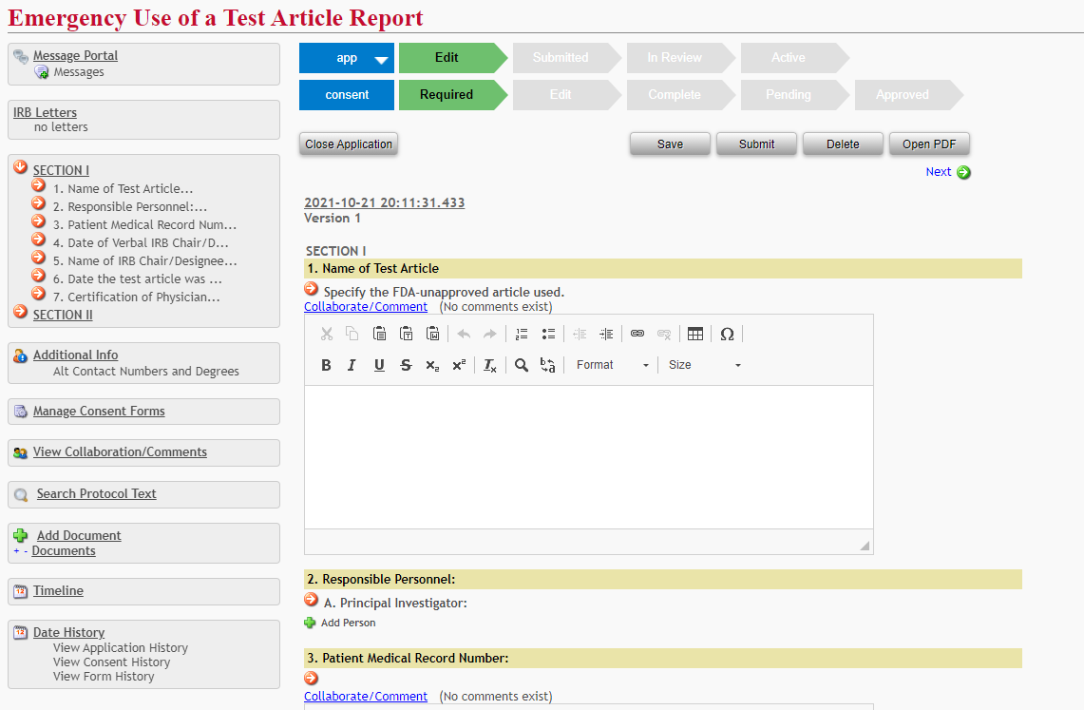

Slide 16
Any subsequent use of the test article must have prospective IRB review and approval
"FDA regulations require that any subsequent use of the investigational product at the institution have prospective IRB review and approval. FDA acknowledges, however, that it would be inappropriate to deny emergency treatment to a second individual if the only obstacle is that the IRB has not had sufficient time to convene a meeting to review the issue" (FDA Guidance, Emergency Use of an Investigational Drug or Biologic, January 1998)

Slide 17
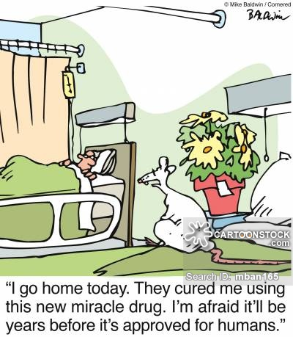

Slide 18
Expanded Access ("compassionate" use)
The aim of the FDA Expanded Access regulations (21 CFR 312 Subpart I) is to facilitate availability of investigational new drugs to patients with serious disease when there is no satisfactory alternative therapy
Requires prospective IRB approval*
Requires informed consent
Notes:
Open Label Protocol IND
Usually uncontrolled studies, carried out to obtain additional safety data after completion phase III studies, prior to FDA approval
Treatment IND
Mechanism for providing eligible subjects with investigational drugs for the treatment of serious and life-threatening illnesses for which there are no satisfactory alternative treatments. Treatment IND may be granted after sufficient data have been collected to show that the drug "may be effective" and does not have unreasonable risks.
A sponsor may apply for a waiver of local IRB review under a treatment IND if it can be shown to be in the best interest of the subjects, and if a satisfactory alternate mechanism for assuring the protection of human subjects is available, e.g., review by a central IRB.
Parallel Track Access
permits wider access to new drugs for AIDS under a separate "expanded access" protocol that "parallels" the controlled clinical trials
Emergency IND
In an emergency situation that does not allow time for submission of an IND in the usual manner, FDA may authorize shipment of the drug for a specified use. Such authorization is usually conditioned upon the sponsor filing an appropriate application as soon as practicable. Prospective IRB review is required unless the conditions for exemption are met
Group C Treatment IND
Means for the distribution of investigational agents to oncologists for treatment of cancer under protocols outside the controlled clinical trial
Generally Phase 3 study drugs that have shown evidence of relative and reproducible efficacy
Although treatment is the primary objective and patients are not part of a clinical trial, safety and effectiveness data are collected
Because administration of Group C drugs is not done with research intent, FDA has generally granted a waiver from the IRB review requirements
18

Slide 19
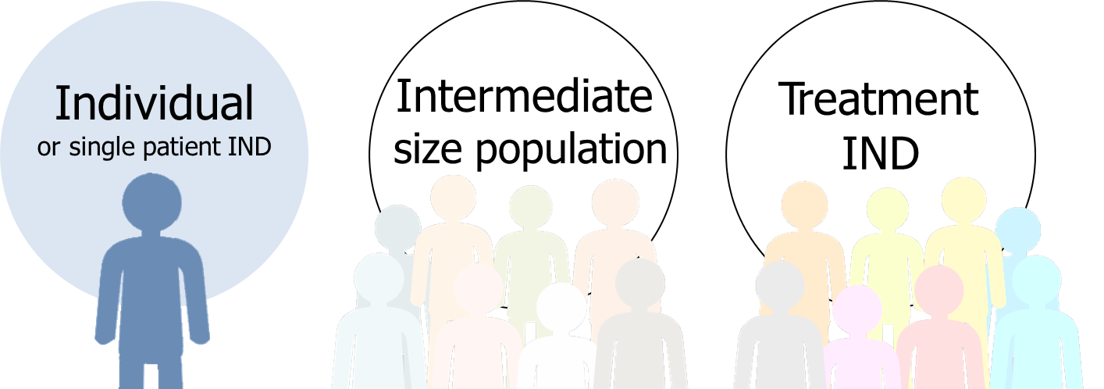
21 CFR 312 subpart I
Three distinct categories of access:

Slide 20
Individual patient EAP (21 CFR 312.310)
Physician often takes role of sponsor/investigator
responsible for sponsor activities such as tracking and reporting
Physician must determine probable risk from drug does not exceed that from disease
FDA must determine that the patient cannot obtain access under another type of IND
Treatment generally limited to one course (though FDA may allow ongoing therapy)

Slide 21
Individual patient EAP (21 CFR 312.310)
*FDA allows waivers of the requirement for review and approval at a convened IRB meeting for individual patient expanded access INDs
IRB chairperson or designated IRB member provides concurrence
Only applies to individual patient EAPs

Slide 22
Process
Contact IRB Office
Complete Single Patient Expanded Access Protocol in RSS
Complete FDA form 3926
Check box 10b if requesting waiver of the requirement for review and approval at a convened IRB meeting
Obtain written permission from the Sponsor (to use drug and to reference sponsor’s IND)
Await approval by convened IRB, or concurrence by IRB chair
Obtain informed consent

Slide 23
Process
Contact IRB Office

Slide 24
Process
Contact IRB Office
Complete Single Patient Expanded Access Protocol in RSS

Slide 26
Process
Contact IRB Office
Complete Single Patient Expanded Access Protocol in RSS
Complete FDA form 3926
Check box 10b if requesting waiver of the requirement for review and approval at a convened IRB meeting

Slide 27
FDA 3926 (Individual Patient Expanded Access Investigational New Drug Application)

Slide 28
Process
Contact IRB Office
Complete Single Patient Expanded Access Protocol in RSS
Complete FDA form 3926
Check box 10b if requesting waiver of the requirement for review and approval at a convened IRB meeting
Obtain written permission from the Sponsor (to use drug and to reference sponsor’s IND)

Slide 29
Process
Contact IRB Office
Complete Single Patient Expanded Access Protocol in RSS
Complete FDA form 3926
Check box 10b if requesting waiver of the requirement for review and approval at a convened IRB meeting
Obtain written permission from the Sponsor (to use drug and to reference sponsor’s IND)
Await approval by convened IRB, or concurrence by IRB chair

Slide 30
Process
Contact IRB Office
Complete Single Patient Expanded Access Protocol in RSS
Complete FDA form 3926
Check box 10b if requesting waiver of the requirement for review and approval at a convened IRB meeting
Obtain written permission from the Sponsor (to use drug and to reference sponsor’s IND)
Await approval by convened IRB, or concurrence by IRB chair
Obtain informed consent before using drug

Slide 31
Consent
CF must include "a statement that the study involves research, an explanation of the purposes of the research and the expected duration of the subject’s participation, a description of the procedures to be followed, and identification of any procedures which are experimental" (21 CFR 50.25(a)(1) )
"given the compassionate nature of the request, consent documents should meet the requirements listed in 21 CFR 50.25, using plain language that is specifically aimed at 'patients' who expect direct benefit, as opposed to 'subjects' who may not expect direct benefit"

Slide 32
https://www.fda.gov/news-events/public-health-focus/expanded-access
Expanded Access to Investigational Drugs for Treatment Use — Questions and Answers Guidance for Industry (June 2016)
https://www.fda.gov/media/85675/download

Slide 33
