Slide 1
Early-Onset, Alzheimer’s Disease: An Introduction
Daniel L. Murman, MD, MS
Director, Cognitive & Behavioral Neurology Division
Vice Chair, Clinical & Translational Research
Professor, Department of Neurological Sciences

Slide 2
Why Focus on Early Onset AD?
Alzheimer’s disease (AD) isn’t expected at such a young age
Atypical forms of AD are more common in young onset patients, making diagnosis harder and often delayed
Genetic contribution is more common
More psychosocial issues, because of younger age when symptoms start

Slide 3
Topics to Cover
How Frequent?
Causes and Genetics
Typical vs Atypical Presentations
Diagnosis & Staging with Biomarkers
Treatments
Research Opportunities

Slide 4
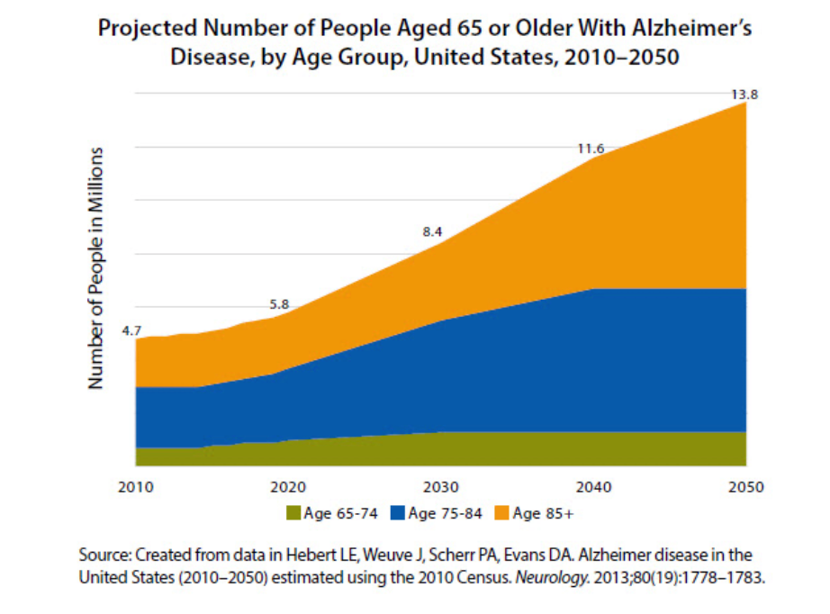
AD Projections over next 30 years
Age 45-64 in 2050
US = 759,000
NE/wIA = 4,478
Age 45-64 in 2023
US = 368,000
NE/wIA = 2,175

Slide 5
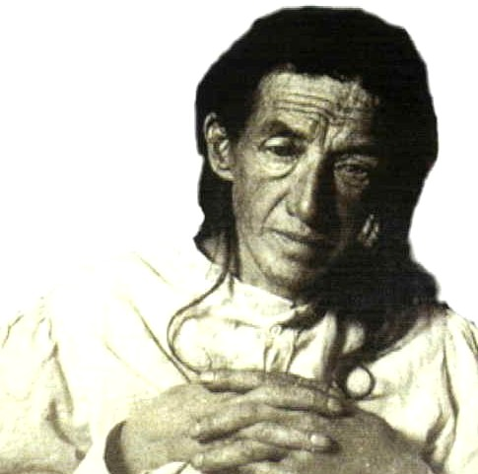
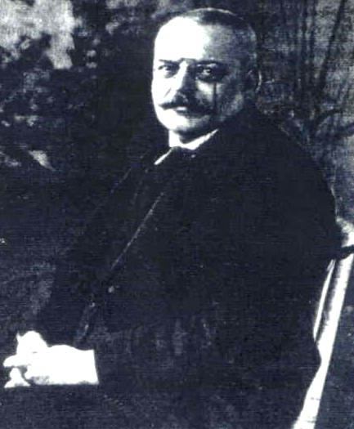
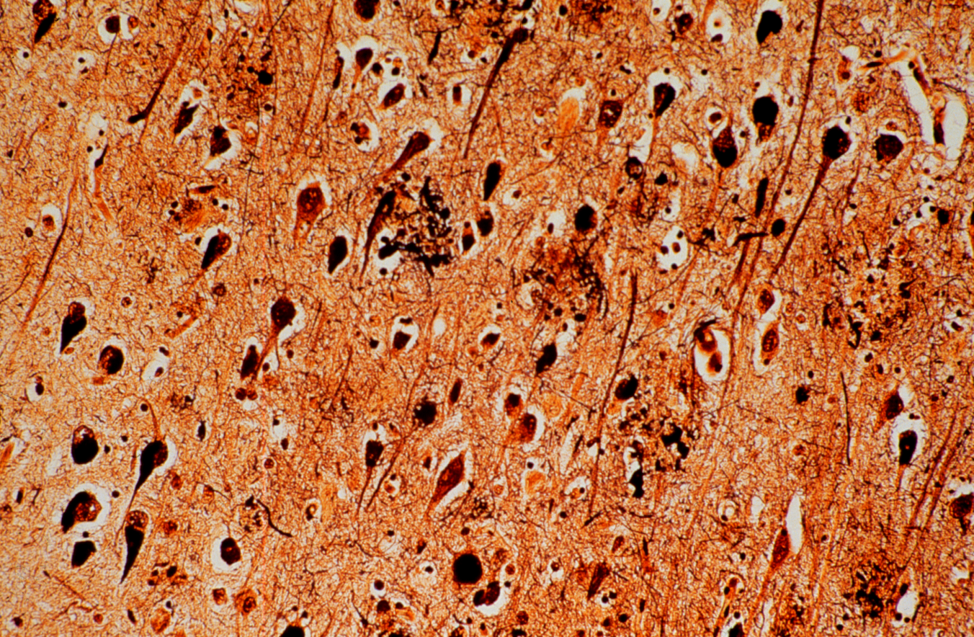
Alzheimer’s Disease
Amyloid Plaques
Auguste D.
Alois Alzheimer
Neurofibrillary Tangles
What Alois Alzheimer’s saw and described in 1906

Slide 6
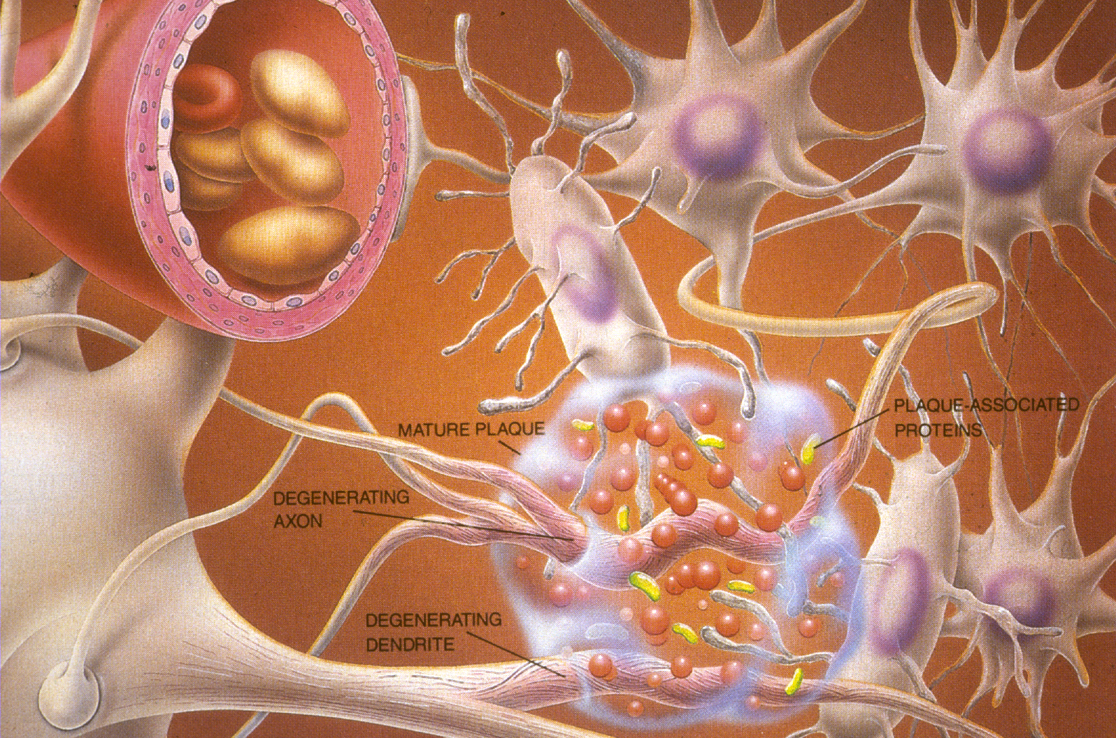
The Picture Now

Slide 7
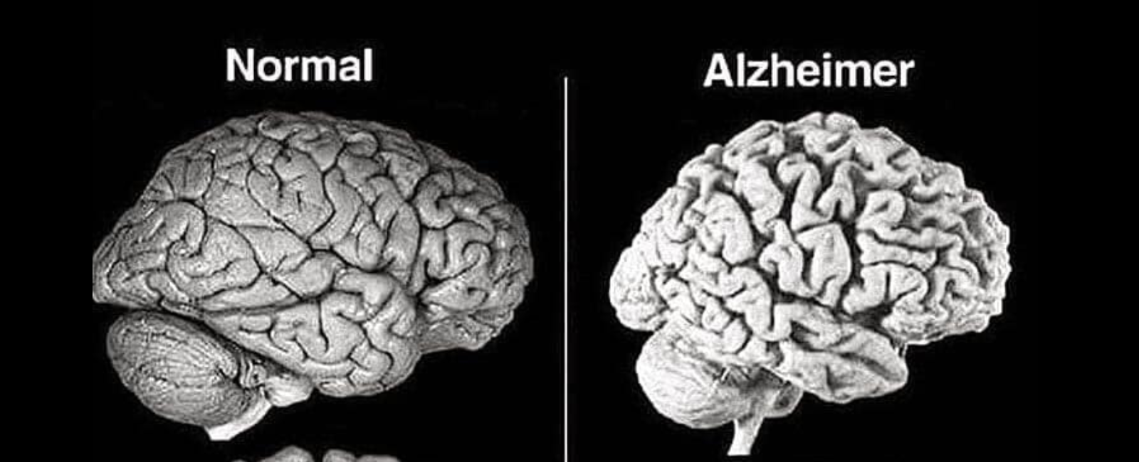
Brain Atrophy 2
Brain Atrophy (Shrinkage) in AD

Slide 8
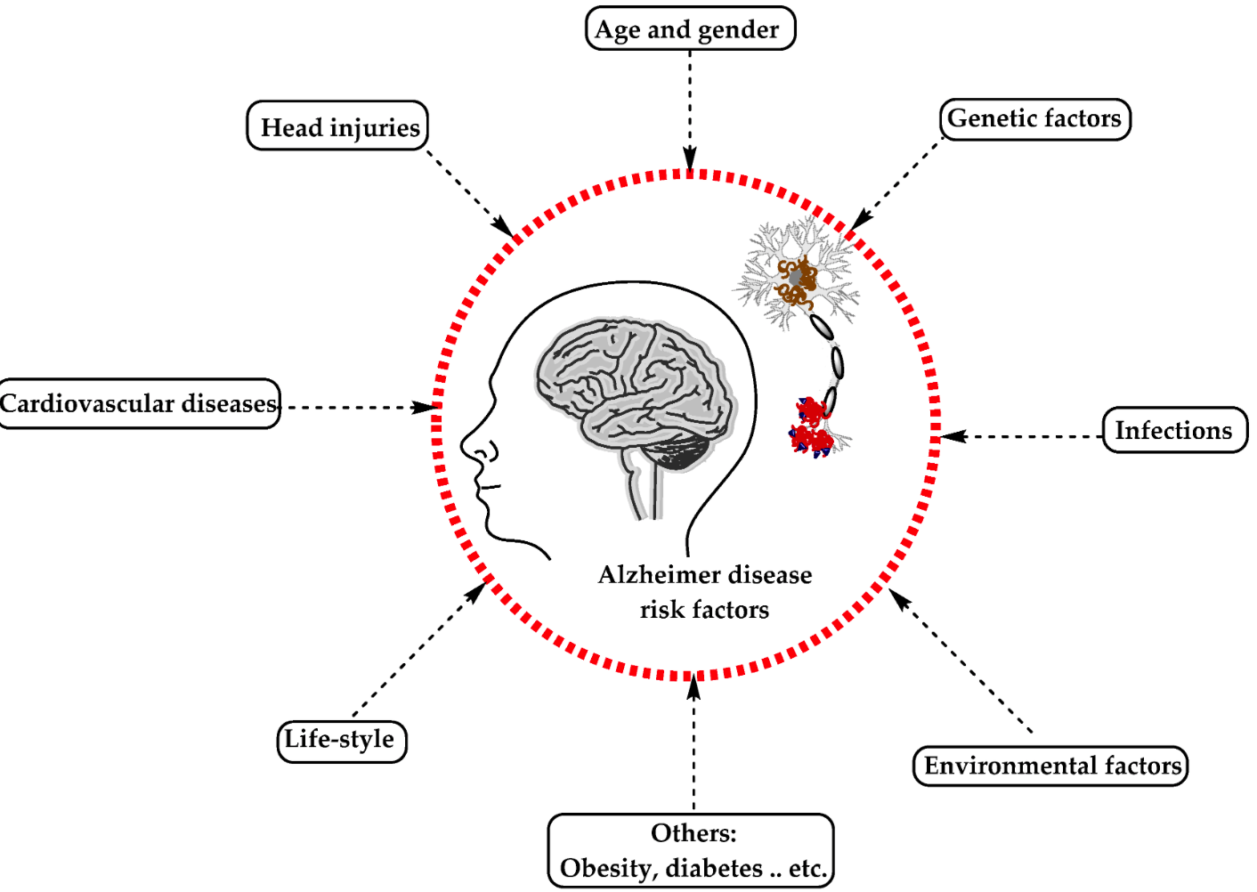
AD Risk Factors

Slide 9
Genes Involved in AD
Causative Genetic Mutations
Very early onset (40’s and 50’s), autosomal dominant inheritance
Presenilin 1 (PSEN1)
Presenilin 2 (PSEN2)
Amyloid Precursor Protein (APP)
Susceptibility Genes
Increase risk but are not sufficient by themselves, other factors impact risk
Apolipoprotein E (APOE) ε4 allele
Approximately 30+ other genes

Slide 10
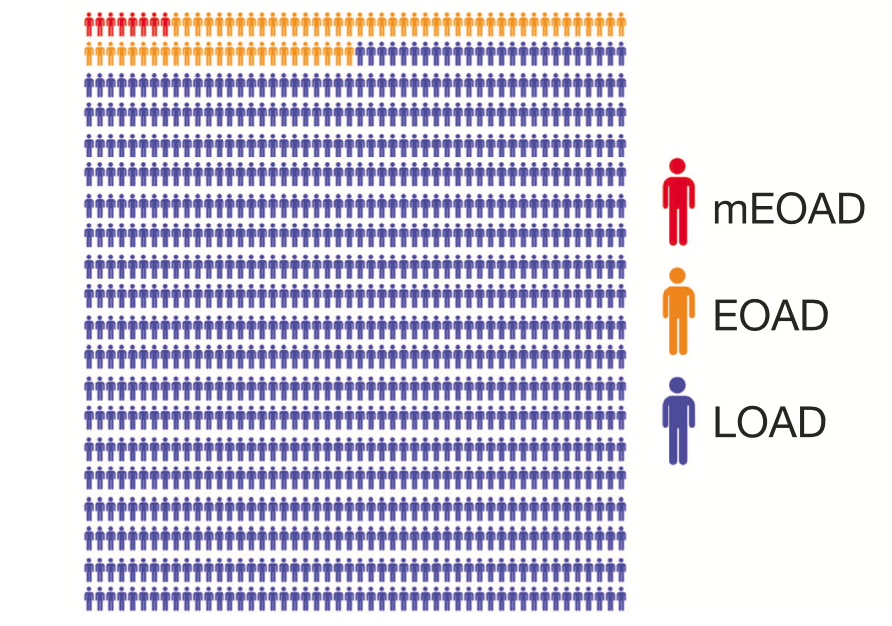
Causative Genes in AD
10% of EOAD, 1% of all AD

Slide 11
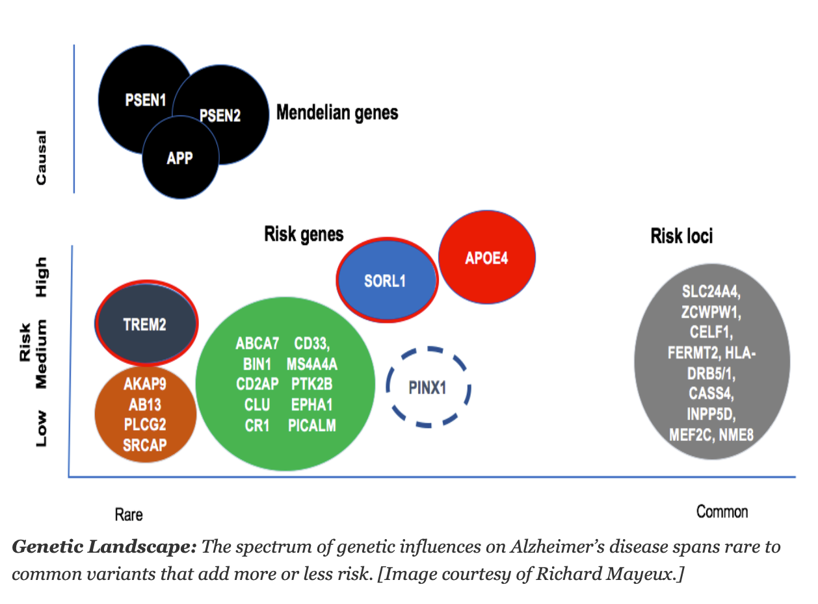
Gene Variants and AD Risk

Slide 12
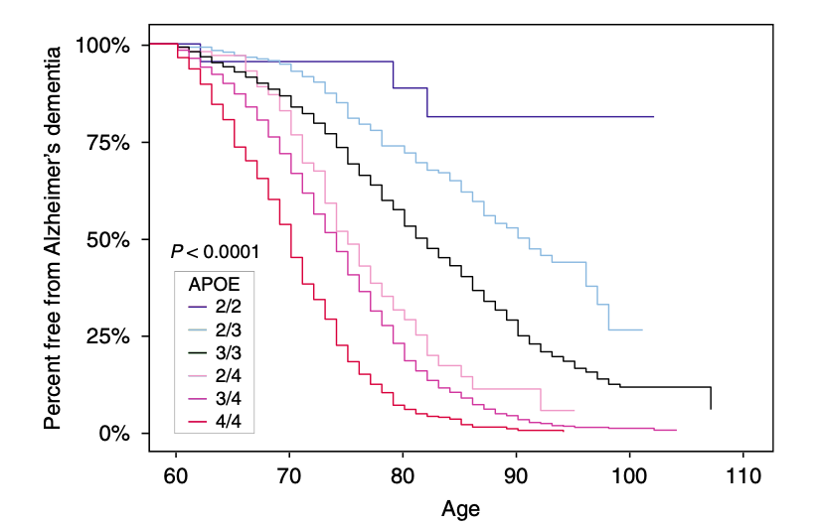
APOE genotype and Age of Onset of AD
e3e3
e3e4
e4e4
Reiman EM, et al. Nature Communications 2020

Slide 13
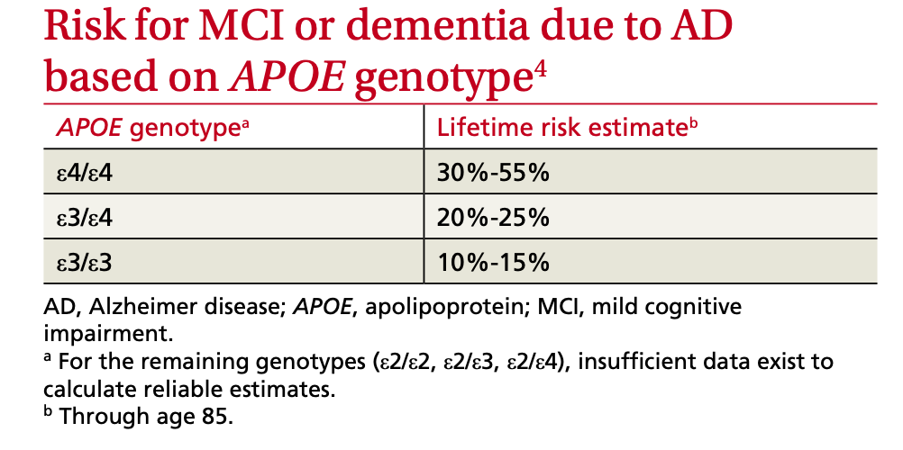
Lifetime Risk of AD
From Qian J, et al. PLOS Med 2017.
Having a first degree relative with AD increases
your baseline lifetime risk of AD by 30%
Woman age 45, lifetime AD risk = 19%, with FH 25%
Man age 45, lifetime AD risk = 10% with FH 13%

Slide 14
Summary: Causes and Genes
AD is a multifactorial disease, with many risk factors/causes.
Formation of aggregated forms of amyloid beta and tau that produce the amyloid plaques and neurofibrillary tangles are key events in the development of AD
Strongly genetic forms of AD are very rare, but many genes impact risk of AD
The APOE e4 allele increases risk of AD, with average age of onset between age 70 and 75, but risk is influenced by many other factors.

Slide 15
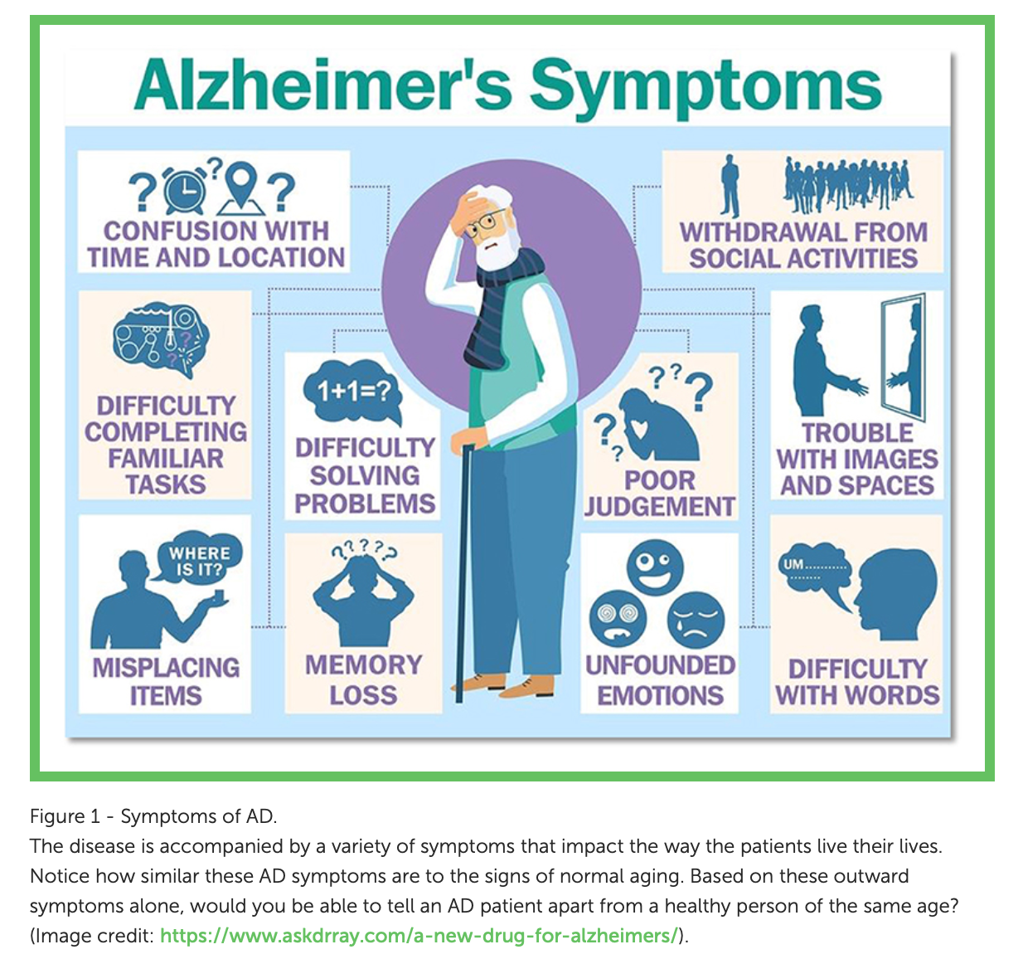
Alzheimer’s Symptoms 2

Slide 16
Variants of Alzheimer’s Disease
Typical
Memory Predominant Variant
Atypical
Language Predominant Variant (logopenic Primary Progressive Aphasia)
Frontal Lobe Predominant Variant (behavioral/dysexecutive AD)
Visual-Spatial Predominant Variant (Posterior Cortical Atrophy variant)
Asymmetric Cognitive and Motor Variant (Corticobasal Syndrome)

Slide 17
Dementia Staging
Completely Independent
Mild Cognitive Impairment
Cognitive decline without significant functional limitations
Mild Dementia
Cognitive decline sufficient to cause impairment of some instrumental ADLs
Moderate Dementia
Cognition impaired to point that need some help with basic ADLs
Severe Dementia
Severe limitations of cognition and need help with all basic ADLs
Independent
with IADLS
Reminders
Assistance
with IADLs
Supervision
Assistance
With Basic ADLs
Completely Dependent

Slide 18
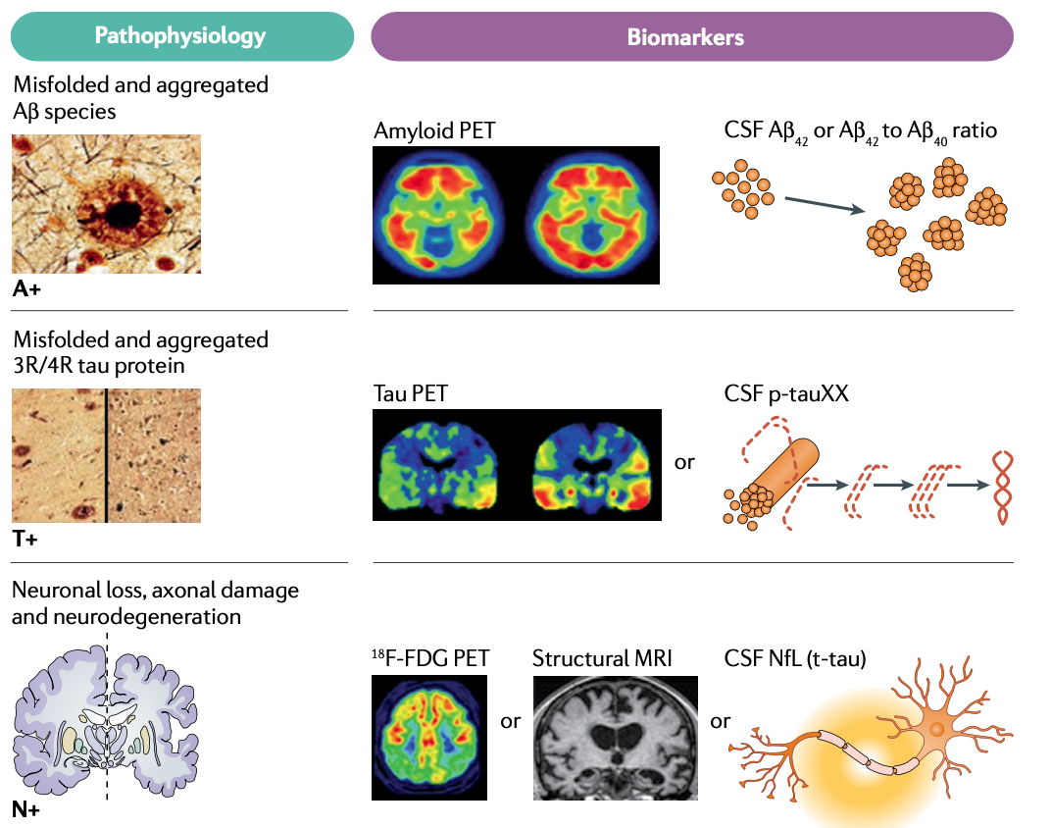
ATN Biomarker Classification
Hampel H, et al. Nature Rev Neurology 2021

Slide 19
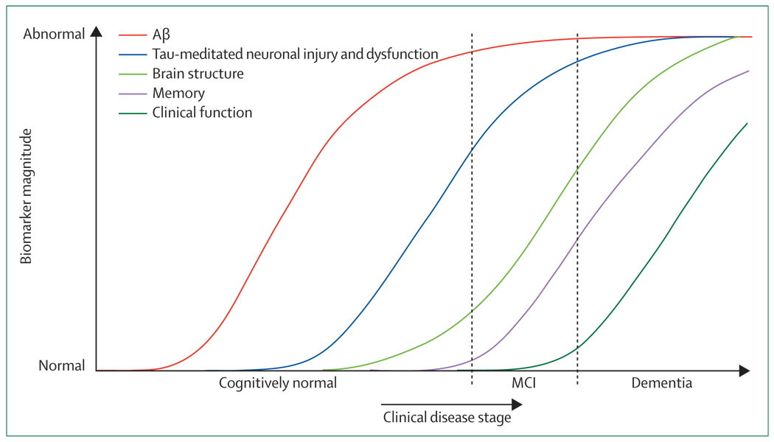
Time Course of AD Biomarkers
From Jack CR, et al. Lancet Neurol 2010; 9:119-128.

Slide 20
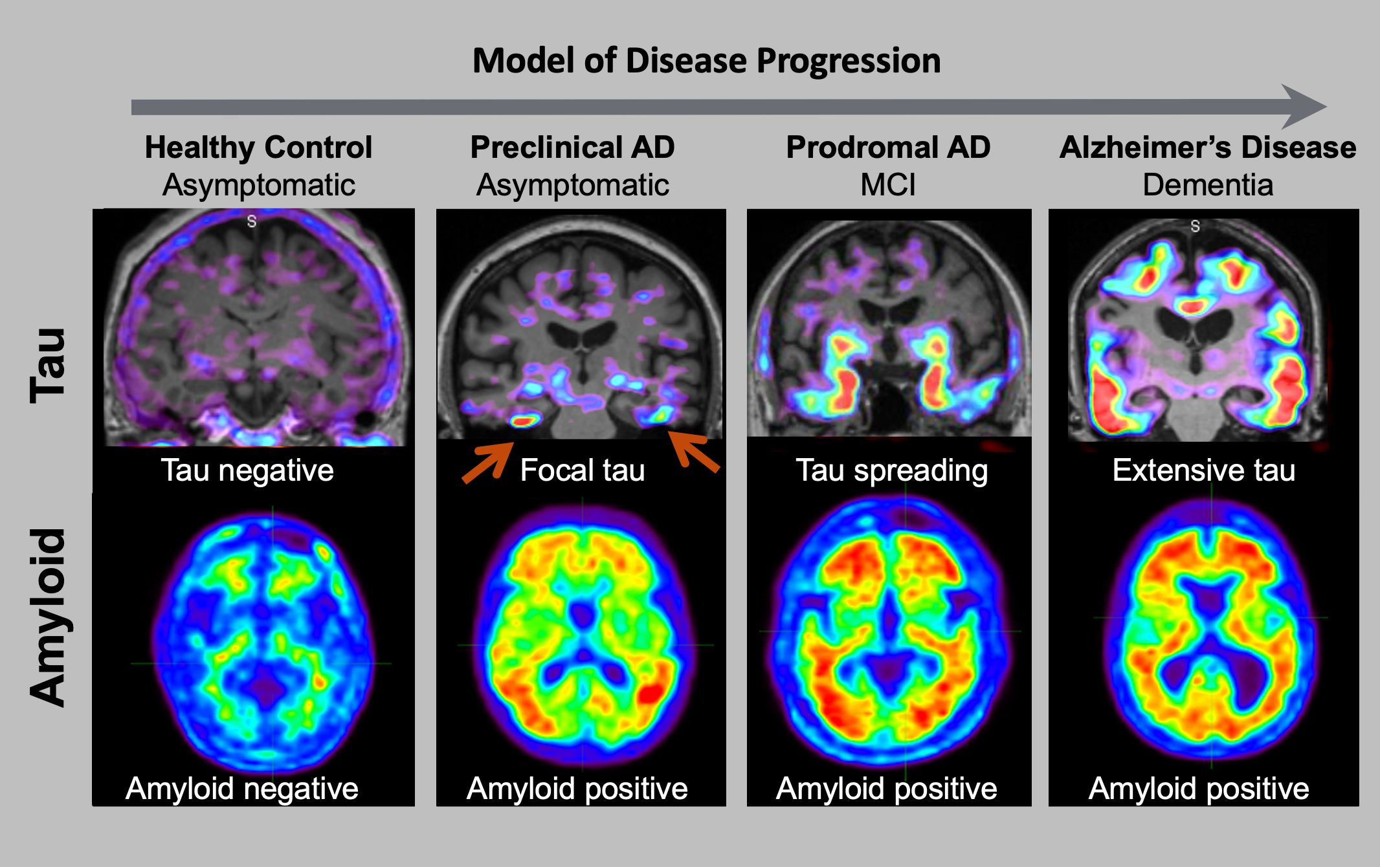
Evolution of Amyloid (“plaque”) and Tau (“tangle”) Accumulation in AD

Slide 21
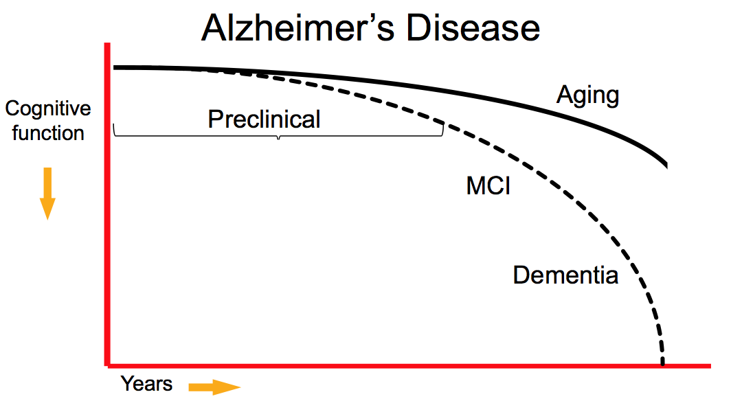
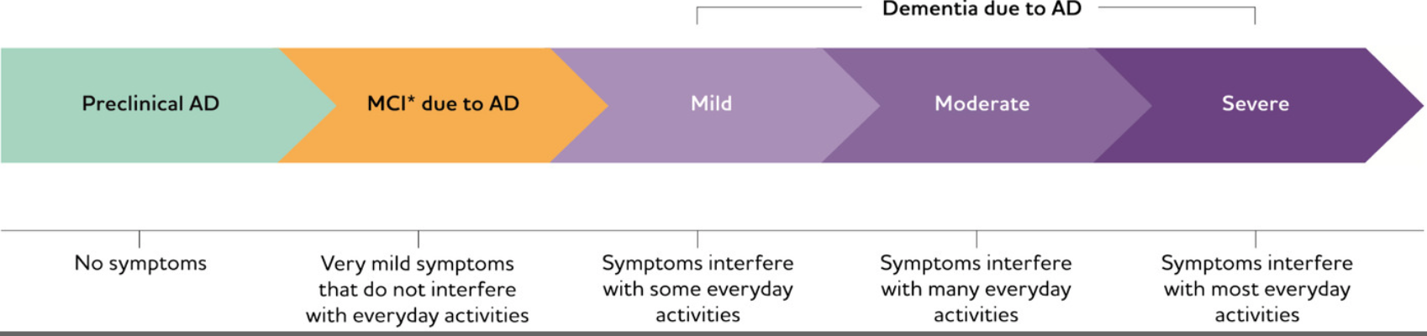
The Time Course of AD

Slide 22
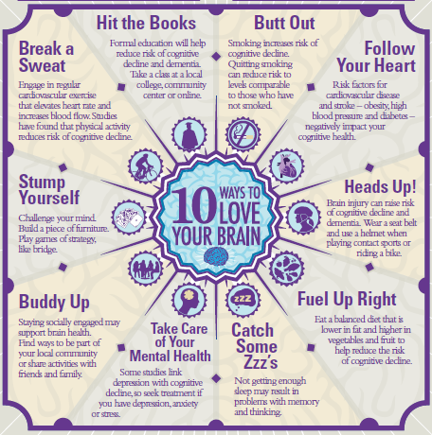
Livestyle for “Brain Health” 2
Lifestyle for “Brain Health”
Exercise Regularly
Stay Mentally Engaged
Eat a Healthy Diet
Keep Socially Connected
Control HTN, Lipids, DM
Get Good Sleep
Avoid Toxins/Head Trauma
Alzheimer’s Association

Slide 23
FDA-approve Medications 2
FDA-approved Medications for AD
Cognex (tacrine) - 1993*
Aricept (donepezil) - 1996*
Exelon (rivastigmine) - 2000*
Razadyne (galantamine) - 2001*
Namenda (memantine) - 2003*
Aduhelm (aducanumab) - 2021*
Rexulti (brexpiprazole) – 2023*
Leqembi (lecanemab) - 2023*
Kisunla (donanemab) – 2024*
*FDA approval year

Slide 24
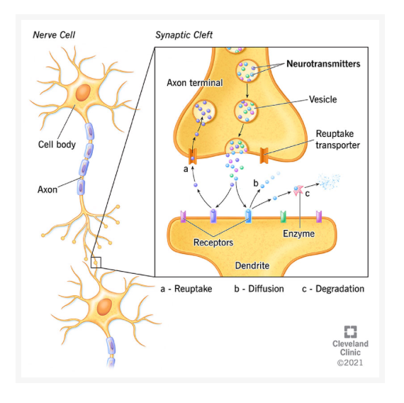
Brain uses electrical signals
The brain uses electrical and chemical
signals to communicate
Neurotransmitter
Examples:
Acetylcholine
Glutamate
Serotonin
Dopamine
Drugs modify
neurotransmitters
and this
communication

Slide 25
Symptomatic Medications for AD
Cholinesterase Inhibitors (Aricept/donepezil, Exelon/rivastigmine, Razadyne/galantamine)
Increases acetylcholine at the synapse
Side effects can include: nausea, diarrhea, runny nose, vivid dreams
Improves memory, everyday function and decreases psychiatric symptoms
Glutamate Modulators (Namenda/memantine)
Modulates glutamate at NMDA receptors
Side effects can include: dizziness, confusion/”spaciness”
Improves memory and everyday function

Slide 26
Anti-Amyloid Immunotherapy
Monoclonal antibodies that target and remove amyloid plaques in the brain
Given as IV infusion (every 2-4 weeks)
Two drugs are available
lecanemab/Leqembi, donanemab/Kisunla
Slow declines in cognition tests and everyday function by about 30% in early stages of AD
Can be associated with Amyloid-Related Imaging Abnormalities (ARIA)

Slide 27
Stage for New AD Medications
Anti-amyloid
Immunotherapy
MMSE 20 or higher
MoCA 18 or higher

Slide 28
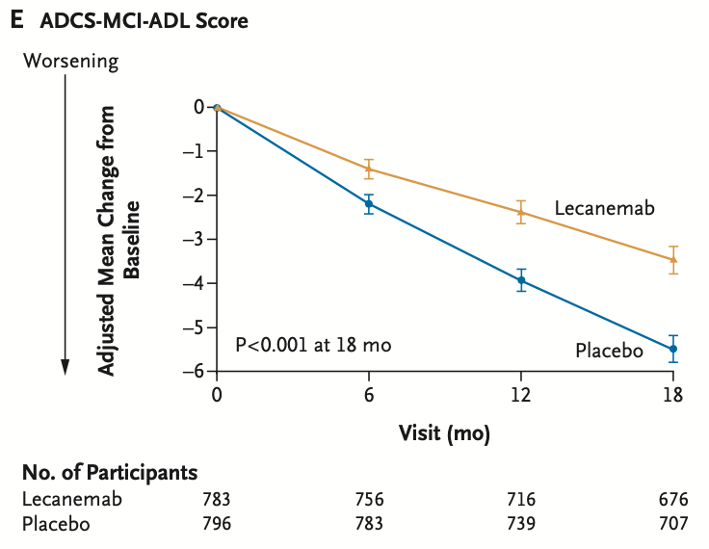
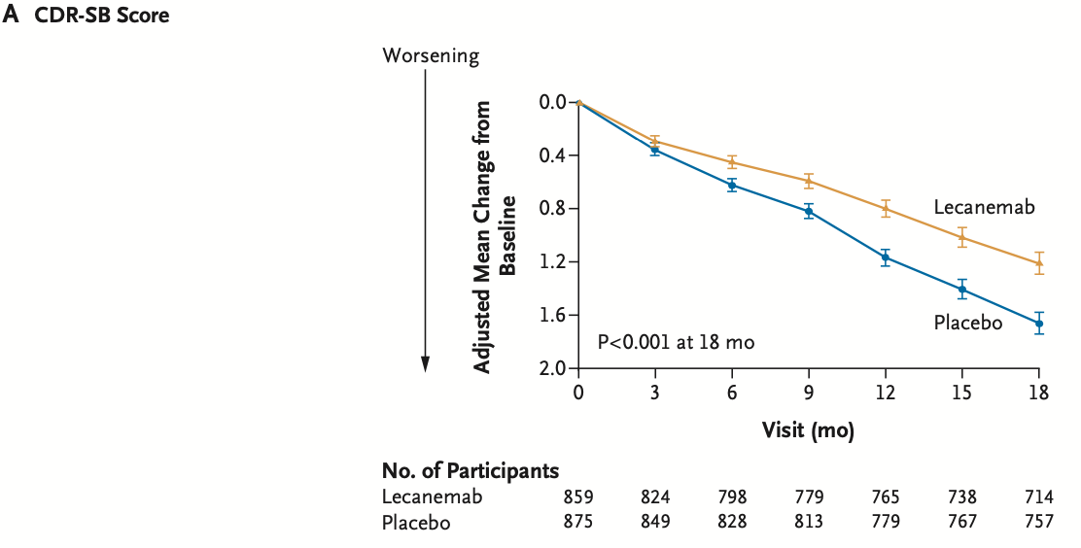
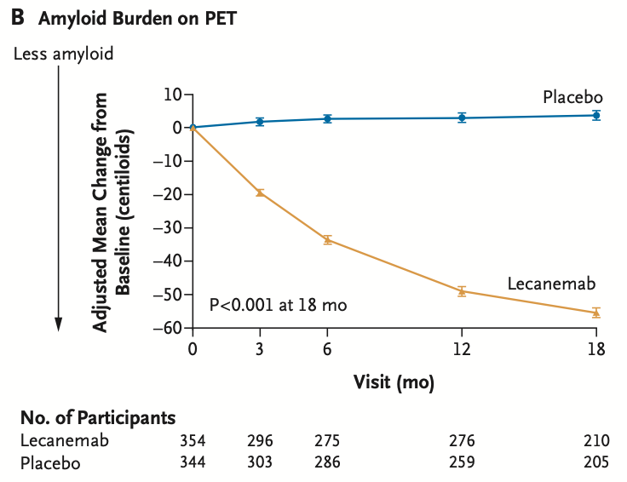
Anti-Amyloid immunotherapy2
Anti-Amyloid Immunotherapy for AD
An example: lecanemab in prodromal to mild AD
Benefits
27% less decline on CDR
36% less decline on IADLs
71% reduction of amyloid plaques on PET scan*
*average level of amyloid plaques on PET at end of trail was in “normal” range in those receiving lecanemab
van Dyck CH, et al. NEJM 2022

Slide 29
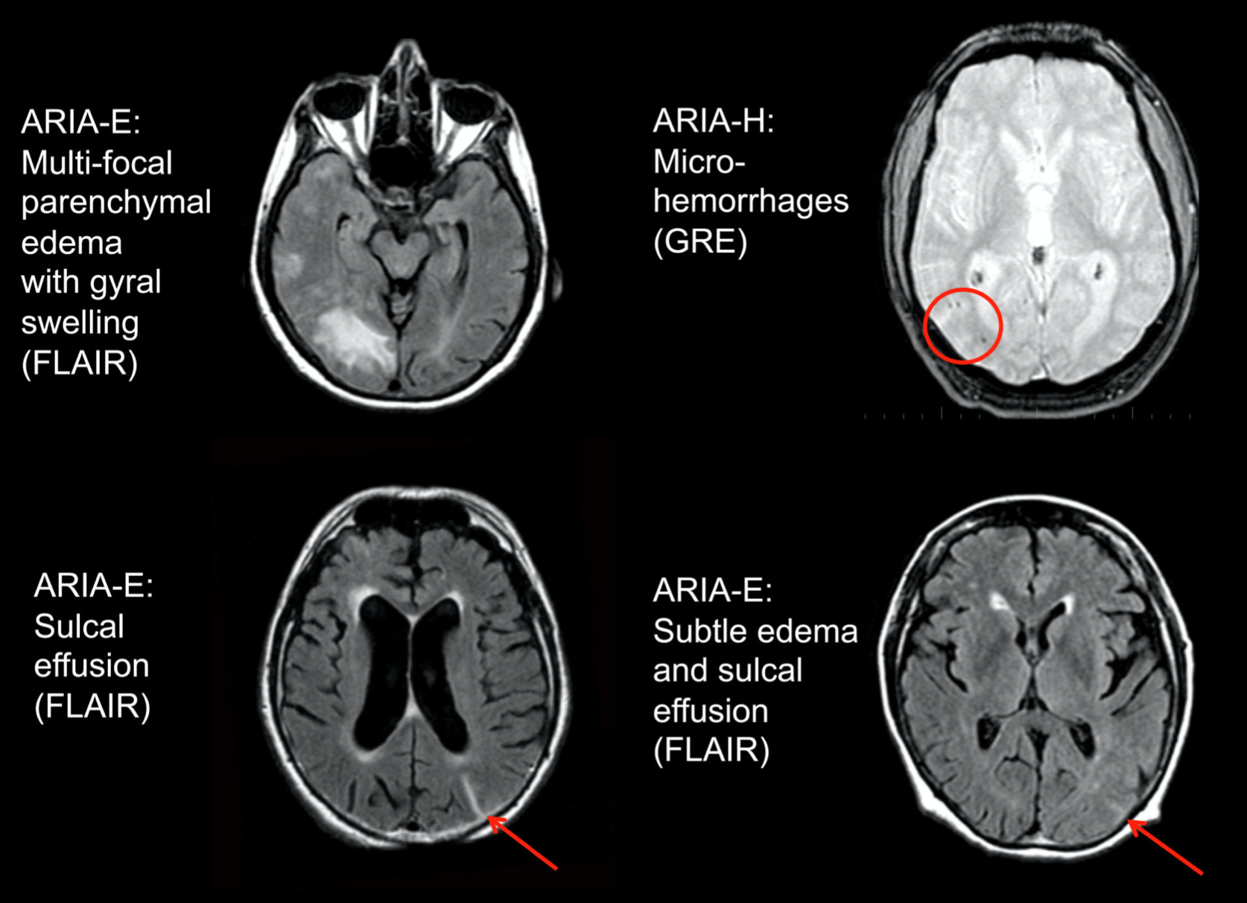
Anti-Amyloid Immunotherapy for AD
An example: lecanemab in prodromal to mild AD
Amyloid-Related
Imaging Abnormalities
(ARIA)
ARIA with lecanemab
ARIA-E: 13%
ARIA-H: 8%
Patients must be able to have multiple brain MRI scans to monitor for ARIA
Patients cannot be on strong blood thinners (e.g. Coumadin, Eliquis)
78% were asymptomatic;
3% had severe AE;
ARIA-E is reversible;
Risk of ARIA higher
with APOE e4

Slide 30
Anti-Amyloid Immunotherapy in AD
Kisunla (donanemab) in prodromal to mild AD
Benefits
CDRsb 29% slowing
IADLs 40% slowing
83% reduction of amyloid plaques
Donanemab was stopped when the subject’s amyloid PET scan normalized
Risks
ARIA-E = 16%*
ARIA-H = 15%*
* with modified dosing
No symptoms with ARIA in >90%
Severe ARIA = 3%
Three deaths related to complications of treatment (0.4%)
Sims JR, et al. JAMA 2023; 330:512-527.

Slide 31
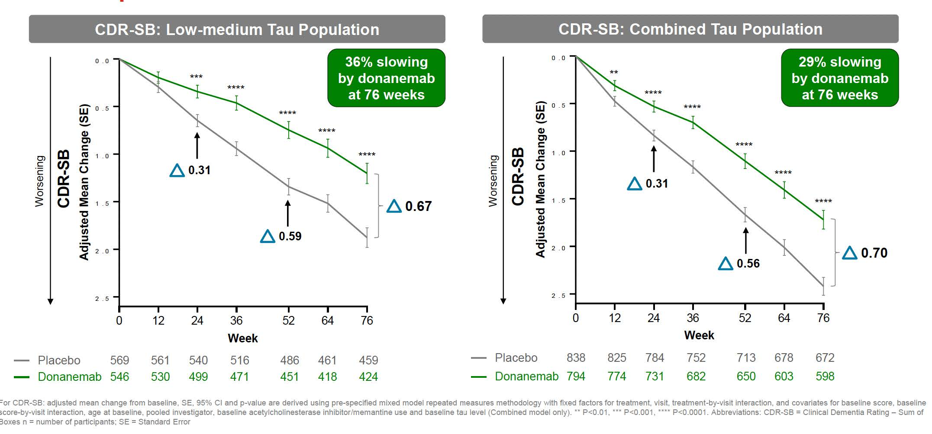
Benefits 2
Benefits: CDR & donanemab

Slide 32
Clinical AD Research at UNMC
Early Diagnosis & Monitoring
Driving for early detection of Alzheimer’s
TCD measures of CVR
Novel Treatments
Trailrunner study of remternetug
Trontier study of trontinemab
Caregiver Research
AD patient-caregiver synchrony and AD patient & caregiver outcomes
Possible new study comparing two treatments for caregiver depression

Slide 33
Email for more info
Email for more info: adtrials@unmc.edu
AD Prevention Trial – Trailrunner Study
Age 65-80, normal cognition, positive AD blood biomarker test
Remternetug vs placebo, sq for 1.5 years, then 3-5 years of follow-up
AD Treatment Trial of drug using BBB shuttle technology – Trontier Study
Age 50-90, prodromal to mild AD, amyloid PET positive
Trontinemab vs placebo, IV for 1.5 years followed by opportunity everyone to go on the study drug

Slide 34
National Early Onset AD Research
Longitudinal Early-Onset Alzheimer’s Disease Study: LEADS
Observational study of 500 EOAD patients and includes cognitive testing, lab tests, spinal fluid tests, and brain imaging (MRI, PET)
Closest sites in Rochester, MN (Mayo Clinic), Chicago, IL (Northwestern Univ.) and St. Louis, MO (Washington Univ.)
Dominantly Inherited Alzheimer’s Network (DIAN)
Study patients with a genetic mutation causing AD and their families. Located in St. Louis, MO at Washington University.
DIAN Treatment Unit (DIAN-TU) is conducting clinical trials for patients and at-risk family relatives.

Slide 35

Questions

Slide 36
UNMC/NE MED

Slide 37
Partnering with Providers and Navigating the Healthcare System
Julie Pavelka MS, APRN-NP
Nebraska Medicine Department of Neurological Sciences
Memory Disorders Team

Slide 38

Team

Slide 39

Gate Keeper
Primary Care Provider (PCP)
Physician
Nurse Practitioner (NP)
Physician’s Assistant (PA)
Notes:
Family Practice or Internal Medicine (Gerontologists if over 65)

Slide 40

Memory Disorders Team
Memory Disorder Specialist
Neurologist
NP/PA
Memory Disorders Registered Nurses
Medical Assistants/Certified Nursing Assistants

Slide 41

Therapy
Physical Therapy
Speech Therapy
Occupational Therapy
Nutrition Therapy
Trainer

Slide 42
Additional Team Members Continued
Social Worker
Pharmacist
Mental Health
Psychiatrist or NP/PA (that specializes in Psychiatry)
Psychologist
Therapist/Counselor

Slide 43

Additional Team Members
Financial Planner
Attorney
Support Groups
Faith Affiliations
Family and Friends

Slide 44

Preparation for Visits
Complete necessary paperwork
Minimize stress
Keep a medication record
Be ready to answer questions
Take notes
Discuss future care
Ask for recommendations
Leave with a plan

Slide 45
Complete Necessary Documents
Early in the course of the disease, it's important to complete paperwork that assists with future decision-making and care. Make sure the Provider’s office has copies. Revisit these documents periodically during doctor visits to ensure that your care decisions and written goals are consistent. The documents include:
Privacy Release of Information
Advanced Directive
Living Will
Durable Power of Attorney for Health Care
Notes:
The two most common advance directives for health care are the living will and the durable power of attorney for health care.

Slide 46
Complete Necessary Documents Continued
Privacy Release – form at the Provider’s office that indicates who can discuss diagnosis, treatments, and other medical concerns.
Advanced Directive – legal documents that provide instructions for medical care and only go into effect if you cannot communicate your own wishes.
Durable Power of Attorney for Health Care – designates who can make medical care decisions when the person with dementia is no longer able to do so.
Living Will – legal document that tells your Health Care Team what medical treatments you want if you are unable to make these decisions.
Notes:
A living will is a legal document that tells doctors how you want to be treated if you cannot make your own decisions about emergency treatment. In a living will, you can say which common medical treatments or care you would want, which ones you would want to avoid, and under which conditions each of your choices applies. A durable power of attorney for health care is a legal document that names your health care proxy, a person who can make health care decisions for you if you are unable to communicate these yourself. Your proxy, also known as a representative, surrogate, or agent, should be familiar with your values and wishes.

Slide 47
Minimize Stress
For some people with dementia, talking about an appointment ahead of time may be helpful. For others, it may be stressful. Use past experiences as a guide. To minimize stress:
Schedule appointments, when possible, during the best time of day for the person with dementia.
Allow for plenty of time to travel.
Bring a friend/family member to serve as a back-seat companion for the person with dementia.
Ask the provider’s office ahead of time if there is a quiet place to wait for the doctor.
Bring a favorite book, magazine or activity for the waiting time.
Focus on something enjoyable to do after the appointment, such as going out for a treat.

Slide 48
Keep a Medication Record
Keep a list of all medications, including over-the-counter drugs and dietary supplements. You might bring a bag of all prescription and nonprescription drugs for the doctor to review. A complete record should include:
Name of the medication
Daily dosage
Purpose
Name and contact information of the prescribing doctor
Prior medications that have been tried and stopped
Keep a log of daily medication use. Record any possible side effects, changes in behavior or problems that may be related to medication use. Note any missed dosages.
Prepare a list of questions you have about any medication or side effect. If the person with dementia lives in a care facility, ask the staff ahead of time about any concerns regarding medications.

Slide 49
Be Ready to Answer Questions
Keep a log between appointments to help the person with dementia or you to answer the doctor's questions. Record changes in memory, behavior or mood. Make notes of times of day or types of experiences that are challenging and those that are positive.
Before the appointment, write down any questions you have regarding symptoms and behaviors.

Slide 50
Take Notes
Take notes during the appointment. You might also invite a friend/family member to take notes. If you don't understand something the doctor tells you, ask for clarification. If the doctor prescribes a new medication or adjusts a dosage, record the following:
Name of the medication
Instructions for taking the medication
Reason for taking the medication or for adjusting dosage
Possible side effects
Instructions for when to call the doctor or to stop taking the medication

Slide 51
Discuss Future Care
Over the course of the disease, treatment goals will change. Discuss with your doctor expected care needs in the short term and long term. Discussions may include plans for:
Decisions about driving
Need for supervision or adult day services
Memory care centers
Nursing home care
Palliative care
Hospice services
Discuss how these decisions meet overall treatment goals and align with advance directives.

Slide 52
Ask for Recommendations
If you need help, ask. The Provider can refer you to various community resources, such as the local area agency on aging, meal services, senior centers, respite care and support groups. Some clinics or hospitals may have a social worker to help identify and arrange support services.

Slide 53
Leave with a PLAN
Write down any instructions or tasks that need to be addressed between now and the next appointment, including:
Appointments or tests that need to be scheduled
Details about changes in treatment or care
Concerns or instructions to share with other caregivers
Behaviors or changes in signs or symptoms to watch out for

Slide 54

Organize Information

Slide 55

Team 2

Slide 56

Movement Disorder Team

Slide 57
UNMC

Slide 58





Navigating Resources Through All Stages
COLLEEN hOARTY, lcsw
The Michael S. Heller Memorial Young-Onset Alzheimer's Conference
NOVEMBER 15, 2025

Slide 59
Today's Objective
To provide information on resources that can be helpful across stages of a diagnosis of Alzheimer's Disease
Information on disability benefits
Care options as care needs increase
Services that can be helpful in later stages
Other resources to have on your radar

Slide 60

Employment and Disability Benefits
Decision to stop working is often not an easy one
Better to make the decision yourself rather than having an employer make it for you
File for disability benefits from your job BEFORE you stop working or you lose them
Take advantage of Short-term Disability and Long-term Disability (STD and LTD) benefits offered through work

Slide 61
Types of Disability Benefits
Employer-sponsored benefits – (could be short or long-term or both)
Private disability policy (short and/or long-term)
Social Security Disability (SSI or SSDI) - can check whether you have enough work quarters earned for SSDI at ssa.gov/myaccount

Slide 62
Initiating Disability Benefits
Short or long-term disability benefits through work or a private policy?
Start there and request paperwork from your office manager or HR to provide to your medical team
No benefits through work?
Start the application process with Social Security
Once receiving long-term disability benefits through employer, someone from the insurance company will likely assist you to apply for SSDI

Slide 63
Social Security Disability (SSDI)and AD
Alzheimer's Disease is one of the diagnoses on the Compassionate Allowances list
Information on applying and helpful tips for applying with this diagnosis:
https://www.alz.org/help-support/caregiving/financial-legal-planning/social-security-disability
SSDI toolkit checklist - https://www.ssa.gov/pubs/EN-64-110.pdf
Can apply by phone, in-person or online https://www.ssa.gov/applyfordisability/index.htm
Eligibility depends on how many work quarters you have earned over a lifetime of earnings and how recently you have earned them
Benefit amount varies based on what you have paid into it

Slide 64
Insurance Coverage
Need to consider insurance options if you are no longer working and you have had insurance tied to your employment (and compare not only monthly premiums but co-pays and coinsurance)
COBRA – continuation of current coverage through job
Spouse's insurance
Affordable Care Act (ACA) Marketplace plan (open enrollment going on right now (healthcare.gov). If you are losing insurance outside of open enrollment, you can qualify for a Special Enrollment Period if applying within 60 days of losing insurance
Medicaid – Annual income must be below $21,597 for a single person and below $29,187 for a couple
Medicare starts after two years of receiving SSDI benefits

Slide 65



Care Options as Care Needs Increase

Slide 66
Planning Ahead is Key
Planning ahead with a progressive illness is very important
If possible, have conversations about what is important to you as a person with Alzheimer's, as a care partner, or as another loved one
Parallel planning – e.g. - planning to maintain care at home while also planning on the possibility of transitioning to a care community if needed - What is your back-up plan?
Start to build your care team – identify people in your life that you can go to for help when you need it. What will you do if/when there are any gaps in care?
Family members
Friends
Professional home care agency or other hired caregivers
Community supports

Slide 67
Maintaining Care at Home
In-home care for companionship, supervision, respite services, or assistance with personal cares
Adult Day Services – programs provide above services outside the home for several hours during the day
Cost – typical cost of agency in-home care is $35-$45/hour, while private individual caregivers often range from $18-$25/hour. Adult day services typically range from $75-$125/day (5-8 hours of care)
Funding options: private payment, veterans benefits, long-term care insurance, Area Agency on Aging programs, respite through Medicare GUIDE program, Medicaid waiver
Addressing home safety – emergency response systems, security modifications (https://www.alz.org/help-support/caregiving/safety/home-safety)

Slide 68
Transitioning Care From Home Into a Long-Term Care Community
At some point it may be a consideration to transition care from home into a long-term care community
Always important to have a back-up plan and to be thinking about Plan B
Plans can change for a variety of reasons (care team changes, complex symptoms that may be hard to navigate at home, care needs may be better met in a long-term care community)
Very important to plan ahead
It can be helpful to meet with a financial advisor and/or elder law attorney to be able to plan financially
Need to make sure Advance Directives are in place

Slide 69
Transitioning Care From Home Into a Long-Term Care Community continued
Memory care communities may be stand-alone or may be part of an assisted living or skilled nursing community
Visit communities ahead of time when you are not under pressure to make a quick decision to see what might be a good fit
Many communities have waiting lists
Utilize senior living advisors if needed
Options for payor sources: private payment, long-term care insurance, veterans benefits, and Medicaid programs

Slide 70


Palliative Care and Hospice Care

Slide 71
Palliative Care
Care that is focused on alleviating and managing distressing symptoms and providing support
Support for both patient and family members
Support with decision-making
Can be initiated at any stage of a progressive illness
Covered by insurance
Outpatient services are available if someone is at home or resides in a long-term care community (appointment is either in-person or via telehealth). At Nebraska Medicine this is provided by a physician.
A few home health and hospice agencies have in-home palliative services (monthly visits from a nurse practitioner)

Slide 72
Hospice Care
Type of palliative care that is focused on providing support in the end stages of a serious illness
A physician must certify that someone likely has 6 months or less to live based on the typical course of their illness
Must have a doctor's order and is covered by insurance
Can be provided in the home, in a long-term care community, or in a free-standing hospice setting
Team consists of medical director, nurse case manager, home health aide, social worker, chaplain, volunteers
Hospice agencies may offer additional services as well
Hospice indicators with an Alzheimer's diagnosis: limited speech or speech that does not make sense; increased dependency with ambulation and activities of daily living; incontinence; unintentional and progressive weight loss

Slide 73
NE Caregiver Tax Credit
The Caregiver Tax Credit Act establishes a nonrefundable tax credit for family caregivers who provide care and support to an eligible family member for tax years beginning on or after January 1, 2025, that requires an application filed with the Nebraska Department of Revenue (DOR).
The tax credit will equal 50% of the eligible expenditures incurred by the family caregiver during the taxable year with a maximum credit of $2,000, or $3,000 if the eligible family member is a veteran or is diagnosed with dementia.
Income limits
Do not have to be residing with the person
Care receiver cannot live in a long-term care setting
https://revenue.nebraska.gov/caregiver-tax-credit-act

Slide 74
Medicare GUIDE Program (Guiding an Improved Dementia Experience)
8-year Medicare pilot project that started this past summer (2025)
In Nebraska there is one contracted agency to provide these services, called Medicine in Motion
Goal is to increase the quality of life for the person with Alzheimer's and to increase caregiver support
Provides ongoing support and care management to families with 24/7 availability
For people with traditional Medicare (not those who have a Medicare Advantage plan) it can provide up to $2500/year of respite services
Info@MedicineinmotionMD.com or 531-359-6571

Slide 75
Additional Resources
Support groups - https://www.alz.org/nebraska/support
State Health Insurance Program (SHIP) https://doi.nebraska.gov/nebraska-ship-smp
Area Agencies on Aging –
Eastern NE Office on Aging – www.enoa.org
Aging Partners - Aging Partners –https://www.lincoln.ne.gov/City/Departments/Aging-Partners
Connections - https://www.connectionsaaa.org/
Omaha area and Council Bluffs area resource lists -
douglas-sarpy-county-community-resources-3-2025.pdf
council-bluffs-pottawattamie-county-community-resources-3-2025.pdf

Slide 76
Thank you! Colleen Hoarty, LCSW Medical Social Worker NE Medicine Neurosciences 402-559-5767 cohoarty@nebraskamed.com

Slide 77

Estate Planning Essentials
Christina L. Usher
Mattson Ricketts Law Firm, LLP

Slide 78
What is an Estate Plan?
Putting together legal documents and designations that will help manage your legal, financial and healthcare affairs BOTH during your life and after your passing.

Slide 79
Situations you may encounter where an estate plan will help
Needing to access a bank account;
Signing a tax return;
Applying for disability;
Signing over a deed;
Managing a retirement account;
Assigning death benefits

Slide 80
Key tools to Any Estate Plan 1. Power of Attorney - Financial & Medical 2. named beneficiaries & Joint Owners 3. Will / trust

Slide 81
Benefits of Estate Planning 2
Benefits of Estate Planning
Providing for your Family. Making sure your family is provided for the way you would do if you were still able and around.
Control. Transfer to the individuals you designate – rather than the State of Nebraska determining your heirs or a conniving heir.
Peace of Mind. One less thing for your family to worry about in a time of crisis or grief.
Planning for Emergencies. Know who will handle the details if you aren’t able
Limiting the likelihood of family fights. Put in place common sense controls and divisions to limit family strife.
Efficiency. Think about costs and possible problems ahead of time to make the transfer of assets more timely and cost effective.

Slide 82
HOW CREATE
Handwritten
Easy
But easy to challenge
Internet
User-friendly and immediate
May not take into account your particular situation
You may not know the questions to ask
Attorney
More robust process but often slower and more expensive
An ongoing resource when you have questions or changes
Better understands the human element of estate planning (e.g. one kid on a bank acct)
What the process should look like with an attorney:
Meet with the attorney in her office or on zoom to discuss your particulars
Decide on what type of documents you need
Receive drafts for your review; ask questions
Review with an attorney and then execute

Slide 83
Power of Attorney
WHO: Anyone and everyone over the age of 18, married or single
WHAT: A document, like a contract, that delegates your legal authority to another if you become incapacitated or immediately, as you designate.
WHY: So that someone has authority to make decisions for you and manage your finances when you are unable.
Use: During your life, when you are incapacitated.

Slide 84
Durable power of attorney
Delegate authority to another
Either immediately or upon incapacity
For Financial and Legal Matters such as: paying bills, managing bank accounts, signing contracts, transferring real estate, signing tax returns, protecting your finances

Slide 85
Medical power of attorney
Delegate authority to another
Only upon incapacity
For healthcare decisions such as: choosing doctors, treatment options, having access to HIPPA information
For end-of-life decisions when you are deemed to be “terminally” ill

Slide 86
When capacity to sign is already an issue
Need only to understand the nature and effect of the document at the time they are signing it.
Pick the best time of day
Can make more than one attempt
Signed in front of a notary
If capacity too much of an issue, can get a guardianship / conservatorship

Slide 87
Guardianship/conservatorship
Guardianship = authority over the body, such as healthcare and living arrangements
Conservatorship = authority over finances and assets
Filed through the court
Helpful to have attorney but not required
Online Court Resources: https://nebraskajudicial.gov/administration/public/guardianship-and-conservatorship-information

Slide 88
Non-PROBATE Transfers
Pre-planned transfers to be made at death, that do not rely on a Will document:
Payable-on-death Beneficiaries on accounts (e.g. IRA, bank account)
Joint ownership of real estate or accounts (e.g. both husband and wife are on title)
Transfer on Death Deed. A special deed for real estate that creates a beneficiary for your house - Revocable
Life Estate. A deed that allows you to keep your land during your life but then transfers it automatically upon your death – Irrevocable
Using a Trust

Slide 89
PROBATE
What it is: The process of submitting the decedent’s Will to the Court to be reviewed and verified as a legitimate Will. Upon favorable review of the Will, the decedent’s named executor (personal representative) is authorized by the Court to take legal actions to settle the decedent’s estate, pay bills, settle claims, talk to the bank, sign a deed, sell a house, pay taxes, and distribute the remaining assets.
Bad Rep: Probate itself is not particularly expensive – typically less than $500. The expensive part is hiring the attorney. However, even if you have a trust, your heirs will likely hire an attorney to get advice on what to do. The costs of trust administration and probate are very similar.

Slide 90
Last will & testament
WHO: Anyone and everyone over the age of 18, married or single
ESPECIALLY:
Families with young children
Married people with children from a previous marriage
Unmarried partners
WHAT: A document which only gains enforceability and grants legal authority upon being submitted to a court for Probate.
WHY: To avoid fights, prolonged proceedings, and unintended consequences
Use: After you die, a Will directs how your net assets are divided and to whom – distribution happens within months after death

Slide 91
trusts
Kinds. There are many, many kinds of trusts. But the one most people use or think of when referring to a trust is a Revocable Living Trust. That is a trust that can be modified, terminated, and fully controlled by you while you are alive.
It only become irrevocable upon your death
A Trust is essentially a contract that you make during your life that says how your income and assets should be handled, both during your life, and then upon your death.
You are the trustee while you are able; however, your trust nominates a few people or a trust company to serve as trustee if you are no longer able to do so. This pre-planned delegation of authority is what makes a trust different than a Will.

Slide 92
Medicaid Planning
Costs of care are expensive; if you are concerned about running out of resources, Medicaid Planning is wise
Main program = Spousal Impoverishment Program
The program helps protect the resources of the at-home spouse; divides the couples' resources
Can keep house and one car
At-home spouse may keep a certain level of income and other resources (e.g. retirement)
If at-home spouse does not have minimal resources after asset split, resources will be shifted to at-home spouse and more of institutionalized spouse’s care covered by Medicaid.

Slide 93
Tools of good estate plan 2
Tools of Good Estate Plan
Useful During Your Life
Durable Power of Attorney for Finances
Power of Attorney for Health Care and Living Will
Limited Power of Attorney for Medical Treatment of your Child
Insurance – Umbrella policies
Useful primarily at or after your Death
Designated Beneficiaries and Transfer on Death designations on banking and financial accounts
Joint tenancies with rights of survivorship; Life estates
Will
Trust (can be useful during life as well)
Transfer on Death designations for your real property and vehicles
Laundry list for personal property
Pre-planned funeral arrangements

Slide 94

Questions?
Christina L. Usher
clu@mattsonricketts.com
402.475.8433

Slide 95
Definitions & Explanations for your REFERENCE

Slide 96
Will v. Trust
Feature | Will | Trust
Takes Effect | Only after death, by submitting to the Court | Effective during life and after death
Distributions | Immediate, within months after death | Can be spread out over decades – good for young kids or people with special needs
NE Inheritance Tax | Must file as part of probate process | Legally required to file with court – saves about ½ of probate costs
Updates and revocability | Easy to update; fully revocable | Easy to update; fully revocable but then have to “undo” titling to the trust
Costs | Easier to set up Probate costs + attorney fees | More complex and expensive to set up & maintain Avoids some probate costs but usually an attorney is still utilized
Taxes | Not an issue | Can be an issue for trusts that last for decades – taxed at higher rate
Biggest Downside | Needing probate, no matter what | Assets don’t get titled into trust so have to do probate anyway

Slide 97
Inheritance tax
There is inheritance tax or estate tax (so-called “Death Taxes”) at both the Federal and State levels (just like income tax)
The Federal Tax has a very high exemption: currently $13,990,000 per person (doubled for married couples)
Nebraska is one of only 5 states that currently have an inheritance tax. The tax is paid directly to the counties.
No tax between spouses
1% tax, after the first $100k, to children & grandchildren
15% tax, after the first $25k, to a non-married partner

Slide 98
Beneficiaries on Accounts
BENEFICIARIES ON ACCOUNTS
Insurance policies and retirement accounts require beneficiary designations. After death, the financial institution transfers the assets in that account to the designated beneficiary without the probate process. A beneficiary has no power over the account before death. A similar result can be obtained by using transfer-on-death or payable-on-death beneficiary designations on bank and investment accounts.

Slide 99
Beneficiaries on Real Estate 2
BENEFICIARIES ON REAL ESTATE & VEHICLES
These designations are similar to designated beneficiary designations but are more formalized. The Transfer on Death Deed is recorded with the Register of Deeds and is a public record. Upon death, title to a residence or other real property automatically transfers to the person designated on the deed without the need for a probate. The Department of Motor Vehicles also provides titles that automatically transfer ownership of a vehicle at death.

Slide 100
Joint ownership 2
Joint Ownership with Right of Survivorship
Ownership of real property, vehicles, and bank and investment accounts can be held jointly with another person. During your lifetime the joint owner has the same power over the asset as you. However, upon death, the surviving joint owner takes immediate ownership of the asset. There is more than one type of co-ownership, so it is important the joint ownership designation provides for “with right of survivorship.”

Slide 101
Living Revocable Trust 2
Living Revocable Trust
A contract between an individual and a trustee for the management of assets placed in the trust. Title to the assets needs to be transferred to the trust. This contract is revocable during life and can be amended or terminated at any time. Upon death, the trust becomes irrevocable and either provides for the distribution of the trust assets (like a Will, but without the need for a probate) or provides for the continued management of the trust assets. (i.e., the trust assets are managed until children reach a certain age and then the assets are distributed).

