Slide 1
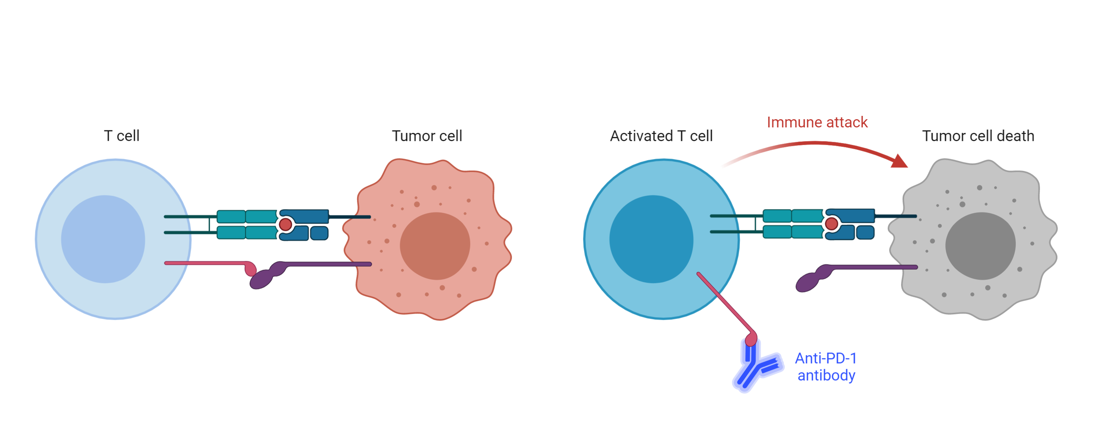
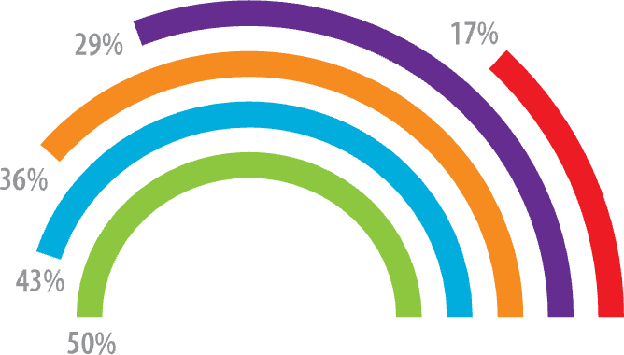
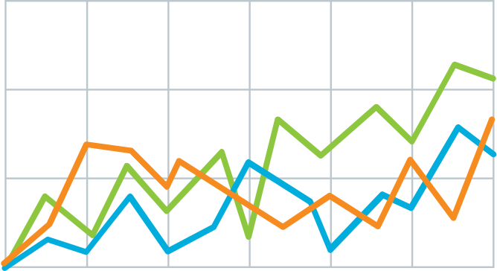
Method
v
Teach people something cool you learned in 5 seconds as they walk by (or scroll by).
Immune checkpoint inhibits T-cell activation.
Anti-PDF-1 antibodies permit T cell activation.
Explain what the graph shows. Like, spoilers are good.
Quickly explain what the graph shows. Help people think.
v
v
Illustrate your takeaway point with an image, graphic or key figure.
Author1, author2, author3, author4, author5
Take a picture to
download the full paper.
Generate a free QR code at https://www.qrcode-monkey.com/

