Slide 1
SLIDE 1: (This slide)
SLIDE 2: Your template slide.
Do a “Save As” now to create a new, separate file for your project.
Delete the intro slide and instruction slide from that file.
SLIDES 3-6: Instructional slides.
Basic hints and tips for your poster design.

Slide 2
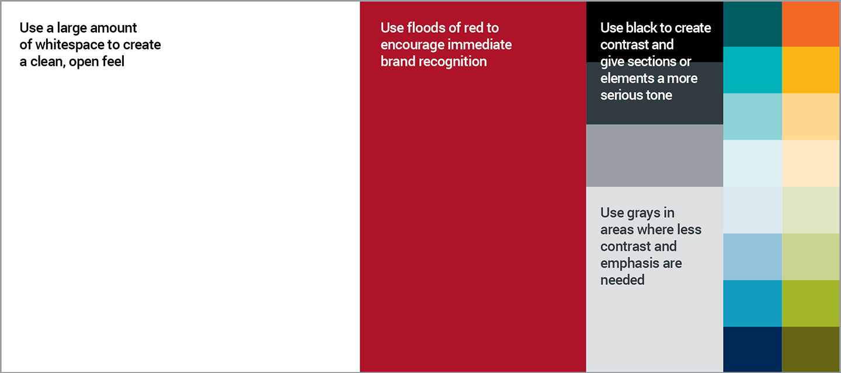




The most important finding or message goes here. Make them want to walk across the room to talk to you.
Type Your Title Here Using Bold, Italicized Font: Resize the text as needed
Author1 ª, Author2 ª, Author3 ^{b}, Author4ª, Author5ª
a. UNMC College of Nursing
b. Author affiliation
BACKGROUND: Explain why your study matters in the fastest, most brutal way possible and make important words BOLD for users who skim. Two sentences should do it.
METHODS
Collected [what] from [population]
Tested it with X process.
Illustrate your methods if you can with a flowchart!
RESULTS
Graph/table with essential results only.
Or list results with bullet points.
Use the entire gray area to expand on the most important aspect of your study.
Were your methods new and interesting? Talk about it more in this area.
Results that blew your mind? Make a big deal out of it here?
If demographics of your study a key element to your findings, include them!
Leave room at the right side or along the bottom for your conclusions.
Create more text boxes, find images or clip art, add color.
Keep it classy and relevant – we are presenting ourselves as serious scientists.
DELETE THIS TEXT BOX!
References
CONCLUSIONS:
Use 1 or 2 sentences to wrap up your findings. Make it MEMORABLE.

Slide 3

UNMC’s branding guidelines: The logos can’t be moved and need space around them. No adding elements within the yellow boxes.
INSTRUCTION SLIDE

Slide 4
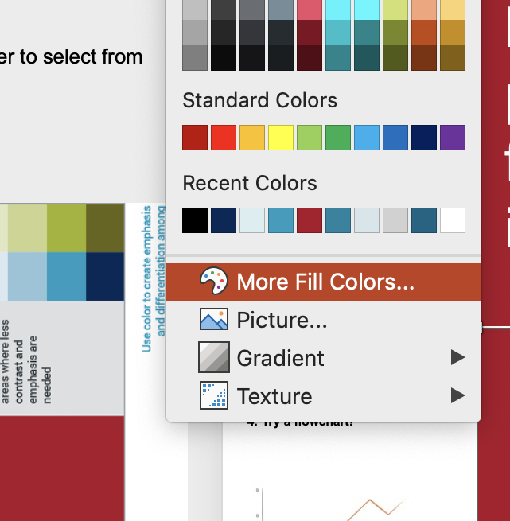
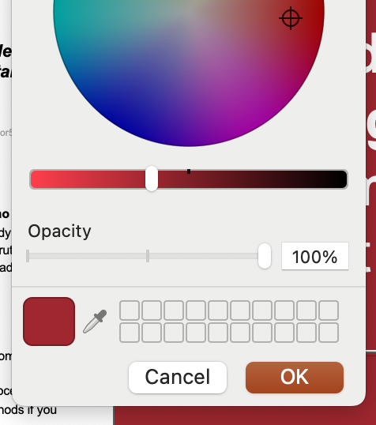
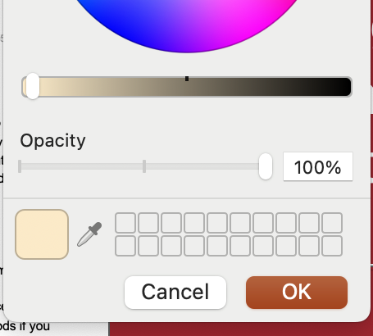
INSTRUCTION SLIDE
PICKING COLORS FROM UNMC’s PALETTE
1. Click on “More Fill Colors”
2. Click on the dropper tool
3. Hover over your color choice on this palette click the one you want.
4. This box will change to show your choice.
Click ”OK”.

Slide 5



INSTRUCTION SLIDE
USING IMAGES IN YOUR POSTER
A note about image use:
Our use of images for a scientific poster is limited and scholarly (for educational and teaching purposes), which generally falls under the “fair use” exclusion of copyright law. However, there are nuances and exceptions. To avoid confusion, find images using copyright or royalty free sources like Canva, Pixabay, or Pexels. Websites like Adobe Stock or Getty Images have limited royalty-free options but expand their selection and quality when paying for their images. No matter what source you use -- always download with care! We do not take any responsibility for issues related to downloads from any of these suggested sites.
MORE INFO on Fair Use: https://ogc.harvard.edu/pages/copyright-and-fair-use
REMEMBER!
-Pictures of humans will attract attention.
-Representation matters! Look for diverse subjects.
-Search with your study’s participants in mind!
(Pediatric researcher? Don’t use an image with an adult.)
-Pay attention to facial expressions.
(Smiling people for a grief study sends the wrong message.)
Images like this make data display more interesting.
Images with off-center subjects leaves room to place a text box with important information.
Change the SHAPE of your images:
click on image
go to ”Picture Format” tab
click down-arrow to right of “Crop”
choose “Crop to Shape”
click on shape you like
use the SAME shape throughout -- don’t use multiple shapes in the same poster
You can place boxes
Use the empty area of the photo to highlight important information
like these to display linked
information together. Use
Check details!!! Women wearing headscarves for religious reasons probably aren’t going to bare their belly. This image may alienate certain viewers by overlooking an important detail.
you can place data or text here
a gradient of color to keep
eyes moving down the list.

Slide 6
The most important finding or message goes here. Make them want to walk across the room to talk to you.
Keep it simple! Aim for a single sentence written like a news headline. Two sentences maximum. Increase the type size as needed to fill the space.
Type Your Title Here Using Bold, Italicized Font: Resize the text as needed
Author1 ª, Author2 ª, Author3 ^{b}, Author4ª, Author5ª
a. UNMC College of Nursing
b. Author affiliation
BACKGROUND: Explain why your study matters in the fastest, most brutal way possible and make important words BOLD for users who skim. Two sentences should do it.
METHODS
Collected [what] from [population]
Tested it with X process.
If possible, use a flowchart to illustrate your methods
RESULTS
Graph/table with essential results only.
Or list results with bullet points.
Use the entire gray area to expand on the most important aspect of your study.
Were your methods new and interesting? Talk about it more in this area.
Results that blew your mind? Make a big deal out of it here?
If demographics of your study a key element to your findings, include them!
Leave room at the right side or along the bottom for your conclusions.
Create more text boxes, find images or clip art, add color.
Keep it classy and relevant – we are presenting ourselves as serious scientists.
Resize & move text boxes as needed. Type smaller than 40pts encourages text-heavy posters. Smaller than 24pts is hard to read from more than a few feet away.
Place a SIMPLE graph, chart or other image anywhere in this left section to break up the text.
Or use graphics, clip art, or a photo that will help users associate ideas with your words. Try shifting the text down and putting it right under the authors near the top.
MIND THE GAP: elements placed too close the edge could be cut off during the printing process.
CONCLUSIONS:
Use 1 or 2 sentences to wrap up your findings. Make it MEMORABLE; will many people only read this and your main finding.
References
QR Code HERE. Links document w/ references, more figures/charts, or full paper.

