Slide 1
CATCH RURAL Falls
Coordinated Action Toward Community Health: RedUce Risk And Limit Falls
Applying Plan-Do-Study-Act (PDSA) Cycles to Improve Assessment of Orthostatic Blood Pressure

Slide 2
Acknowledgements: Funding for the CATCH RURAL Falls Program
This work is supported by the Nebraska Department of Health and Human Services Office of Rural Health Medicare Rural Hospital Flexibility Program.
The content is solely the responsibility of the presenters and does not necessarily represent the views of any funding source.

Slide 3


Introductions and Contact Information
Dawn Venema, PT, PhD
Physical therapist, with experience primarily in geriatric practice
Expertise in fall risk management and mobility
dvenema@unmc.edu
Victoria (Vicki) Kennel, PhD
Industrial organizational psychologist
Expertise in quality improvement, teamwork, and organizational science
victoria.kennel@unmc.edu

Slide 4
Educational Objectives
Describe the intended purpose of Plan-Do-Study-Act (PDSA) cycles
Describe each element of a PDSA cycle
Apply the PDSA approach to improve assessment of orthostatic blood pressure in your clinic

Slide 5
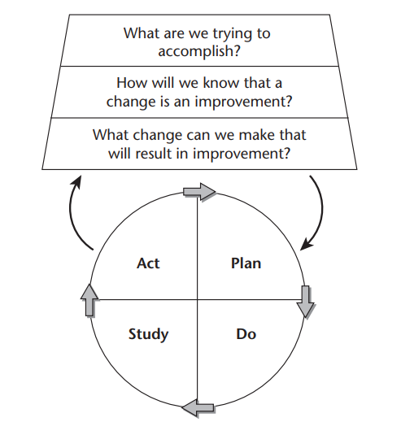
The Model for Improvement
Provides a framework for developing, testing, implementing, and spreading changes that result in improvement
Can be applied widely to many different types of problems and situations
Attempts to balance careful study with action
Emphasizes and encourages ‘trial-and-learning’ as an iterative process for improvement
Allows project plans to adapt as learning occurs
Langley GL, Moen R, Nolan KM, Nolan TW, Norman CL, Provost LP. The Improvement Guide: A Practical Approach to Enhancing Organizational Performance (2nd edition). San Francisco: Jossey-Bass Publishers; 2009. Model for Improvement Figure 1.1. Permission obtained from John Wiley and Sons on 1.13.2025 to use this figure in this presentation.

Slide 6
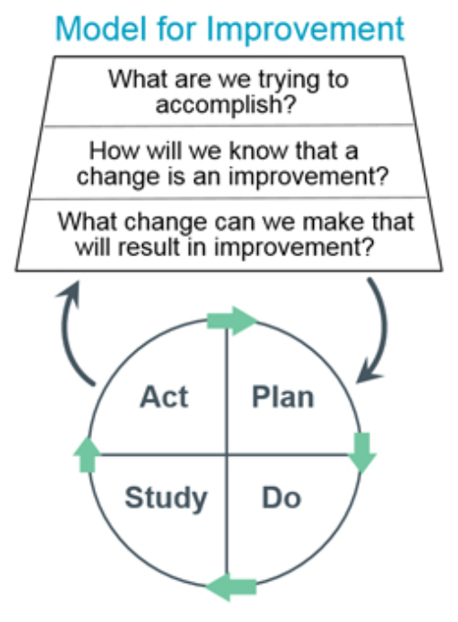
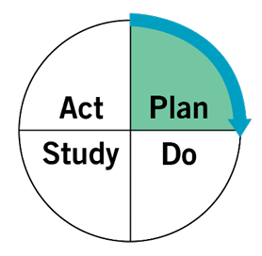
“Plan”
What question do you want to answer with this test?
What do you think will happen? (make a prediction)
Create a plan to test the change
Identify the data you need to collect to help answer your question
Assessment of Orthostatic Blood Pressure Example
Question to Answer: To what extent will our clinic increase our rate of assessment of orthostatic blood pressure for adult patients ages 65 and older who screened positive for fall risk? What will staff report as facilitators and barriers to completing this assessment?
Prediction: The rate of assessment of orthostatic blood pressure will increase from 0% to 50% over the next two weeks. Staff will identify successes and barriers to assessing orthostatic blood pressure that will be addressed in the next test of change.
Plan: During the next two weeks, all patients ages 65 and older who screened positive for fall risk using the clinic’s fall risk screening tool during their appointment will be offered an assessment of their orthostatic blood pressure. Medical assistants and nurses were provided with in-person training and written instructions for how to measure orthostatic blood pressure, and how to educate patients about the purpose of measuring orthostatic blood pressure. The clinic wants to trial if the process works well if the assessment begins as soon as patients are roomed since the assessment requires that patients start the process by lying down.
Data to collect: In order to calculate rates of assessment of orthostatic blood pressure for eligible patients, we will collect data from the medical records of all patients ages 65 and older who screened as at risk for falls during the two-week trial timeframe. We will need to determine which of those patients do and do not have orthostatic blood pressure assessment results documented in the EMR. The completion rate = those who have fully completed assessment of orthostatic blood pressure documented divided by the population of patients ages 65 and older who screened positive for fall risk. Medical assistants and nursing staff will also document their experience/observations of the current process for measuring orthostatic blood pressure in a separate document.
Institute for Healthcare Improvement. QI Essentials Toolkit: PDSA Worksheet. https://www.ihi.org/resources/tools/plan-do-study-act-pdsa-worksheet

Slide 7
Checklist for Developing the Plan
Establish the objective of the test
Ensure key background information is available to understand the plan
Be clear about the change(s) to be tested in this specific cycle
Specify the question(s) to be answered
Specify the measures that will be collected in this specific test cycle
Establish the test design
Specify the scale of the test​
Clarify the people or things selected for this test and your sampling strategy
Clarify the when and where​
Describe the test design​
Describe the method of data analysis planned for the ‘study’ phase​
Discuss the possible influential uncontrolled conditions
Generate your predictions about what will happen (related to the question(s) to be answered in this test cycle)
Langley, G. J., Moen, R. D., Nolan, K. M., Nolan, T. W., Norman, C. L., & Provost, L. P. (2009). The improvement guide: A practical approach to enhancing organizational performance. 2nd. Ed. Jossey-Bass. p 171

Slide 8
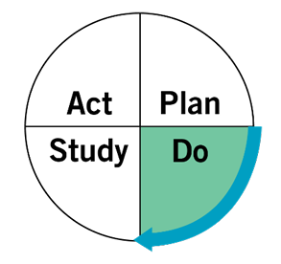
“Do”
Run your test
Collect and monitor data
Document any successes, issues, problems, unexpected observations along the way
Assessment of Orthostatic Blood Pressure Example
Plan is initiated. For two weeks the clinic will run a trial to offer an assessment of orthostatic blood pressure to all patients ages 65 and older who screened positive for fall risk using the clinic’s fall risk screening tool.
Feedback is solicited from staff at the regular monthly staff meeting 1 week later. Staff anecdotally report that the process to measure orthostatic blood pressure is taking longer than expected. Sometimes it is difficult to find another staff member to help with the assessment when needed. Some patients are questioning staff about if they know what they are doing, because they are used to having their blood pressure measured only when sitting up. Two patients refused the assessment. Three patients arrived for appointments with multiple issues to discuss during their clinic visit and there was not enough time to measure their orthostatic blood pressure.
Staff encouraged to continue to document their experience/observations.
After the two weeks are complete, data are pulled from the medical record for analysis. The experiences/observations documented by staff are also compiled.
Institute for Healthcare Improvement. QI Essentials Toolkit: PDSA Worksheet. https://www.ihi.org/resources/tools/plan-do-study-act-pdsa-worksheet

Slide 9
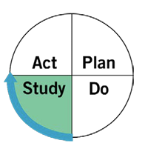
“Study”
Analyze your data for this test
Compare your data to the prediction made for this test
Summarize what was learned from this test
Assessment of Orthostatic Blood Pressure Example
Analysis reveals that rate of assessment of orthostatic blood pressure increased from 0% to 35%.
Staff meet again to discuss the improvement observed, successes and barriers, and brainstorm next steps.
Discussion about the test of the starting the process as soon as patients are roomed (since the assessment requires that patients start by lying down) reveals the following:
  Staff reported that it made sense to start the process as soon as patients were roomed, given the amount of time it takes to complete the assessment of orthostatic blood pressure.
  Staff felt concerned about leaving some patients alone while they were lying down in the exam room for 5 minutes because the exam tables are rather narrow, and they were afraid some patients might fall from the table. Staff reported staying in the room for the 5-minute period, which made it difficult to complete other tasks.
  In some cases, a second staff member was needed to help safely assist a patient from the standing to lying position, and vice versa, and to provide support during the measurement of orthostatic blood pressure. The primary challenge with this was that it took time to both find and wait for another available staff member to support the assessment.
  In addition to reflections on the process, staff wanted to revise the patient education materials and process to help them better explain orthostatic blood pressure and the process to measure it.
Institute for Healthcare Improvement. QI Essentials Toolkit: PDSA Worksheet. https://www.ihi.org/resources/tools/plan-do-study-act-pdsa-worksheet

Slide 10
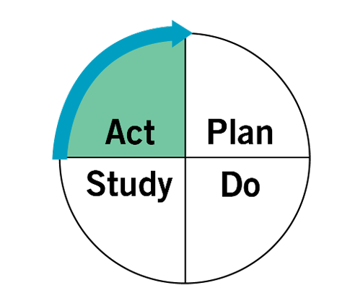
“Act”
Decide to:
  Adapt – modify and run another test
  Adopt – test the change on a larger scale
  Abandon – do not run another test on this change
Create a plan for the next PDSA cycle
Assessment of Orthostatic Blood Pressure Example
Adaptations/Plan moving forward:
Given the length of time it takes to assess orthostatic blood pressure, the clinic decided to continue with starting the process as soon as patients were roomed.
To ensure patient safety, staff decided they will trial remaining in the room for the entirety of the time in which patients must lie down. During that time, staff will gather any additional patient intake information relevant to the patient’s visit to streamline the appointment.
Two staff members plan to revisit their patient education process and materials and will evaluate these in a future test cycle.
Institute for Healthcare Improvement. QI Essentials Toolkit: PDSA Worksheet. https://www.ihi.org/resources/tools/plan-do-study-act-pdsa-worksheet

Slide 11
Rapid Cycle PDSA Testing: Fall Risk Screening Example
Cycle | Plan | Do | Study | Act
1 | Educate MAs and RNs to administer measurement of orthostatic blood pressure and associated patient education for patients ages 65 and older who screen positive for fall risk. | For 2 weeks, all patients ages 65 and older who screen positive for fall risk during their visit will be offered an assessment of their orthostatic blood pressure upon rooming. | Examine rate of assessment of orthostatic blood pressure for eligible patients. Ask staff about process and explore reasons behind successes and barriers. | Keep process. Staff will stay in room through duration of assessment for safety purposes.
2 | Staff will stay in room through duration of assessment of orthostatic blood pressure and gather any additional patient intake information relevant to the appointment while the patient is lying down. | For another 2 weeks, all patients ages 65 and older who screen positive for fall risk during their visit will be offered an assessment of their orthostatic blood pressure upon rooming. Staff will remain in room and collect additional information during that time. | Compare desired to actual rate of assessment of orthostatic blood pressure for eligible patients. Patients seem confused about the process of measuring orthostatic blood pressure and the time it takes to do so. | Revise patient education materials and process for delivering this education to patients.
3 | Educate MAs and RNs on new patient education materials and process for measurement of orthostatic blood pressure.

Slide 12

PDSA Self-Assessment
PDSA cycles are rarely intended to be a ‘one-and-done’ situation
Start with small scale tests of change with a series of follow-up tests before making changes on a larger scale
Use a variety of measures to evaluate the changes and their implementation
Identify and address implementation barriers
Refinement is expected – this is ‘trial-by-learning’ for improvement
Leis JA, Shojania KG. A primer on PDSA: executing plan-do-study-act cycles in practice, not just in name. BMJ Qual Saf. 2017;26(7):572-577. See Table 2 on p. 576.

Slide 13
Summary: Review of Objectives
The Model for Improvement and PDSA cycles are useful tools to guide efforts to improve assessment of orthostatic blood pressure
Create a clear, focused plan for a small test of change to help you get started
Be clear on what question(s) you are trying to answer to help inform the data you need to collect in each test of change
Remember this is an iterative process to support change over time

Slide 14
Model for Improvement Resources
Institute for Healthcare Improvement. QI Essentials Toolkit: PDSA Worksheet. https://www.ihi.org/resources/tools/plan-do-study-act-pdsa-worksheet

Slide 15
End of Presentation

