Slide 1
CATCH RURAL Falls
Coordinated Action Toward Community Health: RedUce Risk And Limit Falls
Applying the Model for Improvement to Improve Assessment of Orthostatic Blood Pressure

Slide 2
Acknowledgements: Funding for the CATCH RURAL Falls Program
This work is supported by the Nebraska Department of Health and Human Services Office of Rural Health Medicare Rural Hospital Flexibility Program.
The content is solely the responsibility of the presenters and does not necessarily represent the views of any funding source.

Slide 3


Introductions and Contact Information
Dawn Venema, PT, PhD
Physical therapist, with experience primarily in geriatric practice
Expertise in fall risk management and mobility
dvenema@unmc.edu
Victoria (Vicki) Kennel, PhD
Industrial organizational psychologist
Expertise in quality improvement, teamwork, and organizational science
victoria.kennel@unmc.edu

Slide 4
Educational Objectives
Describe the Model for Improvement
Create an aim statement for your efforts to improve assessment of orthostatic blood pressure
Establish outcome, process, and/or balancing measures for your efforts to improve assessment of orthostatic blood pressure
Identify specific change(s) to test to improve assessment of orthostatic blood pressure

Slide 5
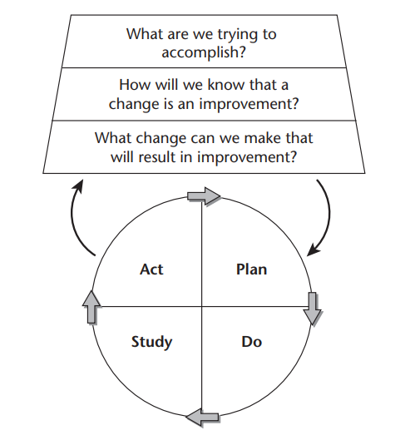
The Model for Improvement
Provides a framework for developing, testing, implementing, and spreading changes that result in improvement
Can be applied widely to many different types of problems and situations
Attempts to balance careful study with action
Emphasizes and encourages ‘trial-and-learning’ as an iterative process for improvement
Allows project plans to adapt as learning occurs
Langley GL, Moen R, Nolan KM, Nolan TW, Norman CL, Provost LP. The Improvement Guide: A Practical Approach to Enhancing Organizational Performance (2nd edition). San Francisco: Jossey-Bass Publishers; 2009. Model for Improvement Figure 1.1. Permission obtained from John Wiley and Sons on 1.13.2025 to use this figure in this presentation.

Slide 6
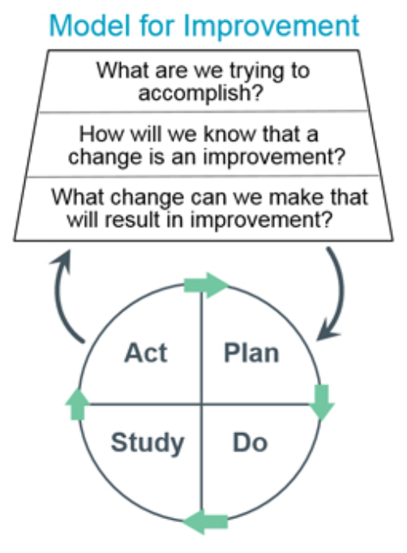
Creating a Project Aim Statement
Aim Statement:
A clear summary statement of what your team hopes to achieve in a measurable way over a specific amount of time including the magnitude of the change you will achieve
Aim Statement Formula Templates:
To improve (your process/problem) from (baseline)% to (target)% by/over (timeframe), among (your specific population), by doing (your intended changes)
To increase / decrease ____________ (process/outcome), from ____________ (baseline %, rate, #, etc.), to ______________ (goal/target %, rate, #, etc.), by/over ____________ (date, timeframe), in _____________ (population impacted), by doing __________ (changes planned)
Fall Risk Screening Aim Statement Example
To increase the rate of assessment of orthostatic blood pressure from 25% to 75% over the next six months for all adult patients ages 65 and older who visit the clinic and screen positive for fall risk.
Institute for Healthcare Improvement. Aim Statement Worksheet. https://www.ihi.org/resources/tools/aim-statement-worksheet

Slide 7
Establishing a Family of Measures
Outcome
How is our system performing? What is the impact on patients?
Process
Are the parts/steps in our system performing as we planned?
Balancing
Are our changes having impacts/causing new problems in other parts of the system?
Assessment of Orthostatic Blood Pressure Example
Outcome: The percent of adult patients ages 65 and older who screened positive for fall risk with a completed assessment of orthostatic blood pressure documented in their medical record
Process: The percent of adult patients ages 65 and older who screened positive for fall risk and were offered an assessment of orthostatic blood pressure
Balancing: The average length of a clinic visit for adult patients ages 65 and older
Name the measure (many are # of, % of, or a rate)
Provide a clear operational definition of your measure including the numerator and denominator (if applicable)
Clarify who will collect the data, how often, what is included/excluded
Provost, L. P. & Murray, S. K. (2011). The health care data guide: Learning from data for improvement. John Wiley & Sons.
Institute for Healthcare Improvement. Quality Improvement Project Measures Worksheet. https://www.ihi.org/resources/tools/quality-improvement-project-measures-worksheet

Slide 8




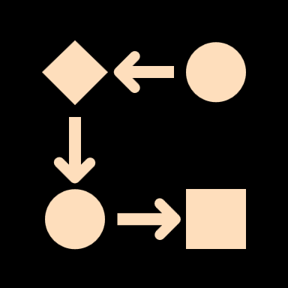

Change Concepts to Inform Improvement Ideas for Assessment of Orthostatic Blood Pressure
Focus on the service
  What improvements can you make to the design of the service?
  e.g., What approaches to assess orthostatic blood pressure work well for your patient population? When might you offer the assessment? How do you inform patients about the process?
Enhance the patient relationship
  How can you better understand and respond to patient needs?
  e.g., What are patients receptive to about assessing orthostatic blood pressure? What is necessary to overcome any resistance?
Manage time
  How can you reduce/optimize the time spent on organizational functions?
  e.g., How can you streamline your assessment or orthostatic blood pressure, knowing the process can take some time?
Manage variation
  How can you reduce the frequency of poor results?
  e.g., How can you standardize your processes to assess orthostatic blood pressure so that all eligible patients receive an accurate assessment?
Improve workflow
  How can you change the workflow so that the process is planned and flows smoothly?
  e.g., When is best in the patient’s visit to complete the assessment of orthostatic blood pressure? How are results shared with the medical staff? When are results documented into the EMR?
Change the work environment
  What would make the environment better able to support improvement?
  e.g., What information, training, resources are needed to support changes to incorporate assessment of orthostatic blood pressure?
Institute for Healthcare Improvement. Quality Improvement Project Change Concepts Worksheet. https://www.ihi.org/resources/tools/quality-improvement-project-change-concepts-worksheet

Slide 9
Summary: Review of Objectives
The Model for Improvement can guide your efforts to improve assessment of orthostatic blood pressure
A clear aim statement guides your work and informs what success looks like for your improvement efforts
Clearly defined measures help to inform if you achieved your aim, made a difference, and the impact of your changes
Think carefully about the specific changes you want to test to improve efforts to assess orthostatic blood pressure

Slide 10
Model for Improvement Resources
Institute for Healthcare Improvement. Aim Statement Worksheet. https://www.ihi.org/resources/tools/aim-statement-worksheet
Institute for Healthcare Improvement. Quality Improvement Project Measures Worksheet. https://www.ihi.org/resources/tools/quality-improvement-project-measures-worksheet
Institute for Healthcare Improvement. Quality Improvement Project Change Concepts Worksheet. https://www.ihi.org/resources/tools/quality-improvement-project-change-concepts-worksheet

Slide 11
End of Presentation

