Slide 1
CAPTURE Falls Education Resources
Fall Risk Reduction Intervention Basics
Slides created by Dawn Venema, PT, PhD
College of Allied Health Professions, University of Nebraska Medical Center
Last updated July 2025

Slide 2
General Instructions for Educators
The content in this slide deck is primarily focused on the selection of interventions to reduce fall risk but could also be used/adapted to address the delivery of interventions.
The content in this slide deck can be adapted to fit your organization’s specific polices and procedures for delivery of fall risk reduction interventions.

Slide 3
General Instructions for Educators – Considerations
Determine your audience by identifying staff roles regarding fall risk reduction interventions (Who needs to know what?)
    Who has responsibility for selection of interventions?
    Who has responsibility for delivery of interventions?
    Different roles likely exist across different health care professions, or between clinical vs. non-clinical staff
      Examples for nursing staff: selection of interventions/development of fall care plans; delivery of interventions such as purposeful rounding
      Examples for multiple types of clinical staff: delivery of interventions such as supervised mobility/ADLs or how to set alarms
      Examples for non-clinical staff: knowledge of visible indicators of fall risk (signage, bracelets, etc); how to answer a call light in a “No-Pass Zone”
Notes:
Think of the end in mind – what do you want to achieve with your education.
Staff to be able to ID their specific role in FRR for the organization. So think about who needs to know what. Not everyone is going to need to know about every single intervention on the table.
Who needs to know what based on their job description and scope of practice for HCPs.

Slide 4
General Instructions for Educators – Considerations
Consider the following for delivery of education that focuses on selection of interventions, specifically linking appropriate interventions to specific fall risk factors
    Use this presentation to introduce the topic
    Develop patient cases (see separate Fall Risk Reduction Intervention Case Study Development Guide for help)
      Consider developing a few different cases with varied risk factors
    Have staff develop a plan of care, compare results, and discuss rationale
    Discuss why a certain intervention is appropriate for a given risk factor to facilitate clinical decision-making skills (see separate Linking Interventions to Fall Risk Factors – Expanded Version for help)
Notes:
Think of the end in mind – what do you want to achieve with your education.
Staff to be able to ID their specific role in FRR for the organization. So think about who needs to know what. Not everyone is going to need to know about every single intervention on the table.
Who needs to know what based on their job description and scope of practice for HCPs.

Slide 5
General Instructions for Educators – Considerations
If your goal is to develop education that focuses on delivery of interventions
  Consider if the intervention requires physical or technical performance of a skill
    If so, allow time for practice and return demonstration of the skill
    Examples: any component of physically assisting patients with transfers and mobility (e.g. gait belt application, use of mechanical lifts, guarding during ambulation) or setting up a video monitoring system for a patient
    Education for these types of skills should not solely involve passive observation of someone performing or discussing the skill
Notes:
Think of the end in mind – what do you want to achieve with your education.
Staff to be able to ID their specific role in FRR for the organization. So think about who needs to know what. Not everyone is going to need to know about every single intervention on the table.
Who needs to know what based on their job description and scope of practice for HCPs.

Slide 6
Learning Objectives
Identify fall risk reduction interventions appropriate for all patients, regardless of fall risk status (universal interventions)
Identify fall risk reduction interventions to be delivered to patients determined to be at risk for falling, per hospital policy
Identify appropriate targeted fall risk reduction interventions for patients with specific fall risk factors identified via fall risk assessment and/or review of the medical record

Slide 7
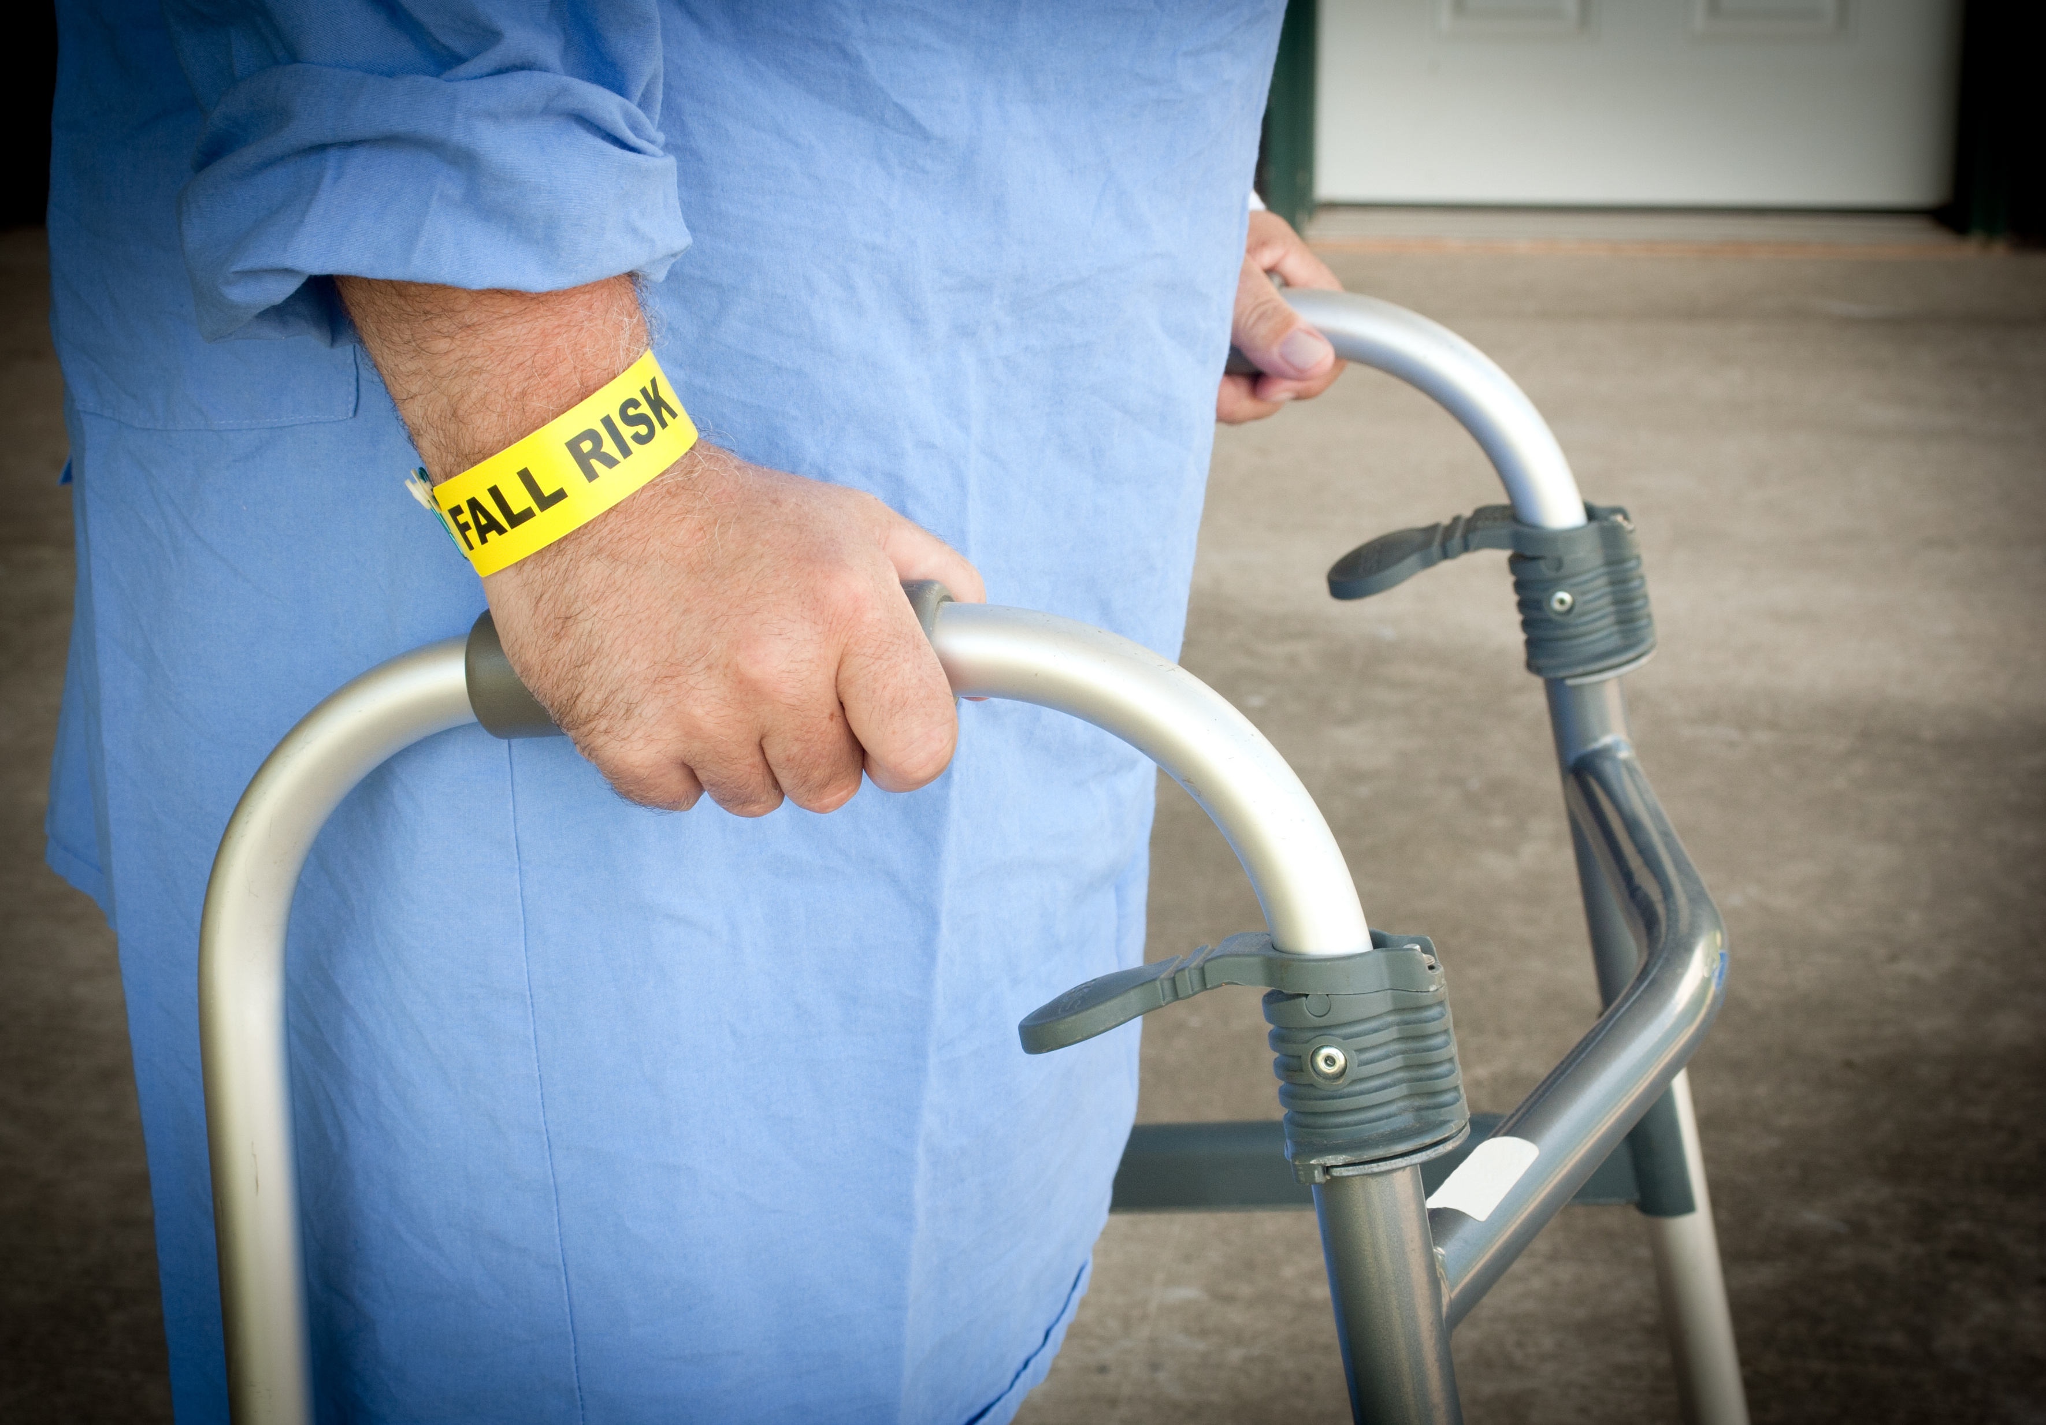
Fall Risk Assessment Informs the Selection of Interventions to Reduce Risk
Fall risk factors for hospitalized adult patients are often multiple and variable
Patients often have multiple risk factors for falls
Risk factors vary among patients
Risk can vary over the course of a hospitalization for an individual patient
Notes:
Key points:
Patients are at risk for falls for many reasons.
Risk factors often vary between patients and can vary over the length of stay
The risk assessment tool is meant not only to identify who is likely to fall, but why via the individual items on the tool
Other fall risk factors not identified by the fall risk assessment tool may be identifiable by review of the patient’s medical history in the medical record

Slide 8
Fall Risk Assessment Informs the Selection of Interventions to Reduce Risk
Risk Factors Typically Addressed by Many Tools:
Assessed by Self-Report, Chart Review, or Observation of Patient
Cognition and Behavior
Dementia
Movement and Mobility
Medications
Polypharmacy
Delirium
Impulsivity or agitation
Overestimation of ability
Memory Impairment
Poor balance
Need for assistive device
Weakness
Need for physical assistance
History
Fall prior to or during current admission
Medical history (neurological, cardiovascular, orthopedic, etc)
Risk of Injury
Osteoporosis
Sensory Impairments
Vision
Continence
Bladder or Bowel
Recent surgery
Vestibular
Peripheral Neuropathy
Hearing
Urgency
Frequency
Drug Interactions
Side effects
Anxiety
Coagulation
Age
Notes:
Key points:
Most fall risk assessment tools address the following risk factors (see slide)
You can discuss what tool your hospital uses and how the individual items on that tool compare to what is on this slide.
While the total score on the tool is important, it’s also important to consider the specific risk factors identified by the tool. In other words, what is driving the score? This can inform what interventions to select so they are best matched to the patient.
Depending on the types of patients you care for, staff may also need to consider risk factors that aren’t necessarily on the tool. If a tool doesn’t have a certain category, staff can and should still use their clinical judgement/expertise to assess factors that may be relevant to their given patient population.
Example: young mothers in labor and delivery; post-op nerve block of the lower extremity in a high school athlete

Slide 9

Fall Risk Reduction Interventions: Purpose
Fall risk reduction interventions are actions taken with or on behalf of a patient to improve or maintain the patient’s safety
Some actions should be taken for ALL patients, regardless if they are at risk of falling or not
Some actions should be tailored to specific patients and their specific risk factors
Notes:
Key points:
Interventions are the actions we take to mitigate the risk factors that we identify upon assessment.
There are things we should do for all patients, regardless if they score positive for fall risk. These are known as universal fall interventions.
However, some interventions should be directed only to patients at risk and tailored to an individual patient’s specific risk factors.

Slide 10

Interventions for Fall Risk and Fall Injury Risk Reduction: What’s on the Menu? A LOT!
Assistive devices/equipment
Bed/chair alarms
Bed in low position
Bedside floor mats
Call light in reach
Declutter environment
Delirium prevention or
mitigation
Documentation of
mobility/ADL assistance
Floor clean and dry
Gait belt
Handoff tool
Handrails in bathroom,
hallway, etc.
Hearing aids
Hip protectors
Lighting
Locked wheels on bed,
wheelchair
Notes:
Key points:
This slide and next shows that we have a lot of options at our disposal. The menu is large – like going to Cheesecake factory for dinner!
May seem daunting for staff to decide what to do. Obviously can’t do all this for everyone (and don’t need to). Don't want to waste time or resources doing things that aren't necessary for that patient.
Can consider tailoring this slide to specific interventions at your disposal in your hospital

Slide 11
Interventions for Fall Risk and Fall Injury Risk Reduction: What’s on the Menu? A LOT!
Medication review by
pharmacy
Nonslip footwear
Orthostatic blood pressure checks
OT evaluation
Pain management
Patient close to nurses' station
Patient/family education
PT evaluation
Purposeful hourly rounding
Seating assessment
Sitter
Supervised mobility and ADLs
Supervised toileting
Top bedrails up
Video monitoring
Visible identification of risk
Vision correction
Notes:
Key points:
This slide and previous one shows that we have a lot of options at our disposal. The menu is large – like going to Cheesecake factory for dinner!
May seem daunting for staff to decide what to do. Obviously can’t do all this for everyone (and don’t need to). Don't want to waste time or resources doing things that aren't necessary for that patient.
Can consider tailoring this slide to specific interventions at your disposal in your hospital

Slide 12
Objective 1: Identify fall risk reduction interventions appropriate for all patients, regardless of fall risk status (universal interventions)
Notes:
Objective 1: Identify fall risk reduction interventions appropriate for all patients, regardless of fall risk status (universal interventions)

Slide 13

Fall Risk Assessment Informs the Selection of Interventions to Reduce Risk
All hospitalized patients might be considered at risk for falling on some level
Health has been negatively impacted requiring hospitalization
Unfamiliar environment
Extrinsic (environmental) risk factors
Notes:
Key points:
On some level, we could almost assume that any patient in the hospital is at risk for falling.
They are hospitalized because their health has been negatively impacted in some way.
They are in an environment unfamiliar to them, which may include some environmental hazards they are not used to, such as IV lines, catheters, etc, or simply an unfamiliar room layout.

Slide 14
Are there Interventions we Should Use for Every Patient? YES!
Universal Interventions: common sense interventions for every patient all the time, regardless of risk status
Rationale: ANYONE can fall, given the right circumstances
Can also reduce risk for visitors and staff
Focus largely on the physical environment, but also on how patients and staff interact
Notes:
Key points:
Universal interventions are steps that a hospital should take to keep all patients safe from falling, regardless of whether a patient was identified at risk per a fall risk assessment tool.
Universal interventions can reduce risk of falling for not only patients, but also visitors and staff.
Universal interventions focus largely on reducing risks in the physical environment but also address how patients interact with the environment and staff. Many are common sense steps to keep patients safe.

Slide 15
Common Universal Interventions
Bed in low position | Night lights/supplemental lighting
Call light/personal belongings in reach | Nonslip, well-fitting footwear
Declutter environment | Pain management
Floor clean and dry | Patient/family education
Handrails in bathroom, hallways, etc. | Purposeful hourly rounding
Locked wheels on hospital bed and wheelchair | Top bedrails up
Notes:
Key points:
If you look at the items on this slide, many of them are intended to reduce slip/trip hazards, or otherwise make the physical environment safer by ensuring adequate lighting or support during mobility.
Pain management may not come to mind when you think about falls, but it is something we focus on for all patients anyway. Managing pain can at least indirectly reduce fall risk. If a patient has pain in their lower extremities, it will alter the mechanics of walking, which may increase fall risk. Or it may lead to a patient getting up on their own because they need to change position due to discomfort. Of course pain meds may have side effects that increase fall risk, so you do need to be mindful of balancing that.

Slide 16
Objective 2: Identify fall risk reduction interventions to be delivered to patients determined to be at risk for falling, per hospital policy
Notes:
Objective 2: Identify fall risk reduction interventions to be delivered to patients determined to be at risk for falling, per hospital policy

Slide 17

Targeted Interventions for Patients at Risk for Falls
Provided in addition to universal interventions
Directed at:
  Those patients identified at risk for falling
  Specific risk factors uncovered by the fall risk assessment tool or by additional clinical assessment
Notes:
Key Points:
Targeted interventions are layered on top of universal interventions for patients who are identified by the fall risk assessment tool as being at risk.
Some interventions are indicated by hospital policy to be done for all patients at risk.
There are other interventions where staff can use their clinical judgment to add to the plan of care, based on the specific risk factors identified on the fall risk assessment tool or ones that are otherwise uncovered upon assessment of the patient.

Slide 18






Targeted Interventions for All Patients at Risk for Falls
Visible identification of risk (e.g. bracelet, signage, sock color)
Handoff tool between staff to communicate risk
Patient/family education specific to the patient’s fall risk factors
Notes:
Key points:
This slide shows interventions to implement and target to every patient at risk, regardless of why they are at risk.
Visual ID of risk – all staff can tell at a glance if a patient is at risk.
Handoff tool – to be used between shifts or between departments. Include information in the handoff that is specific to fall risk reduction for that patient.
Patient and family education - which is also included as a universal intervention, but in this case needs to include more specific information about that patient’s risk factors and the interventions being used to address those risk factors.
This slide can be edited/duplicated to add any additional interventions that are stated in your policy to be used for all patients ID’d at risk.

Slide 19
Objective 3: Identify appropriate targeted fall risk reduction interventions for patients with specific fall risk factors identified via fall risk assessment and/or review of the medical record
Notes:
Objective 3: Identify appropriate targeted fall risk reduction interventions for patients with specific fall risk factors identified via fall risk assessment and/or review of the medical record

Slide 20
Linking Targeted Interventions to Specific Risk Factors
Cognitive or Behavioral Impairments
Difficulty with Mobility and/or Activities of Daily Living
Medications
Risk of Injury
Sensory Impairments
Toileting Needs
Notes:
Key Points:
This slide serves as a reminder of the various categories of risk factors often identified by fall risk assessment tools and clinical assessment of the patient.
The next several slides feature a list of interventions to consider for each of the categories of risk factors
You may choose to refer again to the tool you use at your hospital and which of these are addressed by that tool.

Slide 21
Linking Targeted Interventions to Risk Factors – Cognitive or Behavioral Impairments
Bed and/or chair alarm
Delirium prevention or mitigation
Medication review by pharmacy
Patient placed close to nurses’ station
Purposeful hourly rounding
Sitter
Supervised mobility and/or activities of daily living
Supervised toileting
Video monitoring
Notes:
Key points:
Some patients have cognitive or behavioral impairments, such as impaired memory, confusion, agitation, impulsivity.
These impairments may lead to lack of insight into how to reduce their risk of falling, making other risk factors (e.g. mobility impairments or toileting needs ) even more challenging.
These impairments may be long-standing for the patient or may be acute changes due to patient’s current medical condition. They may also stem from medication side effects or problems with nutrition or hydration.
Interventions directed at cognitive or behavioral impairments seek to either reduce (delirium prevention, med review) or compensate for these impairments (alarms, video monitoring, hourly rounding, supervised mobility/toileting, etc.)

Slide 22
Linking Targeted Interventions to Risk Factors: Difficulty with Mobility or Activities of Daily Living (ADLs)
Assistive devices/equipment
Documentation of mobility/ADL assistance
Gait/transfer belt
Medication review by pharmacy
Nonslip, well-fitting footwear
Occupational therapy evaluation
Physical therapy evaluation
Seating assessment
Supervised mobility and/or ADLs
Supervised toileting
Notes:
Key Points:
Some patients have gait or balance impairments that make it unsafe for them to engage in independent ambulation, transfers, or ADLs such as dressing. These impairments may be long-standing for the patient or may be acute changes due to patient’s current medical condition. They may also stem from medication side effects.
Interventions directed at difficulty with mobility or ADLs seek to either reduce or compensate for these challenges.
Some have a fairly immediate impact, such as having a patient use a walker, gait belt, nonslip footwear, seating assessment for patients who even have trouble with sitting balance and posture, and assisting patients with mobility. If medications can be changed, that might have a relatively immediate effect as well.
Other interventions for these risk factors take some time – for example, exercises for strengthening with PT and OT may not have a large impact during a very brief hospital stay but will be more effective over the course of a longer rehabilitation stay in a swing bed.

Slide 23
Linking Targeted Interventions to Risk Factors - Medications
Medication review by pharmacy
Orthostatic blood pressure monitoring
Notes:
Key Points:
Medications, while intended to cause a positive change in the patient’s medical status, often come with side effects that may increase a patient’s risk of falls. These side effects may include, but are not limited to, sedation, cognitive changes, impaired balance, orthostatic hypotension, or urinary or gastrointestinal effects. Polypharmacy is also a risk factor for falls.
Pharmacists play an important role in reviewing a patient’s current medications and making recommendations for change to reduce risk of falls if possible.
Orthostatic blood pressure checks are important if hypotension is a side effect of any medications a patient is taking. Or if the medical team is currently in the process of adjusting anti-hypertensive meds.

Slide 24
Linking Targeted Interventions to Risk Factors – Risk of Injury
Bed in low position
Bedside floor mats
Gait/transfer belt
Hip protectors
Medication review by Pharmacy
Supervised toileting
Notes:
Key Points:
While the focus of this presentation has been primarily on reducing falls themselves, we should also consider risk of injury.
Despite our best efforts, some patients will fall. Therefore, it is also appropriate to consider interventions that reduce a patient’s risk of injury, in the event a fall occurs. An easy way to think about injury risk is the ABCs (age, bone, coagulation, and surgery).
Some of these interventions on this slide are intended to attenuate forces if a patient falls, specifically lowering the bed, or using a floor mat or hip protectors.
Gait belts can reduce injury risk by helping staff control the patient’s descent during an assisted fall.
Medication review is important from the standpoint of anticoagulation.
And supervised toileting is important because of the increased risk of injury if a fall occurs in the bathroom. It is a tight space with a lot of hard surfaces.

Slide 25
Linking Targeted Interventions to Risk Factors – Sensory Impairment
Assistive devices/equipment
Hearing aids
Interventions to address difficulty with mobility or activities of daily living
Night lights/supplemental lighting
Occupational therapy evaluation
Physical therapy evaluation
Vision correction
Notes:
Key Points:
Some patients have impairments in visual, vestibular, and somatosensory systems that negatively impact their balance during mobility and activities of daily living.
Others have hearing or visual impairments that may make patient education about fall risk more challenging.
These impairments may be long-standing for the patient or may be acute changes due to patient’s current medical condition.
The interventions listed on this slide largely help the patient compensate for loss in any of those sensory systems that might impact their balance and mobility or their ability to receive education. PTs and OTs can be especially helpful in identifying ways to help patients compensate for sensory loss.

Slide 26
Linking Targeted Interventions to Risk Factors – Toileting Needs
Assistive devices/equipment
Call light and personal belongings within reach
Interventions to address difficulty with mobility or activities of daily living
Medication review by pharmacy
Occupational therapy evaluation
Physical therapy evaluation
Purposeful hourly rounding
Supervised toileting
Notes:
Key points:
Some patients have incontinence or urgency of bowel or bladder, causing them to hurry to the bathroom.
For some, this problem can be compounded by mobility impairments that make ambulating to the bathroom or transferring on/off a toilet or commode challenging.
These impairments may be long-standing for the patient, or acute changes due to the patient’s medical condition.
Medication side effects could even be contributing to the problem.
Interventions to address mobility issues can make traveling to/from bathroom or commode safer.
Hourly rounding, specifically with a toileting schedule can reduce the chance the patient may be inclined to get up on their own.
And some PTs specialize in treating incontinence if it is stemming from weakness or dysfunction in pelvic floor muscles. This will not provide an immediate fix, but could be something to consider for a patient in the long run.

Slide 27
Summary
Identify fall risk reduction interventions appropriate for all patients, regardless of fall risk status (universal interventions)
Identify fall risk reduction interventions to be delivered to patients determined to be at risk for falling, per hospital policy
Identify appropriate targeted fall risk reduction interventions for patients with specific fall risk factors identified via fall risk assessment and/or review of the medical record
Notes:
Key points:
In summary, this presentation covered three things…..
End by emphasizing any points relevant to what you want to emphasize for fall risk reduction interventions in your hospital.

