Slide 1
CAPTURE Falls Education Resources
Post-Fall Huddle Basics

Slide 2
General Instructions for Educators
The target audience for this education is all staff members in your facility who may participate in a post-fall huddle
The content in this handout can be adapted to fit your organization’s specific polices and procedures for post-fall huddles

Slide 3
Learning Objectives
Describe the purpose of a post-fall huddle​
As consistent with our organization’s policies and procedures for post-fall huddles, describe the following:
  Who should participate​ in a post-fall huddle
  Who should lead​ a post-fall huddle
  What to discuss​ in a post-fall huddle
  When to conduct a post-fall huddle
  Where to conduct a post-fall huddle​
  What to do after a post-fall huddle is completed

Slide 4

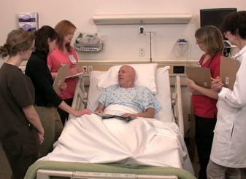
Post-Fall Huddle
CAPTURE Falls Roadmap Post-Fall Huddle
Team who convenes after a patient fall to gather and discuss information about the patient fall and factors that contributed to the fall, and to identify changes necessary to reduce the risk of another fall for that patient
Notes:
Key Points:
Define the post-fall huddle
Different from an event investigation/root cause analysis – not going in depth to identify all root causes to identify how and why errors/adverse events/near misses occurred; not a formal investigation of the event
Need to gather enough information about what happened and why to make immediate changes to reduce the patient’s risk of falling again

Slide 5
Evidence to Support the Use of Post-Fall Huddles
CAPTURE Falls Roadmap Post-Fall Huddle
Recommended practice in many fall risk reduction toolkits
An intervention with good adoption over time
Associated with fewer repeat falls
Safety norms affect perceived success of huddles
Staff participation in huddles affects perceptions of teamwork and safety culture
VHA National Center for Patient Safety Falls Toolkit
Use of post-fall huddles increased from 40 to 80% in our first CAPTURE Falls cohort
Greater proportion of falls followed by a post-fall huddle was associated with a lower repeat fall rate
Organizational and group safety norms had a positive association with perceptions of huddle effectiveness, explained in part by demonstration of good leadership by the huddle leader
Participation in at least one or more huddle was associated with more positive perceptions of aspects of team structure, team leadership, situation monitoring, teamwork across departments, handoffs/transitions, and organizational learning
AHRQ Fall Prevention Toolkit (*root cause analysis)
CAPTURE Falls Toolkit
Reiter-Palmon R, Kennel V, Allen JA, Jones KJ, Skinner AM. Naturalistic Decision Making in After-Action Review Meetings: The Implementation of and Learning from Post-Fall Huddles. J Occup Organ Psychol. 2015;88(2):322-340. doi:10.1111/joop.12084
Allen JA, Reiter-Palmon R, Kennel V, Jones KJ. Group and Organizational Safety Norms Set the Stage for Good Post-Fall Huddles. J Leadersh Organ Stud. 2019;26(4):465-475. doi:10.1177/1548051818781820
Jones KJ, Crowe J, Allen JA, et al. The impact of post-fall huddles on repeat fall rates and perceptions of safety culture: a quasi-experimental evaluation of a patient safety demonstration project. BMC Health Serv Res. 2019;19(1):650. Published 2019 Sep 9. doi:10.1186/s12913-019-4453-y
Notes:
Key Points:
Summarize slide

Slide 6

Post-Fall Huddle: Who to Include
CAPTURE Falls Roadmap Post-Fall Huddle
Ideal
All relevant parties
  Staff providing direct care for the patient at the bedside
  Other members of interprofessional team involved in the patient’s care at the time of the fall
  Patient
  Family/caregiver(s)
Reality
Whomever is available
  Time of day and workload level often limits who participates in the huddle
  Patient ability to participate
  Family/caregiver(s) availability to participate
  Consider creative ways to engage members of the interprofessional team (e.g., use technology; team members ‘on-call’ for a huddle)
Notes:
Key Points:
Will share what is ‘ideal’ or under ‘ideal’ circumstances; and then what we recognize and have experienced to be reality

Slide 7

Post-Fall Huddle: Who to Lead
CAPTURE Falls Roadmap Post-Fall Huddle
Ideal
Trained facilitator
  Experienced in guiding conversations about fall events
  Skilled in encouraging participation and dialogue among all team members in the huddle
  Ability to keep team focused on learning for improvement
Huddle facilitator
  Accountable for calling and leading the huddle
  Ensures all aspects of the fall event are reviewed
  Elicits and clarifies multiple versions of the story
  Encourages positive behaviors and limits negative behaviors from huddle team members
Reality
Whomever is available even if not a trained facilitator
  Nurse assigned to the patient
  Lead/charge nurse
  Fall risk reduction team member
Notes:
Key Points:
Summarize slide
Key is to have someone who can just focus on leading and facilitating the conversation
Designate someone else to take notes during the huddle so the facilitator can focus on leading the discussion

Slide 8
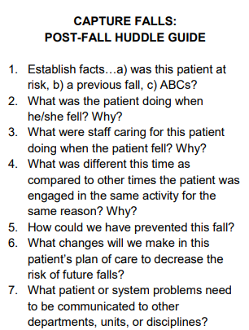
Post-Fall Huddle: What to Discuss
CAPTURE Falls Roadmap Post-Fall Huddle Pocket Guide
CAPTURE Falls Roadmap Post-Fall Huddle Guide and Documentation Form
Ideal
Structured questions for each huddle
  Generate a clear understanding of the fall based on multiple perspectives
  Ask clarifying questions and ‘why?’ to identify actual issues and contributing factors
Reality
Minor modifications as needed
  Stick as close to the guide as possible
  Avoid getting ‘stuck’ in checklist mode
  Accommodate unexpected variations in the situation
  Allow space for ambiguity and follow-up needed
Notes:
Key Points:
Remember the goals of the post-fall huddle: gather and discuss information about the patient fall and factors that contributed to the fall, and to identify changes necessary to reduce the risk of another fall for that patient
Discussion in the huddle should guide the huddle team toward these two goals
Pocket guide intended to help with that
Another version of a huddle guide that includes an opportunity to take notes; may be helpful for another team member (beside the facilitator) to have this document to help take notes

Slide 9
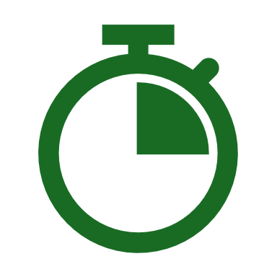
Post-Fall Huddle: When to Conduct
CAPTURE Falls Roadmap Post-Fall Huddle
Ideal
As soon as possible
  Immediately after the fall
    Within 15 minutes
  Preserve adequate recall of important details relevant to the fall
  Changes identified to reduce fall risk should be implemented as soon as possible
Reality
It depends
  The nature of the fall
  Time necessary to complete post-fall clinical assessment
  Emotional state of huddle team members
  Availability of members of the interprofessional team
Notes:
Key Points:
Summarize slide
Many factors influence when a huddle can feasibly happen

Slide 10

Post-Fall Huddle: Where to Meet
CAPTURE Falls Roadmap Post-Fall Huddle
Ideal
Location where the fall occurred
  Similar environment may trigger better recall of the circumstances of the fall
  Allows for adequate assessment of environmental factors that may have contributed to the fall
Reality
A feasible physical/virtual space
  A space similar to where the fall occurred or space for the team to openly discuss the event
  Consider patient ability to engage/be involved
  Consider use of technology to engage other team members and/or family
Notes:
Key Points:
Summarize slide
Feasible location will vary

Slide 11
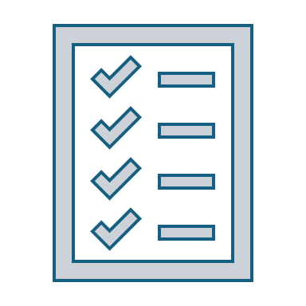



Post-Fall Huddle: After the Huddle
CAPTURE Falls Roadmap Post-Fall Huddle
Complete and submit post-fall huddle documentation
Modify fall risk reduction plan of care for patient
Implement changes in patient’s plan of care to reduce fall risk
Follow-up to ensure fall risk reduction interventions are implemented as intended
Notes:
Key Points:
Huddle is critical, but so are the steps after the huddle
One goal of the huddle is to identify changes necessary to reduce the risk of another fall for that patient – critical to make sure those are actually implemented
Might consider a quick audit

Slide 12
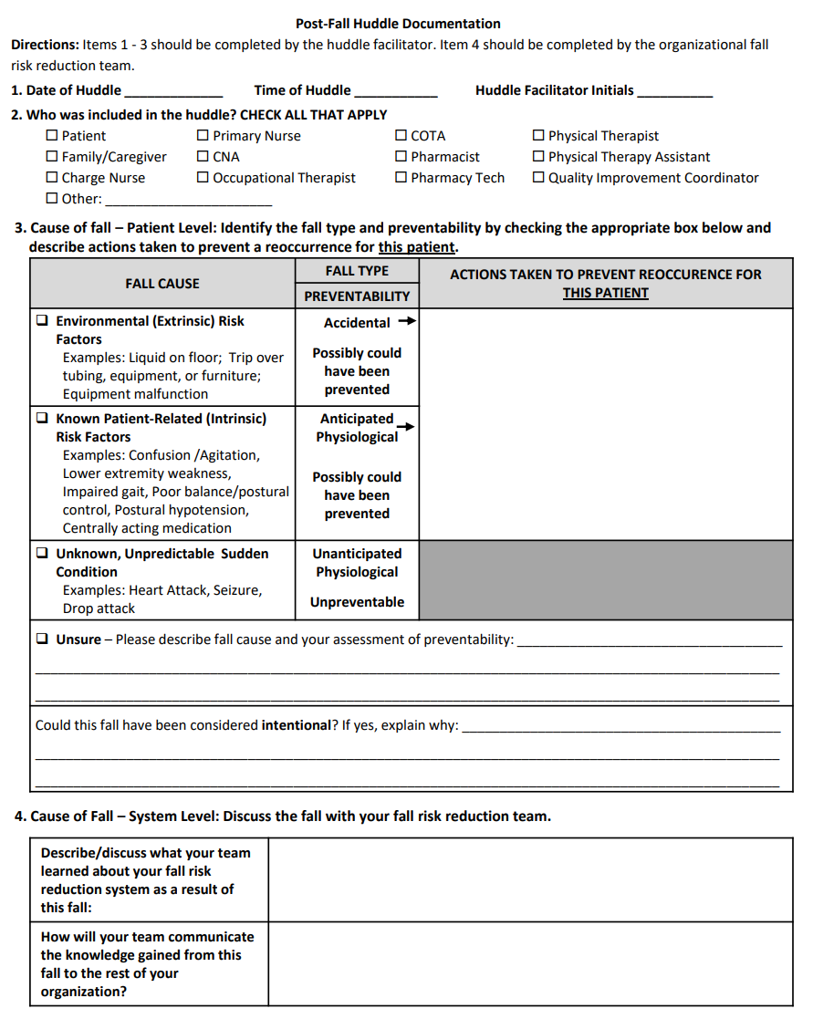



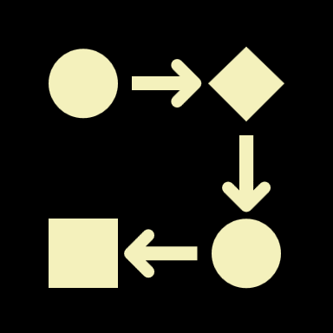

Post-Fall Huddle: Documentation
CAPTURE Falls Roadmap Post-Fall Huddle Guide and Documentation Form
Key Data to Document
Date
Time
Participants
Causes/factors that contributed to the fall
Actions to implement to reduce the risk of another fall
Notes:
Key Points:
Documentation can accompany the fall event report and collectively this information is valuable for the fall risk reduction team
Key data to include (where its helpful to have someone taking notes during the huddle)
Fall risk reduction team can answer final question

Slide 13
Fall Cause and Type
Accidental
Anticipated Physiological
Unanticipated Physiological
  Falls that occur due to environmental hazard (e.g. slip, trip)
  Falls that occur in patients with known intrinsic risk factors (weakness, cognitive impairment, medication side effect, etc.)
  Most in-hospital falls are in this category
  Falls that occur due to an unpredictable medical event, such as seizure, stroke, or syncope
These fall types can be potentially prevented.
Morse JM, Tylko SJ, Dixon HA. Characteristics of the fall-prone patient. Gerontologist 1987;27:516-22.
Ganz DA, Huang C, Saliba D, et al. Preventing falls in hospitals: a toolkit for improving quality of care. (Prepared by RAND Corporation, Boston University School of Public Health, and ECRI Institute under Contract No. HHSA290201000017I TO #1.) Rockville, MD: Agency for Healthcare Research and Quality; January 2013. AHRQ Publication No. 13-0015-EF.
Notes:
Key Points:
Note this on the huddle form – fall type/preventability
Another common classification system used that we are familiar with - Morse classifications.
Useful indeed, some find the Morse classifications can be hard to apply reliably. We focus more on type and outcome when it comes to rates.
But these classifications can be helpful to consider during the huddle when it comes to making a decision about actions taken to prevent another fall for that patient
Can do something to try to prevent falls due to accidental and anticipated physiological causes
Can’t really do much about unanticipated physiological (other than just make sure already have a good plan of care in place)

Slide 14
References and Resources
CAPTURE Falls Website. Available at https://www.unmc.edu/patient-safety/capturefalls/ Accessed July 11, 2024.
CAPTURE Falls Roadmap. Available at https://www.unmc.edu/patient-safety/capturefalls/roadmap/index.html Accessed July 11, 2024.
US Department of Veteran’s Affairs. VA National Center for Patient Safety Falls Toolkit Post Falls Huddle. Available at: https://www.patientsafety.va.gov/professionals/onthejob/falls.asp Accessed July 11, 2024.
Agency for Healthcare Research and Quality. Preventing falls in hospitals toolkit: 3.5 How should you assess and manage patients after a fall? Available at https://www.ahrq.gov/patient-safety/settings/hospital/fall-prevention/toolkit/practices.html#3-5 Accessed July 11, 2024.
Reiter-Palmon R, Kennel V, Allen JA, Jones KJ, Skinner AM. Naturalistic Decision Making in After-Action Review Meetings: The Implementation of and Learning from Post-Fall Huddles. J Occup Organ Psychol. 2015;88(2):322-340. doi:10.1111/joop.12084
Allen JA, Reiter-Palmon R, Kennel V, Jones KJ. Group and Organizational Safety Norms Set the Stage for Good Post-Fall Huddles. J Leadersh Organ Stud. 2019;26(4):465-475. doi:10.1177/1548051818781820
Jones KJ, Crowe J, Allen JA, et al. The impact of post-fall huddles on repeat fall rates and perceptions of safety culture: a quasi-experimental evaluation of a patient safety demonstration project. BMC Health Serv Res. 2019;19(1):650. Published 2019 Sep 9. doi:10.1186/s12913-019-4453-y
CAPTURE Falls Post-Fall Huddle Pocket Guide. Available at https://www.unmc.edu/patient-safety/_documents/roadmap/post-fall-huddle-pocket-guide.pdf Accessed July 11, 2024.
CAPTURE Falls Post-Fall Huddle Guide and Documentation Form. Available at https://www.unmc.edu/patient-safety/_documents/roadmap/capture-huddle-guide-5-1.pdf Accessed July 11, 2024.
Morse JM, Tylko SJ, Dixon HA. Characteristics of the fall-prone patient. Gerontologist 1987;27:516-22.
Ganz DA, Huang C, Saliba D, et al. Preventing falls in hospitals: a toolkit for improving quality of care. (Prepared by RAND Corporation, Boston University School of Public Health, and ECRI Institute under Contract No. HHSA290201000017I TO #1.) Rockville, MD: Agency for Healthcare Research and Quality; January 2013. AHRQ Publication No. 13-0015-EF.

