Slide 1
Mead Environmental Sampling Results
Shannon L. Bartelt-Hunt
Department of Civil and Environmental Engineering

Slide 2
Environmental Sampling Conducted To Date
Environmental Sampling led by Shannon Bartelt-Hunt, Department of Civil and Environmental Engineering and Dan Snow, Director of the Water Sciences Lab
Many types of environmental samples being collected
Surface Water Sampling conducted monthly from April 2021 – October 2021, started again in April 2022
Air Sampling – conducted in March 2021
Surface Soil Sampling – conducted in October 2021
Sampling at Mead Cattle – conducted in November 2021
Deep Core Sampling – conducted in March 2022
USGS Drinking Water Study – conducted in June 2022

Slide 3
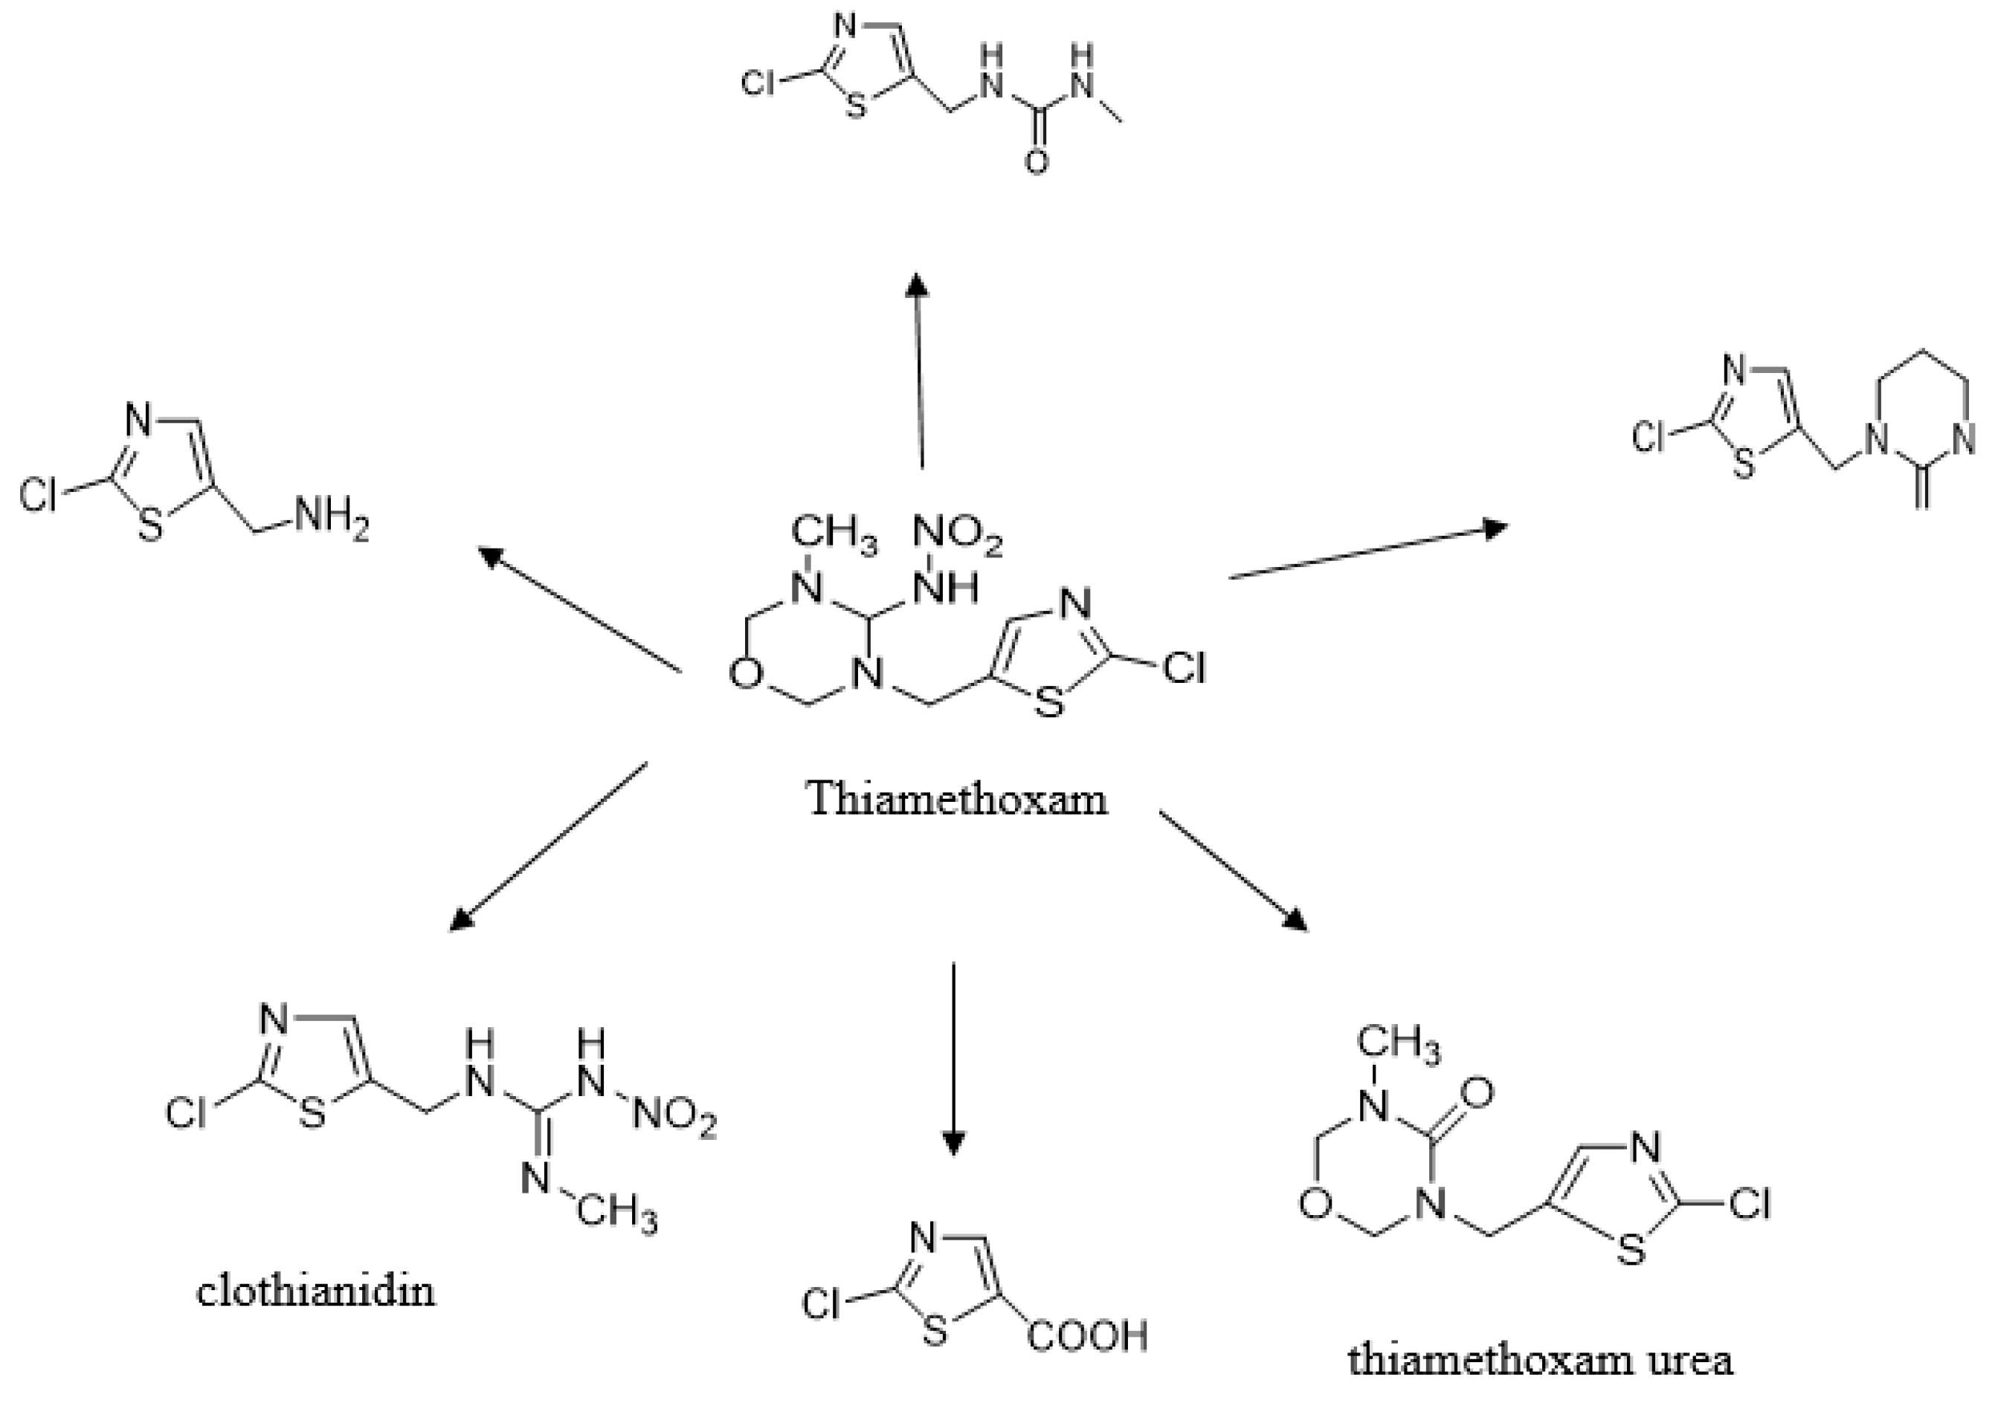
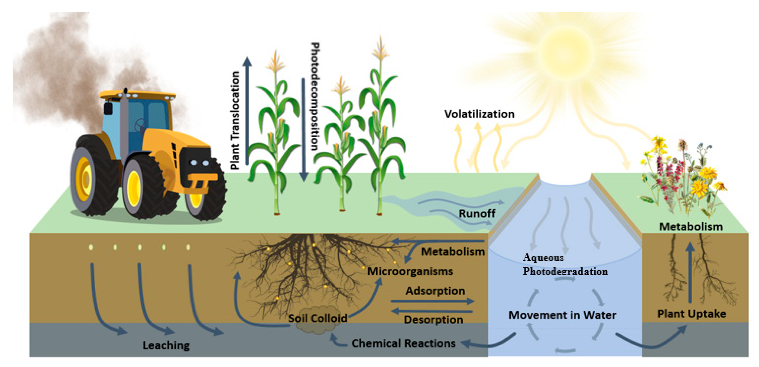
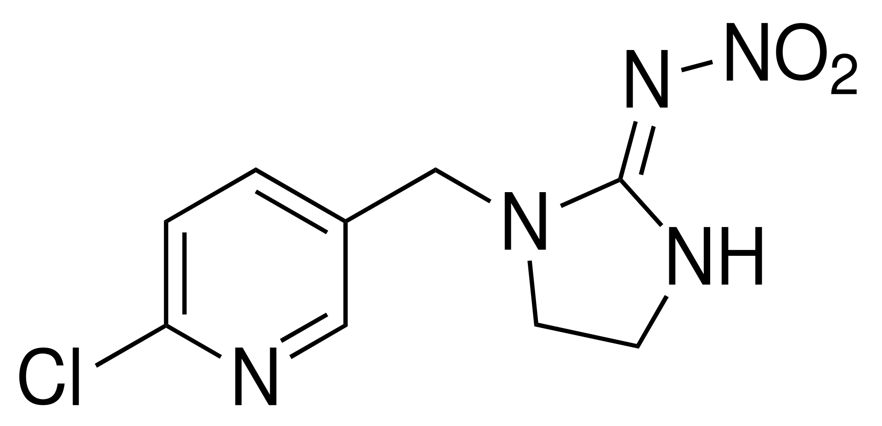
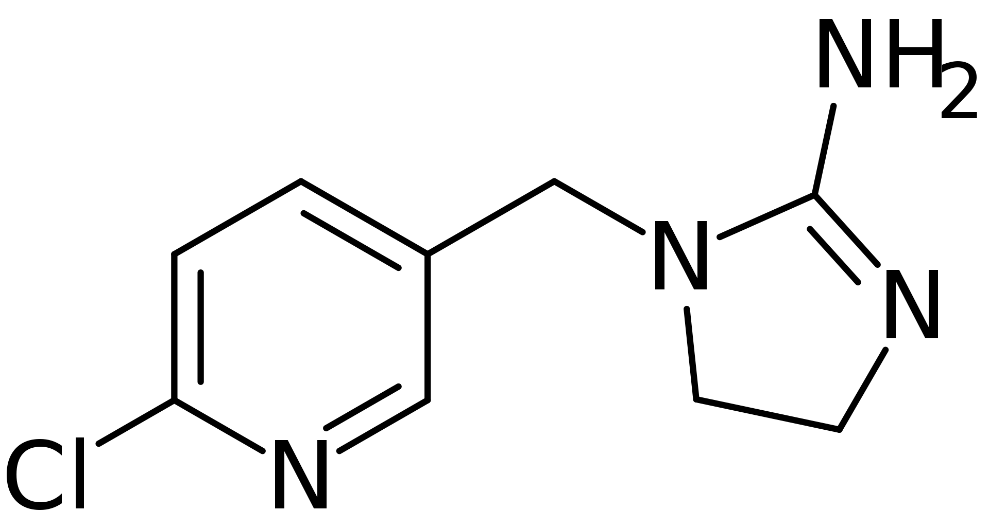
Neonicotinoid Insecticide Can Degrade in the Environment Transformation products can retain toxicity
Imidacloprid → Imidacloprid desnitro
Borsuah, J.F.; Messer, T.L.; Snow, D.D.; Comfort, S.D.; Mittelstet, A.R. Literature Review: Global Neonicotinoid Insecticide Occurrence in Aquatic Environments. Water 2020, 12, 3388.
Imidacloprid desnitro may have greater mammalian toxicity
Loser, D., Grillberger, K., Hinojosa, M.G. et al. Acute effects of the imidacloprid metabolite desnitro-imidacloprid on human nACh receptors relevant for neuronal signaling. Arch Toxicol 95, 3695–3716 (2021).

Slide 4
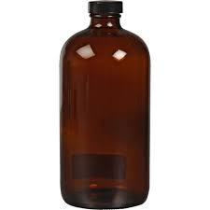
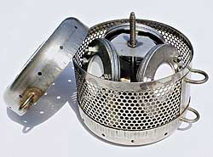
Surface Water Sampling

Slide 5
Contaminants Detected in Surface Water Grab Samples
14 parent neonicotinoid/fungicide compounds
7 neonicotinoid transformation products were selected to be monitored in the surface waters adjacent to the AltEn study area
13 of the 21 were detected in the surface water.
Both parent compounds and transformation compounds detected
Contaminant status | Contaminant name | Number of contaminants
Not detected at all | Acetamiprid, Dimethoate, Dinotefuran, Indoxacarb, Sulfoxaflor, Thiacloprid, 6-Chloronicotinic aldehyde, Imidacloprid olefin | 8
Only detected on route 1 (Johnson Creek) | - | 0
Only detected on route 2 (ENREC) | 6-Chloronicotinic acid | 1
Detected on both routes | Azoxystrobin, Clothianidin, Imidacloprid, Metalaxyl, Picoxystrobin, Pyraclostrobin, Thiamethoxam, Trifloxystrobin, 6-Chloro-N-methylnicotinamide, Imidacloprid desnitro, Imidacloprid urea, Thiamethoxam urea | 12

Slide 6
Initial Findings from Surface Water
We are detecting both the parent compounds as well as degradation products in surface water
We are establishing what may be considered a ‘background’ level from use of treated seed for crop production in the area
Concentrations are increasing downstream with highest concentrations in the Johnson Creek reservoir

Slide 7
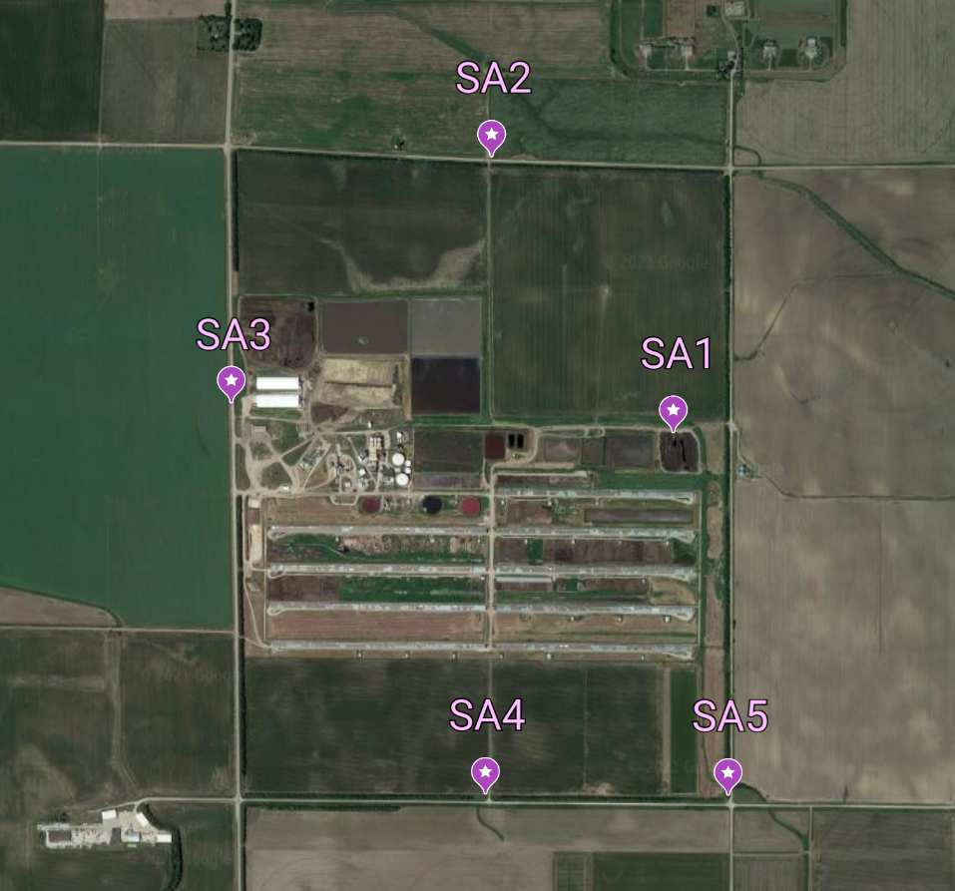
Air Sampling

Slide 8
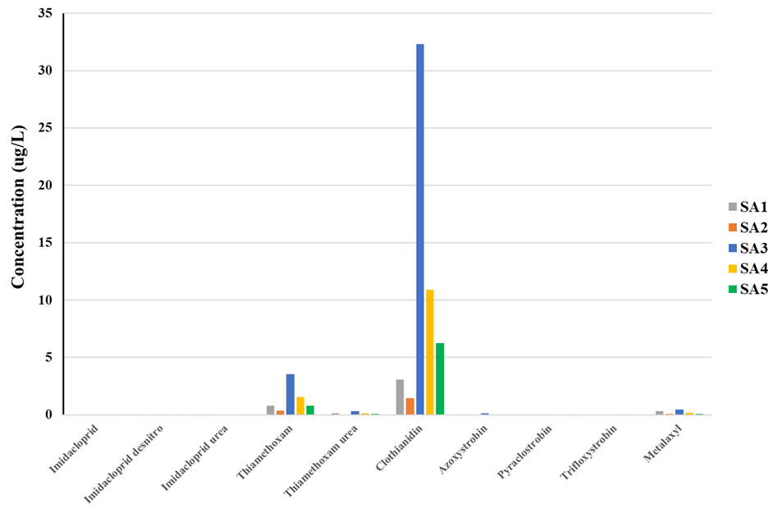
Air Sampling Results
Similar to water, samples were tested for 14 parent neonicotinoid/fungicide compounds and 7 neonicotinoid transformation products
10 contaminants were detected in air samples
Preliminary data and conversions are needed

Slide 9
Data is still being collected and analyzed
Surface soils data and deep cores are being analyzed
We are continuing to collect environmental samples including surface water, soil, groundwater and drinking water
A drinking water study is being done in collaboration with USGS

Slide 10
Future Plans
We will be continuing environmental sampling in 2022
We will be expanding our study area out further from the plant
We will initiate our own groundwater sampling/drinking water sampling

