Slide 1
The Impact of the One Big Beautiful Bill Act on Individuals and Families, the Health System, and Communities
David Palm, PhD
Center for Health Policy
Department of Health Services Research and Administration
College of Public Health
September 10, 2025

Slide 2
Overview of the Presentation
Brief review of the health provisions in the OBBBA
Potential impact on individuals and families
Potential impact of the health system
Potential impact on states and communities, including tradeoffs
Some concluding observations

Slide 3


Current Medicaid Landscape in Nebraska
In December 2024, 364,256 Nebraskans were enrolled in Medicaid – 17% of population
Most were children (49%), but 35% were adults, 10% were disabled individuals, and 6% were seniors
In SFY 2024, spending was over 4 billion – about 70% was federally funded

Slide 4
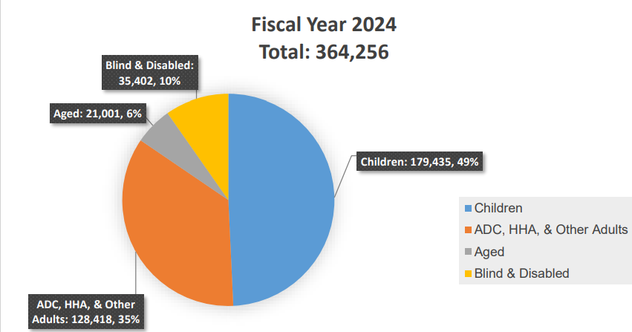
Average Nebraska Monthly Enrollment for Medicaid and CHIP by Category, SFY 2024
Source: Department of Health and Human Services, Division of Medicaid and Long-Term Care," Nebraska Medicaid Annual Report,” December 2024

Slide 5
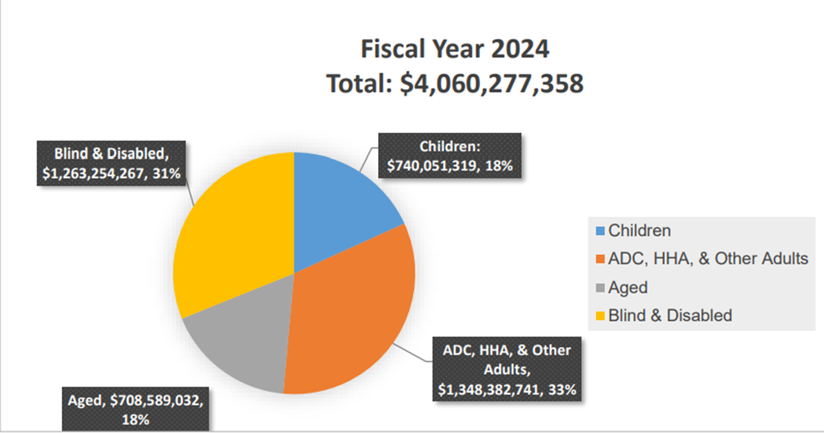
Nebraska Medicaid and CHIP Annual Cost by Eligibility Category, SFY 2024
Source: Department of Health and Human Services, Division of Medicaid and Long-Term Care," Nebraska Medicaid Annual Report,” December 2024

Slide 6
What Are the Projected Cuts?
Cost savings estimated at $1.1 trillion, including $960 billion from Medicaid
About 10 million more uninsured by 2034

Slide 7
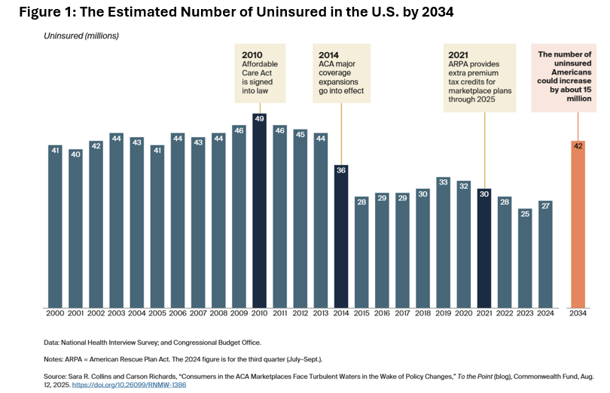

Slide 8
Major Health Provisions - Medicaid
Adult community engagement requirements ($326 billion savings)
Work at least 80 hours a month
Volunteer in a community service
Enroll in an educational program
A combination of these activities
Eliminates new or increased provider taxes ($191 billion savings)
Reduces provider taxes from 6% of a provider’s net patient revenue to 3.5% by 2032

Slide 9
Major Health Provisions – Medicaid Continued
Reduces state directed payments ($149 cost savings)
Conduct eligibility determinations for the Medicaid expansion population every 6 months ($63 billion cost savings)
Retroactive eligibility is modified from 3 months to I month for the Medicaid expansion population ($122 cost savings)
Most immigrants are no longer eligible for Medicaid, Medicare, or Marketplace plans

Slide 10
Major Health Provisions - Medicare
One year 2.5% payment increase for physicians
Because of automatic cuts under PAYGO, Medicare could be cut by $500 billion

Slide 11
Major Health Provisions – ACA Marketplace Plans
By 2028, automatic enrollment is prohibited – must verify eligibility before they are eligible for a PTC
1
PTCs are prohibited for individuals who fail to meet the community engagement requirements
2
Enrollment periods are shorter, and they must file a tax return
3

Slide 12
Other Health Provisions
Beginning July 1, 2026, the caps on student loans for medical and professional degrees is $200,000
SNAP is cut about 20% and the state’s share of administrative costs increased from 50% to 75%
The rule mandating higher nurse staffing levels in LTC facilities is rescinded until 2034

Slide 13
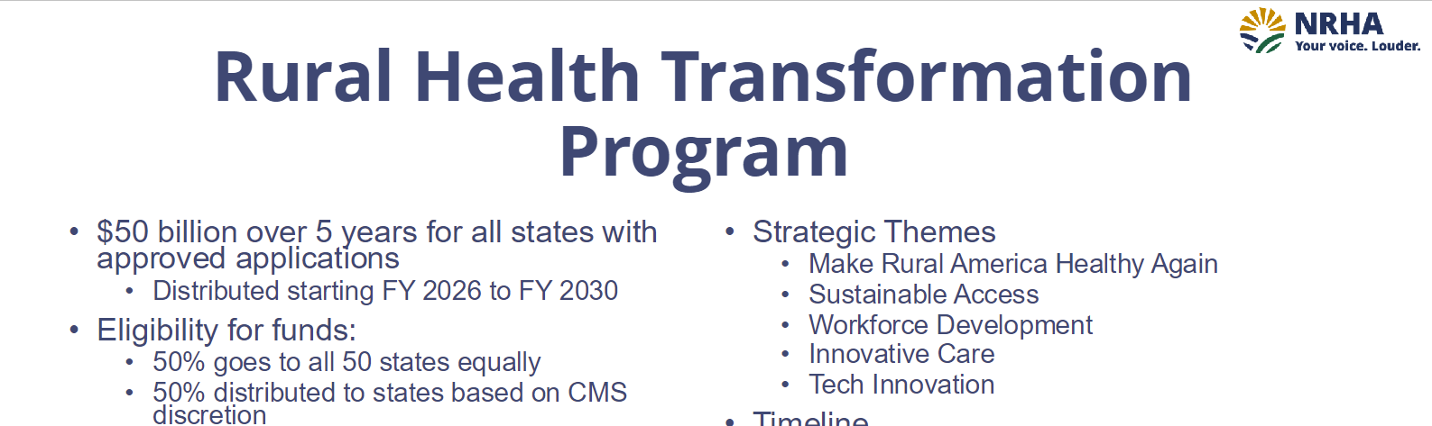
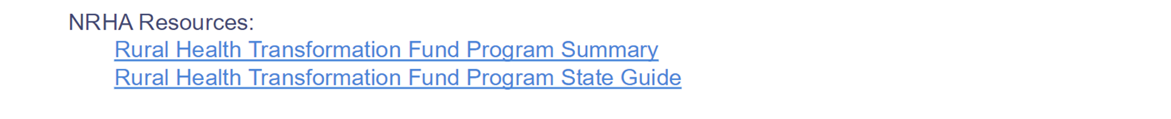

Slide 14
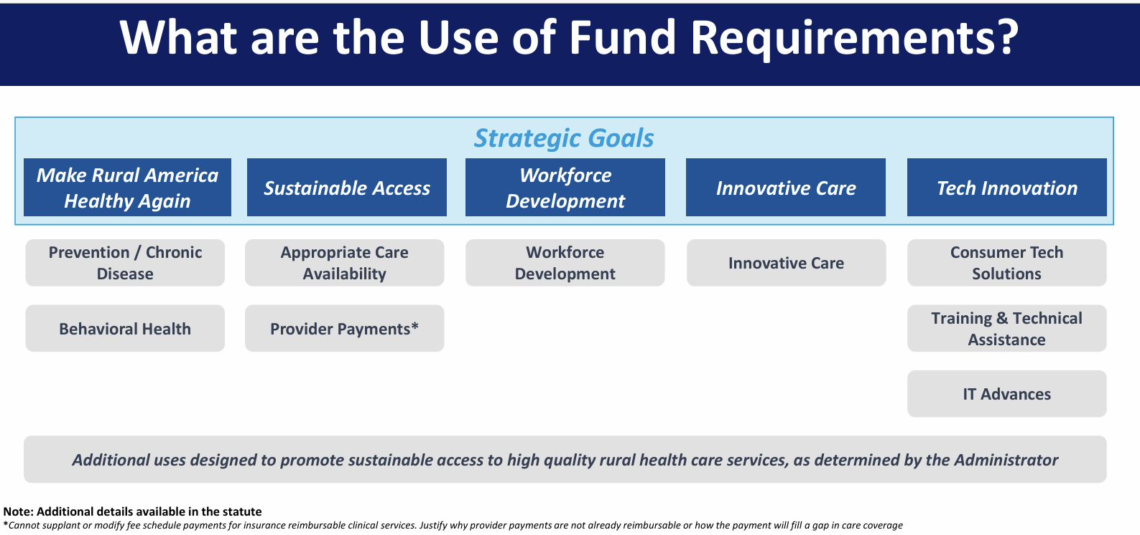

Slide 15

Impact on Individuals and Families

Slide 16
Work Requirements: Potential Impact on Individuals and Families
Most Medicaid enrollees already meet the requirements
States such as Arkansas and Georgia that have implemented work requirements have a POOR track record
Based on the unwinding process due to the elimination of the emergency requirements, NE did well, BUT …..

Slide 17
Work Requirements: Participation
Nearly 30% were not working due to caregiving responsibilities, illness or disability, or school attendance
Based on this data, only a small share of Medicaid adults were not meeting work requirements
Nearly two-thirds of adults ages 19-64 covered by Medicaid were working

Slide 18
ACA Marketplace Plans
In 2025, over 136,000 Nebraskans were enrolled in Marketplace plans, and 95% received tax credits in 2024
If the extra tax credits expire, 14,000 people in NE will lose coverage
The cost of annual premiums will increase between 9% and 36% due to the loss of immigrants and other factors such as tariffs, inflation, and workforce shortages

Slide 19
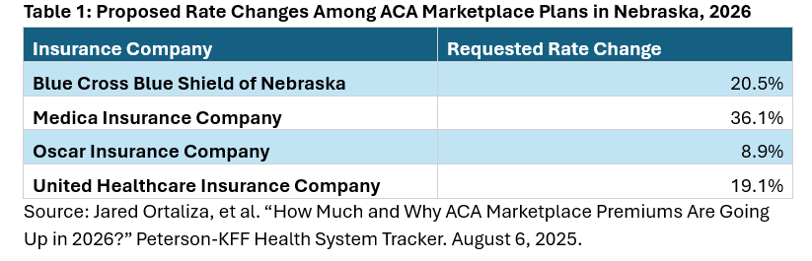

Slide 20

Summary: Impact on Individuals and Families
By 2034, 10 to 15 million people in U.S. will lose insurance coverage
Premiums for the ACA Marketplace plans will increase substantially next year
More “Red Tape” to navigate for Medicaid enrollees and ACA Marketplace enrollees
The availability of services will decline, particularly in rural areas because of more uncompensated care

Slide 21

The OBBBA will Magnify Access Challenges
Many people are already delaying or going without care due to cost
Many people with insurance coverage were unable to get needed care due to prior authorization requirements with managed care plans
Poor access impacts health outcomes

Slide 22
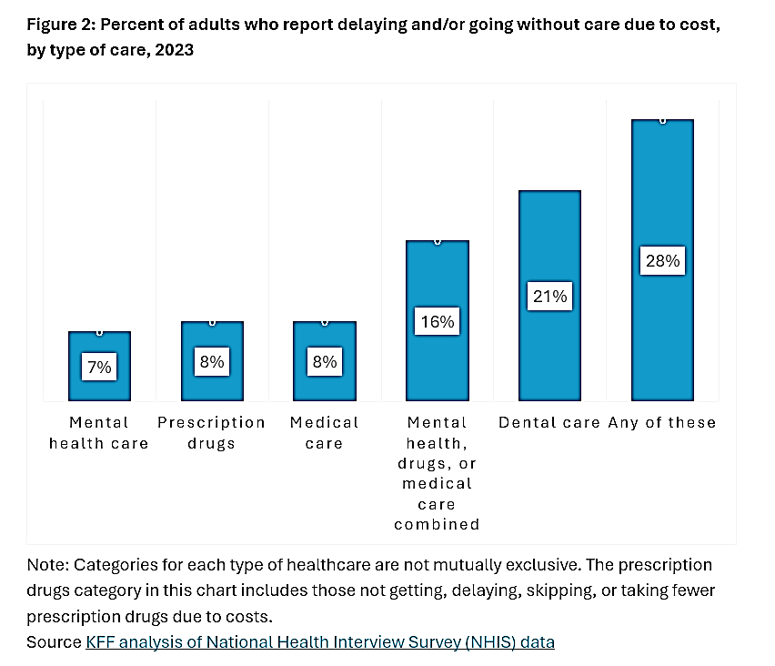

Slide 23
Impact on Access and Mortality
Medicaid cuts will lead to 1,484 excess deaths annually
Almost 95,000 preventable hospitalizations
About 1.6 million people delaying care because of cost
A total of 1.9 million people delaying purchases of medications
Source: S. Basu, S. Patel, and S. Berkowitz. Projected Health System and Economic Impacts of 2025 Medicaid Policy Proposals. JAMA Health Forum. July 17, 2025.

Slide 24

Impact on the Health System

Slide 25
Hospitals
Currently, 44% of rural hospitals in NE have negative total margins
Cuts in Medicaid and the decline in Marketplace plans = lower revenue and higher levels of uncompensated care which leads to fewer services
Chartis is projecting that up to 25% of rural hospitals in NE are vulnerable to closure
Hospitals are also faced with higher operating costs and lower reimbursement from managed care plans

Slide 26
Physician Clinics
Physicians are not required to treat Medicaid patients or any patient without health insurance
As a result, fewer patients will have a regular physician, and more patients will receive care in hospital emergency rooms

Slide 27
FQHCs
In exchange for higher Medicaid payment rates, FQHCs must see all patients regardless of insurance coverage
CBO estimates that FQHCs will see about 4 million more patients with revenue losses at $7 billion
With limited resources, there will be long delays, especially for behavioral health and dental needs

Slide 28
Certified Nursing Facilities (CNL)
Medicaid is the primary payer for 63% of the patients although there are no direct cuts
With less funding overall, states must decide how to allocate their funds (Children vs Seniors)
CNLs are greatly affected by changes in immigration policies – the institutional workforce declined by 23% from 2012-2022 and it is estimated that 600,000 new workers will be needed

Slide 29

Impact on Rural Areas

Slide 30
Funding Reductions Impact Everyone
More dependent on Medicaid $
Availability of services due to workforce shortages already a problem
Proportionately a greater demand and need for services because of older population and more chronic conditions
Many services such as behavioral health, EMS, and maternity care are already dwindling which affects everyone

Slide 31

.
Economic Impact on States and Communities

Slide 32
Economic Impact of Medicaid Cuts and More Uninsured People
NE will lose $3 billion in Medicaid funding over 10 years and have an additional 50,000+ uninsured
Providers will have less money to pay wages, and fewer services will be provided
The debt level for the uninsured will increase because they will pay more in out-of-pocket costs
The insured population will end up paying higher premiums due to cost shifting and spend less on other services

Slide 33
Economic Impact Continued
Health care organizations will have less money to invest in new equipment, buildings, and staffing
Employers will be forced to pay for insurance for low-income workers or leave them uninsured
Many businesses that support the health care system (Labs, construction companies, and various suppliers) will lose money and pay fewer taxes

Slide 34
Early estimates by the KFF indicated that cuts in Medicaid and SNAP would lead to one million jobs lost and a $113 billion decline in states’ GDP

Slide 35
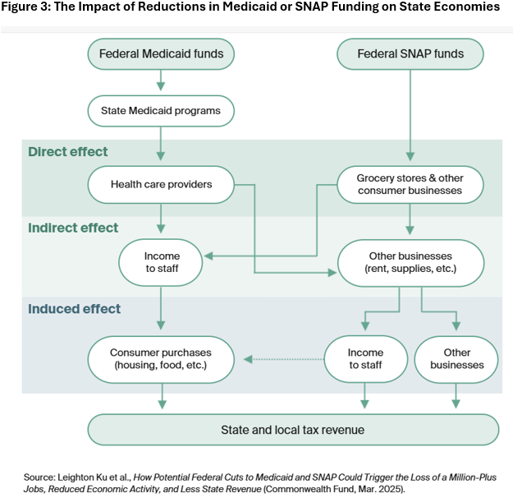

Slide 36
Impact on State of NE and Local Economies
Loss of jobs – early estimates of 4,000 – 5,000
Would lead to less spending which will affect incomes and tax revenue (about $30 million)
Potential loss of several rural hospitals – usually second largest employer in the community
Long-term would lead to lower productivity of workers

Slide 37

Difficult Choices/Tradeoffs at the State Level
What amount of the lost federal revenue would the state be willing to support?
Where would the money come from (e.g., higher taxes, education funds)?
Accept the Medicaid cuts and more uninsured people
Which categories of Medicaid enrollees should bear the greatest burden?

Slide 38
Final Thoughts
The OBBBA will have a serious negative impact on low-income individuals and families
It will have a ripple effect across the health care system
It will force states to make difficult tradeoffs with fewer resources

Slide 39
Thoughts from Jonathan Oberlander In Response to the OBBBA
“American health care will become less affordable, less accessible, and more inequitable. The only rich democratic country in the world with a large uninsured population is now pursuing policies that will reduce insurance coverage. If budgets reflect a nation’s social priorities and moral commitments, the 2025 reconciliation act offers a disquieting view of the current state of U.S. public policy.”
Source: Jonathan Oberlander, “Progress Lost – The Unraveling of Medicaid and the Affordable Care Act,” The New England Journal of Medicine, Downloaded from nejm.org on July 30, 2025.

Slide 40
David Palm, PhD
Associate Professor and Director of the Center for Health Policy
College of Public Health
University of Nebraska Medical Center
Email: david.palm@unmc.edu
Phone: 402.770.3605

