Slide 1



Are the COVID-19 Vaccines Safe?
Safety is the most important priority in vaccine approval
FDA advises a minimum of 3,000 participants to assess safety; the three vaccines that are authorized to use in the US had trials with 30,000 to 50,000 participants
The FDA and CDC have monitoring systems in place to detect any safety signs associated with any of the COVID-19 vaccines
  And they work, as demonstrated with the Johnson & Johnson vaccine; they were able to detect a 1 in a million safety signal
We now have even more data to show that the COVID-19 vaccines available in the US are safe to use
  There is a greater risk of getting a clot from a COVID-19 infection then there is from getting a clot from the Johnson & Johnson vaccine
  Women 18-49 have a very rare risk of getting a clot 1-2 weeks after the Johnson & Johnson vaccine and have the option of other vaccines
  There have been no clotting issues with the Pfizer or Moderna COVID-19 vaccines

Slide 2
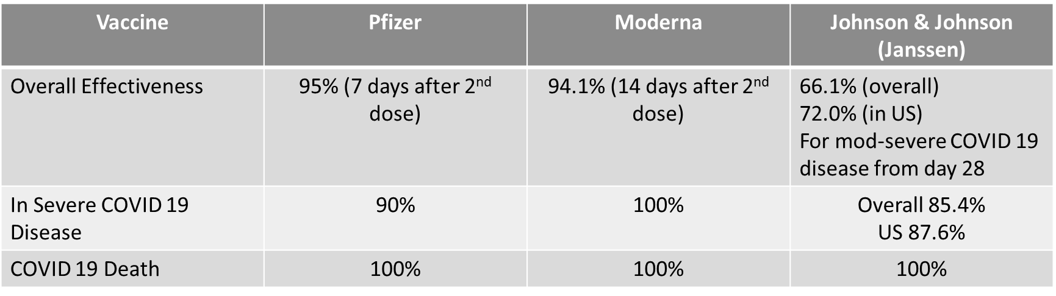
Are the COVID-19 Vaccines Effective?
Reprinted with special permission from The Medical Letter on Drugs and Therapeutics, May 2021.
Take Home Message: The COVID-19 vaccine will save your life

Slide 3

How Were the COVID-19 Vaccines Developed So Quickly?
Major reasons we were able to get these vaccines developed more quickly than usual include:
  Global effort with the world’s leading scientists focused on a single task
  Nearly unlimited resources (money, knowledge, manpower, technology)
  A large pool of diverse adult volunteer trial participants

Slide 4
Why Should We Trust the COVID-19 Vaccine?
The FDA is using the same strict standards that it has for decades
No steps were “skipped”
Two independent advisory committees reviewed the trial results; members and experts of these committees have no conflict of interest and are not associated with any vaccine manufacturers
  The Vaccine and Related Biological Products Advisory Committee (VRBPAC) that advises the FDA
  The Advisory Committee on Immunization Practices (ACIP) that advises the CDC
The ACIP continues to review the vaccines for safety and will make recommendations as needed for each of the 3 vaccines

Slide 5
How Quickly and For How Long Will I Be Protected by the COVID-19 Vaccine?
The CDC states that a person is fully vaccinated and protected
  2 weeks after the second dose of the Pfizer or Moderna COVID-19 vaccines
  2 weeks after the single dose Johnson & Johnson COVID-19 vaccine
The most current data shows that protection lasts at least 6 months, but we will learn more with each passing month how long our protection will last
May need to have vaccine booster shots in the future; scientists are already researching this

Slide 6
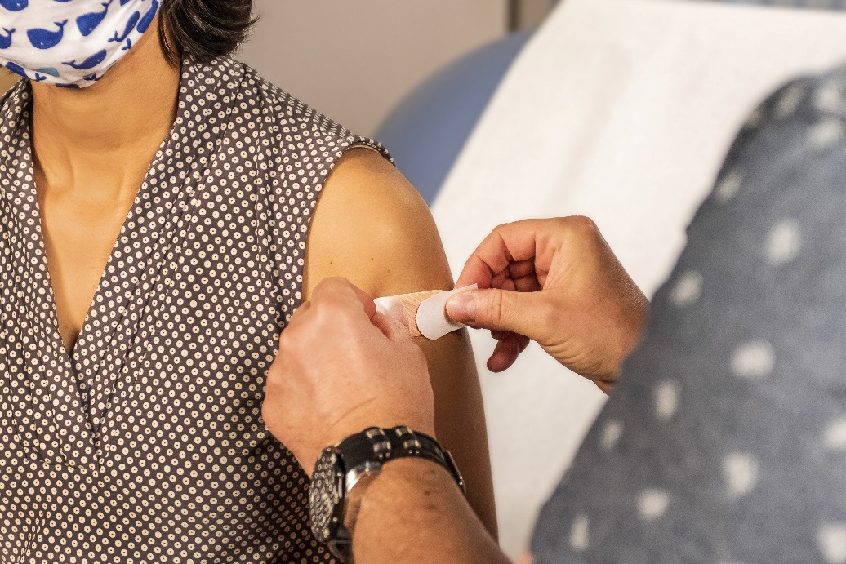
Short-Term Side Effects (1-2 days after the vaccine):
  Fever
  Fatigue
  Headache
  Pain at the injection site
  Side effects were more common after the second dose of the Pfizer and Moderna vaccines
Risk of Anaphylaxis
  Pfizer: 4.7 cases per million
  Moderna: 2.5 cases per million
Reports of Anaphylaxis After Receipt of mRNA COVID-19 Vaccines in the US—December 14, 2020-January 18, 2021 Published Online: February 12, 2021. doi:10.1001/jama.2021.1967
The Most Common Side Effects to the Pfizer, Moderna and Johnson & Johnson Vaccines

Slide 7
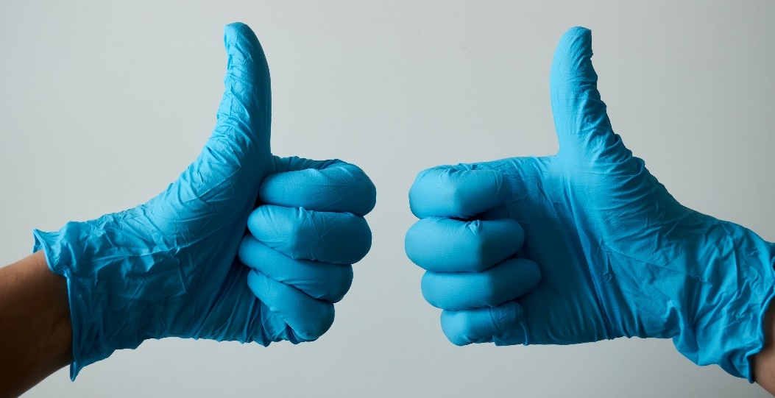
Do I Need to Get the Second Dose of the Pfizer or Moderna COVID-19 Vaccine?
YES!
You are not fully protected until you get your second dose of the Pfizer or Moderna vaccine
The first shot of the Pfizer or Moderna COVID 19 vaccine introduces the body to the spike protein and provides some immunity, but the second dose of both these vaccines significantly increases protection and can lead to longer lasting and more effective protection again the COVID-19 virus and its variants

Slide 8
Do the COVID-19 Vaccines Protect Against the Known Variants?
The Pfizer, Moderna and Johnson & Johnson COVID-19 vaccines all have been showed to protect against the B117, B135, and P1 variants
  We are still learning the details about how much protection each vaccine gives to the known variants
  It appears that the vaccines give more protection than the immunity acquired after natural infection
  Many of the COVID-19 variants are more contagious and therefore the COVID-19 vaccines are a vital tool for stopping the variants from spreading and preventing new variants from immerging

Slide 9
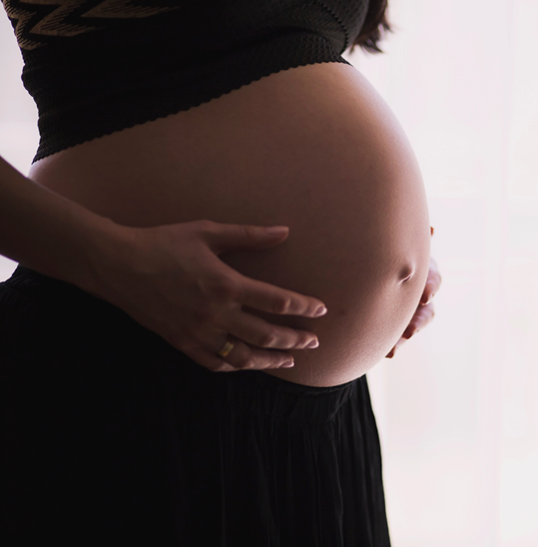

Is the COVID-19 Vaccine Safe To Take if I Am Pregnant or Planning To Become Pregnant?
Study just published shows Moderna and Pfizer COVID-19 vaccines are safe for pregnant women
  No increased risk for miscarriage, premature births and other complications
CDC recommended that coronavirus vaccines be made available to pregnant women, no preference on type or which COVID-19 vaccine to use
  Women should also consult with their doctors when making a decision about vaccination.
Preliminary Findings of mRNA Covid-19 Vaccine Safety in Pregnant Persons, NEJM April 21, 2021 DOI: 10.1056/NEJMoa2104983,
https://www.cdc.gov/vaccines/covid-19/info-by-product/clinical-considerations.html

Slide 10
Does the COVID-19 Vaccine Cause Sterility?
There is no data or evidence that any of the COVID-19 vaccines can cause sterility
People who have received any of the 3 COVID-19 vaccines have not had any increased complications with pregnancy compared to before the pandemic began

Slide 11
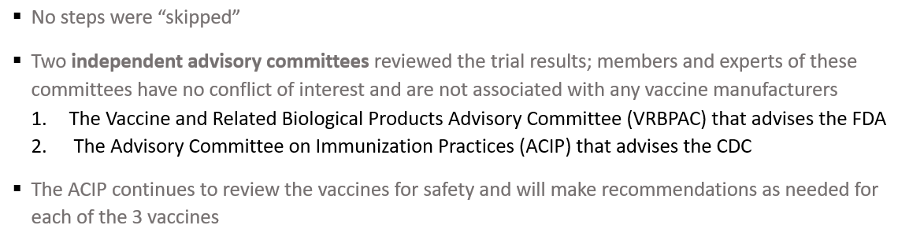
Why Should We Trust the COVID-19 Vaccine?
The FDA is using the same strict standards that it has for decades
  Global effort with the world’s leading scientists focused on a single task
  Nearly unlimited resources (money, knowledge, manpower, technology)
  A large pool of diverse adult volunteer trial participants

Slide 12
