Slide 1
Quality Improvement Slides
Full Quality Improvement Slide Deck as a Resource
Notes:
This set of slides is meant to be a resource for Nursing Homes. While there will be QI content infused throughout each of the modules, based on the questions and cases that are arising in your nursing home, you may want to use additional material from this deck.

Slide 2
Improvement Questions:
What is working? (Appreciative inquiry)
What is not working? Why? Why? Why? (Root cause analysis)
  Are there particular groups who are not benefitting as much as others?
What would success look like? (Aim setting) Whose voices and needs may be under-represented as you decide what is important?
How would you know (what would you see) if successful? (Feedback/Measure)
What could you try that would get you closer to success? (Change ideas)
What could you try out before the next call? (Plan-Do-Study-Act)

Slide 3
Three Part Agenda: Improvement Coaching
Follow-up on last week
Case presentation
Weekly COVID Content
What is working? (Appreciative inquiry)
What is not working? Why? Why? Why? (Root cause analysis)
  Are there particular groups who are not benefitting as much as others?
What would success look like? (Aim setting) Whose voices and needs may be under-represented as you decide what is important?
How would you know (what would you see) if successful? (Feedback/Measure)
What could you try that would get you closer to success? (Change ideas)
What could you try out before the next call? (Plan-Do-Study-Act)
What is working? (Appreciative inquiry)
What is not working? Why? Why? Why? (Root cause analysis)
  Are there particular groups who are not benefitting as much as others?
What might you do next?
What is working? (Appreciative inquiry)
What is not working? Why? Why? Why? (Root cause analysis)
  Are there particular groups who are not benefitting as much as others?
What would success look like? (Aim setting) Whose voices and needs may be under-represented as you decide what is important?
How would you know (what would you see) if successful? (Feedback/Measure)
What could you try that would get you closer to success? (Change ideas)
What could you try out before the next call? (Plan-Do-Study-Act)
Notes:
If natural “cases” come up during the “follow-up” phase , you may want to add the aims/feedback/changes questions…

Slide 4
Humans are Unreliable
The Human Factor
  Memory Failure:
    Humans can hold somewhere between 4 and 7 items in their short-term memory
  Fatigue:
    Physical and mental exhaustion
  Boredom:
    The repeat nature of some of the things we need to do can lead to boredom with the task
  Overload:
    Constantly deluge of new information and additional work for nursing home staff
  Distraction:
    New policies, procedures
  Stress:
    Emotional, financial, family stress
  Lack of Routine Practice:
    Staff in new/different roles
Notes:
Humans are inherently unreliable - it is part of who are – and that is okay. It is important to know that we are unreliable, and we have tools at our disposal to help us to be more reliable.
First let’s consider the Human Factors that make us unreliable (and which are exacerbated by COVID-19)
Memory Failure – we can only hold somewhere between 4 and 7 items in our short-term memory and let’s be honest, caring for multiple residents during a quiet time requires a lo more than 4 to 7 items, during a pandemic there are far more things to remember.
Fatigue – Both physical and mental exhaustion are a very real part of everyday life during this pandemic and can exacerbate our level of fatigue.
Boredom – This sounds bad, as if we aren’t interested in what we are doing, but that isn’t necessarily the case. Boredom can come about without us recognizing it, like donning and doffing PPE – it is something we do repeatedly and is a task that can easily become tiresome as you do it dozens of times a day.
Overload – The constant deluge of new information, changes in resident conditions, new policies, etc can easily result in staff feeling overloaded. And let’s not forgot that are personal lives may not be quite “normal” yet and that can add to our state of overload as well.
Distraction – New policies, procedures, even questions when we are in the middle of a task can distract us from what we are doing.
Stress – A condition that is not new to any of us. In addition to the emotional stress put on us from COVID, there may also be very real issues of financial and family stress that can affect staff.
Lack of Routine Practice – Now you might think – wait a minute we have a whole lot of practice as we have been working 24/7 during this pandemic and that is the case however, we have staff in new or different roles, we have new policies that are created, new guidance that comes out, and even new plans with visitation that we have not yet had a chance to practice – to make routine.
So, we know that we are human, and being human makes us unreliable. Our job is to then create standard processes that help to be more reliable – so we don’t need to rely on ourselves to carry all the reliability we need.

Slide 5
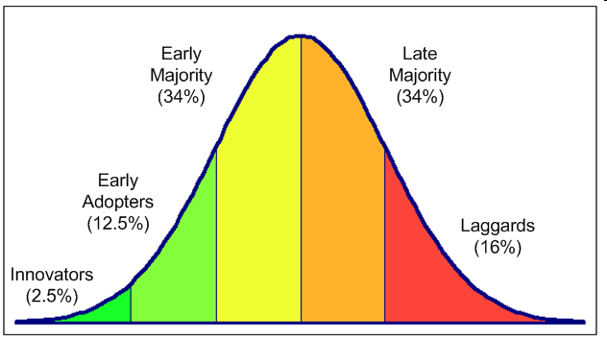
Diffusion of Innovation: Roger’s Adopter Categories
Rogers, E. M. (2003). Diffusion of innovations. New York, Free Press.
Notes:
Everett Rogers was a communications professor who studied the processes by which an innovation spread in a social system.
It is helpful to consider Rogers’ theory because we all fall at different points on this continuum based on the innovation or change being asked of us. For example, for some new technology is easy to adopt they are “Early Adopters” and proud of it. For others, they will keep their flip phone until it no longer functions.
When considering QI, we need to remember that we do not all have the same level of comfort with change, we do not all have the same level of comfort with trying new things and that is okay. There are ways to help bring along individuals in the different phases of this curve. Not everyone has to be onboard immediately – and at times – that is a good and safe thing.

Slide 6
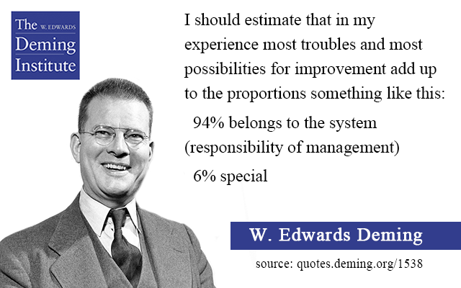

Improvement of Quality
Saying it happens all the time, without specifics, is a problem that is almost impossible to fix!
Notes:
W. Edwards Deming is often thought of as being the father of Quality Improvement. And the key to a lot of what he discovered is that most of the problems with quality are system problems – meaning that they are baked into how the system was build and performs. System problems are not the responsible of the front-line to fix. Deming believe that system problem are the responsibility of management and those problems account for about 94% of the opportunities for improvement in the system. The remaining 6% are due to special circumstances and can be addressed at the point of problem.
The other item we will focus on in QI is knowing what the real problem is – saying that “something happens all of the time” without being able to articulate what the problem is – makes it impossible to fix. We need to know where the system is breaking down and then we can set about to fix the system.

Slide 7
Leadership in Nursing Homes
“Leadership is about accepting responsibility for enabling others to achieve shared purpose under conditions of uncertainty.” (Marshall Ganz)
Wise compassionate leadership is the ability to do hard things in a human way. (https://hbr.org/2020/12/compassionate-leadership-is-necessary-but-not-sufficient)
Notes:
Leadership in Nursing Homes is even more important now than ever.
Marshall Ganz, a senior Lecturer at the Kennedy School of Government at Harvard gives us a great definition that embodies the leadership needed during COVID.
Leadership is about accepting responsibility (which you all do every day) for enabling other (your workforce) to achieve shared purpose (the aim of your organization to provide a home for your residents) under conditions of uncertainty (which COVID provides you an opportunity for daily).
As leaders in nursing home, you need to be both wise (and learned in all the components of your business and the every changing COVID landscape) and compassionate – you are in a business that has compassion at its core. So your role is to be: a wise compassionate leader – doing hard things in a human way.

Slide 8
How to Make Changes Stick
Focus initially on KEY PROCESSES rather than a benchmark
  Having a goal is important but without the processes to get there, it is useless
Evaluate if staff KNOW the process
  Train staff in the process; Provide different learning modalities
KEEP it SIMPLE!
  Processes that are too complicated will not be remembered or followed
Commit to LEARNING
  You don’t have to have it all right the first time through (or the second or the third)
Notes:
Change takes time and it takes intentionality to make the changes stick. A few key points to know:
While it is important to have a goal and know where you want your performance to be – initially it is far more important to focus on key processes rather then the benchmark. What will work in your organization and how will you make the changes locally appropriate so they can become part of routine care.
You may think you have a process that works, double check – ask staff if they know the process. Be prepared to train staff and remember that people learn in different ways – you may need to provide different learning modalities for different staff.
Key to reliability is to KEEP IT SIMPLE. Processes that are too complicated cannot be remembered or followed. A beautiful flow chart that no one can remember is useless. Take advantage of processes that you already have in place and the habitats and patterns of your staff.
Finally, commit to learning – we all know we won’t get everything right the first time, and that’s okay. The goal is to learn your way into a process that works for your organization. Take you time, test small, and find what will work for you.

Slide 9
Lay out the Five Attributes of Your Process
Who does it?
When should it be done?
Where is it done?
How is it done?
What is needed to do it?
Notes:
All Processes have five key attributes that you need to articulate and make sure staff are aware of:
Who does the process – Literally, who in your organization are we talking about doing this process?
When should it be done – Is it a time of time, dependent on a patient conditions, etc?
Where is it done – What is the physical location?
How is it done – How does the process get executed? Are there steps to follow (where those derived from science?)
What is needed to do it – Do you need materials, team members, supplies?

Slide 10
Ask 5…About 5
Ask 5 staff involved in the process to describe the five attributes of the process
  IF 5 direct staff can describe the work with the 5 attributes then:
    You know you have a process in place that people know about
    You have a good chance that you can achieve 95% performance AND sustain the process over time
  IF 5 direct staff cannot describe the work with the 5 attributes then:
    Determine if all 5 cannot describe the work (is there a training/education problem.
      Determine if it is a COMMON or INFREQUENT failure.
      Observation of ONE PERSON does not mean it is a common failure.
    Determine which of the attributes are problematic and work to improve that aspect
Notes:
If you believe you have a process working well in your organization, you can test that theory:
-Ask 5 staff involved in that process to describe the five attributes of the process. This isn’t a test – just a casual question – ask the five independently to describe the process. If the five direct staff can articulate the five attributes as you except, then you know that (1) you have a process in place that people know about; (2) you have a good chance that you can achieve high performance at that process and sustain it.
-IF 4 direct staff cannot describe the work with the five attribute then you need to determine two things:
Is this a common or infrequent failure – we will review more on the next slide – but is this something everyone can’t articulate or just one individual?
Determine which of the attributes is problematic or if the whole process is. Then you will be able to isolate the problem and begin to think about improvement.

Slide 11
Addressing Gaps: Common vs. Infrequent Failure
Common
(More than 1 of the 5 Cannot Articulate the Attribute or Process)
Don’t rely too heavily on education as THE FIX
Get CURIOUS to determine WHY this is occurring
Inform staff on the WHY:
    WHY is this process important
    WHY do we do it this way
Get CURIOUS – WHY are they NOT following the process
Develop a plan to fix ONE attribute
Keep it SIMPLE!
Infrequent
(Only 1 of the 5 Cannot Articulate the Attribute or Process)
Infrequent does NOT mean you have a bad process.
Don’t try to make it perfect – you will use up too many precious resources.
Talk to that one person to reeducate or determine WHY it is occurring.
  Determine if there is a simple fix
MOVE ON to focus on another process
Notes:
A Common failure is one in which 2 or more of the individuals you asked to describe the processes cannot do it.
First things first – let’s not assume that it is a problem with education – let’s assume it is a system problem – and ask why the problem is occurring? Do the staff know there is a process in place? Do they know why this process is important and why we need to execute on it in a particular way?
Then dive in – get curious as to what isn’t working – ask lots of question and get at the root of the challenge.
You will then begin to develop a plan to fix one attribute and try it (you don’t need to fix them all at once) find a place to start and keep it simple.
An Infrequent Failure is one in which only 1 of the five cannot articulate the process. It is still a failure but likely for different reasons. First, don’t redo your entire process because one person didn’t know it. Talk to that person – find out what is occurring. Is there a simple fix? Is this one person who wasn’t trained on the process? Is it a new hire? Uncover the root, fix it if it is simple and prepare to move on.

Slide 12
Creating Flow Charts for Reliable Processes
Obtain
PPE
Put PPE
On
Use
PPE
Take Off
PPE
Considerations:
Who is responsible for enough PPE?
Where is the PPE stored?
When is the PPE inventory done?
How is the PPE supply verified?
What is done when PPE is missing?
Considerations:
Considerations:
Considerations:
Notes:
Flow charts are a big part of reliable design. The key to a flow chart is to lay out 4-6 high level steps at the very most. In this example you can see we laid out four steps to using PPE:
Obtain the PPE
Put on the PPE
Use the PPE
Take off the PPE
Is this extremely simplistic – YES of course it is – and it is intentionally. Remember – we can only remember 4-7 things in our short-term memory. So, if you can’t remember a simple process, you won’t be able to remember or even design a more complex process. Once you lay out the high-level steps then you can assign boxes to team members to address all the considerations that might fall under each box. For this example – I laid out a lot of questions that would need to be considered in the obtaining of PPE. Now let’s work together and layout the next box. What are the considerations in putting on PPE?

Slide 13
Day of Vaccination Flow Chart: High-level Considerations
Staff and Patients Arrive at Location
Informed Consent Confirmed
Vaccination is Given
15 Minutes of Observation
24-48 Hours Post-Vaccination
Considerations:
PPE for staff
PPE for patients
Transportation to site for physically impaired residents
Transportation for memory impaired residents
Considerations:
Who is confirming consent?
How will you handle patients/ staff who change their mind on the day?
Where is consent confirmed for your records?
Who does patient documentation for your records?
Considerations:
Documentation
Considerations:
Who is responsible for observation?
Supplies on hand for Adverse Events:
  Epi-Pens
  Syncope
  Additional Meds
Staffing for patients with memory impairment
Considerations:
Staff absence
Impairment:
  Site pain
  Fatigue
  Headache
  Severe
Reporting of adverse events
Delayed allergic reactions
Schedule 2nd Dose
Notes:
We all know that vaccination in our nursing homes was not a simple process and yet here it is laid out in five boxes. There were countless considerations that went into place to make it successful, and I am sure you improved your process between Clinic 1 and 2 and then 2 and 3. But you can see it is possible to get the high-level flow right and then go into the detail of each step. In addition, by laying it out this way you can also identify where you think the biggest problem in your system might be. For some it may be step 1 – they are afraid of bottlenecks in arrivals. For others it might be verifying the informed consent or having the right space for observation. You will determine the strengths and weaknesses in each step for YOUR organization.

Slide 14
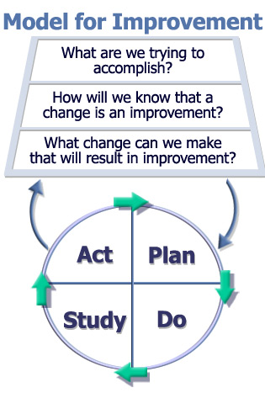
The Basis for Testing and Learning
Model for Improvement: IHI and API
Learn in Small Doses
Segmentation is trying an idea on a portion of the population where you stack the deck in your favor and are most likely to succeed in order to test the idea without dealing with all the obstacles.
Learn in small samples, get your process working, and then spread.
The Improvement Guide, 2nd Edition, Langley, Moen, Nolan, et.al., Jossey-Bass 2009
Notes:
The Model for Improvement, developed by API is a common method used to make improvements. It is three simple questions:
What are we trying to accomplish? That is to say, what is your aim?
How will we know that a change is an improvement? This is where measurement comes in.
What changes can we make that will result in Improvement? These are your change ideas (or ideas you steal from others).
Then you can engage in rapid cycle testing – the PDSA cycle:
Step 1: Finalize the first idea you are going to “try out” (aka test)
Step 2: Design and plan the 5 attributes of the “try out”
Step 3: Perform the “test”
Step 4: Evaluate with a huddle and decide what to do next
Step 5: Act on your next step
Unlike research, in QI you can stack the deck in your favor – you can segment your population and test where it is easy, where people are interested in trying your test, where you have the least complicated patients, or the fewest obstacles. Once you get it right in that environment you can then learn in a more complex location.

Slide 15





Rules of Measurement in Reliable Design
Keep it SIMPLE
Make sure it is DOABLE
Use MINIMAL RESOURCES
Know what the data is telling you OVER TIME
Keep to a yes/no format
Small samples rather than all
Person/persons responsible for the design should do the data collection
Process reliability data used to refine the process until 95% reliability is reached
For a process thought to be reliable spot checks need to be made and defects studied
Adapted from Roger Resar
Notes:
Measurement is foundational in healthcare. It is used all the time to let us know how our patients or residents are doing. And yet, it turns a lot of people off. Measurement is the key to knowing if the changes we are making are leading to an improvement.
Measurement for improvement should be immediately useful. Is this better or not. Are we making progress. A few simple reminders:
Keep it simple – even a yes/no format is helpful – and collect at the point of the change.
Make sure it is doable – If you ask for something that is impossible to collect no one will do it. Use small samples rather than the whole population (if it isn’t working on a few, it isn’t working for everyone).
Use minimal resources – the people responsible for the design should do the data collection – it should not be a big burden.
Know what the data is telling you over time. Just as we look at the current state of COVID and what is has done over time, know what your process looks like over time.
Finally – do spot check periodically to make sure the processes you have in place are reliable.

Slide 16
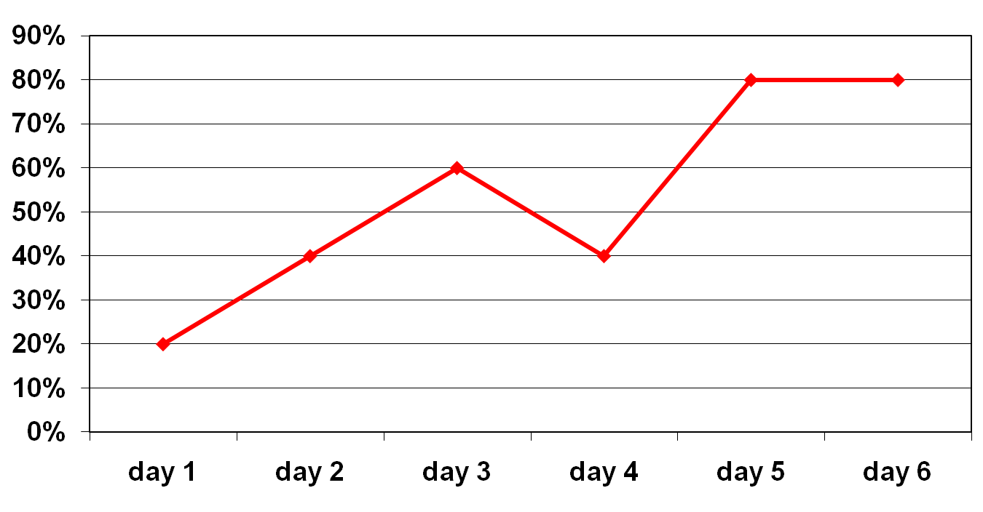
5 PPE Observations a Day
Notes:
16
Tracking data can be as easy as putting up a white board. On the x-axis put the time (days, hours, shifts) – what the right time measurement is for your process. Then on the y-axis put the item you are measuring. In this case it is the % of 5 PPE Observation per day that were done correctly.
It is not necessary to use any fancy data programs to track data overtime.
This is also a good time to remember that data transparency is helpful – put your measures up where everyone can review it.
If you have built a reliable process and are at 95% reliability – consider switching to a time between measure – you can track the number of days between events. For example – number of days between pressure ulcers, or the number of days between new COVID cases.

Slide 17
Diffusion of Innovation: Roger’s Adopter Categories
Rogers, E. M. (2003). Diffusion of innovations. New York, Free Press.
Notes:
When considering QI, we need to remember that we do not all have the same level of comfort with change, we do not all have the same level of comfort with trying new things and that is okay. There are ways to help bring along individuals in the different phases of this curve. Not everyone has to be onboard immediately – and at times – that is a good and safe thing.
For each category there are different strategies to bring people onboard.
First, don’t worry about the laggards – unless they are actively trying to dissuade others from participation, we can just leave them alone for now – that is okay.
The Innovators are already onboard – they came up with the idea.
Most of use will fall into Early Adopters/Early Majority/Late Majority.
The early adopter are a great place to start, they want to try. Put your attention here – work with them to try the change and then make their work visible so others can see what they are doing.
The early majority will need to see what the early adopters are doing to get comfortable with the idea.
And the late majority will need more – they may need to wait to see that change is inevitable and apply a bit of general positive pressure.

Slide 18
Matching Activities to Key Adopter Categories
Early adopters
  Search for successful sites (“Found Pilots”)
  Create pull through communication
  Change agents need a plan for sites that come forward
  Focus on influencers as messengers
  Invest resources initially with the early adopters
  Make the work of early adopters observable
Early majority
  Allow for peer-to-peer contact with early adopters
  Communicate local successes
Late majority
  Peer pressure is necessary
  Communicate adoption of the changes is inevitable
Notes:
These are the activities we just discussed and helpful ways for each adopoter category to be ready for the changes you are proposing.
As for the laggards – they will either come onboard or Leadership can address those who don’t get onboard.

Slide 19
Translation of Reliability into Practice
Standardization
Decision aids and reminders
Take advantage of pre-existing habits and patterns
Make the desired action the default rather than the exception
Create redundancy
Bundle improvements
Encourage teamwork, learning through feedback and training - Resilience
Elegert, Family Practice Management, 2005
Notes:
We have discussed a lot about human factors and how we can unreliable. We use QI and reliability science to help us use tools to turn our ideas into reliable practices. Some of them are:
Standardization – having a standard process that everyone can follow is the first big step to having a reliable process
Use Decision Aids and reminders to make it easy to follow the process – again try to combat the 4-7 items that we are remembering at any one time in our short-term memory.
Make the desired action the default
Create redundancy – if the system fails the first time, how can you make sure it doesn’t get through the second.
Bundle improvements – when improvements can happen in the same space and time it is easier for people to do the right thing.
Finally build resiliency through teamwork, learning, and feedback loops.

Slide 20
4 Steps to Mitigate Threats
(during COVID and beyond)
Make risk visible
  Use your data: Track your outcomes
  Know when things go wrong
  Highlight opportunities where things could go wrong
Honor existing procedures/protocols and adopt new ones as needed
Double down on efforts that address psychological safety and the added stress
Be transparent and account for the current environment
  Ensure everyone in your facilities and larger community (families, consultants, etc) KNOW the current state
Martin, Berry, Mate. How to Safely Restart Elective Surgeries After a COVID Spike. Harvard Business Review; November 19, 2020.
Notes:
COVID is one of those moments when dangers in our system became more apparent. During times of greater threats, these four steps can help you combat the human factors that can contribute to failure:
Make risk visible – it is hard to combat something you can’t see. Use data posted transparently to ensure everyone knows you are at an elevated level of threat. Know when things can go wrong. And highlight weaknesses in your process so you can look for threats.
Honor existing procedure and protocols and adapt new ones as needed – make sure you follow your standard processes AND create training opportunities for new processes you have created.
Double down on efforts that address psychological safety – if a team member does note feel safe to call out a possible failure in the system or a weak point – they will not and that can put the entire system and possibly lives at risk. Encourage and celebrate the identification of weakness and breaks in your system.
Be transparent – everyone in your system should be aware of the current state. For Nursing Homes ”everyone” in your system includes: your staff, your consultants, your residents, your family members, your volunteers, your transportation system, etc. Nursing homes have done a great job of this type of communication during COVID and it should continue well beyond!

