Slide 1
The Importance of the Role of CNAs During COVID-19
Rebecca Treichel, CNA
St. Paul Elder Services, Kaukauna, WI

Slide 2
Giving Compassion, Care, and Love
Confused (move to isolation unit, PPE use)
Scared (mortality in elderly)
Dementia or Alzheimer’s
No family visitors
Trauma-informed care
This Photo by Unknown Author is licensed under CC BY-SA

Slide 3
Keeping a positive mindset at all times
Support system
Faith
Gratitude
Self-care
Staff are experiencing trauma too
This Photo by Unknown Author is licensed under CC BY-NC

Slide 4
Doctor and Nurse relationship with CNA
Eyes and ears for symptom surveillance
Communication is key
Be an “expert noticer”
Slightest changes can mean outbreak brewing
This Photo by Unknown Author is licensed under CC BY-SA-NC

Slide 5
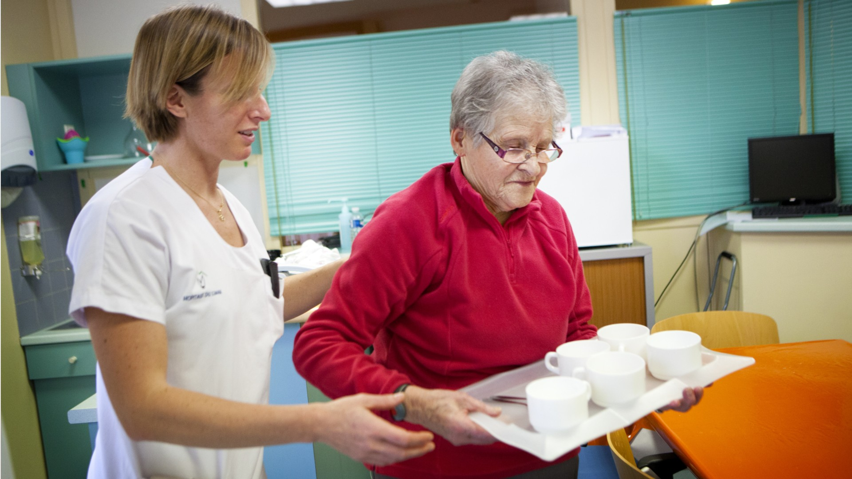
Professionalism
Respect families wishes
Dignity and Integrity
Confidentiality
Reasonable expectations and rational decisions
Following the science
This Photo by Unknown Author is licensed under CC BY

Slide 6
Hygiene and cleanliness in workplace
Proper PPE indicated and protocol for donn/doff
Supplies (correct use)
Education: Take advantage of everything offered

Slide 7
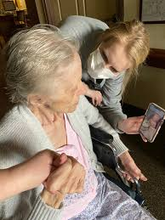
Virtual Visits
New way of seeing loved ones
Doctor appointments via Telehealth
Therapy

Slide 8
CAN / Resident Relationship
Become their family
Trust
Comfort through pain of physical illness
This Photo by Unknown Author is licensed under CC BY-ND

Slide 9
End of life
Only ones with them at time of death
Support family members of dying patient or patient that has died

