Slide 1
Notes for coaches
If you want additional QI Content for the Well-Being content (week 15 on standard schedule), consider circling back to the conversation guide.
These are the slides from week 3 – focusing on the “hear me” pillar, plus the other pillars built out…
You can use the slides and/or share the document (show pdf)

Slide 2
Conversations to Prepare for Improvement

Slide 3
Why Conversation?
Information to assist in problem solving
Support Staff wellbeing
Tap into creativity of staff
Promote joy in work and healthy relationships
Build a more robust system

Slide 4
Notes:
Preparing the ground for improvement by insuring that staff are heard, engaged and an integral part of identifying and addressing issues.

Slide 5
Pillars
Hear Me
Protect Me
Care for Me
Prepare Me
Support me
http://www.ihi.org/resources/Pages/Tools/Conversation-Guide-to-Support-Staff-Wellbeing-Joy-in-Work-COVID-19.aspx
Notes:
Hear me: Listen and act on the lived experience of staff to address concerns and support open and honest dialogue and problem solving
Protect me: Reduce the risk of acquiring Covid-19 and transmission to family.
Care for me: Provide support for team members and their families if they become ill or are isolated. As well as understanding and provide resources to support secondary impacts of covid-19 such as mental health support.
Prepare me: provide training and insure staff have honest and clear information regarding current state and preparedness to address current and future scenarios.
Support me: Acknowledge the demands of the current time and the limitations on what each of us can do. Encourage self care and put in place support systems to insure staff are able to care for their own needs.

Slide 6
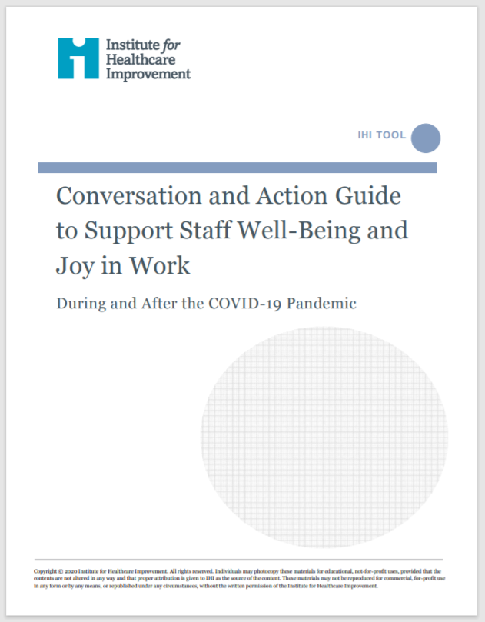
Practice active listening and problem solving
“Here’s what I hear you saying – do I have that right?”
“what do we still need to learn”
“how can we do this together”

Slide 7
Hear Me
Hear Me
Listen and act on lived experience to understand and address concerns to the extent organizations and leaders are able
Short huddles, in small groups or 1:1 where you can ask:
What concerns do you have for residents, yourself, or the team?
Are there steps we can take right now as a team?
What good thing happened today?

Slide 8
Protect Me
Protect Me
Reduce the risk of acquiring COVID-19 and/or being a transmitter to family. Establish and support a physically safe work environment
Do
Be Fact Based
Focus on what we can Control
Offer realistic help
Steps to try:
Reassure and inform
Ask what can be done together
Inform

Slide 9
Care for Me
Care for Me
Provide holistic support for team members and their families, if isolation is required (or other sources of distress occur)
Do
Identify what support looks like for staff and their families
Recognize that mental illness may increase during times of intense stress
Find ways for staff to support colleagues who are (or have family members who are) sick or have died from COVID-19
Ensure staff know about resources if they are furloughed
Steps to try:
Ask what staff need
Address the basics

Slide 10
Prepare Me
Prepare Me
Provide training and support for high-quality care in different settings
Do
Be honest and clear
Encourage rapid learning
Communicate
Steps to try:
Acknowledge impact of changing roles
Ask what staff need
Offer assistance

Slide 11
Support Me
Support Me
Provide training and support for high-quality care in different settings
Do
Be present
Connect to purpose and meaning
Provide emotional and psychological support
Express gratitude
Steps to try:
Ask and listen
Provide gentle reminders to practice self-care
Say thank you and be specific

Slide 12
Leave in Action
Speak to 5 staff members and ask them some version of the questions below:
What concerns do you have for residents, yourself, or the team?
Are there steps we can take right now as a team?
What good thing happened today?
Share next week what came up that was surprising or what new ideas emerged from problem solving
http://www.ihi.org/resources/Pages/Tools/Conversation-Guide-to-Support-Staff-Wellbeing-Joy-in-Work-COVID-19.aspx

