Slide 1
Current State
COVID in [YOUR STATE]
Notes:
Every week we will start by grounding ourselves in data and reflecting on where you are right now with respect to COVID in our state and considering where we have been and where we believe we are going based on the data.

Slide 2
[State] Statistics
Week | Daily New Cases | Infection Rate | Positive Test Rate | ICU Capacity Used | Vaccinated
 | X | Y | Z
https://covidactnow.org/?s=1712636
Notes:
https://covidactnow.org/?s=1712636
Data should be pulled weekly from the website above to provide a framework for how your state is performing at present. It is a way to ground both where you are and where you have been and where your state may be headed. Recommendation is to use the same color coding for entering data to give a visual representation of the current state.
Presenter: Today we have:
-X new daily cases – this is an increase/decrease or about the same from the prior week
-The infection rate is Y – remember this tells us how many people each COVID positive individual infects
-Our positive test rate is – Z – reviewing the positive test rate helps to let us know if we are testing enough to detect most new cases
-As Nursing Homes with higher risk individuals it is always helpful to know the ICU capacity in our state and if we would be able to handle another wave of COVID
-Finally – the vaccination rate in our state is the number we want to see go up! We watch this to see how fast we are vaccinating in our area.

Slide 3
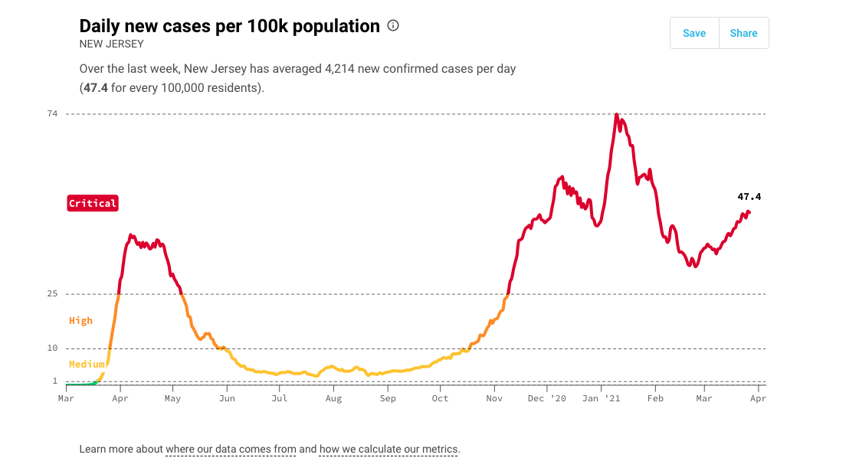
Where are we? Where are we going? Where were we?
Notes:
https://covidactnow.org/?s=1712636
Note: Update this screenshoot weekly – from the website shown above
For facilitator: By looking at our daily new cases per 100k population over time we can see where where were, where we are going, and the trajectory for moving forward.
At present we are:
Our goal is to:

Slide 4
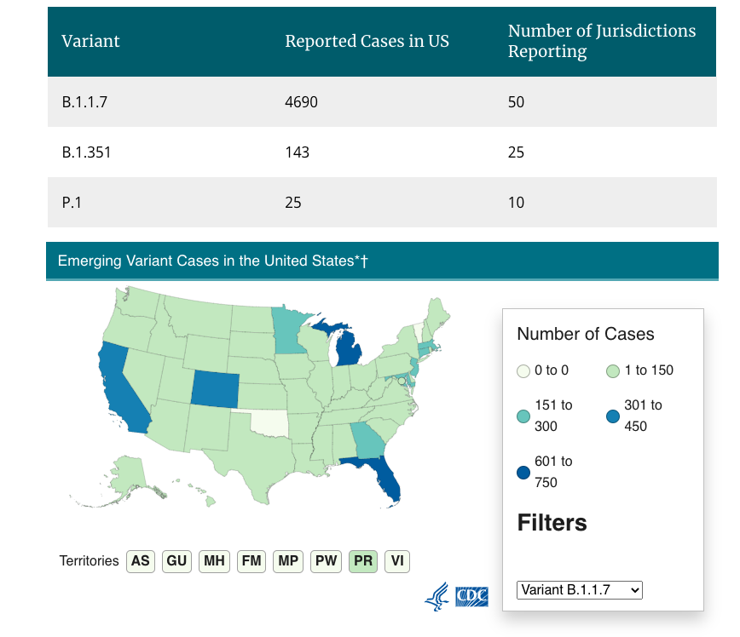
CDC
US COVID-19 Cases Caused by Variants
New Jersey
B.1.1.7 Variant: 160
P.1 Variant: 2
B.1.351 Variant: 1
New York
B.1.1.7 Variant: 136
P.1 Variant: 0
B.1.351 Variant: 1
Pennsylvania
B.1.1.7 Variant: 68
P.1 Variant: 0
B.1.351 Variant: 1
Notes:
https://www.cdc.gov/coronavirus/2019-ncov/transmission/variant-cases.html
The CDC variant map is a good way to remind participants of the most prevalent variants in their area.
IF your state is in close proximity to others, where the workforce frequently travels across state lines you may want to also include the data for other states as a way to gauge what may be headed to your state.
The above map and table should be updated weekly for your state and any surrounding states that you find relevant.
Variant B.1.1.7 is commonly known as the UK Variant (based on origin of detection)
Variant P.1 is commonly known as the Brazilian Variant (based on origin of detection)
Variant B.1.351 is commonly known as the South African Variant (based on origin of detection)

Slide 5
COVID-19 Updates
Vaccine Updates:
Variant Updates:
Research Updates:
CDC Updates:
State DOH Updates:
Regulatory Updates:
Notes:
Notes for Training Center and Facilitator:
-Each week you may want to consider creating slides with the data above. Some weeks will have very few updates on the topics and for others these updates will take several slides.
Vaccine Update: Any new relevant data about vaccines, performance, availability
Variant Updates: Any new data on variants in your area and/or emergence of new variants
Research Updates: Any new published studies on the treatment or identification of COVID
CDC Updates: Any new content from the CDC on vaccination, treatment, travel, etc.
State DOH Updates: It is important to note that some states do not assume all new CDC updates and may have additional updates of their own. It is helpful to check your state DOH website weekly.
Regulatory Updates: Have there been any changes in COVID care – OR – routine nursing home care that should be noted.

Slide 6
Follow-up from Last Week
Notes:
Last week you asked us a couple of questions that we wanted to do a little more research or diving into. Here are those questions and what we learned.

Slide 7
New Questions?
What is top of mind for you?
Do you have any questions/comments/suggestions to share?
Have you tried anything that others could benefit from?
Notes:
Before we dive into the content for today, let’s take a moment and see if you have any questions about the updates we just covered.
Additional questions you may want to ask:
Are there any question/comments/suggestions that you would like to share with the group?
Has anything been particularly challenging or frustrating this week?
Have you tried anything that others could benefit from?

