Slide 1
“Don’t Kiss the Calves” and other stories of diseases we can get on the farm
Jeff Bender DVM, MS DACVPM (Director)
Upper Midwest Agricultural Safety and Health Center
Notes:
My name is Jeff Bender and I serve as the Director of the Upper Midwest Agricultural Safety and Health Center based at the Univ of Minnesota.

Slide 2
Overview
What is UMASH?
Awareness of work risks
“Zoonotic” diseases – those diseases we can get from animals
Precautions

Slide 3
Mission of NIOSH Ag Centers
To minimize burden of occupational disease and injury to agriculture workers and their families
Research
Prevention
Education
Communication

Slide 4
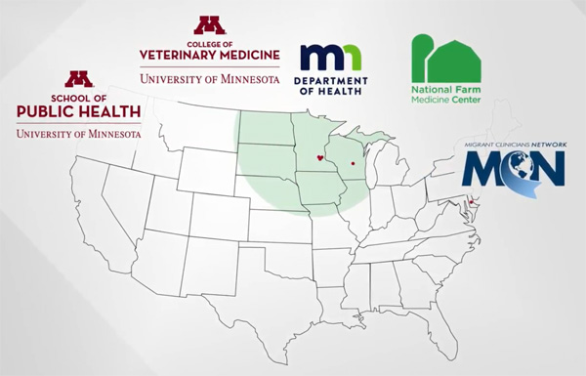
Upper Midwest Agricultural Safety and Health Center
Funding from the National Institute for Occupational Safety and Health
Notes:
UMASH is a collection of regional partners dedicated to improving safety and health to producers, their families, and their workers.

Slide 5
The One Health Approach

Slide 6
Work Risks on a Dairy

Slide 7
Recognize the Risks

Slide 8
Most Commonly Reported Injuries/Fatalities Minnesota, 2017 - 2019
2017 | 2018 | 2019
Equipment related (11) | Equipment related (13) | Grain bin/Silo (11)
ATV/Skid steer (7) | Tractor (9) | Car/Tractor (9)
Tractor (6) | Car/Tractor Incident (6) | Equipment related (8)
Car/Tractor incidents (6) | ATV/Skid steer (5) | Tractor (4)
Grain bin (1) | Grain bin (4) | ATV/Skid steer (2)
Ag Injury News - https://www.aginjurynews.org/
Notes:
If you look at a review of the most commonly reported injuries and fatalities in Minnesota from 2017 to 2019…you will notice that
Equipment related injuries such as PTO, augers, are common
Tractor related issues such as roll-overs
And the number of vehicle and farm equipment injuries and fatalities.
Remember these are high profile issues are linked to severe injuries or fatalities as such (next slide)

Slide 9
Injuries on Swine Operations Minnesota 2003-2011
Average 80 workers are seriously injured on Minnesota hog and pig farms
34% of these are due to swine-human interactions
These account for nearly 3 million dollars over this time period
Hillmer T, Bender J. unpublished

Slide 10
Work Injury and Illness
Notes:
These significant health (events such as deaths) are the “tip of the iceberg”…there are numerous injuries or “near misses” that are not reported or recorded. Which is a reason we need to have an broad and inclusive approach to safety and health on Minnesota Farms

Slide 11
What about Infectious Diseases?

Slide 12
Zoonotic Diseases

Slide 13
What is a Zoonotic Disease?
Diseases we get from animals…and sometimes we give some diseases to animals
Can you think of a recent example(s)?

Slide 14
Outbreaks Associated with Animal Contact
In 2017, there were 59 outbreaks linked to animal contact
1,518 illnesses
312 hospitalizations
3 deaths
Livestock (25 outbreaks) and Poultry (15) were the most common types of animals implicated
https://www.cdc.gov/acoss/annual-reports/index.html?deliveryName=USCDC_1164-DM35990

Slide 15
Zoonotic Animal Agriculture Exposures Minnesota, 2012–2016
Those who live and/or work on farms with food production animals were 8 times more likely to be diagnosed with zoonotic enteric infections than those who do not live or work on a farm
147 vs. 18.5 per 10,000 for other Minnesotans
Klumb et. al. Epi and Infect 2020;148

Slide 16
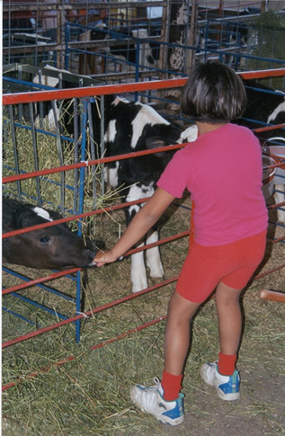
Common Enteric Zoonotic Pathogens
Salmonella
Campylobacter
Cryptosporidium parvum
E. coli O157:H7

Slide 17
Estimated Illnesses, Hospitalizations and Deaths, United States
Agent | # illnesses | # hospital | #deaths
Campylobacter | 1,300,000 | 8,500 | 119
E. coli O157 | 97,000 | 2,100 | 31
Listeria monocytogenes | 1,700 | 1,400 | 266
Salmonella | 1,200,000 | 19,000 | 452
Toxoplasma | 174,000 | 4,400 | 656
Yersinia enterocolitica | 116,000 | 500 | 34
Scallan et al 2011

Slide 18
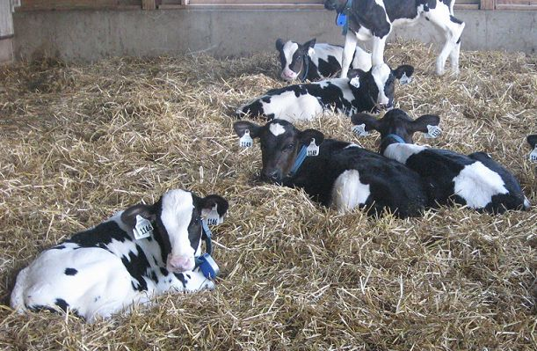
MDR Infections Associated with Animal Contact, 2017
Outbreak of Salmonella Heidelberg in 15 States associated with dairy bull calves
56 human cases
17 (35%) hospitalized
Illness and death among infected calves
Isolates were extremely multi-drug resistant (≥7 drug classes, including ceftriaxone - a key drug for treating complicated Salmonella infections in humans
Dairy Herd Management, May 2018
CDC 2018

Slide 19
Health risks for the backyard flock owner?

Slide 20
Live poultry–associated salmonellosis outbreaks and # ill persons reported United States, 1991–2014

Slide 21
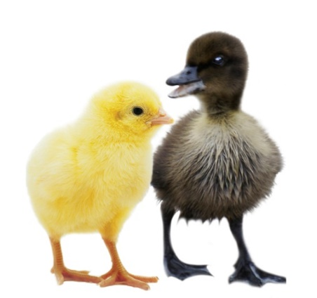
Salmonella infections associated with live poultry contact
Risky behaviors include:
49% (196/400) reported snuggling baby birds
13% (53/400) reported kissing baby birds
Children younger than 5, elderly or immunocompromised persons should not handle or touch chicks, ducklings or other live poultry
Recommendations
http://www.cdc.gov/features/salmonellapoultry/

Slide 22
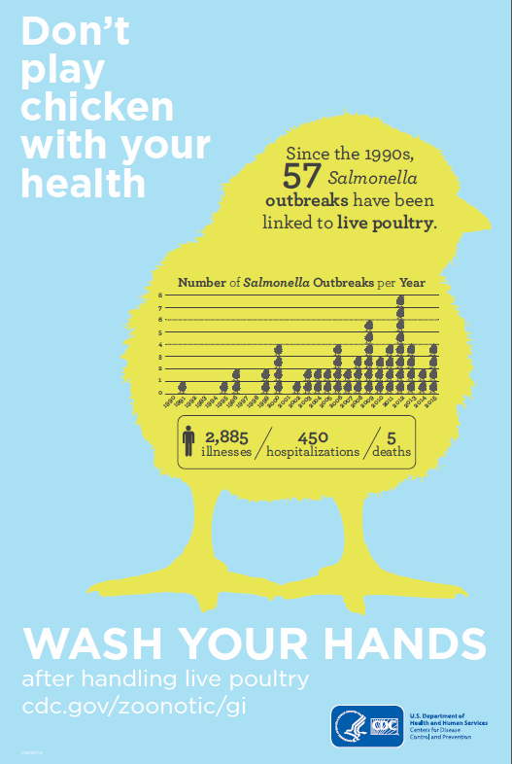
Tips to Stay Healthy around Backyard Poultry Flocks

Slide 23
News Release October 26, 2013
Outbreak at a Pumpkin Patch
Health officials investigate E. coli O157 infections at pumpkin patch petting zoo. Three Minnesota residents have become ill with confirmed E. coli O157:H7 infections after contact with cattle at the farm…

Slide 24
The Problem with E. coli O157:H7
Causes diarrhea – especially bloody diarrhea
Can be fatal cases in children (<5yrs) and the elderly
Leading cause of acute kidney failure in children (Hemolytic uremic syndrome)

Slide 25
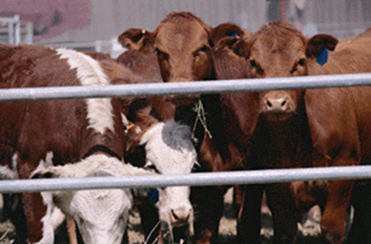
Cattle are the Reservoir
Studies of herd infection rates vary (in MN 17-50% of herds)
In a survey of manure samples from MN County fairs, E. coli O157 was isolated from 75% of fairs (Cho S. et. al. 2006)
Shedding in healthy cattle vary
higher rates reported in younger animals (pre-weaned)
Shedding is intermittent
Higher rates during the summer months
Not an animal pathogen (no illness in sheep and cattle)

Slide 26
Cryptosporidiosis Cryptosporidium parvum
Small coccidian parasite (4.2 to 5.4 µm)
Cattle are the primary reservoir
Causes significant disease in newborn calves
Nearly all cattle operations have evidence of Cryptosporidium infections
Newborn calves can excrete a lot!
(10⁶-10⁷ oocysts/gm of feces)

Slide 27
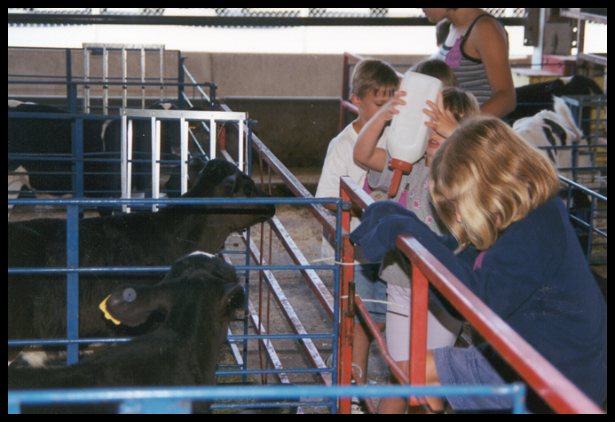
Campylobacteriosis Campylobacter spp.
Again, diarrhea - most common manifestation
Low infectious dose
Highest incidence is in children < 1 year of age
Outbreaks are often associated with raw (unpasteurized) milk

Slide 28
Prevention/Protecting Family and workers

Slide 29
Preventive Measures
Handwashing
Gloves
Dedicated coveralls and boots
A dedicated break area
Wash hands before eating or preparing food

Slide 30
Agritourism Protecting Your Visitors
http://umash.umn.edu/agritourism/

Slide 31
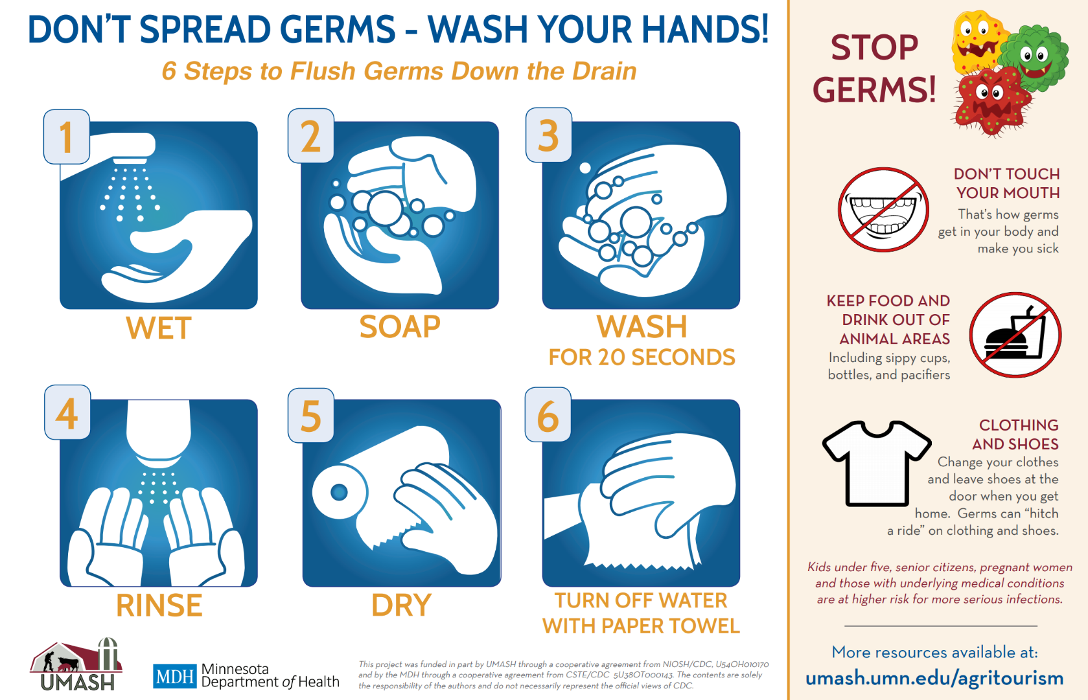
Importance of Handwashing

Slide 32
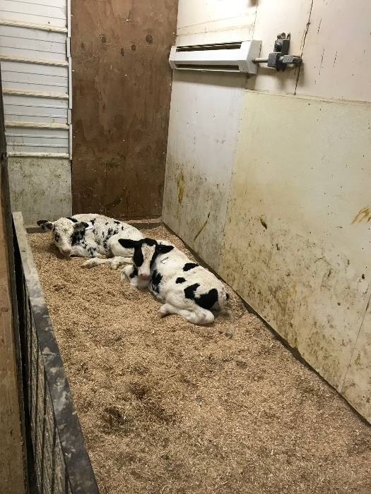
Working with Calves
Practice good biosecurity
Clean equipment (buckets, bottles, nipples)
Have workers do calves first
Wash hands and change coveralls

Slide 33
Caution with Calves: Stopping the Spread of Zoonotic Diseases
https://www.youtube.com/watch?v=J99eNiHmYh8&t=18s

Slide 34
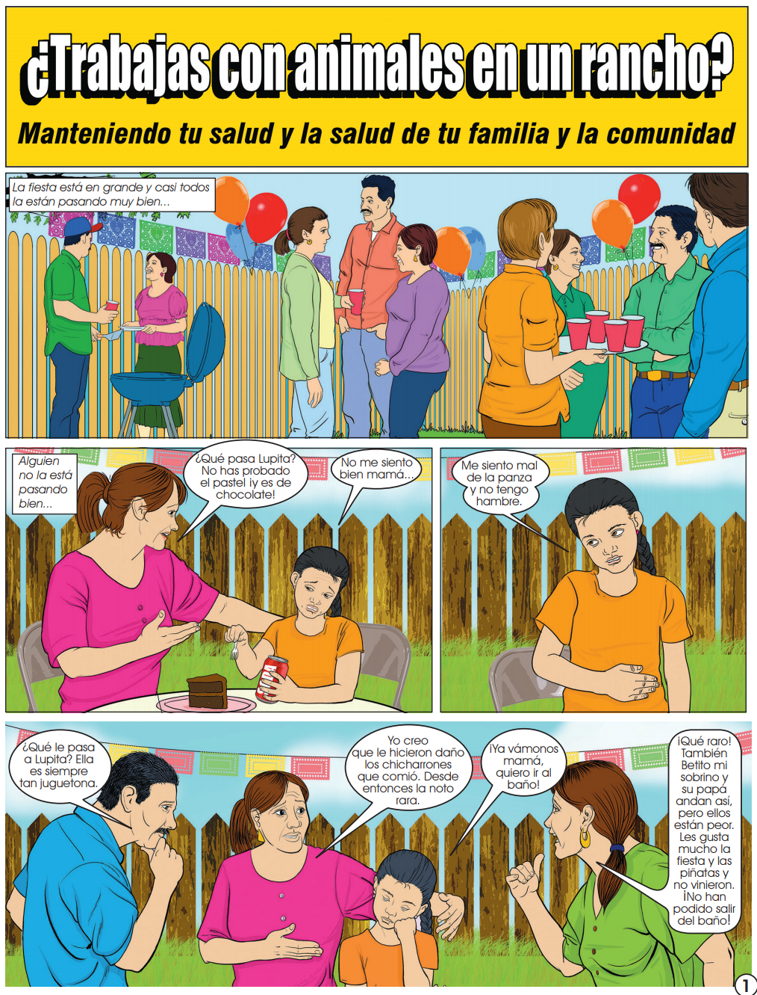
Resources for “Working with Animals”

Slide 35
People Can Give Flu to Pigs! Protecting People and Pigs
http://umash.umn.edu/biosecurity/

Slide 36
In Summary - So what do you need to know

Slide 37
Things to Consider
All workers should be aware of the risks and educated on how to prevent them
Encourage frequent handwashing
Consider who is on the farm?
Children?
Grandkids?
Folks with waning immune systems?
New workers who have not worked on farms
Visitors?

Slide 38
Farm Safety Checklists

Slide 39
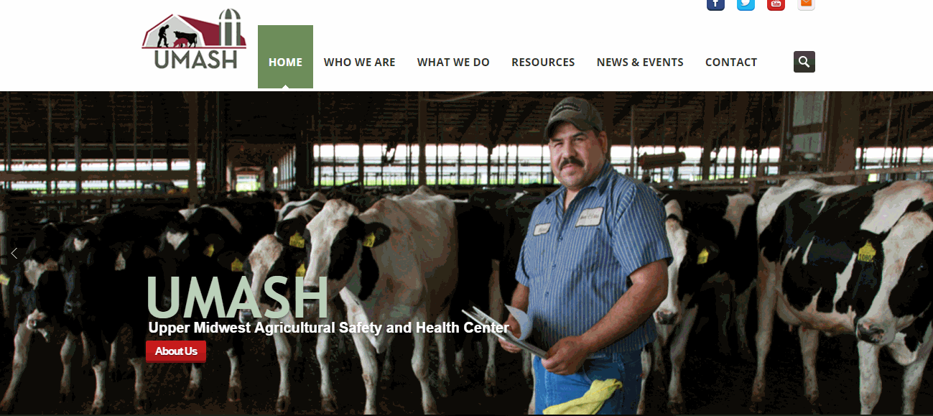
Questions?
www.umash.umn.edu

Slide 40
Extras

Slide 41
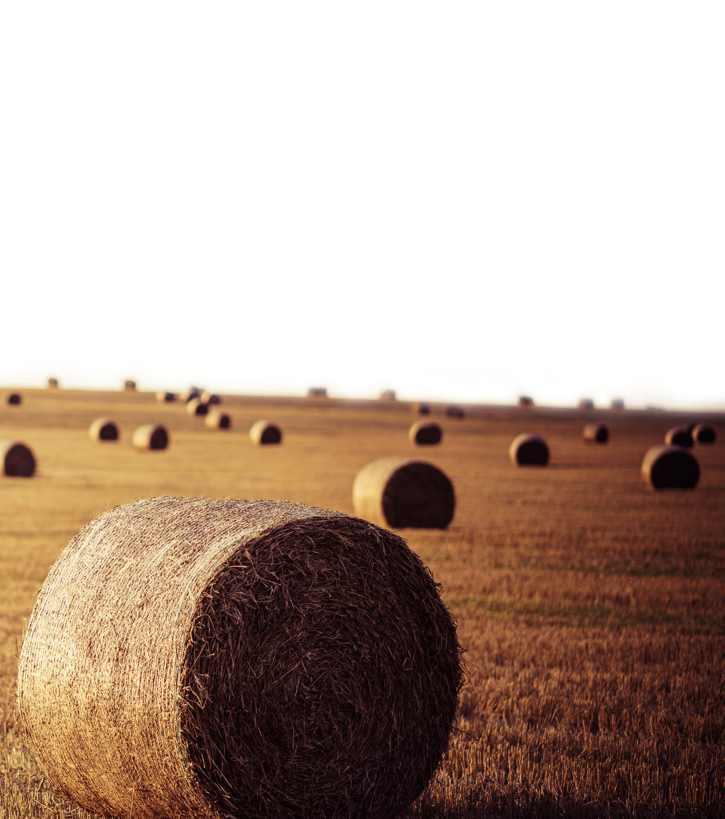
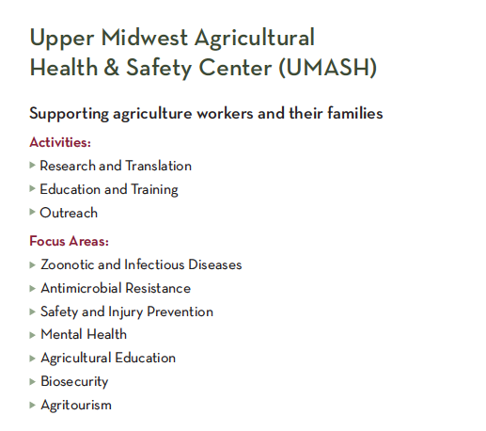
We’re UMASH
Notes:
I’ll give a little background on our center and the work we do. Upper Midwest Ag Safety and Health center is a collaboration of 5-leading research and outreach institutions. Two university of minnesota colleges: the school of veterinary medicine and the school of public health, which is where I am based. Also, the minnesota department of health, where much of their expertise has been in zoonotic dieases, the national farm medicine center, in Marshfield WE, and the migrant clinicians network, which helps our focus on the farm worker population. What we actually do falls into a few buckets: Research, education, and outreach. Give examples of each.
Finally, our focus areas help to understand our expertise. Much of our research focus is on animal agriculture, as you can see by zoonotic diseases, AMR, and biosecurity, but we try to be as plugged into the upper midwest agricultural community as possible. So we create materials and do activities that benefit the workforce, through focus areas like injury prevention, mental health, ag education, and agritourism.
We are one of 11 centers around the country funded by the CDC to work to improve the safety and health of farmers.

Slide 42
UMASH Projects
Research projects
Emerging Issues projects/programs
Outreach

Slide 43
Examples of Current and Previous Projects
Protecting immigrant dairy workers
Worker Injury Surveillance using Company Records
Zoonotic diseases of Veterinarians
Airborne transmission of viruses
Volunteer Fire Fighters Training in Ag Health and Safety
Enteric disease surveillance of agricultural workers
http://umash.umn.edu/spotlight-turning-the-page-research-briefs-from-2011-2016/

Slide 44
New Research Projects
Identifying individual and contextual determinants underpinning farmers help-seeking behaviors and their role in shaping mental health outcomes Marshfield Clinic Research Institute Project lead: Becot, Florence
The influence of on-farm exposures and biosecurity practices on the skin and nasal microbiomes of U.S. swine workers University of Minnesota Project lead: Noyes, Noelle Factors

Slide 45
New Research Proposals
Influencing Transmission of Airborne Viruses and Bacteria in Animal Agriculture University of Minnesota Project lead: Raynor, Peter C
Rural Firefighter Delivering Ag safety and Health (RFDASH) - Next Steps Marshfield Clinic Research Institute Project Lead: Bendixsen, Casper G.

Slide 46
Emerging Issues
Worked with our evaluation team to set up a mechanism to:
Identify
Review
Select
Timely emerging issues

Slide 47
Identified Topics
Women in agriculture
Hazards with manure
Mental Health
Immigrant workers
Farmers and aging in place

Slide 48
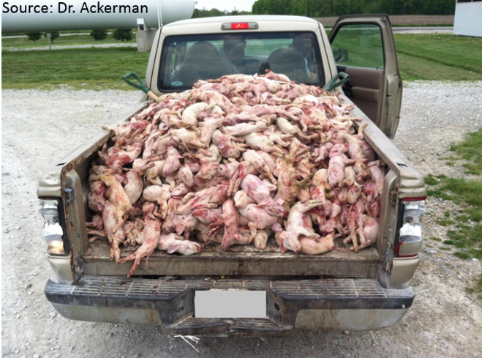
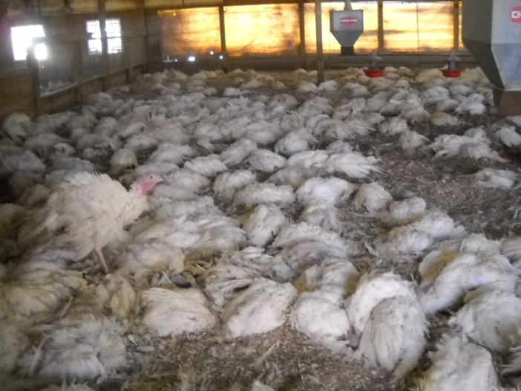
Mental Health Challenges for Farmers
Impact of Porcine Epidemic Diarrhea Virus (PEDv) – 2013
Highly Pathogenic Avian Influenza Virus - 2015
1 daily loss of pigs from PEDv

Slide 49
Partnership Grants
Cultivating Resiliency for Women in Agriculture
Extension
MN Ag Women
Stress and Mental Health Conversations with Gear Up for Ag Health and Safety
Ag Health and Safety Alliance
Using Stories and Education to Build Resilient Agricultural Communities
MN NAMI

Slide 50
Regional Community Forum

Slide 51
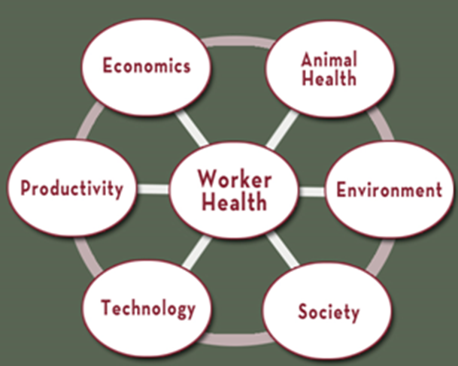
Creating a Responsive Team
Educators
Community leaders
Extension
Health care providers
Veterinarians
Nutritionists
Industrial hygienist
Others?
Notes:
We are dedicated to developing a team to address the variety or problems affecting producers. These include:
Educators?
Community leaders?
Extension?
Health care providers?
Veterinarians?
Nutritionists?
Industrial hygienist?
Others

Slide 52
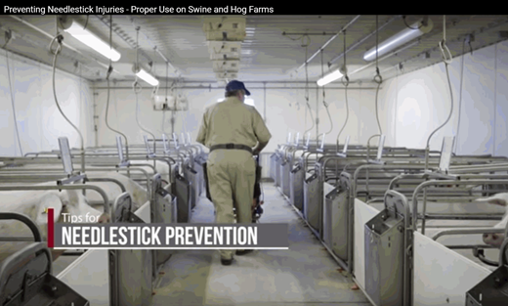
Outreach Team Projects
COVID-19 Preparations
Stress and Mental Health
Volunteer Fire Department Training
Notes:
We have a number of other projects reflecting some of these evolving needs in our rural and agricultural communities.
These include work and support for
Stress and Mental Health
Engaging our Volunteer Fire Department Training – training them to be able to respond to farm emergencies
Animal Handling Education
Transmission of airborne viruses
Aging in rural communities

Slide 53
Questions?
www.umash.umn.edu

