Slide 1


UNMC Grand Rounds
Nov. 14, 2022

Slide 2

Who is the NHA?

Slide 3
92 member hospitals
Nearly 50,000 hospital employees
$7.5B in total expenditures
$3.5B in salary and benefits
$15B in total economic impact

Slide 4
Collective Community Benefits
Community benefit refers to the initiatives, activities, and investments undertaken by tax-exempt hospitals to improve health in the communities they serve.
Non-profit hospitals must report community benefits on IRS Form 990.
Non-profit hospitals must complete a community health needs assessment every three years.
$1.38B in total community benefits
  $737M in charity care unpaid costs of Medicare and Medicaid
  $186M in bad debt
  $464M in other benefits like community health improvement initiatives, education programs, and health research

Slide 5
What does the NHA do?

Slide 6
Mission
To serve Nebraska hospitals by being the most trusted voice and influential advocate in health care and a driver of hospital quality and safety improvement.
Vision
To improve the health
and well-being of
all Nebraskans by
supporting and unifying
Nebraska hospitals.

Slide 7


Slide 8
Trust and Confidence
Grow unity among member hospitals to speak with one voice about the high-quality health care provided by Nebraska hospitals.
Promote messaging that Nebraska hospitals are essential for a strong Nebraska, provide care 24/7 throughout the state, and care for all who enter our doors.
Take a leadership role in health care policy and be the convener of the health care community in Nebraska.
Communicate to the public and opinion leaders about current hospital challenges.
Partner with hospitals to promote important public service announcements.

Slide 9
Workforce Development
Lead efforts to develop a statewide health care workforce plan based on current and future health care workforce needs; partner with higher education and business entities focused on workforce development.
Advocate for expansion of nursing, allied health, and clinical support education programs.
Advocate for funding to expand physician residency and nurse clinical training sites in rural Nebraska.
Share best practices for new staffing models and collaborate with higher education to align education models to current hospital operations.
Reach K-12 and nontraditional students to promote health care career opportunities and financial support available to pursue a health care career.

Slide 10
Financial Stability
Advocate for improved reimbursements to Nebraska hospitals that keep pace with medical inflation, are paid in a timely manner, and allow for the sustainability of hospital services across Nebraska.
Strengthen post-acute treatment pathways and improve statewide behavioral health resources.
Collaborate with payers to reduce administrative burdens and improve overall wellness; challenge payers on unnecessary barriers to medically necessary health care.
Improve analysis, member engagement, and advocacy on state and federal hospital regulations.
Protect important federal programs, such as the 340B Drug Pricing Program for Critical Access and Disproportionate Share Hospitals.

Slide 11
Data-Drive Improvement
Strengthen data capabilities to empower members to identify gaps and disparities in care and improve overall health outcomes.
Expand data partnerships with DHHS, public health, and academic institutions.
Continue to improve CMS HQIC measures through education, performance improvement cohorts, coaching and benchmarking.
Establish a unified quality metric that all Nebraska hospitals will work to improve.
Tell Nebraska’s quality improvement story – our hospitals are improving quality and leading in rural health quality.

Slide 12
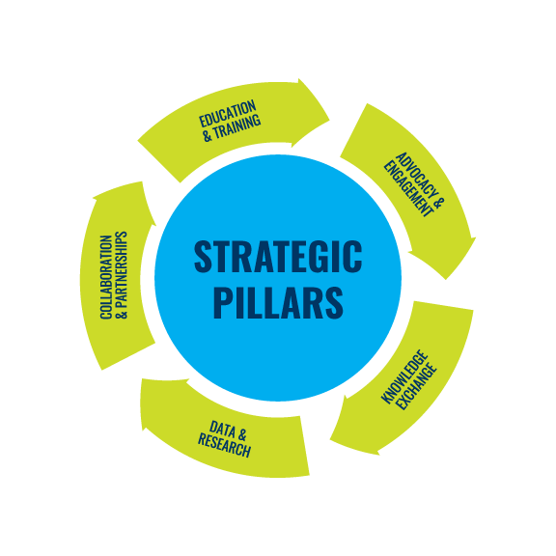
Strengthening NHA Pillars
by action

Slide 13
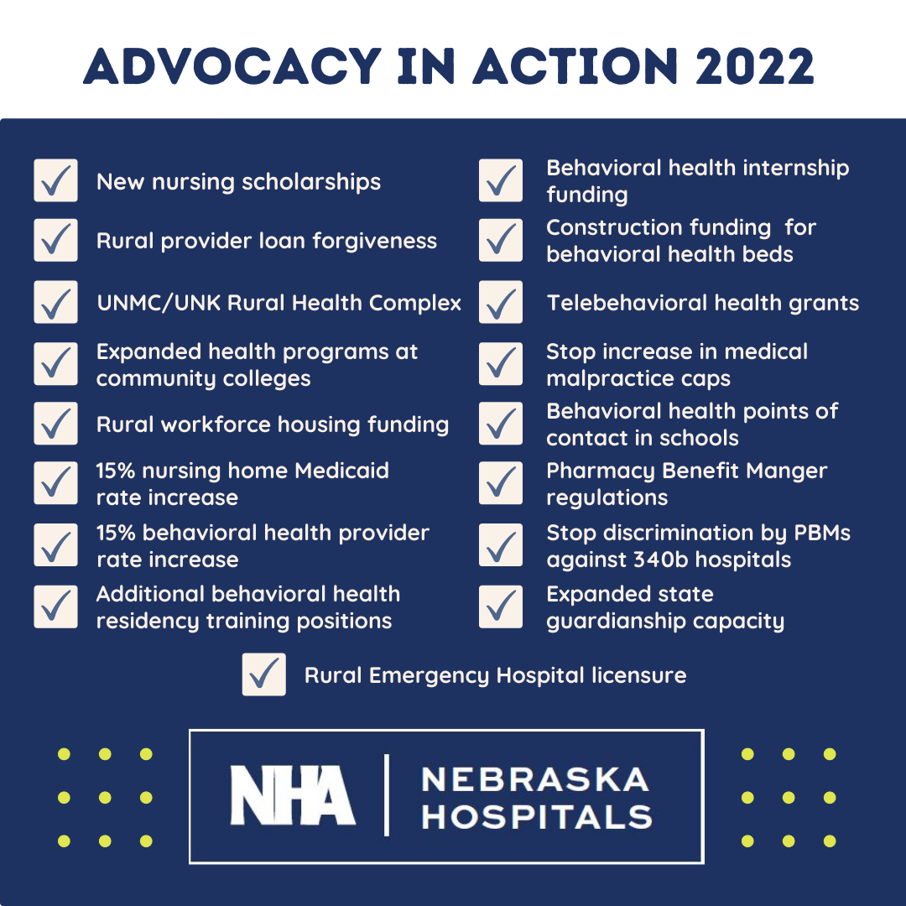

Slide 14
What are the current issues facing Nebraska hospitals?

Slide 15
Financial Challenges
Average cost of patient care is up 20.1% from 2019 to 2021.
  Labor up 19.1% - about half of overall costs
  Supplies up 20.6%
  Pharmaceuticals up 36.9%
60% to 80% of a hospital’s revenue comes from government payers.
  40% to 70% is Medicare
  5% to 12% is Medicaid
  Other is TRICARE or VA
2% Medicaid rate increase for FY23. 3.8% Medicare rate increase for CY23.
340B prescription drug pricing program in jeopardy.
Medicare Hospital Insurance Trust Fund projected to be insolvent in 2028.
  Not have funds to pay all expenses.

Slide 16
Advocacy on Financial Challenges
Stop 4% pay-go payment cut at the end of the year.
Medicare and Medicaid reimbursement increases.
Protecting the 340B program.
Rebasing inpatient behavioral health beds.
Timely payments for Critical Access Hospitals.

Slide 17
Workforce Challenges
Hospitals report being 10-15% understaffed.
According to the Nebraska Center for Nursing, Nebraska will experience a workforce shortage of 5,435 nurses by 2025.
73 of Nebraska’s 93 counties have less than the national average ratio of registered nurses to patients.
9 counties in Nebraska have no registered nurses.
13 counties have no primary care physician.
44 counties do not have any OB-GYN physicians.
78 counties have no practicing psychiatrists.
About 20% of physicians and 18% of nurses in Nebraska are more than 60 years old.

Slide 18
NEBRASKA HEALTH CARE WORKFORCE COLLABORATIVE
Nebraska Hospital Association
Nebraska Rural Health Association
Bryan College of Health Sciences
Center for Nursing/DHHS
Clarkson College
Health Center Association of Nebraska
Metropolitan Community College
Nebraska Association of Behavioral Health Organizations
Nebraska Chamber of Commerce & Industry
Nebraska Community College Association
Nebraska Health Care Association
Nebraska Medical Association
Nebraska Methodist College
Nebraska Nurses Association
Nebraska Pharmacists Association
Nebraska State College System
University of Nebraska Medical Center
University of Nebraska System

Slide 19
NEBRASKA HEALTH CARE WORKFORCE COLLABORATIVE
Drive statewide decisions based on data.
Future workforce projections by Nebraska hospitals, clinics, and other healthcare employers.
Aligning education programs to meet data-directed healthcare workforce needs.
Expand high-demand healthcare education programs by addressing the shortage of faculty, clinical training sites, and clinical preceptors.
Develop a comprehensive cataloging of financial aid resources.
Collaborate on the application process, so no interested applicant is turned away.
Collectively promote pathways to healthcare professions.

Slide 20
Advocacy on Workforce Challenges
Support funding to expand current programs.
Incentivize more clinical sites and residency sites in rural communities.
HOSA Program funding.

Slide 21
Post-Acute Placement Challenges
Delays in patient discharges to the post-acute care settings have become a growing challenge for our hospitals.
COVID-19 has exacerbated the situation and created a large volume of patients who are ready for discharge from hospitals but cannot find an appropriate bed.
In October report 214 patients awaited placement for more than 7 days.
  68 for more than 30 days and 9 more than 6 months.
  Cases more than 400 days.
  Last year, three largest health systems reported 14,000; 12,000; and 9,500 avoidable days.
35 long-term care facilities have closed in Nebraska since 2017. 199 remain.
  Significant workforce issues.
Lack of behavioral health capacity.
Lack of guardianship capacity.

Slide 22
Advocacy on Post-Acute Placement Challenges
New payment models for post-acute facilities to open and operate specialized units.
Grant program for post-acute facility investments to care for complex patients, including capital improvements, training and education, and durable medical equipment.
Improve guardianship capacity, wait list transparency, and prioritization of hospitalized patients.
Hospital reimbursement for holding medically cleared patients awaiting discharge to post-acute settings.
Establish Medicaid Reimbursement for Long- Term Acute Care Hospitals.

Slide 23
Commercial Payer Challenges
Growing Administrative Burdens
According to the AHA, 78% of hospitals and health systems’ report their experience working with commercial insurers is getting worse, not better.
Some commercial insurer policies and practices appear designed to simply create barriers to appropriate payment.
  Contribute to clinician burnout.
  Driving up administrative costs for the health care system.
Prior authorization denials can result in delays of necessary treatment for patients and ultimately lead to unexpected medical bills.
  Current CMS rules allow Medicare Advantage plans to take up to 14 days to respond.
  69% overturn rate of inpatient prior authorization denial appeals.

Slide 24
Commercial Payer Challenges
Telehealth payment. One commercial payer in Nebraska recently cut reimbursements for telehealth to 50 percent of an inpatient visit.
  Nebraskans, especially vulnerable and underserved populations, have relied on telehealth to receive timely care.
  Providers must be fairly compensated for their time and the infrastructure necessary to build telehealth care programs.
White bagging. Requiring hospitals to dispense drug from outside pharmacy.
  Patient safety and timely access to care concerns.

Slide 25
Advocacy on Commercial Payer Challenges
Prior authorization reform for Medicare Advantage.
Standardize prior authorization requirements and processes.
Payment parity for telehealth services.
Address white bagging and limitations on hospital specialty pharmacy.

Slide 26
Data Partnership with UNMC
Announced in October
Collaboration on 837i claims data from all Nebraska hospitals
No patient identifiers, but includes REaL data, zip code, and age

Slide 27


Slide 28
Questions?
Jeremy Nordquist, MPA
President
Nebraska Hospital Association
jnordquist@nebraskahospitals.org
402-578-6442

