Slide 1
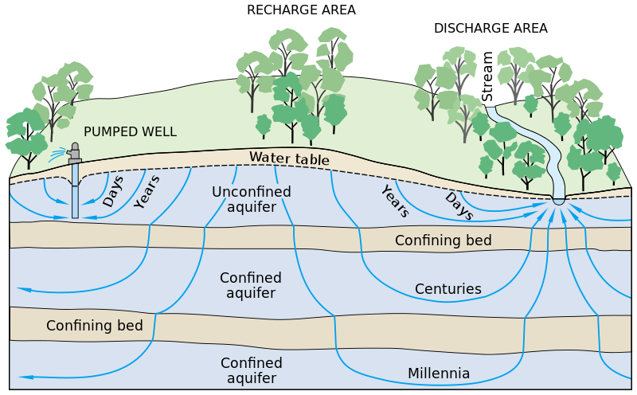
The economic cost of groundwater nitrate contamination
Harshanee Jayasekera, PhD
Post-doctoral Research Associate
December 04, 2023
Water, Climate & Health Program
2023-2024 Research Seminar Series
This Photo by Unknown Author is licensed under CC BY-SA
This Photo by Unknown Author is licensed under CC BY-SA
This Photo by Unknown Author is licensed under CC BY-SA

Slide 2
The health and economic cost of groundwater nitrate contamination in Nebraska
Quantifying the value of clean drinking water
Cost of maintaining current water quality
Avoided costs of impaired water quality

Slide 3
Key points
Nebraska’s drinking water is largely safe
Ensuring safe drinking water is costly
Proactive water quality improvement strategies have positive results

Slide 4
Approach
Irrigation wells
Public wells
Private (domestic) wells
community water system wells
State of Nebraska groundwater
NE Nitrate levels

Slide 5
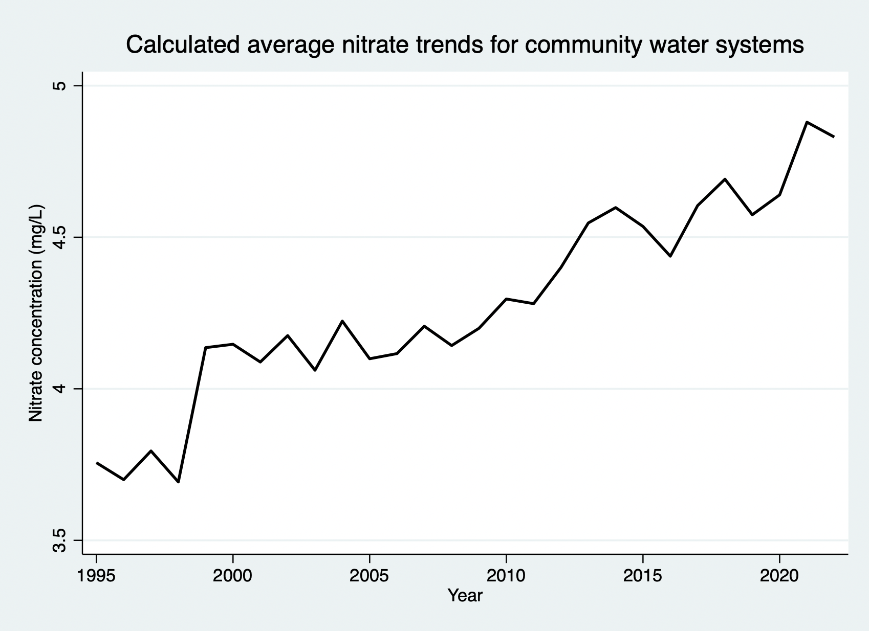
Drinking water nitrate levels Community water system wells
Nebraska’s drinking water is largely safe
Ensuring safe drinking water is costly
Proactive water quality improvement strategies have positive results
Over the last 25 years average nitrate levels have increased by about 2 mg/L

Slide 6
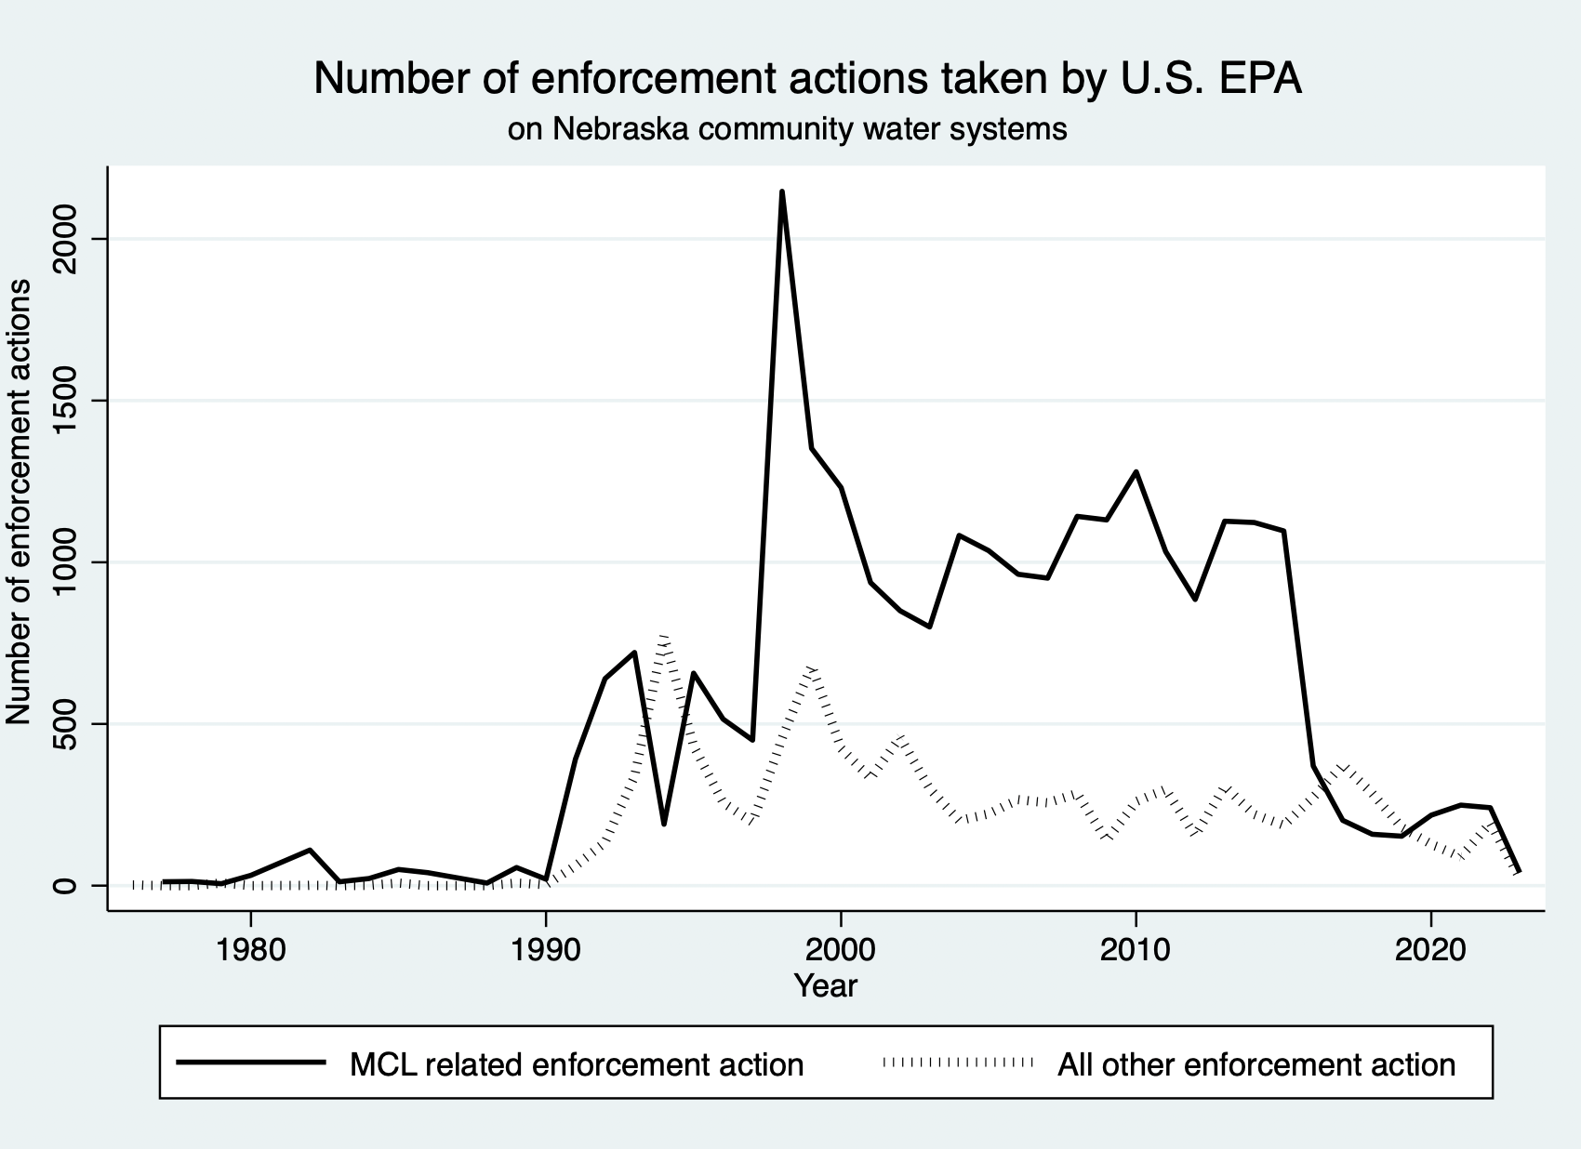
Drinking water compliance record
Nebraska’s drinking water is largely safe
Ensuring safe drinking water is costly
Proactive water quality improvement strategies have positive results
In recent years, NE community water systems have become more compliant
Caution! One compliance violation can trigger multiple enforcement actions

Slide 7
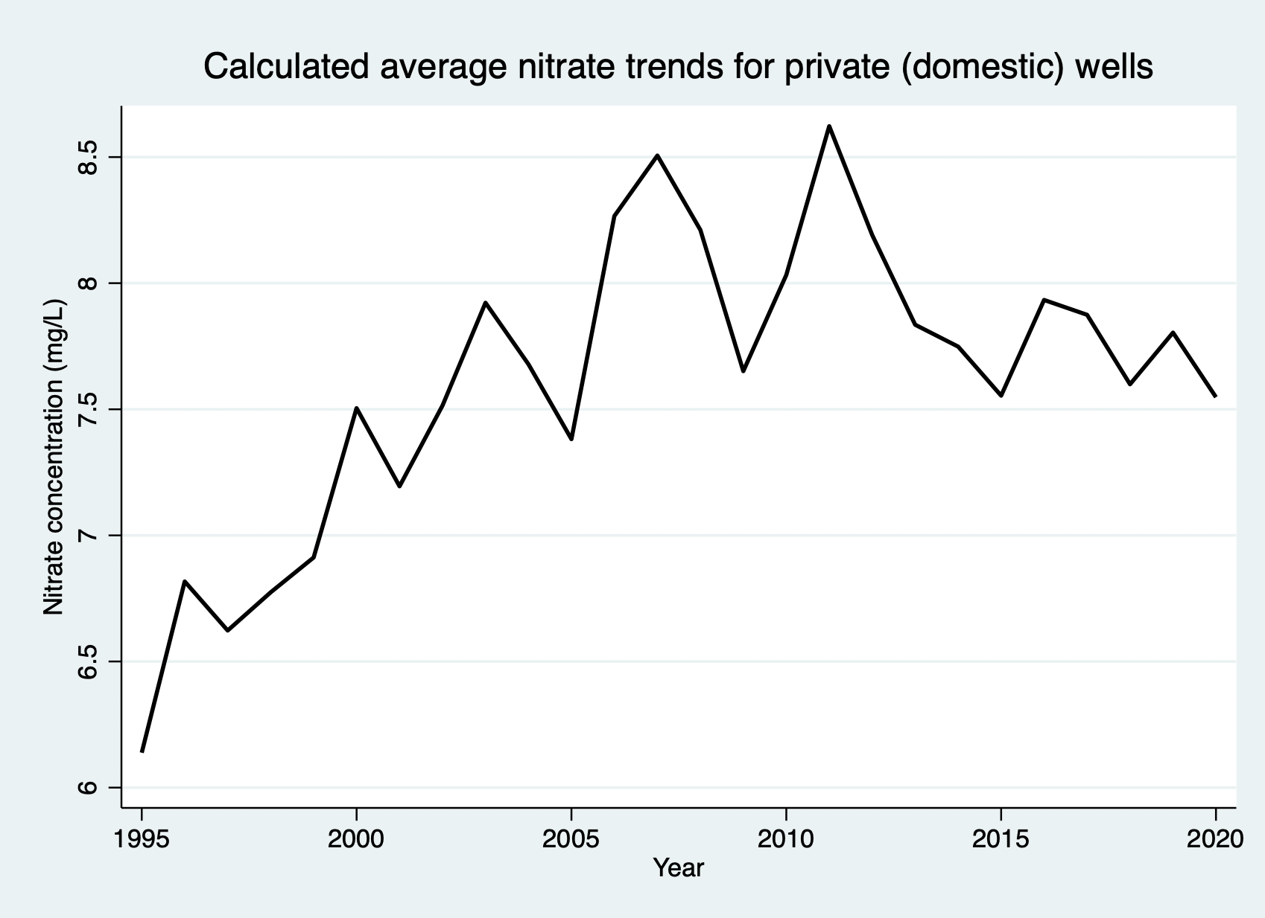
Drinking water nitrate levels Private (domestic) wells
Nebraska’s drinking water is largely safe
Ensuring safe drinking water is costly
Proactive water quality improvement strategies have positive results
Average nitrate levels in private (domestic) wells are closer to 10mg/L

Slide 8
Drinking water nitrate levels
Nebraska’s drinking water is largely safe
Ensuring safe drinking water is costly
Proactive water quality improvement strategies have positive results
On average, Nebraska’s drinking water is safe
However, there are notable exceptions

Slide 9
Cost of ensuring safe drinking water
Nebraska’s drinking water is largely safe
Ensuring safe drinking water is costly
Proactive water quality improvement strategies have positive results
Current nitrate levels are affected by past management actions
Water blending
Water purchasing
High nitrate
Low nitrate
Lower average nitrate

Slide 10
Cost of ensuring safe drinking water
Nebraska’s drinking water is largely safe
Ensuring safe drinking water is costly
Proactive water quality improvement strategies have positive results
Moving wellfields
New infrastructure costs
New pipeline connections
Other costs e.g. easement of land

Slide 11
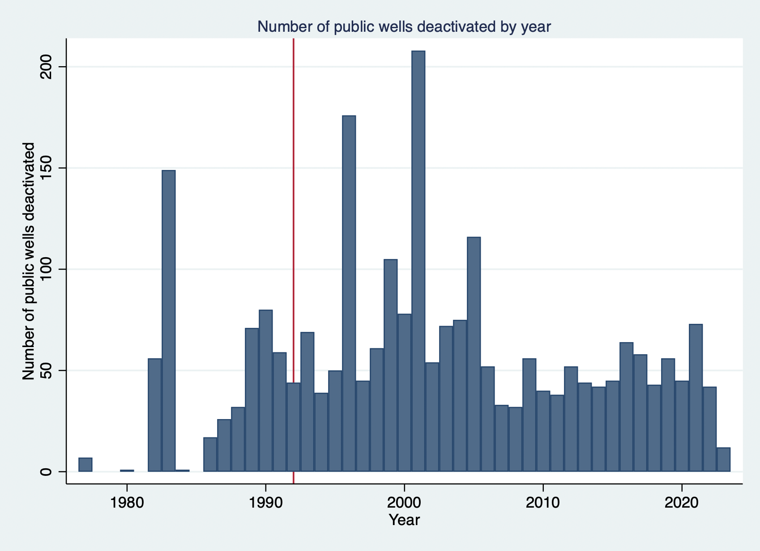
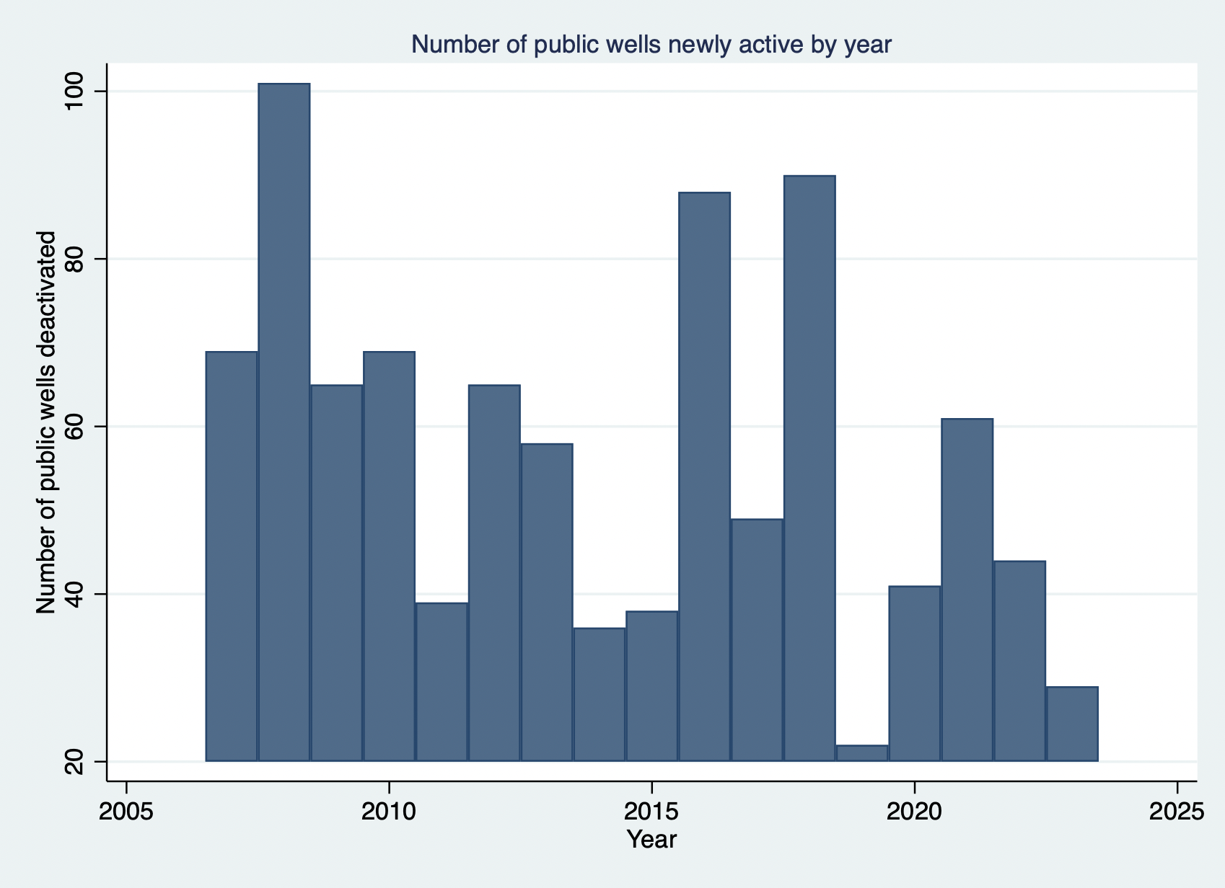
Cost of ensuring safe drinking water
Nebraska’s drinking water is largely safe
Ensuring safe drinking water is costly
Proactive water quality improvement strategies have positive results
Well drilling and decommissioning costs

Slide 12
Cost of ensuring safe drinking water
Nebraska’s drinking water is largely safe
Ensuring safe drinking water is costly
Proactive water quality improvement strategies have positive results
Water purification
Treatment status NE of community water systems
Size (Population) | Is water being treated? |  | Total (water systems)
Water system size (Population) | No | Yes
<= 500 | 302 (87.79%) | 42 (12.21%) | 344
501 – 3,300 | 110 (63.95%) | 62 (36.05%) | 172
3,301 – 10,000 | 10 (35.71%) | 18 (64.29%) | 28
10001 – 100,000 | 5 (41.67%) | 7 (58.83%) | 12
>= 100,001 | 0 (0.00%) | 2 (100.00%) | 2
Notes –
Water systems by the size of the population it serves, and indication if any of the facilities (e.g. well, collection center etc.) in the water system is being treated (for any contaminant not necessarily for nitrate).
Source – EPA Safe Drinking Water Information System

Slide 13
Cost of ensuring safe drinking water
Nebraska’s drinking water is largely safe
Ensuring safe drinking water is costly
Proactive water quality improvement strategies have positive results
Purification costs (Tang et. al, 2018)
Reverse Osmosis (RO) → $0.22 - $4.6 (USD 2010/’000 gallons)
Ion Exchange (IX) → $0.69 - $19.16 (USD 2010 /’000 gallons)
Per capita water use/year → 29,930 gallons (US EPA)

Slide 14
Cost of ensuring safe drinking water
Nebraska’s drinking water is largely safe
Ensuring safe drinking water is costly
Proactive water quality improvement strategies have positive results
Water quality management is expensive
Possibly larger financial burdens on smaller community water systems and rural households

Slide 15
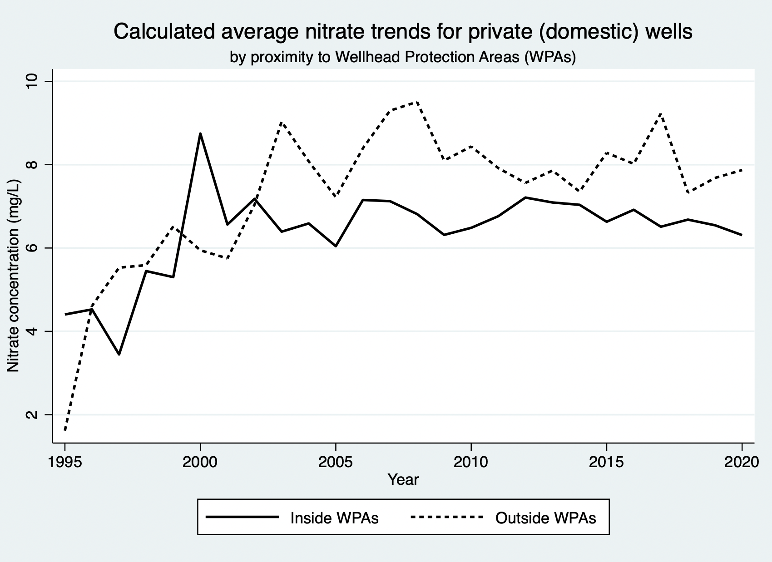
Water quality protection works
Nebraska’s drinking water is largely safe
Ensuring safe drinking water is costly
Proactive water quality improvement strategies have positive results
Wellhead protection areas have managed to reduce source water contamination

Slide 16
Water quality protection
Nebraska’s drinking water is largely safe
Ensuring safe drinking water is costly
Proactive water quality improvement strategies have positive results
Almost all the NE community water system wellfields are in WPAs
Additional protections will likely be successful

Slide 17
Re: Key points
Nebraska’s drinking water is largely safe
Ensuring safe drinking water is costly
Proactive water quality improvement strategies have positive results

Slide 18
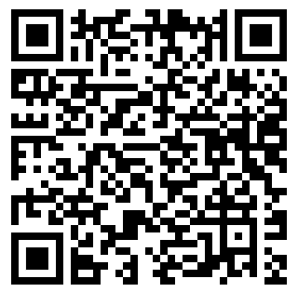
Thank you! Contact: djayasekera@nebraska.edu
Project-related products
Health and economic impact analysis of nitrate pollution in Nebraska's groundwater
Nitrate management in Nebraska community water systems is a complex issue: A short article analyzing nitrate trends in Nebraska community water systems
Nitrate Contamination in Drinking Water: An article, published in The Actuary magazine, that provides an overview of potential pollution causes and adverse health outcomes linked to nitrate contamination
Value of water quality: A recorded Nebraska Water Center seminar presentation on the economic costs of nitrate contamination in Nebraska’s groundwater
This work was supported by the Water, Climate and Health Program, UNMC College of Public Health project, Health and Economic Impact Analysis of Nitrate Contamination of Groundwater in Nebraska, and the Daugherty Water for Food Global Institute at the University of Nebraska.
This Photo by Unknown Author is licensed under CC BY-SA
This Photo by Unknown Author is licensed under CC BY-SA
This Photo by Unknown Author is licensed under CC BY-SA

