Slide 1
Researcher Identity Management
Jess King, MLIS
Leon S. McGoogan Health Sciences Library
Notes:
Introduce myself: wellness, trauma-informed libraries, DEI on campus, graphic medicine, counseling

Slide 2
Objectives
Describe the importance of managing researcher identity
Identify 3 ways researchers can take control of their researcher identity
Notes:
What do you think of when someone mentions researcher identity management?

Slide 3
Why manage your researcher identity?
Distinguish your work from other researchers
Ensure accuracy
Track the impact of your research
Increase the visibility of your work
Find collaborators
Notes:
What is your researcher identity? Your researcher identity is formed by combining all of your research outputs (e.g., articles, books, datasets, conference proceedings, blog posts, etc) and its impact that may be aligned with or act as an author profile. And there are different author profiles that you can build to take control of this.
Why should we play an active role in managing our identity as researchers?
Ensure accuracy-getting credit where credit is due (so getting credit for what is yours)
Increase visibility-make connections with colleagues: my work with graphic medicine got me invited to submit a proposal for a panel talk at comic con by a colleague I've never met before who is a marriage and family counselor out in CA that recently wrote a graphic medicine book on building a better marriage

Slide 4
Training Outline
ORCID
Scopus
Publication Tracking
1
3
5
2
4
6
Google Scholar
H-index
Questions

Slide 5
1. ORCID
1

Slide 6
ORCID
What is it?
Why start an account?
Setting up your account
  Direct Link: https://orcid.org/signin
  Research Guide with link for UNMC Researchers: https://unmc.libguides.com/authortoolkit/orcid
Notes:
ORCID provides a persistent digital identifier that distinguishes an author from every other researcher, it supports automated linkages between a researcher/author and their professional activities.
Why start account
Ensures research output and activities are correctly attributed to the correct person. Important: I have a common name so there are many authors that have published under it.
Don't rely on your name to identify yourself in databases or publisher sites. Names change, they aren't used consistently, and can refer to several different people. ORCID is a reliable identifier that helps you distinguish your name and your work from everyone else's.
Easily connects your contributions and affiliations
Reduces form-filling
Improves recognition and discoverability
Interoperable: works with many institutions, funders, and publishers
Is persistent so won't change

Slide 7
Setting up an ORCID account
Register
Confirm
Add your information
Use your ORCID ID
Notes:
Register
Open the ORCID sign-in page for UNMC researchers. Enter your UNMC NetID credentials.
Once signed in, choose Register for an ORCID ID if you do not have an ORCID ID.
Fill in the appropriate fields. and submit the form.
Confirm
You will receive an email confirmation:
In the email message, click Verify your email address.
Add your information
fill in some basic information for your profile.
Under Employment, add your current position at UNMC.
Under Works add your work
Use your ORCID ID
Include your ORCID identifier on your web profiles, when you submit publications, apply for grants, and in any research workflow to ensure you get credit for your work. our ORCID is the full string, for example: https://orcid.org/0005-0003-3611-0000.

Slide 8
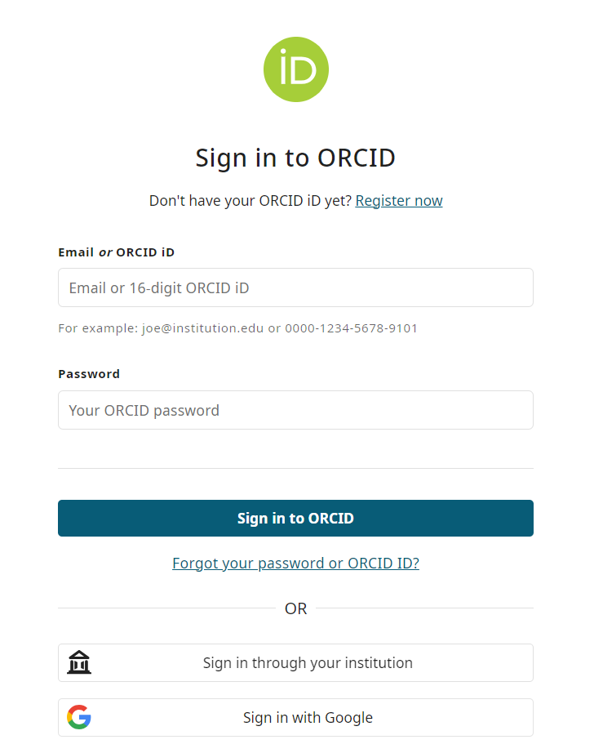
Setting up an ORCID account

Slide 9
2. Google Scholar
2

Slide 10
Google Scholar Author Profile
What is it?
Why start an account?
Setting up your account
  https://scholar.google.com/
Notes:
What is it?
Google Scholar Citations provide a way for authors to track the citations to their articles.
This profile is based on a personal Gmail/Google account. There is no unique identifier with Google Scholar Citations
Why start an account?
This is one way to track your publications. Track who is citing your publications, graph citations over a period of time, and computer citation metrics.
You can obtain citation metrics on publications that are indexed in Google Scholar, retrieve h-index for Google Scholar, and export citations to ORCID.
Audience reach is wide
Index's wide variety of materials and is used by researchers
Make your author profile page public so that it will appear in Google Scholar results when people search for names.

Slide 11
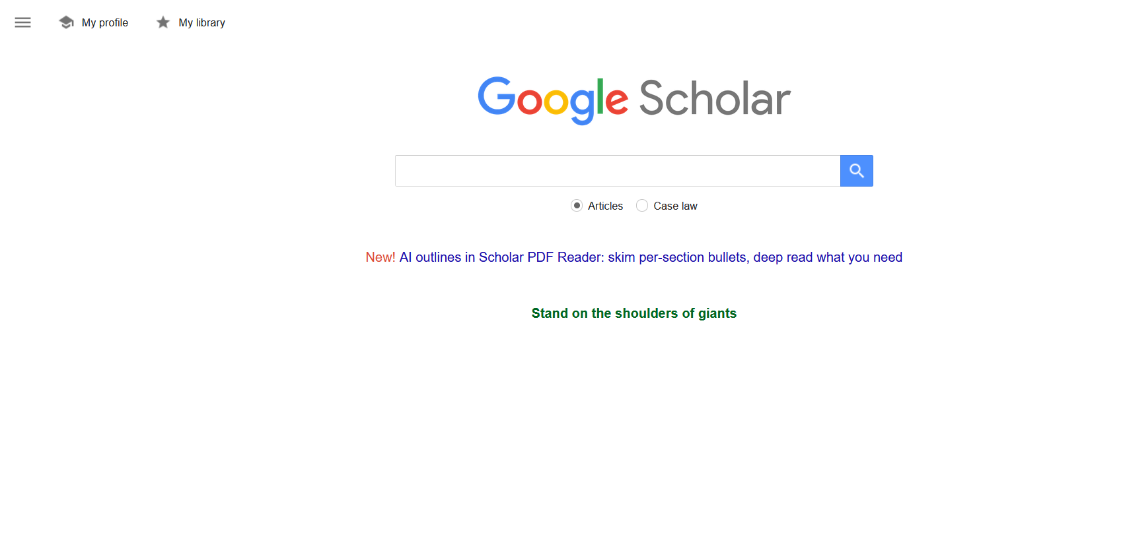
Setting up your Google Scholar Author Profile
Notes:
First, sign in to your Google account, or create one if you don't yet have one. We recommend that you use a personal account, not an account at your institution, so that you can keep your profile for as long as you wish.
Once you've signed in to your Google account, go to My Profile to open the Scholar profile sign up form,

Slide 12
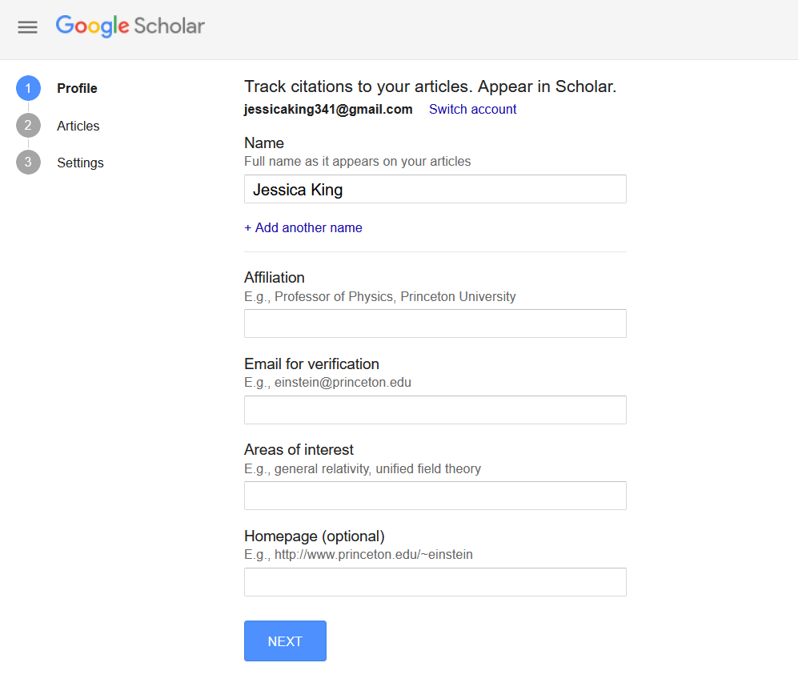
Setting up your Google Scholar Author Profile
Notes:
confirm the spelling of your name
enter your affiliation
you can also enter your university email address; this would make your profile eligible for inclusion in Google Scholar search results.
On the next page, you'll see groups of articles written by people with names similar to yours. Add all articles that you have written. If you publish under several different names, you may need to do several searches to add all your articles.
Once you're done with adding articles, it will ask you what to do when the article data changes in Google Scholar. You can either have the updates applied to your profile automatically, or you can choose to review them beforehand. In either case, you can always go to your profile and make changes by hand.

Slide 13
3. Scopus
3

Slide 14
Scopus
What is it?
What does it do?
Set up account
  Created automatically
Notes:
Scopus is an abstract and citation database of peer-reviewed literature containing citation statistics and impact factors. Scopus is accessible with your UNMC NetID.
Shows number of citations, publication history, and h-index: metrics may be used for tenure, funding, other research performance based decisions
Scopus Author Profile is automatically created by Scopus

Slide 15
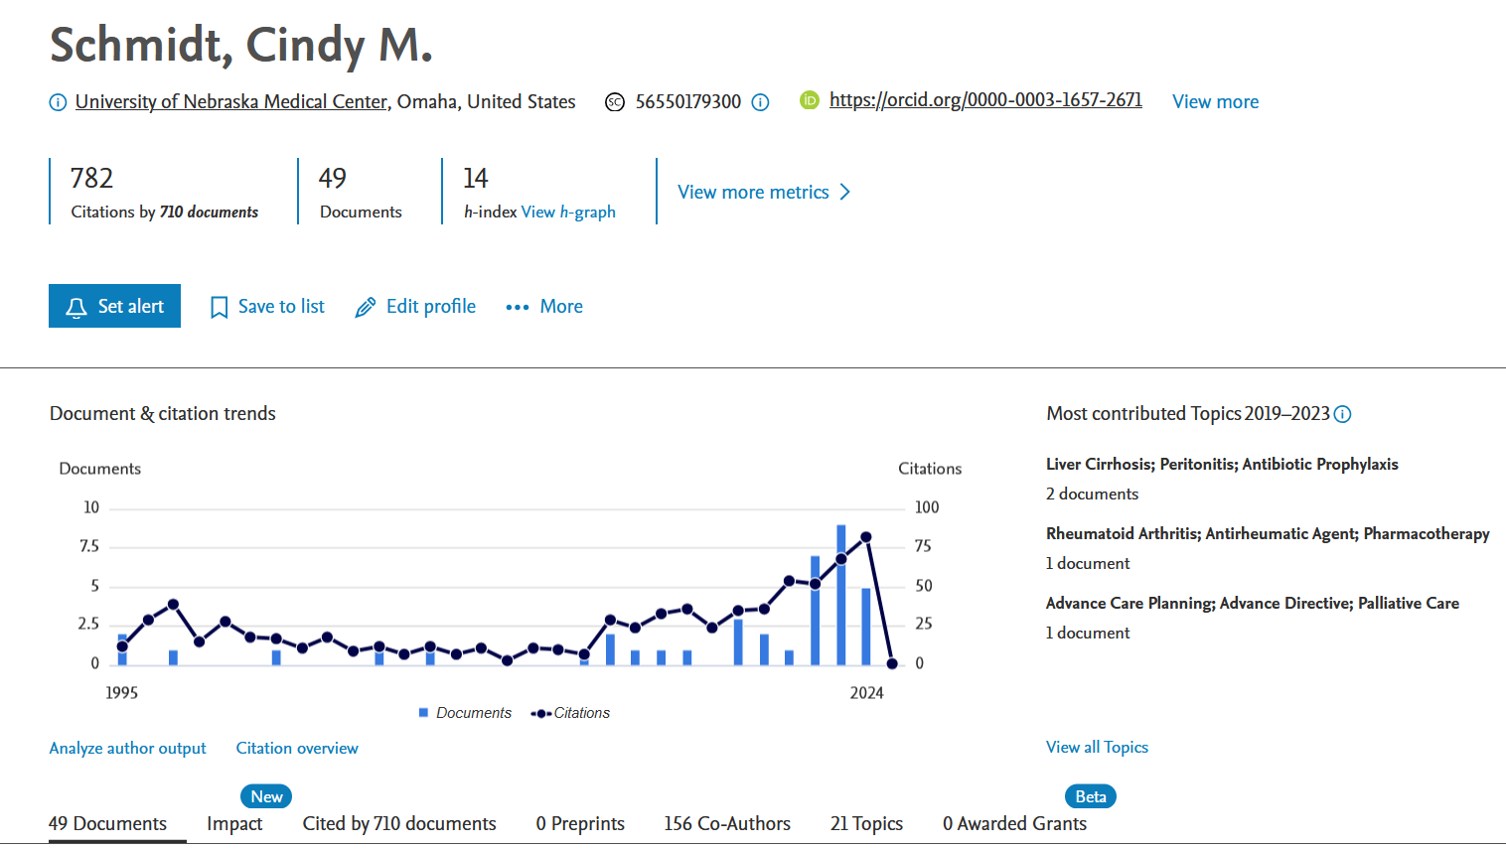
Scopus Author Profile
Notes:
This is another way to track your publications.

Slide 16
4. H-index
4

Slide 17
H-index
What is an h-index?
Why is it important?
Notes:
What is an h-index?
H-index is a type of scholarly metric. Scholarly metrics attempt to measure the impact that an article or journal or author have. In this case, an h-index attempts to measure the productivity and impact that a researcher or author has.
What is high? What is low? This is relative to the discipline and the length of time that a researcher has been publishing. These numbers are also dependent on the content of the database from which it is calculated, the numbers will be different if they are calculated manually vs automatically.
Citation analysis – allows the researcher/author to see who is citing their work and is often used to measure the researcher and article impact.

Slide 18
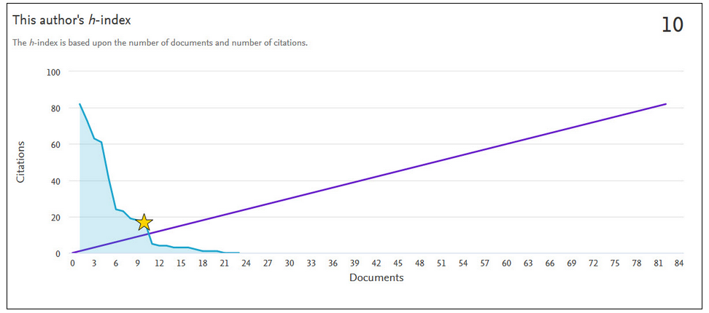
H-index Example
Notes:
Scopus h-index is based on the number of documents and number of citations. It attempts to measure both the productivity and impact of the published work of an author and/or scientist.
The graph includes two lines: the h-index and the 45-degree line
The h-index represents the number of citations received for each of the articles in descending order
The 45-degree line represents the number of citations equal to the number of articles.
Where the author's line meets the 45 degree line marks the h-index

Slide 19
5. Publication Tracking
5

Slide 20
Publication Tracking
Why track my publications?
How to track my publications?
Altmetrics: PlumX Metrics
  https://unmc.libguides.com/c.php?g=930238&p=6721219
Notes:
We've really been talking about this the entire time, but just to recap:
Why: If you don't manage your researcher profile who is going to? You don't want something that isn't yours attached to your name particularly if the quality isn't great and you want to make sure that
Have already seen a few ways to track your publications and take control of that: Scopus, Google Scholar, ORCID
Altmetrics
Altmetrics stands for "alternative metrics". It is metrics and qualitative data that are complementary to traditional, citation-based metrics. This allows authors to measure and monitor the reach & impact of scholarship and research via online activity.
Altmetrics can help answer questions such as:
How many times was it (article, book chapter, conference proceeding, etc.) was downloaded
How many times was it shared on social media?
Which countries are looking at my research?

Slide 21
Contact The Library
Librarian
Jess King, MLIS
jessicad.king@unmc.edu
AskUs
Email: askus@unmc.edu
Phone: 402-559-6221
More Information:
Scholarly Metrics Research Guide: https://unmc.libguides.com/scholarlymetrics
Author Toolkit Research Guide: https://unmc.libguides.com/authortoolkit/orcid
Notes:
available for 1:1 meetings
Digital Commons: another way to manage your researcher identity, can give more information about that it it's of interest

Slide 22
6. Questions?
6
Notes:
ORCID: https://orcid.org/orcid-search/search?searchQuery=UNMC%20coph
Google Scholar: https://scholar.google.com/citations?user=0A0KHX4AAAAJ&hl=en&oi=ao

