Slide 1
EndNote
Jess King, MLIS
Leon S. McGoogan Health Sciences Library
Notes:
With me today is Danielle Westmark
open endnote guide, pubmed, endnote online, embase, google scholar, library catalog, downloads folder, empty word doc

Slide 2
Training Outline
Introduction to EndNote
Customizing EndNote
Available Resources
1
3
5
2
4
6
Importing citations into EndNote
Using Cite While You Write
Questions
Notes:
I want to get an idea of what people's experience is with EndNote. If you are just getting started or haven't been using it for that long = thumbs up reaction, been using it for a long time = celebration reaction with confetti

Slide 3
1. Introduction To EndNote/EndNote online
1

Slide 4
EndNote/Citation Manager
EndNote allows you to:​
  Manage all your citation records in one place​
  Access and store full-text PDFs​
  Generate bibliographies in preferred citation formats​ (APA 7, JAMA/AMA, Vancouver, etc.)
  Install writing tools for Word that allow you to insert in-text citations and reference lists​
  Share collections with colleagues for collaboration​
  Assist with the removal of duplicates

Slide 5
Comparison (Zotero & EndNote)
EndNote (Desktop App)​​ | Zotero
Requires installation on a PC or Mac; EndNote Online available​​ | Cloud Based​ & Desktop installation only​
Direct export (using Firefox) from databases and Google Scholar​​ | Direct export from databases and Google Scholar​​
Fair to moderate learning curve​​ | Fairly easy to learn​​
Can customize to meet research needs​; groups; customize citations​ | Can customize to meet research needs​; folders; customize citations​
Create bibliography and in-text citations in Microsoft Word and Apple Pages​ | Create bibliography and in-text citations in Microsoft Word and Office 365; GoogleDocs​
Notes:
Feature people like about EndNote: if you pull something in from Google Scholar and it's missing some citation information it will do an online search to try and fill in some of that information – Zotero does not have this feature yet

Slide 6
Downloading EndNote
EndNote 20 is available from the UNMC Research Information Technology Office (RITO)
https://www.unmc.edu/vcr/rito/software/endnote/index.html
There are separate instructions for UNMC owned workstations (Mac and Windows), personal Windows computers, and personal Mac computers.
Contact rito@unmc.edu for assistance with downloading the software.
Notes:
https://www.unmc.edu/vcr/rito/software/endnote/index.html

Slide 7
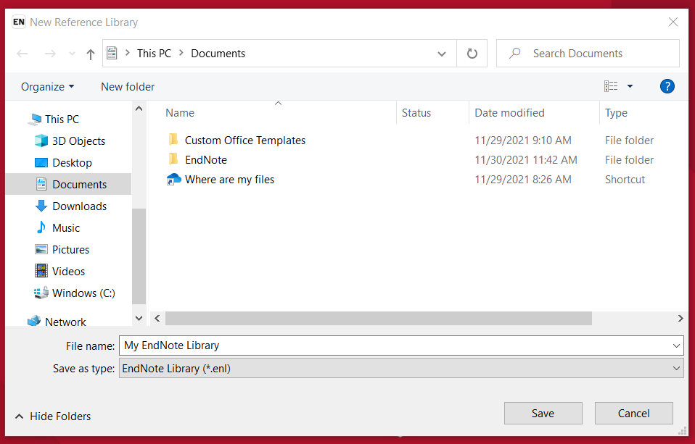
Getting Started
Notes:
The first time you open it up after installation it is going to ask you to create an endnote library
you will then save it (I've done it in my documents folder) on your computer – it's very important that you save it on your computer. Not to the cloud, not to onedrive, apple drive, or removable storage because you run a high risk of corrupting that file. Once file is corrupted it is very hard if not impossible to recover it

Slide 8
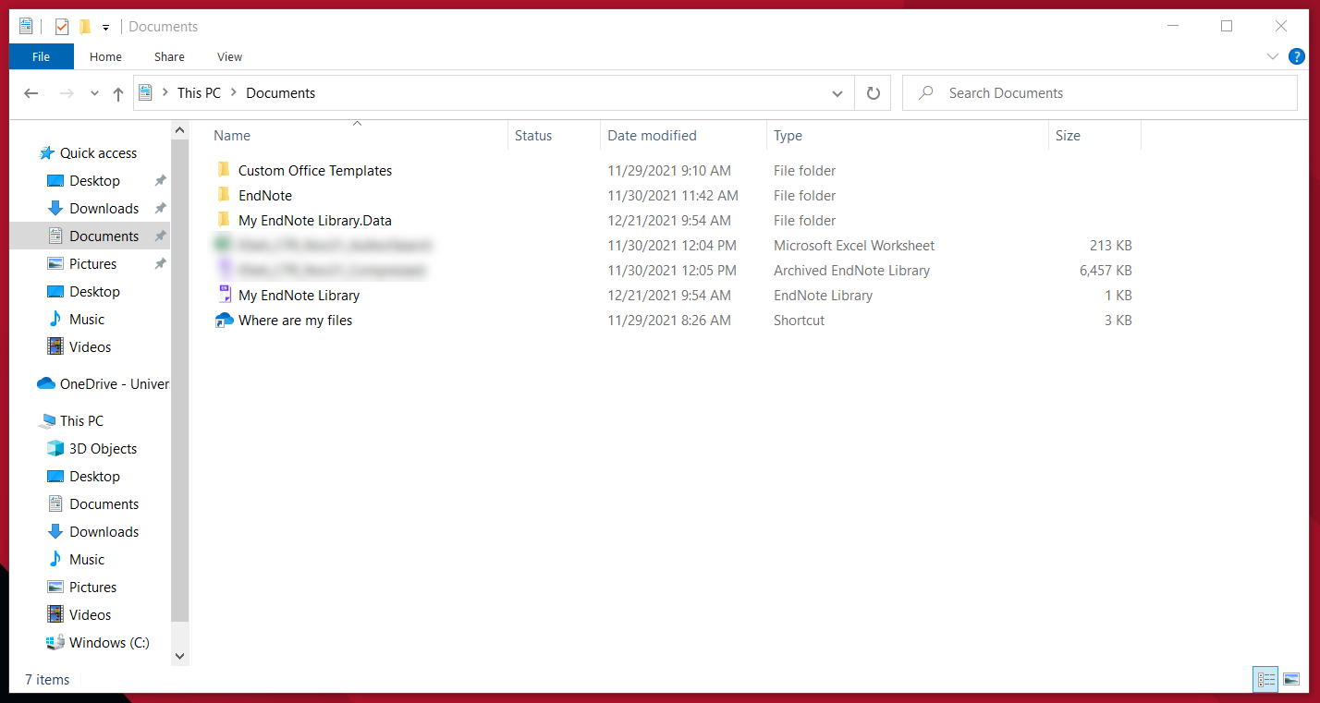
Getting Started
Notes:
See a few files: my endnote library is what you click to open it up, there will be a second one that is a .data you can ignore this file but just remember that if you ever move your endnote library elsewhere on your computer make sure that those two files stay together because your endnote library needs that .data folder to read it. So don't separate them

Slide 9
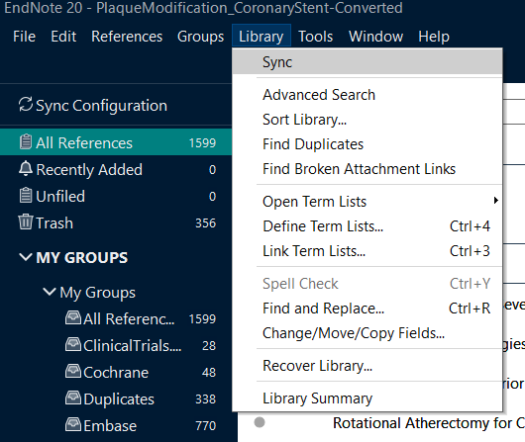
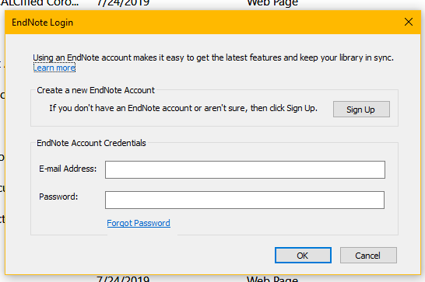
Syncing EndNote with EndNote Online
Click Library > Sync. Create your EndNote online account and/or enter in your account credentials. Use this to backup EndNote library or share with colleagues
Notes:
Go to library and click sync, this is a great option for having a file backup storage in case something happens to your computer or if you work from multiple computers and want to be able to sync those two libraries this is great.
It's completely free, it can be a personal or your unmc email. Endnote online is not tied to unmc at all so use whatever email you prefer

Slide 10
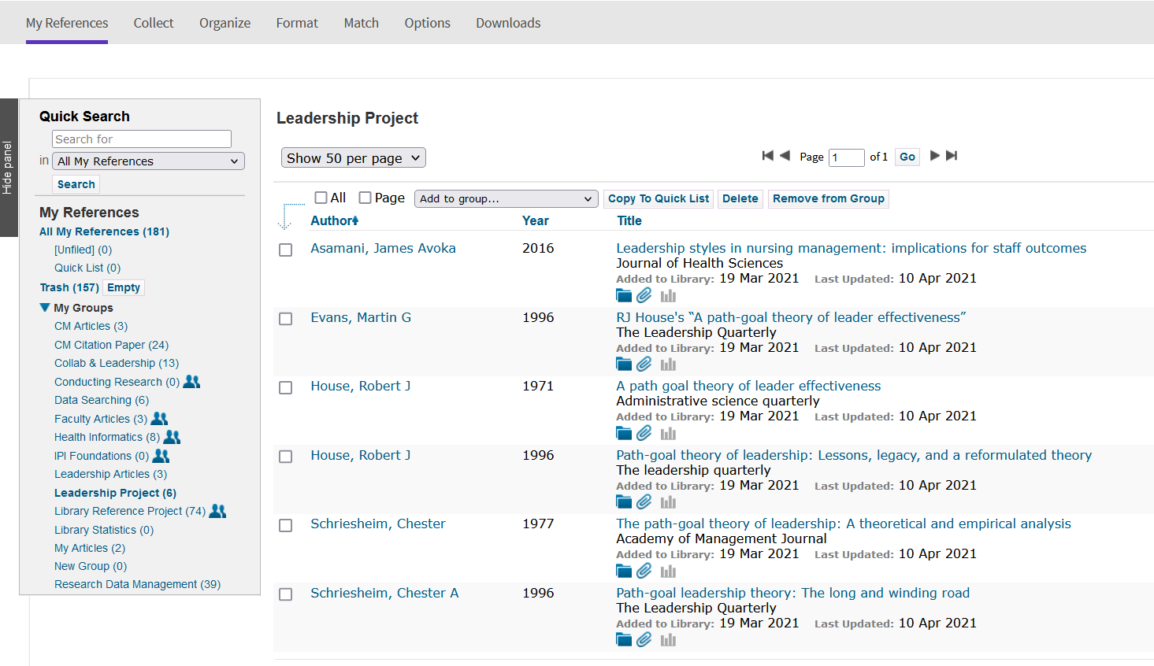
EndNote Online (EN 20 and Older)
https://access.clarivate.com/login?app=endnote
Notes:
https://access.clarivate.com/login?app=endnote
This is what endnote online looks like
Older version EndNote 20

Slide 11
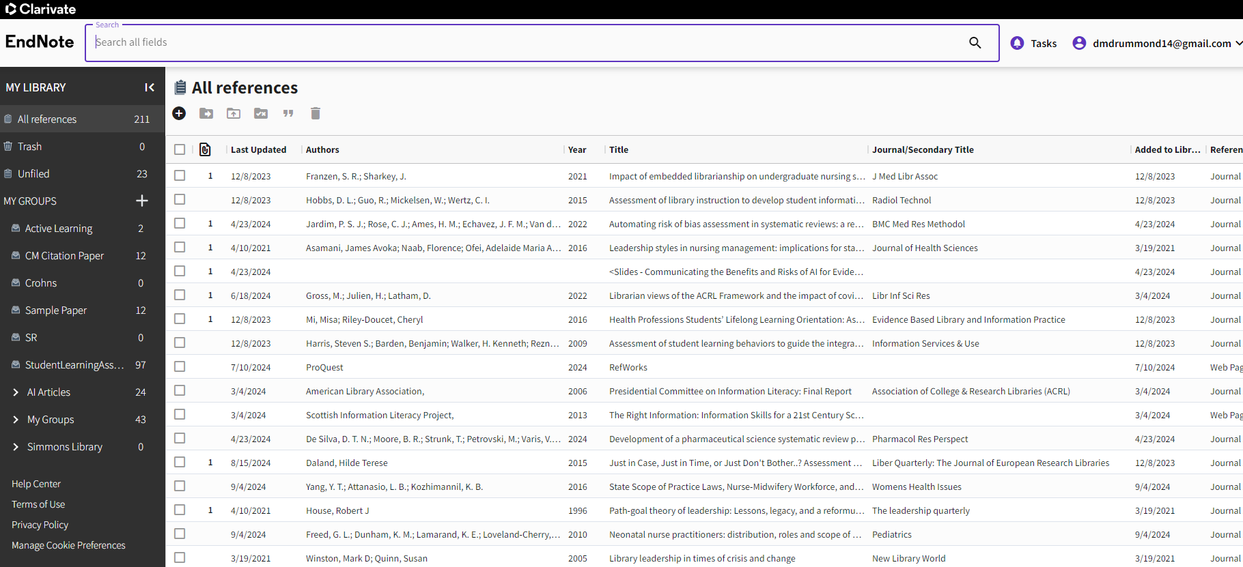
EndNote Web (EN 21 and Newer)
Notes:
This version of EndNote online is available for those who have installed and synced with EndNote 21

Slide 12
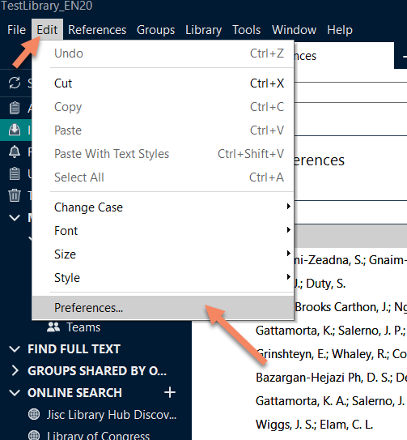
Customizing > Full-Text
Go to Edit > Preferences (Windows) or EndNote > Preferences (Mac)
Notes:
Something else you will want to do is to add the full text link. So when you import citations into endnote you can check to see if there is full text available so go to edit and then preferences.

Slide 13
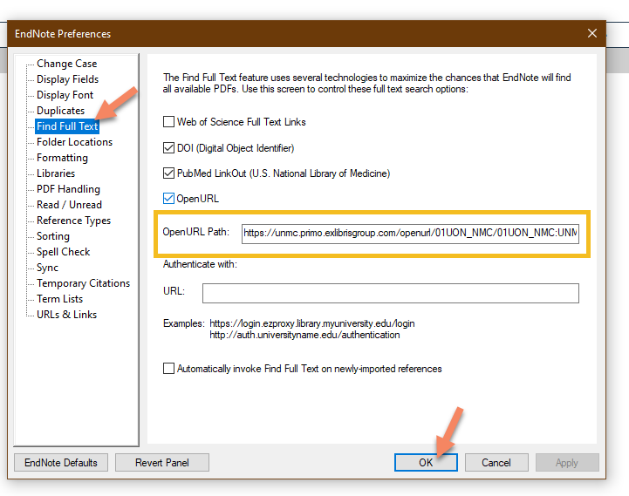
Customizing > Full-Text
Find Full Text
Check the boxes for:
  DOI
  PubMed
  OpenURL
Enter in the URL
Click OK
Link to URL: https://unmc.libguides.com/endnote/fulltext
Notes:
As of Aug 2023, the EndNote find full-text feature does not work with OpenAthens (our library's authentication system) to find articles available through the library. Clarivate (EndNote) is aware of the issue and is working on a solution. This feature does work with open access/freely available articles.
As a workaround, you can be directed to the library's catalog to check for full-text availability or to the interlibrary loan link.
After this is done you can: Select a citation in your EndNote library, Right click and select OpenURL Link which will direct you to the library catalog

Slide 14
2. Adding Citation Records to EndNote
2

Slide 15
Live Demo
Exporting citations from online resources:
  PubMed
  EBSCO (CINAHL, Dentistry Source, etc.)
  Embase
Importing records into EndNote
Notes:
(leaders*[ti]) AND ("social media"[tw] OR twitter[tw] OR facebook[tw] OR instagram[tw])
leaders* AND twitter
Open endnote library
Think of groups as folders: to create right click on my groups and give it a name
Can create a group set: so a main folder with subfolders, just an organizing thing if you need multiple sub-folders on a project
Can also do this from the groups option along the top menu bar
Under all references contains everything
Recently aded
Unfiled
Is option to search within pubmed within endnote, we do not have access to web of science, but the pubmed one will work: quick and easy access to pubmed within endnote
Great for quick and easy search but bigger searches you should go to pubmed.gov so you know you're not missing anything (student* AND wikipedia)
If want some of those article need to add to endnote-that was just searching pubmed
Add them to endnote library
Add from pubmed .gov: (student* AND (wikipedia[title])) download folder & right click so zotero doesn't compete
Remove duplicates: library, find duplicates
Googles scholar change bibliography manager to endnote, must have endnote open to add
Library catalog: endnote tab goes to endnote online so use ris & utf-8
OR – slides Danielle sent 22-32

Slide 16
3. Customizing EndNote
3

Slide 17
Live Demo
Create groups in an EndNote Library and adding citations
Editing citation records and attaching a PDF
Creating a quick bibliography/reference list
Syncing EndNote to EndNote online
Sharing your EndNote library and groups
Notes:
Create group (groups or right click on left hand side, can click on the + to add citations manually)
Editing & attaching pdf (click on a citation – go to edit in right window, in summary view on right – click on attach file, add notes into pdfs & highlight things (if you share group others don't see your notes, if you share full library they do))
Create quick bibliography (select references – references menu – copy formatted reference – paste into word doc)
Sync library to online (library – sync)
Share group or full library (share entire library: file – share, share group: right click – share group)
Find reference updates searches pubmed for updated citation info (references – find reference updates)
If you use jama endnote refers to it as ama, is also a jama one you can download-they're the same
Right click find full text: highight & add notes
OR slides Danielle sent: 38-43, 53-57

Slide 18
4. Writing with EndNote
4

Slide 19
Using the EndNote tab in Microsoft Word (desktop app)

Slide 20
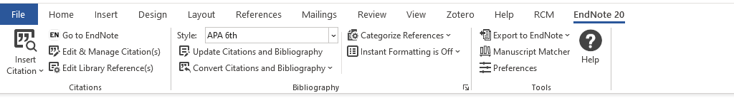
Getting Started
1. When you download EndNote, the Cite While You Write (CWYW) tab is added to your Microsoft Office applications.
Notes:
Shows up in Word and in PowerPoint

Slide 21





EndNote Toolbar
Insert citations; highlighted in EndNote or search; Alt + 7
2. Edit/modify in-text citations
3. Update reference lists; shows any changes made to citations
4. Use EndNote code {author, date} or show full in text citation & reference list. Toggle using instant formatting
5. Preferences; account; using EndNote Online
Notes:
Alt+7 is the keyboard shortcut for insert citation
2. if you want to delete a citation do it from here instead of hitting the backspace
Sometimes people hit the backspace and then they do a bit more work and hit the update button and those citations they deleted are back. So to make sure they stay gone you want to delete your citations from the edit and manage citation option from this section. From the popup you will see your citations, find the one you want to get rid of, click on the dropdown next to it and select remove citation.
4. this is useful for those who don't like to see the bibliography being created while they are writing, when you turn it back on it will go back to whatever citation style you had chosen
5. probably won't need to worry about this

Slide 22
Inserting in-text citations and bibliography lists

Slide 23
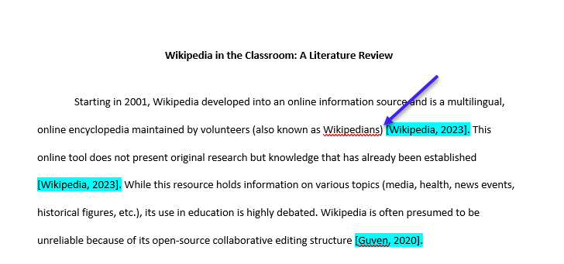
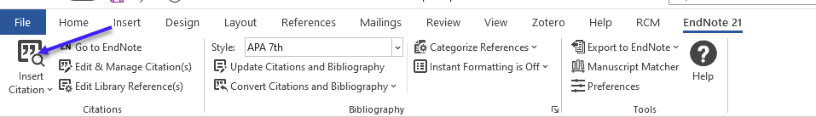
Place your cursor where you want to cite in the document
Click the Insert citation button in the EndNote tab

Slide 24
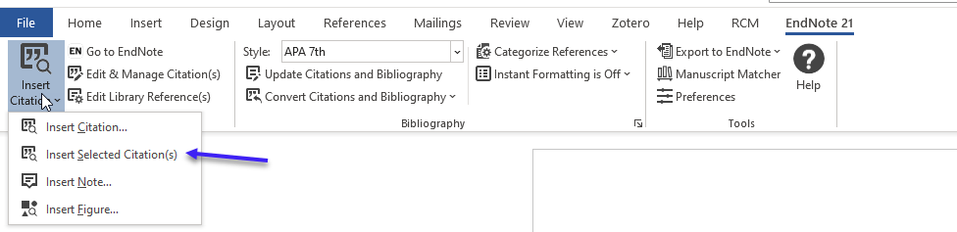
Option 1: Insert Selected Citation(s)
  Place your cursor where you want to cite
  Select/highlight a citation in your EndNote library and then click Insert Selected Citation(s) – OR click the quotation marks in your EndNote library

Slide 25
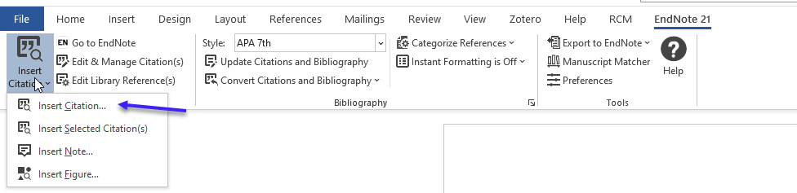
2. Option 2: Insert citation
  Place your cursor where you want to cite
  Search for citations in your EndNote library; search by author, keyword, journal, etc.

Slide 26
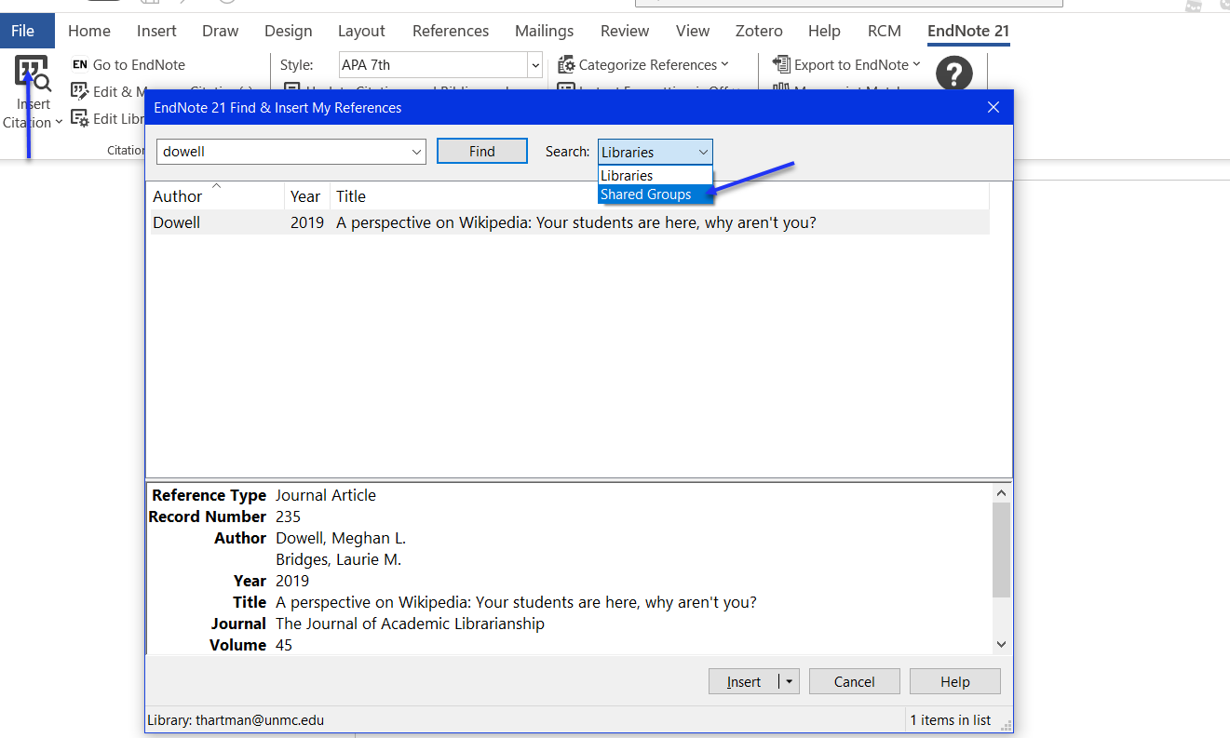
Inserting citations from a shared group (not yours)
Click Insert Citation and use the Drop Down to Shared Groups

Slide 27
Inserting citations from a shared group (not yours)
Click Insert Citation and use the Drop Down to Shared Groups

Slide 28
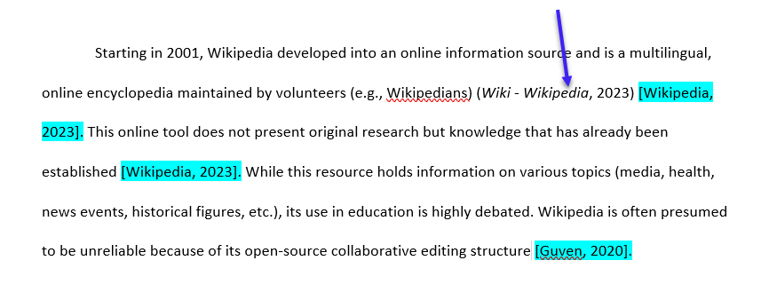
In-text citation, using APA 7th edition

Slide 29
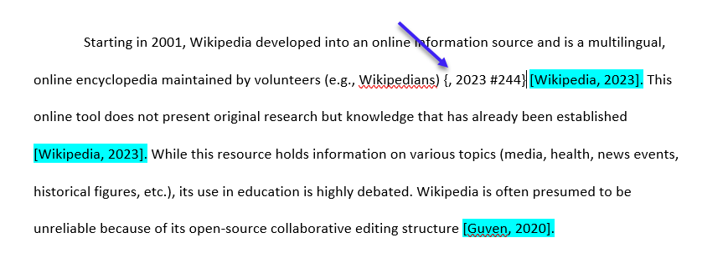
In-text citation with EndNote code/short-hand; (if the citation has an empty author field, it’s left blank).
{author last name, date}
Notes:
This is an example of what that EndNote code can look like when you turn that instant formatting in the toolbar off. So just remember when you're done writing your paper to turn the instant formatting back on so that you citations and bibliography will appear as normal

Slide 30
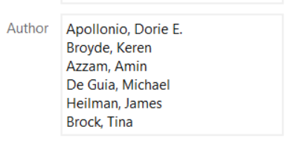
Is the Citation showing odd?
Make sure your citations were entered correctly:
  Author Names:
  Website as an Author:
    National Library of Medicine,
  No spaces in the field boxes
  Are you using the correct reference type?
    Journal vs. website vs. book
Notes:
Comma after website as an author or organization name: stops endnote from trying to break it up into first name last name

Slide 31
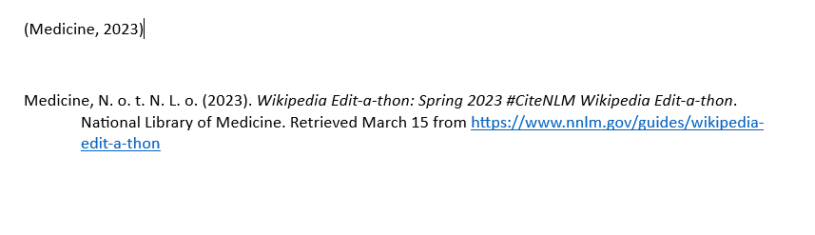
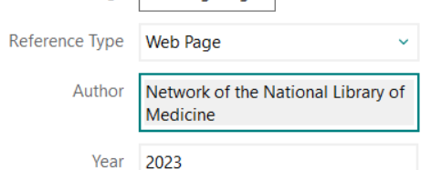

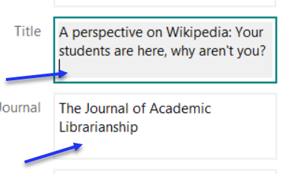
Missing the comma after website name:
Extra spacing in the citation
Notes:
Extra space will show up in your Word doc as well
Anytime you make an adjustment to your citation in EndNote remember to click update citation and bibliography in the top toolbar in your word doc

Slide 32
{ } with Formulas
If you are using formulas in your manuscript that contain curly braces { }, EndNote might read this as a citation.
Here’s a quick fix: https://support.clarivate.com/Endnote/s/article/EndNote-Trouble-with-equations?language=en_US

Slide 33
Modifying Styles

Slide 34
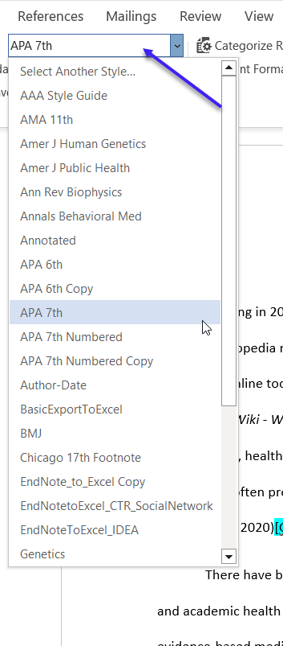
Select your preferred citation style
Choose from the selected styles, or click on “select another style” to find more
APA, JAMA, Vancouver, journal specific styles, etc.

Slide 35
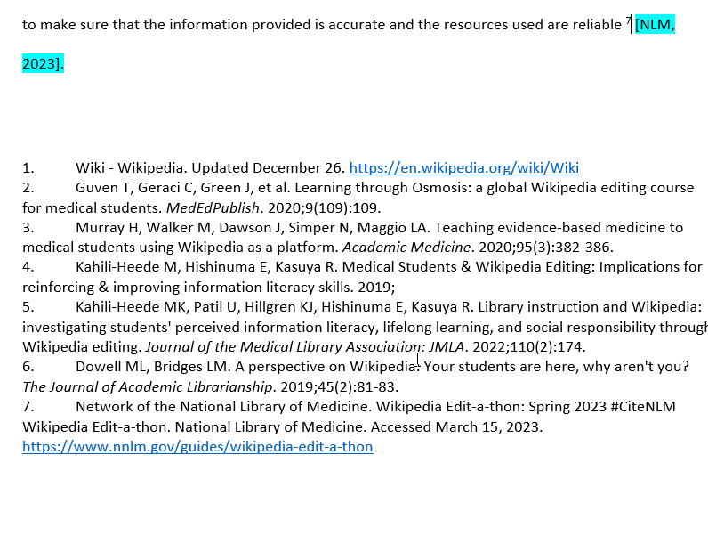
Changing the style also updates your reference list/bibliography

Slide 36
EndNote Output Styles
Thousands of more citation styles are available online: https://endnote.com/downloads/styles/
Download and save to your EndNote Styles folder (Documents > EndNote > Style) OR double click the file to open in EndNote and Save As
Notes:
Always check that the style has not already been created before creating a new one yourself, many journals with those strange or slightly different citation styles already have it available online

Slide 37
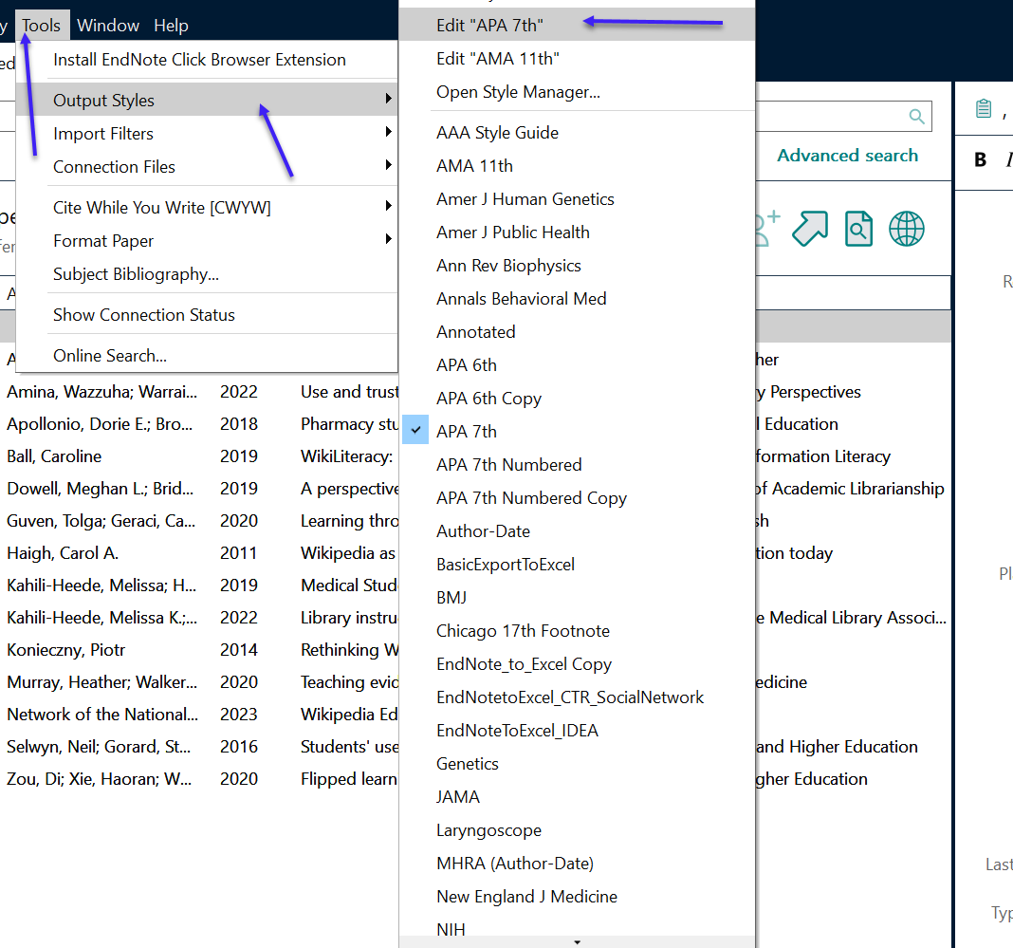
You can modify existing output styles in EndNote Tools > Output Styles > Edit …
Notes:
If a journal uses apa but has it's own special variation you can create a new style for youself

Slide 38
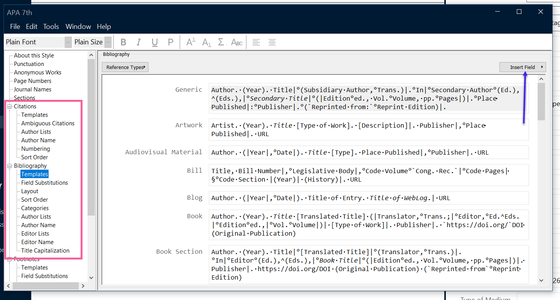
Select the areas you want to modify; add additional items (address, authors, etc.) by clicking the Insert Field box.
Notes:
Give the style a new name so it doesn't overwrite the normal apa style

Slide 39
Collaborating with EndNote

Slide 40
Collaborating with EndNote
Be careful when emailing Word documents with EndNote citations. This can cause the connection/code to EndNote to break, and it may not longer work with your EndNote library.
If you must send a Word document via email, share the library with the colleague/collaborator/etc. and send the EndNote Library (with the .data file) with the Word doc.
You can create a Traveling Library, but this may create duplicated libraries (and a lot of them!)

Slide 41
Step 1: Sync your EndNote Library
EndNote 21 users can sync and share a library to up to 1000 users (EndNote 20.2 can share up to 400 users)
  Edit > Preferences (Windows)/ EndNote > Preferences (Mac)
  Click on Sync
  Enable Sync or log in with your EndNote Online/Web account (this is NOT your UNMC NetID and Password; separate account)

Slide 42
Step 2: Share Your EndNote Library or Group
Share a Library
File
Share…
Share a Group
Select the Group
Click the “people” icon on the right hand side OR Group > Share Group… OR Right Click the group name > Share Group…

Slide 43
Teams / Office 365 (Online)
EndNote 21 Users Only
Sync your EndNote Desktop Library to EndNote Web and share with colleagues (they must have access to EndNote 21 as well).
In Teams or Microsoft Office 365 (Online)
  Home Tab > Add Ins (red box)
  More Add Ins
  Search for EndNote 21 and Click Add
  Log in with your EndNote Web account (this is NOT your UNMC NetID)
  This feature should add citations from your library, shared libraries and groups.
EndNote will insert the citations in EndNote code {last name, date} and the reference/bibliography list. Open the document in the Word app:
  In the EndNote Tab
    Click on Instant Formatting is Off
    If Instant Formatting is On, toggle it to Off and then On again.

Slide 44
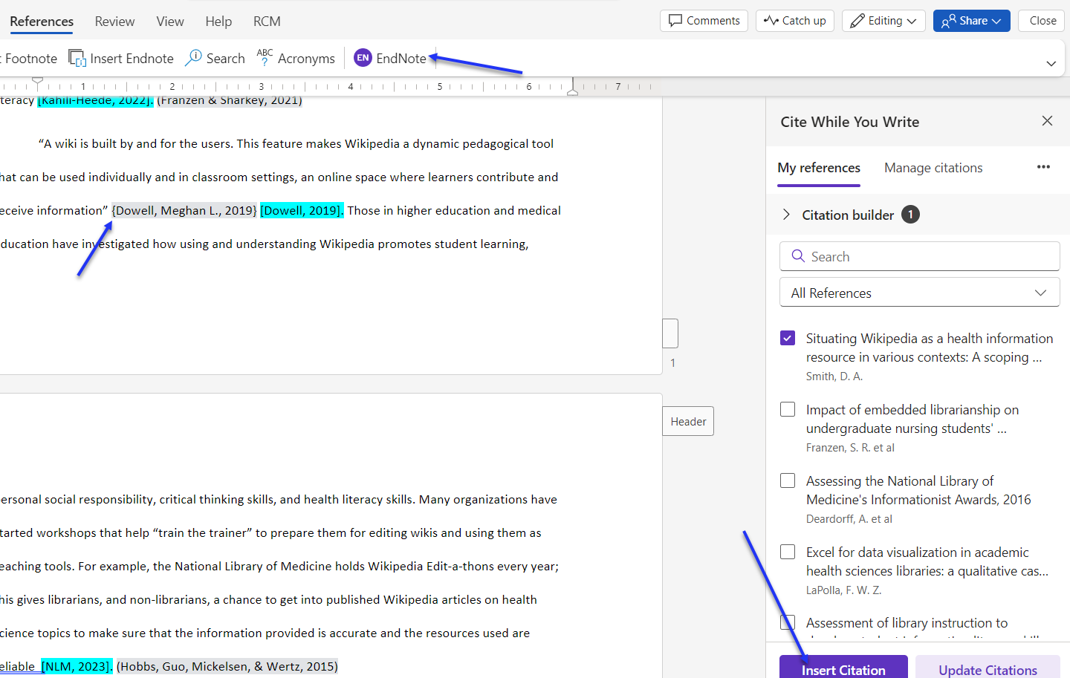
Do NOT use this one
Make sure to use the EndNote with the purple icon! Insert EndNote button is Microsoft Office’s citation feature (does not work with your EndNote library)

Slide 45
Teams / Office 365 (Online)
Work around for EndNote 20 and earlier versions
Sync your EndNote library and share with colleagues.
Use the EndNote code {last name, date} to enter in citations. Can copy/paste from EndNote library.
Assign one person with access to the EndNote library to download the document
  Turn on or turn off/on Instant Formatting to view the references in the desired style format
  Opening the document in the app without downloading, and then saving back to Teams/Online, may break the EndNote code.

Slide 46
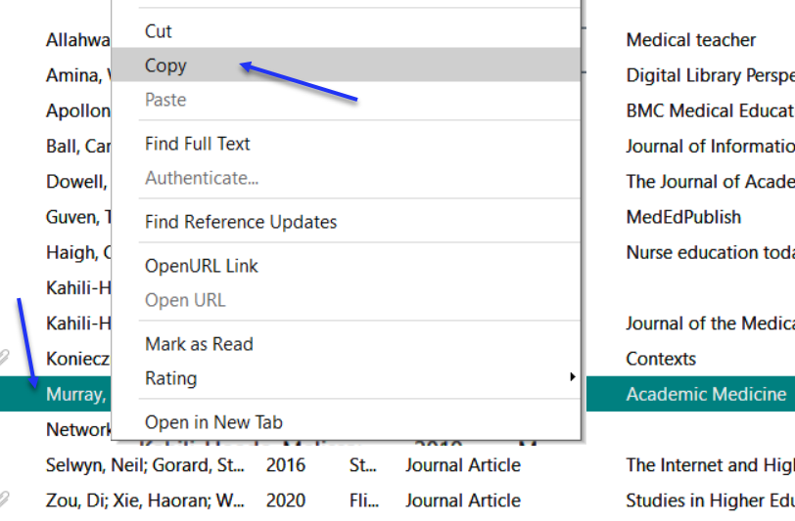
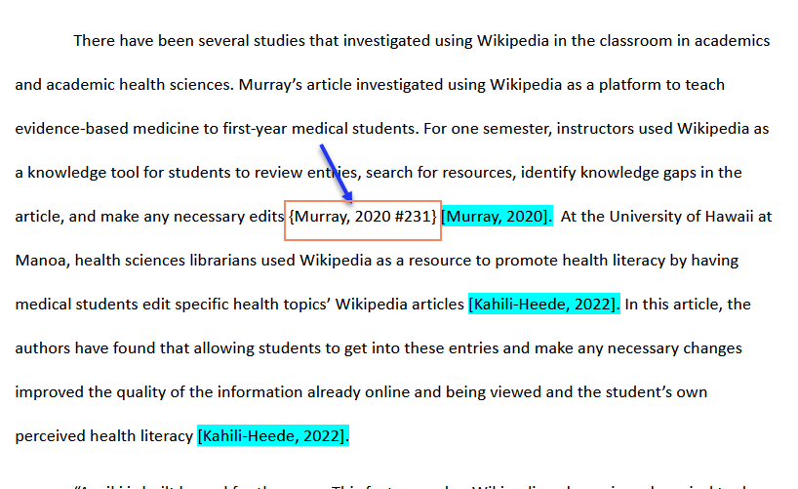
1. Right click a citation in your EndNote Library and select Copy
2. Paste where you want the citation to appear.

Slide 47
5. Resources
5

Slide 48
EndNote Sync and EndNote Online
Syncing EndNote and sharing with colleagues https://unmc.libguides.com/c.php?g=644589&p=6809665
Using EndNote Online (Clarivate tutorials) https://clarivate.libguides.com/endnote_training/endnote_online
Notes:
Sync & Share with Colleagues: https://unmc.libguides.com/c.php?g=644589&p=6809665
EndNote Online: https://clarivate.libguides.com/endnote_training/endnote_online

Slide 49
Contact The Library
Librarian
Jess King, MLIS
jessicad.king@unmc.edu
AskUs
Email: askus@unmc.edu
Phone: 402-559-6221
EndNote Tech Support
Support phone: 1-800-336-4474, press 4
Email: endnote.support@clarivate.com
Webpage: https://support.clarivate.com/Endnote/s/?language=en_US
Notes:
EndNote Tech – knowledge base: Webpage: https://support.clarivate.com/Endnote/s/?language=en_US

Slide 50
6. Questions?
6

