Slide 1
United Healthcare College of Public Health COVID-19 ILAALI ILMAHAAGA. ILAALI BULSHADAADA.
Notes:
COVID-19, Protect Your Child, Protect Your Community

Slide 2
Tallaallada COVID-19 waa mid badbaadsan oo waxtar leh.
Ma jiro tallaal kale oo la
baaray badbaadadiisa oo kaga badan taariikhda Mareykanka.
Tallaalku KUMA qaadsiin karo COVID-19.
Way ka badbaado badan
tahay in la tallaalo marka loo eego qaadista
COVID-19.
Notes:
Thank You for being here today. Getting vaccinated is of course a personal choice. A choice that is worth considering to protect your health and the health of people you care about.
We are here today to learn more about the COVID-19 Vaccine. COVID-19 Vaccines are safe and effective. Millions of people have already been vaccinated and we have the outcomes of their vaccinations to learn from. These new vaccines could be made quickly and still be safe for several reasons.
• Scientists had a head start because they had studied other coronaviruses and both mRNA and viral vector vaccines for decades.
• The government provided a lot of money and resources for vaccine development to prevent people from dying from COVID.
• The vaccine trials could start quickly because people were eager to take part and fight the pandemic.
• The review and authorization of the vaccines was a priority to keep people well and get them back to work and school.
• Stages to develop and produce the vaccines were done at the same time, for example, manufacturing began while clinical trials were still being done.
Every step that must be followed to make a new vaccine and make sure it is safe was followed. No steps were skipped.
No other vaccine has been tested as much as these vaccines in US history.
None of the vaccines contain the virus that causes COVID-19 in any form. They cannot give you COVID-19 and you cannot spread COVID-19.
There is no way that the COVID-19 vaccines can shed the virus. None of the three vaccines authorized in the U.S. contain the COVID-19 virus in any form.
It is safer to get the vaccine than getting COVID-19.

Slide 3
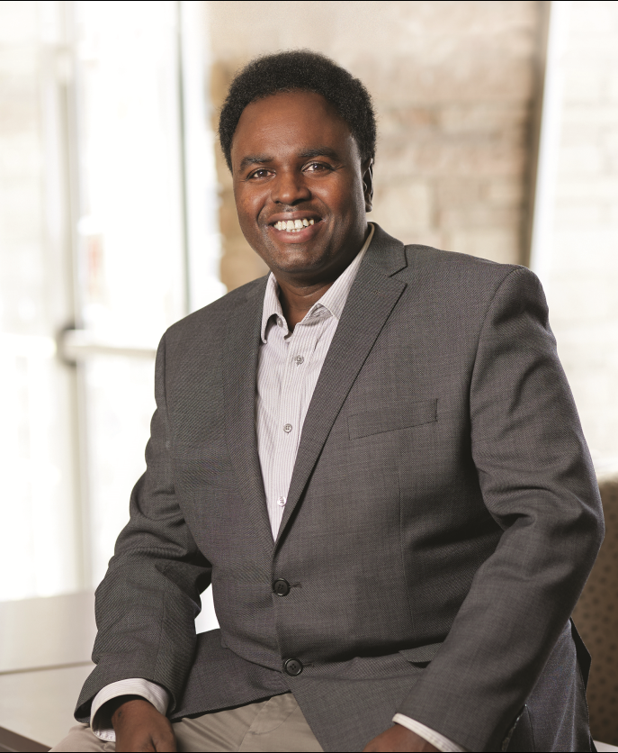
Tallaallada COVID-19 waa mid badbaadsan oo waxtar leh.
Tallaalka waxaa la caddeeyay inuu badbaado u yahay kumanaan qof, oo ay ku jiraan kuwo isiro, jinsiyado iyo da'o kala duwan ah.
Tallaalka COVID-19 ma beddelayo hidda sidahaaga (DNA).
Notes:
The vaccine has been proven safe for thousands of people, including those of different races, ethnicities and ages.
Black and Latinx residents, along with Native Americans and Native Hawaiians, experience the highest rates of infection, hospitalization, and death from COVID-19. This is why you may see more advertising encouraging these communities to get vaccinated. The three vaccines that are available in the U.S. were tested on diverse populations to make sure that the vaccines are safe and effective in those groups.
These vaccines use genetic material that teach your body how to fight the virus. But the genetic material does not change your genes.
The DNA or RNA in the COVID-19 vaccine tells our body’s cells how to build part of the spike protein found on the COVID-19 virus. This step is needed for our body’s immune system to build a response. The immune system then develops antibodies and prepares immune cells to fight against the COVID-19 virus if we are exposed to it in the future. For vaccines with mRNA, the mRNA never enters the cell nucleus where our DNA is located so it can’t alter our DNA.
The J&J vaccine is an adenovirus vaccine that contains DNA. An adenovirus vaccine uses a virus that can’t replicate. The DNA in the vaccine cannot combine with our DNA (or chromosomes) because the vaccine doesn’t
have the enzyme (called integrase) that connects DNA together.

Slide 4
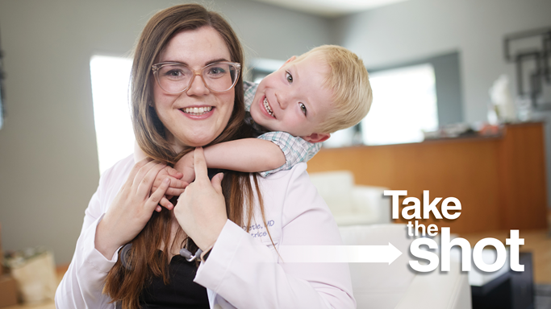
Tallaallada COVID-19 waa mid badbaadsan oo waxtar leh.
Ma jiraan wax caddayn ah in tallaalku sababayo
dhibaatooyinka taranka.
Haweenka uurka lihi waa inay kala hadlaan takhtarkooda
haddii ay tahay inay is tallaalaan iyo in kale.
Notes:
There is no evidence the vaccines will make your child unable to have their own children someday. Remember the vaccine cannot alter your DNA or your child’s DNA. This is a picture of Dr. Emily Dietle who is a Nebraska Pediatrician who took the vaccine and then became pregnant. Emily was also so confident about the vaccine that she enrolled her two year old son in the Pfizer trial.

Slide 5
Tallaalku KAMA koobna:
• Kaydiyayaal
• Ukunta
• Alaabta doofaarka
• Gelatin
• Cinjir
• Fayras kasta oo nool oo COVID-19 ah
Notes:
What is in the vaccine is available for review, the vaccines do not contain any Preservatives, Eggs, Pork Products or any live COVID-19 virus.

Slide 6
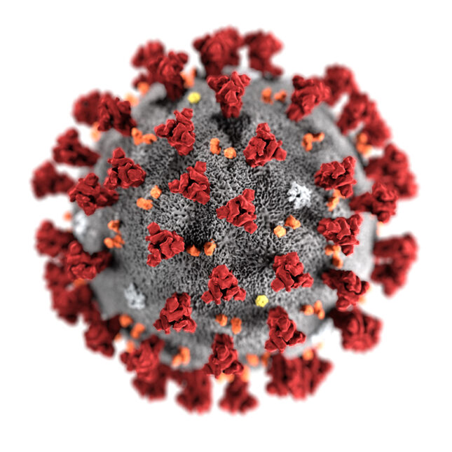
Tallaalku wuxuu ka ilaaliyaa qof walba, oo ay ku jiraan carruur iyo dhallinyaro.
Waxaa jira noocyo kala duwan oo COVID-19 ah, oo ay ku jiraan nooca Delta, oo si sahlan u faafa oo sababi kara astaamo aad u daran.
Tallaaladu waxay ka
difaacaan noocyada kala duwan sida Delta.
Notes:
Viruses are always changing, that is the reason that we must get a flu shot every year. The change can be less harmful or more harmful. The Delta variant is one that scientist’s are very concerned about because it is much easier to catch and spread to others and may cause more severe illness. More dangerous variants like Delta have emerged because not enough people are vaccinated. There may be more variants like Delta in the future.
Vaccines protect against variants like Delta. The best way to protect yourself, your family, and your community is to get vaccinated as soon as possible.

Slide 7
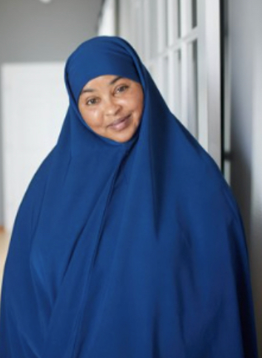
Tallaalka carruurta iyo dhallinyarada wuxuu ilaaliyaa bulshada oo dhan.
Mar haddii qof la tallaalo, way adag tahay in lagu
faafiyo COVID-19 dadka kale.
Dadka waayeelka ah iyo dadka qaba xaalado
caafimaad oo caafimaad oo halis weyn ugu jira inay
si daran ugu xanuunsadaan COVID-19.
Notes:
When eligible children and adults are vaccinated it protects:
• Their friends and family who are not yet vaccinated.
• The elderly and people with certain medical conditions who are at high risk of getting seriously ill from COVID-19.
It also protects the whole community and makes it easier for schools and businesses to keep open. That helps our economy.

Slide 8
Tallaallada qaar waxay u baahan yihiin laba tallaal halka tallaallada kale ay u baahan yihiin keliya hal duris.
Tallaalka u baahan laba duris:
• Durista koowaad waxa uu ka dhigayaa jirkaagu inuu diyaargaroobo.
• Durista labaad waxaa la bixiyaa ugu yaraan saddex toddobaad kadib si
loo hubiyo inaad haysato badbaado buuxda.
• Waa muhiim inaad hesho labada duris si buuxda loo ilaaliyo.
Notes:
Some vaccines need two shots. The first shot gets your body ready. The second shot is given a few weeks later to make sure you have full protection. If the vaccine you are getting needs two shots you must get them both.

Slide 9
DHIBAATOOYINKA UU KEENI KARO WAA CAADI.
Dhibaatooyinka uu keeni karo macnaheedu MAAHA inaad qabto COVID-19.
• Dhibaatooyinka uu keeni karo ayaa macnaheedu yahay in tallaalku uu barayo jirkaaga sida loola
dagaallamo COVID-19.
• Dhibaatada uu keeni karo waxa ka mid noqon kara:
– Xanuun ama barar ku dhaca gacantaada halka aad tallaalka ka helayso. – Madax xanuun , dhaxan, ama qandho.
Notes:
Mild Side Effects are NORMAL and does not mean you have COVID-19, it does mean your body is learning how to fight COVID-19.

Slide 10
• Waxyeellooyinka halista ah aad bay dhif u yihiin
Waxay aad ugu dhowdahay in ilmahaagu
si daran ugu xanuunsan doono caabuqa
COVID-19 marka loo eego tallaalka.
Tiro yar oo dhallinyaro ah ayaa la kulmay
waxyeellooyin sida caabuqa wadnaha ama
xinjiro dhiig.
• Faa'iidada tallaalku waxay aad uga culus
tahay khatar kasta oo ka timaadda.
Notes:
The vaccines are safe. It is much more likely that you or your child will get seriously ill from a COVID-19 infection than from a vaccine. As of August 30th, 2021, over 369 million doses of COVID-19 vaccine have been given in the US. Although serious effects can happen, they are very rare. The risk of these potential harms varies by age and sex.
It is estimated that out of every million people who receive a 2nd dose of Pfizer or Moderna vaccine, just over 3 will get heart inflammation also called myocarditis or pericarditis. This is very rare and is treatable and most people who experience them get better. For the J&J vaccine out of every million people who get a vaccine, around 8 people will get Guillain Barre Syndrome (a disease of the nervous system) and 3 people will get blood clots and unusual bleeding.
The benefits of getting the COVID-19 vaccine continue to outweigh the risks of COVID-19 infection.

Slide 11
Tallaalku wuxuu kaa difaacayaa inaad qaado COVID-19.
Xitaa haddii aad qabtay COVID-19, weli waa inaad qaadataa tallaalka
Lama oga ilaa iyo goorta qof laga ilaalinayo inuu markale u bukoodo COVID-19.
Weydii agaasimahaaga macluumaadka dhakhtarka
Notes:
Natural immunity is the protection that you get after you've had COVID-19. Getting vaccinated will boost your immunity for better and longer protection against COVID-19. In fact, a recent study found that people who were not vaccinated were more than twice as likely to get infected again compared to people who were vaccinated.
Vaccination also helps protect against more infectious forms of the virus such as the Delta variant that might not have been around when you first got infected. Getting vaccinated will reduce your chances of getting COVID19 again.

Slide 12
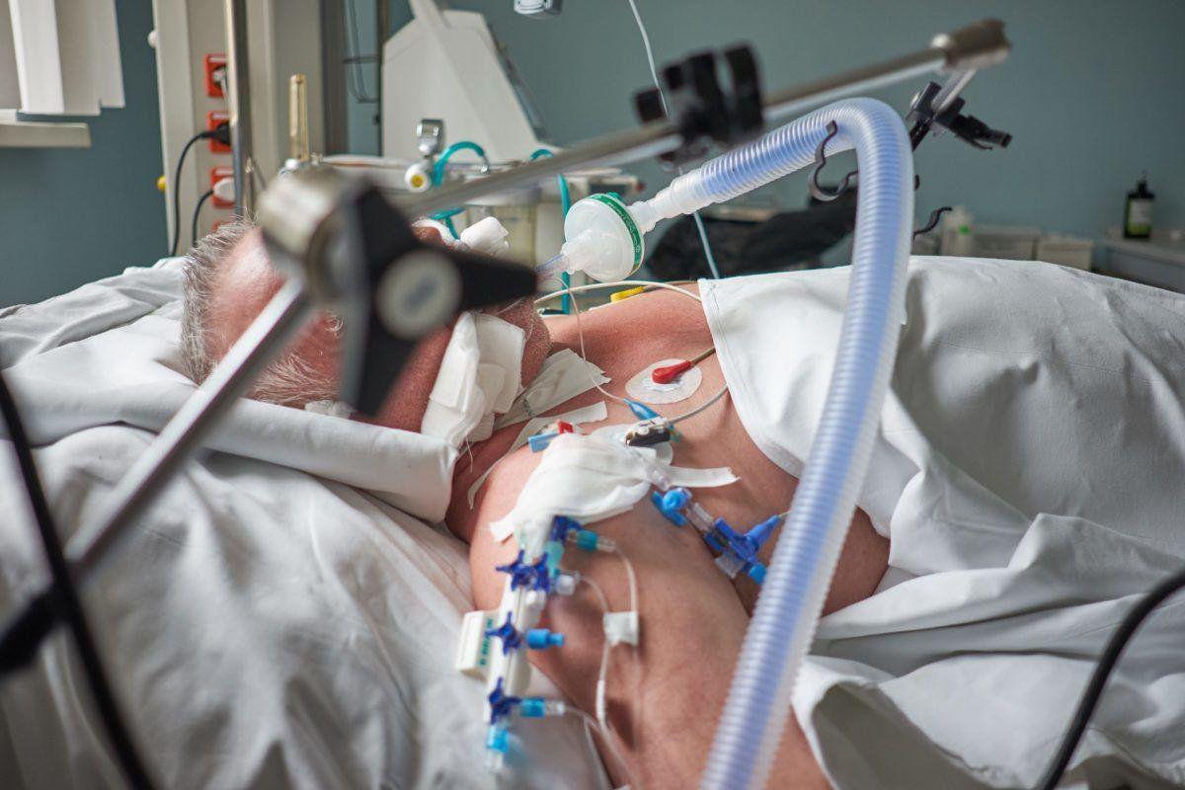
Tallaalku wuxuu kaa difaacayaa inaad qaado COVID-19.
Haddii aad weli qaadayso
COVID-19 kadib marka aad
is tallaasho, tallaalku wuxuu
kaa difaacayaa inaad si
daran u bukooto.
Notes:
If you still get COVID-19 after you get vaccinated, the vaccine helps protect you from getting seriously ill.

Slide 13
Credits
CDC
National Resource Center for Refugees, Immigrants and Migrants
United Healthcare
University of Nebraska Medical Center

