Slide 1
Conversations to Prepare for Improvement

Slide 2
Why Conversation?
Information to assist in problem solving
Support Staff wellbeing
Tap into creativity of staff
Promote joy in work and healthy relationships
Build a more robust system

Slide 3
Notes:
Preparing the ground for improvement by insuring that staff are heard, engaged and an integral part of identifying and addressing issues.

Slide 4
Pillars
Hear Me
Protect Me
Care for Me
Prepare Me
Support me
http://www.ihi.org/resources/Pages/Tools/Conversation-Guide-to-Support-Staff-Wellbeing-Joy-in-Work-COVID-19.aspx
Notes:
Hear me: Listen and act on the lived experience of staff to address concerns and support open and honest dialogue and problem solving
Protect me: Reduce the risk of acquiring Covid-19 and transmission to family.
Care for me: Provide support for team members and their families if they become ill or are isolated. As well as understanding and provide resources to support secondary impacts of covid-19 such as mental health support.
Prepare me: provide training and insure staff have honest and clear information regarding current state and preparedness to address current and future scenarios.
Support me: Acknowledge the demands of the current time and the limitations on what each of us can do. Encourage self care and put in place support systems to insure staff are able to care for their own needs.

Slide 5
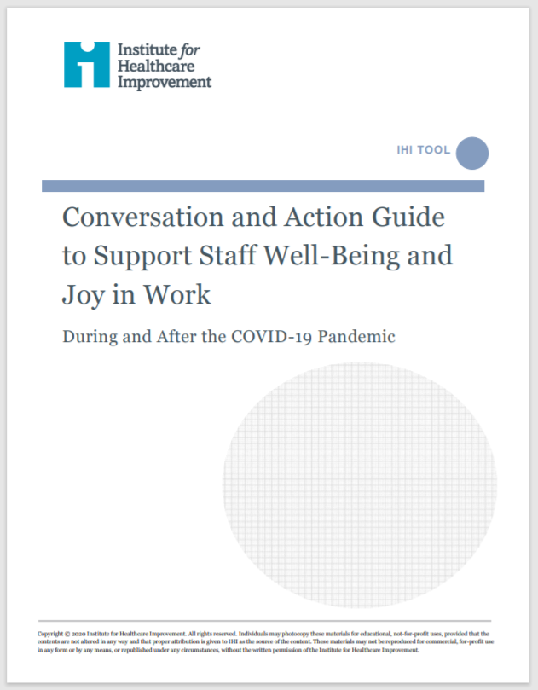
Hear Me
Listen and act on lived experience to understand and address concerns to the extent organizations and leaders are able
Short huddles, in small groups or 1:1 where you can ask:
What concerns do you have for residents, yourself, or the team?
Are there steps we can take right now as a team?
What good thing happened today?

Slide 6
Practice active listening and problem solving
“Here’s what I hear you saying – do I have that right?”
“what do we still need to learn”
“how can we do this together”

Slide 7
Leave in Action
Speak to 5 staff members and ask them some version of the questions below:
What concerns do you have for residents, yourself, or the team?
Are there steps we can take right now as a team?
What good thing happened today?
Share next week what came up that was surprising or what new ideas emerged from problem solving
http://www.ihi.org/resources/Pages/Tools/Conversation-Guide-to-Support-Staff-Wellbeing-Joy-in-Work-COVID-19.aspx

