Slide 1
Are Our Processes Reliable?

Slide 2
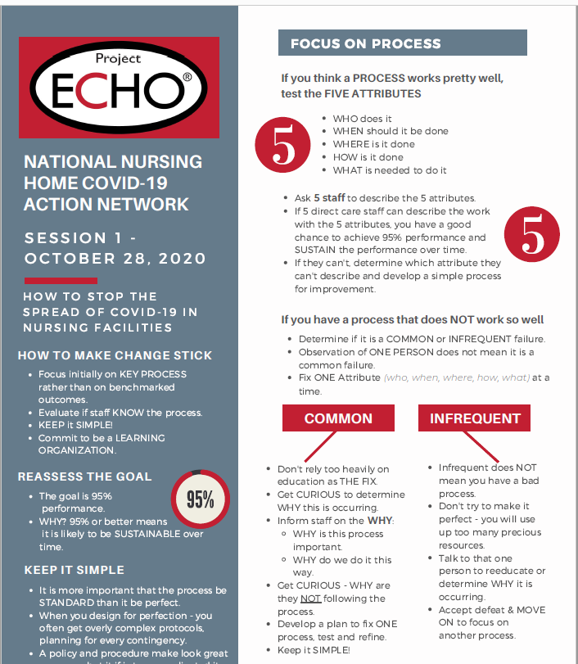
Core questions
How do we know if our process is reliable?
What do we do if it is not?
.

Slide 3
How do we know if a process is reliable?
Ask 5 staff
WHO does it
WHEN should it be done
WHERE is it done
HOW is it done
WHAT is needed to do it
If all staff can provide consistent answers high likelihood it is reliable

Slide 4
What do we do if it isn't?
If you have a process that does NOT work so well...
Determine if it is a COMMON or INFREQUENT failure.
Observation of ONE PERSON does not mean it is a common failure.
Fix ONE Attribute at a time using an improvement process

Slide 5
Leave in Action
Choose one process in your facilities covid-19 response that you are unsure is reliable
Ask 5 staff
WHO does it
WHEN should it be done
WHERE is it done
HOW is it done
WHAT is needed to do it
Observe if the responses are correct and consistent

