Slide 1
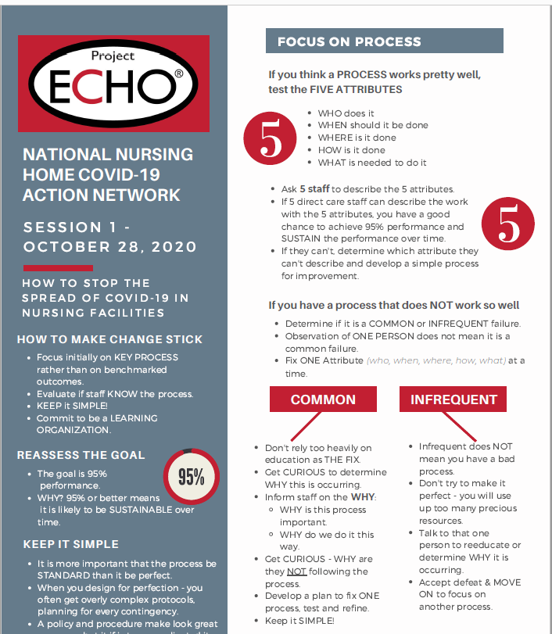
Follow-up on Last week’s “leave in Action”
.
What process did you investigate?
What did you learn?
Notes:
May want to drill into the common/infrequent distinction…

Slide 2
To PIP or not to PIP…
Implement change
Monitor for ongoing issues
Yes
Opportunity for Improvement Identified
High degree of belief?
Low Risk?
Low Cost?
High staff buy-in
Yes
Yes
Yes
No
No
No
No
Start Performance Improvement Project
Identify team
Choose change model
Charter project
Test & measure on a small scale
Increase size of test and measure
Hold the gains

Slide 3
Improvement in 5 Steps
Get curious about the nature of the problem
  Observe it
  Talk to staff (huddles!)
  Map/diagram/brainstorm
  Measure it
Set a goal for what you want to achieve
Decide what you want to try
Start by testing/trying it on a small scale…1 day, 1 resident
Measure your impact in ways that make sense

Slide 4
A focus on trauma and isolation?
What are staff and residents feeling? How are our current efforts making a difference? What could be better?
What is a reasonable goal for our facility
  All residents have at least 1 meaningful virtual or window visit with family per week by December 15th?
  All staff report they feel ‘heard and supported’ at work by November 30th?
What can we try?
  Improving virtual visits
  Staff huddles
  Ideas from ‘psychological PPE’
  PTSD Screening?

Slide 5
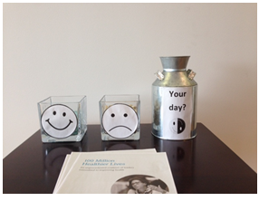
4. Pick something to test
  Develop and test a discussion prompt guide for staff to use with residents during virtual visits
5. Measure your impact
  # of residents engaged in a virtual/window visit at least once/week
  Staff absentee rates
  ‘Marble measure’

Slide 6
Leave in Action
Think about your conversations, discoveries and observations over the past few weeks and months and identify one area that you might want to focus on through a PIP versus a ‘just do it’ approach.
Connect with 2 other staff members to ask their opinion on what you might be able to impact in this area?

