Slide 1
ECHO COVID 19
CONVERSATIONS SERIES
Managing COVID-19 in Nursing Homes
Kathleen Unroe MD, MHA
Associate Professor of Medicine, Indiana University
Scientist, Regenstrief Institute

Slide 2
Financial Disclosures
Dr. Unroe is the CEO of Probari (www.probarisystems.com) a healthcare start-up founded to improve care in nursing homes through implementing the evidence-based OPTIMISTIC clinical care model.

Slide 3
Learning Objectives
Name nursing home challenges in preventing and treating COVID-19 outbreaks
Identify key aspects of preparation
Review navigating an outbreak – case study
Describe common clinical courses of nursing home residents with COVID-19

Slide 4
Overview
Nursing home residents are at high risk of getting COVID-19 and needing treatment and support.
80% of residents with COVID-19 will survive.
About 15-20% of residents with COVID-19 will die.
Nationally, about 40% of deaths are nursing home residents.

Slide 5
Multiple Challenges
Most rooms double occupancy; shared bathrooms
Building structures → unique solutions to cohorting
PPE – supplies and training
Off-site labs, time to receive COVID-19 results
Access to providers – role of telehealth
Personal care requiring prolonged exposure
Staffing

Slide 6
Structural Challenges
Resident’s home – NOT the hospital → thus quality of life considerations continue to be paramount
Most rooms double occupancy; 2 rooms typically share 1 bathroom (4 residents) → private rooms best when possible
Building structures → unique solutions to cohorting, plan in advance, including break rooms/work rooms that may need to be relocated

Slide 7
PPE Challenges
Many facilities lack N95s → stock up, hospital partners may be able to help
CNAs and LPNs have minimal training in PPE use → lots of resident contact, so need significant support in PPE use
Activities staff, office staff, therapy staff, social services may have no PPE use training → so they will need it!
Visitors can be asked to bring their own masks → have PPE supply set aside for them

Slide 8
Challenges
Diagnostic Services (Radiology, Lab)
Off site and shared with home health and other SNFs → create strong communication lines, who is your point person at the lab if you need answers?
COVID-19 Testing
Initially limited
Variable time to results
Plan for ongoing resident and staff tested needed
Medical providers
May cover multiple facilities
Telehealth may extend access BUT requires effort on part of staff to manage

Slide 9
Challenges
Resident level
Personal care requiring prolonged interactions
Cognitive impairment – impaired insight and judgment
Multiple co-morbidities
Staffing
Typical ratio 1:20 patient to nurse with 2-3 CNAs
Housekeeping, dietary, maintenance, activity staff shared throughout the building

Slide 10
Keep it out! Prevention
Double down on hand hygiene
Mid-March State and Federal Regulation:
Restrict all visitors
Social Distancing – no group dining or activities
Screening staff and residents for fevers and cough
Clinical staff wear medical grade facemask

Slide 11
https://www.ahcancal.org/News/news_releases/Documents/Analysis-COVID-Outbreaks-in-Nursing-Homes.pdf

Slide 12
Outbreaks
Unfortunately, despite these measures, outbreaks continue to occur
In the setting of continued community spread, numbers of nursing home residents continue to rise

Slide 13
Outbreak – facility case
4 star nursing home
>100 beds
78% (69) of our residents were infected with COVID-19

Slide 14
Treatment
Supportive Care
Active Monitoring – vital signs, labs
O₂ via nasal cannula
Nutrition support
Dehydration – monitor labs, push oral fluids, IVF
De-prescribing
DVT prophylaxis
Monitor for secondary bacterial infection
If infiltrate on chest xray, COVID vs. Bacterial
UTIs

Slide 15
When to hospitalize?
Confirmed goals of care are consistent with hospitalization
Vitals become unstable despite interventions
Urgent need for diagnostics and therapeutic
https://www.optimistic-care.org/probari/covid-19-resources

Slide 16
Safe Transitions
Safe Transitions
WARM hand-off – provider to provider conversation
Communicate COVID-19 concern clearly
POLST, code status communication
Family contact information clear
Place mask on all patient
Nursing facility notifies EMS of COVID-19 +/exposure

Slide 17
Clinical courses
Survivors:
12 residents had periods of malaise/fatigue but also long periods were they were asymptomatic
42 residents had significant symptoms, periods of stabilization, and symptom recurrence
Decedents:
9 had symptoms that steadily, slowly worsened over time
5 had rapid onset of multiple symptoms and decline

Slide 18
Clinical courses
Common Symptoms: Fever, hypoxia, anorexia, and fatigue/malaise
But watch for atypical symptoms
Overall Mortality: 20%
8 died in facility
6 died in hospital

Slide 19
Lessons learned
Constant assessment, LOW threshold to test
CBC (Lymphopenia)
BMP
Chest x-ray
Respiratory viral panel
Identify best strategy/partnership with labs
https://www.optimistic-care.org/probari/covid-19-resources

Slide 20
Key points
Multiple challenges inherent in the nursing home setting which we must navigate
Advance care planning is a skill and is critical before and during an outbreak
Infection control practices are necessary and require significant vigilance and effort over time
Even if you do the right things, outbreaks can occur and require a plan for managing staff and residents and transitions of care
Nursing home residents may experience a variety of clinical courses with COVID-19

Slide 21
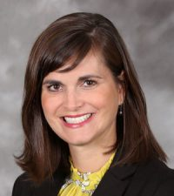
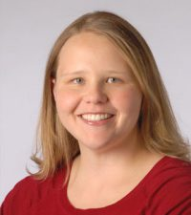
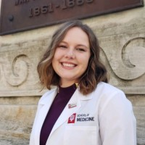
Acknowledgements
Dr. Ellen Kaehr
IU Health Geriatrics
Dr. Kristi Lieb
IU Health Geriatrics
Lauren Albert
2nd year medical student, IU

Slide 22
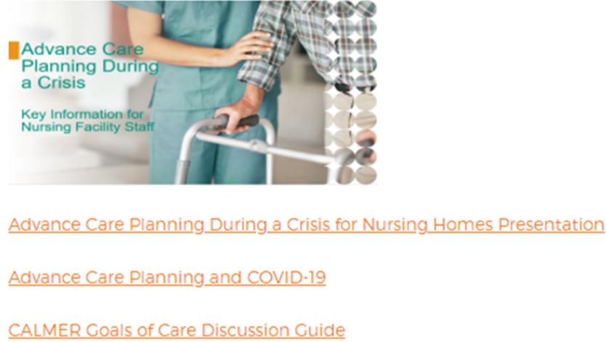
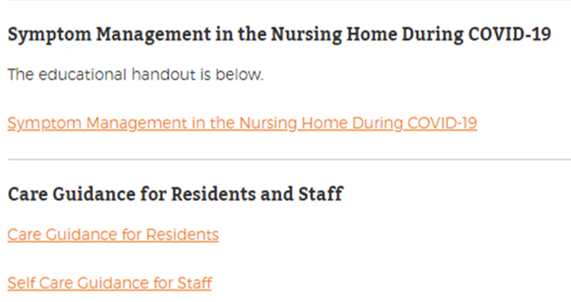
Additional COVID-19-Specific Resources
https://www.optimistic-care.org/probari/covid-19-resources

Slide 23
Thank you!
@kathleenunroe
kunroe@iu.edu
https://www.optimistic-care.org/probari/covid-19-resources

