Slide 1
Beyond Mass Shootings and Mental Illness Gun Violence as a Public Health Crisis
Clinical Professor
Neuropsychiatry and Behavioral Sciences
USC School of Medicine
Columbia, SC
Clinical Professor
Biomedical Sciences
Director, Ethics Distinction Track
USC School of Medicine
Greenville, SC
M. Carmela Epright, Ph.D.
Professor
Department of Philosophy
Furman University
Greenville, SC

Slide 2
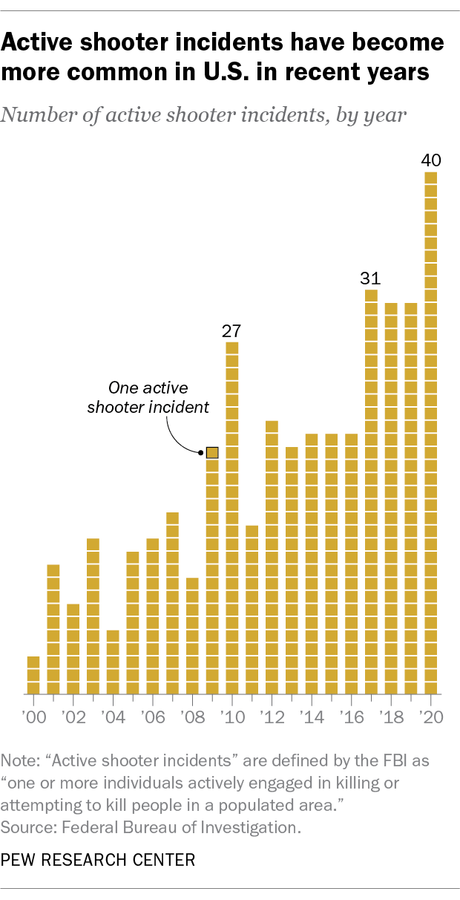
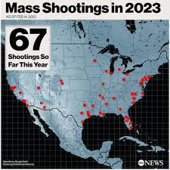
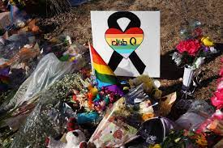
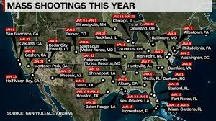
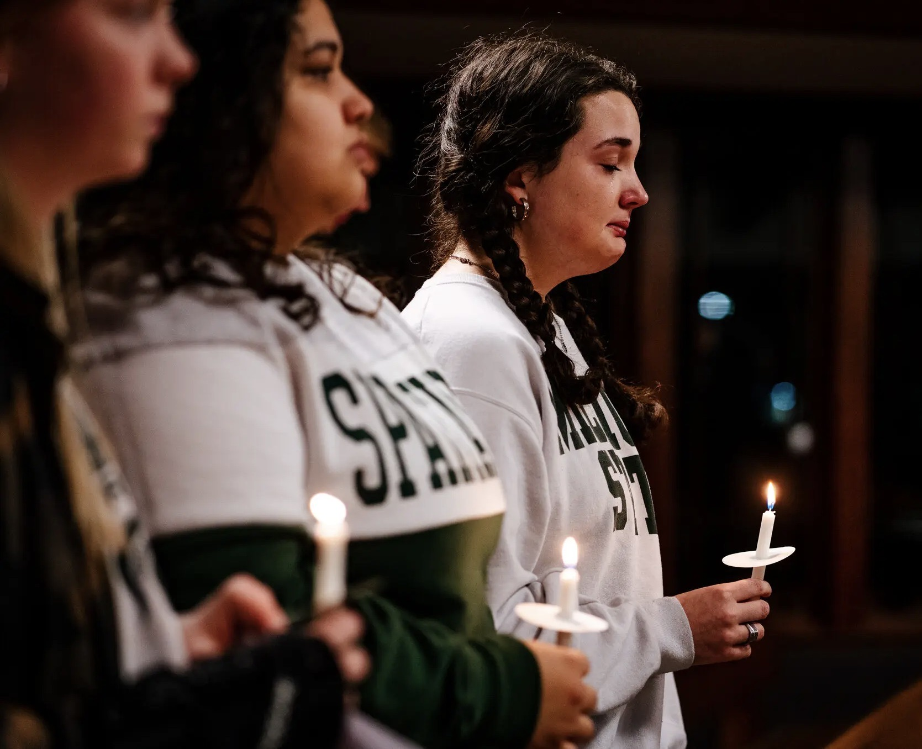
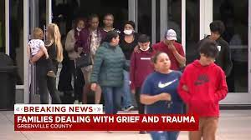

Slide 3
Mass Shootings in America
Definitions:
Active Shooter Event: “An individual actively engaged in killing or attempting to kill people in a conﬁned and populated area.” In most cases, active shooters use firearms and there is no pattern or method to their selection of victims (FBI, Most Federal Agencies)
Mass Shootings: The murder of 4 or more people, not including the shooter
Gun Violence Archive, https://www.gunviolencearchive.org, Feb. 25, 2023

Slide 4
Mass Shootings in America
Using the broader term “Mass Shootings”
2021 690 mass shootings, 3,406 victims, 703 deaths.
2022 647 mass shootings, 3,503 victims, 663 deaths.
2023 (February 17th) 102 mass shootings involving 376 people, 102 deaths
Gun Violence Archive, https://www.gunviolencearchive.org, Feb. 25, 2023

Slide 5
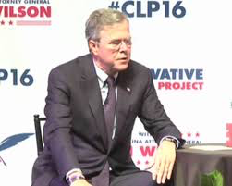
“Explaining” Mass Shootings

Slide 6
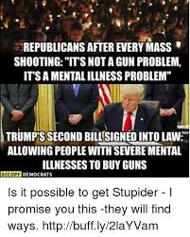
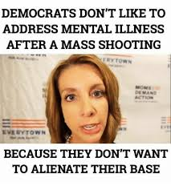

Slide 7
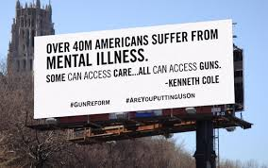
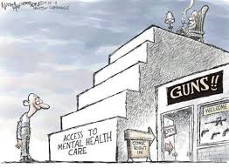
Explaining Mass Shootings

Slide 8
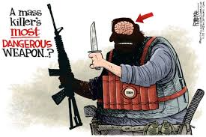
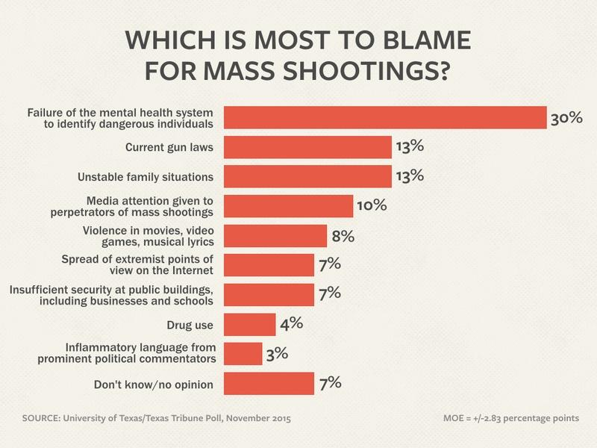
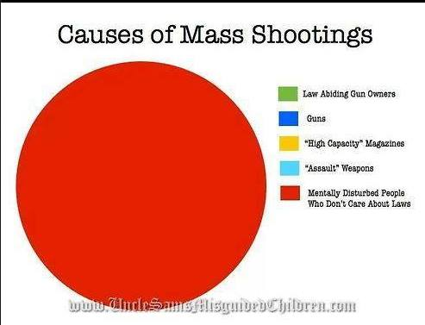

Slide 9
Mental Illness in Criminal Context
M’Naghten Rule:
Did the defendant know that the act was wrong at the time that it was committed?
“Cognitive Prong”

Slide 10
Mental Illness in a Criminal Context
American Law Institute Standard:
"if at the time of such conduct, as a result of mental disease or defect, Defendant lacks substantial capacity either to appreciate the criminality of his conduct or to conform conduct to the requirements of the law."
“Volitional Prong”

Slide 11
Mass Shootings and Mental Illness
Mass shooters rarely meet the court’s understanding of “legal insanity”
Rarely meet DSM-5 criterion for other severe mental illnesses
Statistically no more plagued by less debilitating forms of mental illness than any other member of general population
Richard A. "Violence and mental illness—how strong is the link?." New England journal of medicine 355, no. 20 (2006): 2064-2066.

Slide 12
Mass Shootings and Mental Illness
Most people who are mentally ill are not violent and most violence is not perpetrated by persons with mental illness
Mental illness is not a major contributing factor to gun violence (including mass shootings)
Frierson Richard A. "Violence and mental illness—how strong is the link?." New England journal of medicine 355, no. 20 (2006): 2064-2066.

Slide 13
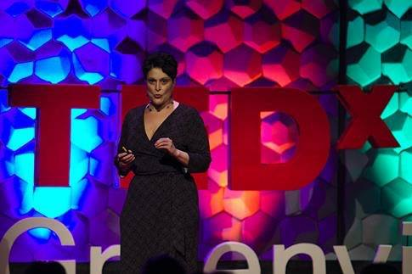
“Most Mass Shooters are not Mentally Ill”
“We need to do something about mental illness!”
Yes, we do. But it won’t stop mass shootings.

Slide 14
Expanding our Focus
Active Shooter Events and Mass Shootings Constitute a small portion of gun deaths
2021: 1.4%
Gun Violence Archive, February 25, 2023

Slide 15
Gun Violence and Public Health
Gun violence is a multifactorial problem that is best approached using methods of public health:
RESEARCH
Identifying Risk/Protective Factors
Development of Interventions
Implementation Requires the Participation of Multiple Parties
Implementation Requires Evidence

Slide 16
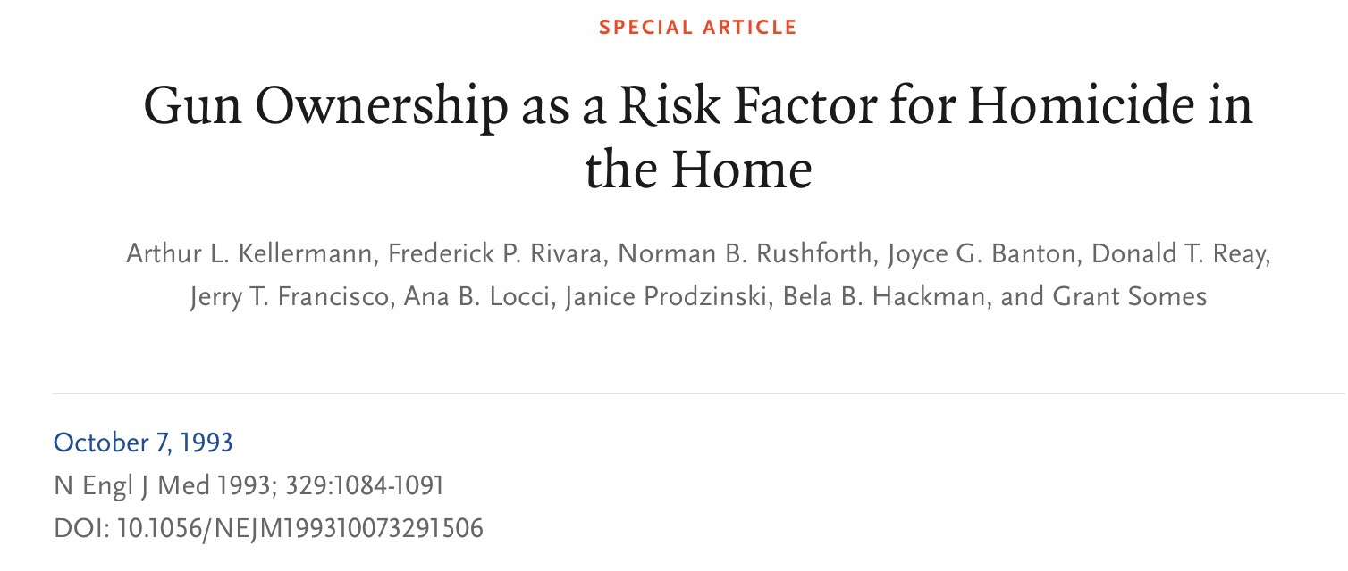
Why is there so little research regarding gun violence?

Slide 17
Why is there so little research regarding gun violence?
Findings: Gun Ownership ”strongly and independently associated with an increased risk of homicide in the home.”
Accidents
Suicide
Domestic violence

Slide 18
Why is there so little research regarding gun violence?
Most were killed by relative
Exacerbated by factors often responsible for homicide
Drug/alcohol use
Domestic Violence
Prior criminal record

Slide 19
Why is there so little research regarding gun violence?
Other factors:
Storage
Education
Isolation
Poverty

Slide 20
Why is there so little research regarding gun violence?
Authors noted that keeping a gun for the purposes of self protection was counter productive (used for defense in less than 10% of incidents, 11% of these were unsuccessful)
Otherwise, authors made no recommendations and suggested additional investigation

Slide 21
Why is there so little research regarding gun violence?
“None of the funds made available for injury prevention and control at the Centers for Disease Control and Prevention may be used to advocate or promote gun control.”
“Dickey Amendment” 1996
Amendment resulted in the elimination of $2.6 million from CDC, the amount the agency had previously spent on gun research

Slide 22
Beyond the Dickey Amendment
Jay Dickey and Mark Rosenberg

Slide 23
Beyond the Dickey Amendment
”Science has Answers.
Research is the Way to Free Them.”
Former Congressman Jay Dickey (R-AK) shortly before his death in 2017.

Slide 24
Beyond the Dickey Amendment
CDC and Automobile Deaths
Since 1968 Reduction of Death by78%
Seat belts
Airbags
35 mph bumpers
Road Hazards
Education
Speed limits
Engineering

Slide 25
Beyond the Dickey Amendment
2019 Congress Approved $25 million in funding to CDC and NIH
$12.5 million each
CDC at least 18 research studies
NIH at least 15
Funding is insufficient
…But, specifically opening federal agencies to research on guns encourages collaboration with private funding agencies and universities

Slide 26
Identifying Risk
Greatest Risk: Suicide
62% of Gun Related Deaths
Suicide is Generally Impulsive
25% Thought and Attempt Within 5 Minutes
65%Thought and Attempt Within 1 hour
Carroll, Aaron, “Guns and Public Health vol 1-4. Health Care Triage, https://www.youtube.com/@healthcaretriage, 2018.

Slide 27
Identifying Risk
Guns and Suicide
Completed Suicide: Gun: 85%
Completed Suicide: Other Methods ~2%
Ability to Delay Suicide 73% Effective in Preventing Suicide
Carroll, Aaron, “Guns and Public Health vol 1-4. Health Care Triage, https://www.youtube.com/@healthcaretriage, 2018.

Slide 28
Protective Factors
Over half (53%) of Americans Favor Stricter Gun Laws
Support depends upon the proposed intervention, political party, rural/urban, age of respondent
87% Favor Preventing Mentally Ill People From Buying Guns
81% Instituting Background Checks for Private Sales
61% Federal Database
Gramlich, John. "What the data says about gun deaths in the US." (2022).

Slide 29
Where to Start
Popular Interventions that work:
Employing Existing Laws
Gun Safety/ Education
Gun Storage/Safety Locks
Waiting Periods
Gramlich, John. "What the data says about gun deaths in the US." (2022).

Slide 30
Where to Start
Background Checks
Previous Incarceration
Restraining Orders
Domestic Violence/Stalking
Involuntary Commitment
Fugitive Status
Gramlich, John. "What the data says about gun deaths in the US." (2022).

Slide 31
Where to Start
Working Together: Family/Community/Professionals
Parents
Police
Physicians

Slide 32
Conclusions
Mass Shootings/Active Shooter Events While Increasing and Headline Grabbing Constitute a Tiny Percentage of Gun Deaths
Mental Illness is NOT a Major Factor in Gun Violence, Expanded Mental Health Care (While Necessary!!!) will do Little to Curb Gun Violence
Richard A. "Violence and mental illness—how strong is the link?." New England journal of medicine 355, no. 20 (2006): 2064-2066.

Slide 33
Conclusions
Public Health Model is Best Means of Curbing Gun Violence
Research
Risks/Prevention
Development of Interventions
Promoting Communication Between Experts and Community

Slide 34
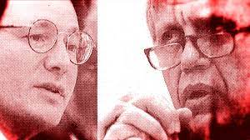
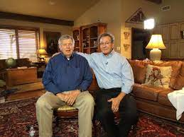
Conclusions
Must Avoid False Dichotomies:
Ban ALL Guns! vs. No Regulation!

Slide 35
What We Must Acknowledge:
Even Our Best Efforts and Interventions will not Eliminate Gun Violence
Guns are Never the Only Factor in Homicide/Suicide
Gun Ownership is a Constitutional Right (As Upheld in Multiple Cases by SCOTUS)
Legitimate Reasons to Own Guns
Carroll, Aaron, “Guns and Public Health vol 1-4. Health Care Triage, https://www.youtube.com/@healthcaretriage, 2018.

Slide 36
What We Must Acknowledge:
System Isn’t Working to Keep Guns Out of the Hands of People Who Shouldn’t Have Them
There is a Relationship Between Gun Ownership and Homicide and Suicide
We Need to Do Research For the Public Good Using Public Funds
Carroll, Aaron, “Guns and Public Health vol 1-4. Health Care Triage, https://www.youtube.com/@healthcaretriage, 2018.

Slide 37
What We Must Acknowledge:
Like Every Question that Matters:
Gun Violence is Complex, Multifaceted, and Requires the Expertise and Involvement of
Everyone:
Experts and Members of the Community

Slide 38
What We Must Acknowledge:
Hard Questions Can Only Be Approached with Humility and Interdisciplinary Involvement

Slide 39
Citations
Bauchner, Howard, Frederick P. Rivara, Robert O. Bonow, Neil M. Bressler, Mary L. Nora Disis, Stephan Heckers, S. Andrew Josephson et al. "Death by gun violence—a public health crisis." JAMA psychiatry 74, no. 12 (2017): 1195-1196.
Butts, Jeffrey A., Caterina Gouvis Roman, Lindsay Bostwick, and Jeremy R. Porter. "Cure violence: a public health model to reduce gun violence." Annual review of public health 36 (2015): 39-53.
Carroll, Aaron, “Guns and Public Health vol 1-4. Health Care Triage, https://www.youtube.com/@healthcaretriage, 2018.
Ferguson, Christopher J., Mark Coulson, and Jane Barnett. "Psychological profiles of school shooters: Positive directions and one big wrong turn." Journal of Police Crisis Negotiations11, no. 2 (2011): 141-158.

Slide 40
Citations
Frierson Richard A. "Violence and mental illness—how strong is the link?." New England journal of medicine 355, no. 20 (2006): 2064-2066.
Gun Violence Archive, https://www.gunviolencearchive.org
Gramlich, John. "What the data says about gun deaths in the US." (2022).
Hemenway, David, and Matthew Miller. "Public health approach to the prevention of gun violence." N Engl J Med368, no. 21 (2013): 2033-2035.
Metzl, Jonathan M., and Kenneth T. MacLeish. "Mental illness, mass shootings, and the politics of American firearms." American journal of public health 105, no. 2 (2015): 240-249.

Slide 41
Citations
Ranney, Megan, “How the Public Health Approach Can Solve Gun Violence,” TEDx Providence,https://www.ted.com/talks/megan_ranney_how_the_public_health_approach_can_solve_gun_violence October 22, 2019.
Stuart, Heather. "Violence and mental illness: an overview." World psychiatry 2, no. 2 (2003): 121.
Webster, Daniel W. "Public health approaches to reducing community gun violence." Daedalus 151, no. 1 (2022): 38-48.

