Slide 1
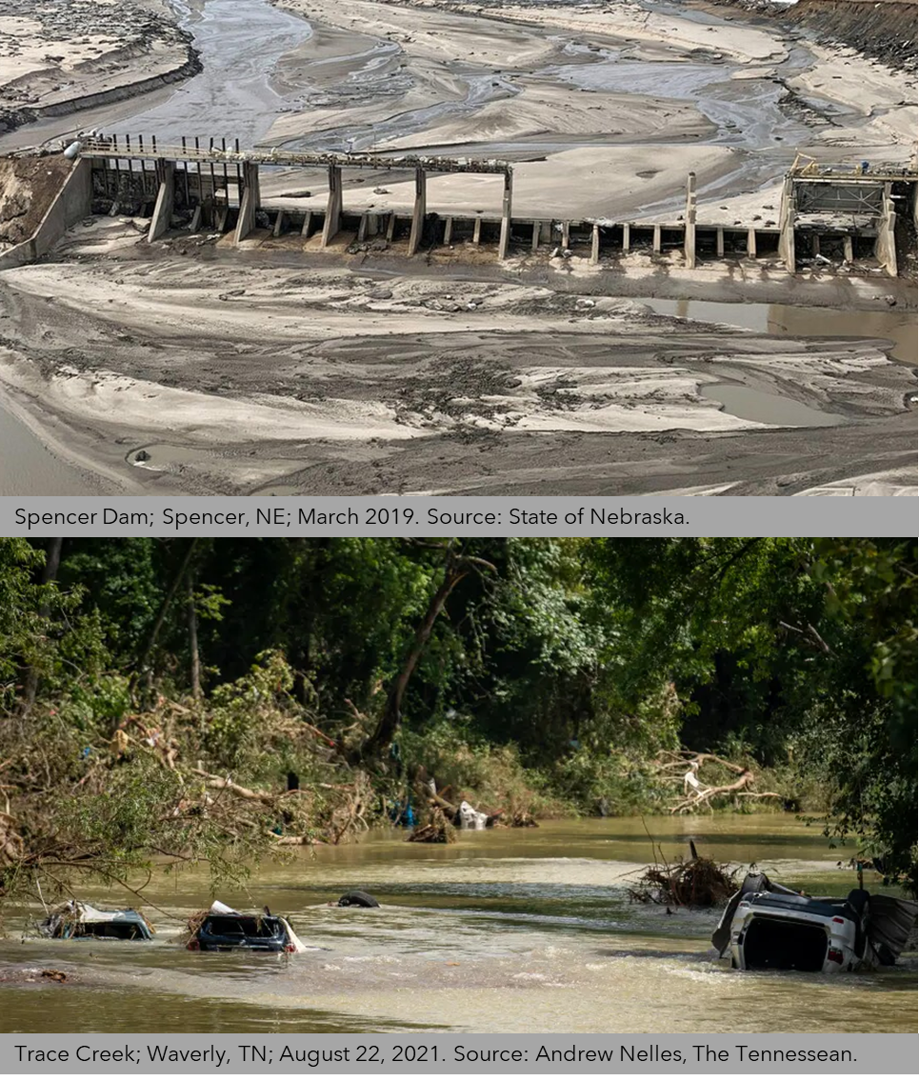
A Public Health Computer Simulation Tool to Improve Disaster Preparedness in Rural Communities
Kristina W. Kintziger, PhD, MPH
Claire M. Hubbard Professor of Health & Environment

Slide 2
Complex Systems
Complex adaptive systems (CAS) – many individual elements interacting on a micro-level in a dynamic and non-linear manner to affect the system behavior
Distributed control
Non-linearity
Diversity
Emergent behavior/order
Connectivity
State of paradox

Slide 3
Complex Systems & Climate Science
This Photo by Unknown Author is licensed under CC BY

Slide 4
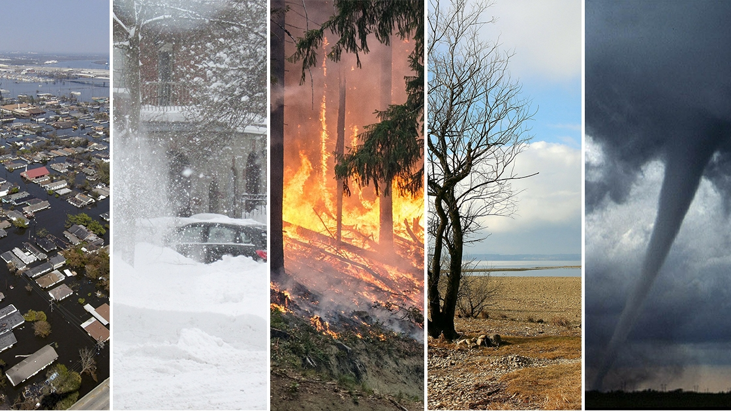
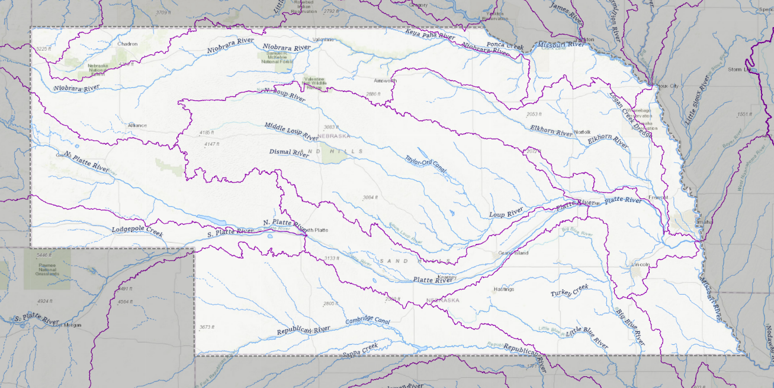
Complex Systems & Natural Hazards
Source: USGS National Water Dashboard.
This Photo by Unknown Author is licensed under CC BY-SA-NC

Slide 5
Complex Systems, Health Care, & Public Health
Environment
Politics
Economy
Society
Individual
Life
An adapted Meikirch model of individual health.

Slide 6
Complex Systems & Disaster Management
Water
Emergency Management Agencies
Transportation
Food & Agriculture
Emergency Medical Services
Responding Systems
Power
Impacted Systems
Hospitals
Fire Departments
Housing
Law Enforcement
Infrastructure/
Built Environment
Public Health
Communications

Slide 7
Multi-method Modeling to Support Preparedness in Rural Communities

Slide 8
Interdisciplinary Collaboration
Epidemiology
Engineering
Geography
Nursing
Health Policy
Public Health Practitioners
Emergency Managers

Slide 9
Motivation
Decline in healthcare capabilities in rural communities
Affects ability to respond to hazard events
Rural communities face many existing challenges to disaster preparedness and response

Slide 10
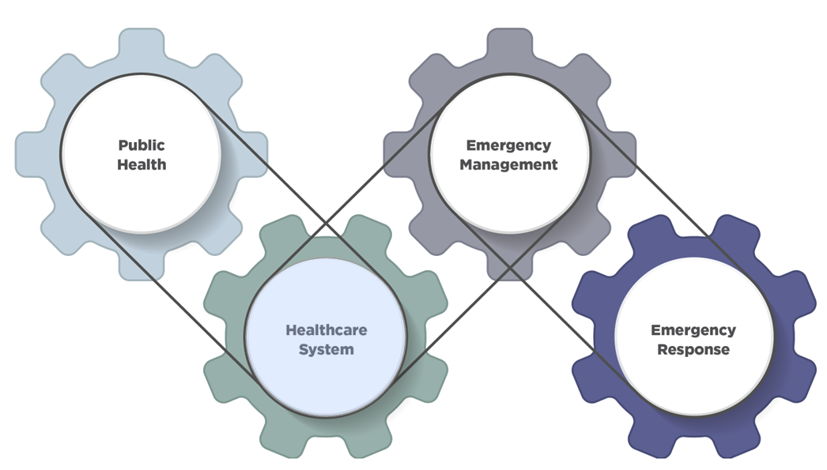
Study Objective
To assess the efficacy of disaster planning on public health outcomes in rural communities
As a function of healthcare access
By applying complex systems theory and model-based systems engineering methods
To the refinement and validation of a multi-method computer simulation of the rural healthcare system and related disaster planning functions

Slide 11
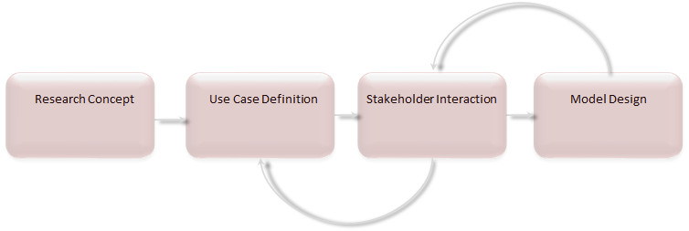
Research Design
Identified case studies
Conducted stakeholder workshops
Constructed a multi-method model-based systems engineering (MBSE) computational simulation

Slide 12
Key Definitions
Healthcare system
Natural hazard
Disaster severity
Rural

Slide 13
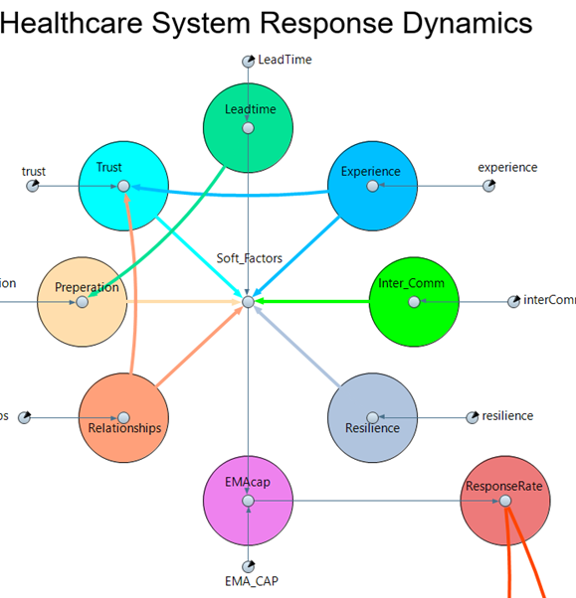
MBSE Methods Considered
System dynamics modeling – systems level, top-down approach
Agent-based modeling – individual agent level, bottom-up approach
Discrete event modeling – logical and separate sequence of events, queuing approach

Slide 14
Methods
Task 1: Model Conceptual Design
Select case events
Stakeholder Workshop 1
Task 2: Model Development
System dynamics model
Agent-based model
GIS layers/SDOH data
Task 3: Model Calibration
Stakeholder Workshop 2
Public-facing tool

Slide 15
Case Studies
2019: Nebraska Floods
2021: Waverly, Tennessee Flood Event

Slide 16
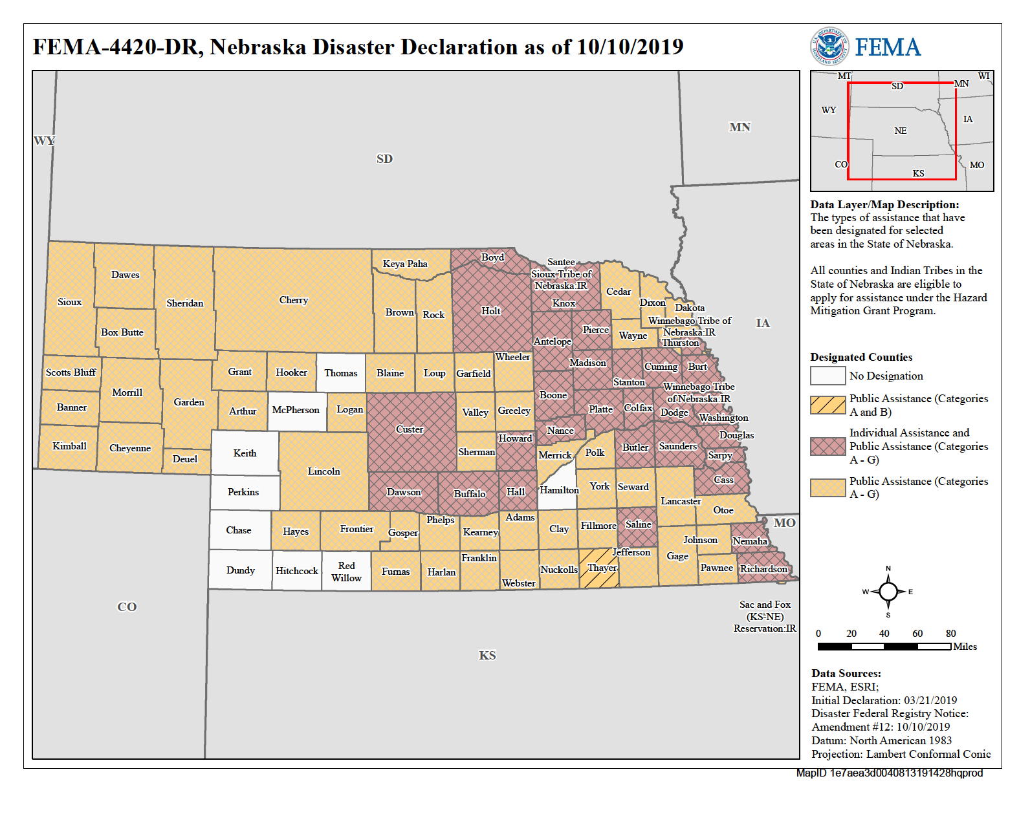
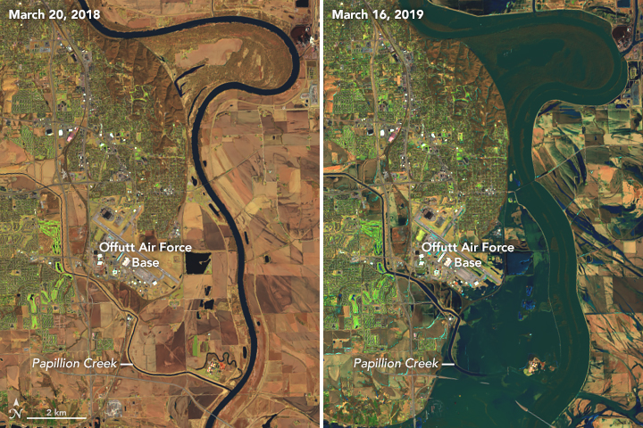
Nebraska Floods, 2019
Source: NASA Earth Observatory.
In-land flood
Causes:
Record snow fall
Frozen rivers/lakes
Rapid increase in temperature
Winter Storm Ulmer

Slide 17
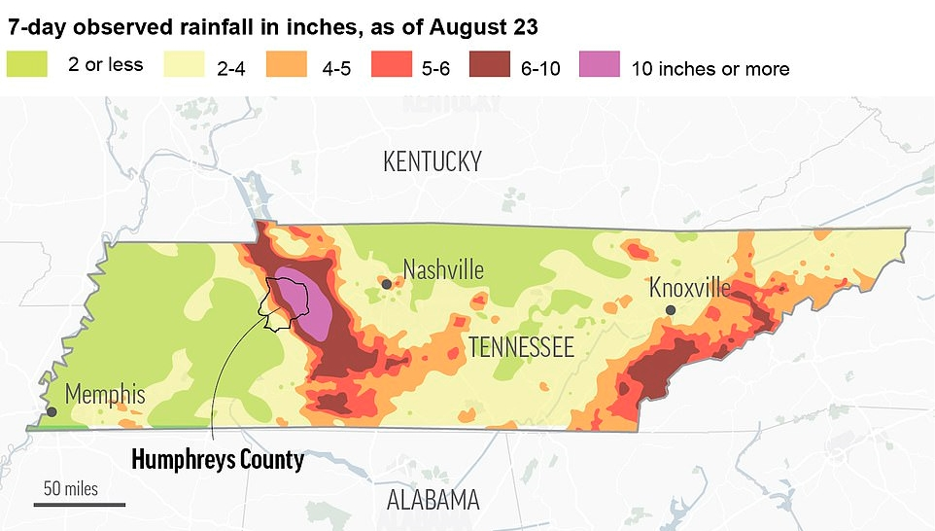
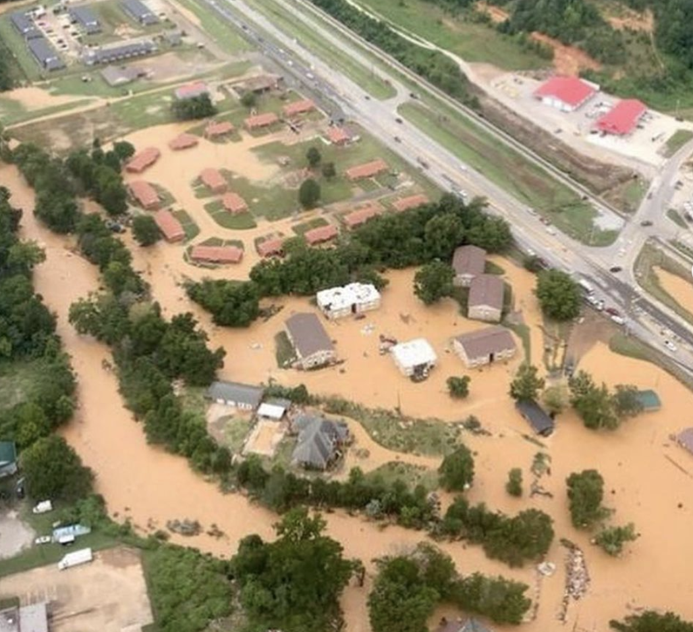
Waverly, Tennessee Flood, 2021
Large-scale flash flood
Causes:
Stalled frontal boundary
Record rainfall
Railroad bridge failure
Source: National Weather Service.
Source: TN Emergency Management Association.

Slide 18
Case Study Details
2019
Nebraska
2021
Waverly, TN
84 counties, 104 cities, 5 tribal nations
4 fatalities
Extended warning (days)
Extensive infrastructure and agricultural impacts
Delayed patient care
Multiple sequential disasters complicated response
Costliest inland flood in US history
4 counties
20-22 fatalities
Little to no warning
Extensive infrastructure impacts
Delayed patient care
Response complicated by COVID-19
One of Tennessee’s deadliest natural disasters

Slide 19
Simulation Results

Slide 21
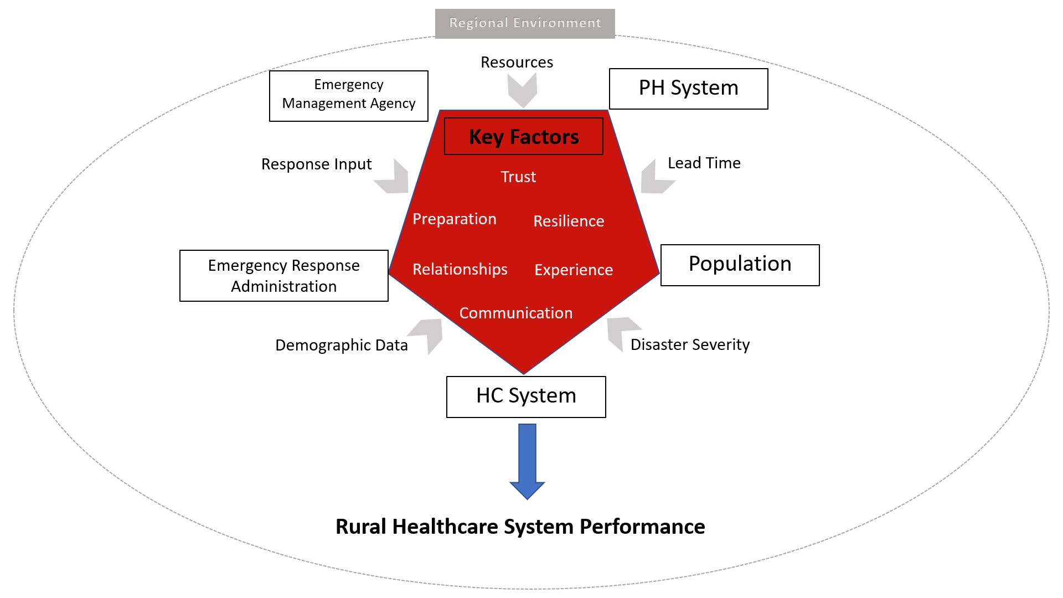
Functional Elements, Key Factors, and Variables

Slide 22
List of User-Modifiable Input Values
Name | Type | Value* | Operational definition
Trust | Factor | 1-5 | Interorganizational trust
Resilience | Factor | 1-5 | Community resilience
Communication | Factor | 1-5 | Effectiveness of communication among organizations
Preparation | Factor | 1-5 | Degree of disaster planning and activities prior to an event
Relationships | Factor | 1-5 | Formal and informal relationships among organizations
Experience | Factor | 1-5 | Prior experience with similar events
Demographic Data | Variable | 1-5 | Population data, i.e., socioeconomics and location
Response Input | Variable | 1-5 | Ability to respond to an event
Resources | Variable | 1-5 | Availability of resources
Disaster Severity | Variable | 1-5 | Relative impact of event on the community
Lead Time | Variable | 1-5 | Amount of advanced notice for event

Slide 23
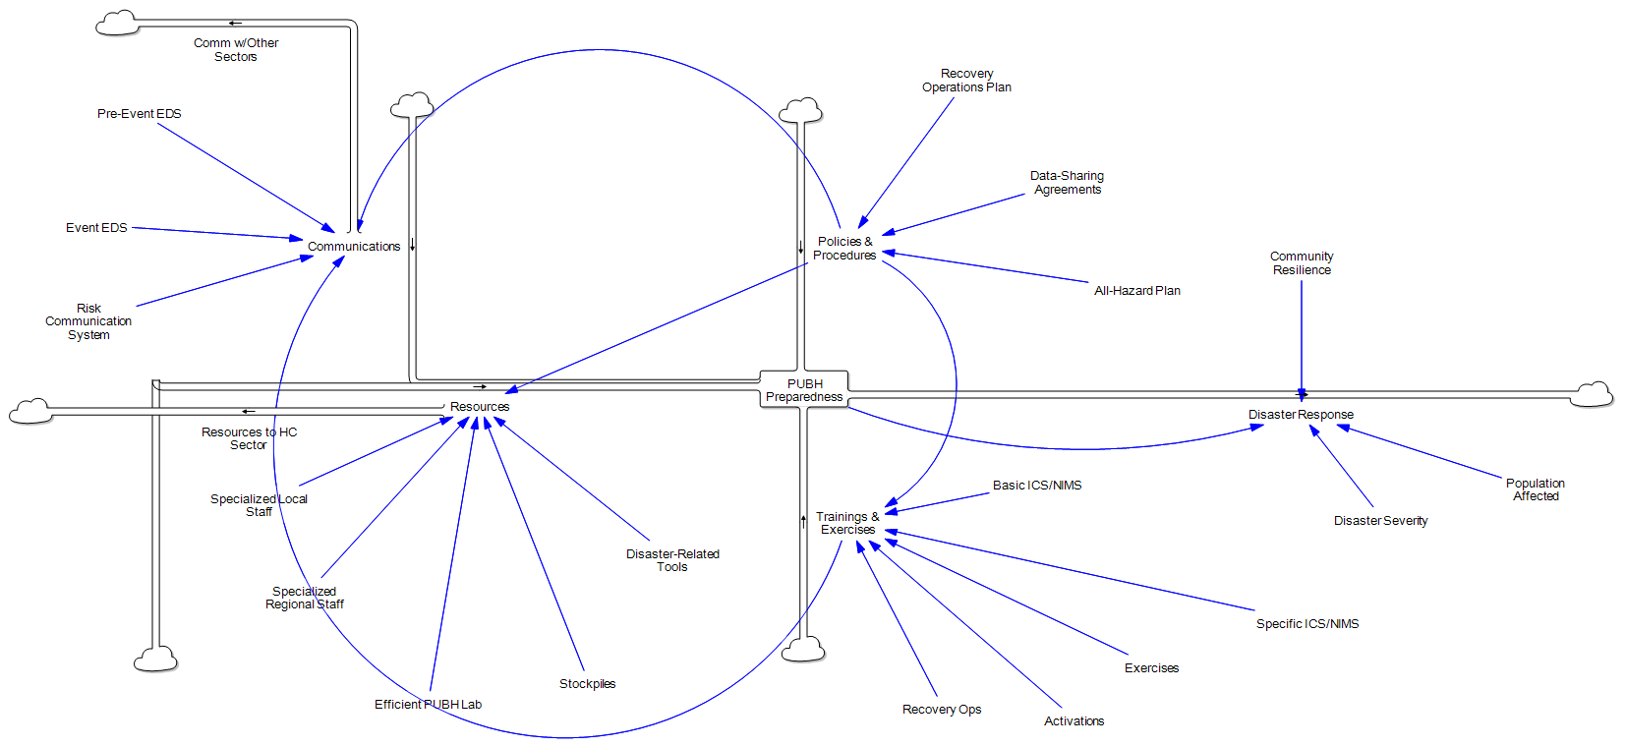
Public Health Preparedness: SD Model

Slide 24
Patient Flow Through Health Care During a Disaster: DE Model

Slide 25
Results
Accurately reflects the outcomes of the case events as they unfolded
Enhanced the robustness of the simulation with integration of different modeling approaches e
Multi-criteria decision-making useful to deal with missing data

Slide 26
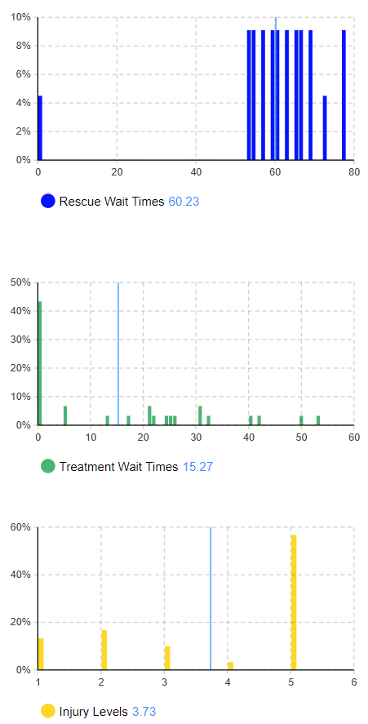
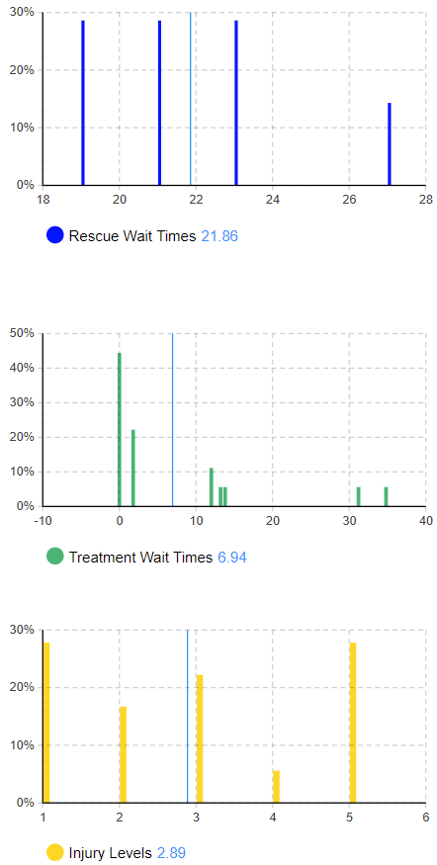
Worst vs. Best Case System Configurations

Slide 27
Healthcare and Emergency Response Needs Over Time, Best vs. Worst Case Scenarios

Slide 28
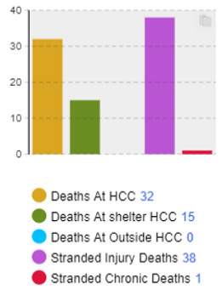
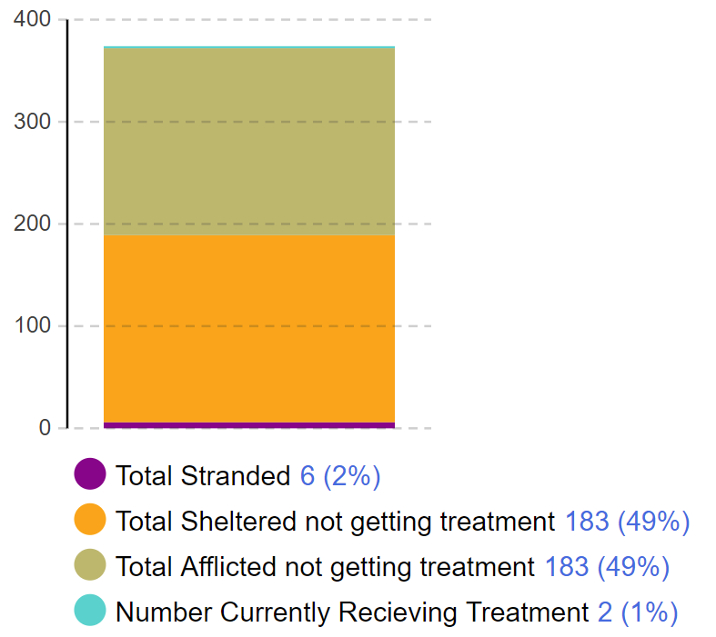
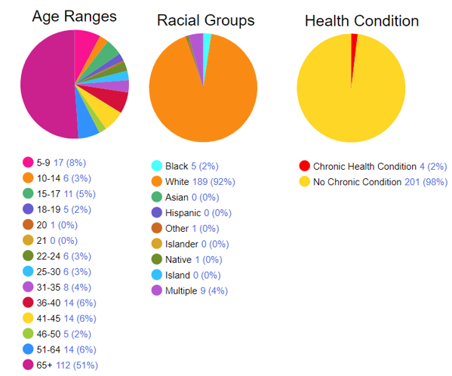
Other Results and Outputs
Number of Affected and Afflicted Individuals During Event by Location
Casualties Over Time Across Different Healthcare Sites
Age, Race, Chronic Condition Status of Those Affected by Flood Event

Slide 29
Public Health Implications
In-depth understanding and simulation of how rural preparedness systems interact to prepare for and respond to a disaster
Creation of a public health simulation tool that can be used to:
Test rural existing policies and procedures,
Determine how to use existing resources most effectively, and
Identify where additional resources are needed.

Slide 30
Next Steps
Expand simulation to include
Other natural hazards
Longer timeframe of interest
Create a public-facing tool that can be used by rural disaster planners/practitioners
Generic rural communities
Changeable impacts
Suite of interventions or policies

Slide 31
Acknowledgements
University of Tennessee, Knoxville
College of Nursing/Applied Systems Laboratory: Tom Berg, Tracey Stansberry, Scott Lawson, Gerald Jones, Jr.
Department of Geography: Liem Tran
Nebraska
NE Emergency Management Agency (EMA)
NE Department of Health & Human Services
Dodge, Hall, & Platte County EMAs
Tennessee
Humphreys County EMA
City of Waverly
Natural Hazards Center
Research in U.S. Territories, Tribal Areas, and Rural Communities

Slide 32
Thank you!
Final Report: https://hazards.colorado.edu/public-health-disaster-research/public-health-computer-simulation-tool-to-support-disaster-preparedness-in-rural-communities

Slide 33
Thank you!
Follow Us!
Learn More
Raheleh Mohammadi
unmc.edu/publichealth/wch
@UNMC_WCHP
Sign Up for Our Newsletter
@KKintziger
wchp@unmc.edu
Donate

